Slide 1
ITK-SNAP 4.6
Where the release stands, and what's coming for cardiac
Version 4.6.0-alpha.1 · Lab update, August 2026
Notes:
Audience: cardiac users, not developers. Set expectation early: this is a status update, and there is no release date yet.

Slide 2
Where 4.6 stands
Three things, and then the detail
1
2
3
What's already in
What's coming — cardiac first
No release date yet
Open images and whole workspaces straight from a URL. Two AI-assisted segmentation models you can use today.
Propagation across phases, 4D cardiac I/O, one-button automatic segmentation, and mesh tooling.
The two most visible cardiac features are waiting on one piece of server work. Slide 7 says which.
Notes:
Say the no-date bullet out loud here rather than letting them wait for it. Honesty up front buys you the rest of the talk.

Slide 3
Open your data straight from a URL
The largest block of work in 4.6 — done and merged
Your study data stays where it lives.
scp:// sftp://
ITK-SNAP now opens images — and whole workspaces — directly from a URL. No download step, and no local copy quietly drifting out of sync with the server.
A workspace with several layers opens over a single authenticated connection, and the second time you open it, it comes from the local cache instantly.
Your lab server, over SSH
http:// https://
Public datasets, cached
fw://
Flywheel, with API-key auto-load
itksnap-fw://
A link that opens in a running ITK-SNAP
Notes:
Spend real time here — for anyone whose data is on a server or in Flywheel this is the most immediately useful thing in the release.

Slide 4
Two AI models today — not interchangeable
Which one you pick matters for cardiac work
nnInteractive
SAM2
RECOMMENDED FOR CARDIAC
2D, POINT PROMPTS
Works in
3D — scribble one slice, get the whole structure
Works in
2D — one slice at a time
You give it
point, box, scribble (paintbrush), lasso (polygon)
You give it
a point
Image type
grayscale
Image type
grayscale or colour
Trained on
medical images (DKFZ, nnU-Net lineage)
Trained on
natural images and video
For cardiac chambers and myocardium, use nnInteractive. It is 3D-native and medically trained — one scribble on a short-axis slice propagates through the stack.
Notes:
How you use it: AI paintbrush, left button includes / right button excludes. Or turn on AI mode for the polygon tool and your outline becomes a lasso prompt. Changing the active label resets the interaction.

Slide 5
Also new in 4.6
1
Work across windows
2
Cancel a running task
A Window menu listing every running ITK-SNAP, and Send to Other Window between them.
An X in the progress overlay stops a long download or computation.
3
More formats
4
Clearer failure on big images
.vti and .vtp I/O, and .seq.nrrd sequence export — contributed from our fork.
An explicit out-of-memory dialog instead of a hard failure.

Slide 6
Stability since 4.4
24
9
2
bugfixes
memory leaks
crashes fixed
last week
Including a server connection race and two long-standing DICOM crash and hang bugs.
One note on how: a lot of this was found by pointing AI coding agents at the codebase and at our own crash logs — including a regression that had been dormant since March.
Notes:
One or two sentences on the AI-agent angle, then move on. This audience is not here for engineering.

Slide 7
What's coming — cardiac first
In the order they matter to this room
1
Propagation across phases
Waiting on server work
Segment one cardiac phase, propagate to the rest.
2
4D cardiac I/O
On a branch — not yet merged
Phase and time handling for cine CTA and echo, plus sequence export.
3
cmesh integration
Waiting on a release tag
Mesh operations move to a proper shared library.
4
One-button automatic segmentation
Waiting on server work
Pick a model, press once, get labelled cardiac anatomy — no prompts.
Also on the list: 3D/2D cursor sync under free rotation (a bug), developer documentation, and a rolling bugfix stream.
Worth saying once: propagation and automatic segmentation wait on the same piece of server work. It is already written — it needs promoting, not inventing.
Notes:
Do NOT present 4D cardiac I/O as shipping. It is on a branch and merge decisions are pending. This is the easiest slip to make with this audience.

Slide 8
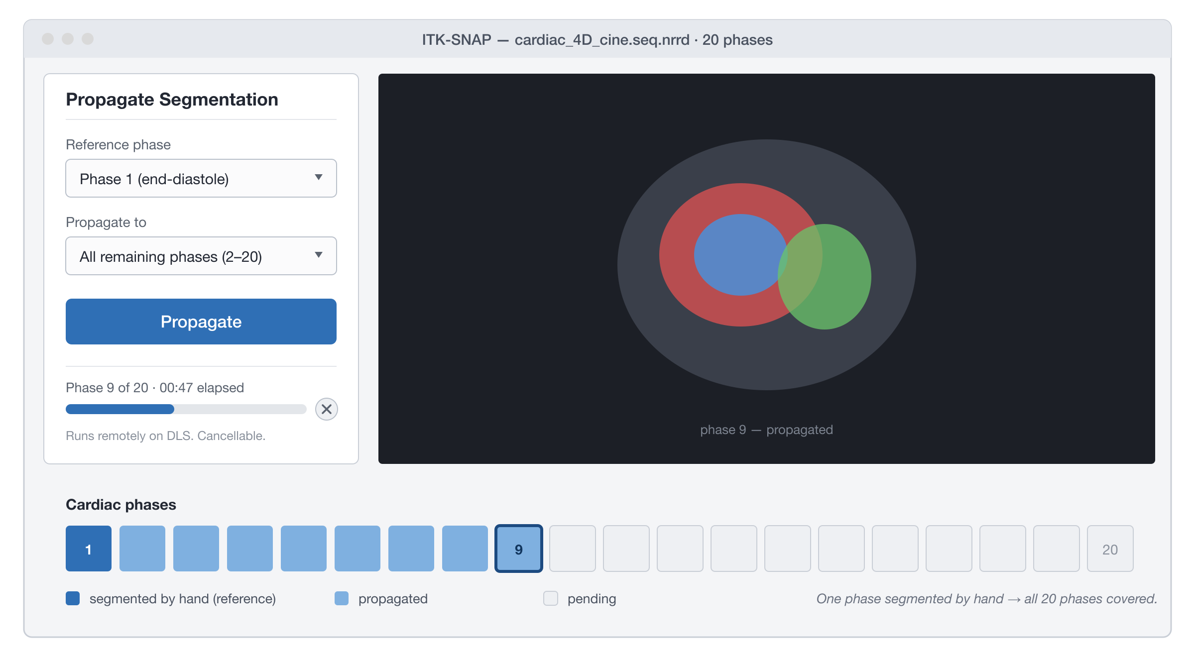
What propagation will look like
CONCEPT MOCK-UP
Segment one phase by hand. Press Propagate. The rest are filled in — on the server, with progress, cancellable.
Notes:
Keep the mock-up banner visible. Do not let anyone leave thinking this exists today.

Slide 9
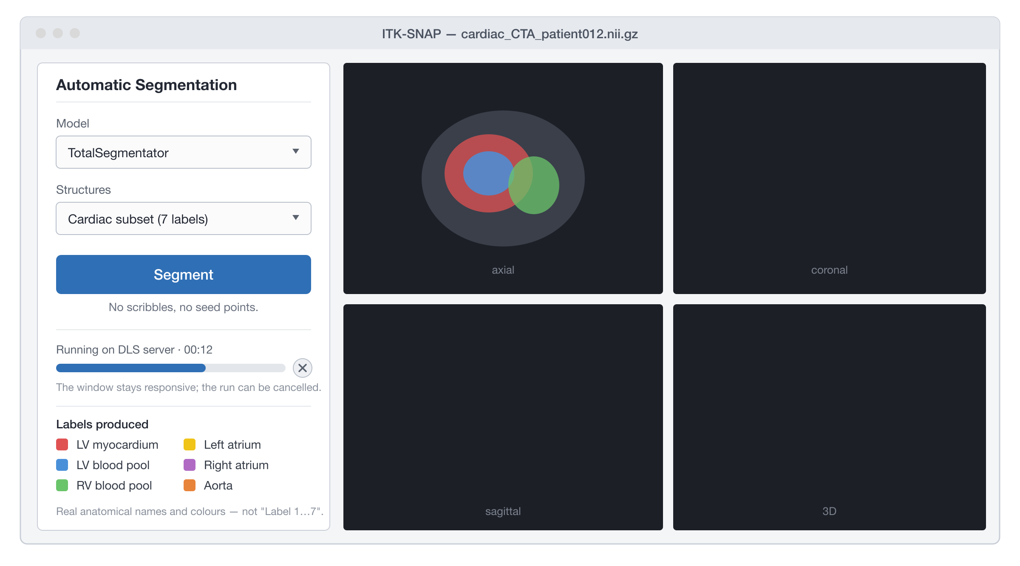
What automatic segmentation will look like
CONCEPT MOCK-UP
Open the image, pick a model, press Segment — labelled cardiac anatomy with real names and colours.
Notes:
The model behind this is TotalSegmentator, which is written and on a branch today. nnInteractive and SAM2 are what you can use now — keep the three separate.

Slide 10
Demo
Pre-recorded — because this is a network feature, and I am not gambling a live SSH handshake on the room's wifi.

Slide 11
What you'll see
About five minutes
1
Paste a Flywheel URL — the image opens, with no download step
2
Cancel a load mid-download from the progress overlay
3
Open a multi-layer workspace over one connection
4
nnInteractive: scribble one short-axis slice, get the 3D chamber
5
Send an image to a second ITK-SNAP window
6
Re-open the same remote image — instant, from cache
Notes:
Shot 4 carries the talk for this audience — use real cardiac data. Scrub credentials and PHI from every shot before showing it.

Slide 12
What's next
The server refactor — it unblocks propagation and automatic segmentation together.
What I need from you
If you use Flywheel — try the fw:// path and tell me what breaks.
Cardiac datasets I can test propagation against.
No release date yet. The next checkpoint is that server work landing.

Slide 13
One more thing…
Notes:
Pause here. This is a deliberate beat -- do not talk over it. Then advance.

Slide 14
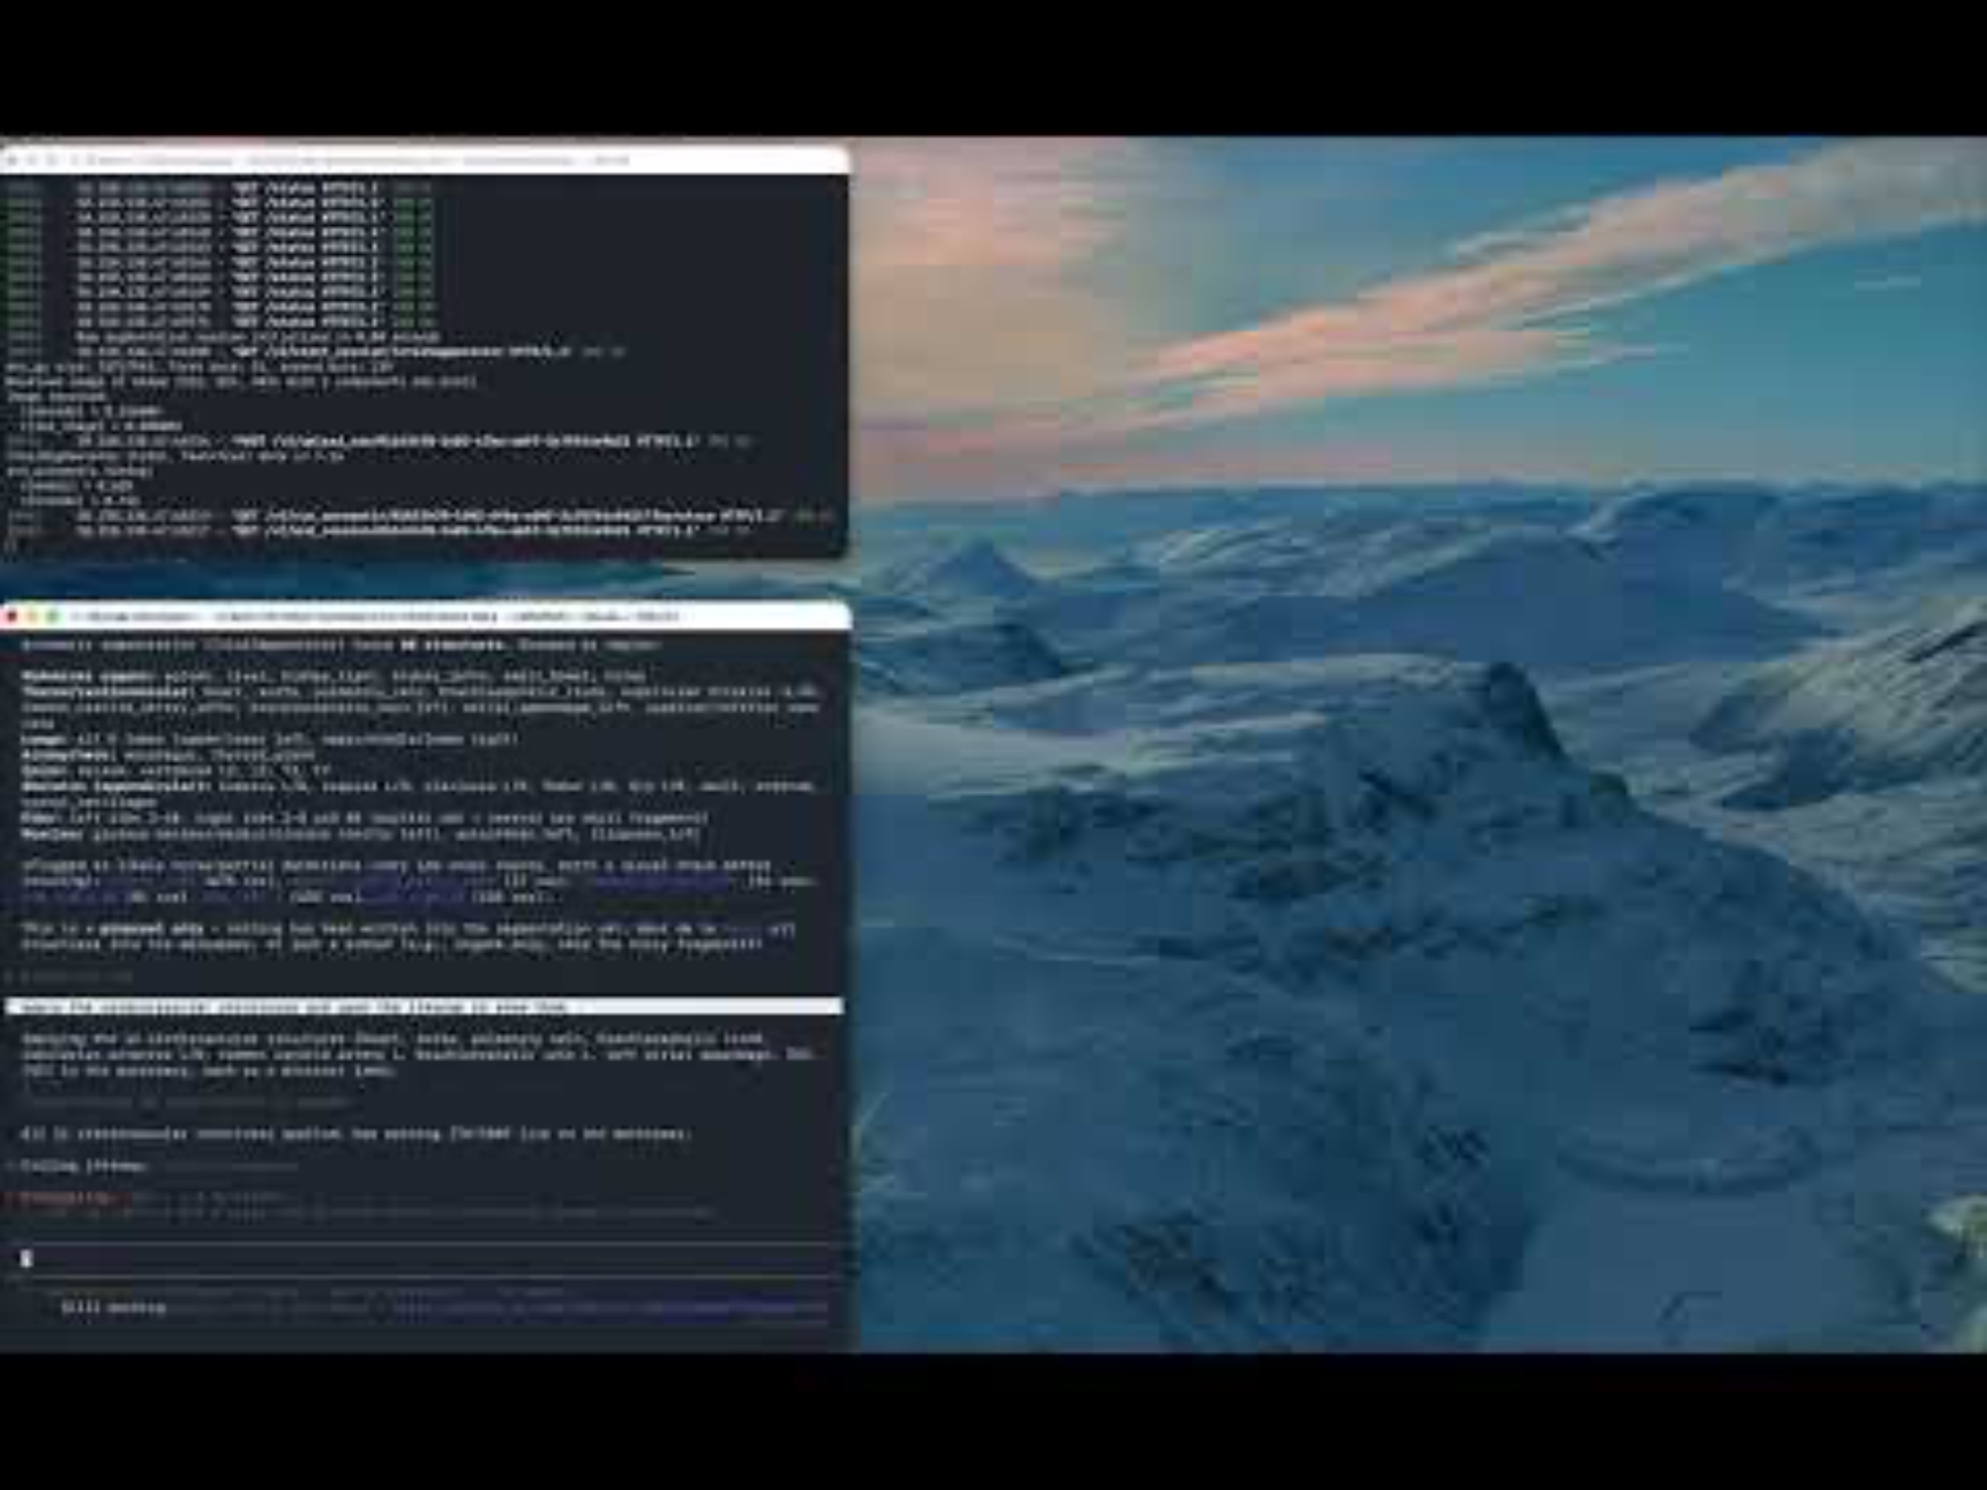
ITK-SNAP, callable by an AI agent
A research prototype — not part of 4.6, and not on the 4.6 roadmap
Model proposes, human disposes.
An AI agent can drive ITK-SNAP over the Model Context Protocol — open a study, run a model, apply a segmentation, hand the uncertain cases to a person.
And every edit comes back as a structured record of what changed and who changed it — the agent, or you.
Submitted to the SIIM-CAIMI26 AI Builder Showcase.
Hao · Pouch · Yushkevich. Notification late August; conference is 26–27 October, at Penn.
Notes:
ACCURACY: it is SUBMITTED, not accepted -- notification is 26 August, after this talk. Do not say 'accepted'. Say clearly that this is not in 4.6 and is not competing with the cardiac roadmap; it lives on a separate branch. Clip 2 is the star. If you are short on time, play only that one. Honest limitation if asked: the confidence gate that decides which cases get routed to a human is implemented and unit-tested but not yet wired into the flow -- today a person still chooses. That is the next increment.

