Slide 1
SOCIAL NETWORK ANALYSIS OF STACKOVERFLOW DATASET
Submitted by:
Jill Jani, 18BCE1302
Parimala Chowdary, 18BCE1309

Slide 2
Abstract
Stack Overflow is one of the leading platforms for developers where people ask and answer programming-related questions. More than 21 million questions have been asked, more than 31 million answers have been provided, and more than 80 million comments have been made! We have used a raw data set of Stack Overflow Tag Network from the Kaggle website. This data set contains network of technology tags from Developer Stories that we will use to determine popular and correlated technologies. We will also identify important network components that will help us retrieve language specific information.

Slide 3
Problem Statement
Stack Overflow is a vast community where millions of questions are asked and answered daily. In such applications, tagging is highly appreciated. Because they not only help us in easier understanding of the content available in the application but also, makes the discovering of new trends easily. These tags can also be effortlessly accessed by all the learners. Stackoverflow has a huge database of questions and answers. But it does not provide beginners with information about trending technologies and tech stacks followed by experts. Such situations can also make the newbies stressful as they are unsure of what is on high demand in the market workplace. But, this can be overcome by considering the graph’s nodes and edges. In this case the nodes are the tags that appear in a user's questions in stackoverflow.

Slide 4
Objectives
In this project we aim:
(1) To determine popular and related technologies using the stackoverflow tag network dataset. This is performed by identifying groups in dataset and finding node centrality. We will use exploratory data analysis to highlight the vital aspects of the analyzed data.
(2) To determine clusters, bridges, communities, cliques in the dataset to group technologies often used together.
(3) To retrieve language specific subgraph and cliques using ego networks.

Slide 5
Tools Used
Networkx
Pandas
Numpy
Matplotlib
Other Python libraries
Gephi

Slide 6
Methodology

Slide 7
Methodology
Our analysis approach is divided into four phases: data extraction, data cleansing, and visualization, and network analysis. In the first step, we will collect the raw data from Kaggle. Next we will do basic data cleaning. We will then try to visualize the data to understand the structure of network. We will then try to find clusters, ego networks and tech-specific subgraphs and cliques to determine most commonly used tech stacks. We will also determine popular and trending technologies in accordance with their centrality.

Slide 8
Methodology
The data is collected from Kaggle website
Analyzing the dataset to understand the structure of network and identifying high centrality tags
Data Cleaning
Network Analysis
Data extraction
Data Visualization
Cleaning the data and dealing with null values to reduce error.
Analyzing the data to identify trending and highly correlated technologies

Slide 9
Overview of the Dataset

Slide 10
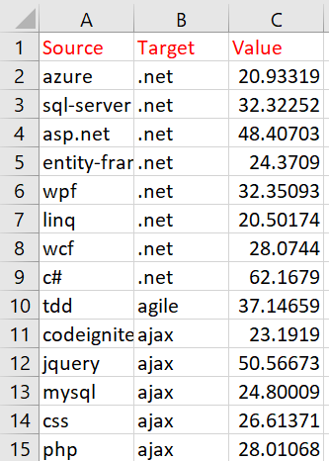
About DataSet
Stack_network_links.csv
the source tech tags
the target tech tags
the value of the the link between each pair

Slide 11
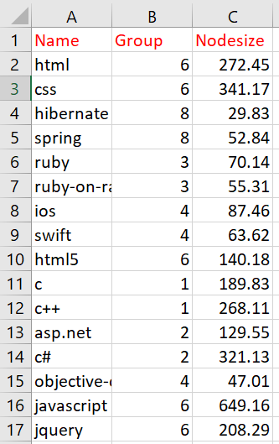
About Dataset
Stack_network_nodes.csv
nodes of the network,
the name of each node, which group that node belongs to (calculated via a cluster walktrap),
and a node size based on how often that technology tag is used

Slide 12
Thank you!

