Slide 1
Net New Jobs: States and major metros
Firm Size Employment Dynamics, 2001 to 2013, with Census’ QWI Explorer data tool
© Jill Coghlan and Elise Bowditch,
June 23, 2015

Slide 2
Net New Jobs: contents
Goals
Methodology
Primary Findings:
Firm Size “NetNew”
States and Metropolitan areas
Sample NAICS profile
References & Appendix

Slide 3
Net New Jobs: Goals
We examine Net-New-Jobs in three Firm Size subcategories :
(1) 0-19 “Small” Firm Size, (2) “greater than 500 “Large” Firm Size and (3) summed the three intermediate components together,
For firms which are under Private Ownership, and
For 47 states (excluding Alaska and Hawaii as special cases, and Massachusetts, as not available), and the top 51 Metropolitan regions in the country.

Slide 4
METHODOLOGY

Slide 5
Net New Jobs: Methodology - 1
To describe “Net New Jobs”, we chose Census’ QWI’s “Full-Quarter Employment (Stable) : Counts” as representing a worker’s employment (E) across three successive quarters.
Chose (a) 2001Q4 as the starting point, aligned with the final quarter of the “Early 2000’s Recession”,
And (b) 2013Q4 as end point, the most currently available QWI-Q4, for a Q4-to-Q4 comparison.

Slide 6
Net New Jobs: Methodology - 2
Calculations for “Net New Jobs”
1) # Δ, (t₁) 2001Q4 to (t₂ )2013Q4:
Δ _{Ε} = Ε (t₂) − Ε (t₁)
2) % Δ = Δ _{Ε} / Ε(t₁ )
NOTE on 1) and 2), Totaling our 3 components, to develop % change, negative numbers were summed as Absolute values, on a “negative-to-positive” axis.
3) % Δ per annum : %_{Εα} = %_{Ε} / (t₂ − t₁ )
4) % Share : Ε (t₂) − Ε (t₁ ) / Σ _{E α}

Slide 7
Net New Jobs: Methodology - 3
Geography concerns:
Chose 51 top-population Metropolitan Statistical areas, each with more than one million people.
Each component of a Multi-State metropolitan center was tested to confirm at least 10% of total Metro jobs, in considering whether to include that locale in the metro or as part of the state; see MultiState Metros in APPENDIX A.
Both states and metros were separated into size categories, major, midsize and small, to help conclude if a % trend was important or marginal.
Census’ OnTheMap application also confirmed when workers’ jobs reached across state lines.

Slide 8
PRIMARY FINDINGS

Slide 9
Primary Findings - 1
A pair of Firm Size categories
(a) 0-19, the smallest size, and (b) >500,
…together account for more than 70% of employment in 30 Metros, and at least 60% of total employment in another 12 cities; the intermediate categories are less distinctive.
The same pair of Firm Size groups account for > 70% of employment counts in 12 of our 47 states, and > 60% in another 18 states.

Slide 10
Primary Findings – 1 Metro, Large Firm Successes

Slide 11
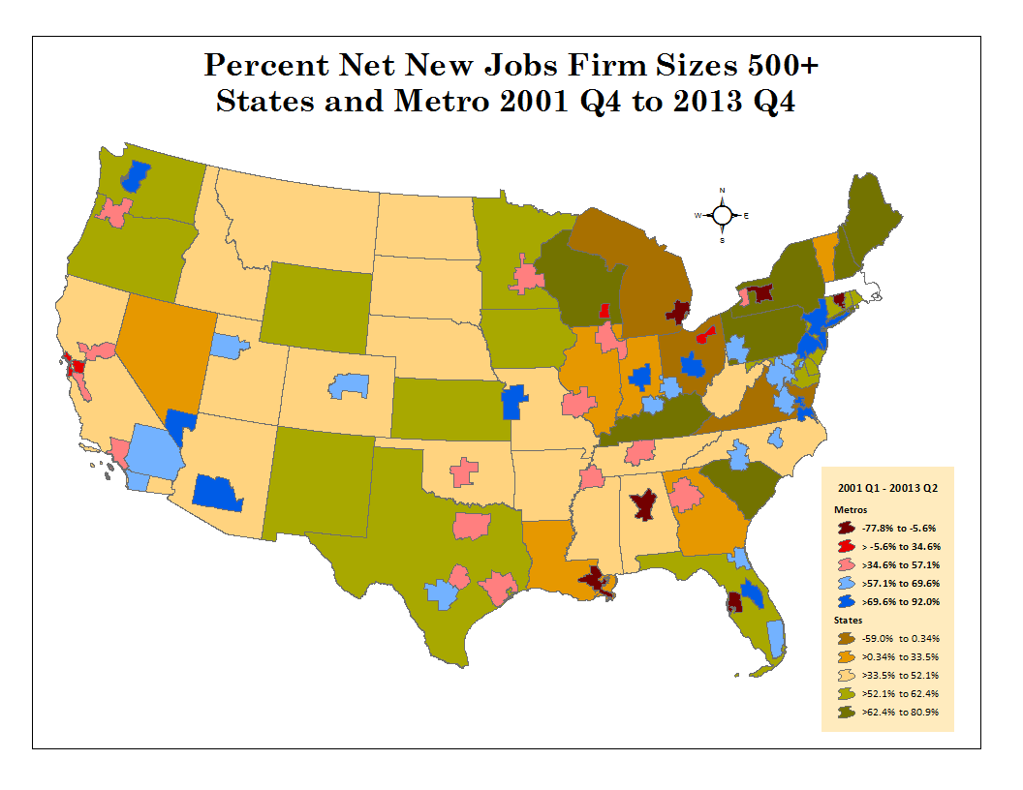
Primary Findings – 1 Large firm, >500 Successes:

Slide 12
Primary Findings - 1: Small Firm (0-19) Metros & Large firm (>500) States:

Slide 13
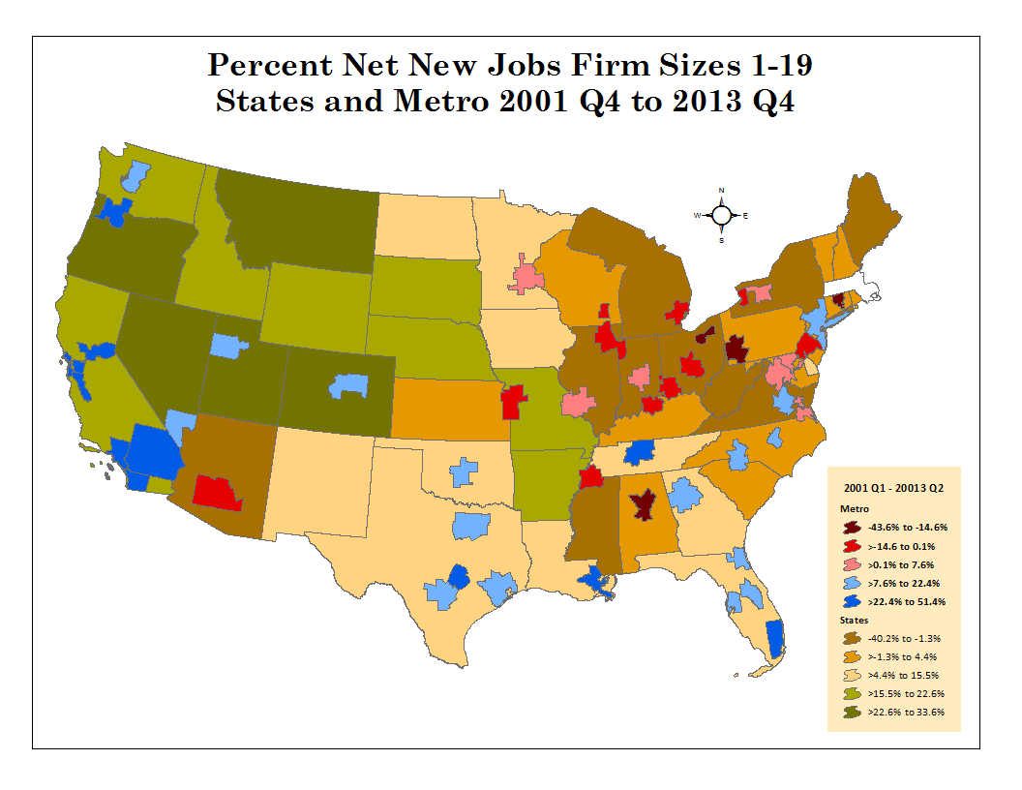
Primary Findings – 1: Small Business (0-19) Successes:

Slide 14
Primary Findings – 2: % Share of Net New Jobs
The largest Firm Size, the “greater than 500” category, dominates the % Share of “Net New Jobs” growth, stealing from both Small and Intermediate Firm Size groups.
When the 0-19 category shows growth, it can be accompanied by parallel strength in the >500 category.

Slide 15
Primary Findings – 2: Net New Jobs: metro, % share

Slide 16
Primary Findings – 2: Net New Jobs: State, % Share

Slide 17
Primary Findings – 3: Per Annum Growth
The “per annum” % change averages 0.75% for States and 0.85% for Metros, with a third of our locales between 0.55% and 1.22%.
10 Metros and 8 States did better than 1.5% annual growth, with only four below -0.4%.
Net New Jobs growth was slow within our research time-frame, from the end of “The Early 2000’s Recession” and including both the trough and recovery from the recent Great Recession.

Slide 18
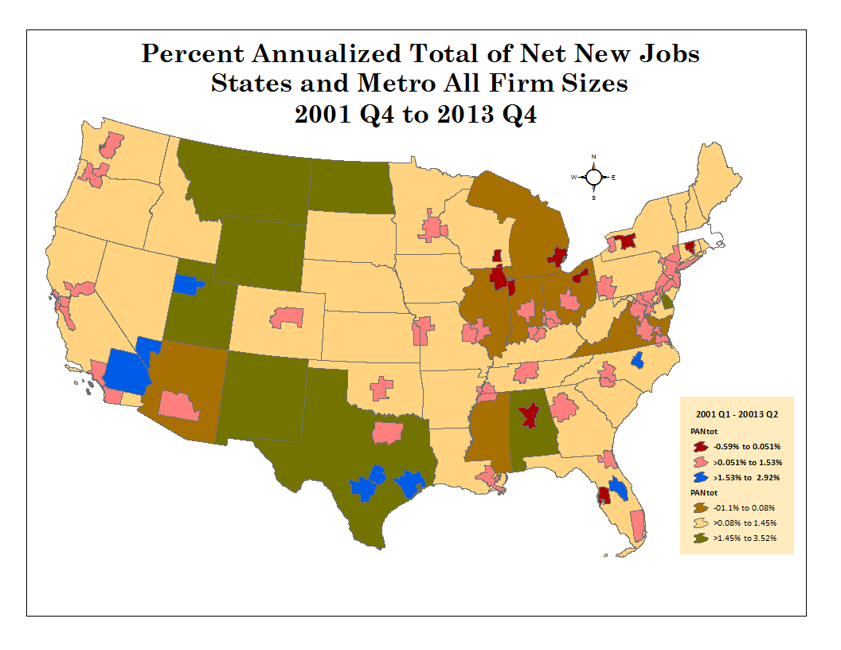
Primary Findings – 3: Per Annum Growth

Slide 19
SAMPLE NAICS PROFILE:

Slide 20
Sample NAICS profile:
HealthCare/Education profiles were developed for California Metros, as those exhibiting the largest growth in the 0-19 Employee Firm Size.
Also developed HealthCare/Education for several Mid-Atlantic locales in comparison.

Slide 21
NAICS Profile: CA v. NJ-PA health-Care/Education

Slide 22
references:
Arias, Gascon and Rapach, “Metro Business Cycles”. Federal Reserve Bank of St. Louis Working Paper, 2014-046B.
Hurst and Pugsley, What do Small Businesses do”, NBER Working Paper, 17041, May 2011.
Partial support for this research came from the Eunice Kennedy Shriver National Institute of Child Health and Human Development research infrastructure grant R24 HD042828, to the Center for Studies in Demography & Ecology at the University of Washington.

Slide 23
Appendix A: Multi-State Metros

Slide 24
Thank you.
CONTACTS:
Jill Coghlan for Data: jillcoghlan@gmail.com
Elise Bowditch for Maps: ebowditch@gmail.com
All rights Reserved – Copyright 2015.

