Slide 1
Bight SAV Winter Update
Friday, Jan 23rd, 2026
^{10:00am – 12:00pm PT}
^{Teams link:}
Notes:
Word slides

Slide 2
Agenda
Wrap up data QA/QC
Discuss results and interpretation of data analysis
Primary analysis
Secondary analysis + appendix material
Brainstorming conclusions + recommendations to include in Bight Report

Slide 3
QA/QC

Slide 4
QA/QC
Request for “gut-check” QC measures
As Leaf Area increases, so too should Above Ground Biomass

Slide 5
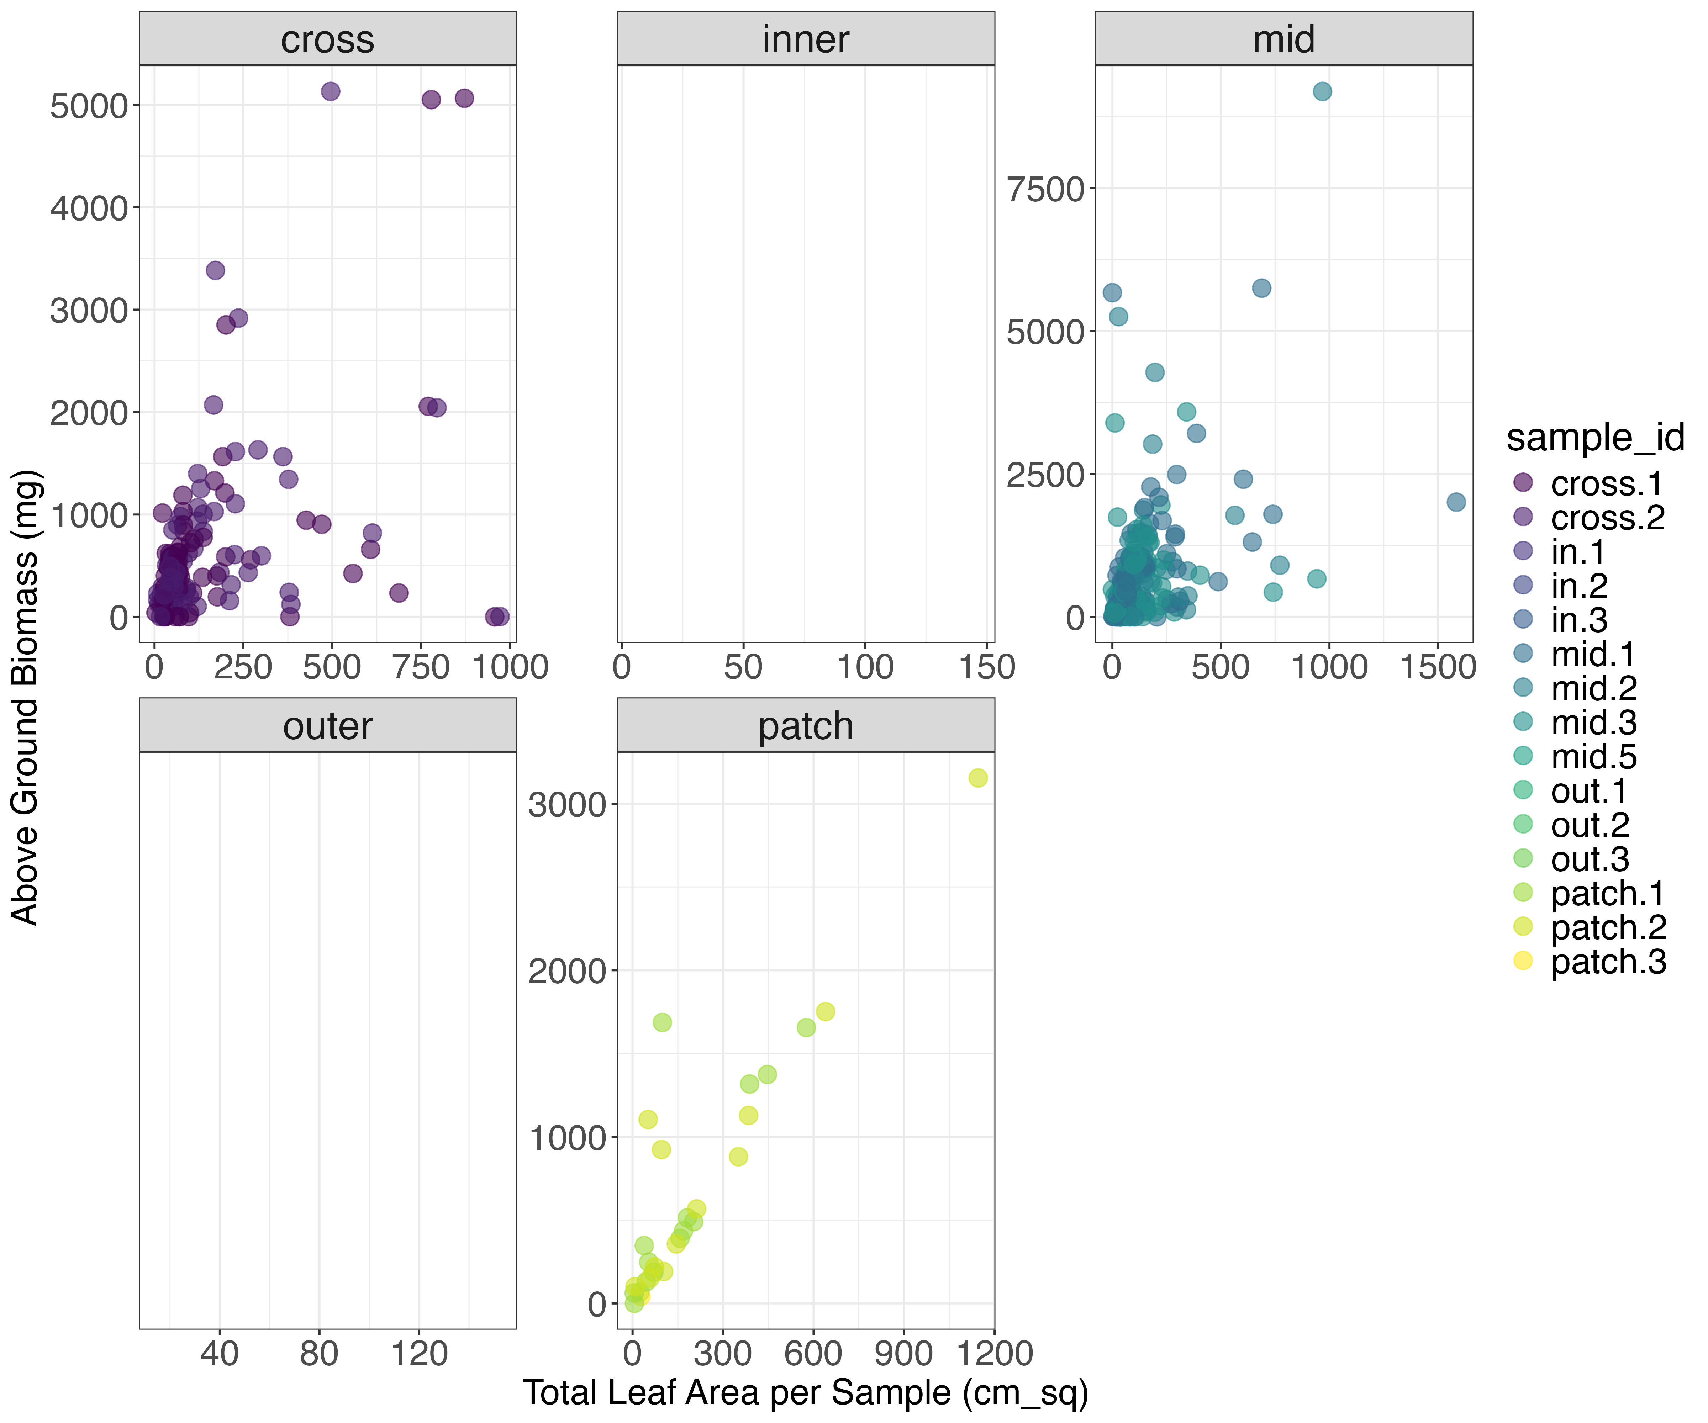
Leaf Area vs. Above Ground Biomass

Slide 6
Primary Analysis

Slide 7
Primary Analysis
What is the condition of eelgrass across the region?
Does it differ by strata (small embayments, large embayments & estuaries)
Notes:
Word slide sset up graphic – initial conclusions before figure – conclusion as title to slide

Slide 8
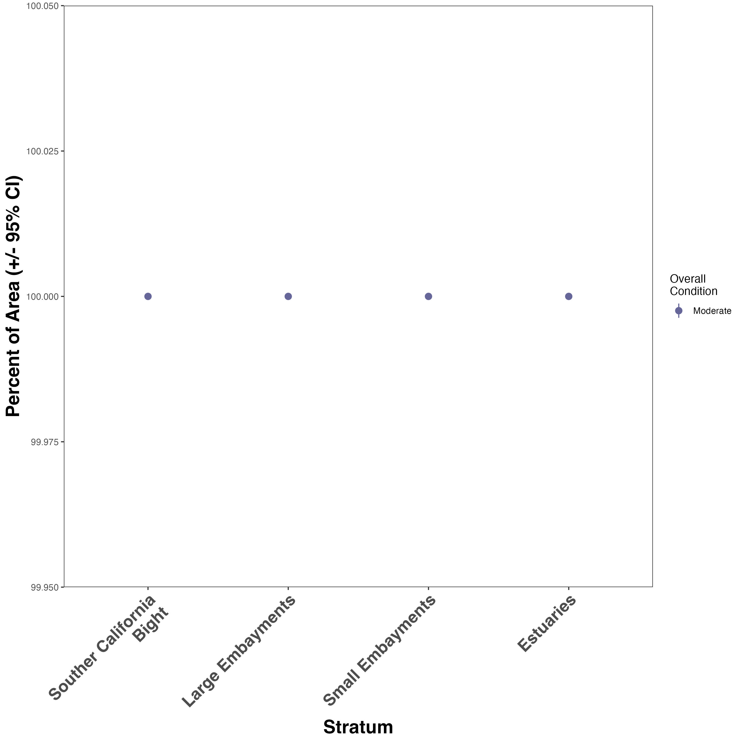
Area-weighted overall condition scores for eelgrass beds across Bight
All in overall moderate condition by stratum
Good news: Results are comparable to RESCQ survey
Notes:
Caveat: Not very sensitive to subtle differences in ecosystem function

Slide 9
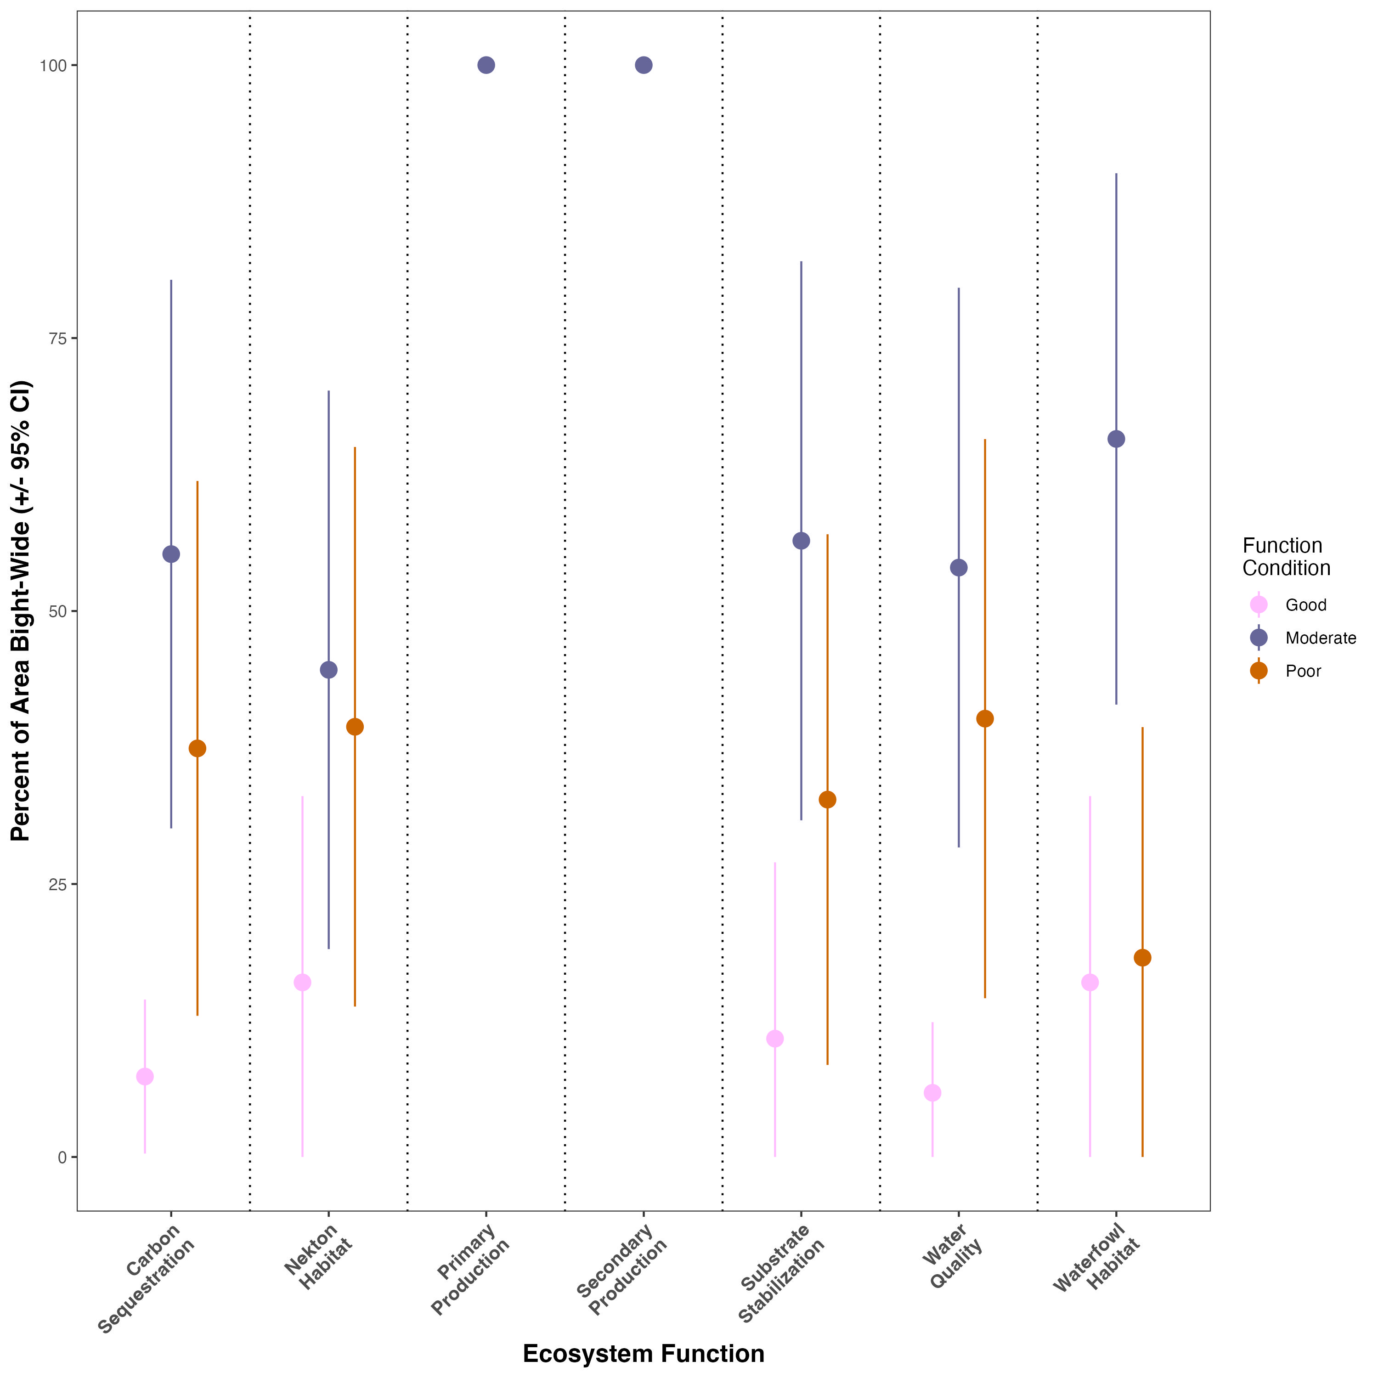
OVERALL: Area-weighted function scores for eelgrass beds across Bight
Most (55% - 100%) area is in Moderate condition for all ecosystem functions
About 10-15% of area for all functions is in Good condition
About 30-40% of area for all functions is in Poor condition

Slide 10
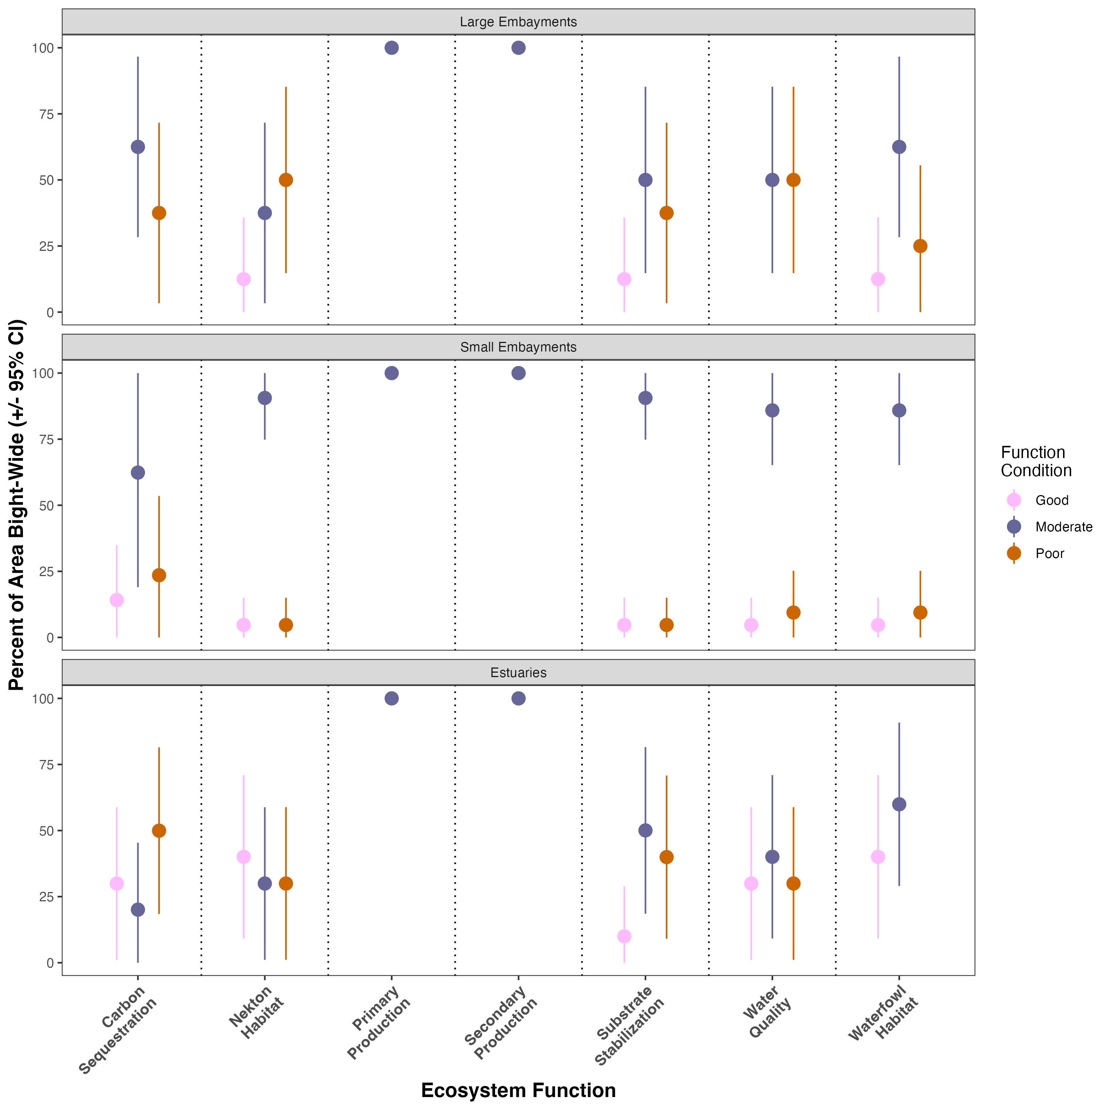
BY STRATUM: Area-weighted function scores for eelgrass beds across Bight
Small embayments have the highest percentage (65-100%) of area in Moderate condition for each function
Estuaries have the most area(15-40%) in Good condition

Slide 11
Secondary analyses

Slide 12
Secondary analyses
(1) Understanding relationships between index/function scores and potential environmental drivers

Slide 13
Potential environmental drivers we discussed
Driver
Ecosystem function
Distance to inlet
Site protection status
Inlet status (open/closed)
Depth
Sediment grain-size
Substratum physical quality
Natural vs restored
Carbon sequestration
Substrate stabilization
Water quality
Nekton habitat
Waterfowl habitat
Primary production
Secondary production
OVERALL index score

Slide 14
Potential environmental drivers we discussed
Driver
Ecosystem function
Distance to inlet
Site protection status
Inlet status (open/closed) – all open
Depth – not significant
Sediment grain-size – insufficient data
Substratum physical quality – insufficient data
Natural vs restored – insufficient data
Carbon sequestration
Substrate stabilization
Water quality
Nekton habitat
Waterfowl habitat
Primary production
Secondary production
OVERALL index score

Slide 15
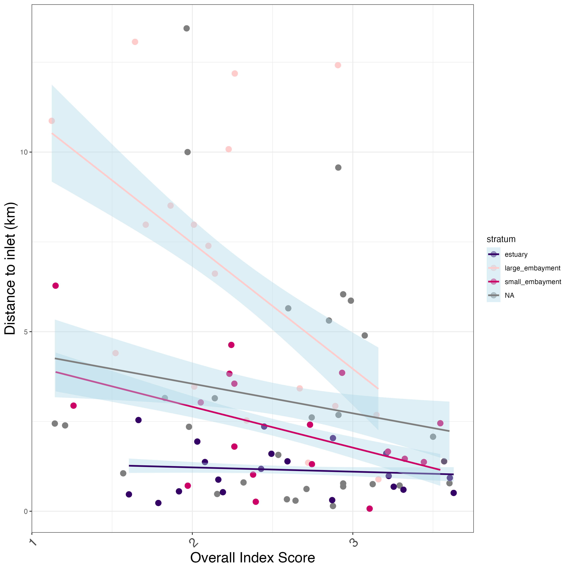
Distance to inlet vs. overall score
Overall index scores decrease with increasing distance from inlets, except in estuaries
Most pronounced effect in large embayments
Notes:
More representation of points further away in large embayments, combined with lesser marine influence and lower flushing rates

Slide 16
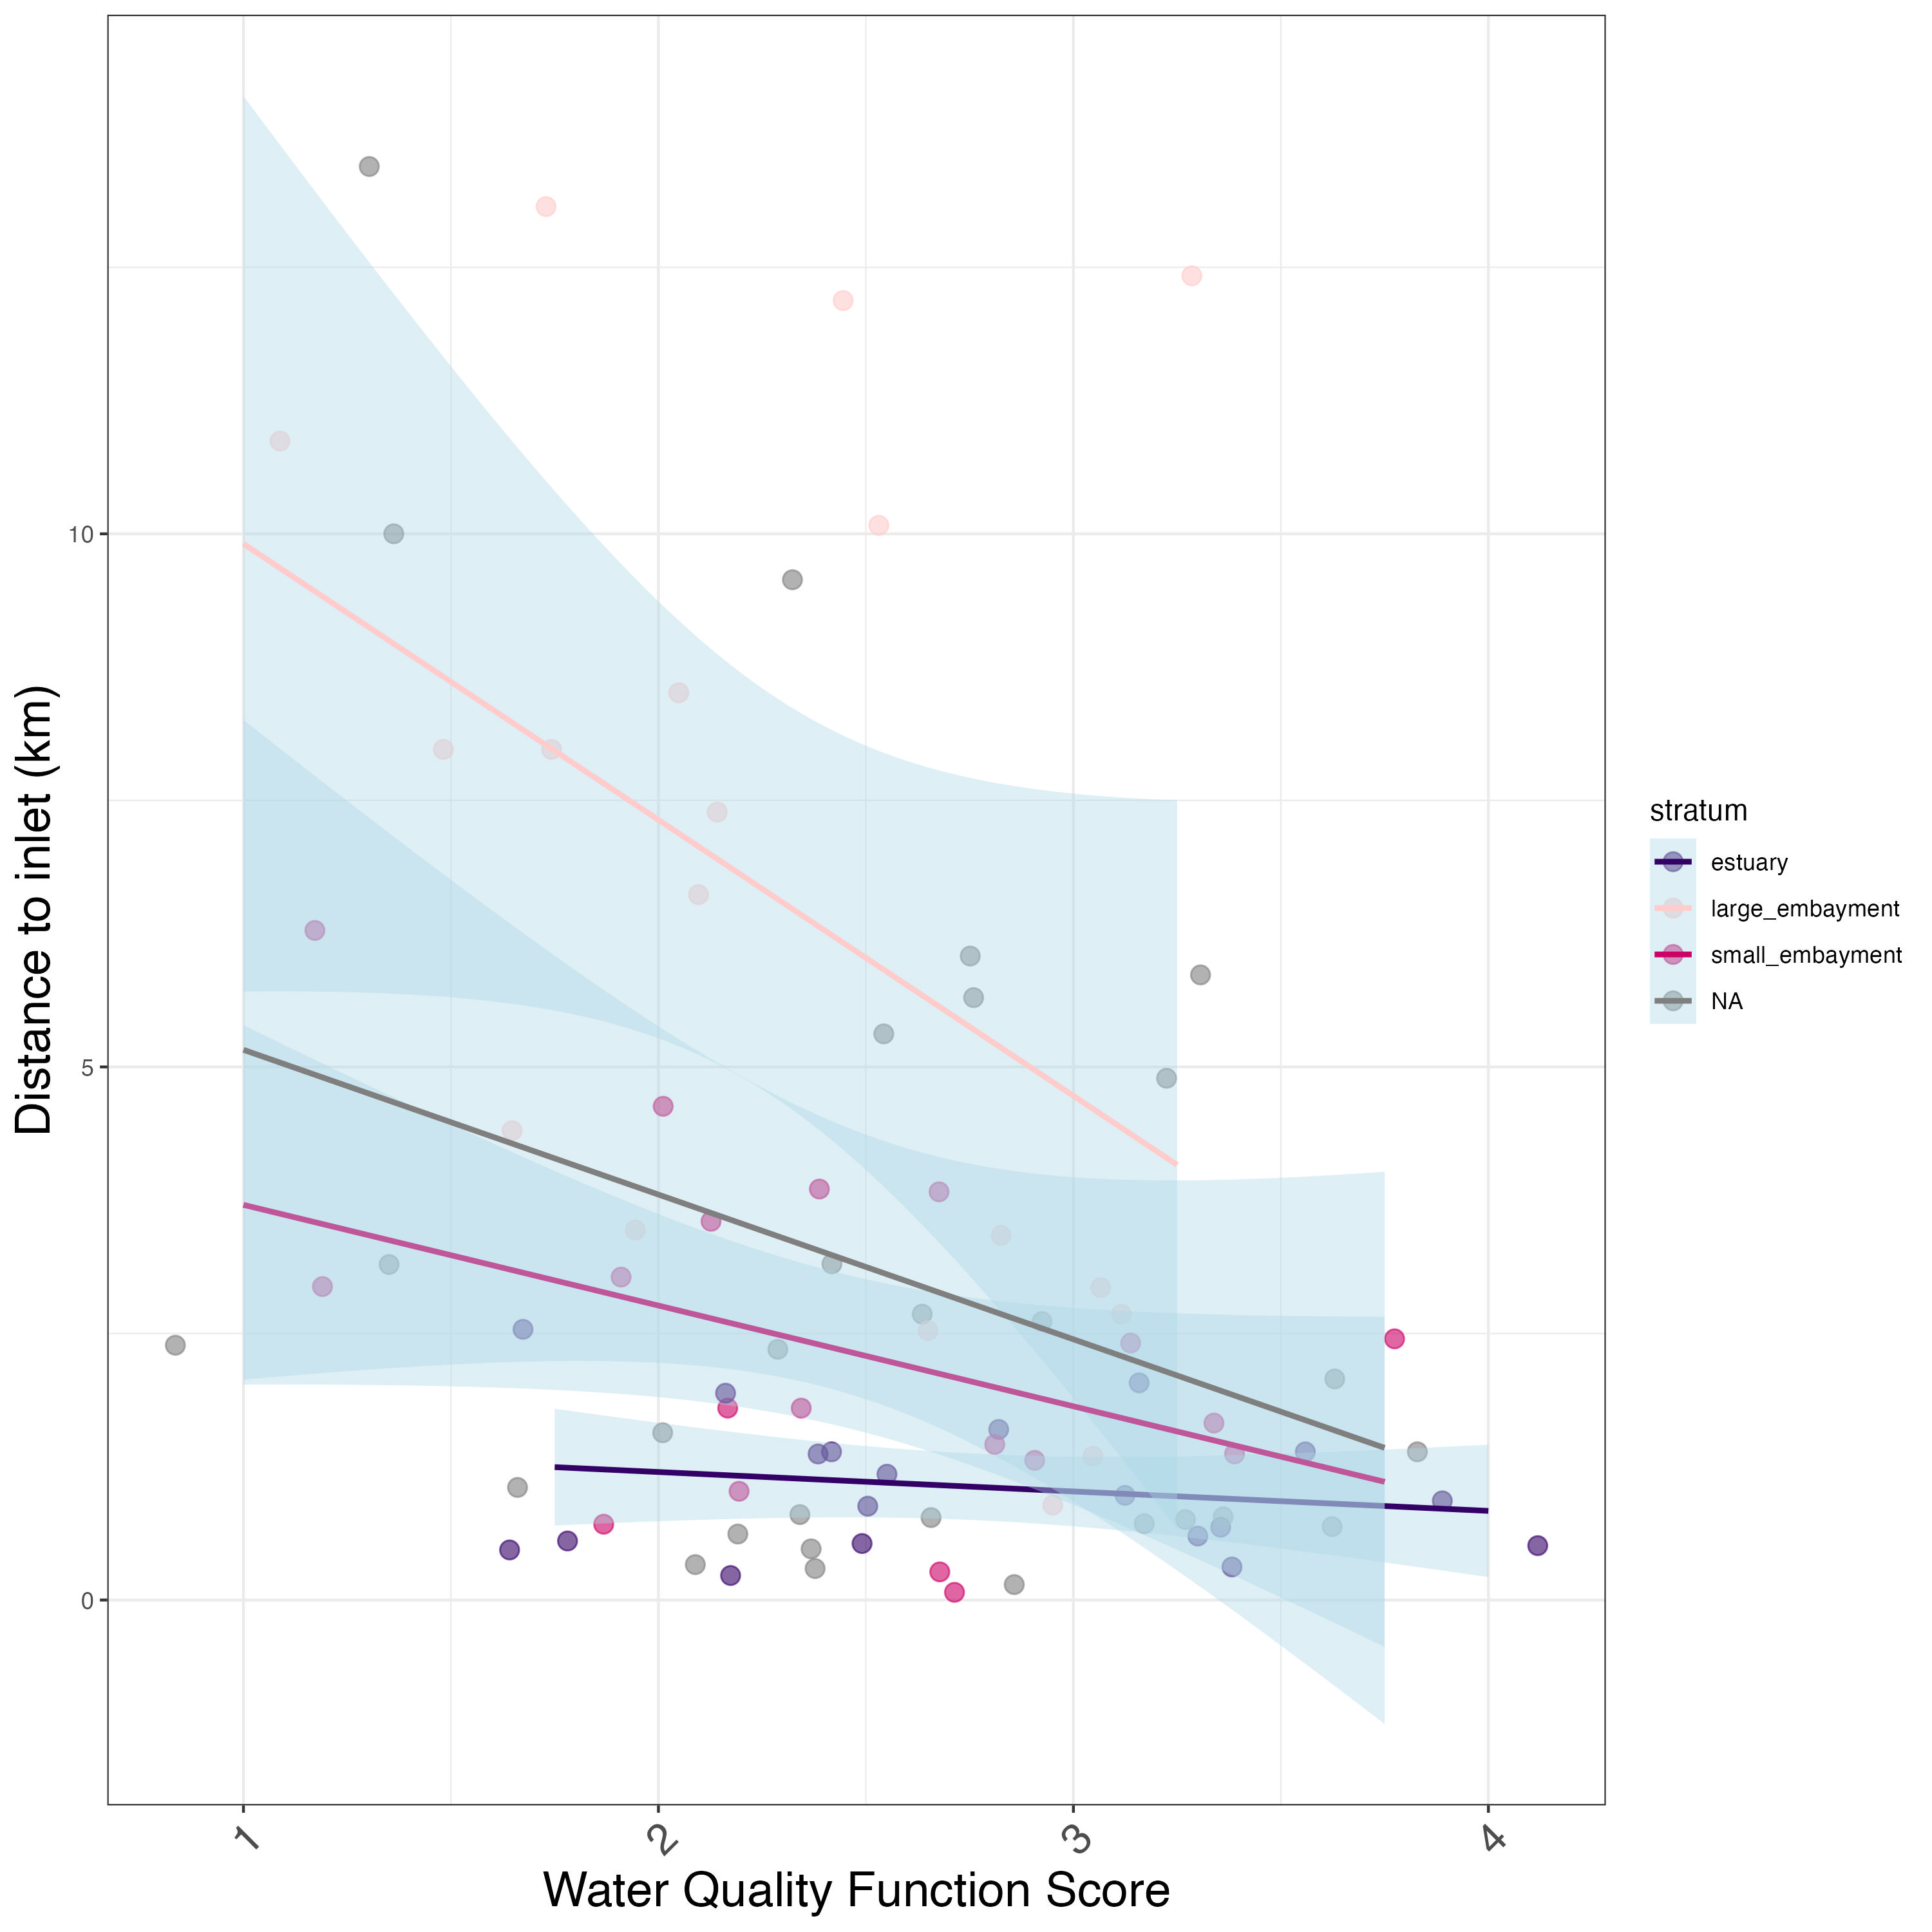
Distance to inlet vs. water quality condition
Water quality function scores increase with decreasing distance to inlet, especially in large embayments.
Our the individual components of the index are responsive to a known gradient
Notes:
-Potential drivers that had no effect: species, site protection status, inlet status (all open).
-not finished: scrubbing historical Caulerpa maps for a “within 1 km of a known infestation” – still in progress
Most of our sites are WITHIN water bodies. Further away means closer to headwaters. This relationship makes sense. Small embayments tidal flushing period is short, large embaryments are longer. Estuaries are not very sensitive to this (why?)
-Estuaries are lowest – why is this? Shape may come into play.

Slide 17
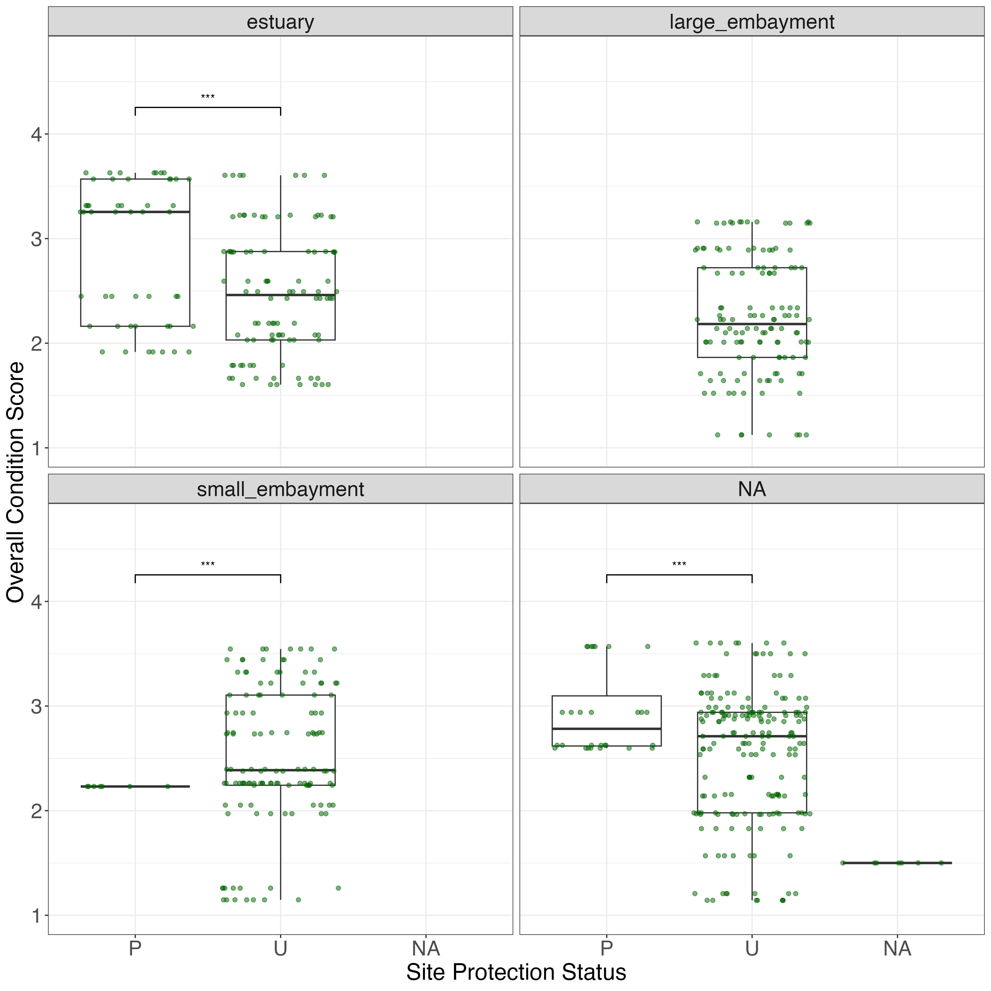
Site protection status vs. overall score
Protected sites had significantly (***) higher eelgrass index scores than unprotected sites
EXCEPT for in large embayments, which had no sites in protected areas
Note that some site protection status was undetermined
Notes:
Protection could enhance overall scores or ecosystem function
This tool could/should be applied to coastal eelgrass beds –
Methods stuff –
Don’t recommend tool validation – put it in the discussion
Mapping extent – helps with site recon
Having trend patterns for this highly ephemeral organism
Throw them straw dogs

Slide 18
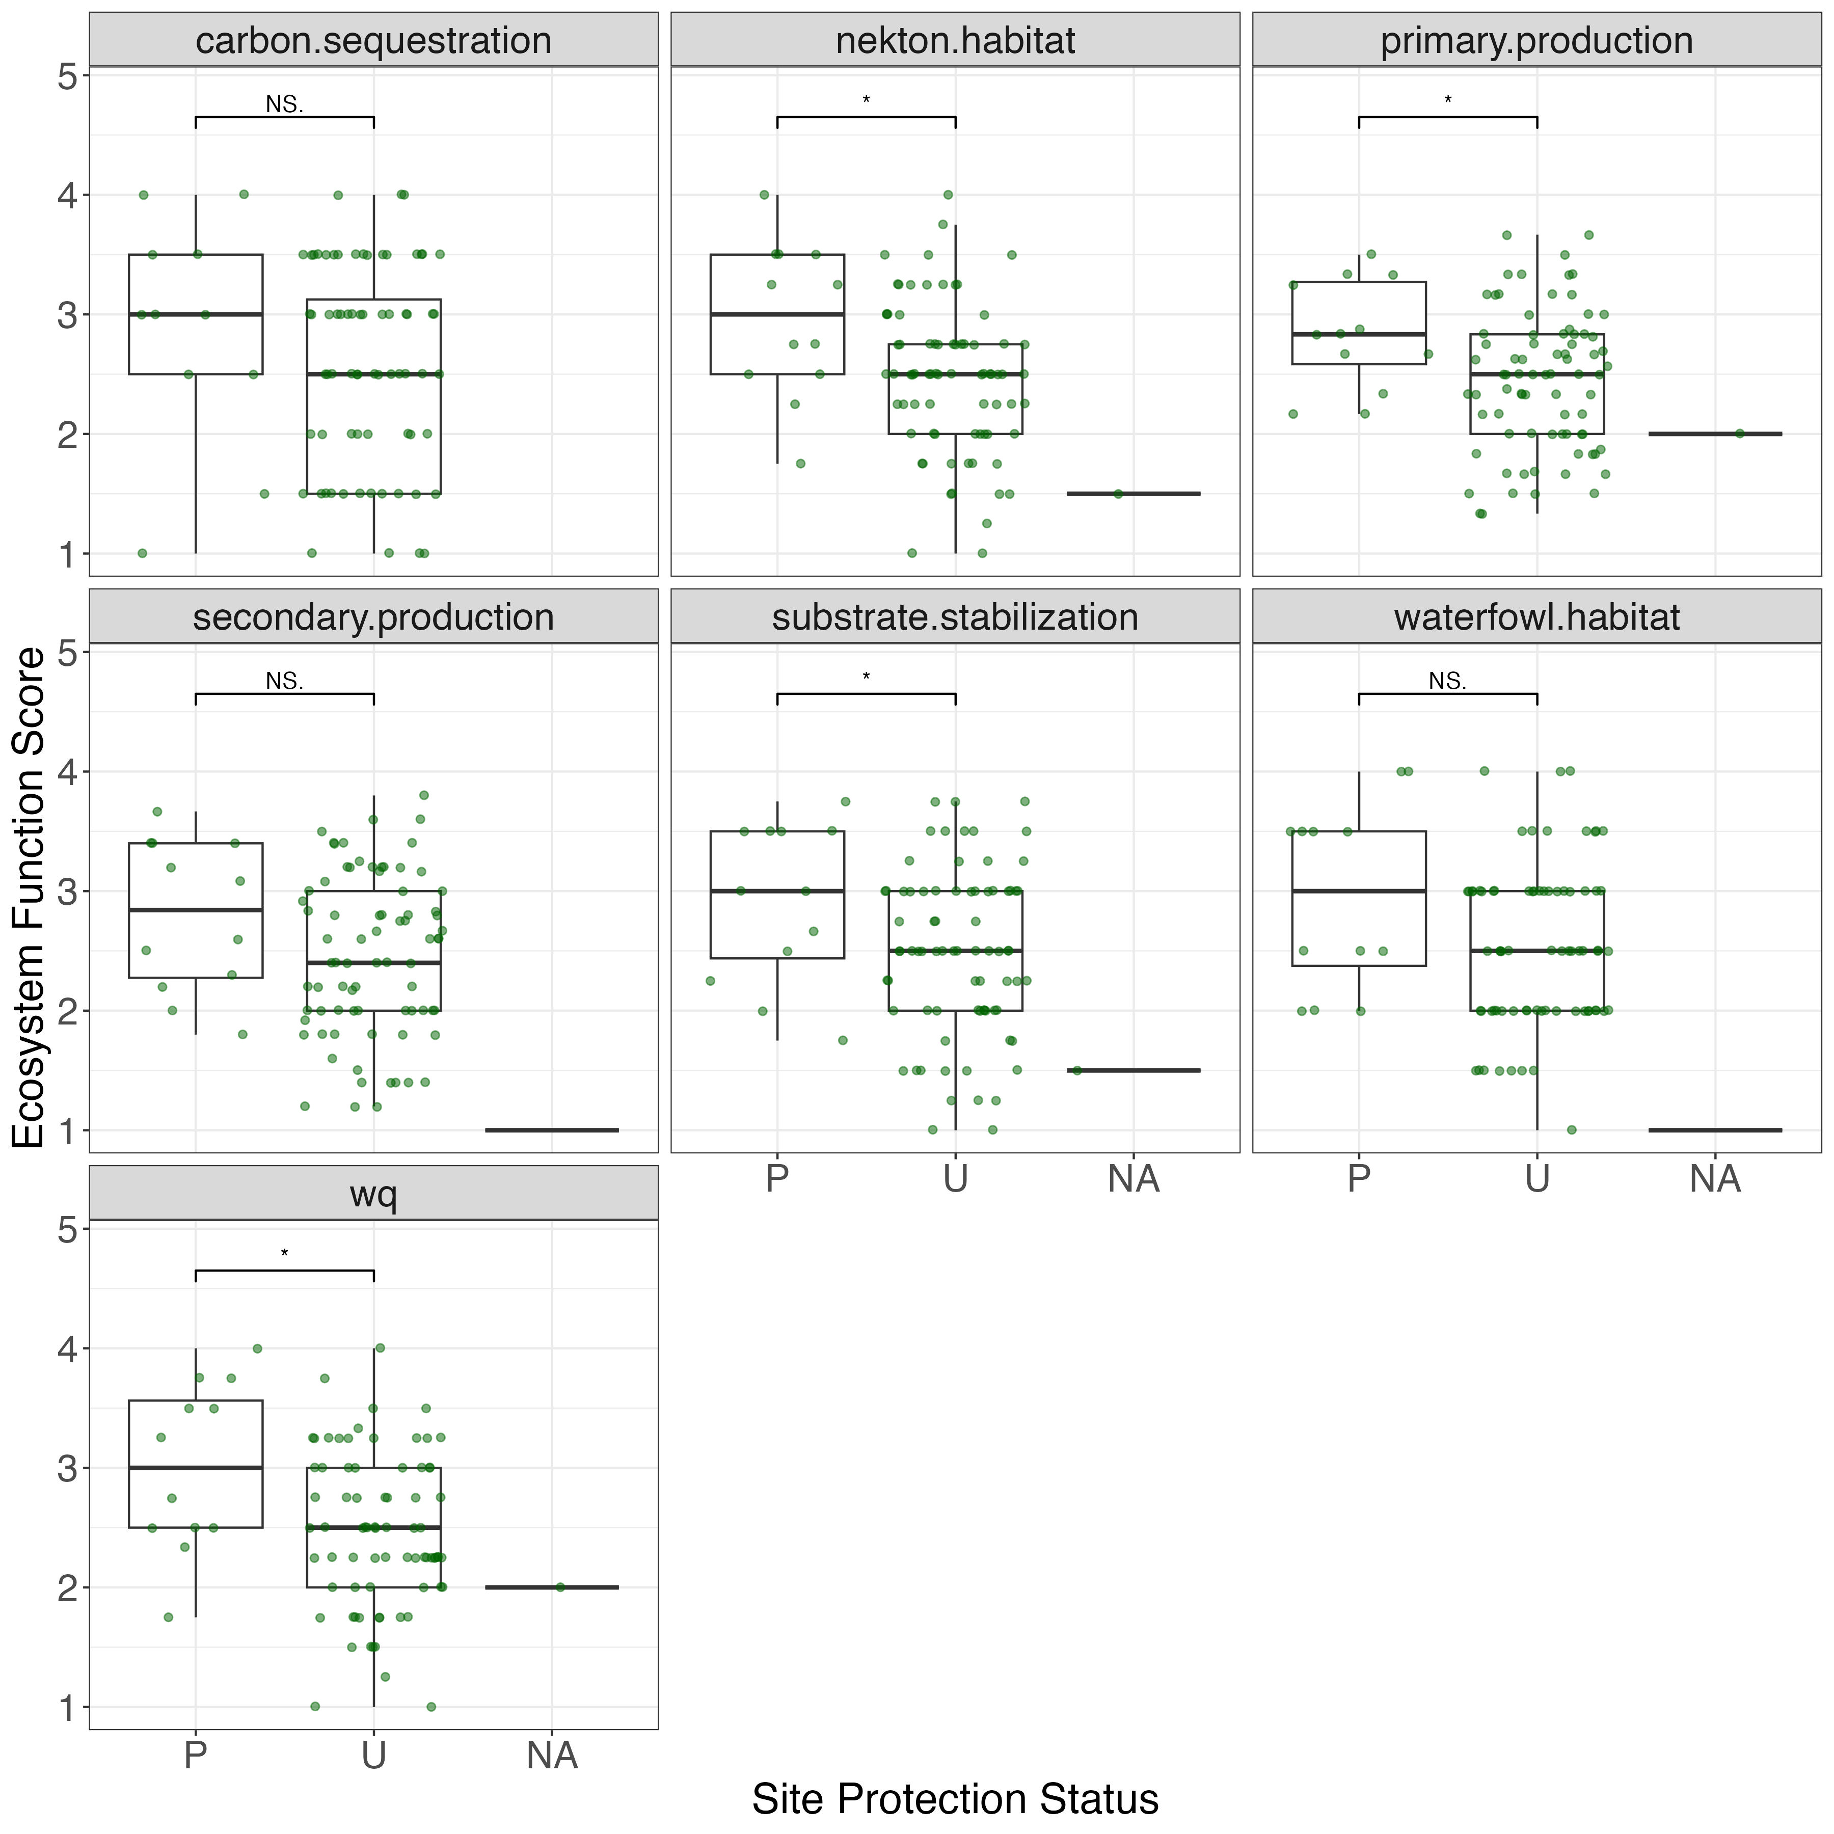
Site protection status vs. ecosystem function
Protected sites had significantly (*) higher ecosystem function scores for Nekton Habitat, Primary Production, Substrate Stabilization, and Water Quality than Unprotected sites
Another line of evidence that our tool is discriminating between good/bad sites

Slide 19
Other items
Appendix material

Slide 21
Appendix material
This is info for ecosystem managers
What would be the most useful format for them?
What type of data are they looking for?

Slide 22
Appendix material: one or both options?
Option 1
Option 2
Maps
Index score
Ecosystem function scores (x7)
Tables
Grouped by stratum
Grouped by waterbody (useful for managers)

Slide 23
Bight Report

Slide 24
Timeline

Slide 25
Project timeline
Public landing page available
Target deadline: March 2026
Recorded data portal webinar available
Key graphics created, preliminary analysis complete
Verbal report to overall Bight committee
Draft report written
Status update meeting
Gather all SAV field/lab data
Analysis Review Meeting
SOP Revisions Discussion
Wrap up meeting
c
June/ July 2025
February 2026
August/September 2025
January 2026
Notes:
The rough order of events are to :
Complete data submission
Committee reviews the data – with potential meeting review the reviews/questions
Complete initial data analyses w/ initial review via email
Complete draft final analyses based on review of initial analyses (plus any additions) with a meeting to walk through analyses and form conclusions and reccommendations
Begin report writing
Hold meeting to discuss SOPs and potential revisions
Hold meeting (as necessary) to review draft report
Present to Bight Oversight Committee
Finalize report

