Slide 1
Bight 2023 SAV update
01/15/2025
Notes:
In advance of the meeting, you can expect to receive:
Meeting agenda
Additional QA/QC requests from our Fall meeting
Full analysis for the Bight report

Slide 2
Last time
Discussed Bight 2023 timeline
Discussed development of RESCQ calculator
Previewed eelgrass condition index scores with RESCQ data

Slide 3
This time
Preview major findings of eelgrass index with data from Bight 2023 survey
What is the condition of eelgrass across the region? Does it differ by strata (small embayments, large embayments & estuaries)
Overall condition scores
Ecosystem function scores
Preview “secondary and tertiary” analyses requested by committee
Index scores vs. other environmental data
Site-specific eelgrass condition
Notes:
Committee has requested several other QAQC checks –also done.
-Leaf area vs AFDW
-shoot density vs AFDW

Slide 4
Major findings

Slide 5
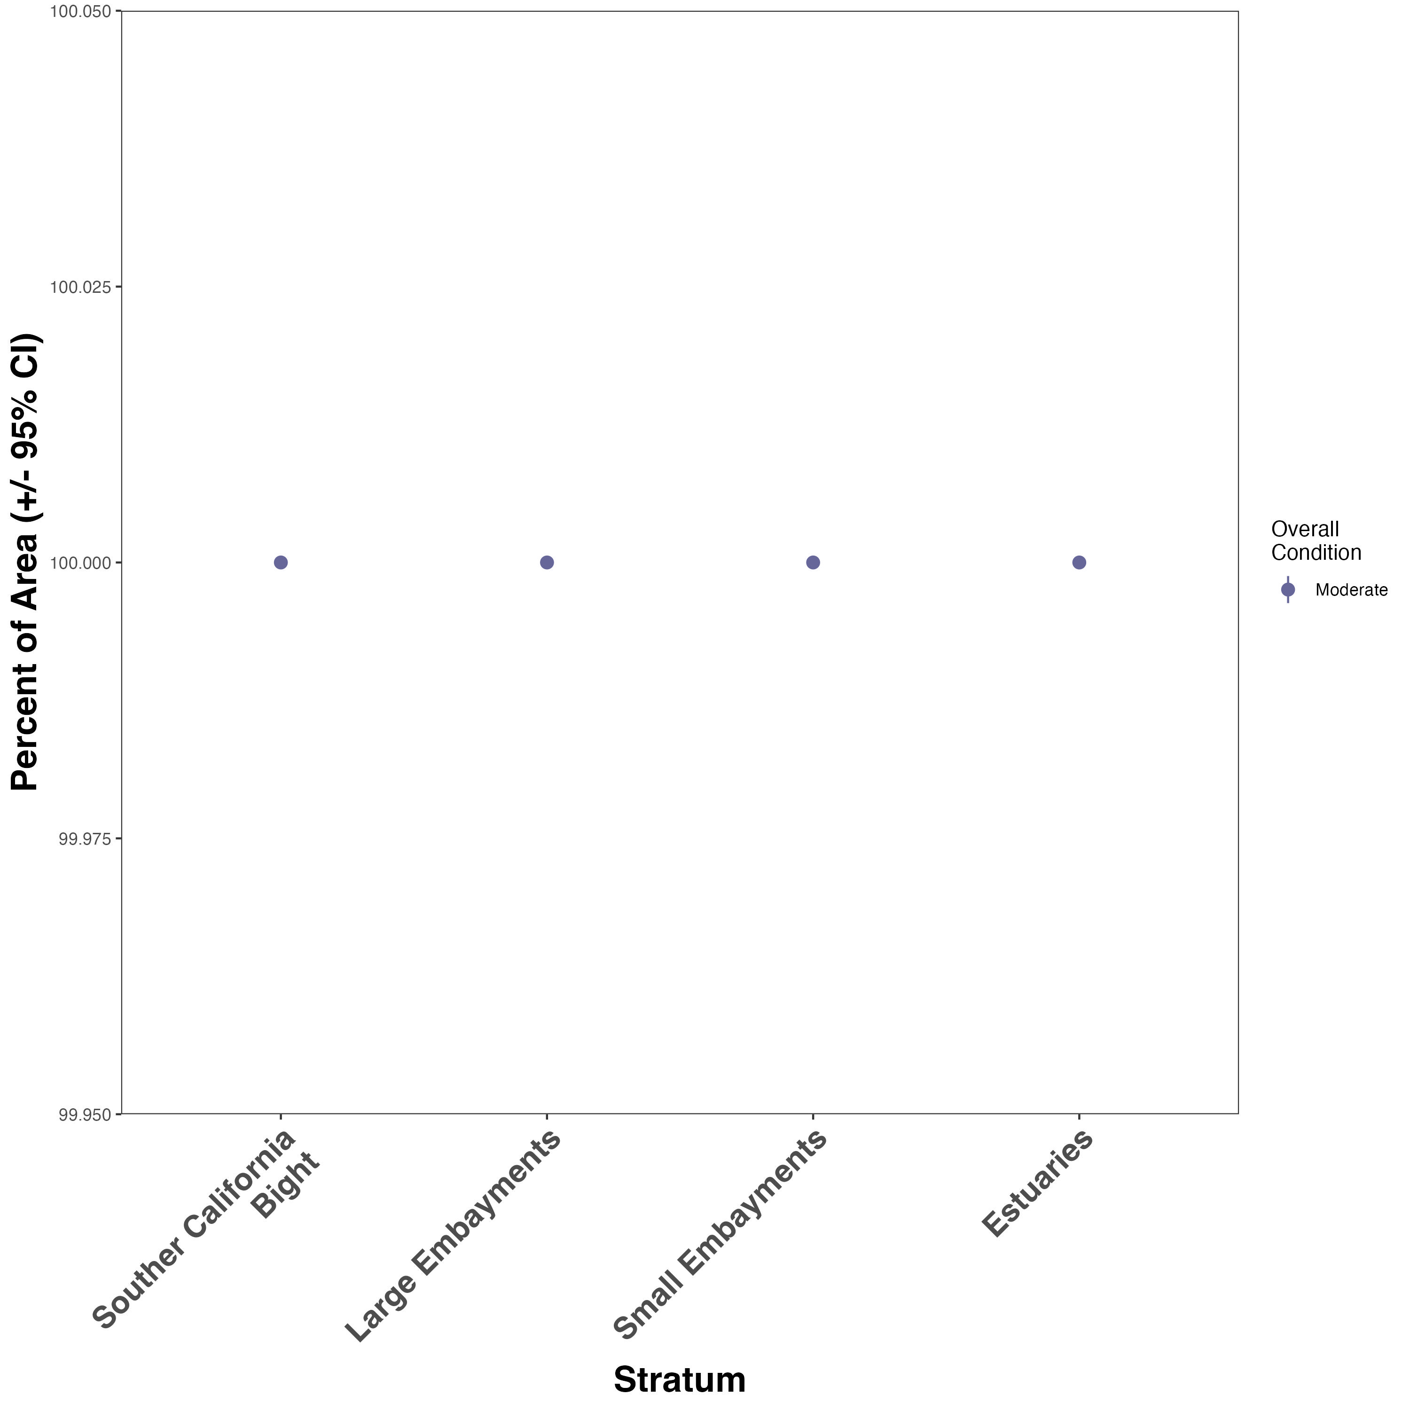
Area-weighted overall condition scores for eelgrass beds across Bight
All in overall moderate condition by stratum
Good news: Results are comparable to RESCQ survey
Notes:
Caveat: Not very sensitive to subtle differences in ecosystem function

Slide 6
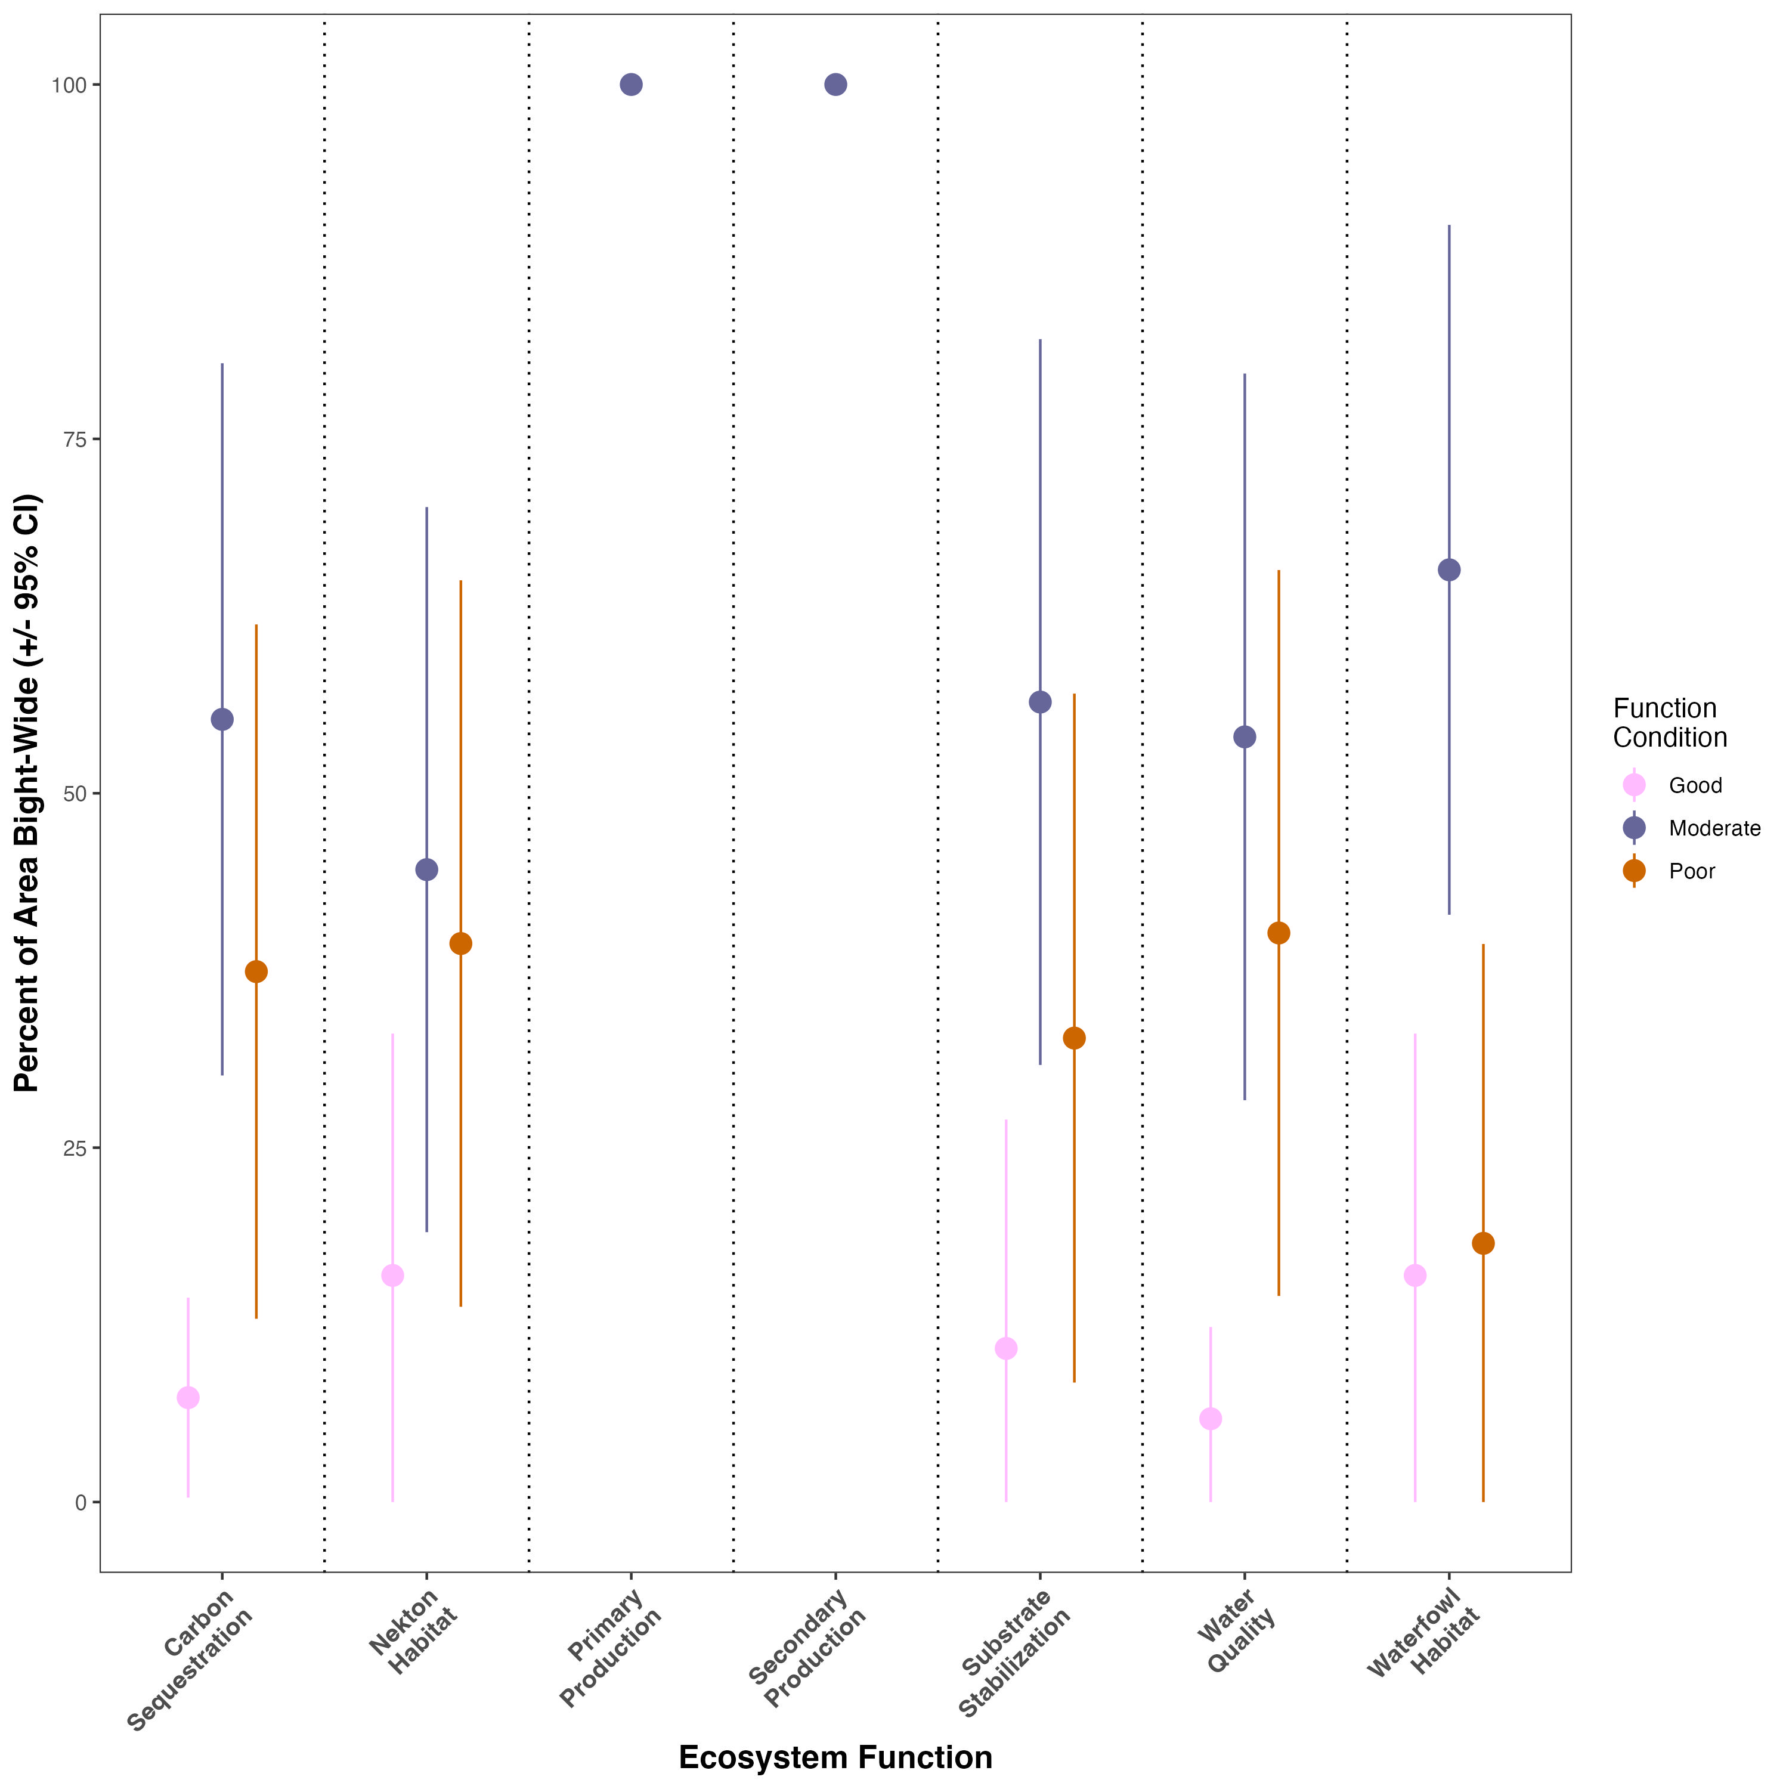
Area-weighted function scores for eelgrass beds across Bight
Most (55% - 100%) area is in Moderate condition for all ecosystem functions
About 10-15% of area for all functions is in Good condition
About 30-40% of area for all functions is in Poor condition

Slide 7
Function scores vs potential environmental drivers

Slide 8
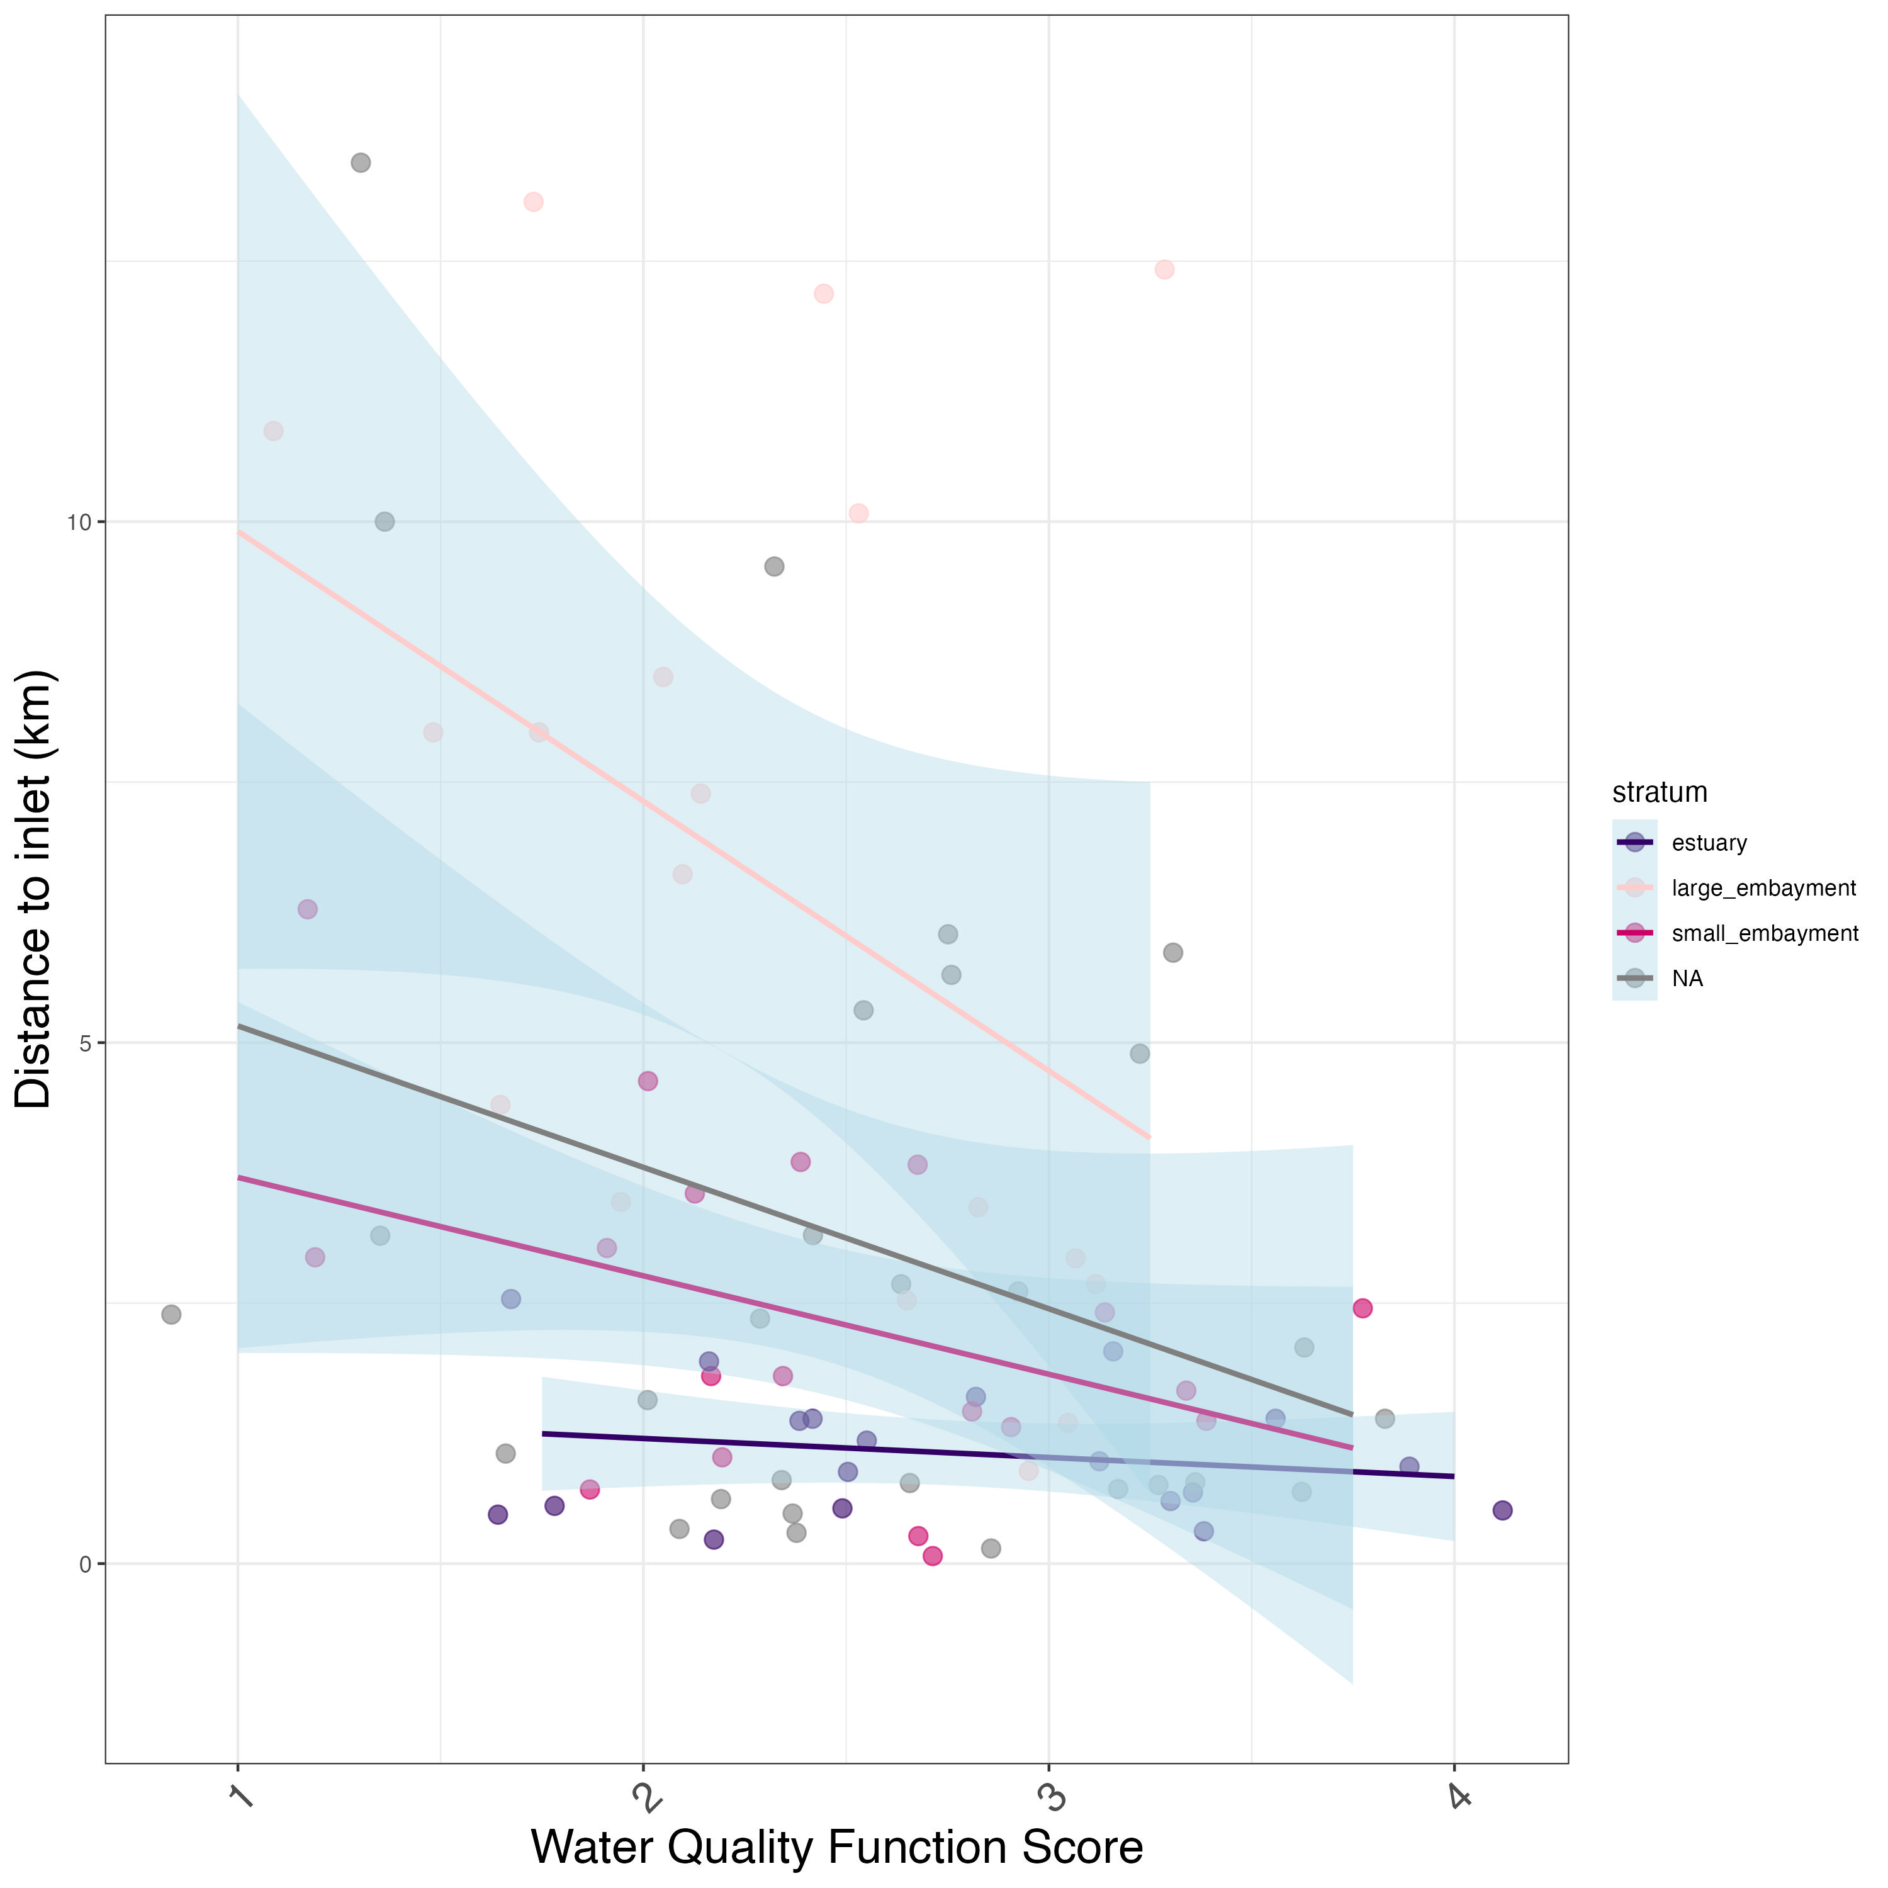
Distance to inlet vs. water quality condition
Water quality function scores increase with decreasing distance to inlet, especially in large embayments.
Notes:
-Potential drivers that had no effect: species, site protection status, inlet status (all open).
-not finished: scrubbing historical Caulerpa maps for a “within 1 km of a known infestation” – still in progress
Most of our sites are WITHIN water bodies. Further away means closer to headwaters. This relationship makes sense. Small embayments tidal flushing period is short, large embaryments are longer. Estuaries are not very sensitive to this (why?)
-Estuaries are lowest – why is this? Shape may come into play.

Slide 9
Site-specific information

Slide 10
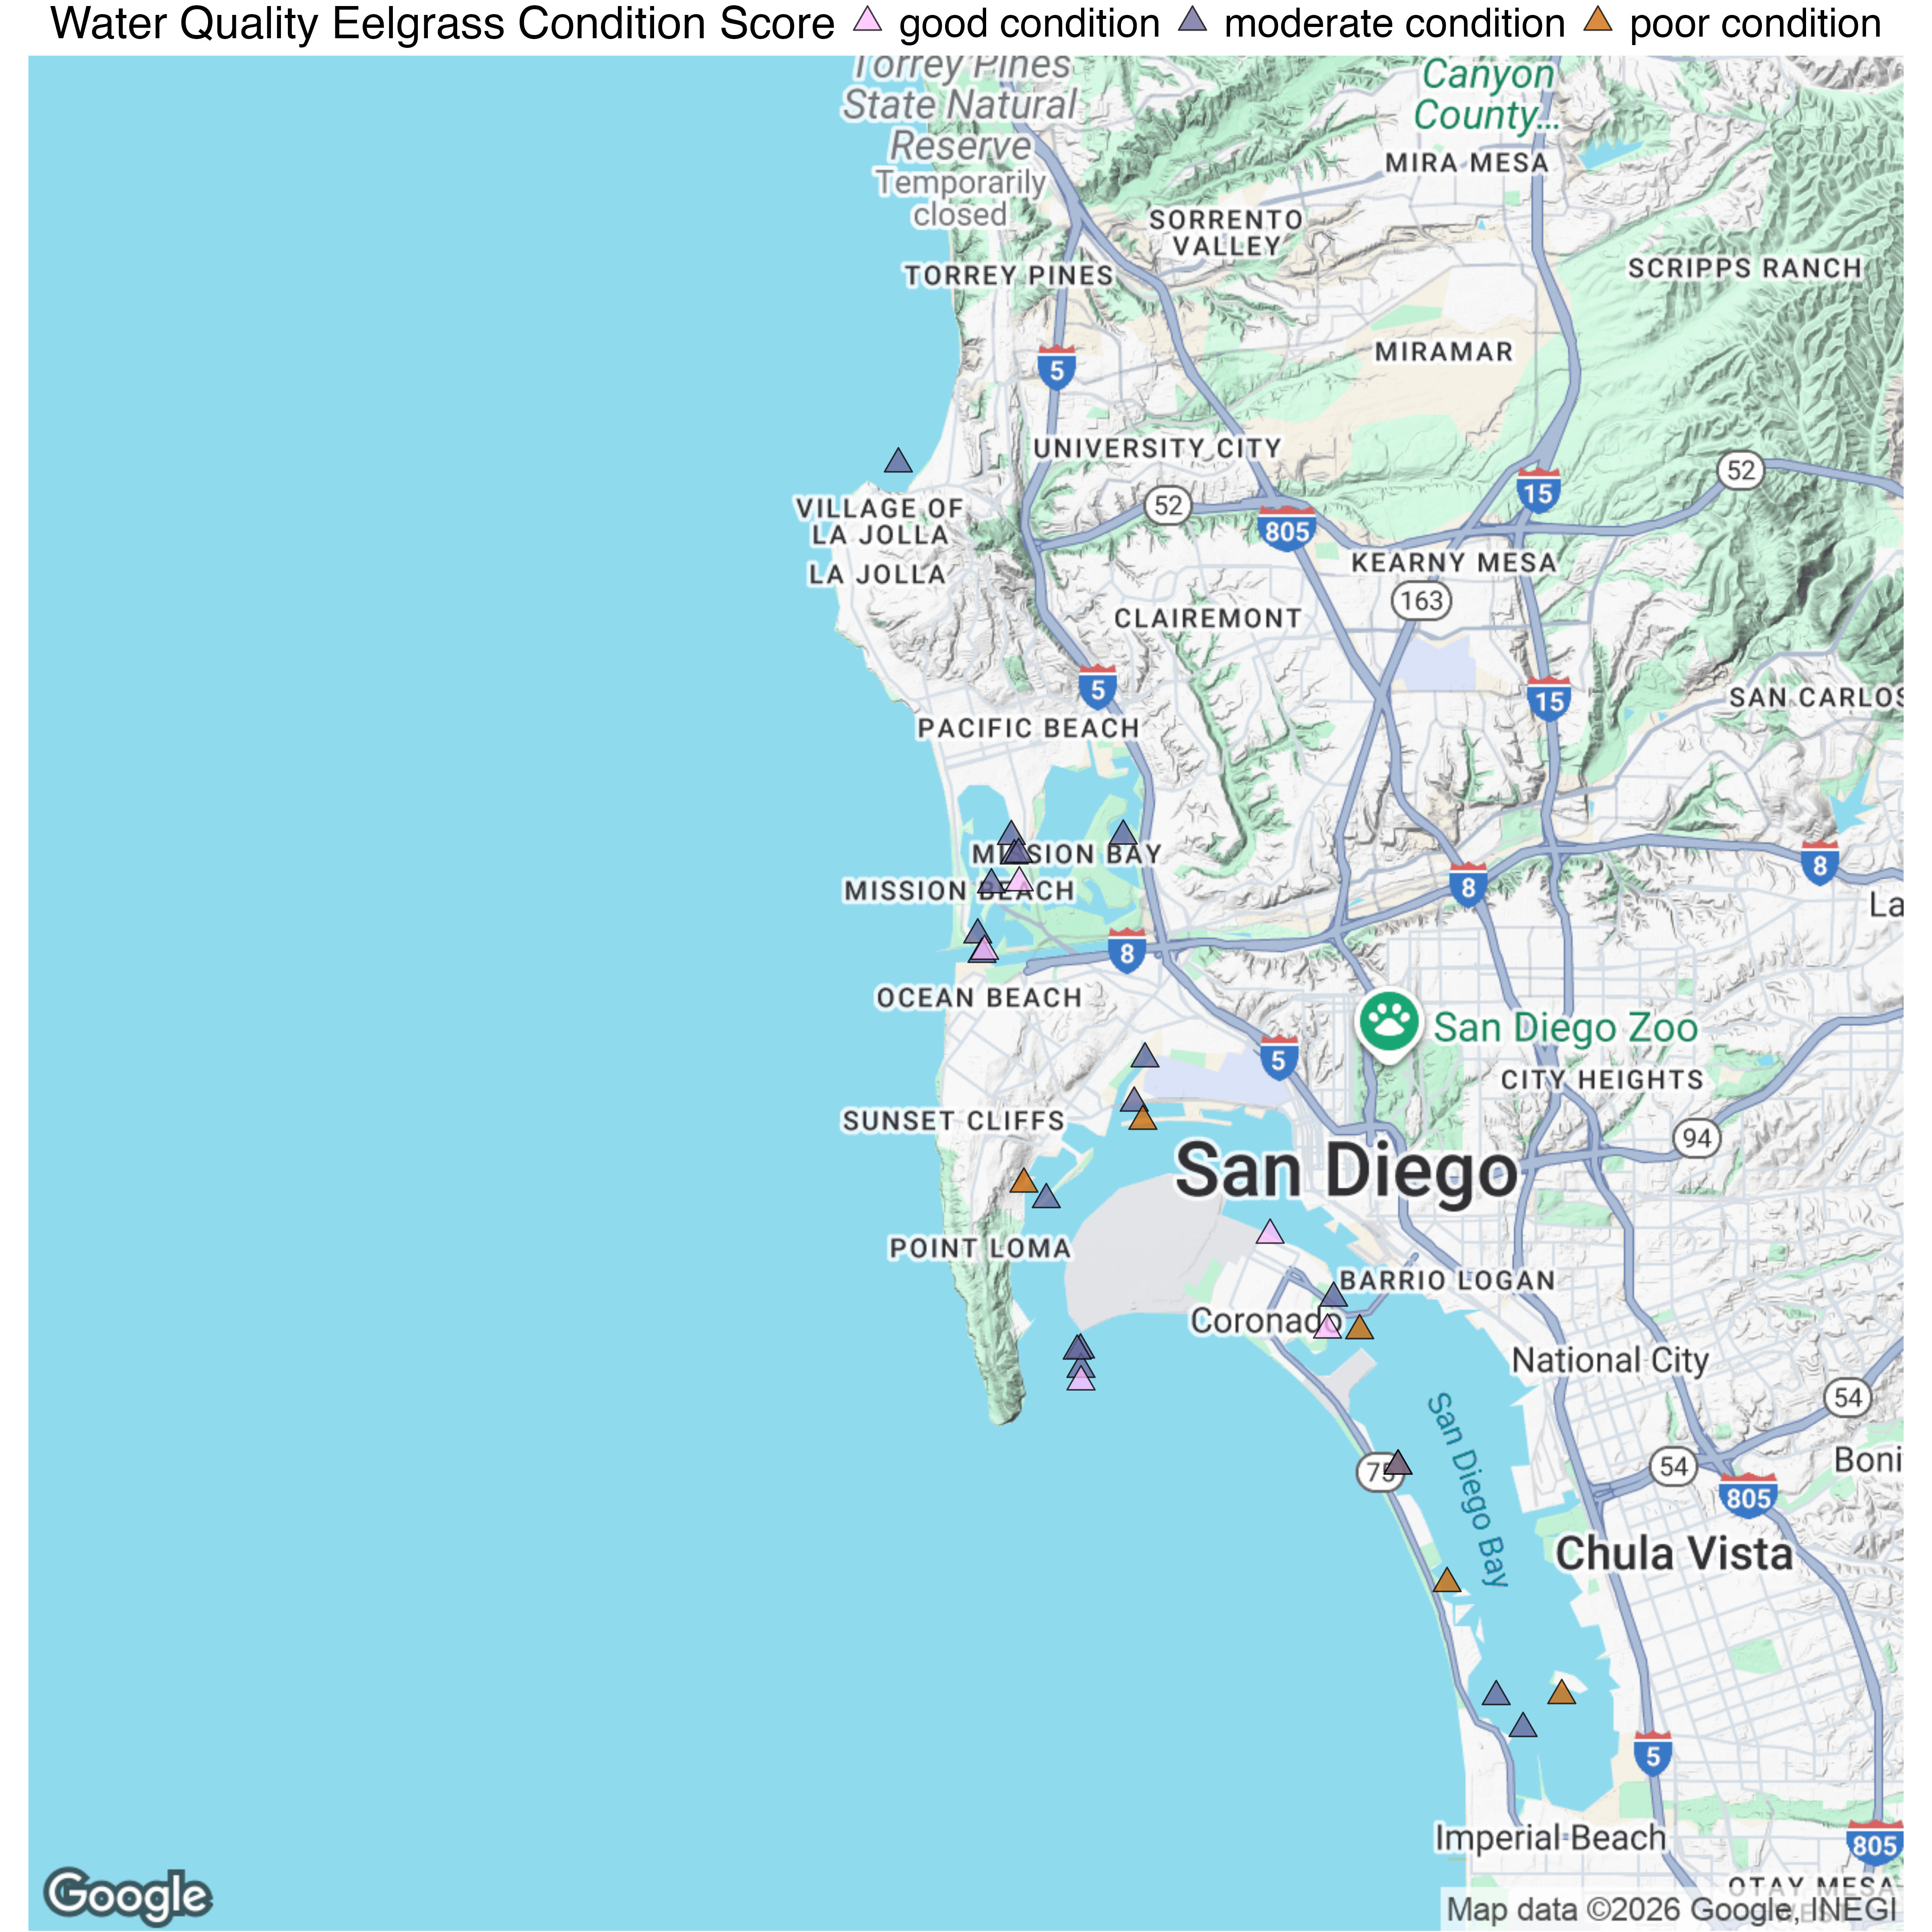
Site-specific water quality condition
Maps
Appendix tables for all water bodies
Covering all 7 functions
San Diego: Mission Bay has pretty good WQ, but there are some problem areas within San Diego Bay.
Notes:
Goals for meeting:
Approve QAQC of the data
Feedback on data analysis and findings (they’ve already agreed on analyses)
Discuss any tool refinement before reporting
Brainstorm management applications to highlight in Bight Report

Slide 11
Project timeline
Public landing page available
Target deadline: March 2026
Recorded data portal webinar available
Key graphics created, preliminary analysis complete
Verbal report to overall Bight committee
Draft report written
Status update meeting
Gather all SAV field/lab data
Analysis Review Meeting
SOP Revisions Discussion
Wrap up meeting
c
June/ July 2025
February 2026
August/September 2025
January 2026
Notes:
The rough order of events are to :
Complete data submission
Committee reviews the data – with potential meeting review the reviews/questions
Complete initial data analyses w/ initial review via email
Complete draft final analyses based on review of initial analyses (plus any additions) with a meeting to walk through analyses and form conclusions and reccommendations
Begin report writing
Hold meeting to discuss SOPs and potential revisions
Hold meeting (as necessary) to review draft report
Present to Bight Oversight Committee
Finalize report

Slide 12
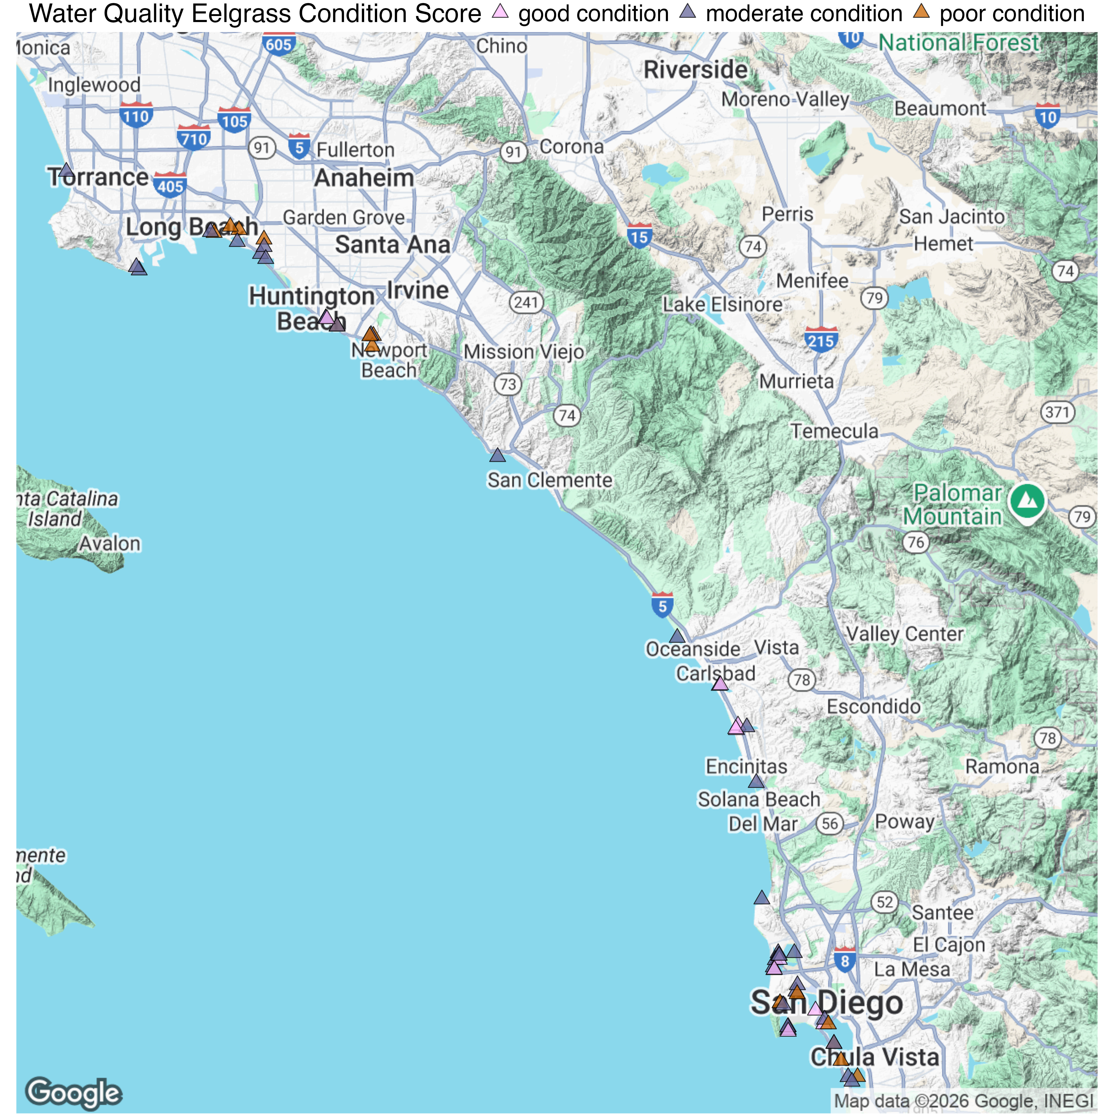
Site-specific eelgrass condition
Map
tables

Slide 13
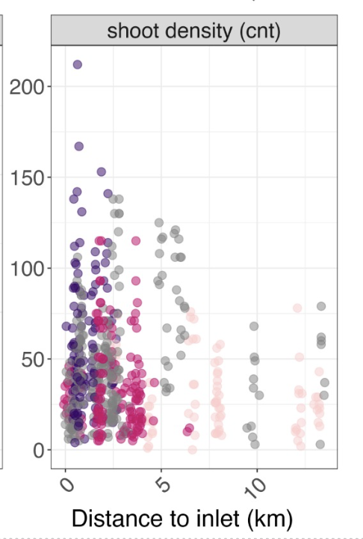
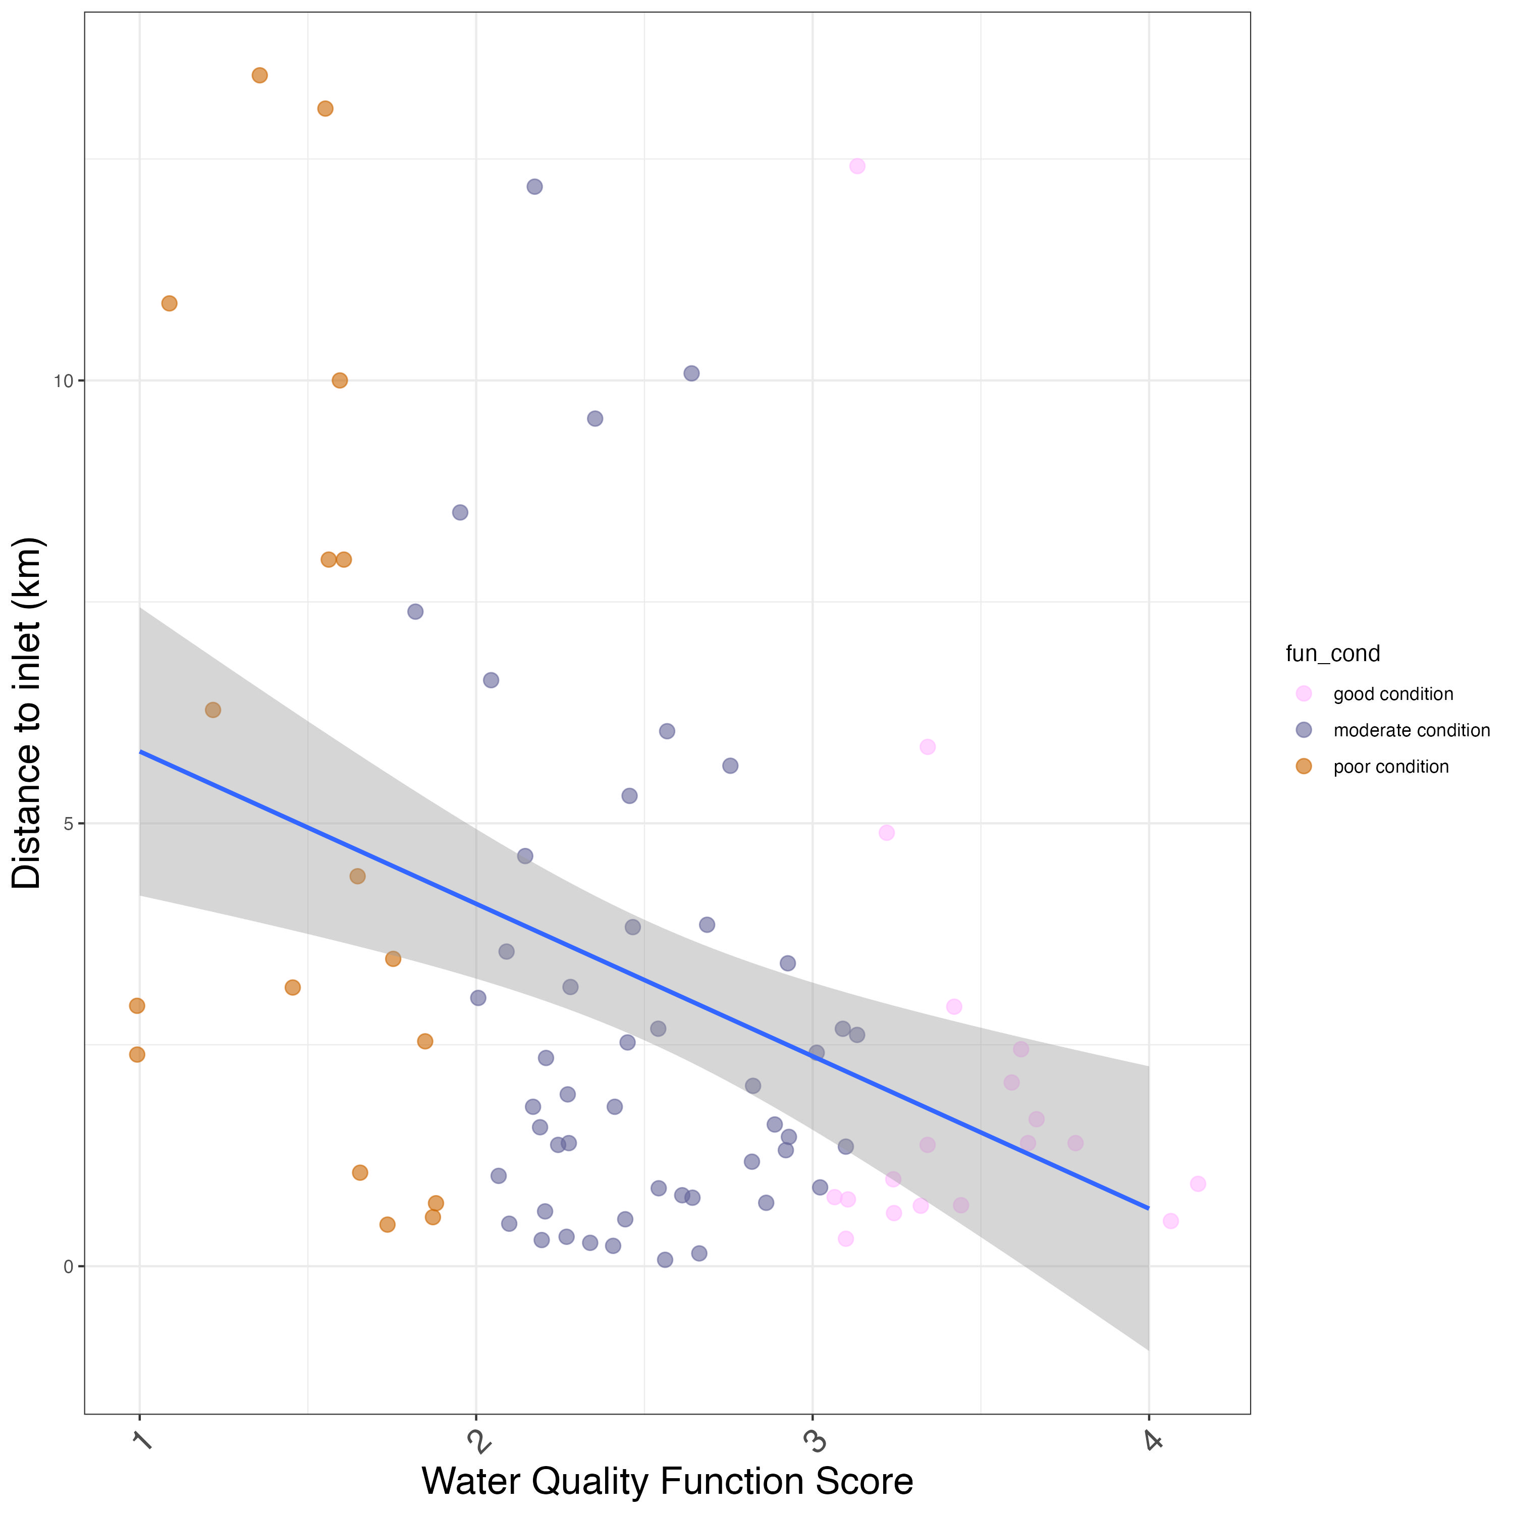
Structural metric vs. distance (not significant)

