Slide 1
HEURISTIC EVALUATION OF CONTENT MANAGEMENT SYSTEMS: CMS SPECIFIC HEURISTICS
Ronald Bos, Jilles van Gurp, Jan Herman Verpoorten, Sjaak Brinkkemper

Slide 2
Content Management Systems
CMS: “A system that supports the creation, management, distribution, and publishing of corporate information, covering the complete life-cycle of a website” (Robertson, 2003, adapted)
Separation of content, structure, and layout
Majority of CMS are instance of Web Applications:
  “any software application that depends on the Web for its correct execution” (Gellersen & Gaedke, 1999).
Restrictions on interaction
  Limited to types of interaction that current web browsers offer
Also different from normal web pages

Slide 3

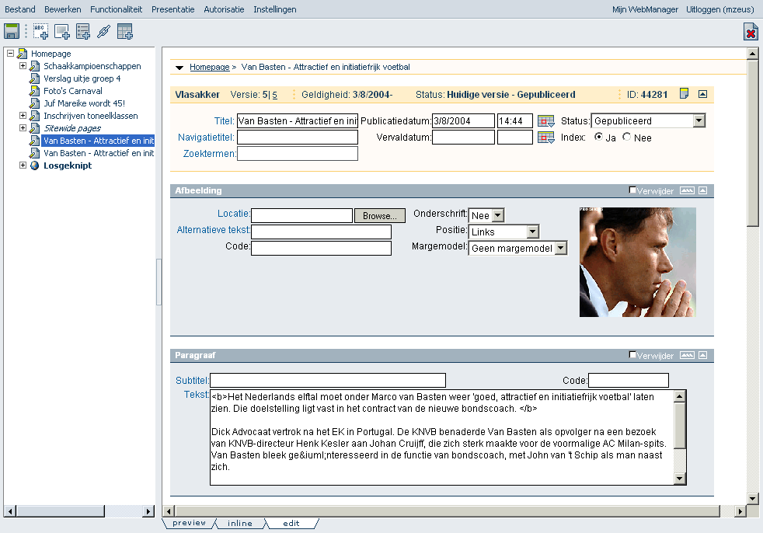
GX WebManager
GX Creative Online Development
WebManager
  One of the top CMSs in Dutch market
  KPN (Dutch telco), Postcodeloterij (lottery), Mercedes, Planet Internet (Dutch ISP), Ajax, Voetbal International, various municipalities

Slide 4
Heuristic Evaluation
Cheap and effective method to find usability problems
Small number of evaluators judge compliance of interface to heuristics
Existing heuristics are aimed at user interfaces in general
Heuristic evaluation of GX WebManager using Nielsen’s (1994) heuristics
  n = 7
  82 unique problems

Slide 5
CMS Specific Heuristics
Assumption: set of CMS specific heuristic will better help evaluators find usability problems
This assumption implies that evaluators would find a relevant number of usability problems insufficiently supported by Nielsen’s heuristics
Quantitatively & qualitatively analyzed

Slide 6
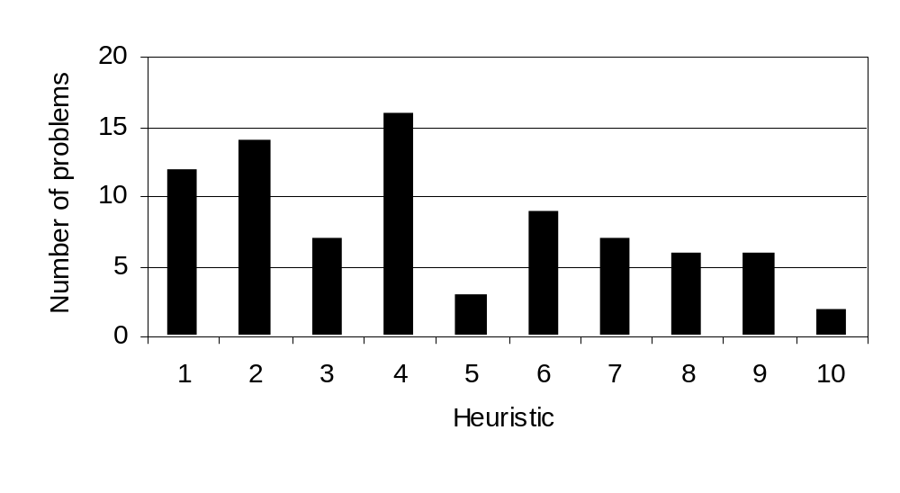
Results Heuristic Evaluation GX WebManager
Quantitative analysis: number of problems found per heuristic
  Some heuristics yielded more problems than others (M = 8.2; sd = 4.3)
Qualitative analysis also supported the assumption

Slide 7
Method - Development of New Heuristics
Sources:
  Quantitative & qualitative analysis of results HE WebManager
  Task analysis: task specific characteristics
  User analysis: user specific characteristics using an adapted version of Mayhew’s (1992) user profile checklist
  Usability guidelines available in existing literature
CMS should be adapted to its users and their tasks

Slide 8
Method – Validation of Heuristics
In existing literature validated by comparing results of HE using different heuristics
  Evaluators will not be able to disable their knowledge of existing heuristics
Expert validation (n = 9) was used to validate and adjust heuristics
Heuristics rated on:
  Relevance for finding usability problems during HE
  Importance to follow
  Frequency of violation

Slide 9
Results – CMS specific heuristics
New heuristics based on Nielsen’s (1994)
  2 omitted
  8 adjusted and/or combined
  4 new
Expert validation
  All heuristics scored high on relevance, importance, and frequency of violation
  Only one heuristics was slightly adjusted

Slide 10
Results – CMS Specific Heuristics
1. Visibility of system status | 7. Error prevention and recovery
2. Match between system and real world | 8. Provide help and instructions
3. Consistency | 9. Conformance to other applications
4. Recognition rather than recall | 10. Follow web application conventions
5. Flexibility and efficiency of use | 11. Browser controls and navigation
6. Aesthetic and minimalist design | 12. Allow easy data entry that minimizes the chance of errors

Slide 11
Conclusions
CMSs differ from classical desktop applications
CMS specific heuristics will better help finding usability problems
Utility of CMS specific heuristics twofold:
  Form the basis of a cheap and effective usability evaluation method
  Can be used as “rules-of-thumb” during user interface design

