Slide 1
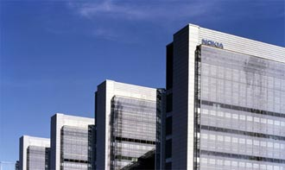
Applying OSS development practices in software product line development
Jilles van Gurp
Nokia Research Center
Software & Applications LAB
Software Architecture Solutions Group

Slide 2






Overview
OSS = license + set of practices
Six development themes
  Communication
  Tooling
  Code ownership
  Technical roadmap
  Quality management
  Release management
What is the OSS practice for these themes?
  Paper provides examples from eclipse; mozilla & linux projects for each theme
  How does this apply to SPL development practice?
  What lessons can be learned?

Slide 3
Executive summary
OSS = inter organizational reuse
SPL = intra organizational reuse
OSS development practices represent what developers feel is the best way of developing software if not obstructed by management + deadlines + corporate stupidity + etc.
Judging by the development speed and quality of many OSS projects, these developers might be on to something.
SPL engineering and OSS are the two most succesful strategies for large scale reuse.
  Why not do both?

Slide 4
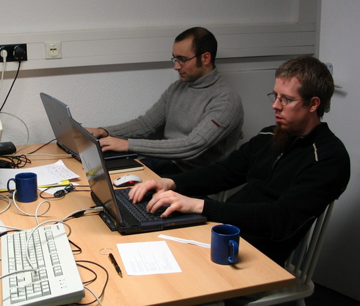
Communication in OSS world
In OSS projects development teams are
  Large
  Geographically distributed
  Crossing organizational boundaries
  Composed of developers only
Communication infrastructure consists primarily of
  Email (private and mailinglists)
  Newsgroups
  IRC
  Project website
  Development tools (next theme)
Face 2 face meetings not so common
two KDE developers at a (rare) developer meeting

Slide 5
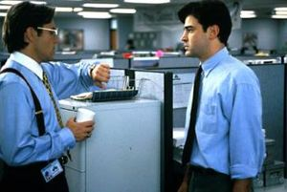

Communication issues in SPL development
Large development teams
Development may cross (intra) organizational boundaries
Organizations are large, sometimes multinational
Secrecy & customer relationships form obstacles for direct, open communication
Significant involvement from people who are not developers
Face 2 face meetings are important

Slide 6
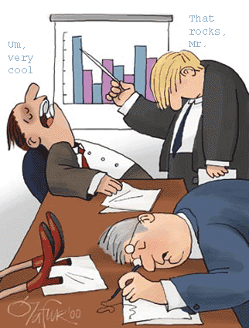
So how can OSS practice help here?
Use the same tools: email, mailinglists, instant messaging
  Documented discussions
  Information sharing
  Consensus based decision making
De-emphasize face to face meetings because
  Generally excludes important people not on location
  Eats up valuable development time
  Leaves no trace in relevant tools
Ensure non-developers stay in the loop
  Make sure they are on the mailinglists, wikis, etc.

Slide 7
OSS Tools
Minimum prerequisites for launching an OSS project:
  Mailinglist
    primary communication channel for the people working on the project
    public discussion
  Version control
    Preferably Subversion these days but CVS remains popular too.
  Bug tracking
    Bugzilla or similarly capable system
Optional
  Build, integration and testing facilities
  Website
    A place where you list the access points to the tools above + maybe documentation and marketing information
  WIKI
    A place for developers/users to collaboratively work on non development artifacts

Slide 8
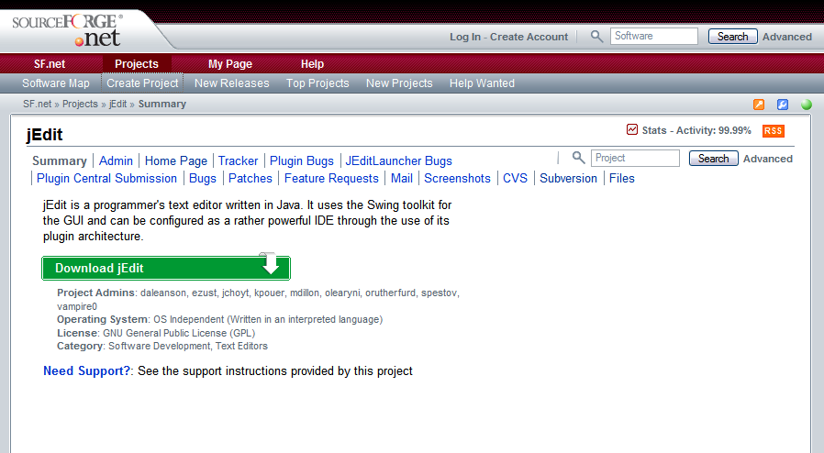
Everything required to set up a project, for free

Slide 9
The reality of tools
OSS projects are tool centric
  Tangible results of the project live inside the tools
    Source code in the SCM
    Bug reports in the bug tracking system
    Documentation in the WIKI
  People communicate through tools + mail
    All other forms of communication optional
Interesting concequences
  Anything outside the tools is irrelevant.
    software_architecture.ppt on somebody's laptop is not accessible to anyone and disconnected from the information in the SCM and bugtracking db. It might as well not exist and it is probably out of date/inacurate/obsolete/misleading/.... !
  Tools are the only interface to the project
  Tools are not compatible with many of the traditional waterfall model phases:
    You won't find a requirements specification for the linux kernel
    Nor is there a detailed design document for the Firefox browser
    While there are some open source UML tools, they are rarely used in open source projects!
community makes its own tools

Slide 10
SPLs and the other reality
Good news!: tooling tends to be way better in corporations!
  Expensive SCM systems, IDEs and UML tools are common.
  + Variability modeling, build configuration, component technology, ....'
  And we can buy even more if we need to!
Bad news:
  Tools are still incompatible with many of the traditional waterfall model phases
  not necessarily development centric or even developer friendly
  poorly integrated with each other
  Information exists outside the tool chain: alternative reality
  A lot of problems arise from the problematic relation between the tool reality and the reality outside the tools
    Management makes decisions based on slideware - they don't understand the tool reality. Also there seems to be a reality distortion field clouding their judgement sometimes!
    Sales sells software based on requirement specifications
    Customers receive software based on artifacts in the SCM

Slide 11
Tool recommendations
More focus on integration
  Lesson from OSS community:
  anything not in the integrated toolchain is irrelevant and distracts from the tool reality
Reassess the added value of non-developer oriented/friendly features in commercial tools
  Lesson from OSS community:
  simple, standard tools lower the barrier of entry
Reassess the added value of requirements, architecture and design documentation.
  Are they really that important to the development team?
  Lesson from the OSS community:
  It is possible to develop large, complicated software systems on a tight schedule without those assets.

Slide 12
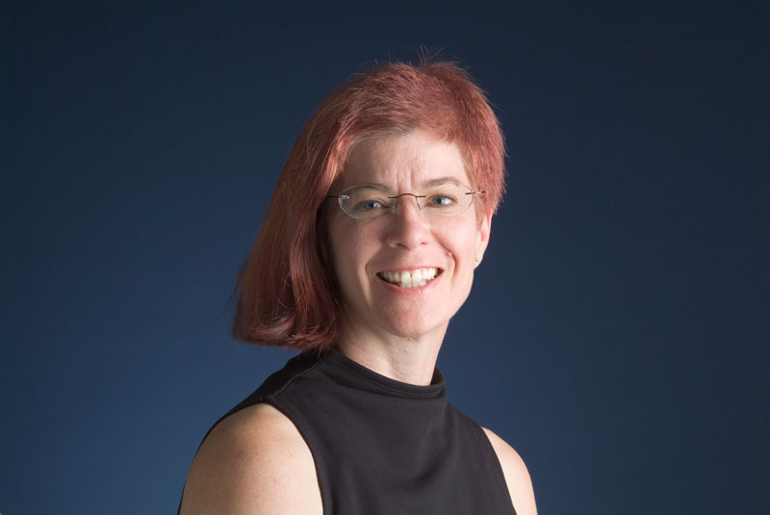
OSS Code ownership & governance
project owner(s)
  individuals
    sometimes organized into foundation
  coordinate development, communication, planning, sponsoring, legal issues, etc.
  sometimes not developers
    e.g. mozilla's president: Mitchel Baker
Module/component owners
  Senior developers with established reputations
  Safeguard code quality & drive development
  Code reviews
  Commit approval
  Initiate new development
Sponsors
  Influence by voting with your wallet

Slide 13
Ownership in SPL
Problems
  technical decisions complicated by non technical concerns
  decision power with people without technical competence
  no clear ownership or owner does not have full authority
  conflicts of interest, e.g. product deadlines vs. product line quality
Solutions
  Introduce code ownership as is common in OSS projects
    Must have authority to take actual decisions
  Separate product and product line development as much as possible
    higher degree of autonomy
  Don't micromanage development teams
    e.g. deciding on spending time on refactoring instead of feature development should be up to code owner,not his manager

Slide 14
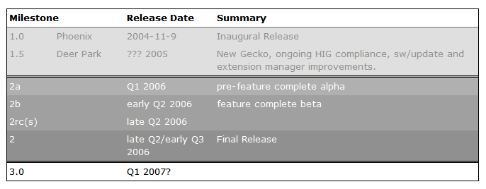
Roadmaps in OSS
Roadmap: what are we building
Tend to be
  sketchy
  short term
  realistic - what can be achieved in
  time frame X
  not set in stone
Purpose
  Ensuring relevant people know what is being worked on
  Realizing long term project vision through having short term plan for specific features
  Planning & coordinating development
  Generate interest from users and contributors
Decisions
  Based on consensus, usually result of community discussion.
  Painful decisions taken by respected/influential developers
Firefox 2.0 roadmap

Slide 15
Roadmaps in SPL organizations
Tend to be
  very detailed
  Medium to long term
  Basis for committing resources
  Not very flexible after resources have been committed
    e.g. product development dependencies
Purpose
  Planning
  Marketing
  Ensuring future competitiveness
Decisions
  Based on market demand + requirements + corporate strategy
  Painful decisions are not taken by developers

Slide 16
SPL Roadmap: learning from OSS
Purposes are different!
Need to be more flexible, short term oriented
  Agile!
  Make more effective use of opportunities spotted by individual developers
More room for refactoring and other non feature related activities

Slide 17
Quality management in OSS & SPF development
OSS Developers value quality
  not necessarily all quality attributes (e.g. usability)
How
  Testing of alpha versions & nightly builds by end users
  Explicit code reviews (see code ownership)
    Bug fixes are attached to bug report and only committed when approved
  Automated tests & continuous integration
    Functional - correctness, regression testing
    Non functional - performance, security, memory usage, ...
  Endless delay of the perfect 1.0 release.
In principle SPF developers can do the same
  Except maybe for exposing nightly builds/alpha versions to end users
  I'm sure they do :-)

Slide 18
Release management in OSS
Release process tends to be comparatively strong
  due to amount of end users involved early on: they care
  desire to deliver good quality
  user feedback
nightly builds >> alphas >> betas >> release candidates >> 1.0 >> 1.0.1 .... 1.0.n
  increasingly strong commit review process towards release
  larger groups of testers
  process does not stop after release
Mentality: it is done when it is done and not sooner!
  Release process can take several months after last alpha milestone
  Some projects are quite good at predicting when they are done

Slide 19
Release management in SPF context
Problems
  Much less 'users' (product developers)
  Much pressure to release on time
    users are waiting for release
  product developers are less eager to alpha test
  supporting old releases is time consuming and impractical
Solutions (from my experience)
  Don't expose every build to product teams
    creates too much feedback, product teams need to have stable code
  During release phase, test with one or two product teams
    Don't give them new builds every day
    Select low risk products
    Have them plan to upgrade to the release version!
  Expand to multiple product teams during beta phase
  Don't release too early & don't commit to specific release date too early

Slide 20
Conclusions
It's not black and white
  in practice many OSS practices are already adopted in enterprise
  OSS development practice has evolved from and is influenced by corporate development
Some things to remember
  Meritocracy: technical decisions are best taken by technically competent persons
    OSS developers have the advantage of being in charge
  If OSS developers don't waste time on certain things, why should we?
    How valuable is the non technical overhead really?
  Beware of the conflict between tool reality and slideware reality
  If a non functional requirement is important: test for it and set targets!
How to apply this in SPF context?
  That is the big question :-), good luck.

