Slide 1
On the notion of Variability in Software Product Lines
Jilles van Gurp
Jan Bosch
Mikael Svahnberg

Slide 2
SEGROUP, University of Groningen
Frameworks
http://segroup.cs.rug.nl/
Founded August 2000
Before that we were known as RISE, University of Karlskrona/Ronneby, Sweden
Third author is still in Sweden
SPLs
SOC
Software Architecture

Slide 3
Contents
What and why
Variation points
Features
Managing Variability
Concluding remarks

Slide 4
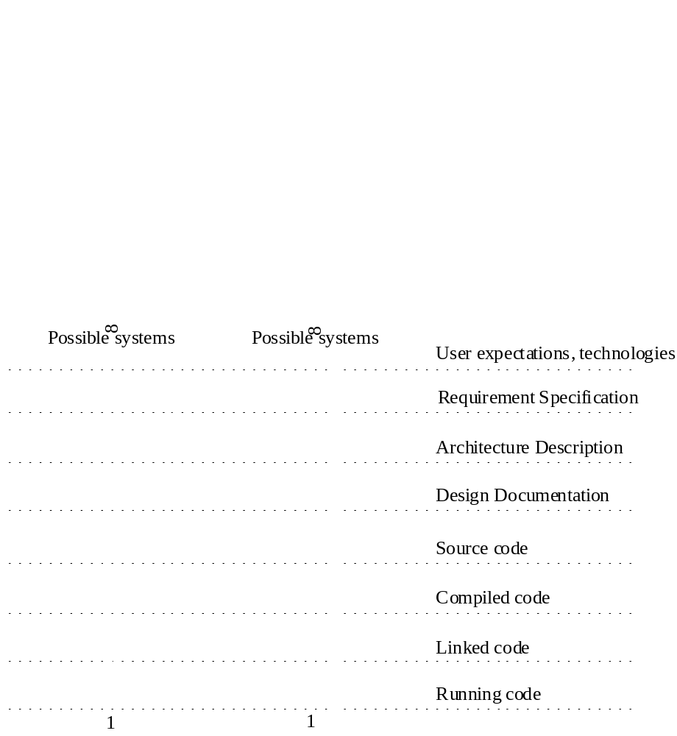
Development = constraining variability

Slide 5
So, what is variability?
Variability is a delayed design decision
Rather than specifying now, you allow for choice later
Variability is relevant throughout the development process, including run-time

Slide 6
Why do we need variability?
Reuse = using an existing piece of software in a different context
Reuse requires that the reused software adapts to the new context
Software without variability is not reusable
Opportunistic reuse does not work, the software needs to be prepared for reuse
So, reuse requires variability

Slide 7
Variability is needed for reuse
More variability in software
More supported contexts
More reusable software!
SPLs are all about reusing software assets

Slide 8
How much variability do we need?
Just enough, not more, not less
Variation points increase complexity
  So, too much variability increases the cost of software
Variation is needed to meet future requirements
  So, too little variability makes meeting those requirements expensive
That’s what we want in a SPL
lots of variation
cost
no variation
changes

Slide 9
Variation point
A concrete point in one of the representations of the software where variants of an entity can be inserted.
.o file
if statement
idl interface
property
abstract class
#define

Slide 10
Variation point stages
Implicit
Designed
Bound
Introduce variation
point & variants
Select Variant
i.e. create an abstract description of the variants and specify the variants (can be done later)

Slide 11
Example
During requirement specification the need is identified to draw multiple graphical widgets on the screen
Implicit
During the design an abstact widget class is introduced and several subclasses
Designed
During implementation a widget subclass (e.g. a button) is instantiated and used.
Bound

Slide 12
Adding variants to a variation point
Open/closed variation points
Variants can be added in specific representations only.
  E.g. you can’t add subclasses in the requirements specification. Nor can you do so in an executing program (unless you have dynamic linking).
  But you can add subclasses in the source code

Slide 13
Variability Realization Techniques
Technique | Binding-time | Example | Variation point
Inheritance | Implementation | GUI Components | Abstract class
Plugins | Link-time / Run-time (language dep.) | Winamp visualization plugin | Interface
Parameters | Application startup | Xterm parameters | A variable
#define | Compilation | Support for different platforms | Preprocessor directive
Notes:
Mention Mikael Svahnberg’s article about variability realization techniques

Slide 14
When is the best time to introduce variability?
Before you have invested in assets that need to be redesigned if you introduce variation
I.e. before you design the system

Slide 15
Feature
A logical unit of behavior that is specified by a set of functional and quality requirements [bosch]
Unit of incrementation as systems evolve [gibson]
Notes:
Gibson: Feature Requirements Models: Understanding Interactions

Slide 16
Features and Variability
Feature = unit of change
Variation = allowing for change
Variation can be described in terms of features
Features are typically specified early
Variation points need to be identified early

Slide 17
Managing Variability
Find the variation points early
Constrain the variation points
Select the appropriate technique for implementing
Manage the variants

Slide 18
Feature Diagrams
Can be used to model features and the relations between them
Can be used to trace features
Can be used to model variability

Slide 19
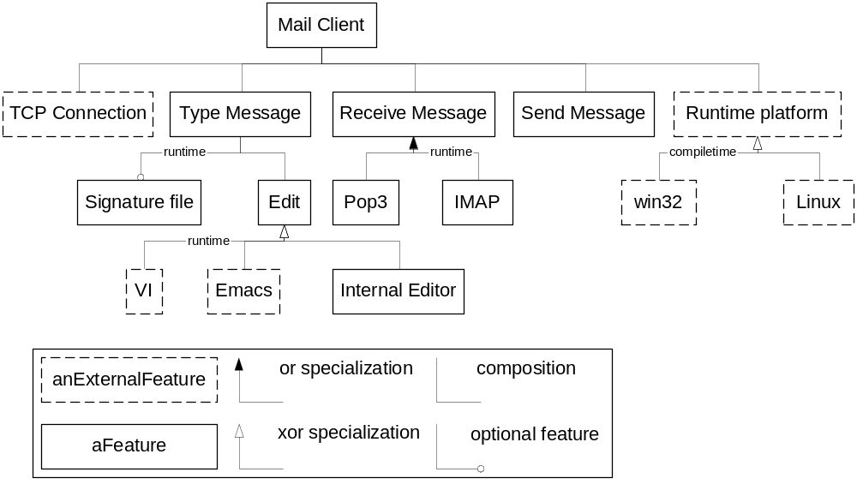
Example Feature Diagram

Slide 20
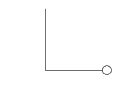
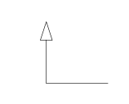
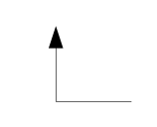
Patterns of Variability
Variation point = specialization
Three types:
  0 or 1 variant = optional variant
      E.g. printing debug information
  1 out of n variants = single variant (xor)
      E.g. a background picture on your desktop
  m out of n variants = multiple parallel variants (or)
      E.g. retrieving email from a POP3 account and an IMAP account simultaneously

Slide 21
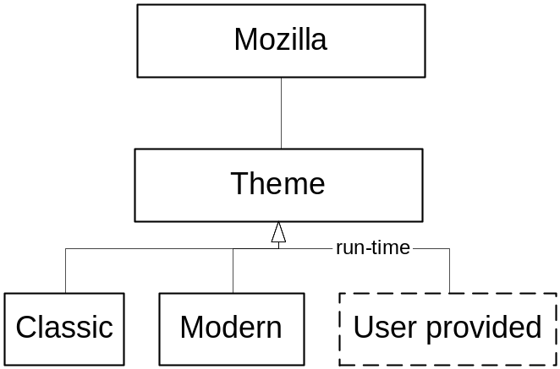
Example 1, single variant
Designed during AD
Bound at run-time
Open at run-time

Slide 22
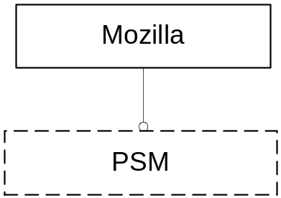
Example 2, optional variant
Introduced during AD
Bound at link time
Open at link time (= run-time)

Slide 23
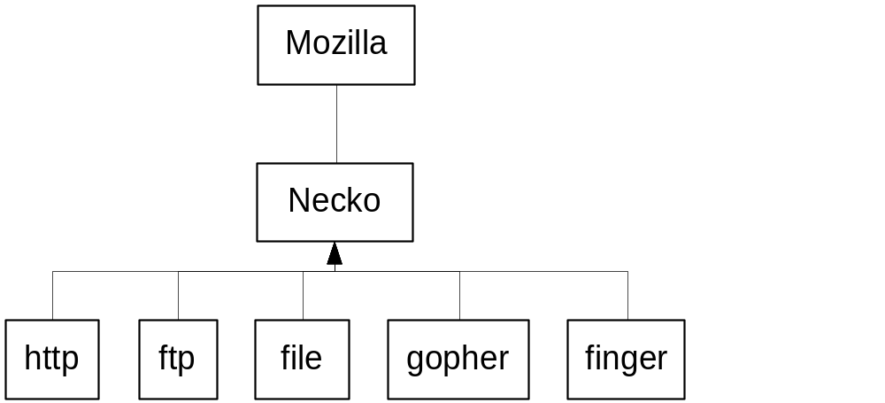
Example 3, multiple parallel variants
Introduced during AD
Bound at run-time
Open during DD

Slide 24
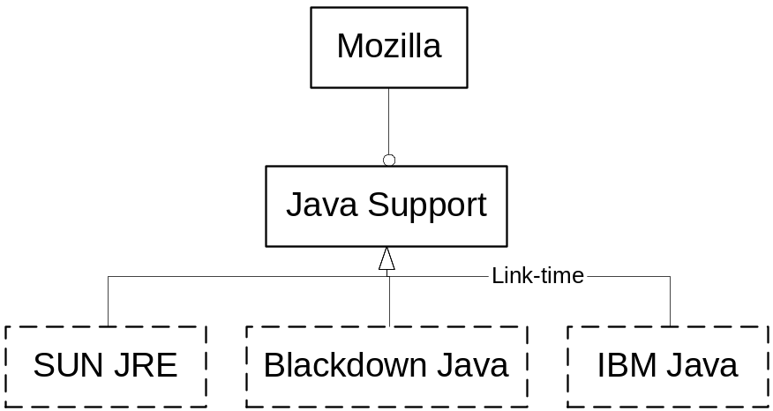
Example 4, optional single variant
Introduced during AD
Open at run-time
Bound at run-time

Slide 25
Trends in variability
Variation points are increasingly open and bound at run-time
    E.g. MS media player can download and use new codecs without even restarting the application
Going from static to dynamic linking has been a major push in doing so
    E.g. DLLs can be upgraded separately from the apps that use it
    E.g. jar files can be downloaded on demand and used right away
Notes:
refer to funnel diagram at the beginning

Slide 26
Why run-time variability?
Going through the edit/compile/debug/deploy cycle is expensive
It is convenient for end users
Because we can!

Slide 27
Variation management process
Make Feature Diagram
For each variation point:
Abstraction level
Assess binding time
When it’s open
Select Realization Technique + variant management technique (e.g. manual or automatic)
Add variants
Bind

Slide 28
Related Work
Recent work
  Bachmann & Bass
  Clauss (improved UML notation)
  Upcoming feature modeling workshop at GCSE

Slide 29
Our Contributions
Terminology
    Makes discussions about variability to the point
Patterns of variability
Extensions to the feature diagram notation
    Enables communicating variability
Methodology for managing variability

Slide 30
Future work
Integrate with UML (people are already working on this)
    Trace variation points in e.g. use case diagrams or collaboration diagrams or even source code
    Tool support
Further develop methodology and best practices
    Our method can be used as a starting point
Taxonomy of variability realization techniques
    Mikael Svahnberg
Validation. E.g. case studies.
    One of my colleagues is working on this
Late variability techniques
    E.g. Separation of Concerns, AOP, SOP, MDSOC

Slide 31
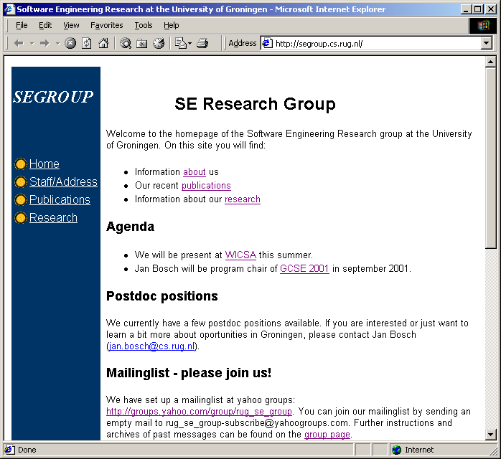
Contact information
jilles@cs.rug.nl
jan.bosch@cs.rug.nl
mikael.svahnberg@bth.se
http://segroup.cs.rug.nl/
Contact info
More publications
Personal homepages
Mailing list

