Slide 1
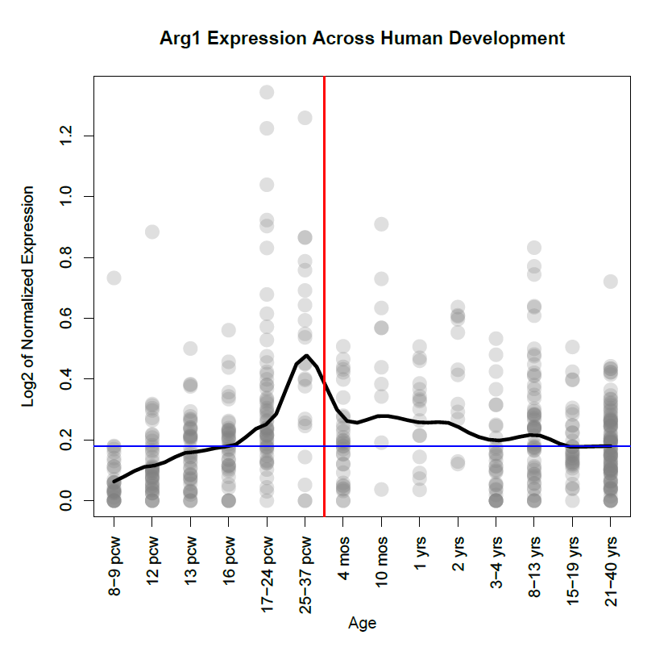
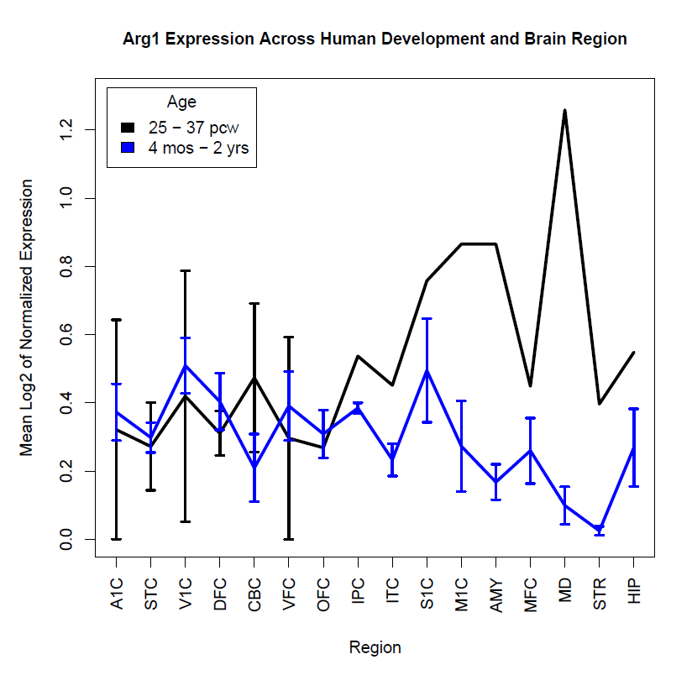
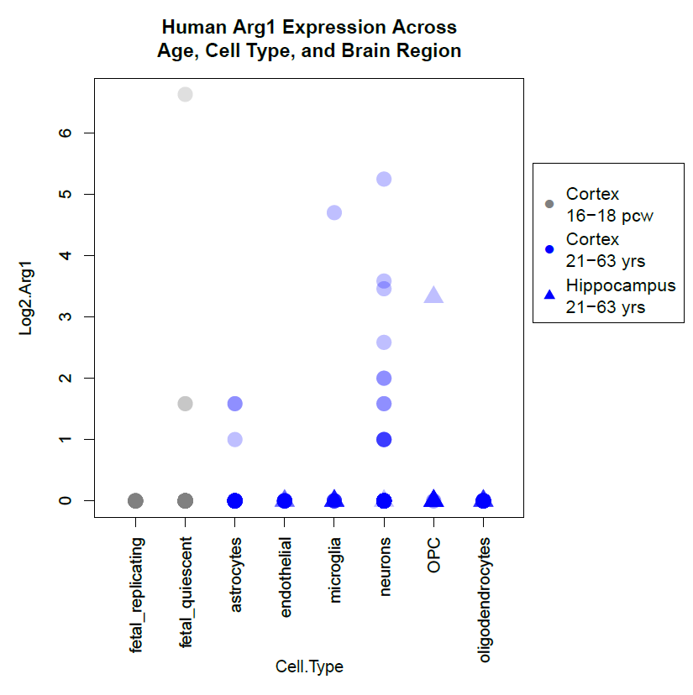
Figure 1 FIRST DRAFT: Arginase 1 Expression in Humans Across Age, Brain Region, and Cell Type
Age
Brain Region
Cell Type
Ideas:
Maybe do 17 pcw – 2 yrs v. 21 – 40 yrs for Brain Region AND Age plot? 17 pcw – 2 yrs more likely time, since symptoms arise usually around 3 yrs. Would also compare better with Cell Type plot
Brain Region – Full brain region names?
Cell Type Specificity Bar plot (with outliers on top), just try it to compare
If infinite standard error, just make a note of that on plot with a star or something
Cortical
Subcortical

Slide 2
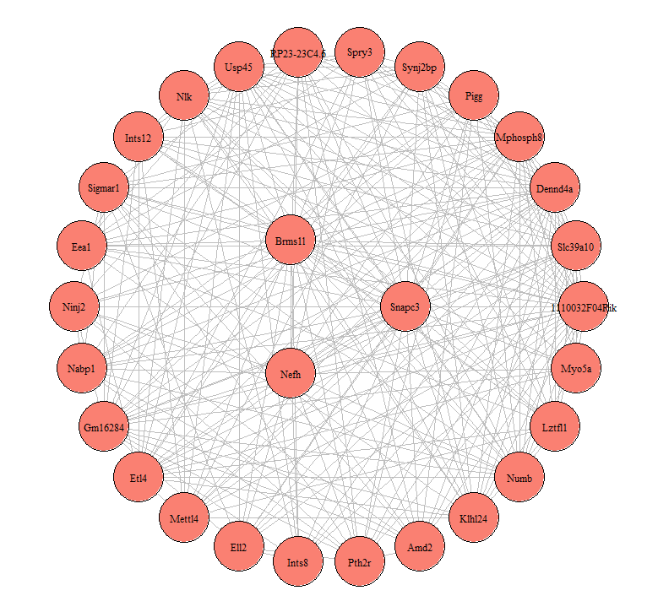
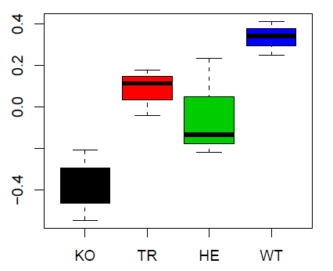
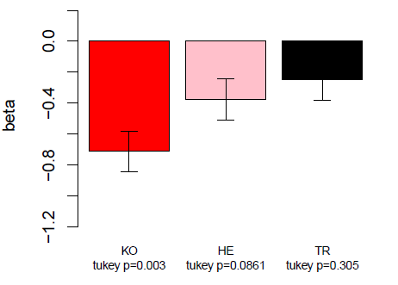
a. Module Eigengene
c. Hub Genes
b. ANOVA, adj. p = 0.03

Slide 3
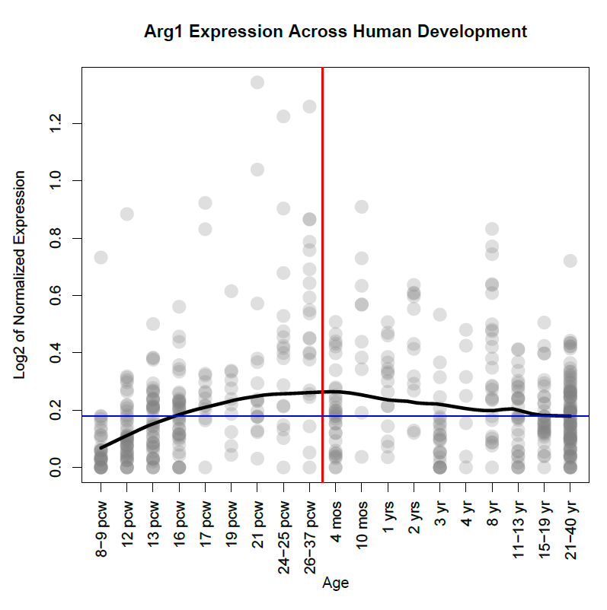
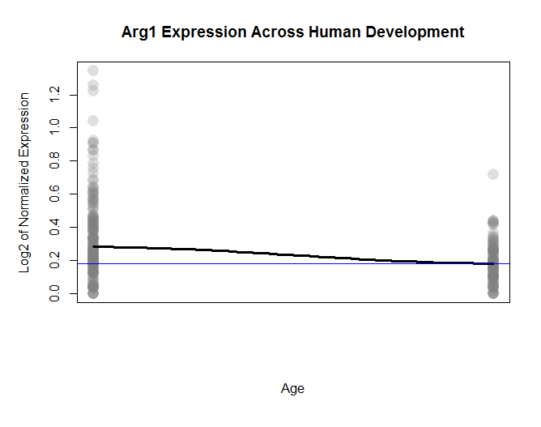

Slide 4
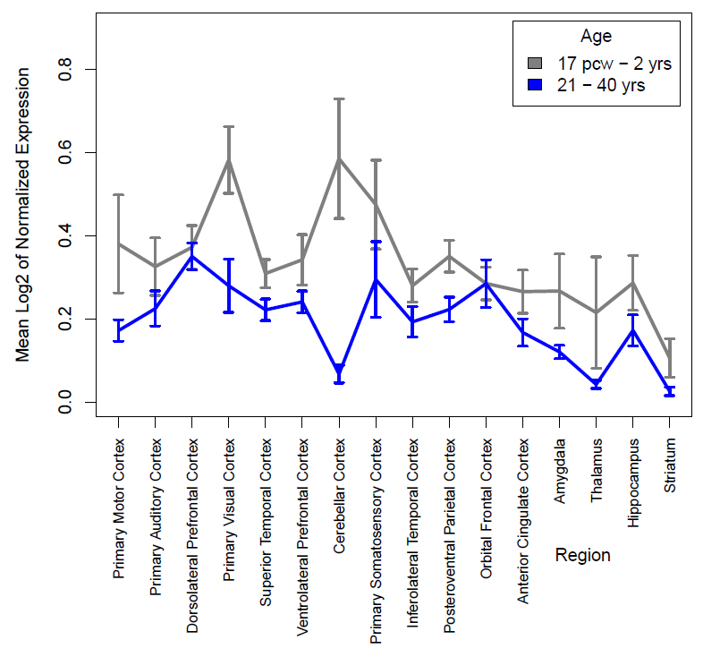
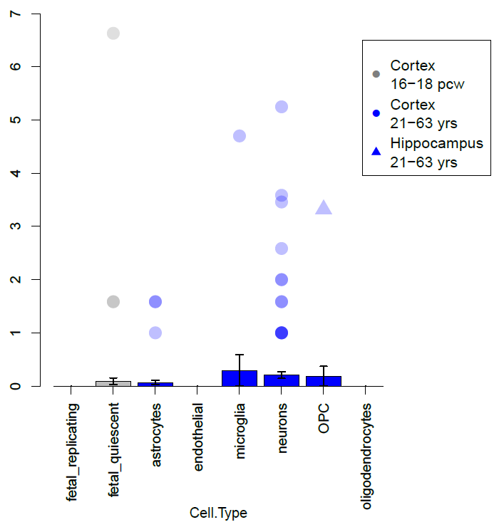
Figure 1: Arginase 1 Transcript Expression in Humans Across Age, Brain Region, and Cell Type
(a) Age
(b) Brain Region
(c) Cell Type
Outlier Key
Mean Log2 of Expression \ Outlier Log2 Expression
Subcortical
Cortical
(a) Allen BrainSpan samples, Log2 taken of RPKM of Arg1 expression from multi-region brain tissue samples. Red line represents birth and blue line is the LOWESS regressed value of the 21-40 yr age bin. Black line is the LOWESS regression line, span = 0.33. Darker point clusters indicate more samples with this expression value. (b) Mean of Log2 of RPKM of Arg1 expression from different brain regions (Allen BrainSpan). SEM depicted for each region. (c) Mean of Log2 of Arg1 expression from different cell types (Barres 2015) represented by barplots, with SEM depicted. Points represent ‘outliers’, which in this dataset were any samples with Log2 expression greater than zero. Darker point clusters indicate more samples with this expression value.

Slide 5
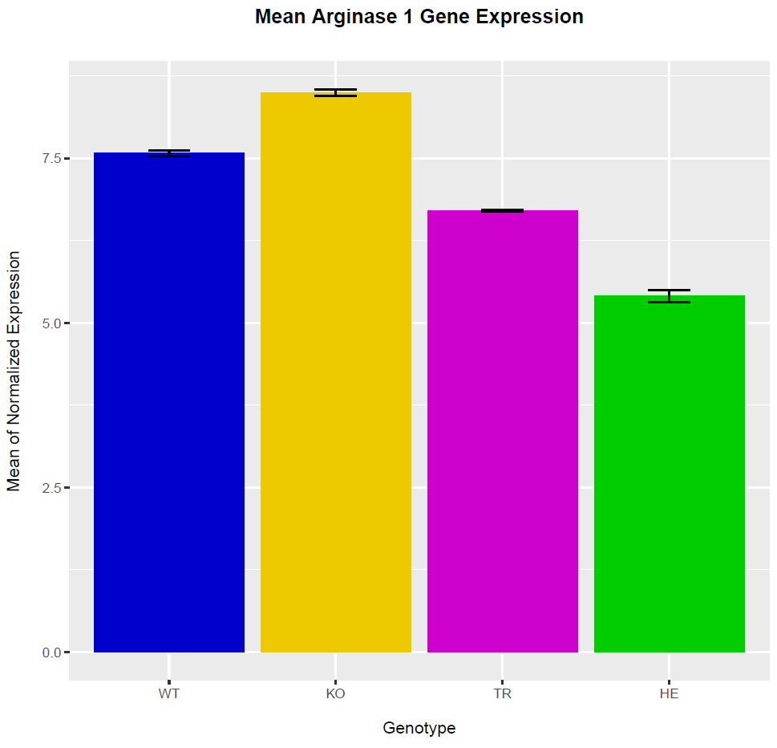
Figure 2: Arginase 1 in KO, HE, TR, and WT Mice
(b)
(a) Western blot of Arginase 1 in mice. (b) Mean of Normalized Arginase 1 gene expression in the prefrontal cortex of each genotype. SEM depicted.

