Slide 1
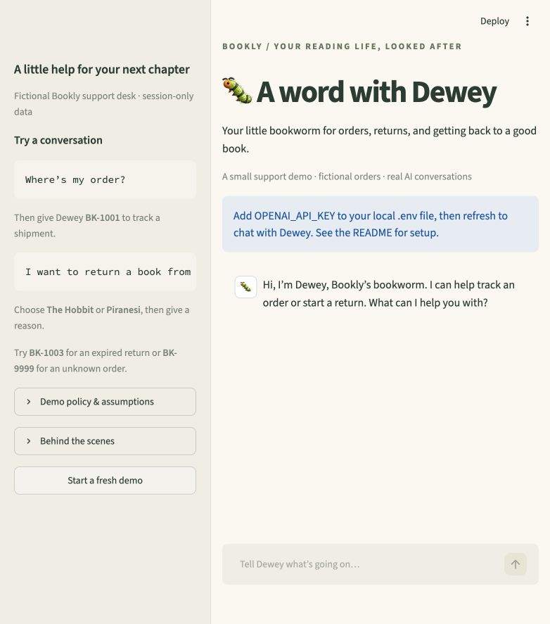
Dewey, Bookly’s bookworm
A welcoming conversation.
A carefully controlled action.
Track an order. Start an item-level return.
Clarify what is missing and act only
after the customer confirms.
Python + Streamlit + OpenAI
Fictional orders; session-only records
BOOKLY / DEWEY 1 / 5
Notes:
Thesis: a support agent should resolve a concrete customer problem while making its actions trustworthy. Dewey uses a friendly bookstore identity and two narrow journeys. Intended benefits are less customer effort and more reliable self-service; these are goals, not measured outcomes. Screenshot is the actual local interface before an API key is configured. No live-model acceptance result is claimed. Source: PLAN.md; app.py; assignment PDF, pages 1–3.

Slide 2
Conversation and action flow
Customer chat
Streamlit
Conversation
OpenAI + Python loop
Bookstore tools
Local mock data
Instructions: tone + operating rules
Memory: messages + pending proposal + created requests
get_order / check_return_eligibility / prepare_return
Prepared proposal → customer button → Python submission
Maximum six sequential model requests per message
BOOKLY / DEWEY 2 / 5
Notes:
Streamlit sends customer messages to agent.py. The Responses API interprets requests and can call three Python tools. The explicit loop validates arguments, runs tools sequentially, appends results, and stops after at most six model requests. VOICE and OPERATING_RULES are separate instructions. History includes tool requests/results; pending returns and created returns live separately in session state. SDK retries and parallel tool calls are disabled. create_return is internal to Python and reachable only from the UI callback. Sources: agent.py; tools.py; app.py. API reference: https://developers.openai.com/api/docs/guides/function-calling

Slide 3
Three decisions and their tradeoffs
Direct API orchestration
Visible tool use and a bounded loop.
Tradeoff: own the history and error handling.
Python rules + confirmation
Validate eligibility before changing records.
Tradeoff: one more customer step; no exceptions.
Session-only memory
Enough context for multi-turn resolution.
Tradeoff: no durable or cross-device history.
BOOKLY / DEWEY 3 / 5
Notes:
These decisions are deliberate simplifications for a roughly four-hour proof of concept. Direct API orchestration exposes the workflow but requires history and error handling. Python policy plus explicit customer confirmation adds a step and rejects policy exceptions, but makes changes predictable. Session-only memory limits privacy and infrastructure scope at the cost of durability and cross-device continuity. Sources: PLAN.md; agent.py; tools.py; README.md.

Slide 4
Evidence and demo rehearsal
34 automated checks passing
Policy boundaries, duplicate protection, stale proposals,
SDK serialization, and actual Streamlit buttons.
Live rehearsal after API setup
BK-1001 Tracking with a missing order number
BK-1002 Item selection, reason, confirmation, reference
BK-1003 Expired window; no return created
Live model behavior is not yet verified.
BOOKLY / DEWEY 4 / 5
Notes:
34 automated cases passed locally with python -m pytest -q. They include rule boundary cases, item membership, no-write preparation, duplicate prevention, stale proposals, a six-call loop bound, interrupted responses, and SDK serialization over httpx.MockTransport. Streamlit AppTest exercises actual Confirm, Cancel, reset, and chat controls. Simulated model responses do not establish live model quality. Before submission, configure an OpenAI key and rehearse tracking, an eligible return, and an expired return. No live API call was made during implementation. Sources: tests/test_dewey.py; README.md.

Slide 5
The first production change
Authenticated customers.
Real, durable order and return systems.
Order ownership checks and idempotent writes must replace
the session-only mock before handling real customer actions.
Then: evaluate and challenge Dewey
Adversarial conversation evaluator + pre-send evidence checker.
Measure quality, latency, cost, and false alarms before rollout.
BOOKLY / DEWEY 5 / 5
Notes:
First authenticate customers and connect the agent to owned-order APIs with durable, idempotent request creation. The POC has neither customer authentication nor durable storage: knowing an order ID must not grant production access. Then introduce evaluation, monitoring, and escalation. Explicit user-requested follow-ups: an LLM evaluator that generates adversarial conversations and judges against real traces; a pre-send LLM checker comparing draft responses to tool evidence. Measure false alarms, missed errors, latency, and cost. Neither LLM replaces deterministic action validation. Sources: PLAN.md; README.md.

