Slide 1


Evaluation of Fairness Trade-offs
in Predicting Student Success
Hansol Lee and René F. Kizilcec
Computing and Information Science
Cornell University
EDM 2020 FATED Workshop
Paper available at arxiv.org/abs/2007.00088

Slide 2
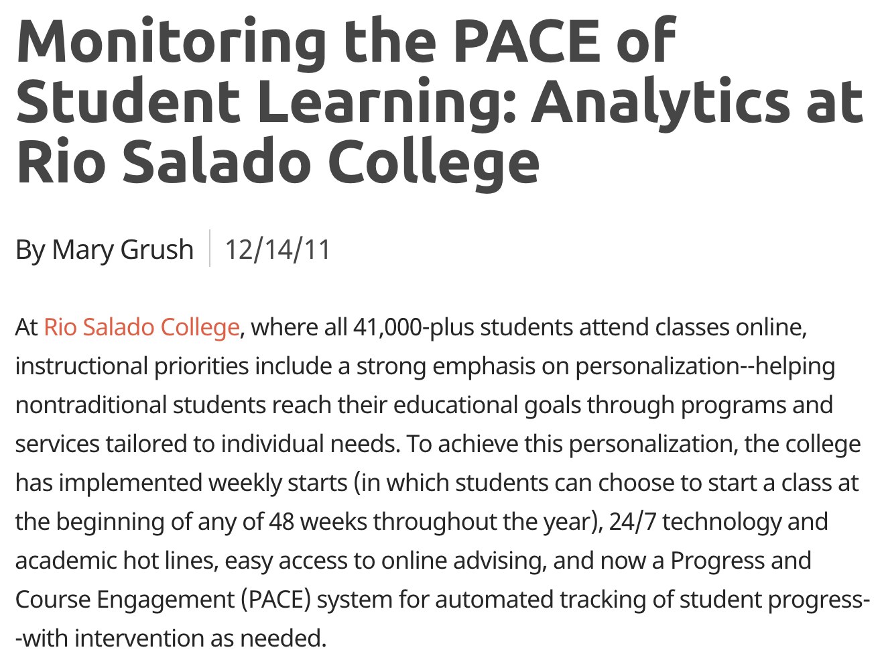
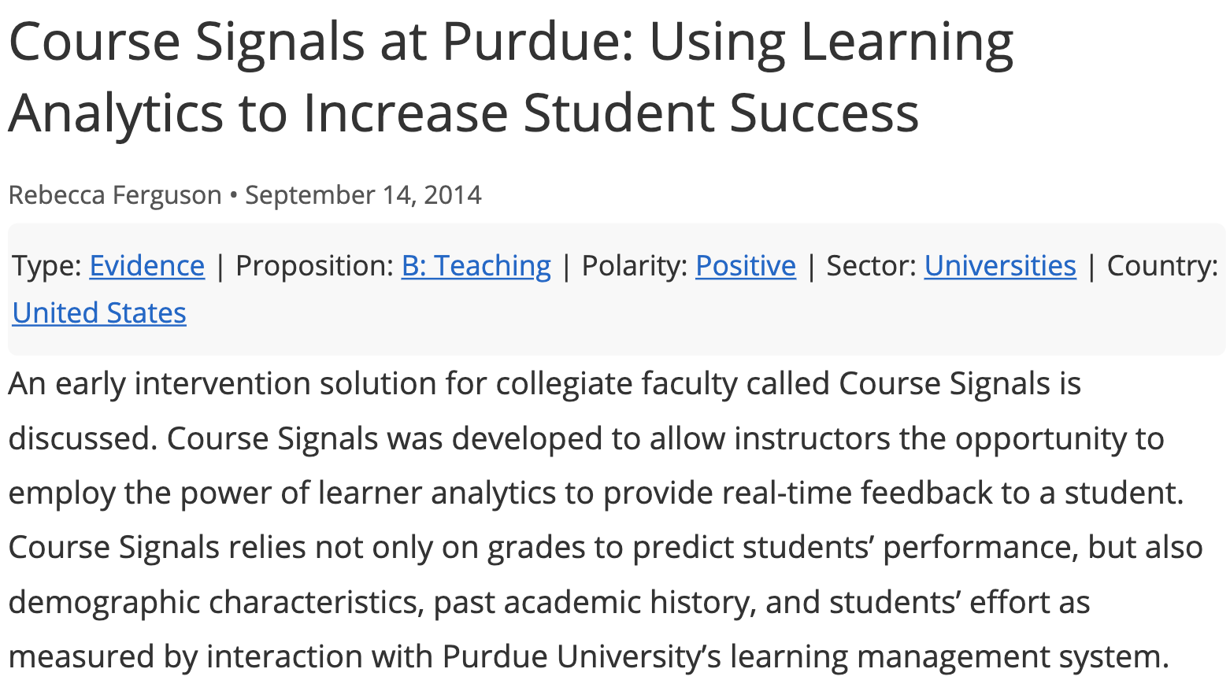
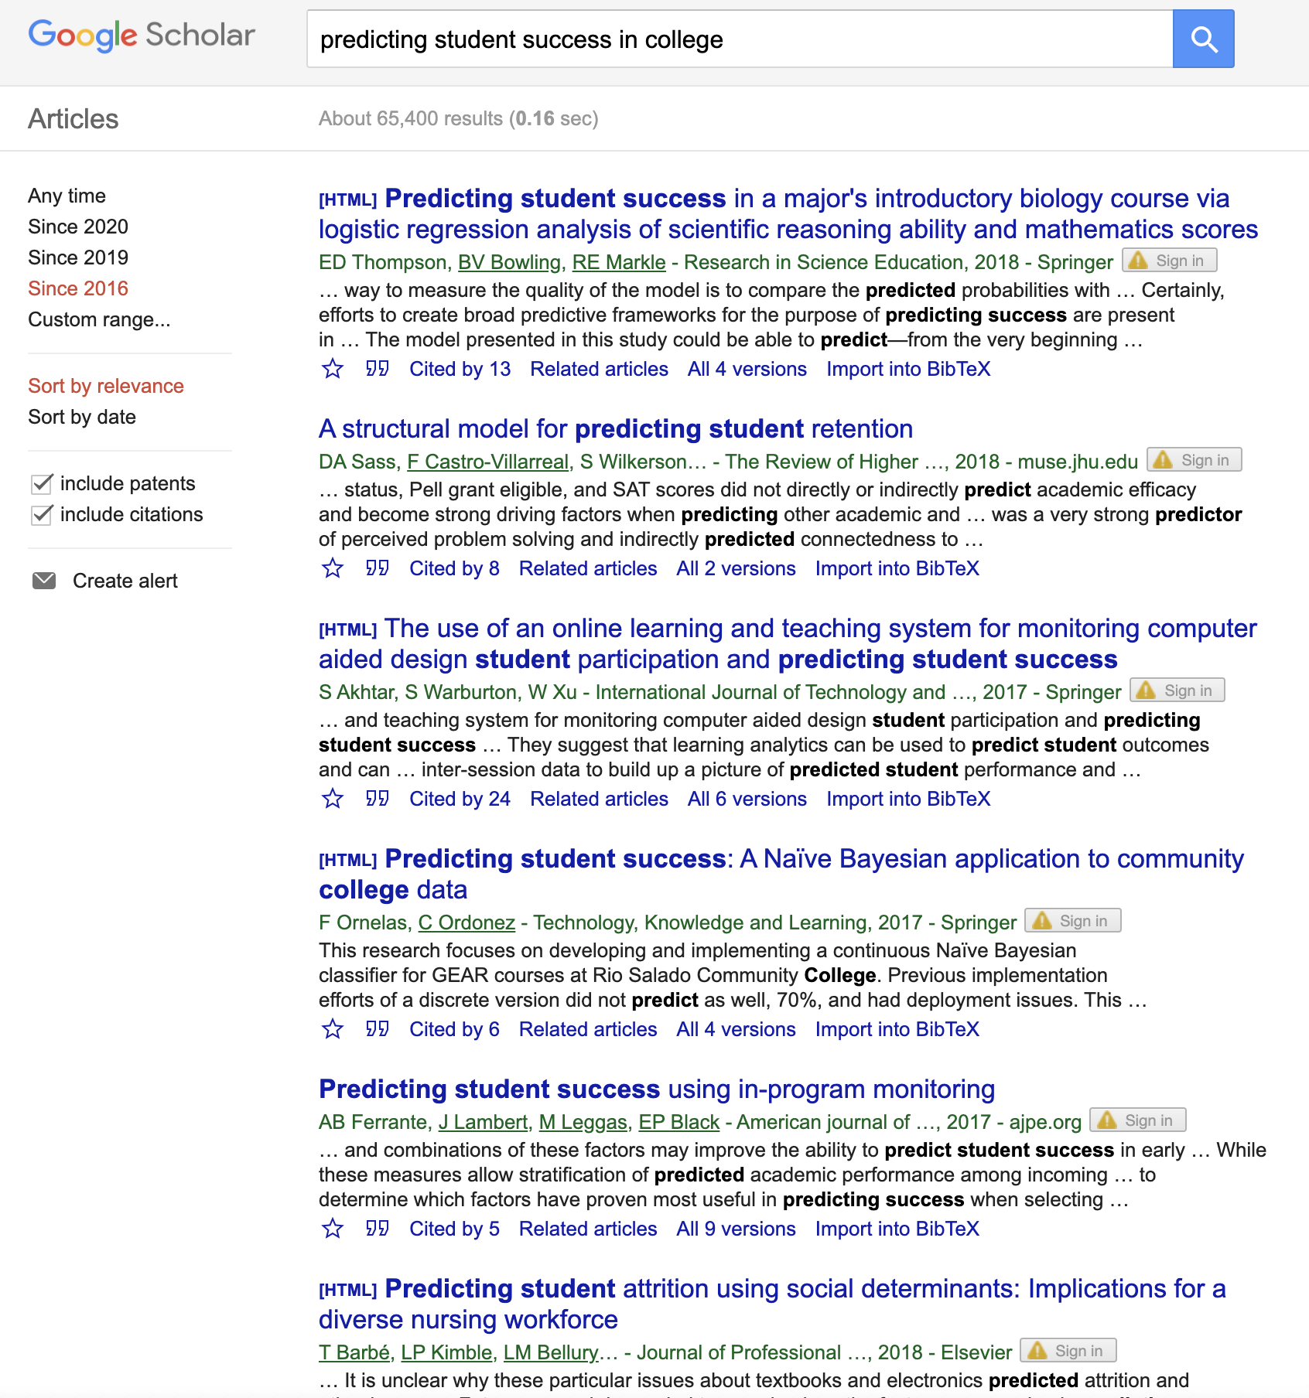
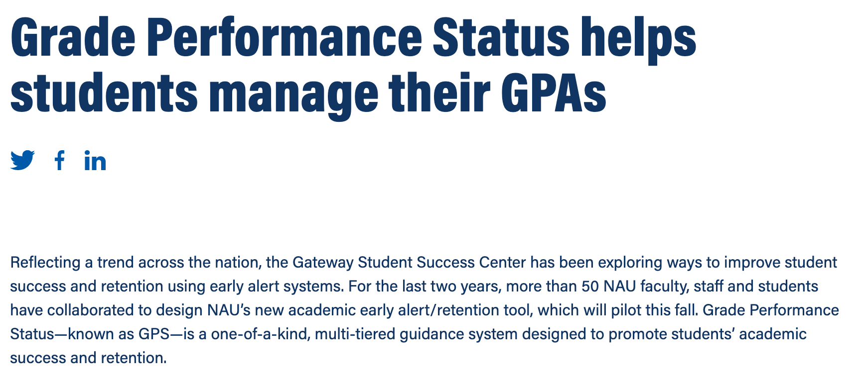
Predicting student success
Sources: 1) https://campustechnology.com/articles/2011/12/14/monitoring-the-pace-of-student-learning-analytics-at-rio-salado-college.aspx
2) http://evidence.laceproject.eu/?evidence=course-signals-at-purdue-using-learning-analytics-to-increase-student-success
3) https://news.nau.edu/grade-performance-status-helps-students-manage-their-gpas-2/#.XweAkJNKidZ

Slide 3
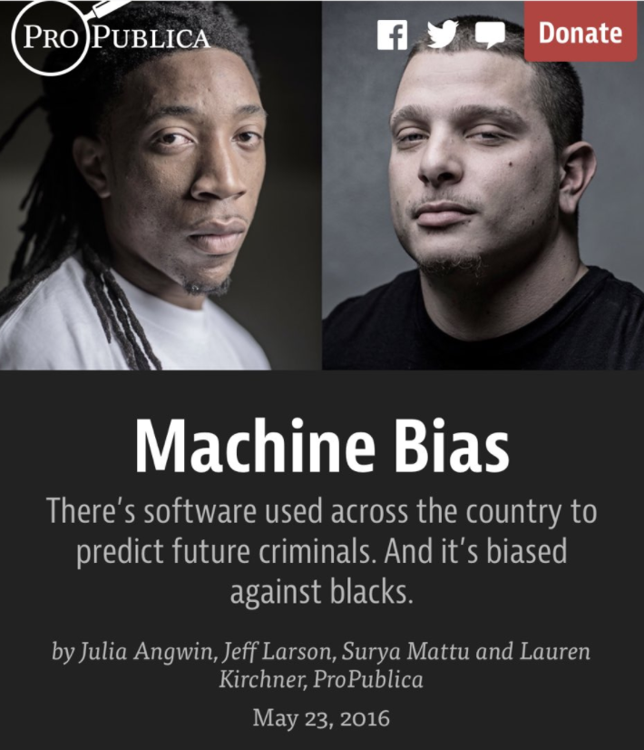
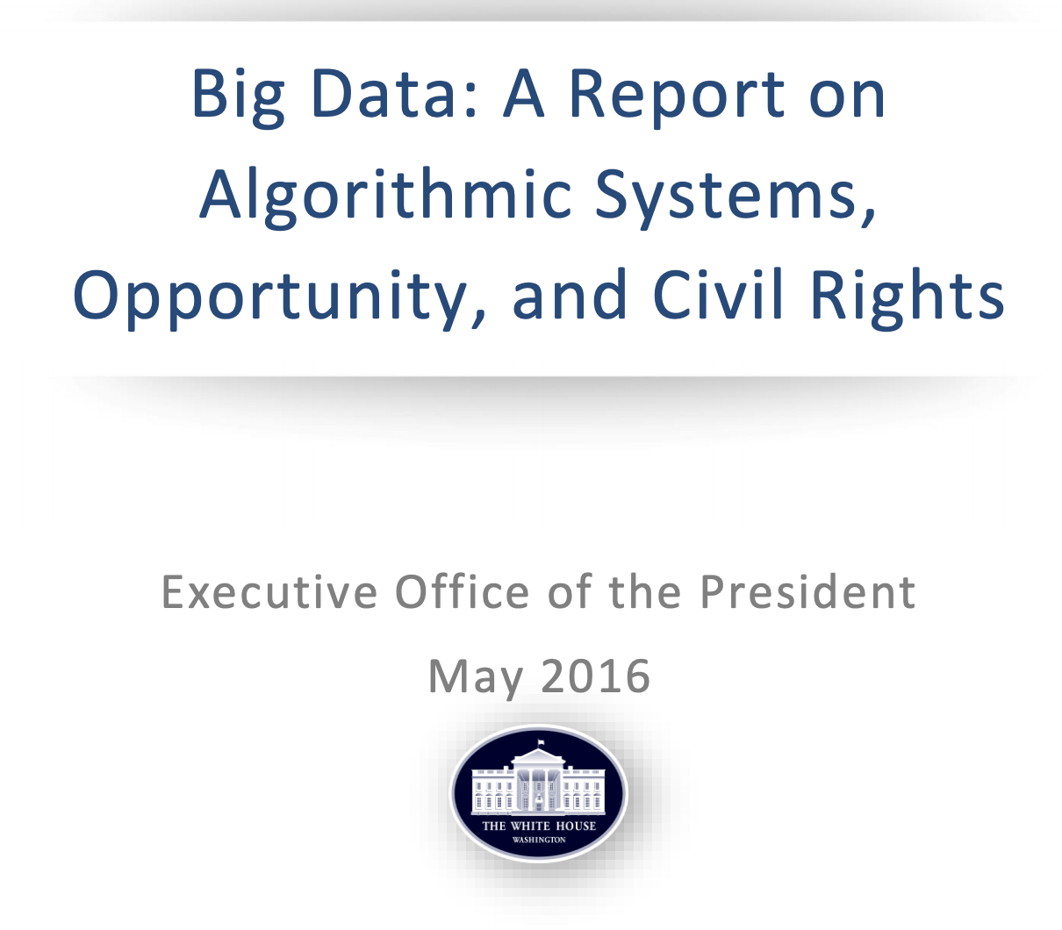
Fairness concerns
Sources: 1) https://www.propublica.org/article/machine-bias-risk-assessments-in-criminal-sentencing
2) https://obamawhitehouse.archives.gov/sites/default/files/microsites/ostp/2016_0504_data_discrimination.pdf

Slide 4
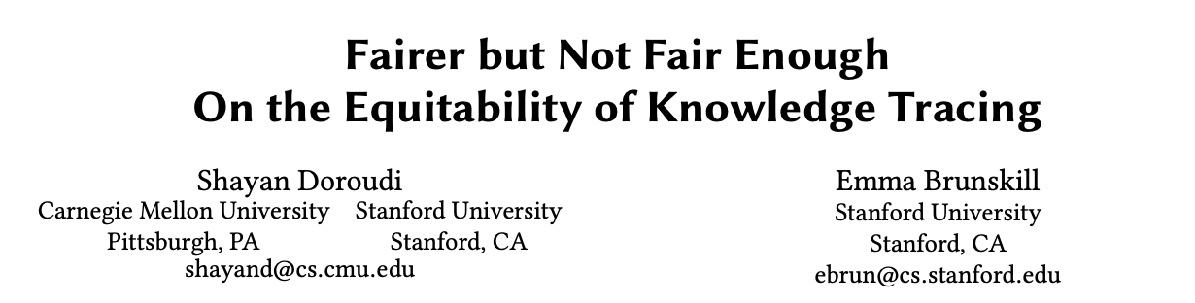
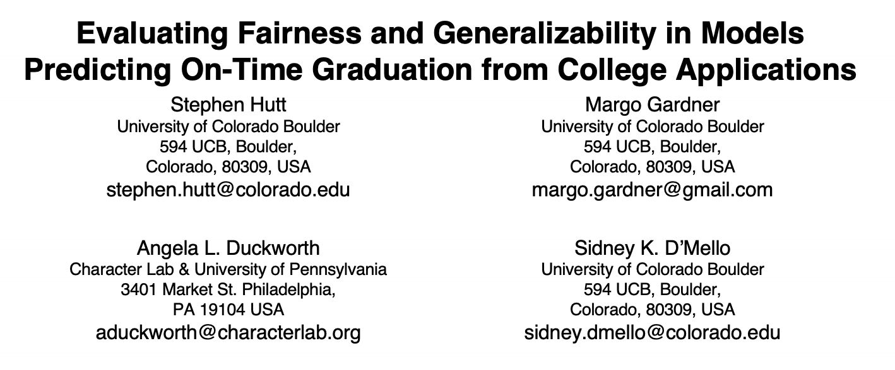
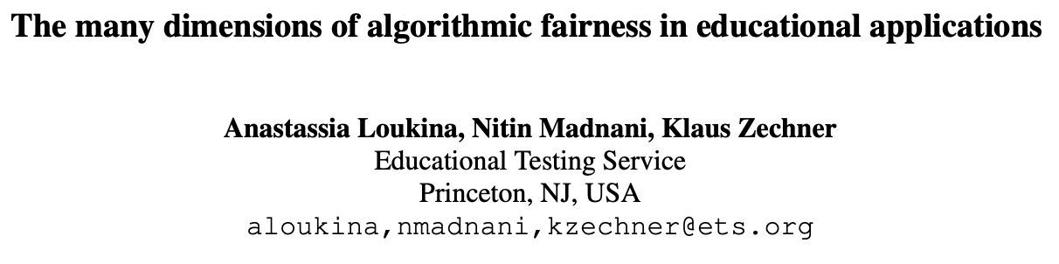
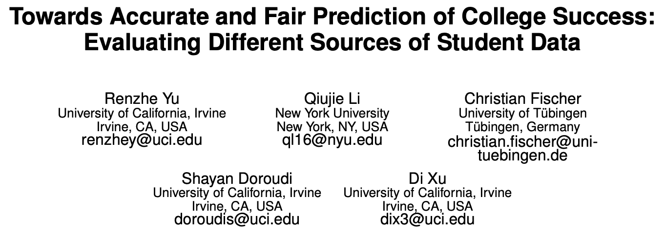
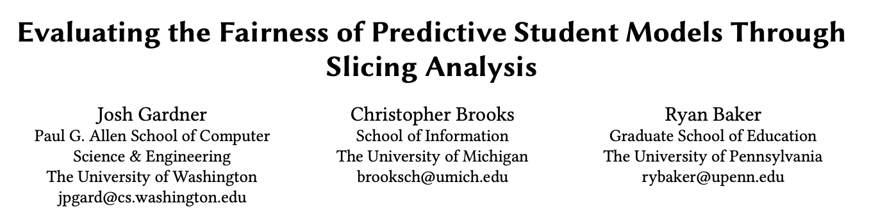
Early Work on Fairness in EDM
For a comprehensive review,
check out our forthcoming Algorithmic Fairness in Education review chapter
[http://tiny.cc/on39rz]
...and more!
Doroudi et al. (2019); Loukina et al. (2019); Gardner et al. (2019); Hutt et al. (2019); Yu et al. (2020)

Slide 5
This Study
Considering 3 statistical measures of fairness
Demographic parity (Feldman et al. 2015)
Pr(Pred=1 | Group=Male) = Pr(Pred=1 | Group=Female)
Equality of opportunity (Recall) (Hardt et al. 2016)
Pr(Pred=1 | Group=Male, Actual=1) = Pr(Pred=1 | Group=Female, Actual=1)
Positive predictive parity (Precision) (Chouldechova 2016)
Pr(Actual=1 | Group=Male, Pred=1) = Pr(Actual=1 | Group=Female, Pred=1)
Impossibility Theorem Chouldechova (2016); Kleinberg et al. (2017)
Research Questions
How fair is a course success prediction model?
How does correcting for one fairness measure affect other fairness measures and model accuracy?

Slide 6
Methods
Evaluation of Model Fairness
How fair is a course success prediction model?
Build a random forest model using administrative data to predict median grade or above.
Then evaluate its accuracy and fairness (using URM/Gender)
Evaluation of Fairness Trade-Offs
How does correcting for one fairness measure affect other fairness measures and model accuracy?
Alter the predictions (i.e. move the decision thresholds separately for each subgroup) in the testing set such that equality of opportunity is satisfied
Then evaluate the resulting model accuracy and fairness.

Slide 7
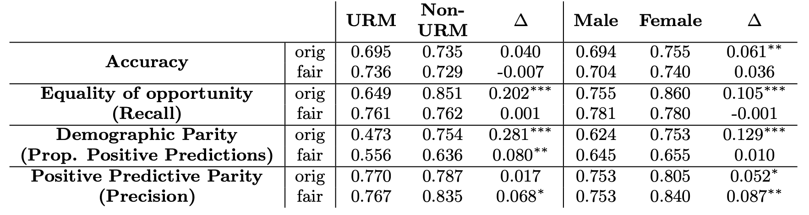
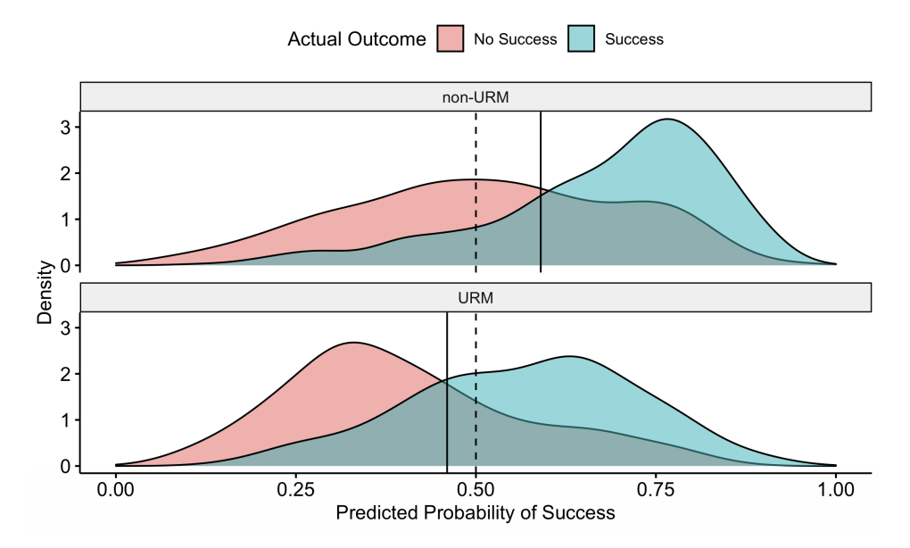
Results by Student URM Status
Non-URM
URM
Notes:
“Orig” answers the first question
“Fair” answers the 2nd
Probability distributions of success for underrepresented minority (URM) and non-URM students

Slide 8
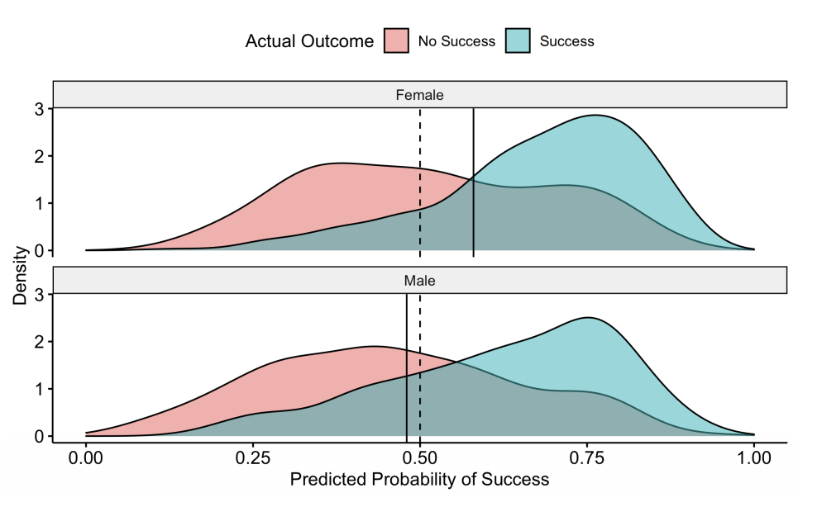
Results by Student Gender
Female
Male
Notes:
“Orig” answers the first question
“Fair” answers the 2nd
Probability distributions of success for underrepresented minority (URM) and non-URM students

Slide 9
Conclusion
Original model violates demographic parity & equality of opportunity, but not positive predictive parity
Consistent with Liu et al. 2019
Consistent with the Impossibility Theorem (Chouldechova (2016) and Kleinberg et al. (2017))
Correcting for equality of opportunity improves demographic parity
- But, 10% decrease in positive predictions for Non-URM and Female groups
Correcting for equality of opportunity reduces positive predictive parity
But, 3~5% increase in precision for Non-URM and Female groups
Setting group-specific thresholds introduces another fairness concern

Slide 10
Takeaways
There is no single overarching definition of fairness in education.
E.g., demographic parity may be more important in college admissions than in student success prediction
Furthermore, many fairness measures are often in tension.
We need to evaluate fairness criteria for each application scenario.
Decide what fairness criteria are most important
Make explicit the fairness trade-offs that are made
Notes:
example:
College admissions → demographic parity

Slide 11
Thank you!
Hansol Lee and René F. Kizilcec
Computing and Information Science
Cornell University
EDM 2020 FATED Workshop
Paper available at arxiv.org/abs/2007.00088

