Slide 1

A Natural-Language Approach to Early Forecasting of Undergraduate Majors:
An Investigation of Efficacy and Bias
Alexander Wang
aswang96@stanford.edu
David Lang
dnlang86@stanford.edu
Andreas Paepcke
paepcke@cs.stanford.edu
Mitchell L. Stevens
stevens4@stanford.edu

Slide 2
Introduction and Motivation
For students, elucidates potential academic pathways
For universities, enables capacity planning and resource allocation
Dangers in learned biases for both parties
Notes:
Narrows large number of options down to potential pathways
Helps anticipate fluctuating resource requirements
Push students towards a pre-determined identity
Unfair resource allocation

Slide 3
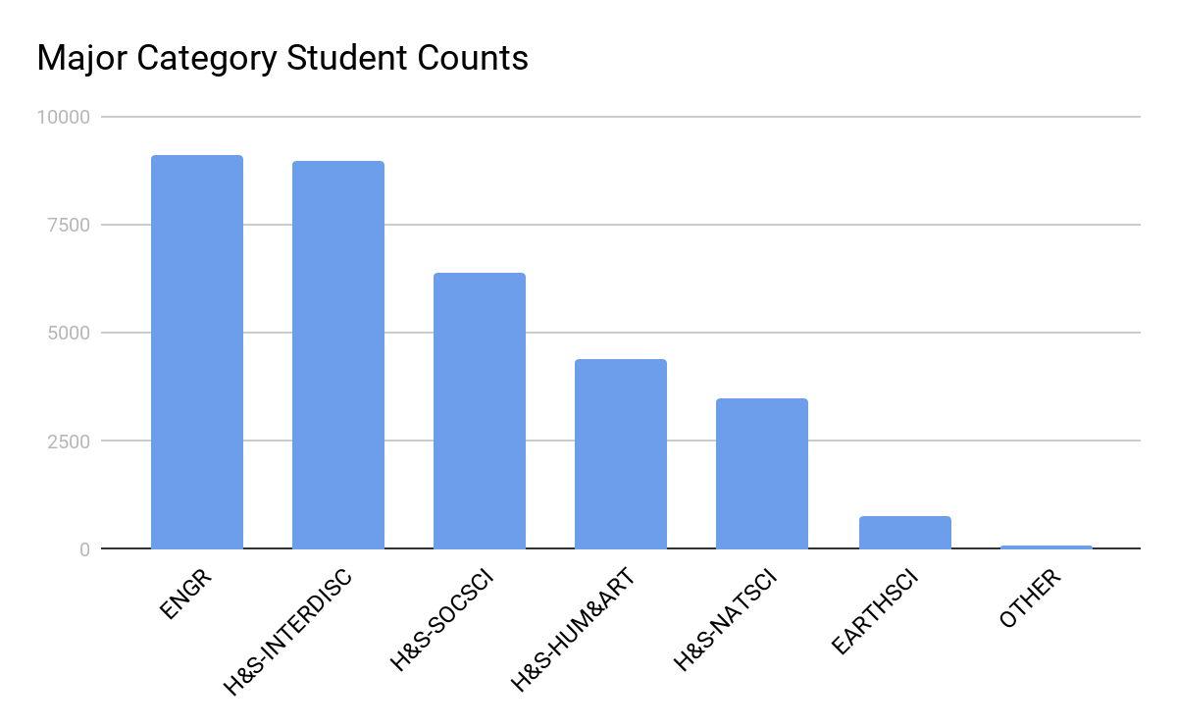
Data
Private research institution
2010-2020
33,257 undergraduate cases
89 unique majors
16,308 males, 16,949 females
Includes course history (including grades and term taken)

Slide 4
Data Representation
Course Code | Grade | Term
a1 | B | Fall 2019-2020
a2 | A- | Fall 2019-2020
b1 | B+ | Winter 2019-2020
b2 | A | Winter 2019-2020
Course Sequence | a1 | a2 | b1 | b2
Grade Sequence | B | A- | B+ | A
Term Sequence | 1 | 1 | 2 | 2
Notes:
Converts each student to 3 sequences of strings, that we can think of sentences
This gives us, across all students, 3 corpuses, which we can run 3 separate word2vec models on to create a course code embedder, grade embedder, term embedder.
We dub this course2vec.

Slide 5
Models
Multi-hot encoding logistic regression
Course2vec logistic regression
Course2vec LSTM
Transformer

Slide 6
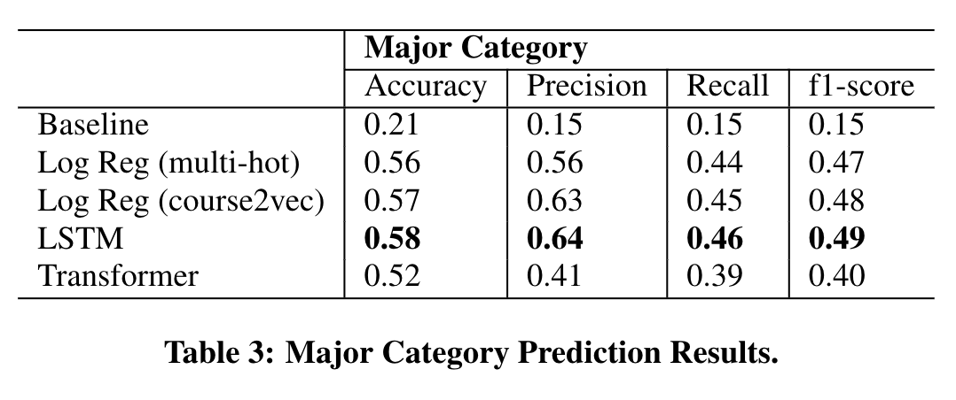
Results by Major Category

Slide 7
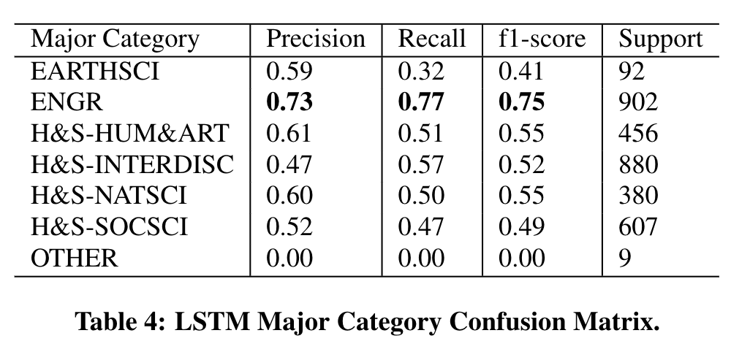
Results (LSTM)

Slide 8
Bias Testing/Error Analysis
Create 8 subsplits for evaluation:
Male
Female
High-GPA
Low-GPA
Sex-Engr Stereo: (Male ⋂ ENGR) ⋃ (Female ⋂ ~ENGR)
Sex-Engr Anti-Stereo: (Female ⋂ ENGR) ⋃ (Male ⋂ ~ENGR)
GPA-Engr Stereo: (High-GPA ⋂ ENGR) ⋃ (Low-GPA ⋂ ~ENGR)
GPA-Engr Anti-Stereo: (Low-GPA ⋂ ENGR) ⋃ (High-GPA ⋂ ~ENGR)

Slide 9
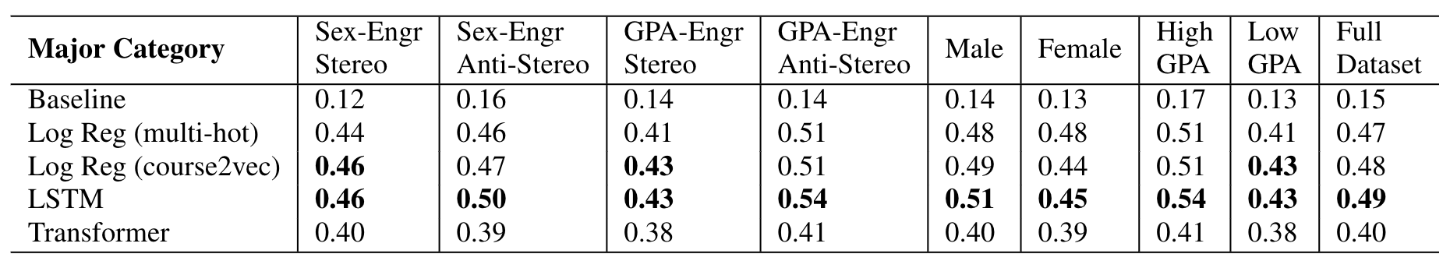
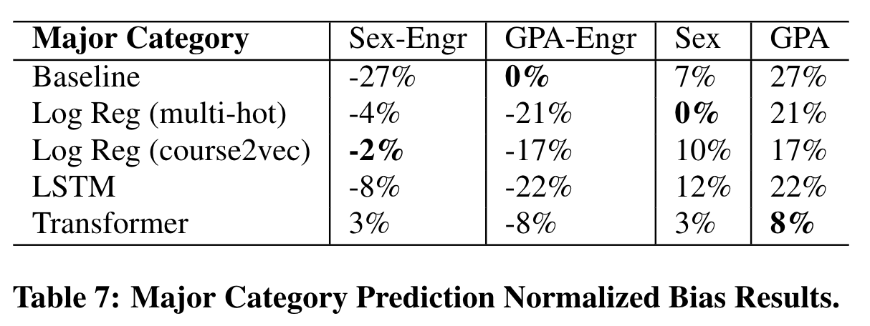
Bias/Error Results

Slide 10
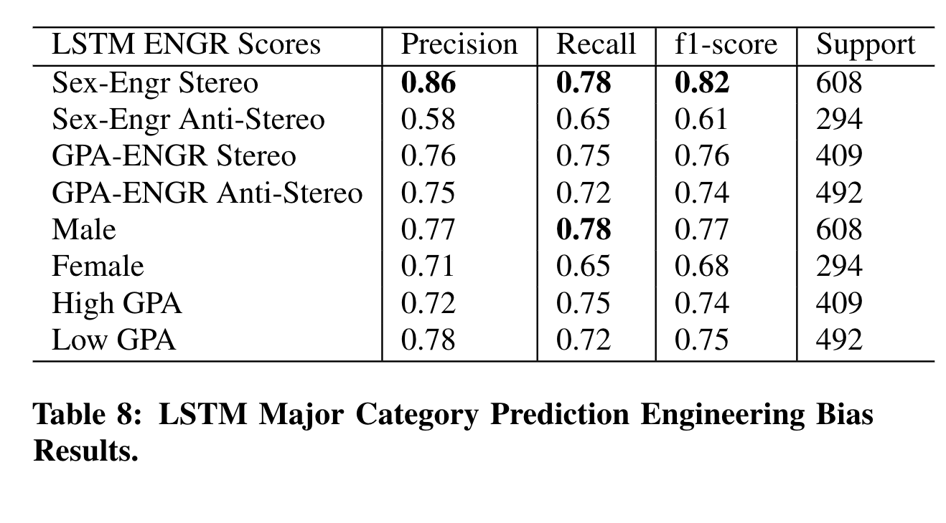
Bias/Error Results

Slide 11
Bias/Error Results
Women are likely to exit a course sequence in highly quantitative fields at a higher grade threshold than men.
Claudia Goldin, Notes on Women and the Undergraduate Economics Major (2015)
Conditional on achievement, men relatively over-estimate their skills while women under-estimate their skills.
Eric Cech, Brian Rubineaum, Susan Silbey and Caroll Seron, Professional role confidence and gendered persistence in engineering (2011)
Female undergraduates are relatively more likely than males to exit engineering programs.
Shelley J Corell, Constraints into preferences: Gender, status, and emerging career aspirations (2004)
Notes:
Male engineering students are more easily identified amongst a Sex-Engr Stereotype population, rather than within male students!
Can compare to just the male population, where precision decreases

