Slide 1






BLAh: Boolean Logic Analysis for Graded Student Response Data
Andrew Lan, Rice University
Andrew Waters, OpenStax
Christoph Studer, Cornell University
Richard Baraniuk, Rice University
Phil Grimaldi

Slide 2
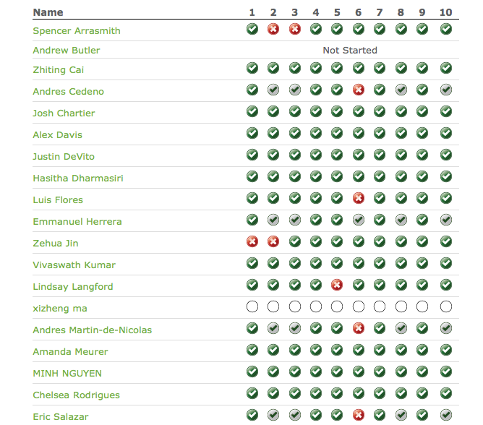
Gradebook data
Questions
Johnny
Eve
Patty
Neelsh
Nora
Nicholas
Students
Barbara
Agnes
Vivek
Bob
Fernando
Sarah
Hillary
Judy
Janet

Slide 3
Existing work
Item response theory (IRT) models
1PL (the Rasch model)
Multidimensional IRT (MIRT)

Slide 4
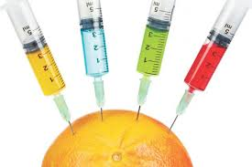
Linear, additive models
Student response models are all GLMs
Linear
Additive (multidimensional)
Problem: compensation
high knowledge in one concept can compensate low knowledge in other concepts

Slide 5


Obvious non-linearity (AND)
What if the student does not know

Slide 6
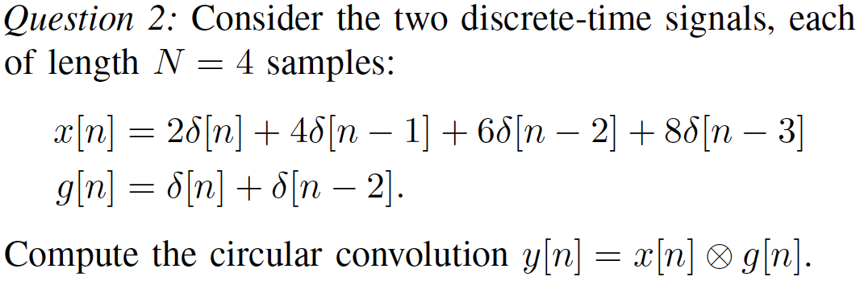

Obvious non-linearity (OR)
Solution using convolution
Solution using DTFT

Slide 7
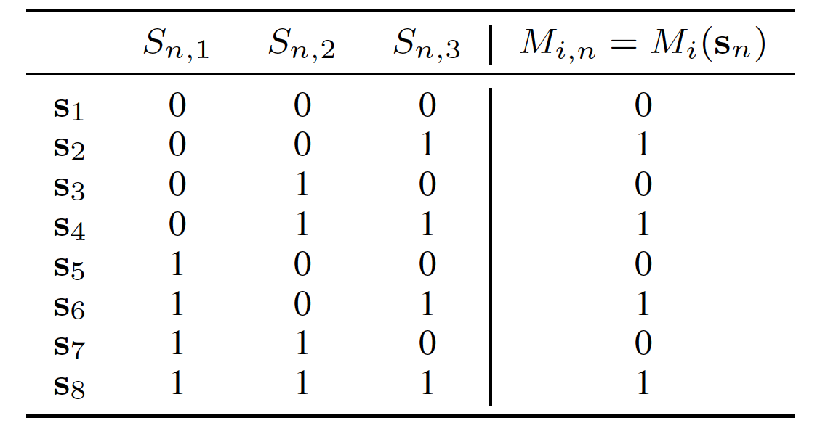
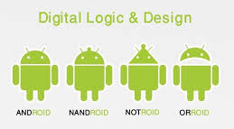
Boolean logic functions!
Binary-valued graded student response as output of a
Boolean logic function
BLAh: Boolean Logic Analysis

Slide 8


The BLAh model
concepts, indexed by
: Student concept knowledge
: Question difficulty on concept
: Latent concept knowledge exhibition state
: Question’s Boolean logic function, parameters

Slide 9
MCMC inference algorithm
MH-within-Gibbs sampling
Gibbs sampling for and
Metropolis-Hastings (MH) for :
random walk on the truth-table values

Slide 10
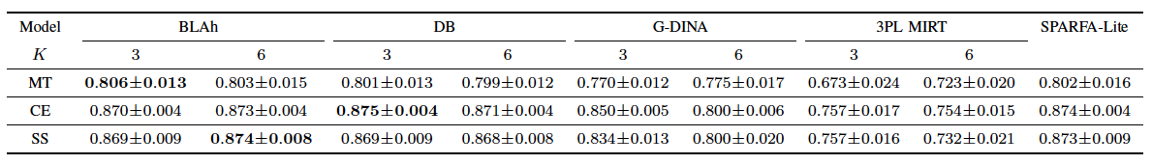
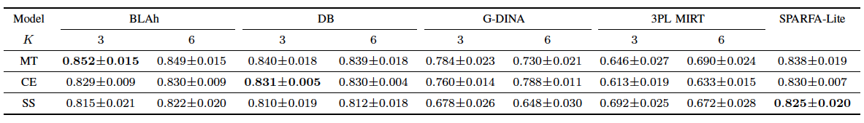
Prediction performance
Accuracy (ACC) and area under curve (AUC)
Non-linear models slightly outperform linear models
But much larger capacity for interpretability!

Slide 11
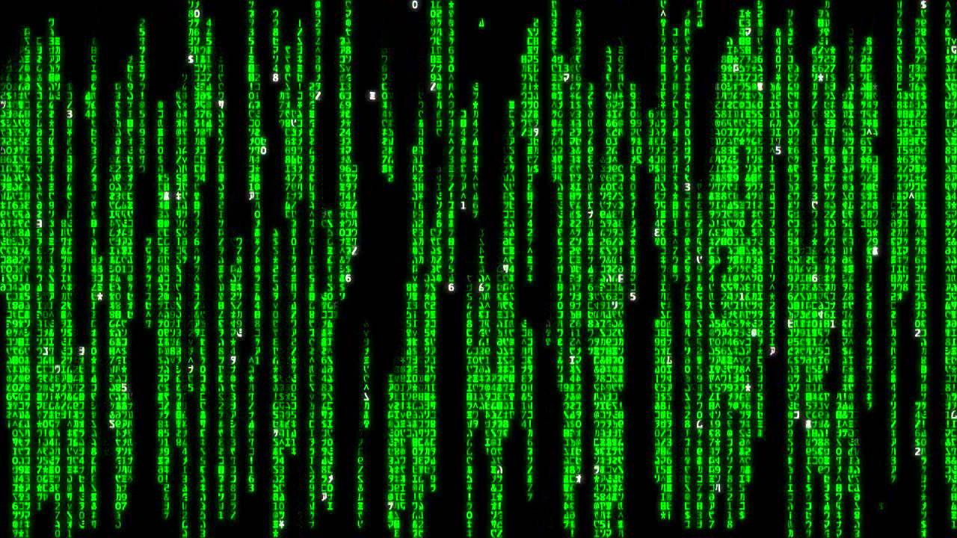
Challenges
Curse of dimensionality
possible Boolean logic functions!
Identifiability
Flip the signs of and ,
Flip the truth-table values,
Same data likelihood!

Slide 12

Solution: ordered logic functions
Intuition: higher knowledge does not hurt
Define an ordering among latent concept knowledge exhibition states as
And use it to define the restricted set of ordered Boolean logic functions

Slide 13
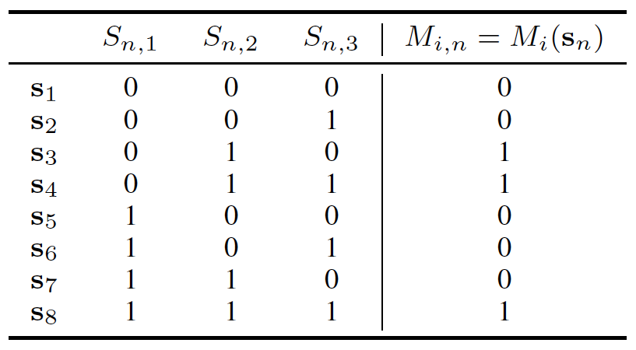

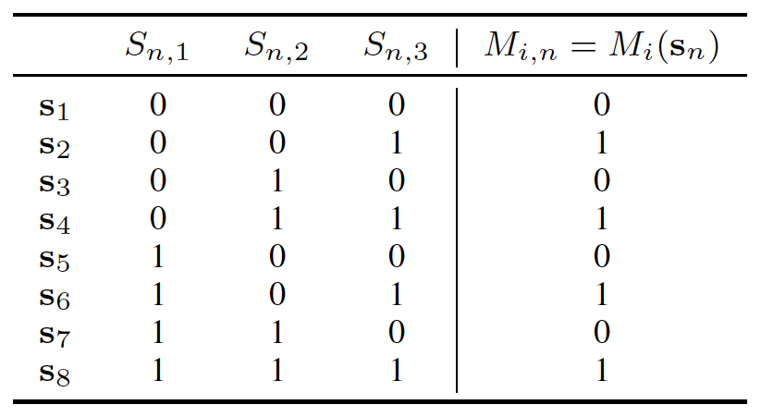

Ordered logic functions

Slide 14

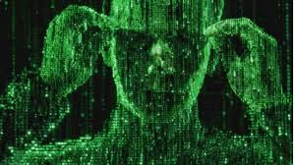
Advantages
Curse of dimensionality issue alleviated
For ,, while
Most real-world questions do not involve more than 4 concepts
Identifiability issue resolved

Slide 15
Inference algorithm
New MH random walk needed
Old random walk extremely inefficient
We develop a computationally efficient new MH random walk

Slide 16
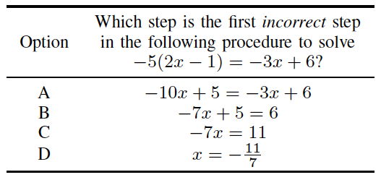
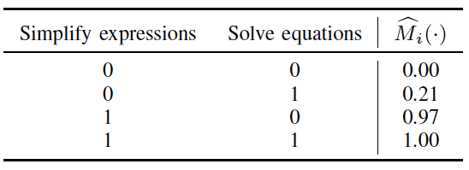
Interpretability

Slide 17
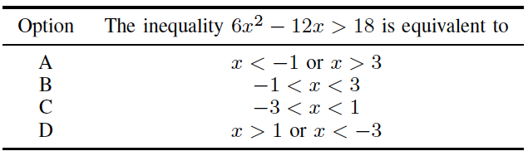
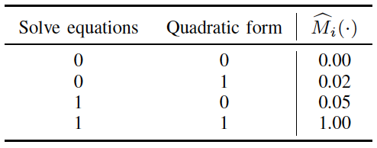
Interpretability

Slide 18
Summary
BLAh: Learning Boolean logic functions for each question from student response data
Good prediction performance
Restricted set of ordered Boolean logic functions
Alleviates curse of dimensionality
Interpretability

Slide 19
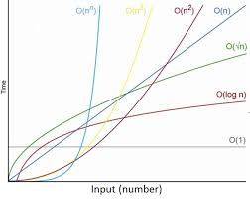
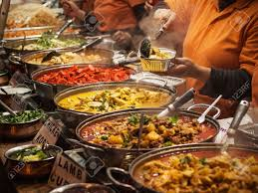
Future directions
Size of the restricted set
Learn the number of concepts

Slide 20


Comments appreciated!
➔ Go to www.sparfa.com and get SPARFA merchandise!

