Slide 1
Eliminating testing through continuous assessment
Steve Ritter
Founder and Chief Scientist
Carnegie Learning
with April Galyardt, Stephen Fancsali

Slide 2
TESTING IS A PROBLEM
I hope you can help fix it

Slide 3
Overview
Bad News: Testing is broken

Slide 4
Overview
Bad News: Testing is broken
Good News: Adaptive learning is a better way to do testing
Notes:
PLEA for help

Slide 5
Overview
Bad News: Testing is broken
Good News: Adaptive learning is a better way to do testing
But there are lots of challenges
Notes:
PLEA for help

Slide 6
Why do we test students?
Formative
Are students on track?
Identify gaps/opportunities for remediation
Summative
Has the student learned enough to get course credit?
Are aspects of the educational system (teachers, schools, curricula) performing well?

Slide 7
Why do we test students?
Formative
Diagnosis
Summative
Autopsy

Slide 8
TESTING IS BROKEN

Slide 9
Traditional testing assumptions
Knowledge
Knowledge displayed in assessment is correlated with ability to use knowledge in other contexts
Domain is sampled in the test
Environment
Testing takes place in an environment where there is no learning and no external sources of knowledge

Slide 10
Problems with testing
Takes time away from learning
Inefficient in diagnosis
Assumptions violate beliefs about how people learn

Slide 11
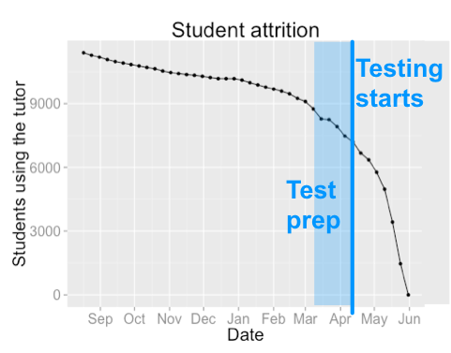
Testing takes time away from learning
Directly
US 8th graders average 25.3 hours of tests
Only formal school-wide testing counted
Yearly classroom instruction is 135 hours
And indirectly
Council of Great City Schools, 2015

Slide 12
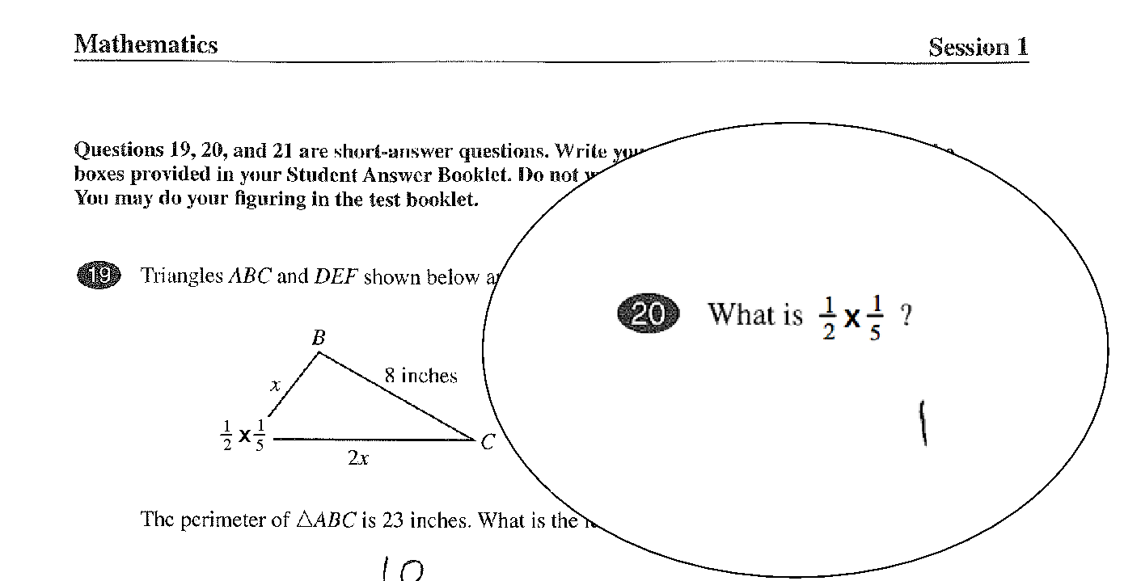
Testing is inefficient

Slide 13


What does this student understand about fractions?
Transcript:
One half times one-fifth.
Now, I have to find a multiple of 10.
so half would go to five-tenths
and one-fifth would go to two-tenths
and multiply that and that would be
one whole
Notes:
‹#›

Slide 14
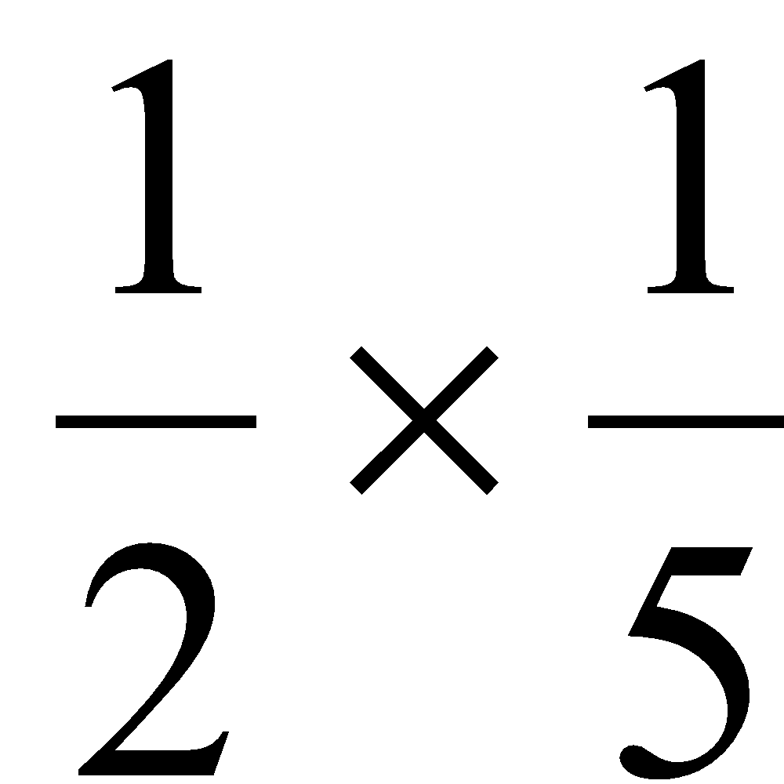
Process
Multiply Fraction ( )
Find common denominators
1/2 = 5/10
1/5 = 2/10
Apply operator to numerators
5x2=10
Keep common denominator
10
Simplify fraction
10/10 = 1
Notes:
‹#›

Slide 15
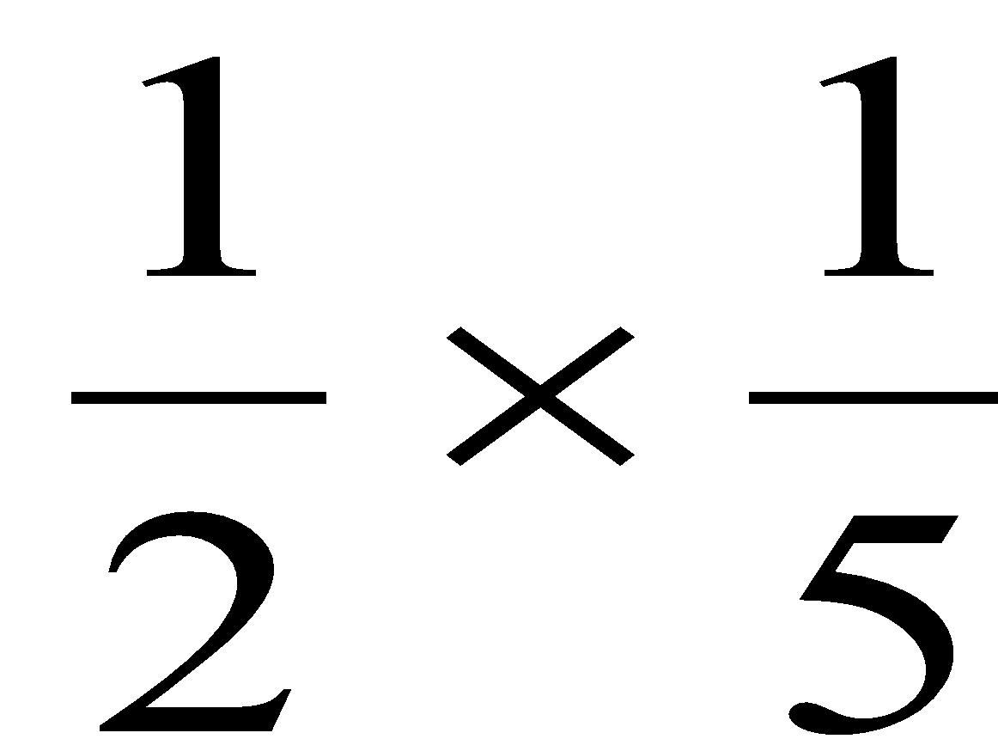
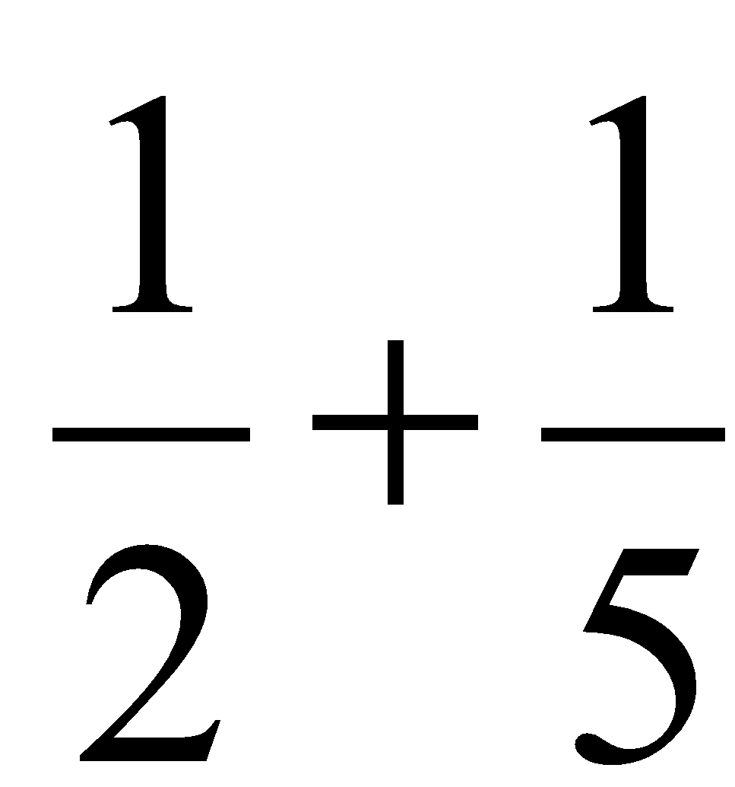
Process
Multiply Fraction ( )
Find common denominators
1/2 = 5/10
1/5 = 2/10
Apply operator to numerators
5x2=10
Keep common denominator
10
Simplify fraction
10/10 = 1
Add Fractions ( )
Find common denominators
1/2 = 5/10
1/5 = 2/10
Apply operator to numerators
5+2=7
Keep common denominator
10
Simplify fraction
7/10
Notes:
‹#›

Slide 16
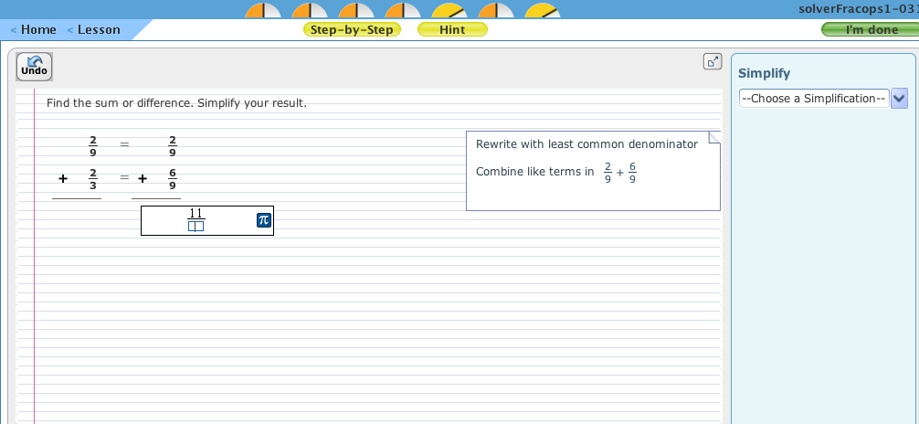

Slide 17
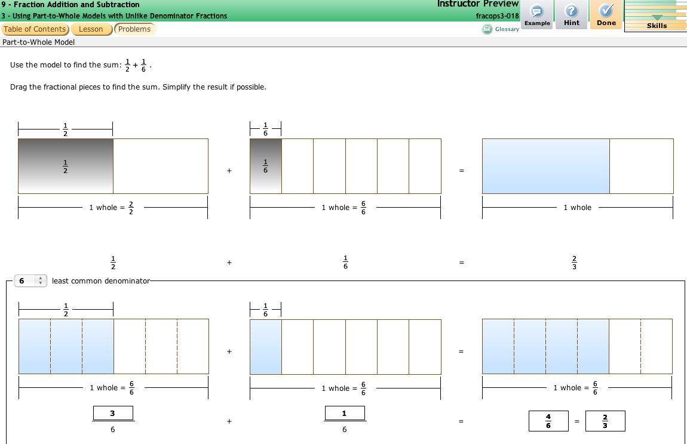

Slide 18
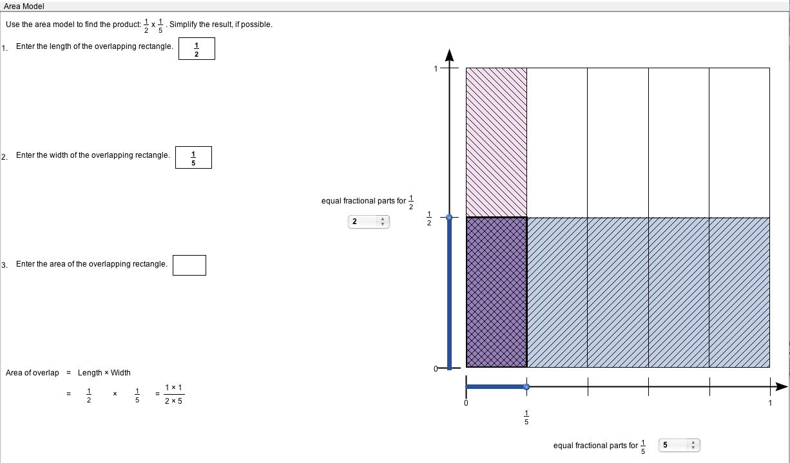
Notes:
Walk through the area model: visually shows what ½ of 1/5 is

Slide 19
Testing and learning science
Test assumes maximizing peak knowledge is the goal
But: spaced practice effects show that learning history, not just peak, affects decay
Typical testing focuses on facts, not procedures
No extended tasks
Lack of context prevents testing conditions of knowledge use (when, not what)
Test always misaligned with curriculum
Typical testing assumes a neutral environment is “fair”
But people react to test environment differently (anxiety, stereotype threat)

Slide 20
Public perception of testing
Parents rank test scores last as measure of school effectiveness
2/3 of public school parents say there is too much testing
20% of New Yorkers opted out of testing last year
PDK/Gallup (2015, August). 47th annual PDK/Gallup Poll of the Public’s Attitudes Toward the Public Schools. http://pdkpoll2015.pdkintl.org/wp-content/uploads/2015/08/PDKPoll2015_PP.pdf
Demause, N. (2016, April 7). New York Opt-Out Rates Remain High, Tests Remain Massively Confusing. The Village Voice. http://www.villagevoice.com/news/new-york-opt-out-rates-remain-high-tests-remain-massively-confusing-8482769

Slide 21
WHY IS ADAPTIVE LEARNING BETTER?

Slide 22
Adaptive Learning is more efficient
No time taken away from learning
Assessment tasks can be complex
Question format need not be known in advance
Can include context, take time
Supports good learning practices
Spaced practice
Test effect
Feedback on progress
Can build on priors
Notes:
ALSO: No surprises
Traditional test samples from a space; we’re covering the curriculum

Slide 23
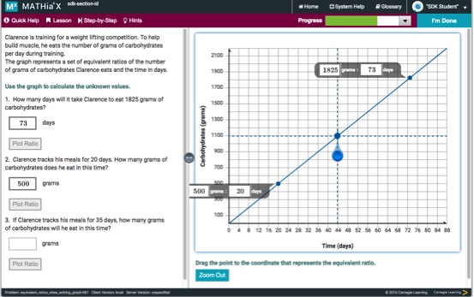
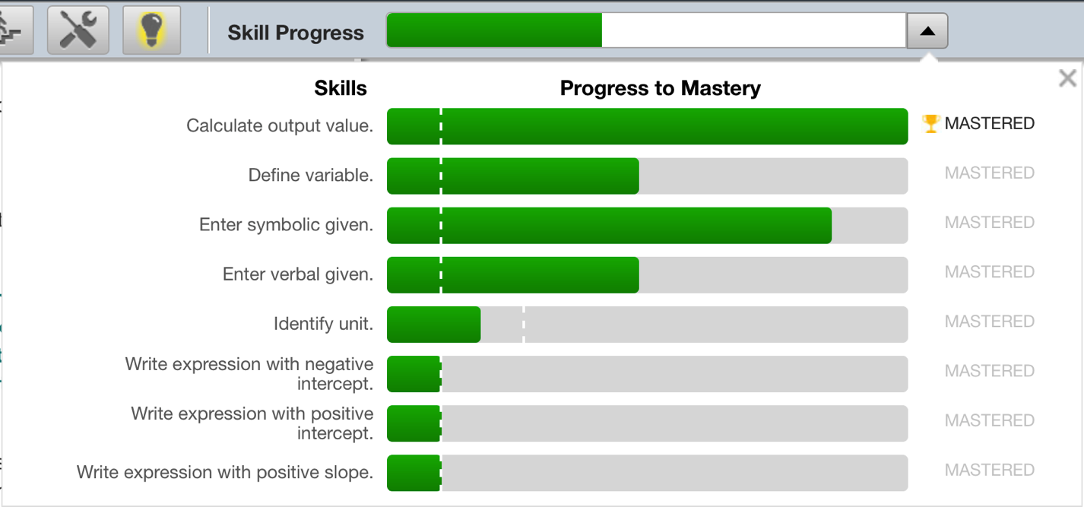
Cognitive Tutor/MATHia
Basal curriculum for grades 6-11
Blended (text + software)
Software used for 40% of class time
Target 50 hours
Mastery-based (BKT)
Skill model refined through ML

Slide 24
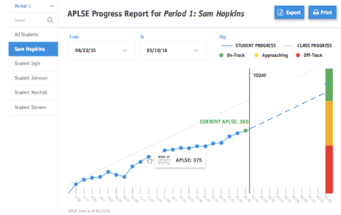
Assessment goal
Cumulate formative assessments
Provide continuous feedback, relative to target
Allow students to progress (and graduate) at their own pace

Slide 25
Approach
Technical
Build model to predict end-of-year test scores
And subscales
Use model to score topics
Weight topics for importance
Score is cumulative score on topics
Validate on subpopulations
Determine reliability by time
Legal & public policy
Develop usage guidelines
Time, in-school vs. out-of-school, etc.
Process for item introduction, revision and validation
Gain public acceptance for method

Slide 26
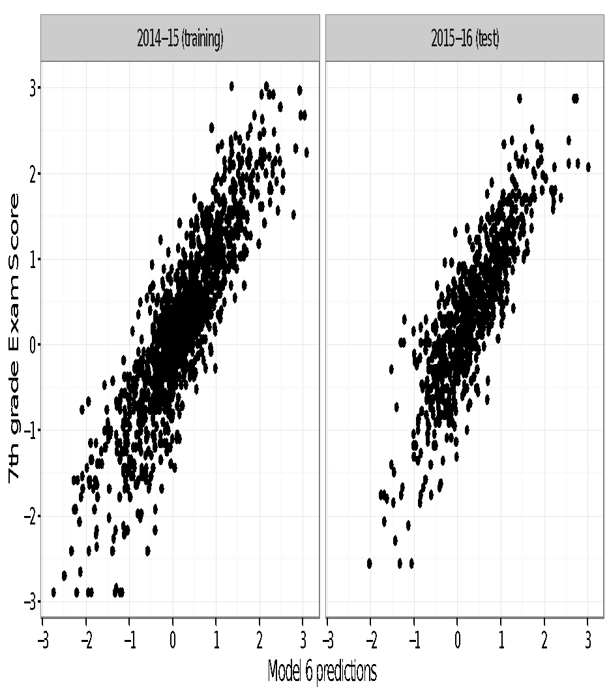
Results so far
Models trained on one year, tested on different year
Reasonable prediction of end-of-year scores
Strongest predictors:
pretest
problems to mastery
hints and errors
time/problem
Demographics not predictive

Slide 27
But why predict standardized test score?
Is Cognitive Tutor a better test?
Grades and test scores don’t correlate that well
22% of students under- or over-perform end-of-year exam, compared to grades (most underperform)
 |  |  |  | Grade
 |  | A | B | C | D | F
 | 1 | 1.1% | 5.8% | 9.7% | 4.7% | 3.7%
 | 2 | 2.2% | 7.5% | 9.5% | 3.5% | 2.1%
FSA Score | 3 | 3.6% | 9.7% | 9.3% | 2.4% | 1.2%
 | 4 | 3.8% | 7.3% | 3.8% | 0.7% | 0.3%
 | 5 | 4.5% | 2.7% | 0.8% | 0.1% | 0.0%

Slide 28
Challenges
Cheating
Redoing a section
Forgetting
Item development, validation, revision
What is an item?
Prior performance as Bayesian prior

Slide 29
READY TO HELP?

