Slide 1
Estimating Student Proficiency: Deep Learning Is Not The Panacea
Michael Mozer University of Colorado, Boulder
and
Kevin Wilson, Xiaolu Xiong, Mohammad Khajah, Robert Lindsey, Siyuan Zhao, Yan Karklin, Eric Van Inwegen, Bojian Han, Chaitanya Ekanadham, Joseph Beck, Neil Heffernan

Slide 2
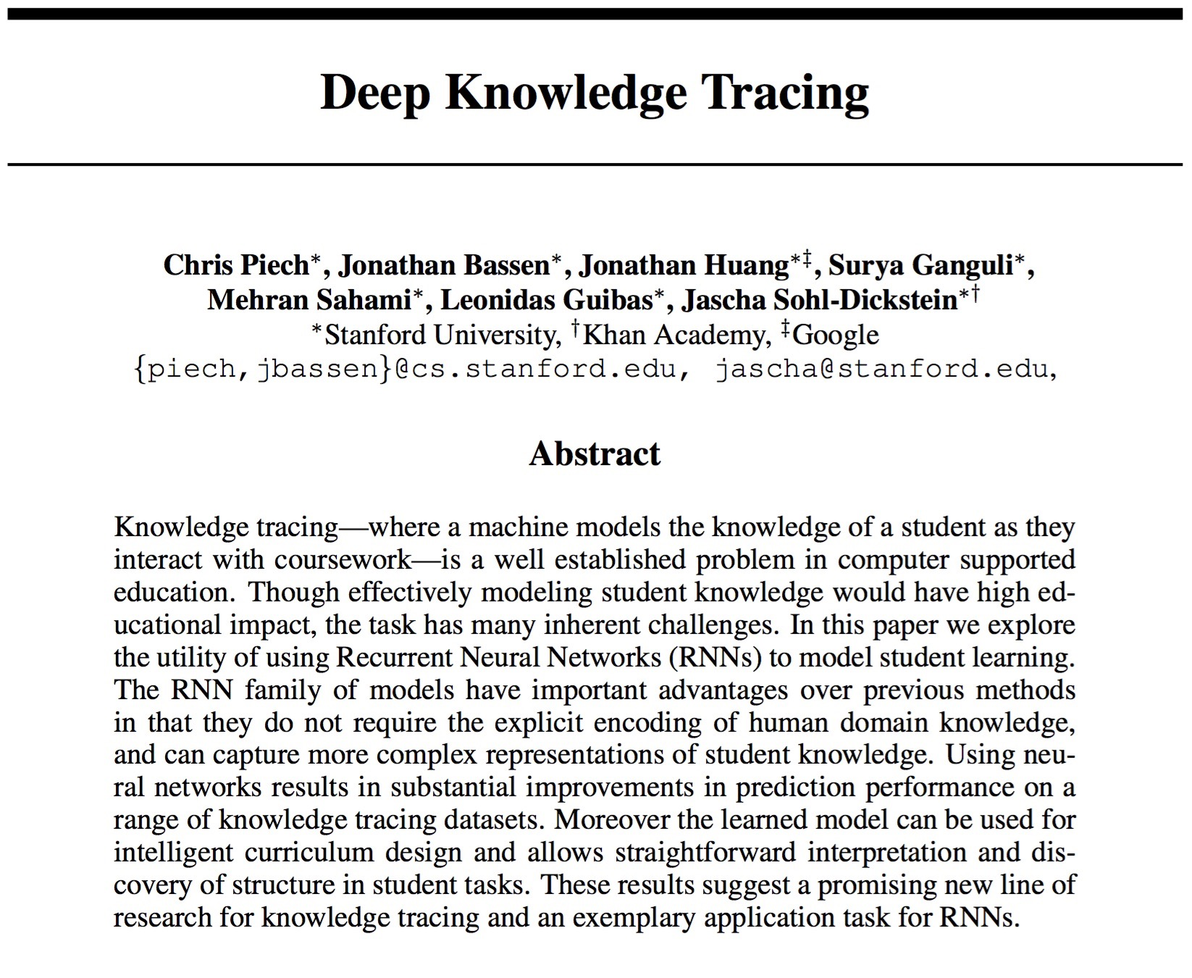

Slide 3

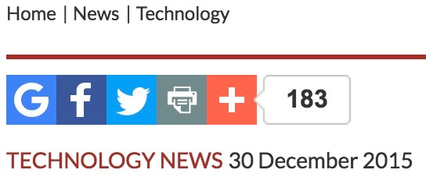
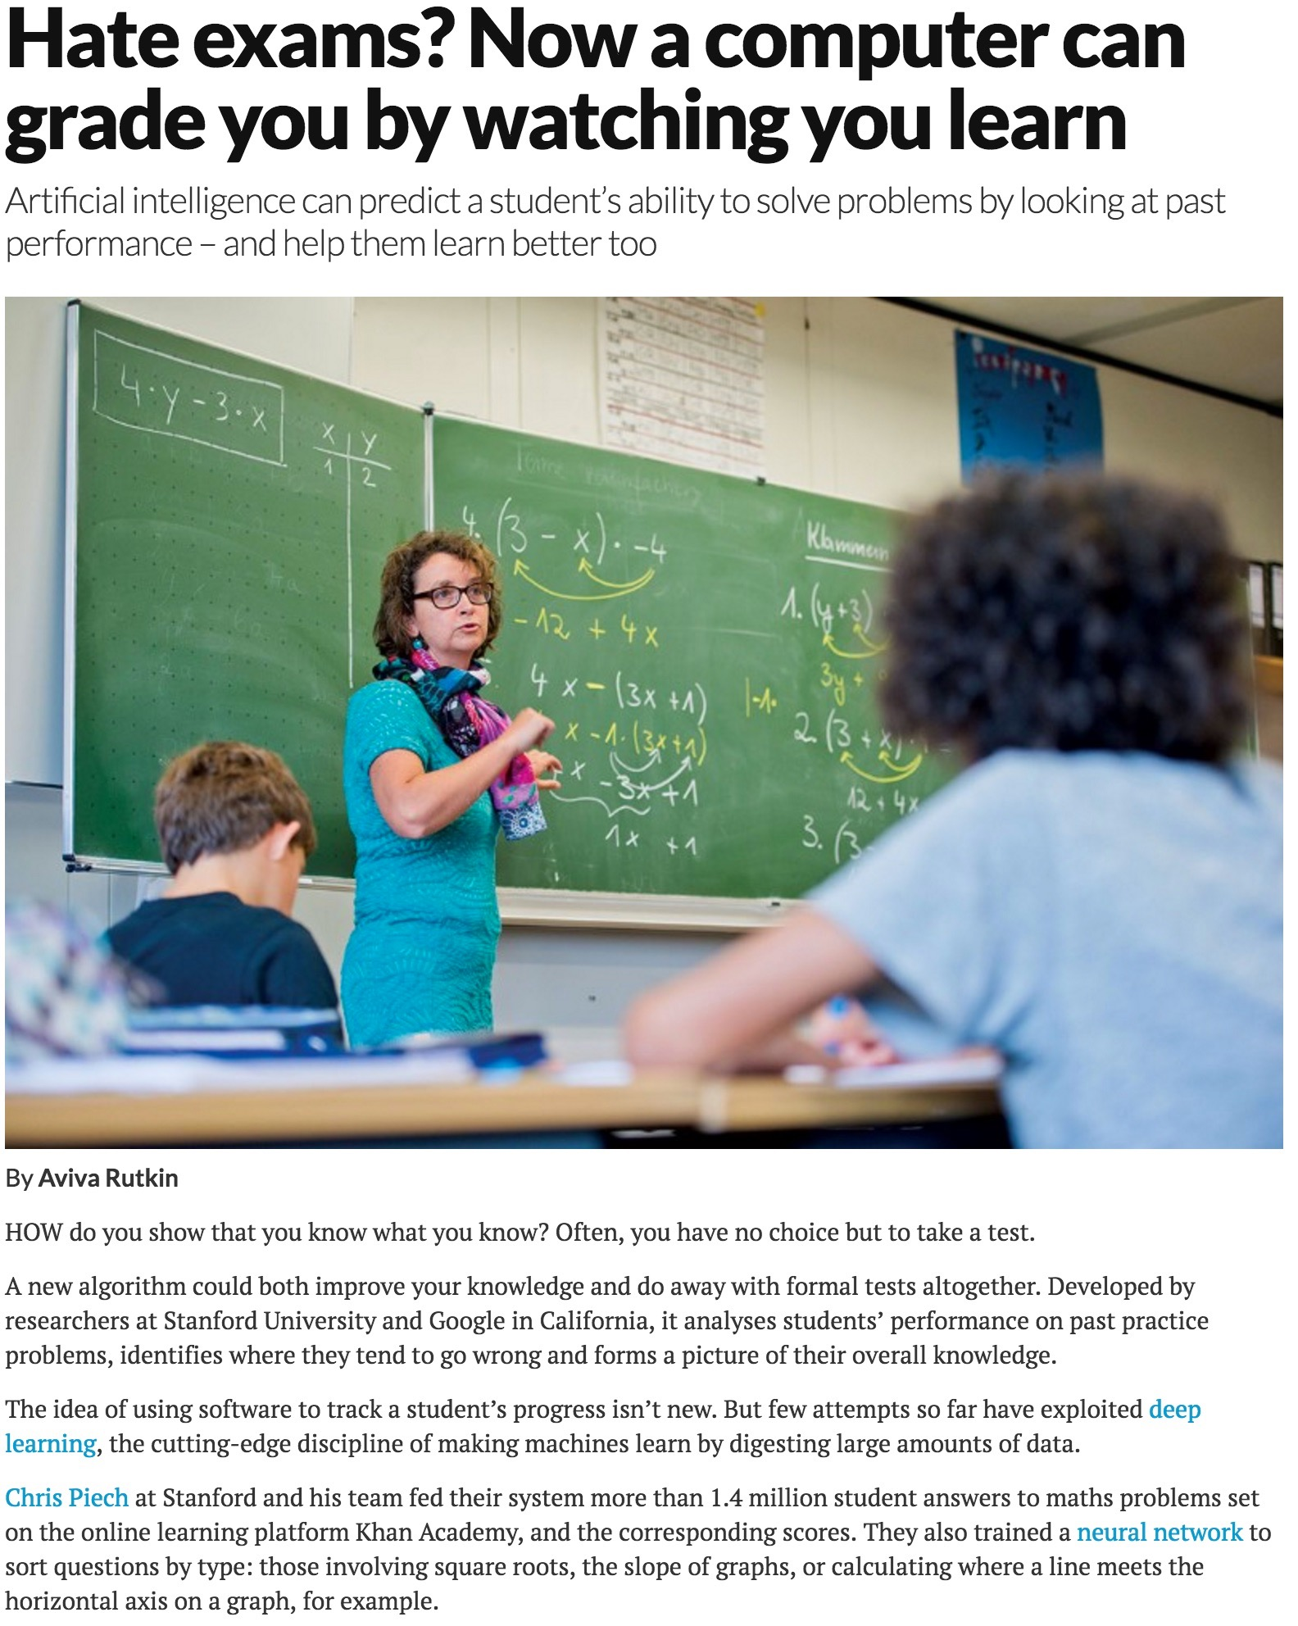
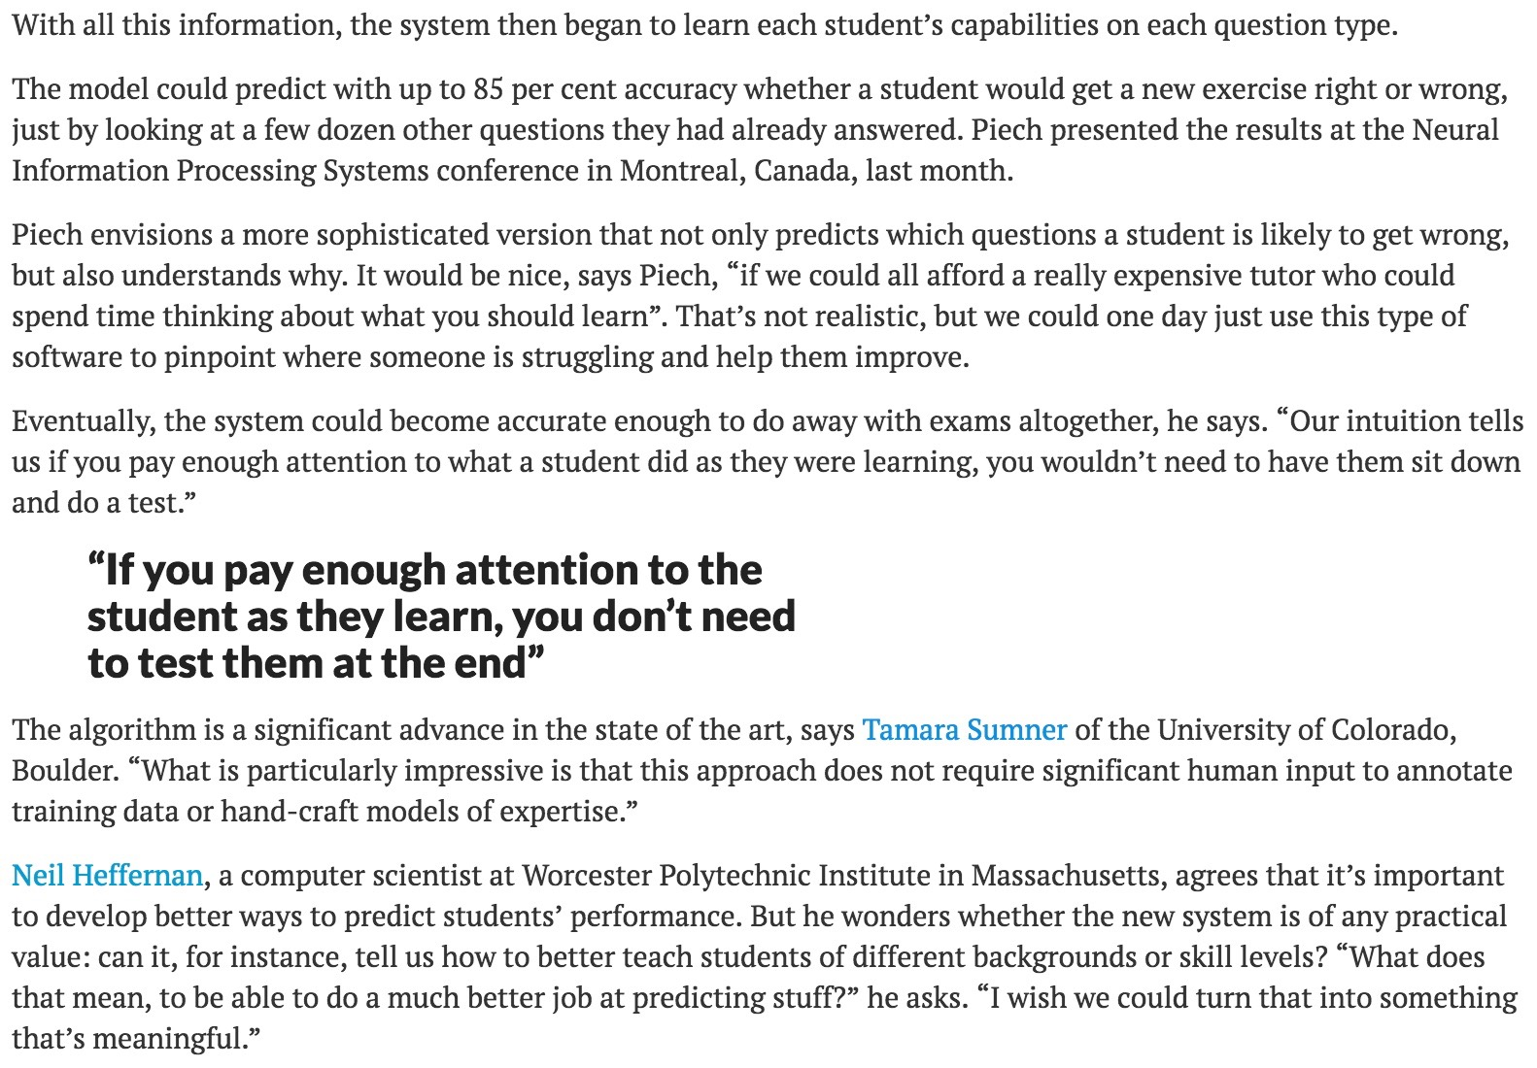

Slide 4
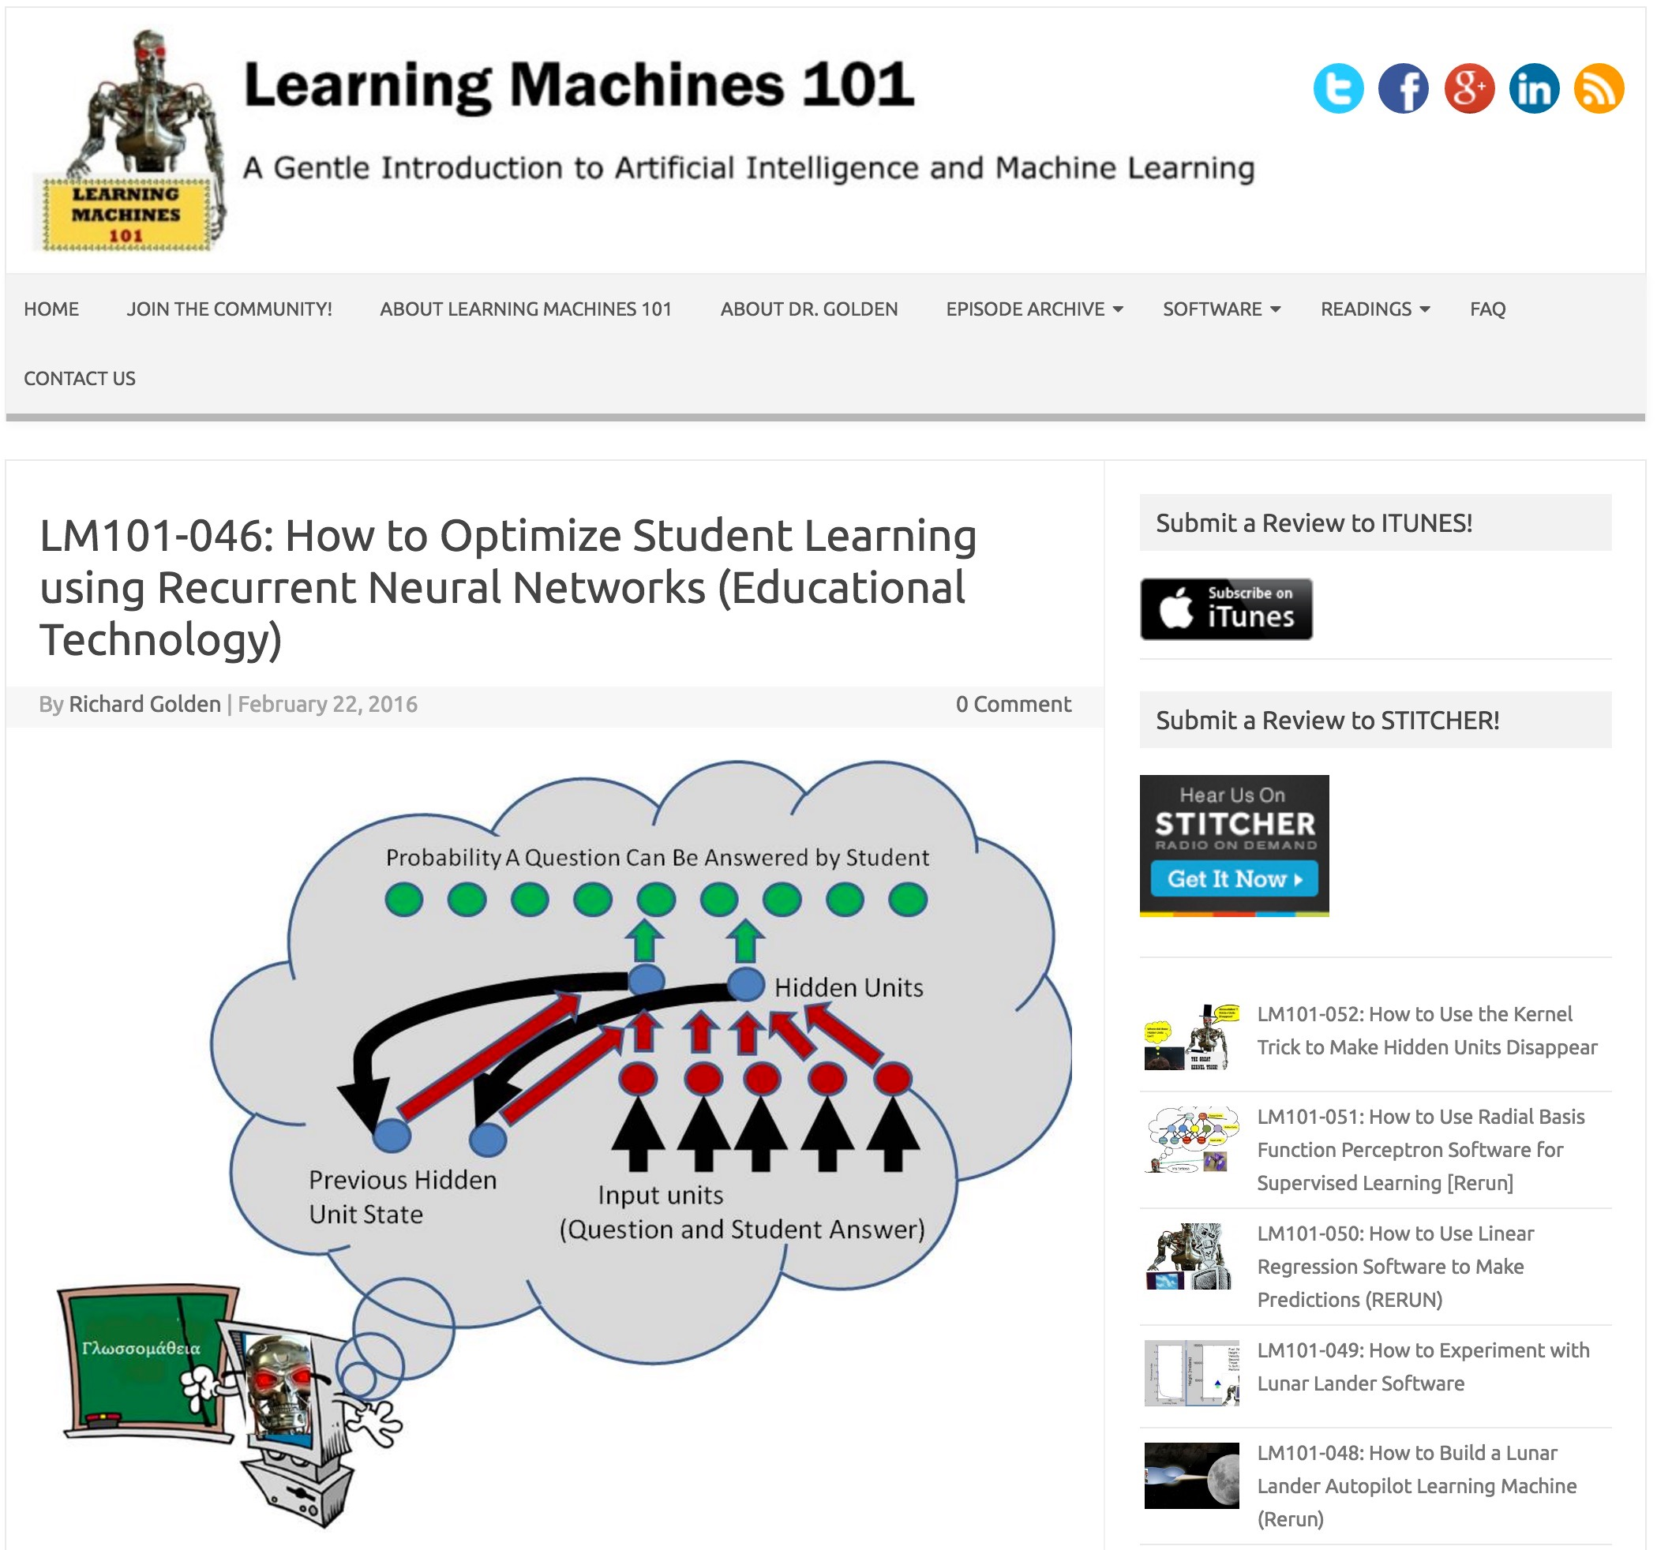
Notes:
Blog/Podcast by psychologist Richard Golden
there’s a schematic of DKT which I’ll explain shortly

Slide 5

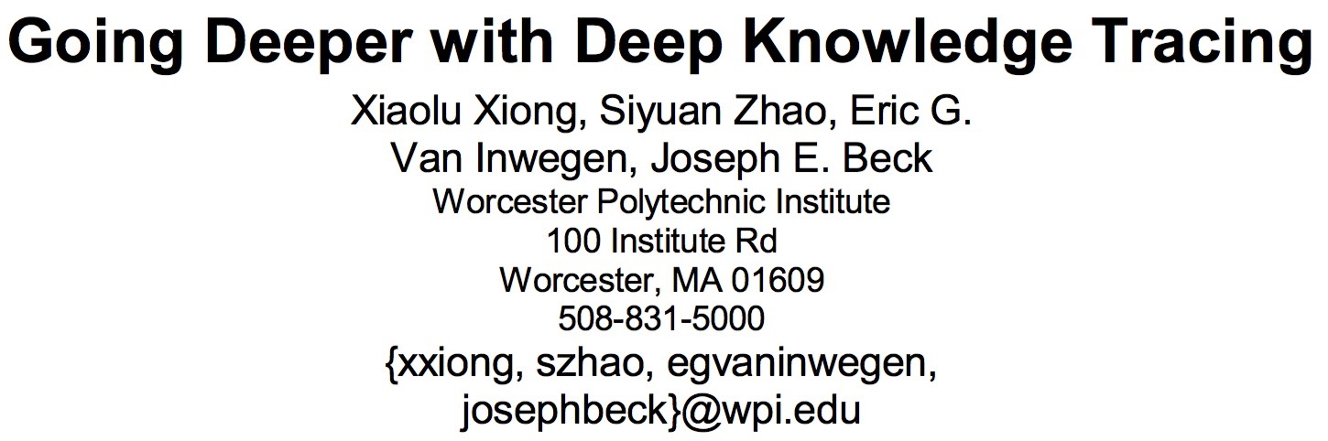
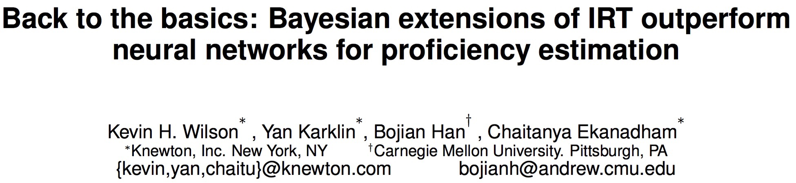
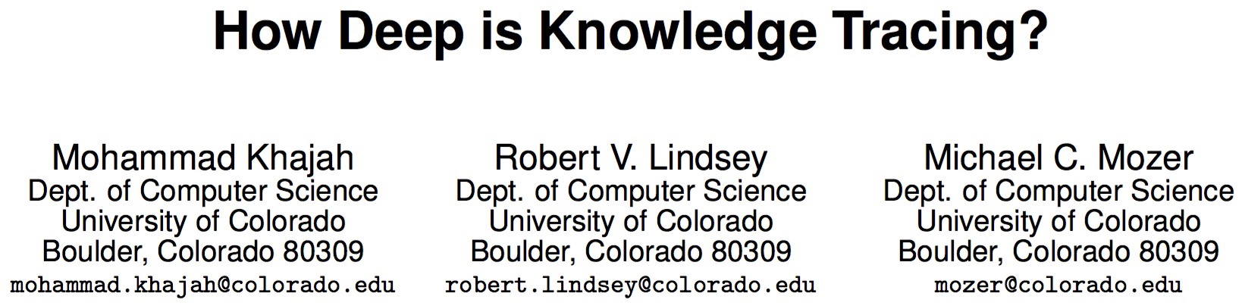
sdfsdf
Notes:
logistic regression, Bayesian IRT, BKT
focus on our work, but we all wrote up a single paper that integrates the results and it should be on the workshop page

Slide 6
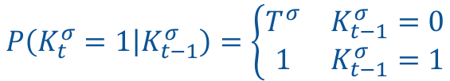
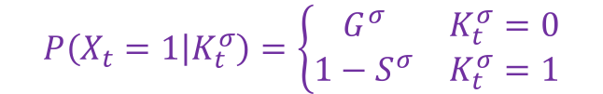
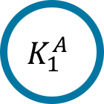
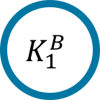

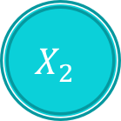
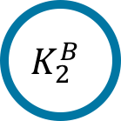
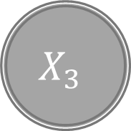
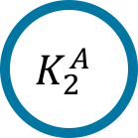

Bayesian Knowledge Tracing (BKT)
HMM with binary latent state per skill
$$P\left(K_{t}^{σ}=1 | K_{t−1}^{σ}\right)=\left\{\begin{matrix}T^{σ} & K_{t−1}^{σ}=0 \\ 1 & K_{t−1}^{σ}=1\end{matrix}\right.$$
…
$$K_{1}^{A}$$
$$K_{2}^{A}$$
…
$$K_{1}^{B}$$
$$K_{2}^{B}$$
$$P\left(X_{t}=1 | K_{t}^{σ}\right)=\left\{\begin{matrix}G^{σ} & K_{t}^{σ}=0 \\ 1−S^{σ} & K_{t}^{σ}=1\end{matrix}\right.$$
$$X_{1}$$
$$X_{2}$$
$$X_{3}$$
$$X_{4}$$

Slide 7
BKT
versus
DKT
one model per skill
single model for all skills
problems
exercises

Slide 8
Deep Knowledge Tracing (a.k.a. generic recurrent neural net)
predicted accuracy
on trial n+1 for every exercise
output
…
E₁↑
E₂ ↑
E₃↑
E_{k}↑
student knowledge state
…
hidden
exercise attempted on trial n
and accuracy
input
…
E₁↑
E₁↓
E₂↑
E₂↓
E_{k}↑
E_{k}↓

Slide 9
AUC Comparison (Piech et al., 2015)
data set | BKT | DKT
Assistments | 0.67 | 0.86
Khan Math | 0.63 | 0.85
Piech Synthetic | 0.54 | 0.75
AUC computed for each skill then averaged
AUC computed based on entire data set

Slide 10
Digression: AUC Calculation
AUC per skill
Skill | Actual | Pred.
A | 1 | 0.7
A | 1 | 0.7
A | 1 | 0.7
A | 0 | 0.3
A | 0 | 0.3
A | 0 | 0.3
B | 1 | 0.5
B | 0 | 0.5
AUC across skills
Skill | Actual | Pred.
A | 1 | 0.7
A | 1 | 0.7
A | 1 | 0.7
A | 0 | 0.7
B | 1 | 0.3
B | 0 | 0.3
B | 0 | 0.3
B | 0 | 0.3
AUC=0.50
AUC=1.00
Average
AUC=0.50
Average
AUC=0.75
AUC=0.50
AUC=0.875
AUC=0.50
Weighs skills equally
Ignores whether model can predict relative skill accuracy
Weighs trials equally
Reflects whether model can predict relative skill accuracy

Slide 11
A Fair Comparison
data set | BKT | DKT
Assistments | 0.67 | 0.86
Khan Math | 0.63 | 0.85
Piech Synthetic | 0.54 | 0.75
0.73
0.62

Slide 12

Piech Synthetic Data Set
2000 simulated students for training, 2000 for testing
Each student given same sequence of 50 problems
$P\left(\text{correct}\right)=g+\frac{1−g}{e^{δ−α}}$
Model given problem index; skills must be inferred
problem
1 | 2 | 3 | 4 | 5 | 6 | 7 | … | 49 | 50
A | B | A | A | C | E | B | … | D | A
𝞭₁ | 𝞭₂ | 𝞭₃ | 𝞭₄ | 𝞭₅ | 𝞭₆ | 𝞭₇ | … | 𝞭₄₉ | 𝞭₅₀
𝝰_{A} | 𝝰_{B} | 𝝰_{A} | 𝝰_{A} | 𝝰_{C} | 𝝰_{E} | 𝝰_{B} | … | 𝝰_{D} | 𝝰_{A}
skill
difficulty
ability
𝝰_{A}

Slide 13
Why Is DKT Doing So Well?
data set | BKT | DKT
Assistments | 0.67 | 0.86
Khan Math | 0.63 | 0.85
Piech Synthetic | 0.54 | 0.75
0.73
0.62

Slide 14
Three Hypotheses
 | BKT | DKT
skill interactions | not allowed | allowed
influence of study history | strong theory | flexible
skill discovery | no | yes
Does flexibility of DKT make it inevitably better?
Our approach
Make BKT even more Bayesian
Related approaches
Bayesian variants of IRT (Wilson et al., 2016)
Logistic regression (Xiong et al., 2016)

Slide 15
Skill Interactions
 | BKT | DKT
skill interactions | not allowed | allowed
influence of study history | strong theory | flexible
skill discovery | no | yes
BKT does not use data from skill A to inform knowledge state of skill B.
To allow for a limited sort of interaction between skills, incorporate into BKT a global IRT-like student ability that is shared across skills.
Pardos and Heffernan (2010)
Xu and Mostow (2013)
Yudelson, Koedinger, and Gordon (2013)
González-Brenes, Huang, and Brusilovsky (2014)
Khajah, Lindsey, and Mozer (2014)

Slide 16
Influence of Study History
 | BKT | DKT
skill interactions | not allowed | allowed
influence of study history | strong theory | flexible
skill discovery | no | yes
BKT considers early trials in a sequence to be as important as the most recent trials.
In contrast, DKT can place more weight on the recent trials.
Easy to incorporate in BKT with forgetting.
Qui, Qi, Lu, Pardos, and Heffernan (2011)

Slide 17
Skill Discovery
 | BKT | DKT
skill interactions | not allowed | allowed
influence of study history | strong theory | flexible
skill discovery | no | yes
Many schemes have been proposed to discover the mapping from skills to problems in a domain (the cognitive model).
Cen, Koediger, and Junker (2006)
Desmarais and Naceur (2013)
González-Brenes (2015)
Lindsey, Khajah, & Mozer (2014)
based on MCMC sampling via CRP prior
fully automated
outperforms expert assignment on 3/5 data sets; matches on 2/5

Slide 18
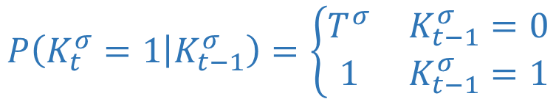
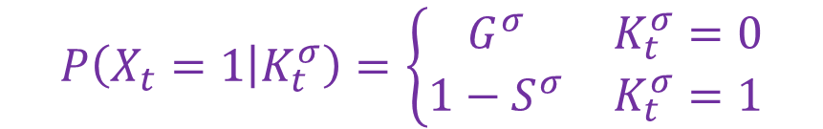


Standard BKT Model
$$P\left(K_{t}^{σ}=1 | K_{t−1}^{σ}\right)=\left\{\begin{matrix}T^{σ} & K_{t−1}^{σ}=0 \\ 1 & K_{t−1}^{σ}=1\end{matrix}\right.$$
$$K_{1}^{A}$$
$$K_{2}^{A}$$
$$K_{1}^{B}$$
$$K_{2}^{B}$$
$$P\left(X_{t}=1 | K_{t}^{σ}\right)=\left\{\begin{matrix}G^{σ} & K_{t}^{σ}=0 \\ 1−S^{σ} & K_{t}^{σ}=1\end{matrix}\right.$$
$$X_{1}$$
$$X_{2}$$
$$X_{3}$$
$$X_{4}$$

Slide 19
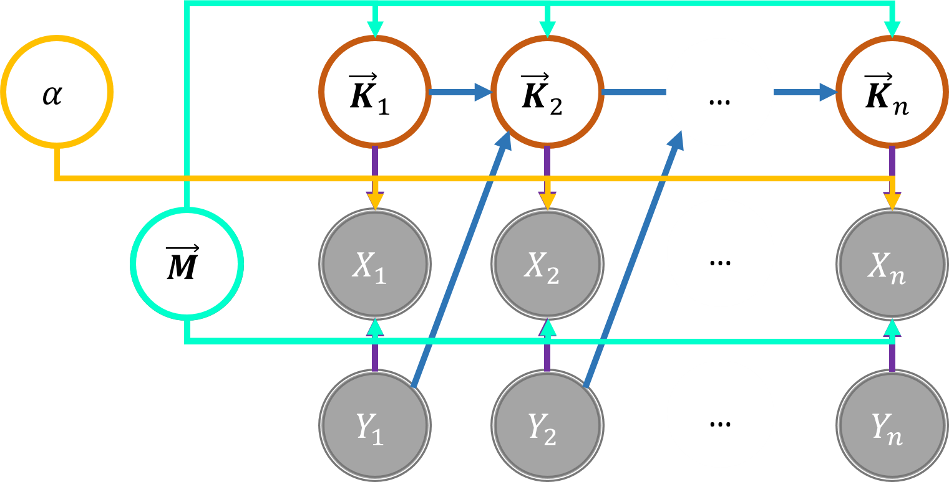
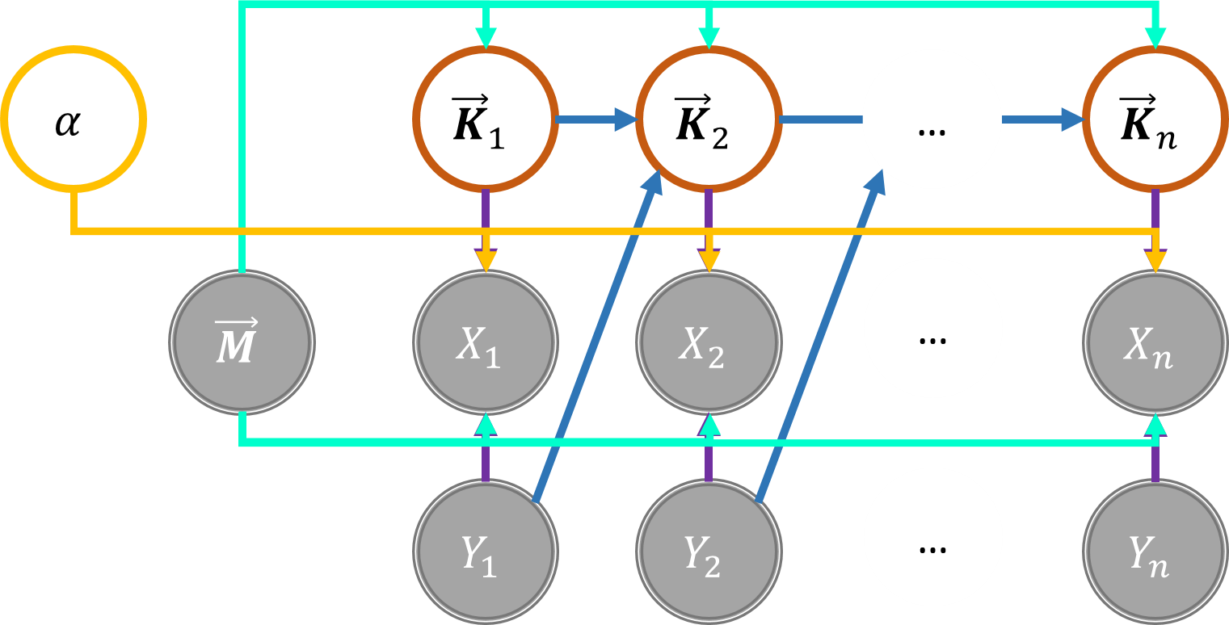
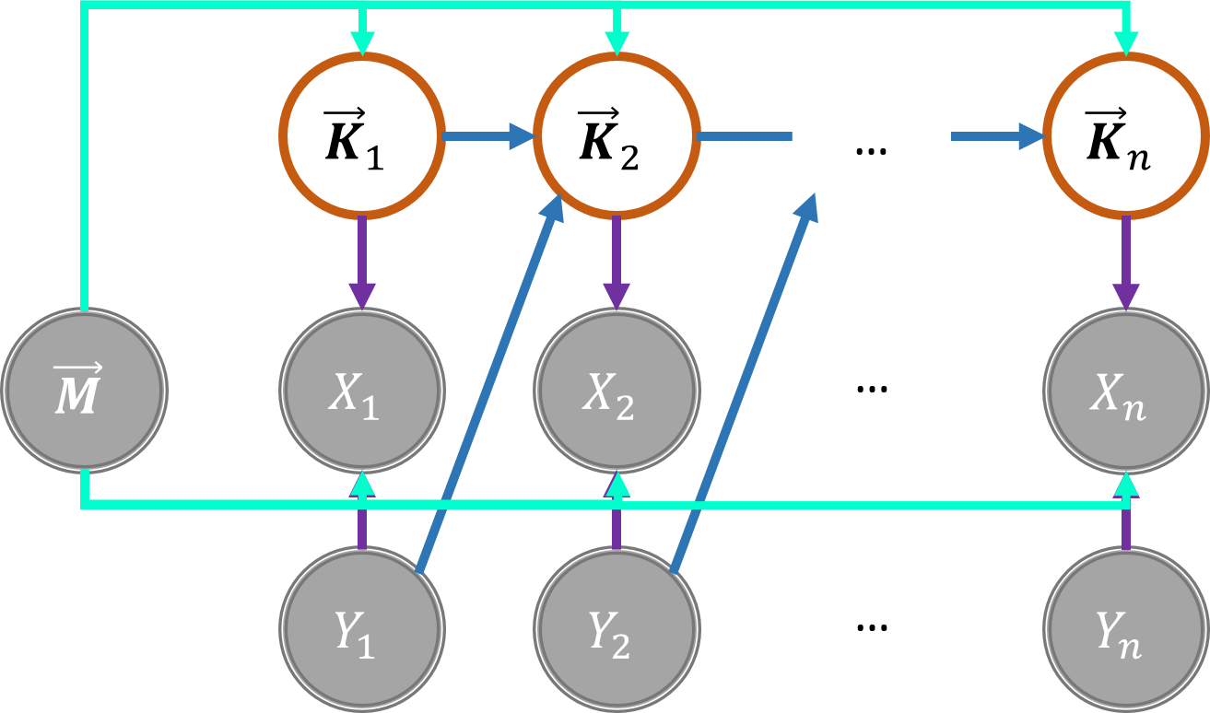
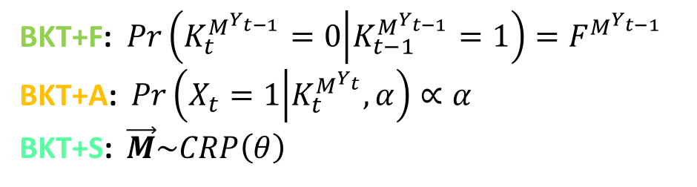
Equivalent Representation of BKT
Enhanced BKT
Assignment of
exercises to skills
BKT+F: $Pr\left(K_{t}^{M^{Y_{t−1}}}=0 | K_{t−1}^{M^{Y_{t−1}}}=1\right)=F^{M^{Y_{t−1}}}$
BKT+A: $Pr\left(X_{t}=1 | K_{t}^{M^{Y_{t}}},α\right)∝α$
BKT+S: $\vec{M}\sim CRP\left(θ\right)$
Exercise IDs
https://github.com/robert-lindsey/WCRP/tree/forgetting

Slide 21
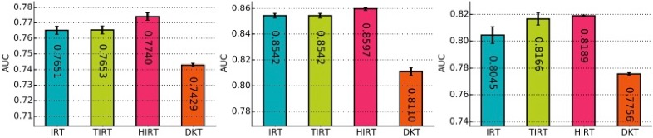
Wilson et al. Results
item-response theory
temporal IRT
hierarchical IRT

Slide 22
DKT
BKT/IRT
low bias
high bias
(expressive)
(constrained)
more accurate
less accurate
difficult to interpret
easy to interpret
DKT may be sexier but no evidence that it’s better.
Notes:
Promise of DKT: when we have a lot more auxilliary features and no good theory of how those features relate to performance

