Slide 1
Linux Kernel: Mini-Project
By Jill Platts

Slide 2
What is a Loadable Linux Kernel Module (LKM)?
A way to add code/functionality to the kernel while it’s running.
Benefits:
No need to rebuild kernel.
Saves memory due to only being loaded when needed.
Much faster to maintain and debug.
Excellent tool when coding within the kernel, due to load/unload advantage.

Slide 3
What is /proc?
A virtual filesystem, /proc contains information about running processes and system resources, such as CPU information, memory information, list of running modules, and much more.

Slide 4
Project Scope
Create, load, and unload a custom /proc “pseudo”-file via a Linux Kernel Module (LKM).
Custom /proc “pseudo”-file will interact with user-space via read and write functions.

Slide 5
Communication Between User-space and Kernel-space: A Message on the Current Development State of a Running Kernel
From the Linux command-line, a developer/development status/state message can be written and read using common Linux commands.
To write: echo “Date:12/01/19, Time:12:00PM, Working on:/proc file system, Author:JPlatts” >> /proc/devstate
To read: cat /proc/devstate
A consistently updated developer/development status/state message can help a team of developers keep track of what part of the kernel was last worked on, when it was last worked on, and who last worked on it.

Slide 6
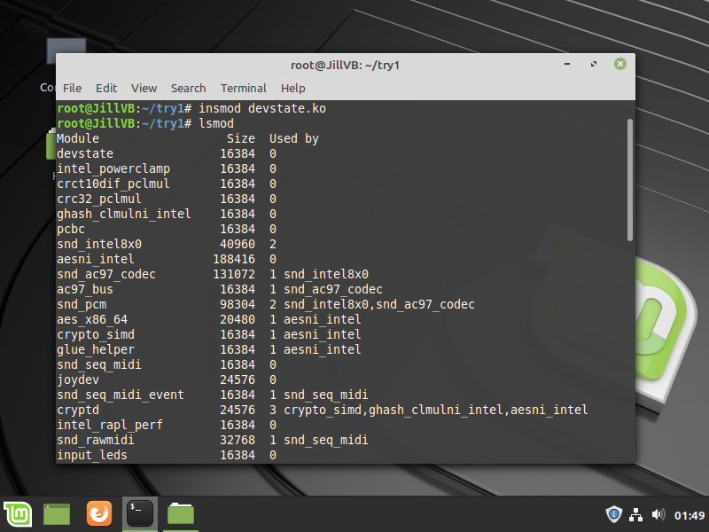
Linux Kernel Module (LKM): Loading

Slide 7
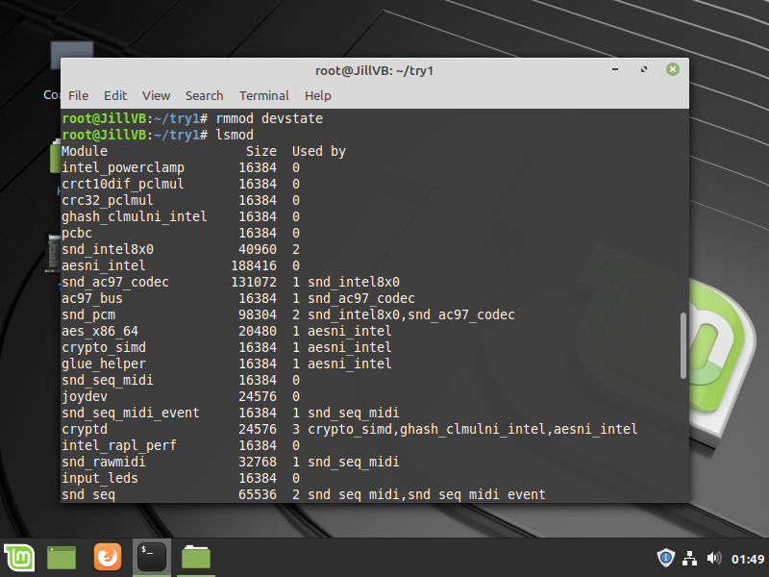
Linux Kernel Module (LKM): UNLoading

Slide 8
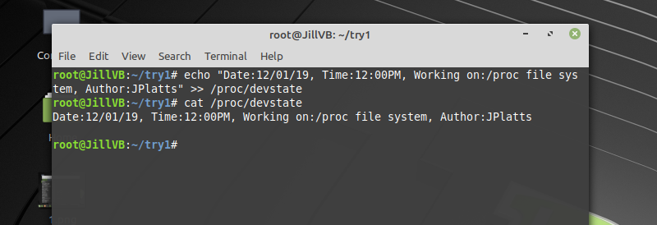
Read and Write to the /proc File

Slide 9
A Variety of Uses
This project and the /proc “pseudo”-file can be easily repurposed to keep track of other information relevant while the Linux OS/kernel is running.

Slide 10
Information and code can be viewed on the project’s GitHub page - https://github.com/jmppmj/linuxkernelproject

