Slide 1
The World of Music
By:Jillian
Jeffrey
Jessica

Slide 2
Our initial mission
Look at the relationship between geographical location and popularity of music genres.

Slide 3
However… things happen…
Music streaming sites do not share their user’s geolocation through their API
Good thing for user privacy
Not good thing for our project

Slide 4
Our New Mission!
To analyze the evolution of studio
features and sentiment of lyrics of
popular music in the last 30 years

Slide 5
New Questions!
Are there any patterns in song characteristics over time?
Can differences be found in the sentiment of song lyrics over the past 30 years?
Does the winter or summer time influence the data of popular music from the last 30 years?

Slide 6
Hypothesis
We believe that we will observe lower values for characteristics such as energy and danceability over the winter season compared to summer
The sentiment of songs over the past 30 years will be different with sentiment leaning toward negative

Slide 7


APIs
Spotify
lyrics.ovh
Billboard

Slide 8
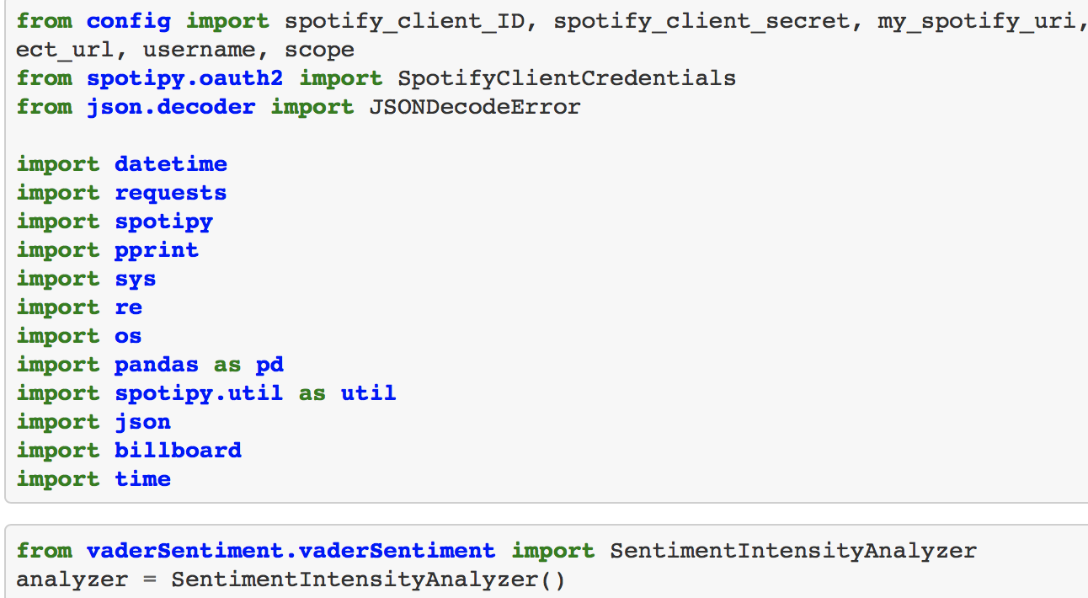
Modules Used

Slide 9
Data Collected
Spotify: Audio features
Billboard: Top 100 songs from Summer (week of June 20th) and Winter (week of Dec 21st)
Lyrics: Used Vader to get sentiment Analysis

Slide 10
What?
Instrumentalness: this value represents a measure of the vocals in the song. The closer it is to 1.0, the more instrumental the song is.
Acousticness: this value describes how acoustic a song is. A score of 1.0 means the song is most likely to be an acoustic one.
Danceability: describes how suitable a track is for dancing based on a combination of musical elements including tempo, rhythm stability, beat strength, and overall regularity. A value of 0.0 is least danceable and 1.0 is most danceable.
Tempo: the speed at which a passage of music is or should be played.
Valence: to describe whether something is likely to make someone feel happy (positive valence) or sad (negative valence).
Energy: describes sounds as a form of energy. Defines volume, pitch and frequency as they relate to sound energy.

Slide 11
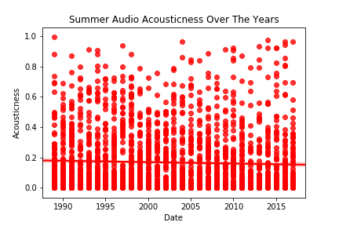
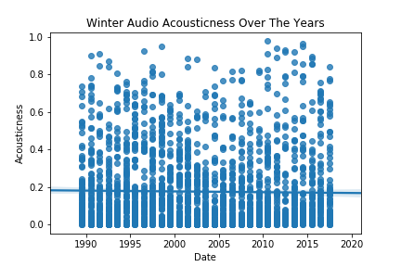
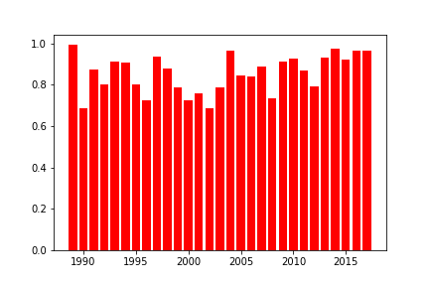
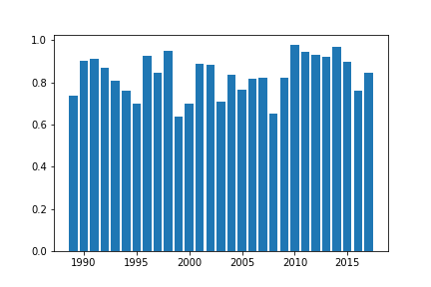
Date vs Acousticness

Slide 12
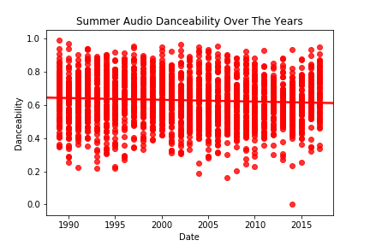
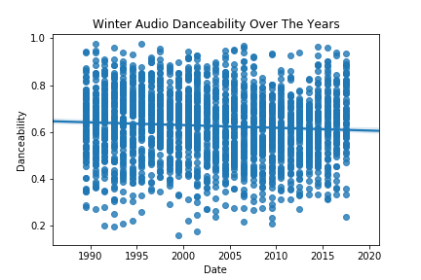
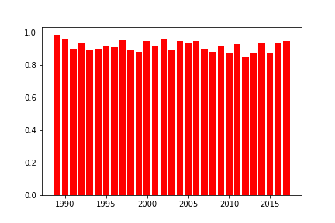
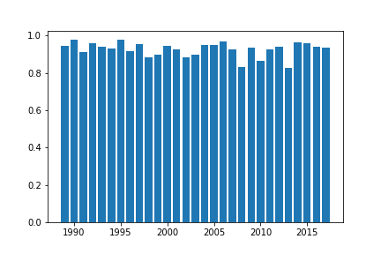
Date vs Danceability

Slide 13
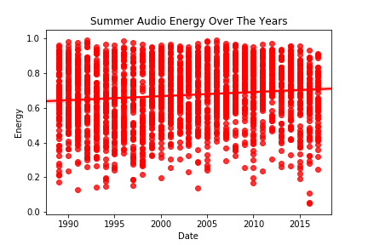
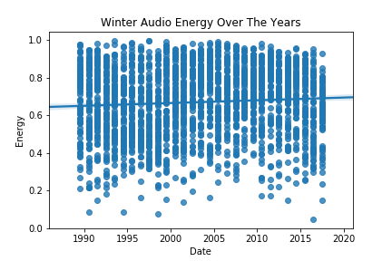
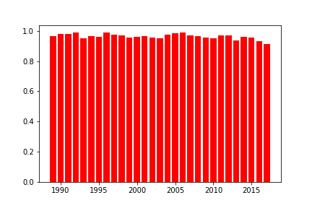
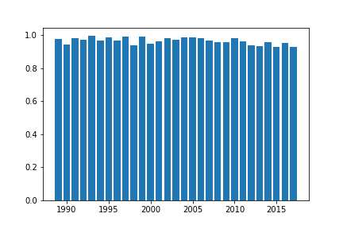
Date vs Energy

Slide 14
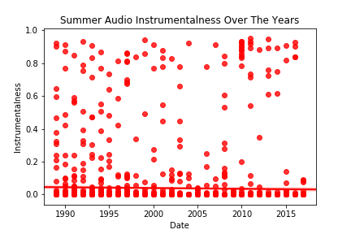
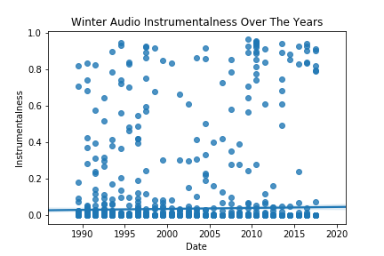
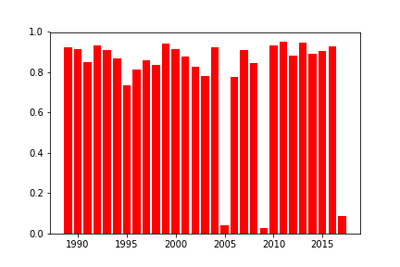
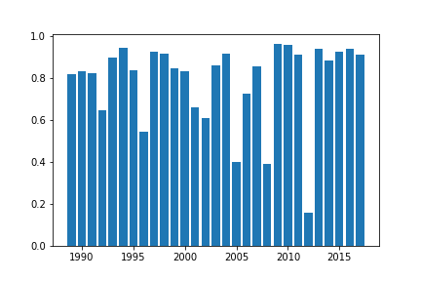
Date vs Instrumentalness

Slide 15
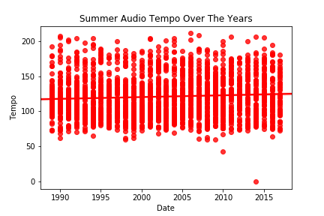
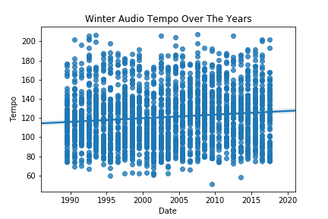
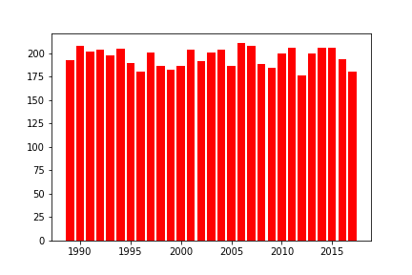
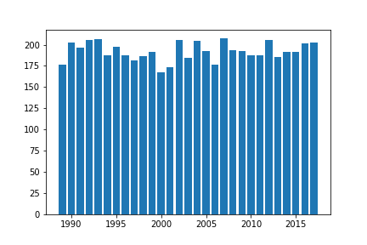
Date vs Tempo

Slide 16
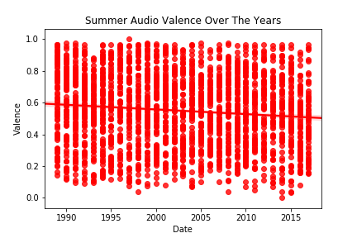
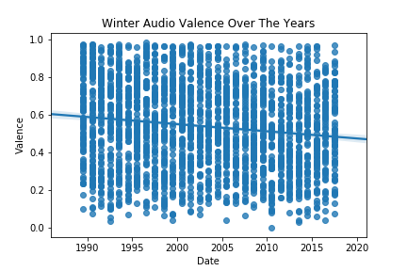
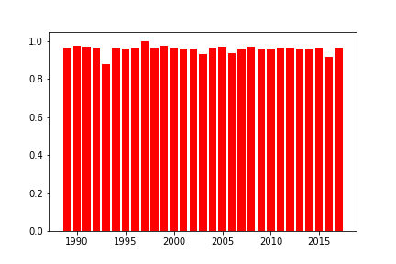
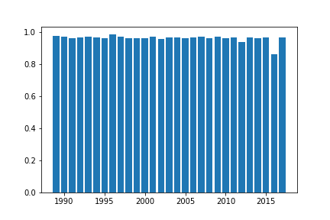
Date vs Valence

Slide 17
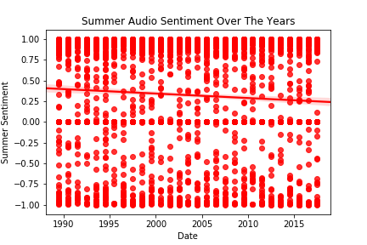
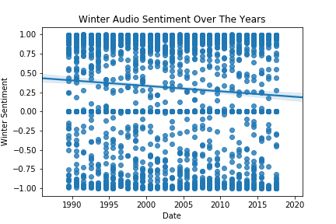
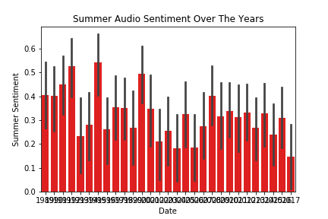
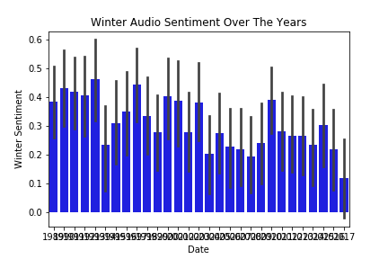
Sentiment over Time

Slide 18
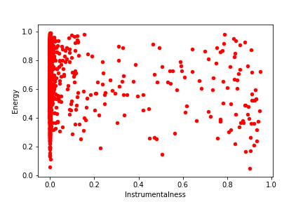
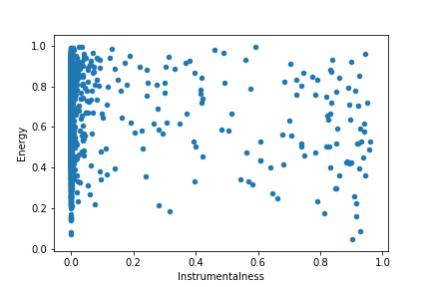
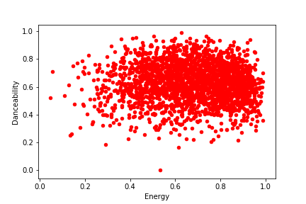
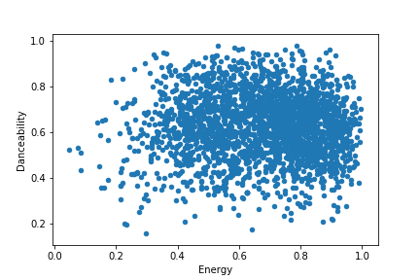
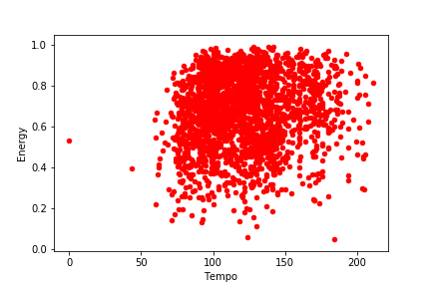
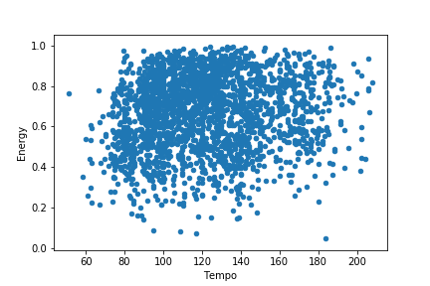
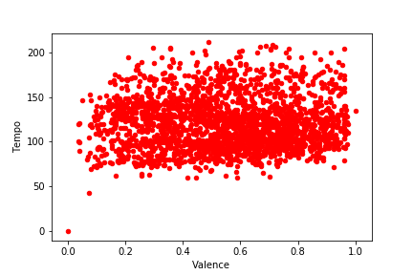
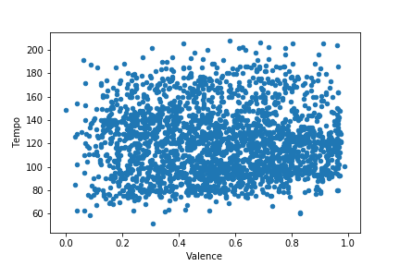
Other Graphs of Note
Summer = Red
Winter = Blue

Slide 19
Conclusion
Limitations: Not all lyrics were found, Music trends in popular music and pop culture
A slight decrease in danceability and valence over the years, for both seasons
A slight increase in energy and tempo over the years, for both seasons
Globally, sentiment of music has become less positive over time
For: tempo and energy, and danceability and energy of music increases during the summer as compared to winter music listening habits

Slide 20
Discussion/Questions

Slide 21
Thanks! :)

