Slide 1
AI developments and M&M
6 February
Notes:
Graham and I have been discussing over the Autumn to continue in some form where we finished last spring. I started around Christmas to generate some ideas and today I’m showing you what I think is a strong concept.

Slide 2
Agenda
Capabilities with agentic developments
Goals/vision
Basic facility example
Demo of Pan-EU vision
Overview of Data & Method
Data-driven development has fundamentally changed:
Execution capacity is 10x at least
2-hour task takes 5 min etc..
Bottleneck has moved to:
Management, data access, reviewing and validation
Are we developing the right things?
Ambition calibration
Notes:
Here's the agenda for today,
The first message of today is that this type of data-driven work has changed; Since the end of last year, with the latest updates in AI assistants. The execution capacity has increased by 10x atleast, which means we can suddenly do a lot more in a lot less time.
The bottleneck for this type of work has moved from execution, to management, data access, reviewing and validation. Now, no tool is without it's flaws and if you’re constantly executing at 10x and reviewing at 1x then you’re gonna be building things faster than you have time to review and validate. The right balance is a knife’s edge to be the most effective. I don’t think anyone has an answer to this issue yet...
But most importantly, with this new capacity we should I think, be calibrating the ambition to be building the RIGHT things. Because of course if execution time is not a worry then a major part of the costs of the work has been removed, which I think opens a lot of doors.
Keep in mind during this presentation that the work I’m gonna show you was started around Christmas, and for the first few weeks was done when my son was napping, or in the evenings. The last few weeks up to 20 hrs/week, and still I’ve managed to do more work than I’d be able to do in months previously. Some of this time has been spent exploring, testing different ideas, some of which Graham has skimmed through already. This last version has taken shape during the last 2-3 weeks.

Slide 3
Pan-EU vision
All recorded Europe industrial facilities goes through an analysis, where we can quantify recovery potential based on:
Waste characteristics
Waste quantity
Recovery maturity
Type of process waste per facility.
Including characteristics and properties.
-> We want to know what’s being generated and where.
Amount of generated process waste per facility and region.
Regional hotspots of waste types.
-> We want to know how much of it there is.
Share of generated waste being reported as waste.
Likelihood of weak regional recovery pathways.
-> We want to know if regional actors can recover the waste.
Notes:
You probably know what the vision is but just to state it formally. The visions is very similar to what we've already discussed.
------
There are more items on the wish list of this vision but this already gets us quite a long way.
I think today I’ve managed to tick most of these points, and what I’ll show you is a demo with a logical structure in place, but where the results are not accurate or verified. So there's work still to be done... but with the new execution capacity, it’s mostly a matter of planning, data access and computation.
Basically we want to find facilities/regions with high amounts of generated process waste and high amount reported waste (preferably disposed waste), which means that they can’t internally or externally recover the waste.

Slide 4
Example: SSAB Luleå
What process tech?
Process waste generation?
Reported waste?
Classify process based on E-PRTR reported emissions.
Specifies generated process wastes (BOF slag, EAF slag, dusts etc.)
-> SSAB Luleå is BF-BOF (as of now)
Estimate using process I/O data from BAT reference documents.
Min-max mass-balance of generated waste
-> Generates 700k-1,1M tonnes/year process waste
Allocate Eurostat national * NACE waste statistics to facilities.
Generated waste/Reported wate = Recovery maturity
-> Reports ∼70-100k tonnes waste = high recovery maturity!
Notes:
Let's do a very brief example of a method from this vision, The numbers I’ve taken from SSAB environmental reports for now:
----
This last box require some assumptions which should be analysed if we’re to trust them absolutely but the logic is that:
- A country reports national waste to Eurostat largely based on the environmental reports or surveys of companies.
A country with high amounts of reported waste relative to it’s total generation, likely has poor recovery pathways, since many ‘wastes’ get reclassified as by-products if recovery pathways exist.
Example is that SSAB Luleå generates 700 ktons of residues, whereas Sweden’s nace sectors C24_C25 only have a reported 1,1 Mt of reported total waste! So low amount of reported waste compared to generated waste -> high recovery maturity.
(The real statement is, how large fraction of the reported national * Nace waste can be allocated to SSAB Luleå)

Slide 5
Method Pipeline
Process Technology Classification
Process Waste Estimation
Allocation of Reported National * NACE Waste
Geospatial Clustering of Recovery Sources
Process Technology Classification
Process Waste Estimation per Facility
Recovery Maturity Indicator
Geospatial Clustering of Recovery Sources
Allocation of National * NACE Waste to Facilities
Notes:
As a flow diagram it looks like this: First we classify and estimate, then allocate. Calculate recovery maturity indicator, Put all this in a clustering algorithm and find interesting regions for recovery streams for Ragn-sells.

Slide 6
Demo of Method Components
All results are preliminary and haven’t been verified to be accurate.
Think of this demo as very basic and only to visualise the concept of the current method.
Process technology classification
Emissions-based
Process waste estimation per facility
Supervised/rules-based with process I/O data
Possible allocation methods
Emissions basis (E-PRTR data)
Gross-value added basis (Economic data)
Regional SBS basis (Eurostat business stats)
Geospatial clustering of recovery markets
Group facilities based on similarities in regions/industries/wastes
Which regions/industries/wastes are interesting from Ragn-sells perspective?
Notes:
Now this is a data application and since the numbers are not accurate yet, it provides no value for now, but once we calibrate it we have a record of all European industrial wastes, including showing the areas we’re recovery maturity is lacking.
More data and functionality can be added on to this.
- Oxide composition etc. and do queries in a subgroup based on CaO etc.
- Queries of:
- Specfic waste types (low recovery maturity of BOF slag).
- CaO amounts in a subgroup
- Overlay logistical networks
Since results are not accurate now, I need to first correct data quality issues (missing data leading to overestimation etc.), then with optimising and validation we should be able to get close enough where this can be trusted and utilised.

Slide 7
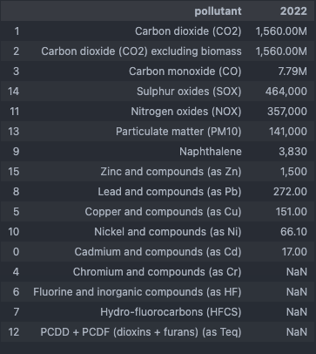
Data Overview
E-PRTR data (Keystone data - emission fingerprints)
1: Classify process technology
2: Estimate process waste generation
3: Allocating reported national × NACE waste to facilities
Fig 1. Reported Air emissions of SSAB Luleå
-> BF + BOF tech

Slide 8
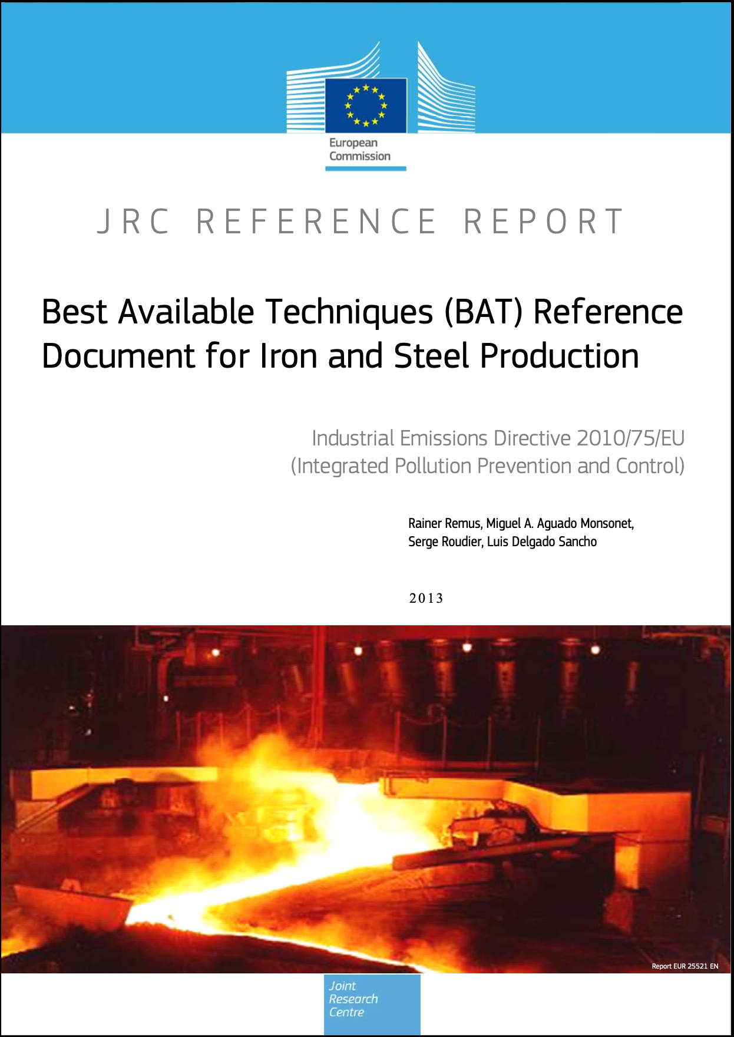
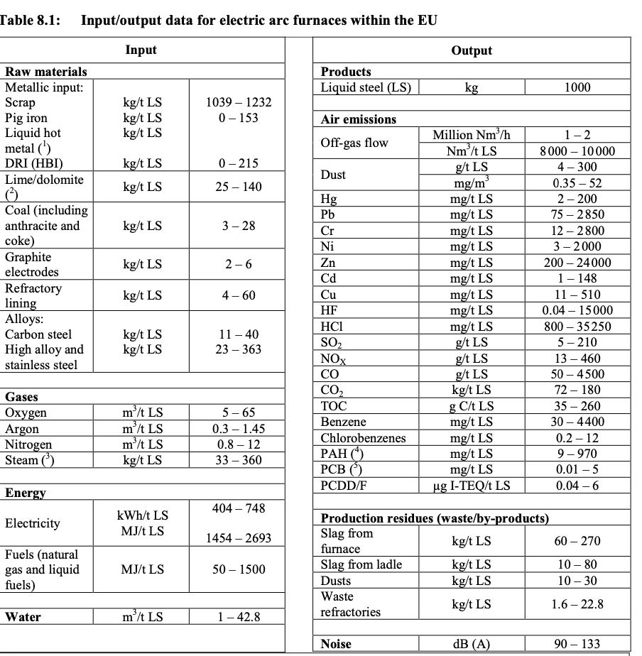
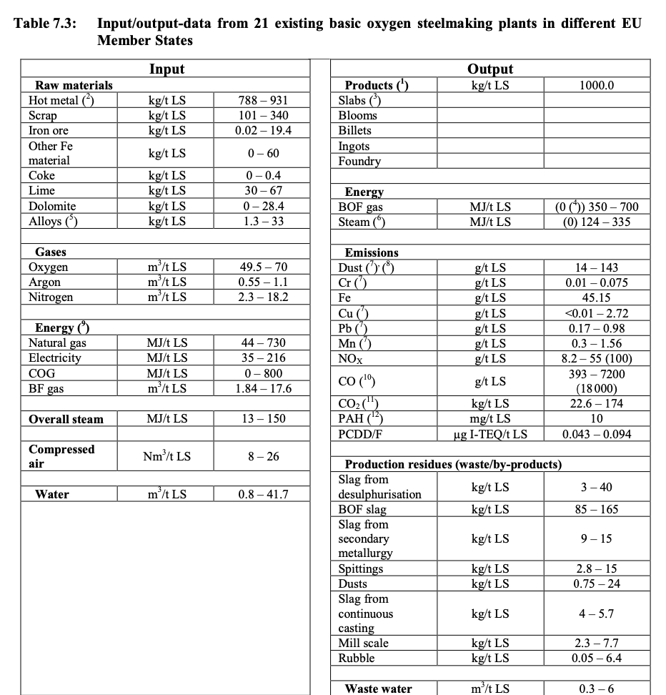
Data Overview
BAT reference documents
Gives I/O tables of processes.
t CO₂/t LS,
t Slag/t LS
→ Compute: t Slag/t CO₂
30 different BAT categories exist
All of them don’t include I/O process tables
Not perfect, wide ranges of parameters.

Slide 9
Data Overview
Eurostat national × NACE waste statistics
The share of generated wastes that get reported as waste.

Slide 10
Discussion
Other datasets exist, and can be used if we meet obstacles e.g need to infer recovery maturity, validation etc.
GEM tracker (All steelmaking plants in Europe)
Next steps...
Notes:
Concept and potential feels strong, there’s many issues still to be resolved but with todays execution capacity with agentic AI, the issue is mostly getting the right data and coercing it well enough. Getting this to a working level feels like it is within reach even with a relatively small budget, and the potential outcome/payback is large.
I’ve sent a bunch of other datasets for Graham to take a look at, that could be interesting as well, but this is a packaged concept that feels strong.
Other datasets :
- GEM tracker for all steelmaking plants in Europe (validation data for the classifier)
Lots of regional off-site hazardous waste transfers to Recovery would indicate there are competent regional actors handling waste (E-PRTR off-site waste transfers).
Discrepency between generated process wastes and off-site waste transfer (Any moderately environmentally ambitious facility would be reporting a certain amount of waste to R/D)
Waste recovery capacity in adjacent regions (was_fac) (Eurostat)
Waste treatment of certain waste codes ina country (was_trt)
Trade in recyclable raw materials (env_trdrrm)
MFA (Domestic material inputs/reported waste etc.)

Slide 11
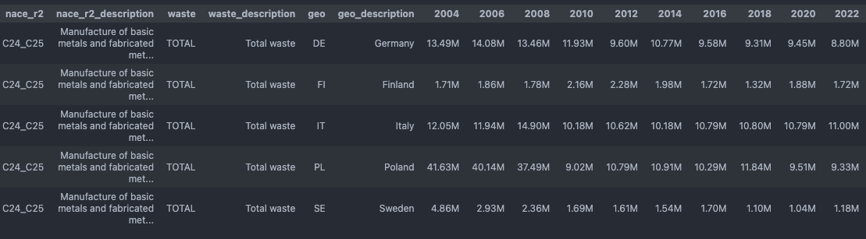
Reported waste comparison
Notes:
A country with stagnant waste trends, might still be recovering waste at a similar pace, but it seems likely that such recovery is probably a lower form of recovery. If it’s a higher form of recovery, that recovery would have a higher economic impact and the “waste” would stop being considered waste, and more likely to be considered a SRM that provides value. (NEEDS more investigation).

