Slide 1
RAG
Week 8 Lab

Slide 2
Vector database

Slide 3
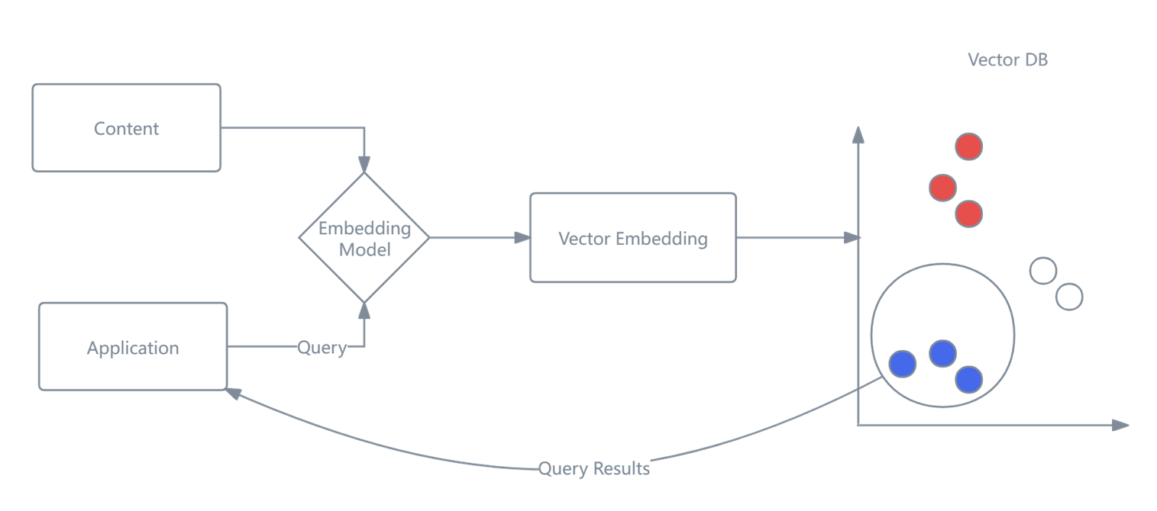
Role of Vector Databases
🧠 What are vectors (embeddings)?
When you convert data into a vector, you turn it into a list of numbers that captures its meaning. For example:
“cat” → [0.12, -0.98, 0.44, ...]
“dog” → [0.10, -0.95, 0.40, ...]
Similar items have similar vectors (they’re close in space).
Notes:
A vector database is a specialized database designed to store and search vector embeddings—universal representations of data like text, images, audio, or videos.
Instead of exact matches (like SQL), vector databases perform similarity search:
Find items closest to a given vector Use metrics like: Cosine similarity Dot product
The following figure illustrates the general workflow of using a vector database. First, the query content is encoded into a vector embedding using an embedding model. Then, similarity metrics such as cosine similarity or dot product are applied to search the vector database for the most relevant results.

Slide 4

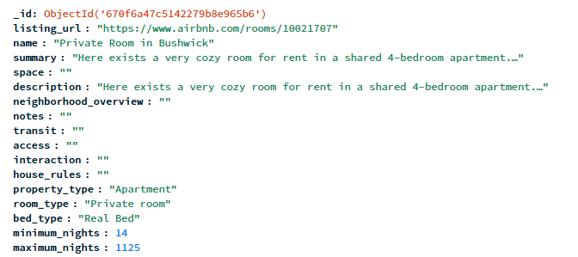
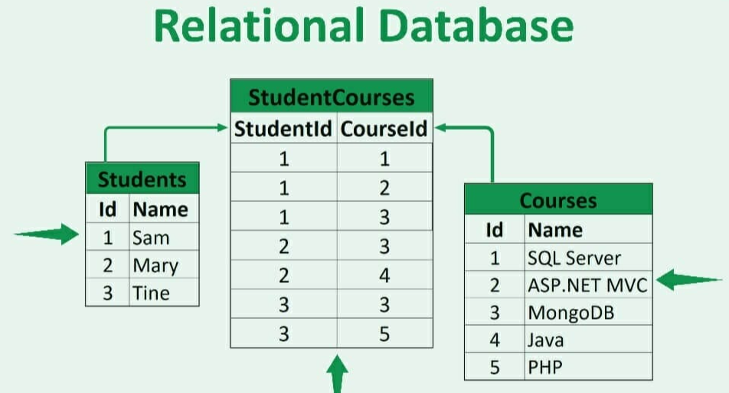
Mongo DB
MongoDB is a popular open-source NoSQL database designed for modern applications that require scalability, flexibility, and high performance.
Unlike traditional relational databases, MongoDB stores data in a document-oriented format, using BSON (Binary JSON) to represent data structures.

Slide 5
Open 08_Vector_database_setup.pdf to set up vector database
Open 08_RAGwithMongoDB.ipynb in Colab to RAG with mongoDB

