Slide 1
Architecture Upgrade
27 March 2026
Tales⁹ - the Smart Bar Table SDK

Slide 2
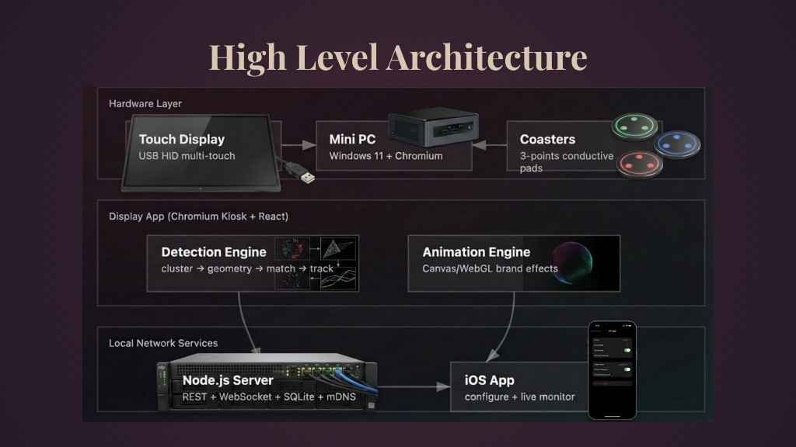
The Original Design
Three separate components communicating across the network

Slide 3
The Problem
Complexity
Three moving parts: Windows PC, Node.js server, Chromium browser
Fragility
Boot times, Windows updates, driver conflicts, process coordination
Commercial Reality
Bar staff need plug-and-play reliability, not a desktop computer

Slide 4
The Insight
What if the display is the computer?

Slide 5
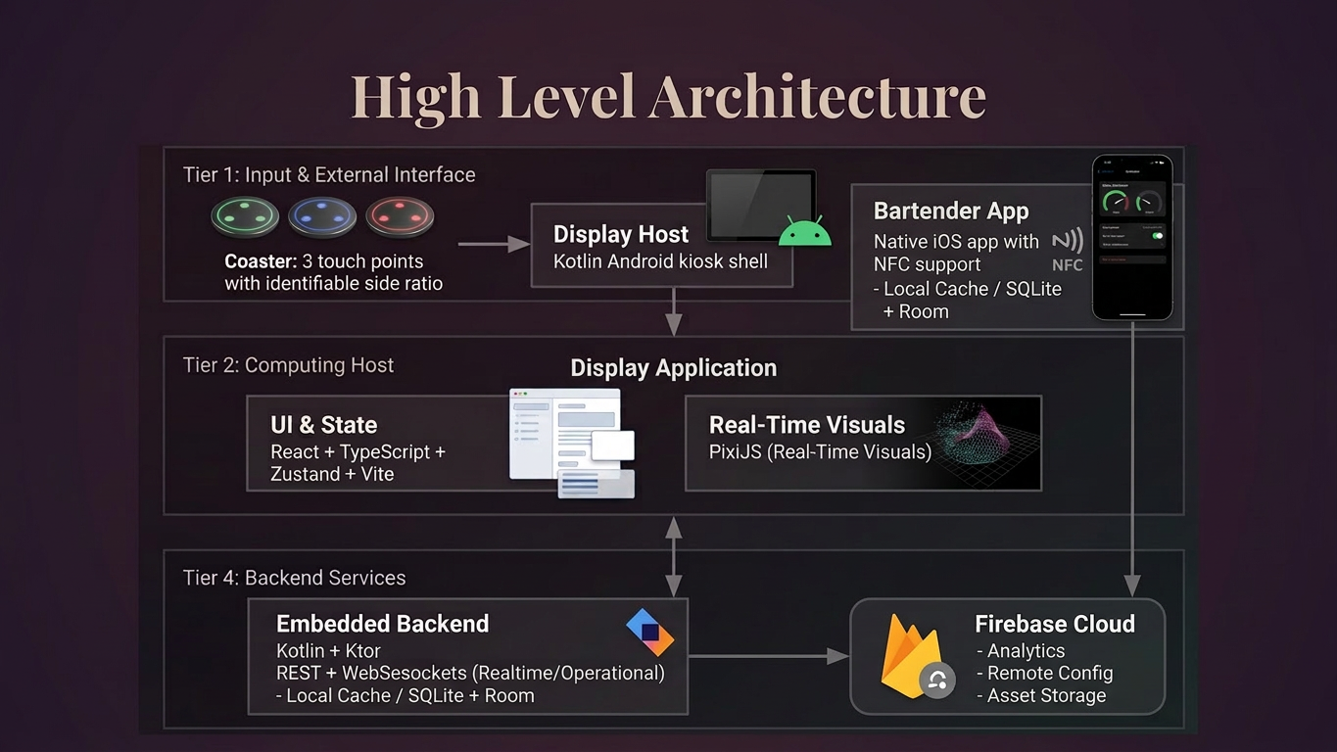
The New Architecture
Single device, embedded runtime, unified process

Slide 6
Before & After
Component | Original | Proposed
Hardware | Windows Mini PC + Monitor | Android Tablet (single device)
Display Shell | Chromium Kiosk (external) | WebView (embedded)
Backend | Node.js Server (separate) | Ktor (same process)
Rendering | React + Canvas | React + PixiJS

Slide 7
Display Layer — Stack Choices
Component | Choice | Why
Host Shell | Kotlin Android | Native kiosk mode, single APK deployment, direct hardware access
UI Framework | React + TypeScript | Preserve existing components, compile-time type safety
Rendering | PixiJS | WebGL-accelerated 60fps with 8 coasters active (Canvas2D choked at 4)
State | Zustand | Lightweight, no boilerplate, perfect for transient coaster positions
Build | Vite | 50ms hot reload vs Webpack's 3s — iteration speed matters

Slide 8
Backend Layer — Stack Choices
Component | Choice | Why
Server | Ktor | Same language as shell (Kotlin), coroutines for concurrency, runs embedded
Database | SQLite + Room | Compile-time query validation, battle-tested embedded DB, offline-capable
Real-time | WebSockets | Coaster placement → visual feedback <50ms (polling can't hit that)
Config API | REST | iOS bartender app uses request-response for menu/settings
iOS App | Native Swift | NFC coaster pairing requires Core NFC, mDNS for auto-discovery

Slide 9
How It All Connects
┌─────────────────────────────────────────────────────────┐
│ ANDROID TABLET (Single Device) │
│ │
│ ┌────────────────────────────────────────────────────┐ │
│ │ KOTLIN SHELL (Main Process) │ │
│ │ │ │
│ │ ┌─────────────┐ ┌─────────────────────┐ │ │
│ │ │ Ktor │◄────►│ Room + SQLite │ │ │
│ │ │ Server │ │ (Menu, Orders, │ │ │
│ │ │ :8080 │ │ Sessions) │ │ │
│ │ └──────┬──────┘ └─────────────────────┘ │ │
│ │ │ WebSocket + REST │ │
│ │ ┌──────▼──────────────────────────────────┐ │ │
│ │ │ WEBVIEW (localhost:8080) │ │ │
│ │ │ ┌────────────────────────────────────┐ │ │ │
│ │ │ │ React + Zustand + TypeScript │ │ │ │
│ │ │ │ ┌────────────────────────────┐ │ │ │ │
│ │ │ │ │ PixiJS Rendering Layer │ │ │ │ │
│ │ │ │ │ • Coaster sprites │ │ │ │ │
│ │ │ │ │ • Particle effects │ │ │ │ │
│ │ │ │ │ • Brand animations │ │ │ │ │
│ │ │ │ └────────────────────────────┘ │ │ │ │
│ │ │ └────────────────────────────────────┘ │ │ │
│ │ └─────────────────────────────────────────┘ │ │
│ └────────────────────────────────────────────────────┘ │
│ ▲ │
│ │ WiFi (REST + WebSocket) │
└──────────────────────────┼───────────────────────────────┘
│
┌──────▼──────┐
│ iOS App │
│ (Swift) │
│ • Config │
│ • Monitor │
│ • NFC pair │
└─────────────┘

Slide 10
Three Wins
1
Simpler Deployment
One APK, kiosk mode built-in, boots in seconds
2
Better Visuals
PixiJS gives us WebGL particle effects that would require custom shaders otherwise
3
Unified Runtime
Kotlin shell hosts everything: UI, server, database. No IPC, no process coordination

Slide 11
The Tradeoff
What We Lose
What We Gain
Desktop debugging convenience
A product that bar staff can power-cycle without calling IT

Slide 12
Technical Validation
"I've validated the touch detection algorithm works identically in browser.
The migration preserves all our core IP—the clustering geometry, the coaster tracking—while dramatically simplifying what we ship."

Slide 13
Questions?
Architecture Evolution: From Prototype to Production

