Slide 1

Pyctools
A picture processing algorithm development kit
Jim Easterbrook, ex BBC R&D

Slide 2
Some history – mid 1980s
Very limited RAM and disc capacity
Monolithic Fortran programs
Ran as batch jobs overnight – not enough RAM to run simultaneously
Used “Kingswood picture files”
Custom video stores for display, e.g. 50MByte in 6 foot tall 19 inch rack

Slide 3
Some history – late 1980s
More RAM, more disc and more power
Still centralised – tech memos refer to “the MicroVAX”
Started breaking programs down into smaller parts with intermediate files
Experimented with Transputers and Occam – discovered that parallelism is hard

Slide 4
Some history – early 1990s
UNIX arrived and we got multiple computers
Started using shell pipes to connect tools running in parallel
“pic-tools” name first appeared
“picsubs_tng” C library replaced Fortran library – started using Pascal and C as well as Fortran, also used Modula-2 and Ada later on

Slide 5
What's wrong with pic-tools?
Slow! Picture data piped from program to program, 4KBytes at a time
Using “makefile” or shell scripts to connect programs is not very user friendly
Simple pipelines easy, but anything more complex can easily deadlock
Very, very non-standard and non-portable
A mess of different programming languages & dialects

Slide 6
What's right with pic-tools?
Power and flexibility of connecting simple parts to make complex simulations
Simple parts are easy to define, test and reuse
“Audit trail” – every file includes metadata giving its life history
Pipelining programs gives easy parallelism

Slide 7
Shopping list for a pic-tools replacement
Exploit existing libraries – build on others' work
Use standard file formats
Easy to use, but powerful and flexible
Easy to extend, both “shared” and “private”
Need parallelism to benefit from multi-CPU, multi-core computers

Slide 8
Recent history
Multi-camera capture system used Python with existing C++ “vplibs”
Used Michael Sparks' Kamaelia to create networks of parallel components
Since retiring I thought I'd try writing a pic-tools replacement using this experience

Slide 9
Pyctools, pronounced pic-tools
Py because it's written in Python
Uses NumPy, OpenCV, SciPy, Python Imaging Library to process data
Uses gexiv2 to handle metadata
Uses ffmpeg to read & write video files
Open source – get it from GitHub:
https://github.com/jim-easterbrook/pyctools

Slide 10
Pyctools uses “components”
Based on Michael Sparks' Kamaelia replacement Guild
Components have named input(s) and output(s)
Unit of work is a single frame
Connect components to make a pipeline or network
Make any configuration adjustments
Press “go” and wait for last components to finish

Slide 11
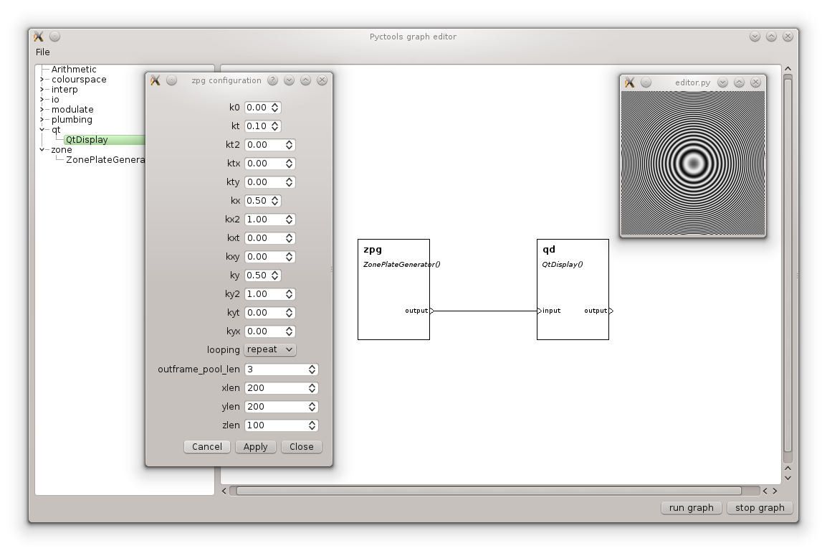
Pyctools has a GUI!

Slide 12
Pyctools GUI is easy to use
All components installed on the computer are available
Connect components by click & drag
Configure components with simple dialogs
Press “run graph” to run it
Network can be saved as a runnable program
Demonstration!

Slide 13
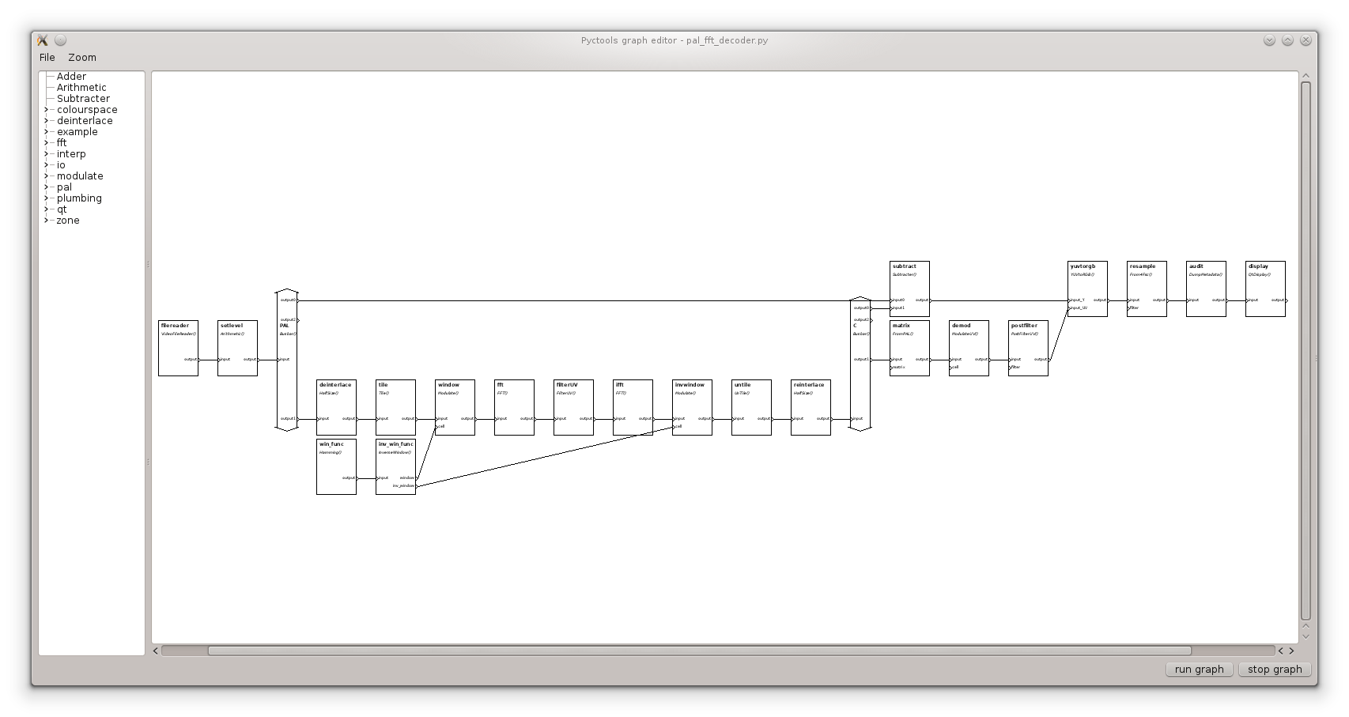
Networks can get complicated

Slide 14
But isn't Python slow?
Python is mostly used for “plumbing”
Hard work is done in libraries (e.g. NumPy) written in C/C++
Where no library function is suitable can use Cython – looks like Python but up to 1000x faster
Write Python first, then gradually convert to Cython

Slide 15
Parallelism
All components are running in one Python interpreter
Python is infamously non-parallel – “Global Interpreter Lock” (GIL)
Components run in Python threads, but only one thread runs at a time in the Python interpreter
C/C++/Cython functions can surrender GIL to allow other threads to run while number crunching continues
C/C++/Cython can also use OpenMP

Slide 16
Load balancing
Need to stop any component getting too far ahead
Original pic-tools used limited capacity pipes
Each Pyctool component has a finite “pool” of output frames – cannot generate a new output frame until the consuming component releases an earlier one
  Uses Python “weakref” to notify pool when frame is released (i.e. deleted)

Slide 17
Components are event driven
“Events” include:
  An input frame arriving
  An output frame being available from the “pool”
  The configuration changing
Choice of event loops:
  Normal Python thread
  Qt event loop – allows component to send Qt signals

Slide 18
Input / Output
Headerless “raw” files – use separate metadata file to store dimensions and format (UYVY, YUYV, YV12, RGB, BGR, etc.)
Other formats – use ffmpeg to read and write
  8-bit or 16-bit data – ffmpeg does its own conversion
  Lossless(?) formats FFV1 or H264 with qp=0
  Can use any encoder options that ffmpeg will accept
Always create separate metadata file for audit trail

Slide 19
Extending Pyctools
Core – fork on GitHub, submit pull request
Components – separate projects add to existing hierarchy, thanks to “namespace packages”
Can be published (GPL) or private, including partners under NDA

Slide 20
Demonstrations
Temporal aliasing
De-interlacing
PAL decoding (time permitting)

