Slide 1
Data 601 @ UMBC Class 2: Python
Data 601
September 6, 2018
These notes are CC BY 4.0
Notes:
See also https://web.stanford.edu/class/stats101/intro/intro-lecture01.pdf for inspiration
Useful: https://arxiv.org/pdf/1503.05570.pdf
A Data Science Course for Undergraduates: Thinking With Data by Ben Baumer, The American Statistician Vol. 69 , Issue. 4
Timing in Fall 2018:
Slide 35 at minute 45
Bowling demo started at minute 63
Finished in 2 hours, 25 minutes

Slide 2
From Week 1: Reading summarization
Find someone who was assigned the other article
Tell the other person one idea presented last week
Listen your partner's recollection from last week
Describe what you learned from reading the article
Ask what they learned reading their article
Activity: talk with a partner

Slide 3

Answer to anonymous question
How will tests be structured?
Rubric is subject to change
aspect | deficient: 0 points | points for sufficient | description of sufficient
project proposal submitted on time | missed deadline | 1 | submitted prior to deadline
project proposal submitted using Blackboard | submitted via email or paper | 1 | submitted using Blackboard
project proposal explained plan for proposal | lacks detail | 1 | clear plan
project proposal includes alternative plan | no alternative provided | 1 | alternative plan provided
project proposal relevant to Data 601 objectives | complexity below objective or out of scope for 601 | 1 | appropriate complexity and within scope
data gathered from documented source | no source cited | 1 | explanation of where data came from
data quantity is appropriate | too little data (manual analysis is feasible) or excessive data based on compute resource | 1 | more than manual analysis, and fits on your compute device
data gathered in a manner compliant with source constraints | violates source's policy regarding access | 1 | explanation of why gathering is acceptable
data inconsistences are documented | no explanation of issues | 1 | problems in data are identified
data cleaned (using Python) if necessary | data has inconsistencies not corrected using Python | 1 | data has no inconsistencies resolvable in Python
documentation on what cleaning was performed | no explanation of cleaning process | 1 | justification for changes to data is provided
analysis of cleaned data for characteristics | no characterization of data is performed | 1 | relevant aspects of data set are enumerated
analysis includes at least one visualization | no visualizations present | 1 | at least one visualization used
visualization uses appropriate plot types | inappropriate plot type | 1 | valid use of histogram or scatter plot
visualization has labeled axes and caption | missing caption or axis label | 1 | descriptive captions and labels used
axis label for visualization includes units if appropriate | axis label lacks units | 1 | units, where appropriate, are present
visualization is intuitive to understand and not misleading | naive reading of plot yeilds incorrect conclusion | 1 | purpose of the visualization is clear to reader
code used for getting data, cleaning, analysis, and visualization is concise | dead code is present | 1 | only relevant code is provided
story of patterns observed | no explanation regarding correlations | 1 | correlations are explained
pattern predictions are made | no predictions made | 1 | reasonable and testable predictions are explained
test of predictions is made | predictions are left untested | 1 | test of predictions are provided
explain what you learned doing this project | no lessons learned are documented | 1 | knowledge gained is documented

Slide 4
aspect | deficient: 0 points | points for sufficient | description of sufficient
project proposal submitted on time | missed deadline | 1 | submitted prior to deadline
project proposal submitted using Blackboard | submitted via email or paper | 1 | submitted using Blackboard
project proposal explained plan for proposal | lacks detail | 1 | clear plan
project proposal includes alternative plan | no alternative provided | 1 | alternative plan provided
project proposal relevant to Data 601 objectives | complexity below objective or out of scope for 601 | 1 | appropriate complexity and within scope
data gathered from documented source | no source cited | 1 | explanation of where data came from
data quantity is appropriate | too little data (manual analysis is feasible) or excessive data based on compute resource | 1 | more than manual analysis, and fits on your compute device
data gathered in a manner compliant with source constraints | violates source's policy regarding access | 1 | explanation of why gathering is acceptable
data inconsistences are documented | no explanation of issues | 1 | problems in data are identified
data cleaned (using Python) if necessary | data has inconsistencies not corrected using Python | 1 | data has no inconsistencies resolvable in Python
documentation on what cleaning was performed | no explanation of cleaning process | 1 | justification for changes to data is provided
analysis of cleaned data for characteristics | no characterization of data is performed | 1 | relevant aspects of data set are enumerated
analysis includes at least one visualization | no visualizations present | 1 | at least one visualization used
visualization uses appropriate plot types | inappropriate plot type | 1 | valid use of histogram or scatter plot
visualization has labeled axes and caption | missing caption or axis label | 1 | descriptive captions and labels used
axis label for visualization includes units if appropriate | axis label lacks units | 1 | units, where appropriate, are present
visualization is intuitive to understand and not misleading | naive reading of plot yeilds incorrect conclusion | 1 | purpose of the visualization is clear to reader
code used for getting data, cleaning, analysis, and visualization is concise | dead code is present | 1 | only relevant code is provided
story of patterns observed | no explanation regarding correlations | 1 | correlations are explained
pattern predictions are made | no predictions made | 1 | reasonable and testable predictions are explained
test of predictions is made | predictions are left untested | 1 | test of predictions are provided
explain what you learned doing this project | no lessons learned are documented | 1 | knowledge gained is documented
Rubric is subject to change

Slide 5

Course schedule and outline (scope)
Aug 30: Overview Data Science
Sept 6: Python in Jupyter
Sept 13: Math (stats)
Sept 20: Regression
Sept 27: Clustering
Oct 4: Evaluation, cross-validation, overfitting
Oct 11: Substitute's choice
Oct 18: Getting data
Oct 25: Automation
Nov 1: Data cleanup
Nov 8: Scaling up
Nov 15: Property graphs
Nov 22: No class (Thanksgiving)
Nov 29: Elasticity, Cost/benefit
Dec 6: Ethics and Legality
Dec 13: Presentations

Slide 6
Outcomes for this evening
By the end of today's class, you should be able to do the following:
Describe examples of data structures like Scalars, Lists, Sets, Dictionaries
Explain the difference between vectorized and elementwise operations
Create and call functions in Python
Load data into Pandas and create a scatter plot
Decompose a complex function into multiple simpler functions
Demonstrate use of piped functions in bash
Lots of words, so we will need definitions

Slide 7
Python and Jupyter in Docker
For using the Python interpreter in class, I'm going to assume users have access to Python from their desktop environment. While the Python interpreter can be hosted in Docker, I won't be talking about that in class.
One reason use of Docker gets complicated is file access. If you're just using the REPL, a Docker container is easy to use. Using .py scripts get messy, as does working with input files and output files. Docker is useful for isolation, but that same isolation can cause more work.
Independently from that, the Jupyter web interface can be hosted either by the Operating System or in a Docker image. Again, I'll be working with the assumption students are using Jupyter directly rather than in a Docker image. Same problem can arise with file input and output.

Slide 8
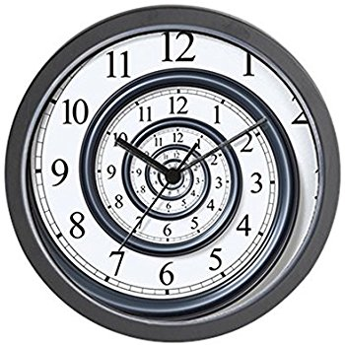
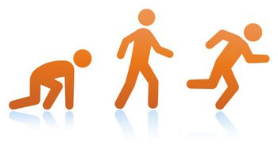
I won't be able to teach you all of Python
Notes:
http://www.padtinc.com/blog/the-focus/a-guide-to-crawling-walking-and-running-with-ansys-structural-analysis

Slide 9
Resources for learning Python
Online
Text – blue underscored text is hyperlinked in this presentation
https://nealcaren.github.io/python-tutorials/
Videos on Coursera
Books: see PDFs posted on Blackboard
Your instructor
Caveat: I'm not a programmer.
https://brohrer.github.io/imposter_syndrome.html
Linked from https://www.kdnuggets.com/2017/09/data-science-imposter-syndrome.html

Slide 10

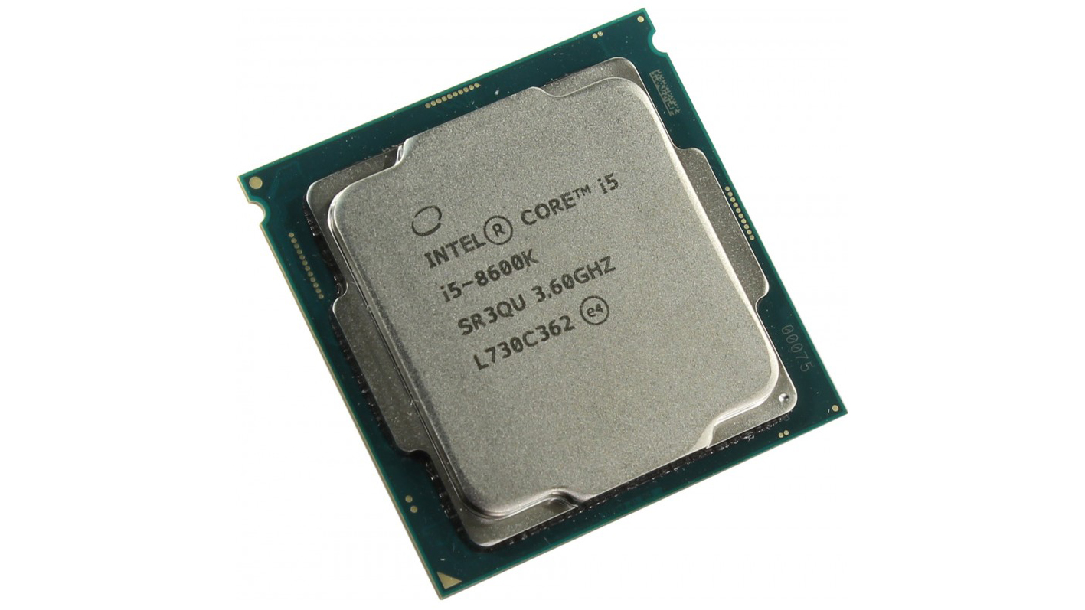
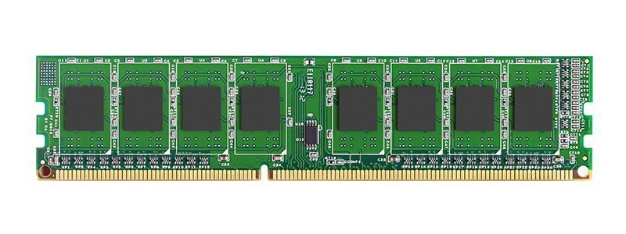
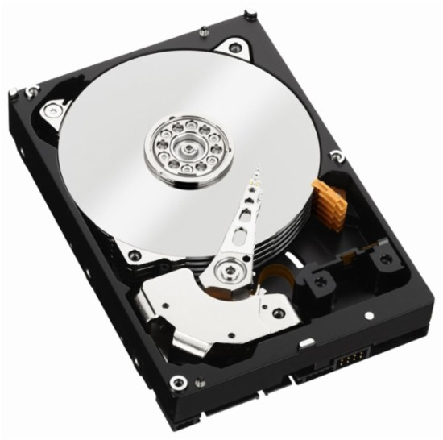
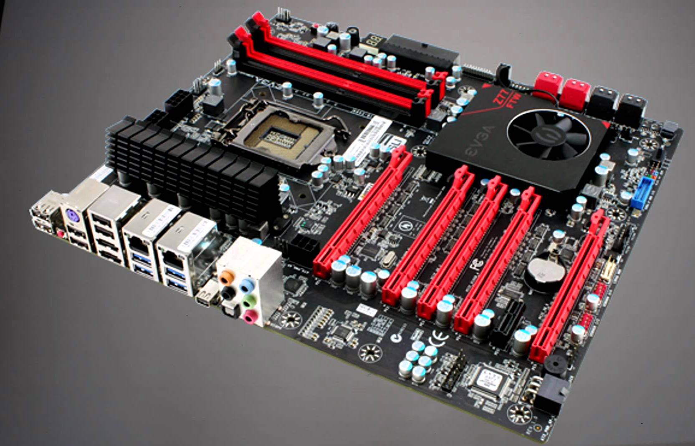
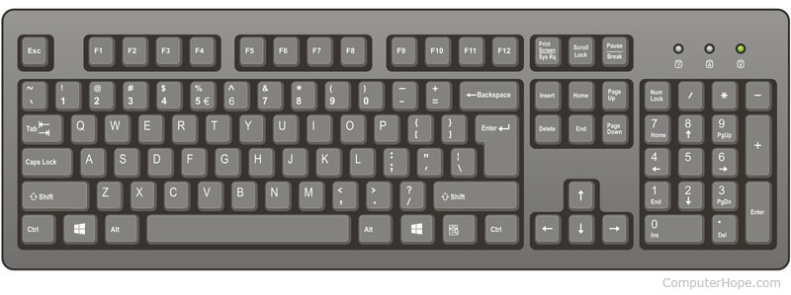
Software runs on hardware

Slide 11
Hardware is fundamental to computing
Hardware gets faster and cheaper due to market competition
Constrained by Physics and by being tangible objects
Rate of change bounded by money and logistics
Software = recipe of instructions
Instructions executed on hardware; hardware is the constraint
Software evolution is fast

Slide 12
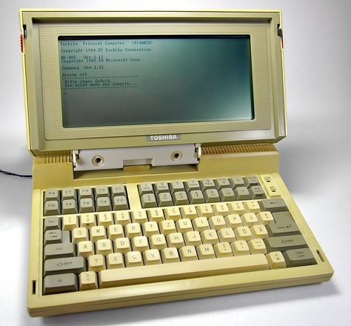
Minimum hardware for Data 601?
Any computer that supports Jupyter with Python 3 kernel

Slide 13

Quiz on Default environments
What software for programming is available on a default installation of Windows?
Notes:
https://alt-london.com/2017/04/27/quiz-time/

Slide 14
Programming tools on a default installation of Windows
Command prompt
Powershell
VBS
C# (ref1, ref2)

Slide 15
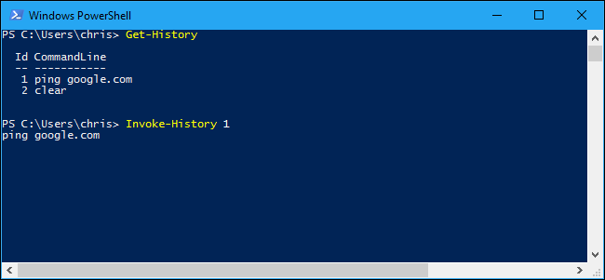
Using your computer's terminal
Interact with your computer via text and typing
Linux and Mac OS X
Windows command prompt
See also PowerShell
Demo: show both
Notes:
https://www.howtogeek.com/298244/how-to-use-your-command-history-in-windows-powershell/

Slide 16
Shown in bash
pwd
ls
echo "hello"
echo "hello, ben, another" | cut -d',' -f2
man cut
echo -e "1\n3\n2" | sort
cd umbc/fall2018/jupyter_notebooks/week1_data_formats
cat sample.csv
cat sample.csv | cut -d',' -f2 | sort
cat sample.csv | cut -d',' -f3 | sort
cat sample.csv | cut -d',' -f3 | sort | uniq
cat sample.csv | cut -d',' -f3 | sort | uniq -c

Slide 17
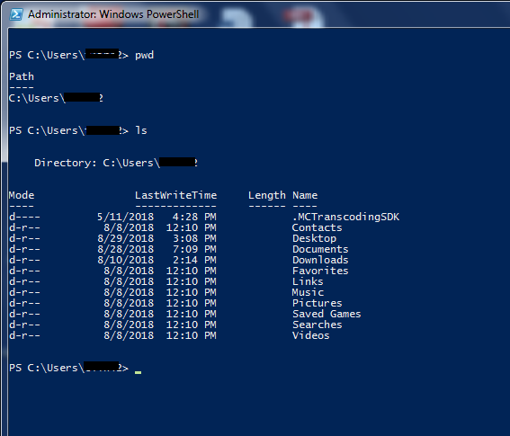
Shown in Powershell: cd, ls

Slide 18
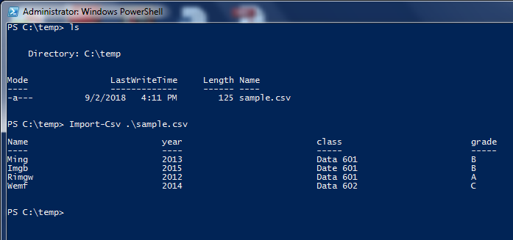
Shown in Powershell: CSV

Slide 19
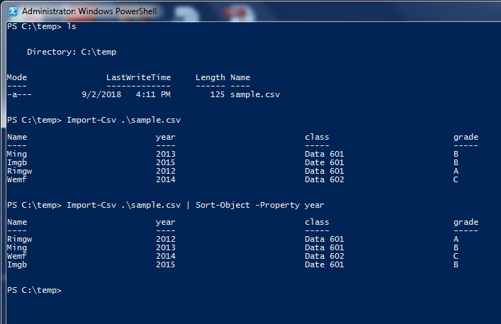
Shown in Powershell: sort column

Slide 20
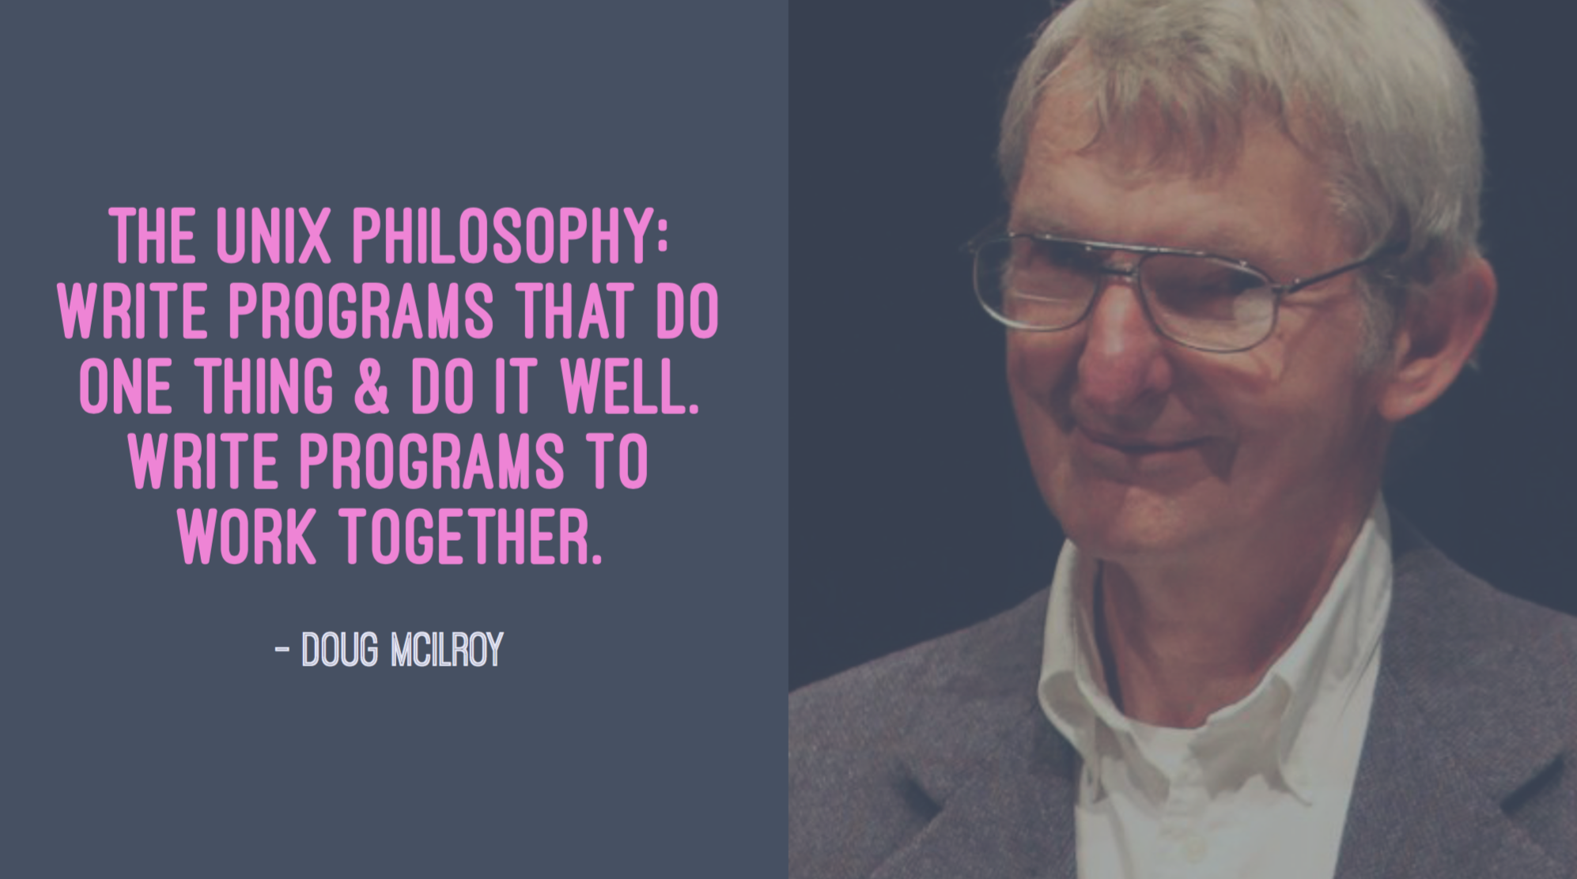
Unix Philosophy
Notes:
http://jonasboner.com/bla-bla-microservices-bla-bla/

Slide 21
Running bash commands online
https://www.tutorialspoint.com/execute_bash_online.php
https://repl.it/
If you have 64bit Windows 10, see Windows Subsystem for Linux

Slide 22
Survey of "standard" software for Data Science
(not comprehensive)
Hive
MapReduce
Pig
JavaScript
Java
Orange
Rapid Miner
SAS
Enterprise Miner
JMP
Online services, ie from Azure, AWS, Google Compute
Matlab
Python
R
Tensor Flow
Jupyter
Julia
Spark
SQL
Excel
PowerBI and other plugins
Tableau

Slide 23

Psychological consequences of diversity
Intimidation (fear) due to knowing you don't know

Slide 24
Psychological consequences of diversity
Intimidation (fear) due to knowing you don't know
When interacting with other people, lack of overlap causes issues
Communication
How you think about the problem
What the challenges are (cost, latency, scale)
How to collaborate
--> Each of these is a negotiation with other humans

Slide 25

Simplify by focusing on just Python
Since 1991
Python 3 is 10 years old!
Notes:
https://tinybuddha.com/blog/4-tiny-powerful-tips-reduce-stress-anxiety/

Slide 26
Survey of "standard" Python packages for Data Science
(not comprehensive)
Dask
Scikit-learn
Numpy
Scipy
Pandas
Matplotlib
Python Imaging Library (PIL)
NLTK
Beautifulsoup
Statsmodels
Seaborn
PyTorch
Keras
Theano
Gensim
Plotly
Bokeh
PySpark
Scrapy
Optional challenge: How many Python packages are there total?
Yes, this question is ill-defined. I'm happy to iterate with you after class

Slide 27
Jargon alert!
Script = a file with extension .py containing Python code.
Application, aka Analytic, aka program = recipe of instructions
Library = generic term for code that was designed with the aim of being usable by many applications.
Module = a file with extension .py containing function definitions which can be referenced by other scripts. Use import to load these functions.
Package = a collection of modules.
All packages are modules, but not all modules are packages.
Overloading terms is common.
If you are confused during the semester, raise your hand during class or see me after class or submit an anonymous question
Notes:
https://docs.python.org/3/tutorial/modules.html
https://stackoverflow.com/questions/19198166/whats-the-difference-between-a-module-and-a-library-in-python
https://knowpapa.com/modpaclib-py/
https://www.aceable.com/blog/traffic-lights/

Slide 28
Python package management
Two package managers: conda and pip
Conda is equivalent to pip+virtualenv in terms of capability.
Difference: conda is used for package management outside Python;
pip is only for Python
For this class I'll advocate for using the simplicity of conda
I use pip
Notes:
https://stackoverflow.com/questions/20994716/what-is-the-difference-between-pip-and-conda

Slide 29
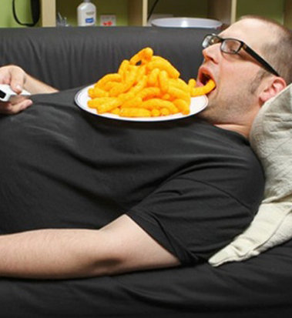
Virtues of a Data Scientist
Using libraries
enables laziness.
see http://blog.teamtreehouse.com/the-programmers-virtues
Notes:
https://www.infoworld.com/article/3122803/application-development/the-power-of-lazy-programming.html

Slide 30

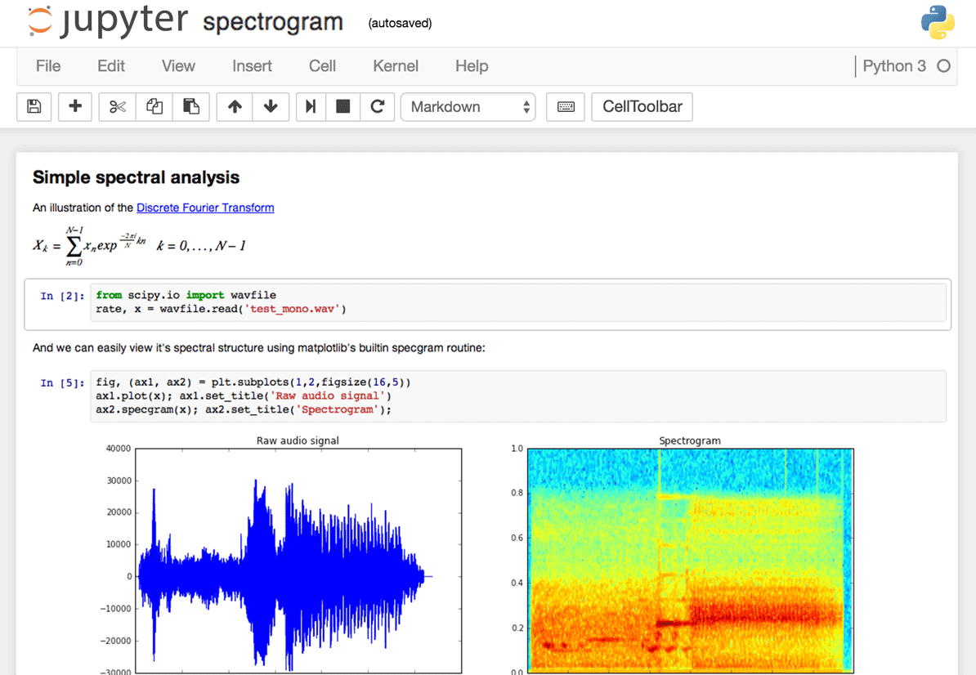
How to interact with Python
REPL: interactive command prompt
Scripts: files with .py extension
Text editors with syntax highlighting
IDEs like PyCharm with autocompletion
Jupyter Notebook (via web browser)

Slide 31
Python in your computer's terminal
REPL = Read–eval–print loop
(There are improvements: https://bpython-interpreter.org/ )
Demo: show Python3 REPL

Slide 32
Shown in Python3 Interpreter (REPL)
Returns expected results, ie 5, 5+4, x = 5+4, x == 9, x == 10, 'hello'
Lists: mylist = [4, 5, 6, 'hello', 5, 2]; mylist[0]; len(mylist); mylist[12]
mylist[0] = [3, 5, 9]
Dictionaries: mydict = {'four':'three'}; mydict['four']; mydict = {'k': 'v'}; mydict['four']; mydict[0]; len(mydict); mydict = {'this key': 'a value', 'another key': 'another value'};
mydict = {4:3, 5:4, 4:2}; mydict = { 'a': 5, 'b':[3,5]}
mydict = {[3, 4]:2, 4:3}; mydict = { 'a':{4:2, 'b':9}, 6: 3}

Slide 33
Programming exercise using the interpreter
On paper, write down a dictionary containing
when you ate today (the key)
what you ate today (the value)
Once completed, enter the dictionary in a Python3 REPL
Verify that you can select an entry by key
Measure the length of the dictionary
Activity: solo programming

Slide 34
Example dictionary
>>> mymeals={'breakfast':'apple', 'lunch':['beans', 'salmon'], 'dinner':['melon', 'salad', 'milk'}
File "<stdin>", line 1
mymeals={'breakfast':'apple', 'lunch':['beans', 'salmon'], 'dinner':['melon', 'salad', 'milk'}
^
SyntaxError: invalid syntax
>>> mymeals={'breakfast':'apple', 'lunch':['beans', 'salmon'], 'dinner':['melon', 'salad', 'milk']}
>>> mymeals['lunch']
['beans', 'salmon']

Slide 35
Generic Computing Language Essentials
Variable assignment
Control statements (if, else)
Loops (while, for)
Sets, tuples
Functions
Reading:
Beginner: Data Wrangling with Python, chapter 2, pages 17 to 40
Learning Python – everything
Advanced: Python Cookbook
PDFs are posted to Blackboard

Slide 36
Python functions bundle code
def myfunc(input):
# transform input to value
return value
If a line of code is a sentence,
then a function is a paragraph
Demo: show Python3 REPL

Slide 37
Shown in Python3 Interpreter (REPL)
a = 5
def my_func(input)
a = 6
print(a)
return
my_func('hello')
print(a)

Slide 38
Creating and editing .py scripts
On Windows, Notepad is available; Mac has textEdit
You will need to be able to view file extensions
There are many text editors and IDEs

Slide 39
Pair programming exercise
Find a partner who you have not yet collaborated with

Slide 40
Pair programming exercise
Find a partner who you have not yet collaborated with
Determine who is the less experienced programmer
The less experienced person creates a .py file that prints "hello"
Or, if both of you are not challenged by this,
create a .py file that prints all palindromic numbers with 7 digits (see this page)
Run the script using the Python interpreter

Slide 41
Idiosyncrasies of Python
Spaces – see style guide https://www.python.org/dev/peps/pep-0008/
--> 4 spaces per indentation level
no explicit type definitions in code (dynamic typing; types are resolved at runtime)
Python indexes from 0. This isn't consistent across languages.
Pro-tip: use a linter like pylint and flake8

Slide 42
Memorizing the nuances of a specific language
Exercise: use terms + definitions as flashcards
Source:
https://www.brainscape.com/packs/python-1786943
for more, see https://www.brainscape.com/subjects/python
see also https://quizlet.com/subject/python/
Activity: form pairs; split the cards in half;
terms + definitions matching; partner checks once done
Answers will be verified as a class

Slide 43
Quiz on Python data structures
Given a list,
my_list = ['a', 'b', 'c', 'd']
What would the command
len(my_list)
return?
Do not shout out the answer. We will vote.

Slide 44
Quiz on Python data structures
Given a list,
my_list = ['a', 'b', 'c', 'd']
What would the command
len(my_list)
return?
3: vote with blue card
4: vote with yellow card
NOT SURE: orange card

Slide 45
Quiz on Python data structures
Given a list,
my_list = ['a', 'b', 'c', 'd']
What would the command
len(my_list)
return?
1 2 3 4
3: vote with blue card
4: vote with yellow card
NOT SURE: orange card
Len = length of list

Slide 46
Quiz on Python data structures
Given a list,
my_list = ['a', 'b', 'c', 'd']
What would the command
my_list[1]
return?
a: vote with blue card
b: vote with yellow card
NOT SURE: orange card

Slide 47
Quiz on Python data structures
Given a list,
my_list = ['a', 'b', 'c', 'd']
What would the command
my_list[1]
return?
0 1 2 3
a: vote with blue card
b: vote with yellow card
NOT SURE: orange card
Python indexes from 0

Slide 48
Essentials of Python for Exploratory Data Analysis (EDA)
Covered so far:
Loading files, ie CSV, JSON, XML (see week 1)
Use of the REPL
Data structures like lists, dictionaries
Pro-tip: What variables exist in the interpreter's memory? dir()

Slide 49
Jupyter for more than just learning and small scale analysis
Analyze video to detect 60 million faces
http://willcrichton.net/notes/rapid-prototyping-data-science-jupyter/
How Netflix uses Jupyter notebooks
https://medium.com/netflix-techblog/notebook-innovation-591ee3221233

Slide 50
Idiosyncrasies of Jupyter notebooks
Order of execution – designed to support non-linear exploration
Has syntax highlighting

Slide 51


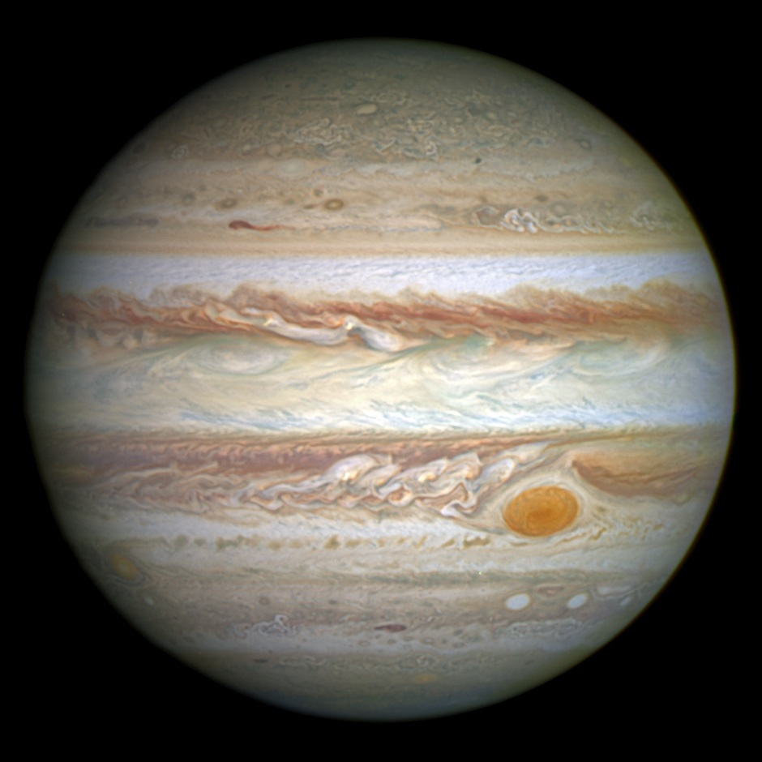
Pandas
A module for Python
Widely used in Data Science
Series
DataFrames for tables
Similar to data.frame in R
Uses NumPy
Many tutorials and documentation
Fancy operations like
groupby
Map, apply
Notes:
https://pandas.pydata.org/pandas-docs/stable/
https://upload.wikimedia.org/wikipedia/commons/2/2b/Jupiter_and_its_shrunken_Great_Red_Spot.jpg

Slide 52

Bowling data from a webpage
Data source:
https://www.bowl.com/Open_Championships/Open_Championships_Home/Past_Results_and_History/
Linked from https://www.bowl.com/records/
Notebook:
https://github.com/umbcdata601/fall2018/tree/master/jupyter_notebooks/week2_python
Activity: sketch your expectation
for time vs participation
Notes:
Hook: what's the motivator?
https://www.bowl.com/records/

Slide 53
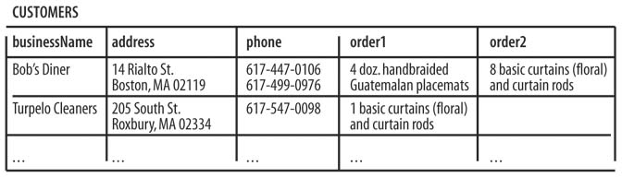
Not all CSVs are equivalent
There are best practices for what good tabular data looks like
Each variable must have its own column.
Each observation must have its own row.
Each value must have its own cell.
More observations on best practices
https://cran.r-project.org/web/packages/tidyverse/vignettes/manifesto.html
http://r4ds.had.co.nz/tidy-data.html
Notes:
https://www.safaribooksonline.com/library/view/fixing-access-annoyances/059600852X/ch04.html

Slide 54
Data cleaning as a showcase of skill
Example of data cleanup articles:
http://www.developintelligence.com/blog/2017/08/data-cleaning-pandas-python/
These usually don't bother to capture the frustration of exploration.

Slide 55
Real data is real dirty
http://usbcongress.http.internapcdn.net/usbcongress/bowl/recordsstats/pdfs/PTIndividualRecordsState.pdf
from
https://www.bowl.com/records/

Slide 56
String manipulation
this_str='a long sentence is fun'
another_str=this_str + ' to write.'
type(another_str.split(' '))
str_as_list = another_str.split(' ')
In Python, strings are immutable. Changing a string does not modify the string. It creates a new one.
Strings are sliceable. Slicing a string gives you a new string from one point in the string, backwards or forwards, to another point, by given increments
source

Slide 57

Timing execution
Manual
import timeit
start_time = timeit.default_timer()
# code you want to evaluate
elapsed = timeit.default_timer() - start_time
Cell magics
%time
%timeit
Jupyter Extension
https://github.com/ipython-contrib/jupyter_contrib_nbextensions/tree/master/src/jupyter_contrib_nbextensions/nbextensions/execute_time
https://github.com/umbcdata601/fall2018/blob/master/jupyter_notebooks/week2_python/timing%20code%20execution.ipynb

Slide 58

Pro-tip: Offline Program Design
Getty images
I use bad meetings as the time to write out programs on paper
Assume clean data
Know the expected input, desired output, and relevant transforms
Notes:
https://www.inc.com/steve-tobak/6-ideas-for-awesome-meetings.html

Slide 59
Map and apply
Map: execute a function on each element of a list or series
Apply: execute a function on each element of an axis in Pandas
http://www.bogotobogo.com/python/python_fncs_map_filter_reduce.php
http://manishamde.github.io/blog/2013/03/07/pandas-and-python-top-10/

Slide 60
Advanced: Concurrency and parallelism
http://dask.pydata.org/en/latest/
https://docs.python.org/3/library/multiprocessing.html

Slide 61
Pro-tip: When to write software and for how long
Writing a script takes time and focus
Flow state
Avoid interruptions and context switching

Slide 62
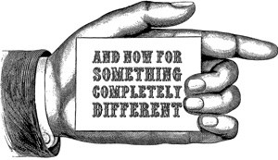
Notes:
http://whereverthewindblows.org/2018/04/25/and-now-for-something-completely-different/

Slide 63
Buzzwords as indicators
The Cloud
Machine Learning
Artificial Intelligence
Big Data
Predictive Modeling
Labeled Data
EDA
ETL
Training models
Deep Neural Network
Moonshot
Structured data
Ben's claim: these words are not used by normal people

Slide 64
Question the speaker
What do you mean by that phrase?
Is the definition shared by speaker and audience?
What is an example of that?
What is the speaker's depth of experience?
What is the speaker's expectation of the audience?
What depth is expected for audience?

Slide 65
Scoring for the gradient of homework
Warm up: graded using 0 to 5 scale; maximum 6
Assignment: graded using 0 to 5 scale; maximum 6
Challenge: 0 or 1

Slide 66
Rubric for Jupyter notebook warm up and assignment
0. Nothing turned in
0. Not using Python 3
Code turned in but one or more cells do not compile or execution takes more than 5 minutes
Cells compile but order of execution for cells is not sequential
Cells compile and are sequential, but function does not return correct values when given valid input
Code compiles and returns correct values when given valid input; does not handle invalid input
Code compiles and returns correct values when given valid input; returns an indicator of problem when invalid input is provided
+1 for use of descriptive variable names (ie expected content, type)
+1 for use of comments
+1 for no dead code or unused variables
Maximum score of 6. Any score above 6 is a 6. For example, 2+1=3; 3+2=5; 4+3=6; 5+2=6

Slide 67
Rubric for Challenge
0. Nothing turned in
Some code provided; written documentation of what attempt was made. Indicate what gave you difficulty. Include citations if applicable. Maximum of 1 page of text. Alternatively, working software.
For challenges, I'm not expecting everyone to solve the problem.
If you learned from a website or book, please site your source.

Slide 68
Homework for Week 2, part 1 of 2
Warm up: Write a function that returns the count of letters and words in a string provided as input.
Assignment: Write a function that takes a list as input and produces a list with each element shifted left by one index.
For example, [3, 7, 4, 1] becomes [1, 3, 7, 4]
https://www.hackerrank.com/challenges/
Next week: code review

Slide 69
Homework for Week 2, part 2 of 2
Assignment: Download data in CSV format from one of the following sites: here or here or here. Load the data into a Pandas dataframe. Use pandas to count the number of rows and columns. Your selection of a CSV should have at least 2 columns and at least 10 rows. Include a link to the data source in the Juptyer notebook you submit.
Challenge: "Write a function that prints the numbers from 1 to N, where N is an input. For multiples of three print “Fizz” instead of the number and for the multiples of five print “Buzz”. For numbers which are multiples of both three and five print “FizzBuzz”."
http://wiki.c2.com/?FizzBuzzTest
https://en.wikipedia.org/wiki/Fizz_buzz
https://www.hackerrank.com/challenges/fizzbuzz/problem
Next week: code review

Slide 70
Not enough homework?
Challenges abound:
https://www.hackerrank.com/challenges/
https://codesignal.com/interview-practice/
https://www.codewars.com/

Slide 71
Reading Assignment (self select your level)
Beginner:
Read "Data Wrangling with Python," chapter 2, pages 17 to 40
Write a half page summary of the text describing what you learned
Turn via Blackboard
Advanced:
Read "Learning Python" by Lutz, chapter 8, pages 239 to 254
Write a half page summary of the text describing what you learned
Turn via Blackboard

Slide 72
End of class
Questions?
Comments?

Slide 73
Bonus material

Slide 74
Python advanced: yield and generators
https://jeffknupp.com/blog/2013/04/07/improve-your-python-yield-and-generators-explained/

Slide 75
Multiple (sequential) JSON blobs in a file
Use of yield
https://stackoverflow.com/questions/20400818/python-trying-to-deserialize-multiple-json-objects-in-a-file-with-each-object-s

