Slide 1
Class 1
Data 601
August 30, 2018
Notes:
See also https://web.stanford.edu/class/stats101/intro/intro-lecture01.pdf for inspiration
Useful: https://arxiv.org/pdf/1503.05570.pdf
A Data Science Course for Undergraduates: Thinking With Data by Ben Baumer, The American Statistician Vol. 69 , Issue. 4

Slide 2
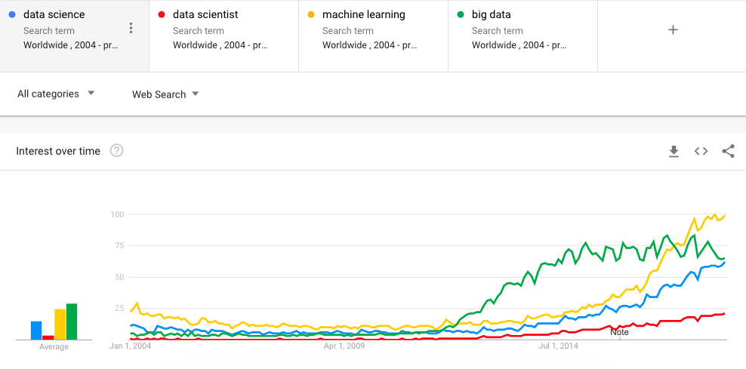
Welcome to Data 601
Once you've found a seat,
Introduce yourself to your neighbor
Ask them what their expectations are for the class
Notes:
https://trends.google.com/trends/

Slide 3
ground rules
when are scheduled bio breaks?
Also, it is acceptable to get up at any time and take a bathroom break
raise your hand if you have a question
it is acceptable to occasionally not participate

Slide 4
Grading
Attendance: 10%
Homework: 30%
Mid-term project: 30%
Final project: 30%

Slide 5

What do you want to learn?
Notes:
Image source: https://www.compli.com/blog/survey/

Slide 6
Course schedule and outline (scope)
Aug 30: Overview of DSci
Sept 6: Python; data formats
Sept 13: Math (stats)
Sept 20: regression. Data cleanup
Sept 27: Evaluation, cross-validation, overfitting
Oct 4: clustering
Oct 11: [Substitute]
Oct 18
Oct 25: Presentations
Nov 1
Nov 8
Nov 15
Nov 22: No class (Thanksgiving)
Nov 29
Dec 6
Dec 13: Presentation

Slide 7
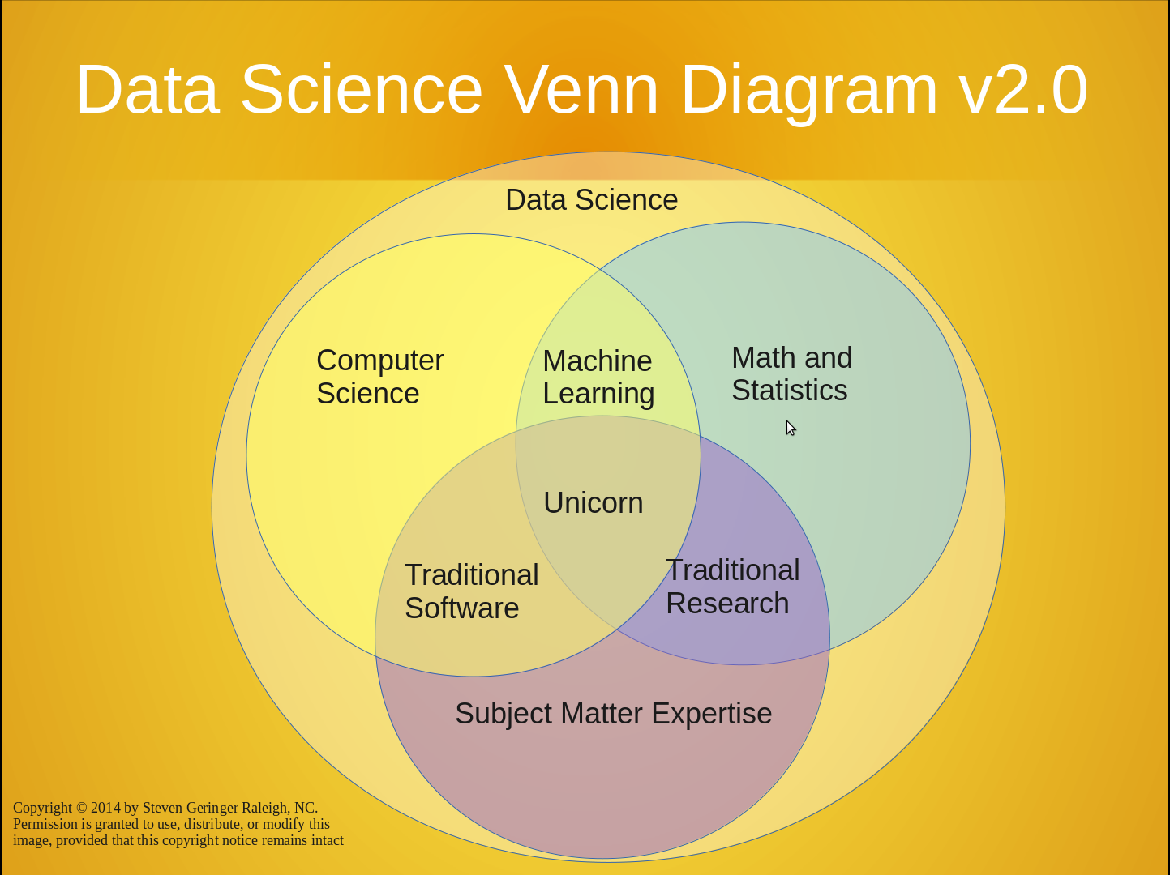
https://www.kdnuggets.com/2016/10/battle-data-science-venn-diagrams.html
There's a lot to cover
Suggested reading:

Slide 8
Profusion of title and labels
https://www.datacamp.com/community/tutorials/data-science-industry-infographic

Slide 9
jargon
--> Know enough to be conversant.
There will always be something you haven't heard of before.
Reference: http://www.datascienceglossary.org/

Slide 10
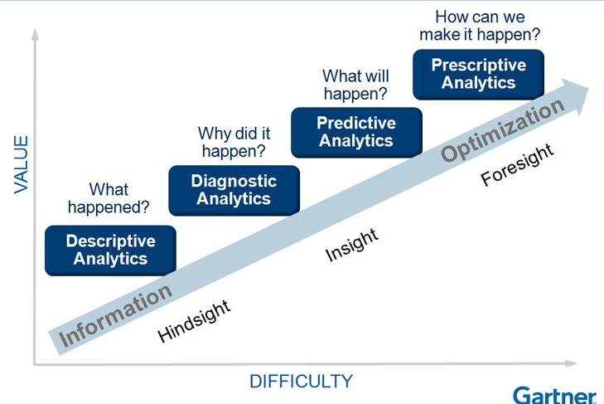
Why learn data science?
Explore: identify patterns​
Predict: make informed guesses​
Infer: quantify what you know

Slide 11
Use case:
Notes:
https://www.thrillist.com/entertainment/nation/how-new-netflix-recommendation-algorithm-works#
https://medium.com/netflix-techblog/artwork-personalization-c589f074ad76
https://www.wired.co.uk/article/how-do-netflixs-algorithms-work-machine-learning-helps-to-predict-what-viewers-will-like

Slide 12
assumption
In class we will assume you are a lone data scientist on an island with an internet connection.
This is not the typical case -- you'll have coworkers, customers, bosses, competitors, collaborators, peers.

Slide 13
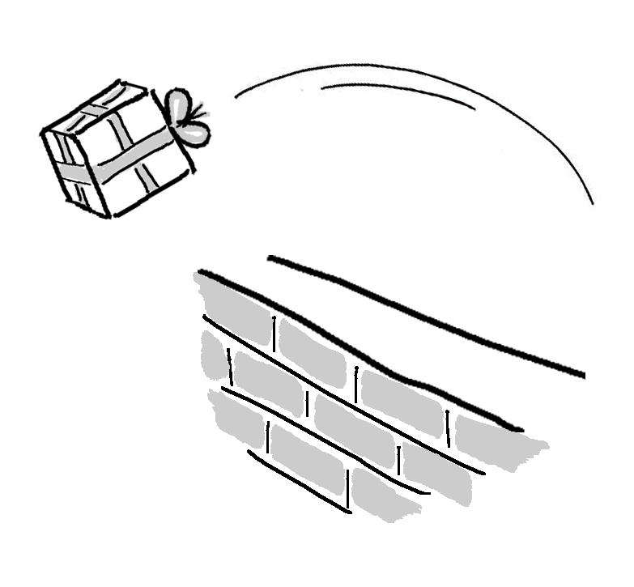
Not covered: product integration
There's a complex network of dependencies (see people enumerated previously) of which data science is one component.
Downstream consumers of your output are likely to be software developers who use containers and support users.
This class is focused on the data science; not with integration.
http://dev2ops.org/2010/02/what-is-devops/

Slide 14

Not covered: security
We focus on data science techniques; these do not emphasize secure design of software.
Notes:
https://betanews.com/2014/04/15/windows-8-1-without-update-will-no-longer-receive-security-updates/

Slide 15
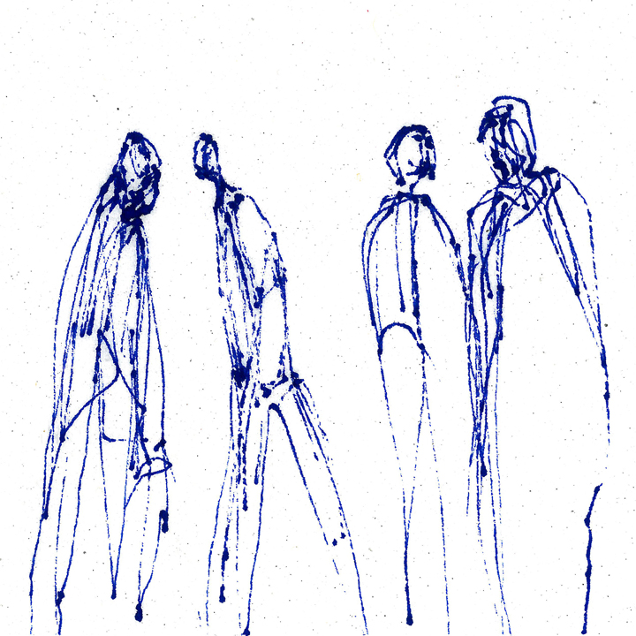
most popular tool in data science
Stand up
Walk around
Introduce yourself to another person
Ask them what they think the most popular software tool in data science is
https://www.trippinsights.com/2018/01/04/milling-about/
Notes:
https://www.trippinsights.com/2018/01/04/milling-about/

Slide 16
most popular tool in data science
Ben's claim: most popular tool in data science is Excel.
Excel is attractive because it's flexible and capable -- it can store data, the transform, and the visualization.
However, as an analytic ages in Excel and is increasingly tailored, it becomes increasingly brittle.
Also, in the list of capabilities I didn't include documentation.

Slide 17
data
CSV
Excel
JSON
XML
Images
Unstructured text
Notes:
An outline of what I plan to cover in Data 601
https://www.loc.gov/preservation/resources/rfs/
https://www.loc.gov/preservation/resources/rfs/TOC.html
https://www.loc.gov/preservation/resources/rfs/stillimg.html#photodigital

Slide 18
data
CSV
JSON
XML
Excel
Images
Unstructured text
Plain text
Platform independent
Not tied to specific software
--> Recommended as data formats by the Library of Congress
See http://www.loc.gov/preservation/resources/rfs/data.html
Notes:
An outline of what I plan to cover in Data 601
https://www.loc.gov/preservation/resources/rfs/
https://www.loc.gov/preservation/resources/rfs/TOC.html

Slide 19
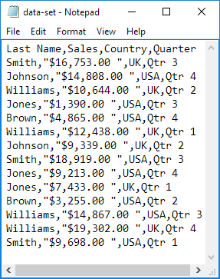
CSV
https://en.wikipedia.org/wiki/Comma-separated_values
A table with rows and columns composed of text
Two delimiters (https://en.wikipedia.org/wiki/Delimiter):
Line break
Comma
May or may not have a header:
First row is descriptions of columns
Notes:
https://www.excel-easy.com/examples/import-export-text-files.html

Slide 20
CSV caveats
Text (not images)
Each column of same type
Name or word or description (text)
Number
Category label (text)
Delimiters within a value
Enclosed within a pair of double quotes: " "
Quotes for quotes, ie 24"
Notes:
Image: https://www.excel-easy.com/examples/import-export-text-files.html
https://tools.ietf.org/html/rfc4180
https://stackoverflow.com/questions/17808511/properly-escape-a-double-quote-in-csv

Slide 21
CSV variations
Delimiters vary:
Tab – see https://en.wikipedia.org/wiki/Tab-separated_values
| (pipe)
Month|count|location
Jan|1332|here
June|5,593|there
Feb|953,24|everywhere, CA
Oct|592|my home town, MD
Notes:
https://en.wikipedia.org/wiki/Delimiter-separated_values

Slide 22
CSV alternative: fixed width
Consistent number of characters per column
ID l_name f_nametuition
0585822Potter, JrHarry 204
0485572Weasley Ron 958
5924245Granger Hermio422
4724926Diggory Cedric1042
4938243Weasley Fred 394
Notes:
https://www.excel-easy.com/examples/import-export-text-files.html

Slide 23
CSV alternative: fixed width
Consistent number of characters per column
ID l_name f_nametuition
0585822Potter, JrHarry 204
0485572Weasley Ron 958
5924245Granger Hermio422
4724926Diggory Cedric1042
4938243Weasley Fred 394
Caveat: each column needs to be at least as long as the longest entry
Notes:
https://www.excel-easy.com/examples/import-export-text-files.html

Slide 24
CSV quiz

Slide 25
science
Science is a systematic enterprise that builds and organizes knowledge in the form of testable explanations and predictions about the universe.
https://en.wikipedia.org/wiki/Science
https://www.youtube.com/watch?v=j12BBcKSgEQ
Data
Model
Question/hypothesis/assumption
Notes:
https://web.stanford.edu/class/stats101/intro/intro-lecture01.pdf

Slide 26
Repeatability

Slide 27
Best practices: Version control
Regardless of how you develop analytics, you'll be creating or editing software.
[lesson] Regardless of how you implement best practices, avoid inventing solutions for which someone else already provided a path.
Suggested resource: https://try.github.io/

Slide 28

Have you used software for version control?
Examples: git, svn, hg
Notes:
https://harveymilk.com/hmcra-family-survey-2/

Slide 29
data science is more than math and software
human interaction in data science
discovering stakeholders
negotiating with data owners
customer engagement
https://hbr.org/2017/01/the-best-data-scientists-get-out-and-talk-to-people

Slide 30
iterating with customers
as a data scientist, you'll often be working for someone other than yourself.
Expect under-specified requirements from customers. Iterate.
Provide incomplete solutions rather than waiting until the product is perfect.
https://en.wikipedia.org/wiki/Minimum_viable_product

Slide 31
when to persist, when to change course, when to seek help
try an attack for 30 minutes, then seek help or do something else for a while
Notes:
http://finalfantasy.wikia.com/wiki/Level_grinding
https://en.wikipedia.org/wiki/Grinding_(gaming)

Slide 32
pro-tip for seeking help
How to ask well-formed questions:
https://stackoverflow.com/help/how-to-ask
[Intentional sidetrack to StackOverflow.]

Slide 33


emotions in data science
As a data scientist, most of your time will be spent in a desert of uncertainty, frustration, and doubt.
There will be rare short-lived interspersed spikes of excitement and happiness due to events like getting a new dataset, creating a new analytic, getting a new result, or being thanked by a stakeholder.
This experience is normal and does not go away.
Notes:
https://www.vhtcx.com/wp-content/uploads/2015/02/canstockphoto3986275.jpg
https://www.vhtcx.com/blog/5-causes-customer-frustration-fix/

Slide 34
Homework
Select one of the following texts:
first 10 pages of "50 years of data science"
or
https://www.forbes.com/sites/gilpress/2013/05/28/a-very-short-history-of-data-science
Write a half page summary of the text
Notes:
Timeline: http://www.dataversity.net/brief-history-data-science/

