Slide 1
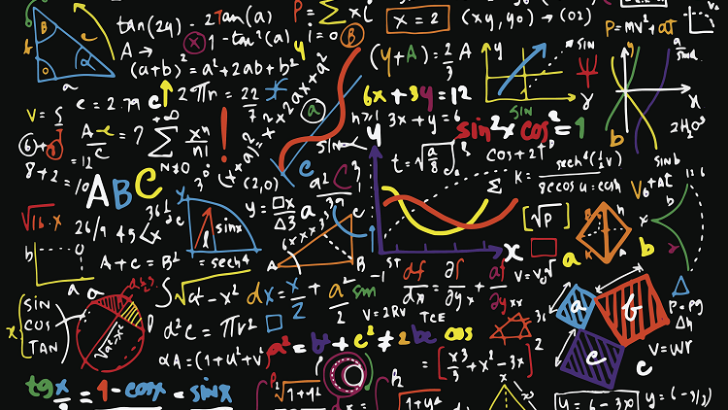
Class 3: Math
How much maths do I need to learn to be a data scientist?
Data 601 @ UMBC
September 13, 2018
These notes are CC BY 4.0
Notes:
http://www.mrbartonmaths.com/blog/tes-maths-newsletter-june-2017/
See also https://web.stanford.edu/class/stats101/intro/intro-lecture01.pdf for inspiration
Useful: https://arxiv.org/pdf/1503.05570.pdf
A Data Science Course for Undergraduates: Thinking With Data by Ben Baumer, The American Statistician Vol. 69 , Issue. 4

Slide 2

Pre-class discussion
What is your experience with using math?
What is your confidence level?
Experience with practical applications?
Is everything in math known, or is there active research?
Notes:
http://www.progressfocusedapproach.com/discuss-progress-with-each-other/

Slide 3
Comments on homework
"Write a function that takes a list as input"
def shift_list():
num_list = input("please enter a list of numbers:")
"The code was found on stackoverflow.com"
Comments versus Markdown
Docstrings for functions; doctests

Slide 4
From Week 2: code review
Find a partner with who you haven't collaborated with recently
Tell your partner what you learned last week
Show your partner most challenging homework solution you wrote
Read your partner's code line by line. Your role of peer-reviewer is a reader, not an evaluator.
Code author: Explain to your partner what each line in code does

Slide 5

Course schedule and outline (scope)
Aug 30: Overview Data Science
Sept 6: Python in Jupyter
Sept 13: Math (stats)
Sept 20: Regression
Sept 27: Clustering
Oct 4: Getting data
Oct 11: Substitute's choice
Oct 18: Data cleanup
Oct 25: Automation
Nov 1: Evaluation, cross-validation, overfitting
Nov 8: Scaling up
Nov 15: Property graphs
Nov 22: No class (Thanksgiving)
Nov 29: Elasticity, Cost/benefit
Dec 6: Ethics and Legality
Dec 13: Presentations

Slide 6
Course schedule and outline (projects)
Aug 30:
Sept 6:
Sept 13:
Sept 20:
Sept 27:
Oct 4: start proposal for mid-term
Oct 11: Substitute; Submit proposal for mid-term project
Oct 18: Start mid-term project
Oct 25:
Nov 1: Submit mid-term project; start proposal for final
Nov 8: Submit proposal for final
Nov 15: Final project assigned
Nov 22: No class (Thanksgiving)
Nov 29:
Dec 6: Final project due
Dec 13: Presentations

Slide 7
Outcomes for this evening
By the end of today's class, you should be able to answer the following:
Randomly select elements from a list
Explain the role of sampling data
Transpose a matrix and a dataframe
Explain uses of Gaussian and uniform distributions
Identify misleading representations of data
Describe three biases that can occur when gathering data

Slide 8
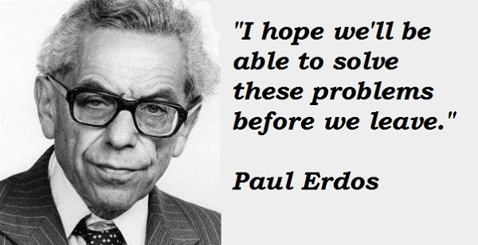
Consider this a survey of an old, diverse field
Linear algebra (vectors, matrices, cross product)
Sets (union)
Statistics (ie mean, median)
How to Lie with Statistics
Error bars
Probability, combinatorics
Calculus
ODEs and PDEs
Caveat: I'm not a mathematician
Notes:
https://www.quora.com/What-are-some-interesting-stories-about-Paul-Erdos

Slide 9
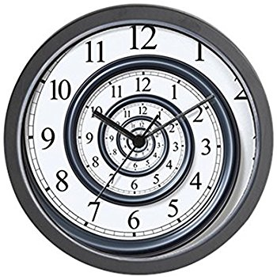
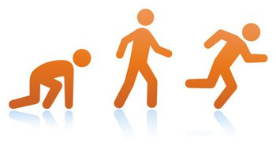
I won't be able to teach you all of Math
Jargon | concept | example

Slide 10
Where Math shows up in Data Science
Cleaning data – filling in gaps for missing data with interpolation
Modeling expectations – sense-making, distribution of each variable
Generating hypotheses that are numerically testable
Evaluating test results to validate hypotheses
Analysis of results – visualization, sanity checks
Explanation of story to audience – what do you expect customers to take away? What is their language?

Slide 11
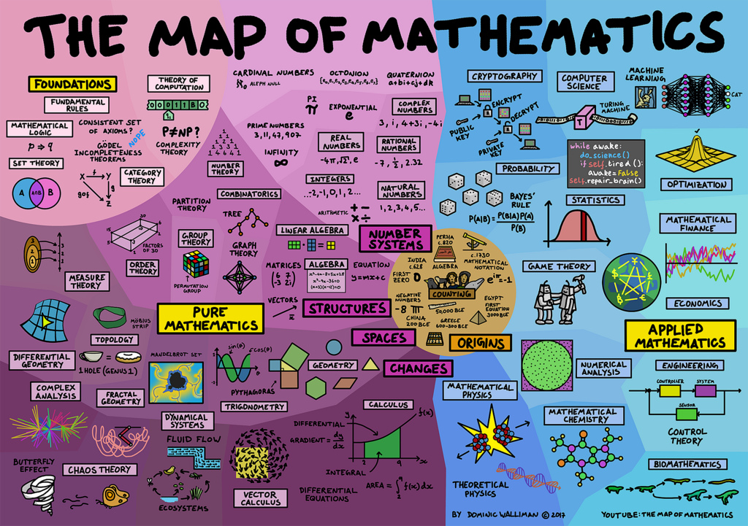
Resources for learning Math
Focus on learning the jargon; this is necessary for searching
For a given topic, evaluate the many options before investing time
Teaching style
Level of complexity
Assumptions about you, the student reader
Free resources
Online (blogs, Coursera, YouTube)
Books

Slide 12
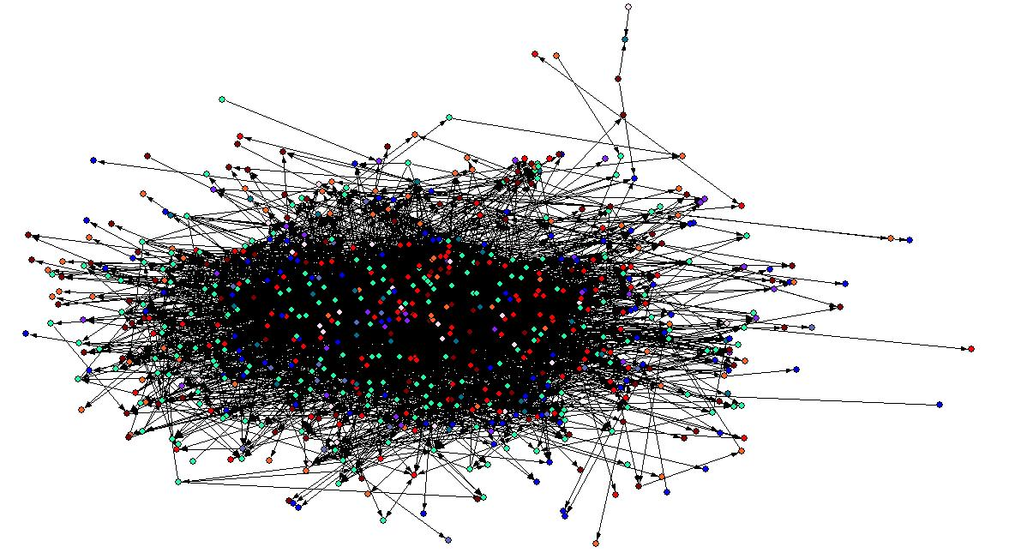
Relevance of Statistics in Data Science
Given randomness and noise, knowledge can be derived from complex data
How:
Quantify relationships between variables in a model using standard language and techniques
Notes:
https://ww2.amstat.org/misc/DataScienceStatement.pdf
http://blog.webometrics.org.uk/2009/04/i-hate-my-job-the-web-is-just-a-jumbled-mess/

Slide 13
Quantifying Relations
Numerical
Categorical
Discrete
Continuous
Nominal
Unordered categories
Ordinal
Ordered categories
Notes:
https://www.ctspedia.org/do/view/CTSpedia/EducationalMaterials055

Slide 14
Discrete versus Continuous variables
Discrete variables: outcomes for coin flips, deck of cards, roll of dice
Continuous variables: time, distance
Continuous: For any two values of a variable, it is possible to get a measurement that is between the two values.

Slide 15


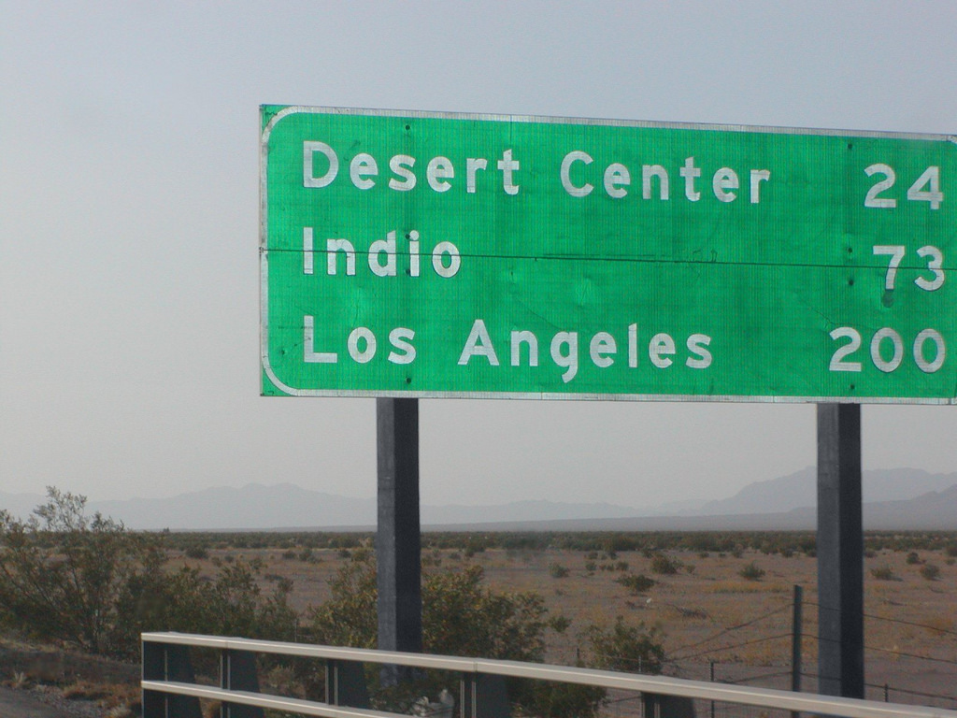
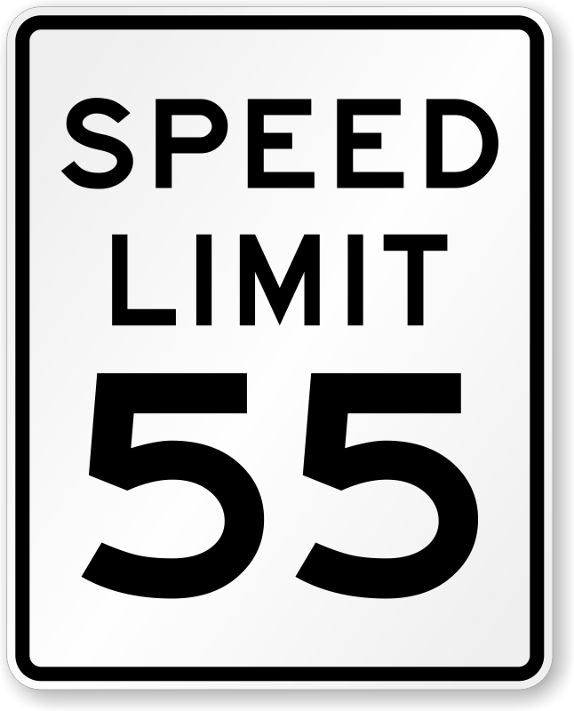
Trick: Rounding continuous to discrete
Rounding is often applied to continuous to make the variable discrete
Notes:
Eye color
Time
Distance
https://omgfacts.com/your-blue-eyes-arent-actually-blue/
https://www.macupdate.com/app/mac/28575/digital-clock
https://www.flickr.com/photos/raymondyue/13908293023
https://www.roadtrafficsigns.com/55-mph-signs

Slide 16
Core to Statistics: Probability
Statistics quantifies relationships between variables in a model using standard language and techniques
Probability is a way of figuring out an applicable model

Slide 17


Uniform distribution
Each outcomes is equally likely:
Chance of any of the possible options is the same as any other outcome
Given a standard deck of 52 cards, what is the chance of getting a card that is a diamond?
Notes:
https://www.memrise.com/course/753193/memorize-a-deck-of-cards-2/
https://www.allworship.com/deck-cards/

Slide 18
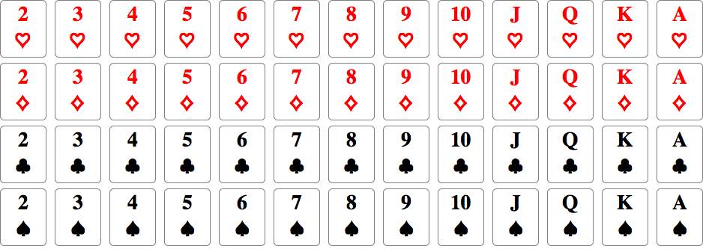
Chance of getting a heart: 13/52
Chance of getting a diamond: 13/52
Chance of getting a club: 13/52
Chance of getting a spade: 13/52
Notes:
https://mathematica.stackexchange.com/questions/16108/standard-deck-of-52-playing-cards-in-curated-data

Slide 19
Randomness and random selection in Python
https://github.com/umbcdata601/fall2018/blob/master/jupyter_notebooks/week3_math/getting%20started%20with%20random.ipynb
random.choice( ['red', 'black', 'green', 5] )

Slide 20
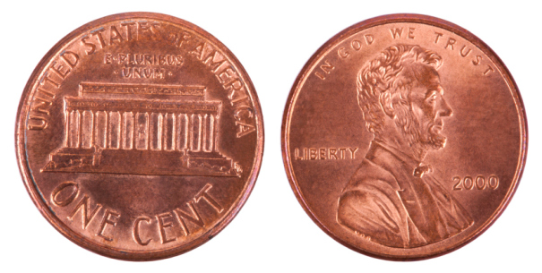
Activity: Coin toss
Using your penny, record (in order) tails/heads for 10 flips
Notes:
https://connexcu.wordpress.com/2013/07/16/dont-flip-a-coin-on-your-financial-future/

Slide 21
What does a data scientist do all day?
I have autonomy because my employer expects I know what I'm doing
Work from 9 to 5 M-F, or 10 to 4, or whatever suits my needs
Read and write emails.
Go to meetings; run meetings
Have impromptu discussions with stakeholders
Write documentation, read papers
Write code
Manage data
No day repeats
No day is predictable
https://www.kdnuggets.com/2017/11/day-life-data-scientist.html
Notes:
https://www.kdnuggets.com/2017/11/day-life-data-scientist.html

Slide 22
How many possible permutations?
1 flip has 2 outcomes: head (H) or tails (T)
2 flips has 4 outcomes: HH or HT or TH or TT
3 flips has 8 outcomes: HHH,HHT,HTH,THH,HTT,THT,TTH,TTT
...
For N flips there are 2^N outcomes
N=10 flips: 2^10= 1,024 outcomes
N=20 flips: 2^20=1,048,576 outcomes

Slide 23
Activity: Pair programming
Find a partner you haven't collaborated with recently
Design (on paper) what needs to happen to simulate a sequence of coin flips
In Jupyter, write a function that counts how many coin flips it takes to find the sequence you flipped.
Don't stress if you don't complete the task during class
Note: there are at least two ways to interpret this request

Slide 24
A solution to modeling coin flips
https://github.com/umbcdata601/fall2018/blob/master/jupyter_notebooks/week3_math/modeling_random_coin_flips.ipynb
import random
sequence_of_interest = (1, 2, 1, 1)
def create_random_sequence(len_of_seq,number_of_coin_flips):
this_run=[]
for indx in range(len_of_seq):
coin = random.randint(1, 2) # random coin flip results in 1 or 2
number_of_coin_flips+=1
this_run.append(coin) # add coin flip result to list
return this_run,number_of_coin_flips
number_of_coin_flips=0
this_run=[] # store the results of the random coin flips in a list
while True:
this_run,number_of_coin_flips = create_random_sequence(
len(sequence_of_interest),number_of_coin_flips)
found_match=False
for flip_indx in range(len(sequence_of_interest)):
if (sequence_of_interest[flip_indx] == this_run[flip_indx]):
found_match=True
else: # patterns don't match
found_match=False
this_run=[]
break
if (found_match==True):
print(this_run)
break
Want to watch how this works? Check out
http://pythontutor.com/visualize.html

Slide 25
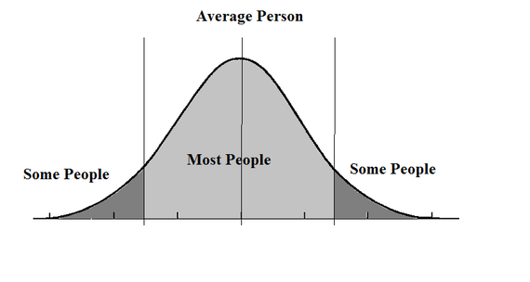
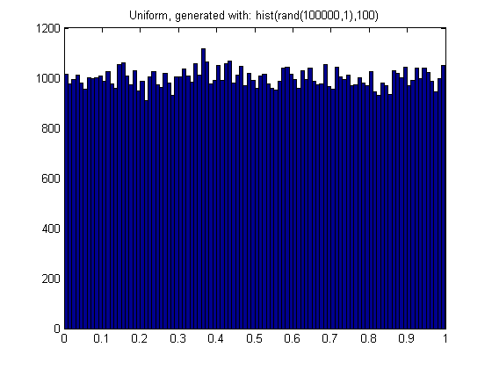
Another distribution: the Bell curve
Uniform distribution
Notes:
https://stackoverflow.com/questions/13844944/random-numbers-with-gaussian-and-uniform-distributions-in-matlab/13845800
https://www.huffingtonpost.com/hans-hickler/pay-attention-to-the-midd_b_5924640.html

Slide 26
Gaussian and Binomial Distribution
binomial distribution is discrete; normal (Gaussian) is continuous
Characteristics of binomial variable:
A fixed number of repeated, identical, independent trials. 𝑛 is usually the parameter chosen to label the number of trials.
Every trial results in either a success, with probability 𝑝, or a failure, with probability 1−𝑝. These must be the only two possible outcomes for a trial.
The random variable of interest is the total number of trials that ended in a success.
Notes:
https://www.quora.com/Probability-statistics-What-is-difference-between-binominal-poisson-and-normal-distribution

Slide 27
Coin flips produce a bell curve!
An exploration of the coin flips:
https://github.com/umbcdata601/fall2018/blob/master/jupyter_notebooks/week3_math/binomial%20distribution%20for%20coin%20flips.ipynb

Slide 28
Results vary: Error bars tell by how much
Variance measures the width of a distribution
Standard deviation is sqrt(variance) and has same units as variable
Lots of info about distribution of variable in Violin plots
Notes:
https://matplotlib.org/gallery/statistics/boxplot_vs_violin.html
https://blog.modeanalytics.com/violin-plot-examples/

Slide 29
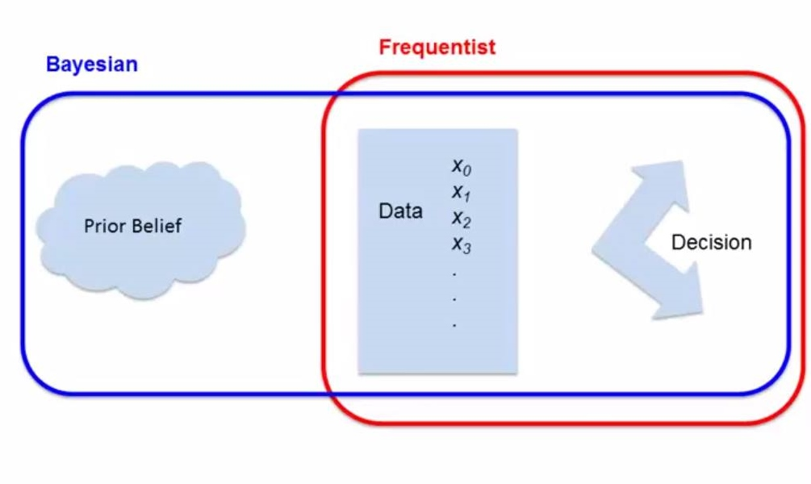
Bayesian versus Frequentist inference
Both approaches allow evaluation of evidence about competing hypotheses.
Bayesian inference: "What is the probability that it recently rained given that it is wet outside?"
Frequentist approach measures repeated events and does not depend on a subjective prior that may vary from one investigator to another.
Jake VanderPlas on difference
Notes:
https://www.datascience.com/blog/introduction-to-bayesian-inference-learn-data-science-tutorials
https://ocw.mit.edu/courses/mathematics/18-05-introduction-to-probability-and-statistics-spring-2014/readings/MIT18_05S14_Reading20.pdf
https://datascienceinsider.wordpress.com/2015/09/17/frequentist-vs-baysian-a-never-ending-debate/

Slide 30
Two events are statistically independent of each other when the probability that one event occurs in no way affects the probability of the other event occurring.
Variance measures width of a distribution
Covariance is the measure of variance for two random variables (joint variability)
Correlation is the normalized covariance, from –1 to 1
More explanation here and visualizations of covariance are helpful

Slide 31
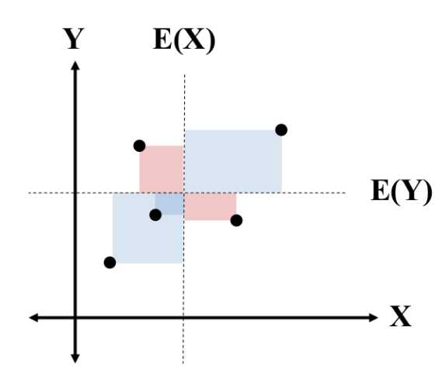
Visualize covariance
Pink areas are less than the average,
so the area has a negative value when summing areas

Slide 32
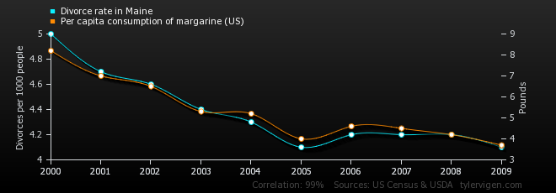
Correlation = 0.992558 for Divorce and Margarine
http://www.tylervigen.com/spurious-correlations
Notes:
https://tylervigen.com/view_correlation?id=1703

Slide 33
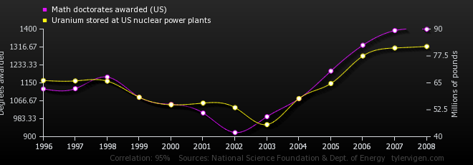
Correlation = 0.952257 for PhDs and Uranium
https://tylervigen.com/view_correlation?id=1100

Slide 34
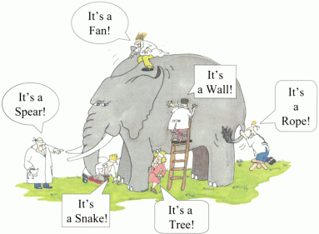
How to (un)intentionally mislead
Counting and math are objective
Collection, analysis, and interpretation of data is implemented by humans
Consequence: data you work with
may have issues you need to account for
Notes:
https://cseweb.ucsd.edu/~ricko/CSE3/Lie_with_Statistics.pdf
https://www.spencerburton.ca/learning-is-subjective/

Slide 35
Data collection: exhaust or sample?
Sampling a population can introduce bias
Area Bias – geographic area of sample needs to be representative of study population
Self-Selection Bias - decision to participate may correlate with traits that affect the study
Leading Question Bias - tone of the question suggests the answer
Social Desirability Bias - reluctance to admit to doing something that is considered socially undesirable
Notes:
Source: https://cseweb.ucsd.edu/~ricko/CSE3/Lie_with_Statistics.pdf

Slide 36
Relevance of folklore in Data Science
Observation
= Data
Test
= (in)validate assumptions
Curiosity about relations
Model = a story using math
to describe relations
in the data
Prediction
= based on assumptions

Slide 37
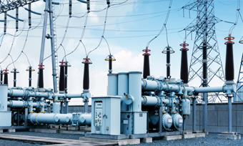
Activity: sketch your expectation on paper
Axes:
Time (days)
Power (megawatts)
Notes:
http://www.threephaseline.com/substation-and-switchyard-services/

Slide 38
Activity: sketch your expectation on paper
Axes:
Time (days)
Power (megawatts)
Randomly select presenter
Display your sketch on the projector
Get feedback from your peers

Slide 39
Time varying data
Source: https://www.bmreports.com/bmrs/?q=demand/rollingsystemdemand
Notebook:
https://github.com/umbcdata601/fall2018/blob/master/jupyter_notebooks/week3_math/visualizing_time_variation_v5_final_product_looks_easy.ipynb
Notes:
Hook: what's the motivator ?

Slide 40
Cyclic patterns in time varying data
Chrome history analysis
https://github.com/umbcdata601/fall2018/blob/master/jupyter_notebooks/week3_math/histogram%20of%20my%20Chrome%20history.ipynb
Math, rather than visual, analysis: Fourier transform

Slide 41
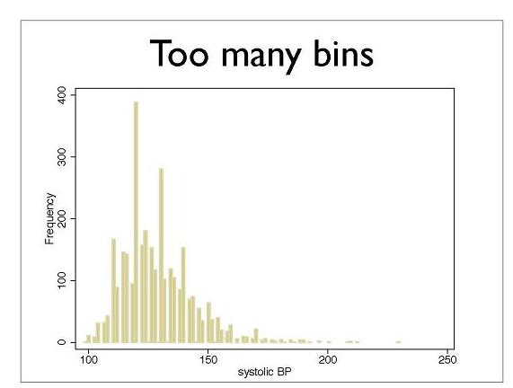
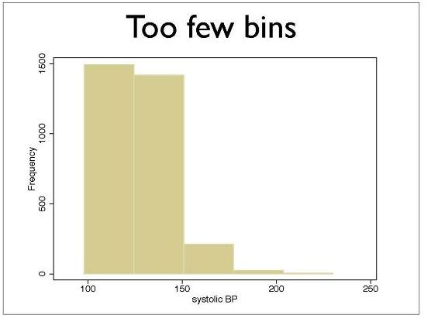
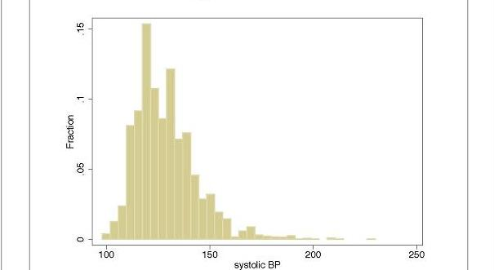
Subjective Design decisions of Histograms
Helpful walk through of design:
https://tinlizzie.org/histograms/
What visualizations are possible?
https://datavizcatalogue.com/
Notes:
https://www.ctspedia.org/do/view/CTSpedia/EducationalMaterials055
See also https://dataviz-literacy.wmflabs.org/#section-common-visualizations

Slide 42
Browser history for two people
How would you find which websites both have visited?

Slide 43
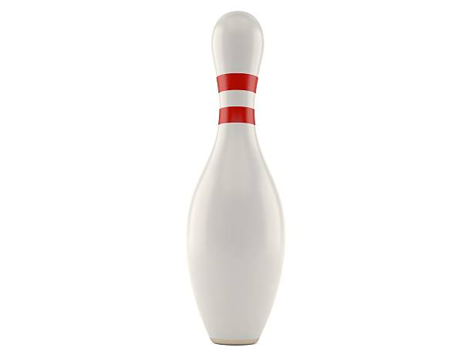


Sets are collections of items
Stuff I own now

Slide 44


Sets are collections of items
I owned 10 years ago

Slide 45
Sets are collections of items
Stuff I own now
I owned 10 years ago

Slide 46
Set intersection (and); Set union (or)
Intersection = the overlap of one or more sets
Union = combination of one or more sets
https://github.com/umbcdata601/fall2018/blob/master/jupyter_notebooks/week3_math/sets.ipynb

Slide 47
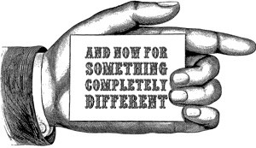

Slide 48
Relevance of Linear Algebra to Data Science
Central to machine learning
Images are arrays of numbers
Text processing (ie word2vec)
Neural network weights are stored as array
Principal Component Analysis (PCA) - lossy dimensionality reduction
https://www.khanacademy.org/math/linear-algebra

Slide 49
Numpy and dimensions of data
NumPy is short for Numerical Python
Scalar values, ie 5
1 dimension
Numpy: array – single type of entries
Python: list, set (unique elements), tuple (immutable)
Linear algebra: vector
2 dimensions:
CSV: Table; Excel: worksheet
Numpy: array of arrays
Linear algebra: matrix
https://github.com/umbcdata601/fall2018/blob/master/jupyter_notebooks/week3_math/introduction%20to%20numpy%20and%20vectors%20and%20matrices.ipynb

Slide 50
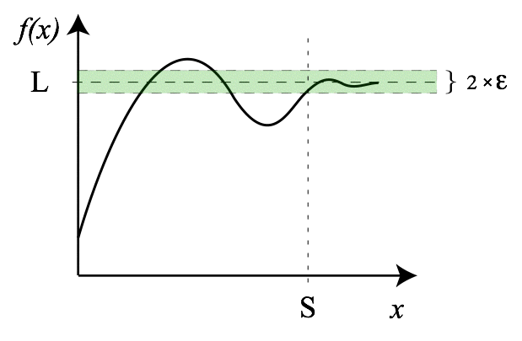
Calculus as gateway to Differential Equations
Calculus: approximation that summing a large number of small things yields a finite value.
Curious about what calculus covers?
See this review of concepts and essential concepts.
https://www.khanacademy.org/math/multivariable-calculus
Notes:
https://en.wikipedia.org/wiki/Limit_(mathematics)

Slide 51

Relevance of Differential Equations in Data Science:
Differential equations enable determination of rate of change of quantities

Slide 52
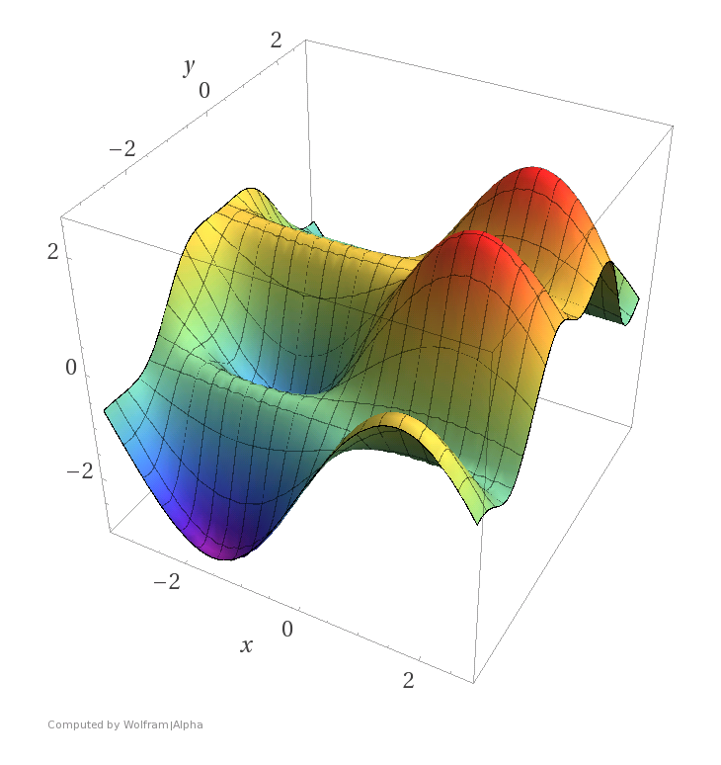
Relevance of Differential Equations in Data Science
Differential equations enable determination of rate of change of quantities
Optimization, which is central to machine learning (ie Gradient descent)
As with most topics in this lecture, there are entire courses and textbooks dedicated to optimization.
There are other applications
Free courses on differential equations are available online
Notes:
https://www.matroid.com/blog/post/the-hard-thing-about-deep-learning

Slide 53
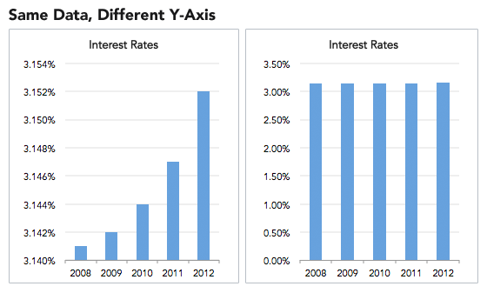
Knowing Math insufficient in story telling: Misleading Visualizations
Notes:
https://heapanalytics.com/blog/data-stories/how-to-lie-with-data-visualization

Slide 54
No one would actually do that, right?

Slide 55
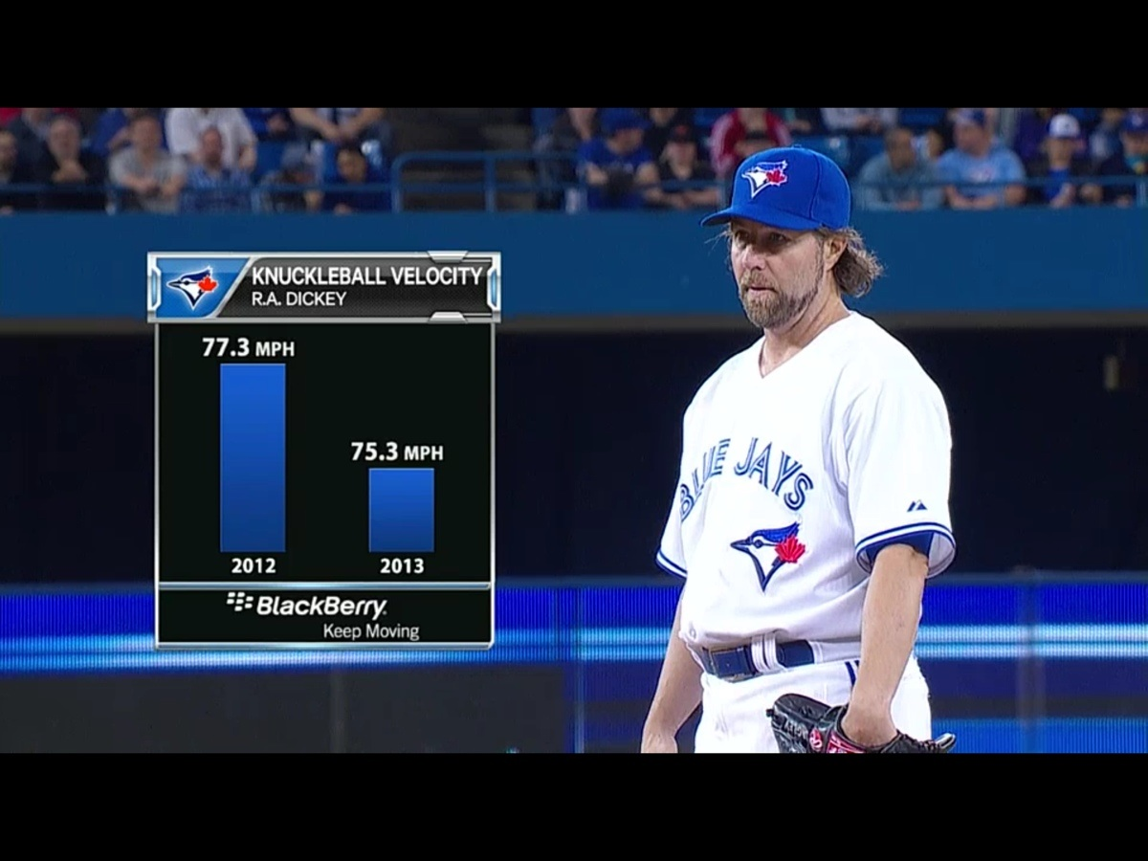
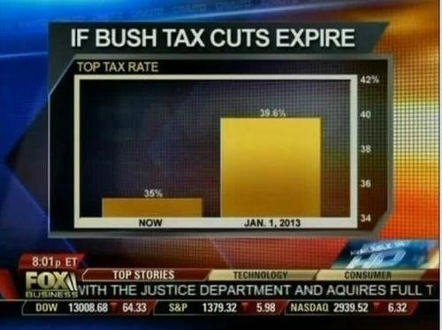
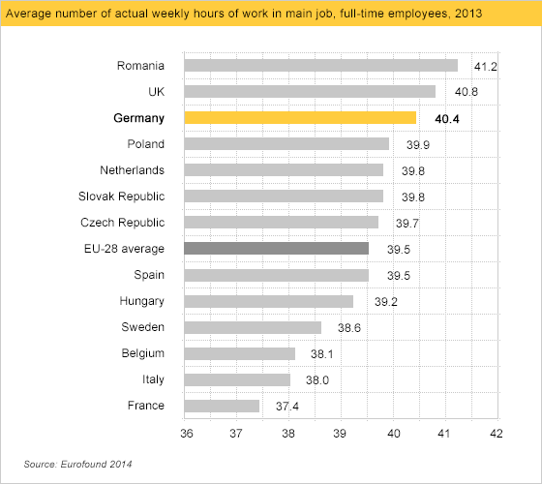
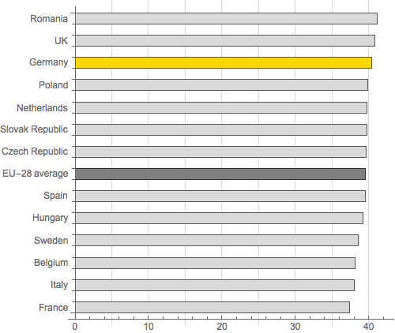
Oh yes
Complete data:
(There are conditions under which not including zero is justified.)
Notes:
https://heapanalytics.com/blog/data-stories/how-to-lie-with-data-visualization
https://callingbullshit.org/tools/tools_misleading_axes.html
https://callingbullshit.org/case_studies/case_study_musician_mortality.html
https://callingbullshit.org/tools/tools_proportional_ink.html

Slide 56
Mistakes when Characterizing data
Even "find the average" isn't as trivial as you may think
Arithmetic mean : what you're used to
Harmonic mean : appropriate when the average of rates is desired
Geometric mean : combining multiple parameters which have different ranges so that a given percentage change in any of the properties has the same effect

Slide 57
XKCD
https://www.explainxkcd.com/wiki/index.php/882:_Significant
https://xkcd.com/1122/
https://xkcd.com/882/
https://xkcd.com/1478/

Slide 58
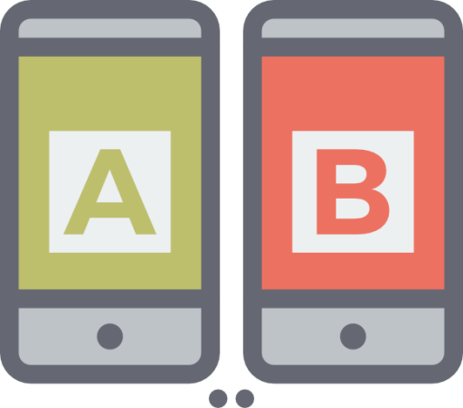
There's more than Exploratory Data Analysis
Comparing models using A/B testing
Notes:
https://www.mugo.ca/Blog/Why-A-B-testing-is-an-important-part-of-your-digital-strategy

Slide 59
Homework: for peer review
Please cite your references if you used sources to help write code.
Warm up: Submit a .py file that writes a list of lists to a .csv file. The list of lists containing only numbers should be defined within your .py script.
Assignment: Write a function that takes as argument a list of five positive integers, calculates the minimum and maximum values that can be calculated by summing exactly four of the five integers, then returns the minimum and maximum values. Submit a notebook.
Assignment: Write a function that takes two strings as arguments, each of the form 'YYYY-MM-DD' and returns the difference in days. Hint: use relevant library
https://www.hackerrank.com/challenges/mini-max-sum/problem

Slide 60
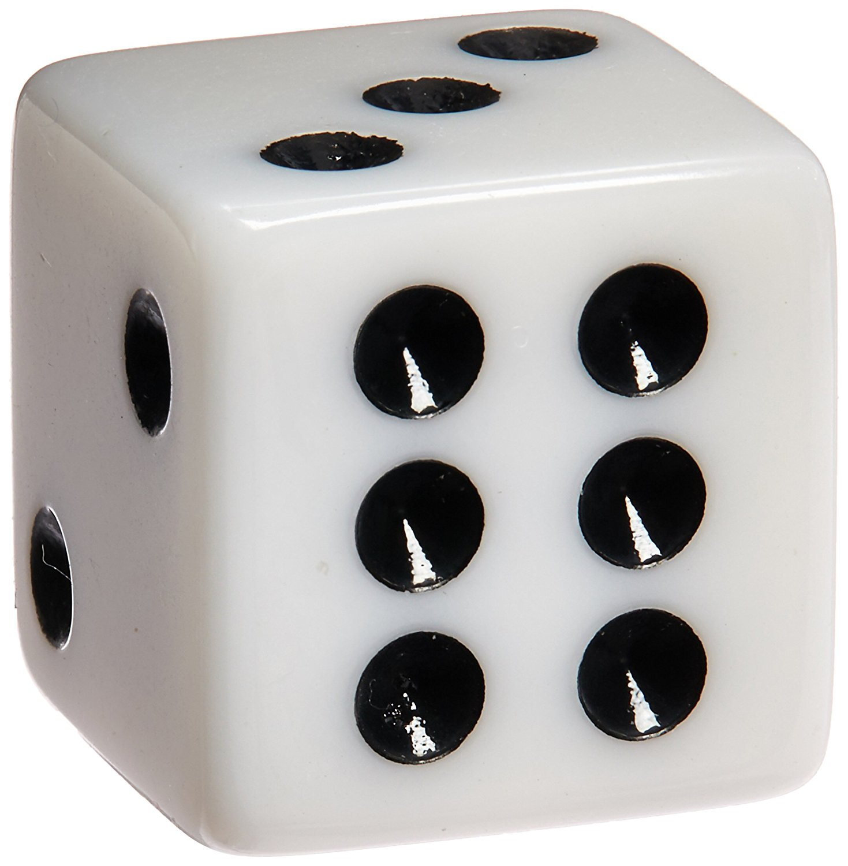
Homework: for grading
All pictures in all homeworks and reports are generated dynamically
Assignment: Acquire a CSV of the power data (source) for at least 10 days and not more than 80 days. Load the data into a Jupyter Notebook. Create a histogram of the hourly power consumption. Submit the .ipynb file containing the analysis and the generated picture of the histogram.
Assignment: Starting with a fair die and a biased 6-sided die where the chance of outcomes is {0.15, 0.15, 0.15, 0.15, 0.15, 0.25}, create a visualization that compares outcomes for simulation of multiple rolls of the fair die and this biased die. The user of your notebook should be able to alter the number of simulations as an input parameter.

Slide 61
Reading Assignment
Read the paper
"Can Graphics Tell Lies? A Tutorial on How To Visualize Your Data" in Clinical and Translational Science (2018) 11, 371–377; doi:10.1111/cts.12554

Slide 62
Check-in activity
Find a partner you haven't talked with previously (or at least recently)

Slide 63
Check-in activity
Find a partner you haven't talked with previously (or at least recently)
Talk:
Explain to your partner two things you learned (or confirmed) during this class

