Slide 1
Overfitting and underfitting

Slide 2
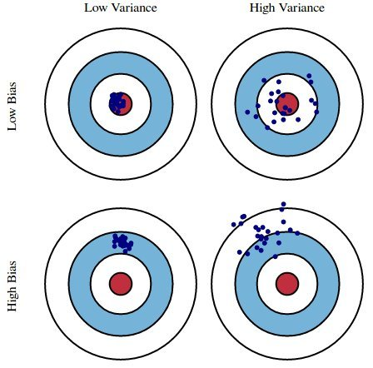
Bias-Variance trade off
Bias can be defined as the difference between the predicted output and the original output.
Variance refers to the amount by which predicted output would change if we estimate it with different training data set.
If the model has high variance, then small changes in the training data can result in large changes in the output, and then the model becomes less robust.
If the model has a high bias, then there will be a large error in the output, and then the model will be less accurate.
Image courtesy - https://www.kdnuggets.com/2016/08/bias-variance-tradeoff-overview.html

Slide 3
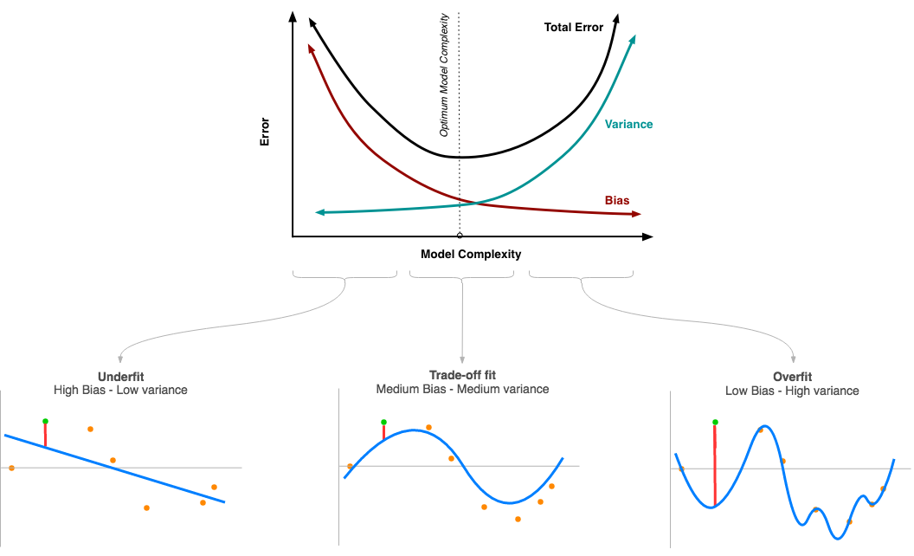
Bias-Variance trade off
Thus, the challenge is to find the model which have low variance, as well as low bias and it is referred to as the Bias-Variance tradeoff.
Image courtesy - http://www.ebc.cat/2017/02/12/bias-and-variance/

Slide 4
Overfitting and underfitting - introduction
Overfitting and underfitting affect the performance of the machine learning model by making it less reliable.
In machine learning the data is divided into two parts – one for training the machine learning model and other to test the performance of the model.
Whenever the model gives the better results on the training data and worst results on test data, then there is a high probability of overfitting.
If the performance of the model on training data is not acceptable, then there is a chance of underfitting.

Slide 5
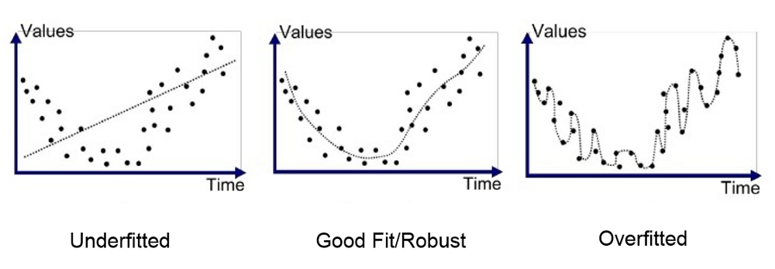
Overfitting and underfitting
Overfitting can simply be defined as overgeneralization of the model; so the model can understand the underlying structure of the data including noise in the data.
Underfitting is opposite of overfitting, and it occurs when the model is too simple to understand the underlying structure of the data.
Image courtesy - https://medium.com/greyatom/what-is-underfitting-and-overfitting-in-machine-learning-and-how-to-deal-with-it-6803a989c76

Slide 6
Solutions to overcome overfitting
Simplify the model by selecting one with fewer parameters (e.g., a linear model rather than a high-degree polynomial model) by reducing the number of attributes in the training data.
Using regularization methods for constraining the model (e.g., Lasso, Ridge).
Gather more training data.
Reduce noise in the training data (e.g., fix data errors and remove outliers).
Use of ensemble-based methods (e.g., Bagging, Boosting).

Slide 7
Solutions to overcome underfitting
Selecting a more powerful model with more parameters.
Feeding better features to the learning algorithms (feature engineering).
Reducing the constraints in the model (e.g., reducing the regularization hyperparameter).

Slide 8
References
An Introduction to Statistical Learning : With applications in R, Springer, 2015, Gareth et al.
Hands-On Machine Learning with Scikit-Learn and TensorFlow: Concepts, Tools, and Techniques to Build Intelligent Systems, O’Reilly, 2017, Aurélien Géron

