Slide 1
011 CS Introduction to Computer
Lecture 4
Prepared and collected by Ahmed A. Asiri
Supported by
COMPUTER FUNDAMENTAL TUTORIAL BOOK
From Tutorials Point Website
1

Slide 2
Input Devices
Following are few of the important input devices which are used in a computer:
Keyboard
Mouse
Joy Stick
Light pen
Track Ball
Scanner
Graphic Tablet
Microphone
Magnetic Ink Card Reader(MICR)
Optical Character Reader(OCR)
Bar Code Reader
Optical Mark Reader(OMR)

Slide 3
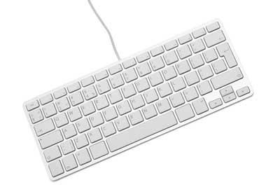
Keyboard
Keyboard is the most common and very popular input device which helps in inputting data to the computer. The layout of the keyboard is like that of traditional typewriter, although there are some additional keys provided for performing additional functions.
Keyboards are of two sizes 84 keys or 101/102 keys, but now keyboards with 104 keys or 108 keys are also available for Windows and Internet.

Slide 4
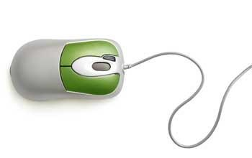
Mouse
Mouse is most popular pointing device. It is a very famous cursor-control device having a small palm size box with a ground ball at its base which senses the movement of mouse and sends corresponding signals to CPU when the mouse buttons are pressed.

Slide 5
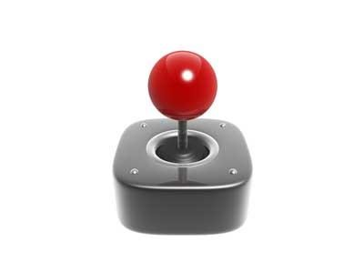
Joystick
The function of joystick is similar to that of a mouse. It is mainly used in Computer Aided Designing(CAD) and playing computer games.

Slide 6
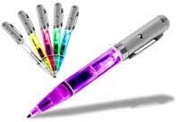
Light Pen
Light pen is a pointing device which is similar to a pen. It is used to select a displayed menu item or draw pictures on the monitor screen.

Slide 7
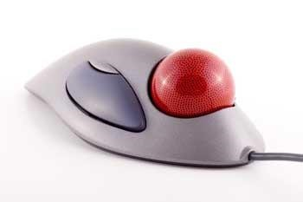
Track Ball
Track ball is an input device that is mostly used in notebook or laptop computer, instead of a mouse.

Slide 8
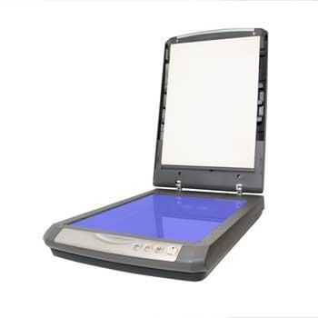
Scanner
Scanner is an input device which works more like a photocopy machine. It is used when some information is available on a paper and it is to be transferred to the hard disc of the computer for further manipulation.

Slide 9
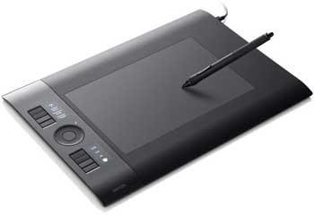
Digitizer
Digitizer is an input device which converts analog information into digital form.

Slide 10
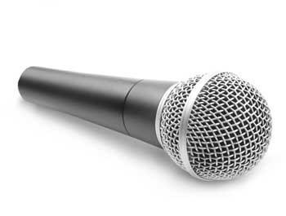
Microphone
Microphone is an input device to input sound that is then stored in digital form.

Slide 11
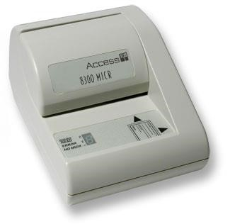
Magnetic Ink Card Reader(MICR)
MICR input device is generally used in banks because of a large number of cheques to be processed every day.

Slide 12
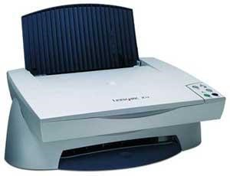
Optical Character Reader(OCR)
OCR is an input device used to read a printed text. OCR scans text optically character by character

Slide 13
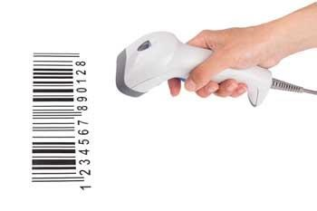
Bar Code Readers
Bar Code Reader is a device used for reading bar coded data (data in form of light and dark lines). Bar coded data is generally used in labelling goods, numbering the books etc.

Slide 14
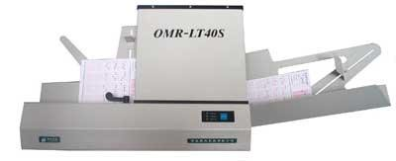
Optical Mark Reader(OMR)
OMR is a special type of optical scanner used to recognize the type of mark made by pen or pencil.

Slide 15
Output Devices
Following are few of the important output devices which are used in a computer:
Monitors
Graphic Plotter
Printer
Monitors
Monitors, commonly called as Visual Display Unit (VDU), are the main output device of a computer. It forms images from tiny dots, called pixels that are arranged in a rectangular form. The sharpness of the image depends upon the number of pixels.
There are two kinds of viewing screen used for monitors:
Cathode-Ray Tube (CRT)
Flat- Panel Display

Slide 16
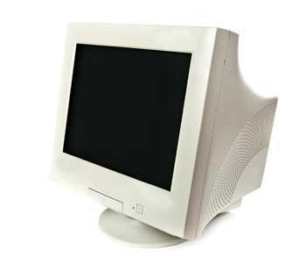
Cathode-Ray Tube (CRT) Monitor
The CRT display is made up of small picture elements called pixels. The smaller the pixels, the better the image clarity, or resolution.

Slide 17
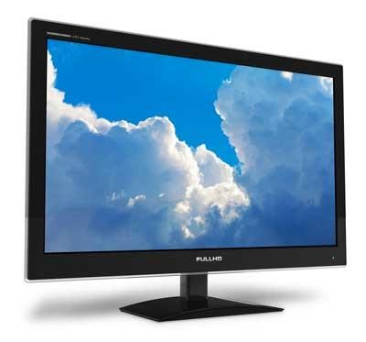
Flat-Panel Display Monitor
The flat-panel display refers to a class of video devices that have reduced volume, weight and power requirement in comparison to the CRT.
The flat-panel display is divided into two categories
Emissive Displays - The emissive displays are devices that convert electrical energy into light. Example are plasma panel and LED (Light-Emitting Diodes).
Non-Emissive Displays - The Non-emissive displays use optical effects to convert sunlight or light from some other source into graphics patterns. Example is LCD (Liquid-Crystal Device)

Slide 18
Printers
Printer is an output device, which is used to print information on paper.
There are two types of printers:
Impact Printers
Non-Impact Printers

Slide 19
Impact printers
These printers are of two types
Character printers
Line printers
Character Printers
Character printers are the printers which print one character at a time.
These are further divided into two types
Dot Matrix Printer(DMP)
Daisy Wheel

Slide 20
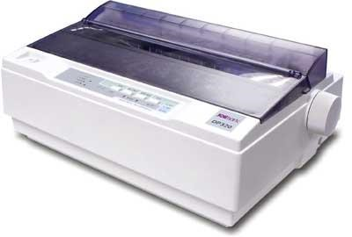
Dot Matrix Printer
In the market one of the most popular printers is Dot Matrix Printer. These printers are popular because of their ease of printing and economical price. Each character printed is in form of pattern of dots and head consists of a Matrix of Pins of size (5*7, 7*9, 9*7 or 9*9) which come out to form a character that is why it is called Dot Matrix Printer.

Slide 21
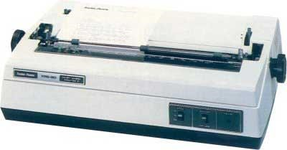
Daisy Wheel
Head is lying on a wheel and pins corresponding to characters are like petals of Daisy (flower name) that is why it is called Daisy Wheel Printer.

Slide 22
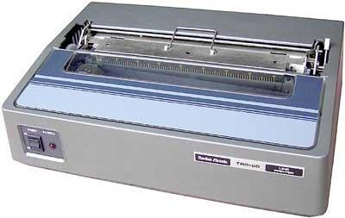
Line Printers
Line printers are the printers which print one line at a time.
These are of further two types
Drum Printer
Chain Printer

Slide 23
Drum Printer
This printer is like a drum in shape so it is called drum printer. The surface of drum is divided into number of tracks. Total tracks are equal to size of paper i.e. for a paper width of 132 characters, drum will have 132 tracks.
Chain Printer
In this printer, chain of character sets are used so it is called Chain Printer. A standard character set may have 48, 64, or 96 characters.

Slide 24
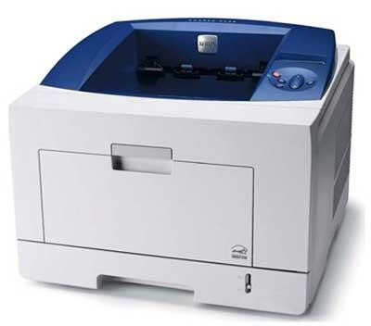
Non-impact Printers
Non-impact printers print the characters without using ribbon. These printers print a complete page at a time so they are also called as Page Printers.
These printers are of two types
Laser Printers
Inkjet Printers
Laser Printers
These are non-impact page printers. They use laser lights to produce the dots needed to form the characters to be printed on a page.

Slide 25
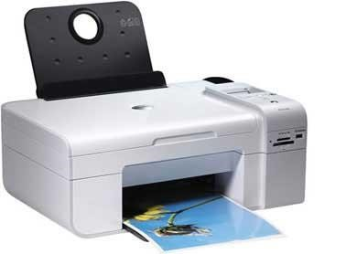
Inkjet Printers
Inkjet printers are non-impact character printers based on a relatively new technology. They print characters by spraying small drops of ink onto paper. Inkjet printers produce high quality output with presentable features.

