Slide 1


SIGNAL HOUSE
SEPTEMBER 2045
Creative
Solutions
MARKETING AGENCY PROFILE PRESENTATION
hello@reallygreatsite.com
www.reallygreatsite.com

Slide 2


SIGNAL HOUSE
SEPTEMBER 2045
Agenda
Introduction
Our Experience
Our Services
Our Notable Clients
Our Strengths
Our Previous Work

Slide 3




SIGNAL HOUSE
SEPTEMBER 2045
Introduction
We are a comprehensive marketing agency dedicated to assisting brands in their growth and audience engagement. By integrating creativity with data-driven strategies, we develop impactful campaigns that deliver measurable outcomes. Our approach blends strategic thinking, creative brilliance, and digital know-how to cultivate unforgettable brands.

Slide 4

SIGNAL HOUSE
SEPTEMBER 2045
DIGITAL MARKETING
CAMPAIGN STRATEGY
Through social media management, targeted advertising, and SEO, we propel online growth and enhance your brand’s visibility.
We create and implement powerful campaigns for product launches, promotions, and brand activations that drive engagement and deliver results.
Our Services
BRANDING & IDENTITY
CONTENT CREATION
We build strong brand foundations through memorable logos, cohesive visuals, and strategic planning to engage your audience.
Our team creates exceptional content that encompasses photography, videography, and copywriting to effectively convey your brand's story.

Slide 5
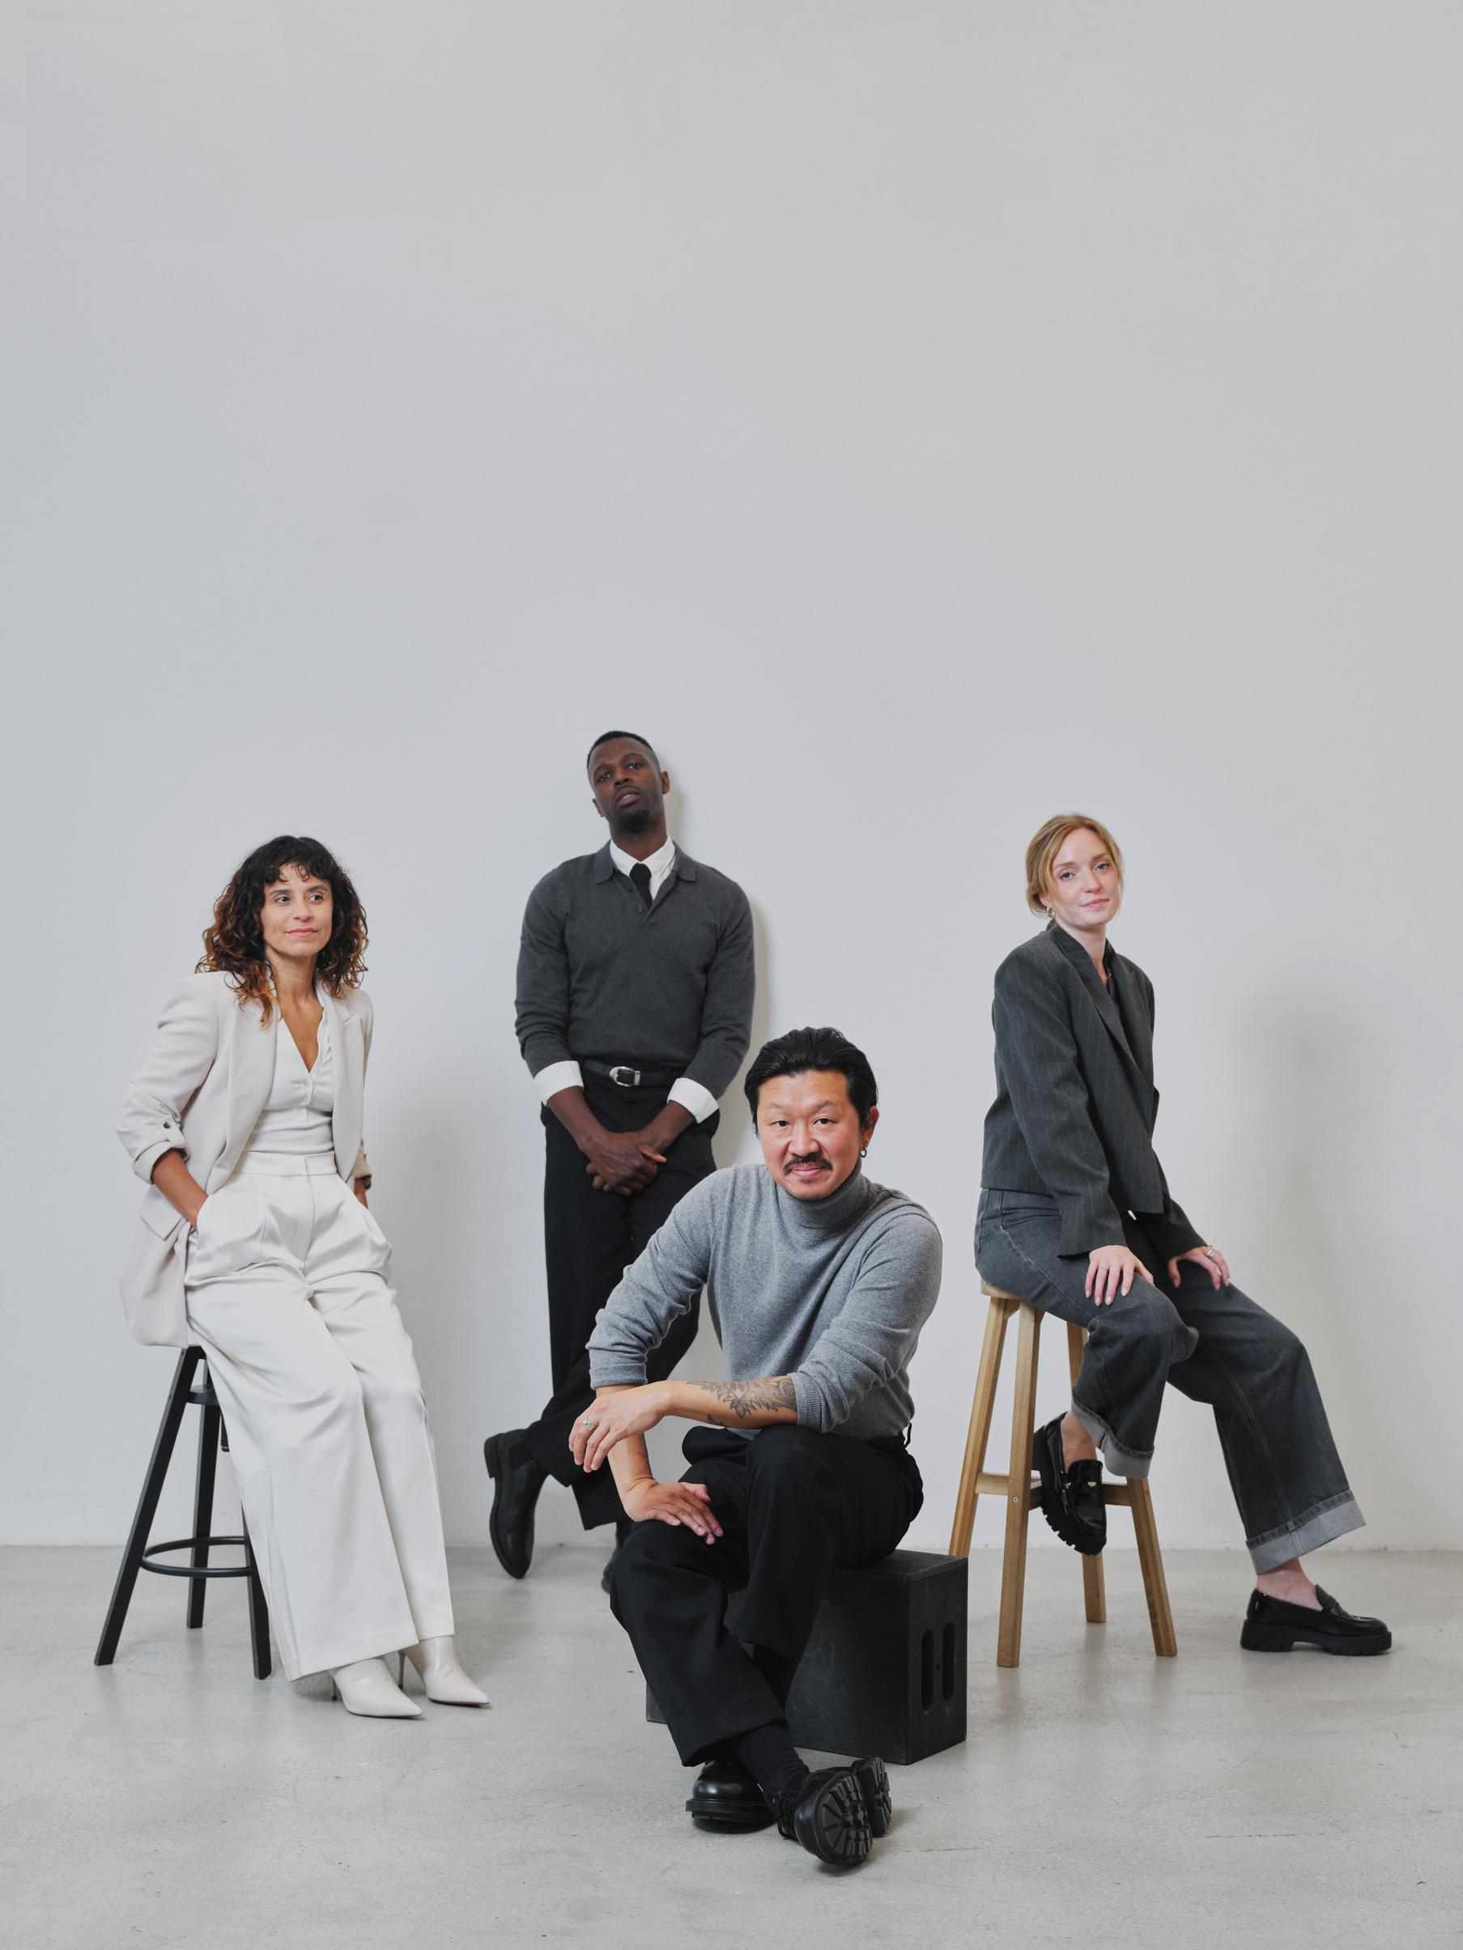
SIGNAL HOUSE
SEPTEMBER 2045
Our Strengths
CREATIVE & TREND DRIVEN EXECUTION
FAST, AGILE, AND ADAPTIVE TEAM
STRONG FOCUS ON ROI AND GROWTH

Slide 6
SIGNAL HOUSE
SEPTEMBER 2045
We don’t just design
visuals. We craft brand
experiences that leave
lasting impressions.

Slide 7
SIGNAL HOUSE
SEPTEMBER 2045
Our Experience
5
50
80
YEARS OF INDUSTRY PROFESSIONAL EXPERIENCE
CLIENTS HAVE BEEN COLLABORATING WITH US.
PROJECTS ARE COMPLETED EXCEPTIONALLY WELL.

Slide 8






SIGNAL HOUSE
SEPTEMBER 2045
Our Notable Clients
ARTSY CAFE
BRICK REALTY
RADIANT BEAUTY
LUXE HOTEL
STREET & STITCH
TOWN & CO

Slide 9
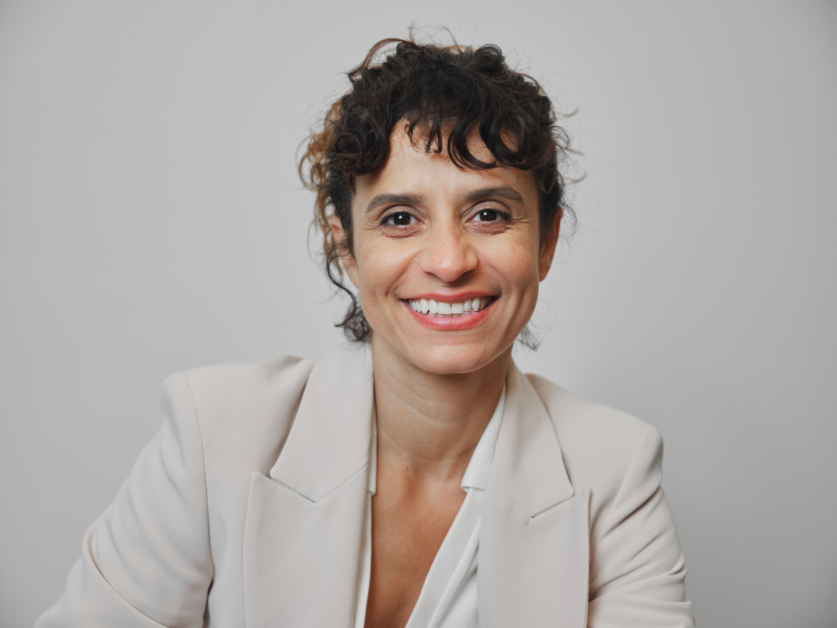
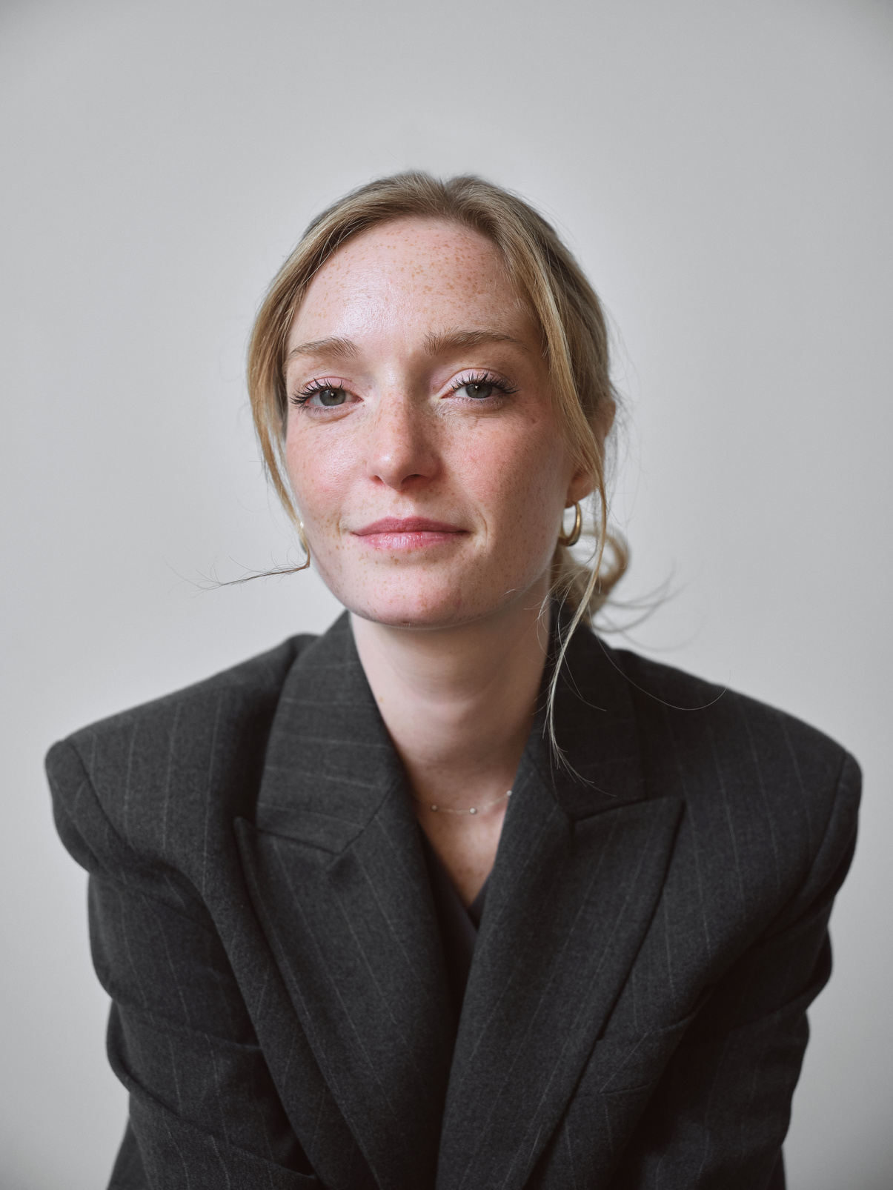
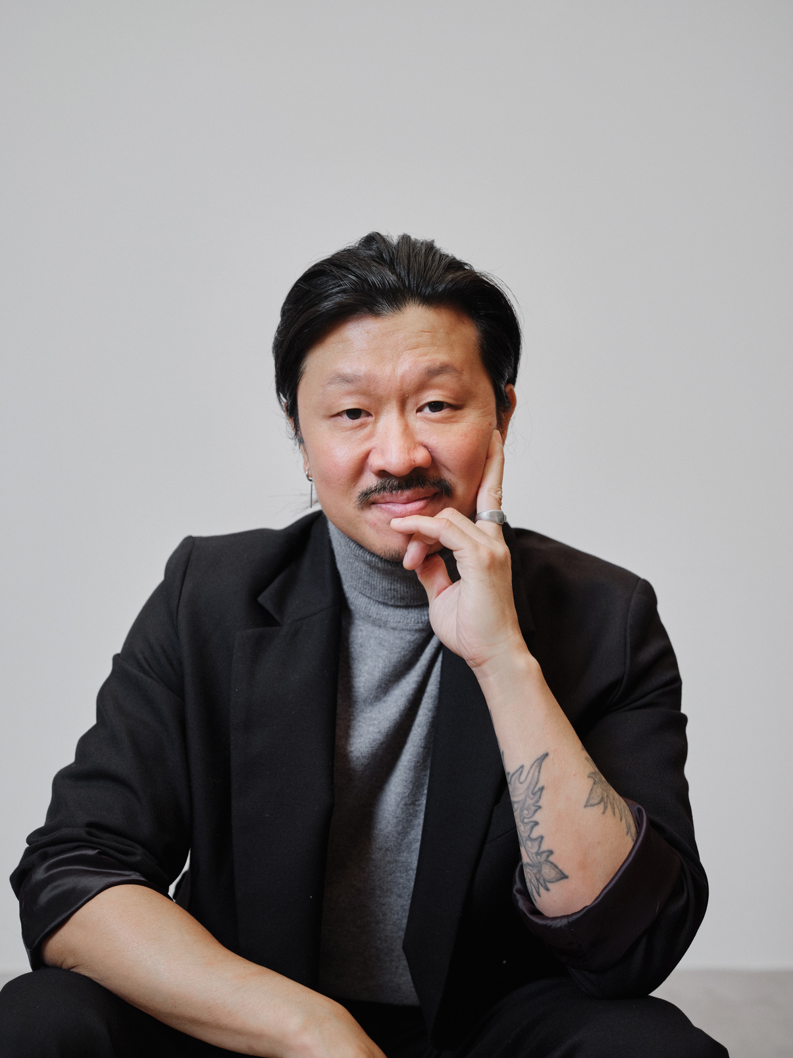
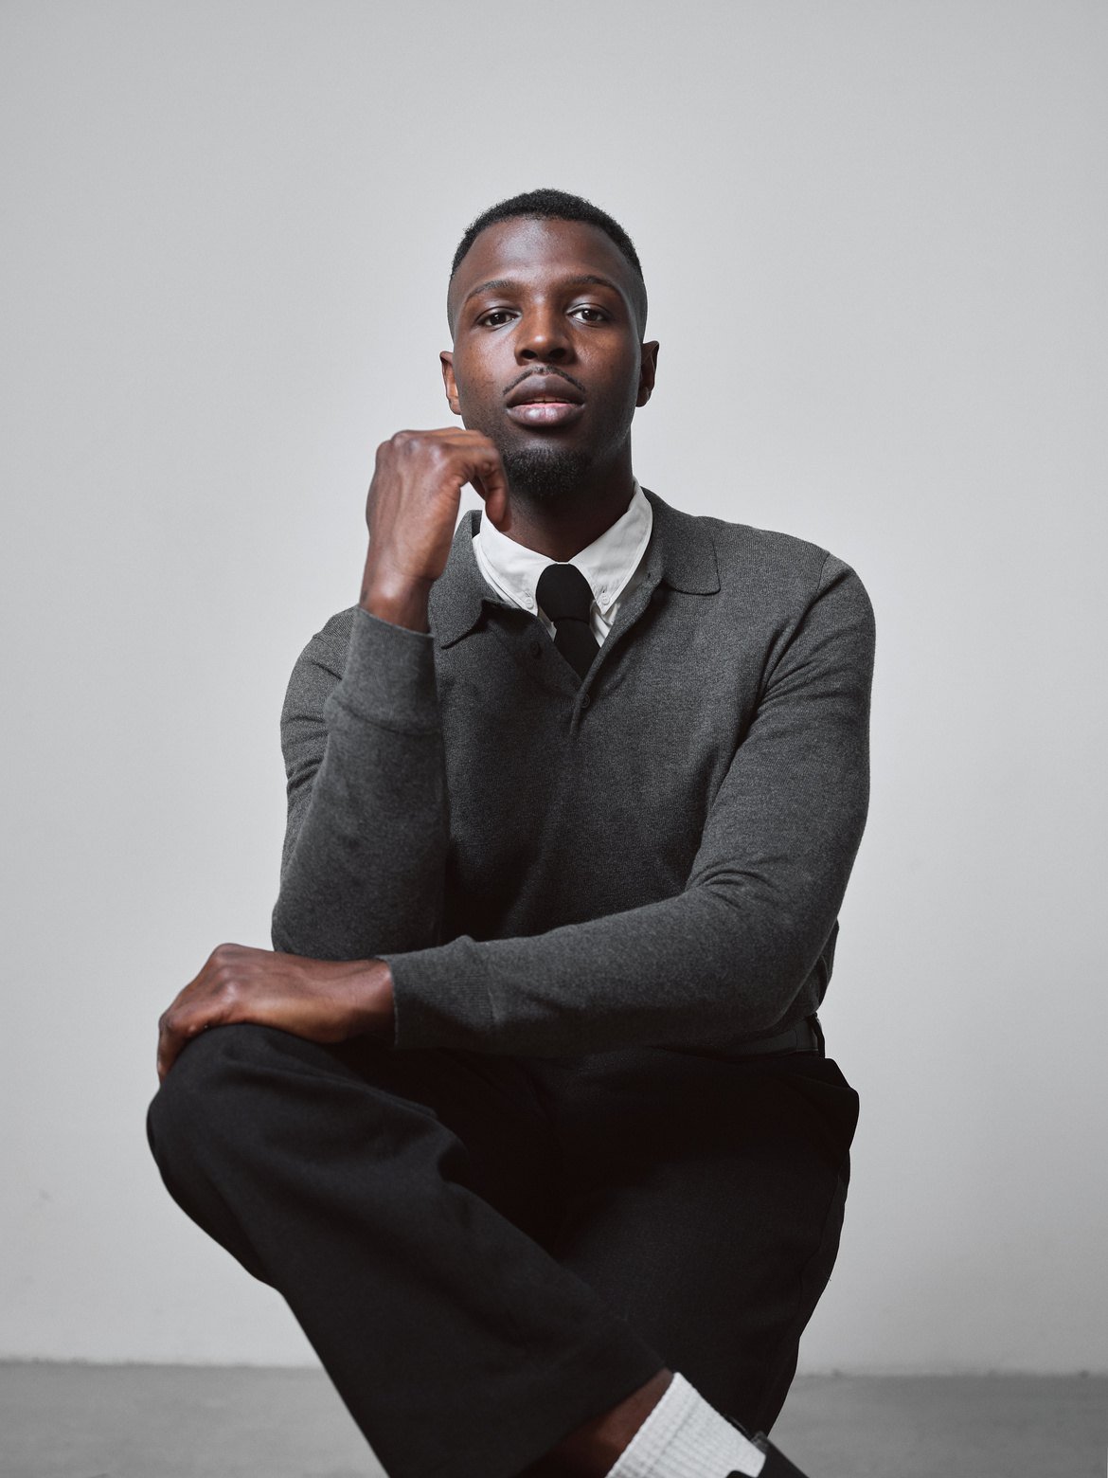
SIGNAL HOUSE
SEPTEMBER 2045
Meet the Team
AMY FLETCHER
RACHEL COLLINS
CALLUM PRICE
DANIEL MORTON
Creative Director
Marketing Strategist
Content Creator
Project Manager

Slide 10

SIGNAL HOUSE
SEPTEMBER 2045
Our Previous Work
CAMPAIGN STRATEGY FOR RADIANT BEAUTY
By blending audience insights, creative storytelling, and strategic media planning, we delivered a data-driven campaign that reinforced the brand's identity and maximized audience impact.

Slide 11
SIGNAL HOUSE
SEPTEMBER 2045
Let's Work Together
to Enhance Your
Brand Presence!
+123-456-7890
123 Anywhere St., Any City
hello@reallygreatsite.com
www.reallygreatsite.com

