Slide 1
Agentic Reinforcement Learning for Medical Vision: A New Frontier in Interactive Image Analysis
Synthesizing Multi-step Reasoning, Tool Orchestration, and Iterative Refinement
Presented by:
Name: MD Jahid Hasan Jim
Roll : 2107054
Department: Computer science and Engineering
Institution : Khulna University of Engineering & Technology
Date : 20/04/2026
20/04/2026
CSE 3230 – Technical Writing & Seminar
01

Slide 2
Overview
01
Motivation & Problem Statement
02
Background & Related Work
03
IBISAgent
04
MedVistaGym & MedVista-R1
05
MedSAM-Agent
06
Comparative Analysis
07
Open Challenges & Future Directions
08
Conclusion
20/04/2026
CSE 3230 – Technical Writing & Seminar
02

Slide 3
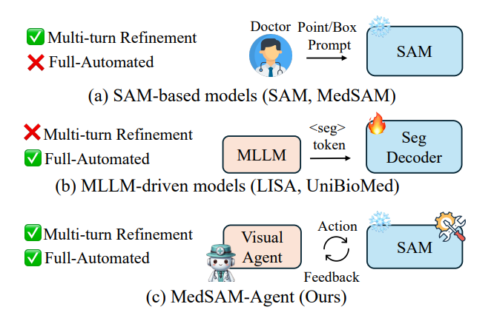

Motivation & Problem Statement
Why we need agentic medical image analysis
Task-Specific Supervised Models
U-Net works well within its training set, but falls apart on data from a different hospital or an unfamiliar pathology.
Interactive Models Require Expert Prompting
MedSAM handles unseen data, but every image still needs a clinician to draw boxes manually — not practical at scale.
LISA-Style Implicit Token Approach
The <SEG> token breaks the model's language ability and locks it into one single pass — no
going back
No Iterative Refinement
Figure 1: Three Segmentation Paradigms
Every existing method commits to one prediction and stops. A radiologist would never work
that way.
(a) SAM-based (b) MLLM-driven (c) Agentic
20/04/2026
CSE 3230 – Technical Writing & Seminar
03

Slide 4

Background & Related Work
nnU-Net
MedSAM / LISA
2015
Auto-configured
2023
Med-domain + <SEG>
2026
U-Net
2021
SAM
2024
Agentic RL
Task-specific FCN
Promptable foundation
Multi-turn MDP agents
Evolution of the field
LISA-Style Limitations
Agentic Approach Advantages
Implicit <SEG> token alters language distribution
Preserves MLLM's native text output space entirely
Joint fine-tuning raises catastrophic forgetting risk
Works in loops: think, act, observe, correct, like a human
Single-turn: no iterative refinement possible
External tools give real-time feedback at every step
Cannot support mask refinement workflows
RL trains the model to interact efficiently, not just randomly
20/04/2026
CSE 3230 – Technical Writing & Seminar
04

Slide 5
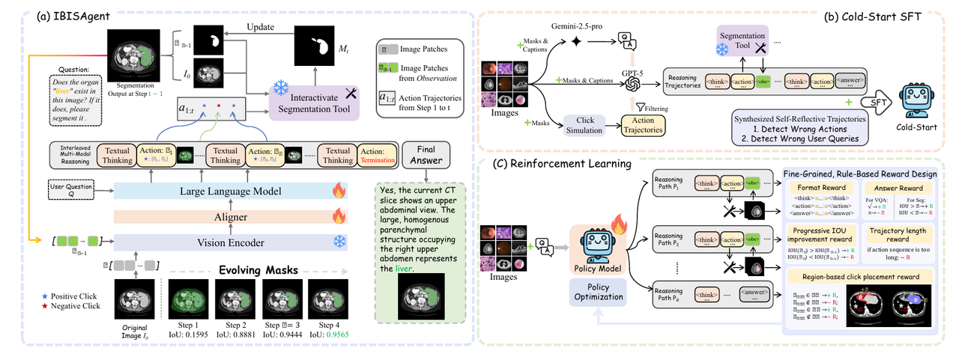
IBISAgent — Architecture & Core Formulation
Jiang et al., 2026 · Zhejiang University & Shanghai AI Lab
Segmentation as a Multi-Step Markov Decision Process
01.
Textual Thinking rt
Internal reasoning conditioned on interaction history
and current visual observation
02.
Action at
Text-based click: {Target, Attribute ∈ {+1,−1}, Coordinate_2d ∈ [0,1]²}
03.
Observation ot
Updated mask Mt overlaid semi-transparently on image
re-encoded by vision encoder
Figure 2: IBISAgent Framework Overview
Policy: rt+1, at+1 ~ πθ(· | I, Q, P<t) ·Reward S = ⅕(Sans + Sformat + Sclick + Spseg + Slen)
20/04/2026
CSE 3230 – Technical Writing & Seminar
05

Slide 6
IBISAgent — Two-Stage Training & Reward Design
Cold-Start SFT → Agentic GRPO Reinforcement Learning
STAGE 1: COLD-START SFT
STAGE 2: AGENTIC RL(GRPO)
01
01
456K samples from BioMedParseData (3.4M images,9 modalities)
888K VQA samples — pixel-level + general medical reasoning
02
02
Five rewards working together: output format, mask quality, click placement, step progress, trajectory length
Gemini-2.5-Pro was used to write diverse question-answer pairs for each image
03
03
GPT-5 wrote the reasoning behind every click , from the model's limited view, not the oracle's
Sclick: penalizes +clicks outside FN and −clicks outside FP regions
04
04
Self-reflective trajectories: self-correction + user-inconsistency
handling
Spseg = 𝟙(ΔIoUt > 0): rewards monotonic mask improvement
05
05
Average trajectory length: 8.69 steps, Avg IoU: 94.27
Slen: linear penalty for steps exceeding optimal threshold Topt
20/04/2026
CSE 3230 – Technical Writing & Seminar
06

Slide 7
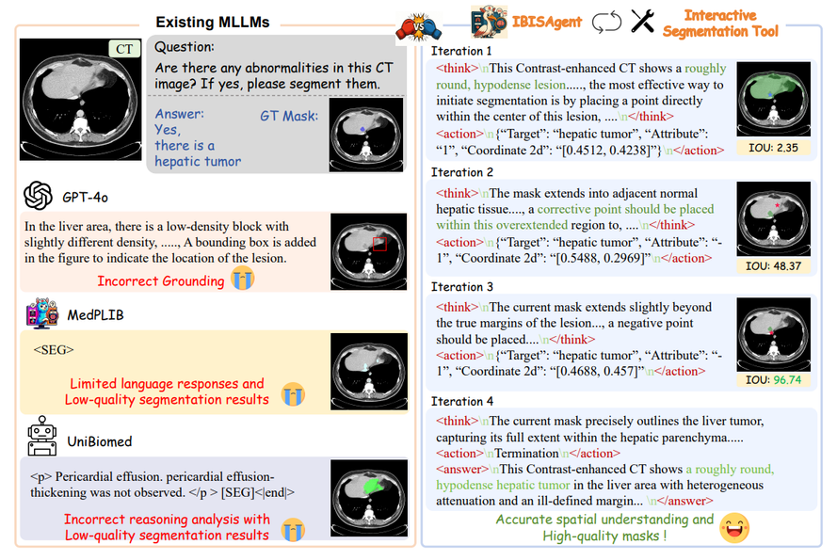
IBISAgent — Experimental Results
In-domain · Out-of-domain · Held-out benchmarks
85.58%
80.63%
72.09%
+35pt
In-Domain IoU
OOD IoU (MeCOVQA-G+)
Held-out IoU
Avg. IoU improvement
vs 50.74% (UniBiomed)
vs 46.54% (Citrus-V)
7 cancer types, 3 centers
over next-best medical MLLM
IBISAgent — Experimental Results
IBISAgent (Ours) | 85.58% | 80.63%
UniBiomed | 50.74% | 24.88%
Citrus-V | 30.61% | 46.54%
METHOD
In-Domain IoU
OOD IoU
MMedAgent | 36.13% | 26.54%
MedPLIB | 22.29% | 33.36%
Figure 3: Qualitative Comparison — Hepatic Tumor Case
20/04/2026
CSE 3230 – Technical Writing & Seminar
07

Slide 8
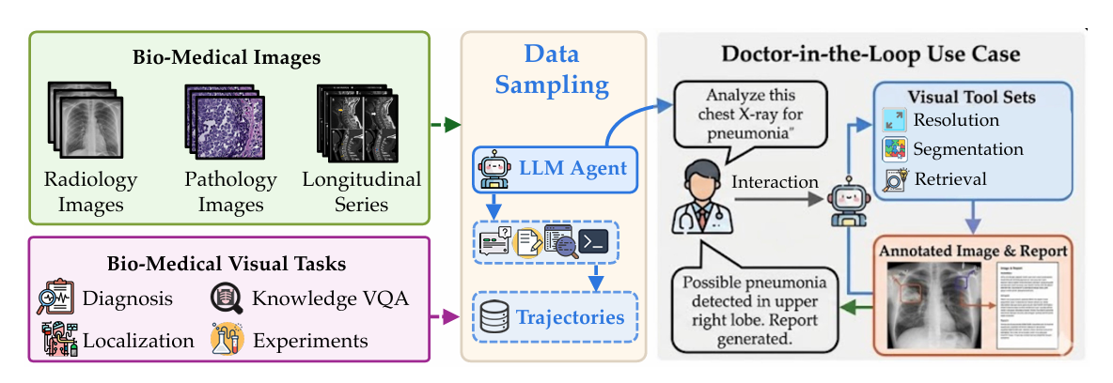
MedVistaGym — Scalable Agentic Training Environment
Lu et al., 2026 · Virginia Tech · UT Southwestern · Georgia Tech · Cisco
A training playground where the model learns to pick and use medical tools
At each step $t$, the agent t$hinks g_{t}$, selects an action $a_{t}∈A$, and receives an observation $o_{t}$from the environment. This repeats until a final answer is produced. Trajectory: U = (g0, a0, ..., gT, ŷ)
15 Tools in 4 Families
01.
Resolution & Refinement
4KAgent: super-res (2×–16×), dehazing, denoising, brightening
02.
Localization & Segmentation
GroundingDINO · SAM2 · BioMedParse · MedSAM2
03.
Visual Understanding & Parsing
BiomedCLIP: zero-shot classification across label types
04.
Knowledge Retrieval
Figure 4: MedVistaGym Environment Overview
GoogleSearch · DrugBank · PubMed · LongDocRAG
20/04/2026
CSE 3230 – Technical Writing & Seminar
08

Slide 9
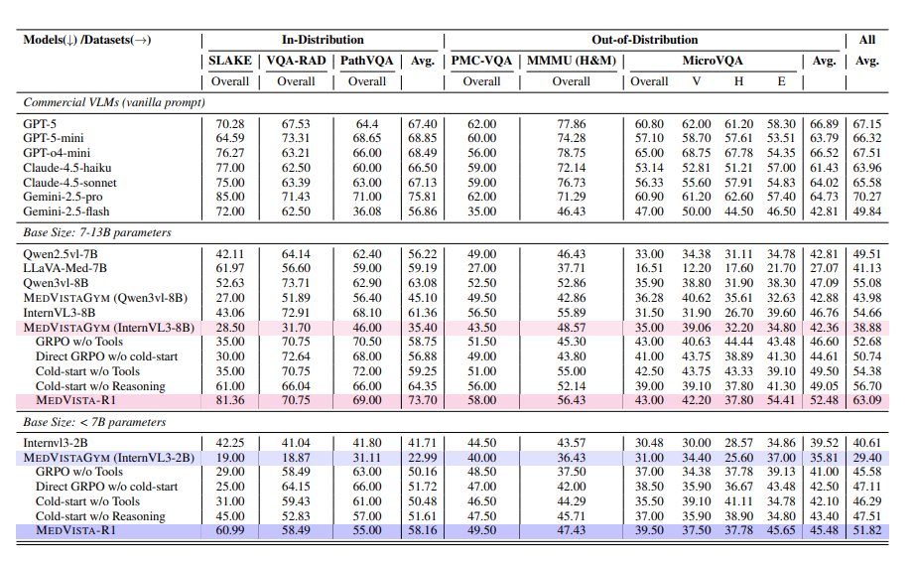
MedVista-R1 — Training Framework & Results
Two-stage SFT + GRPO · InternVL3-8B backbone
STAGE 1: COLD-START SFT
+19–24%
73.70%
63.09%
2B≈8B
01
GPT-5 generates candidate trajectories via live tool invocations
in MedVistaGym
over tool-access
w/o RL
In-domain avg accuracy
Overall 6-benchmark avg
Parameter efficiency gain
02
If the final answer was wrong, the trajectory got thrown out
03
Second GPT-5 pass assigns 4-point quality score for trajectory
filtering
04
Teaches the model how tool calls are supposed to look before RL starts
STAGE 2: AGENTIC RL (GRPO)
01
3-component reward: Rformat + Racc + Rtool
02
Tool reward only fires when the tool was actually useful not just for calling it
03
Max 6 tool calls per query; rollout terminates on repeated actions
04
Training on 8× A100 GPUs with asynchronous tool execution
via Ray
Table 1: Main Results across 6 Benchmarks
20/04/2026
CSE 3230 – Technical Writing & Seminar
09

Slide 10
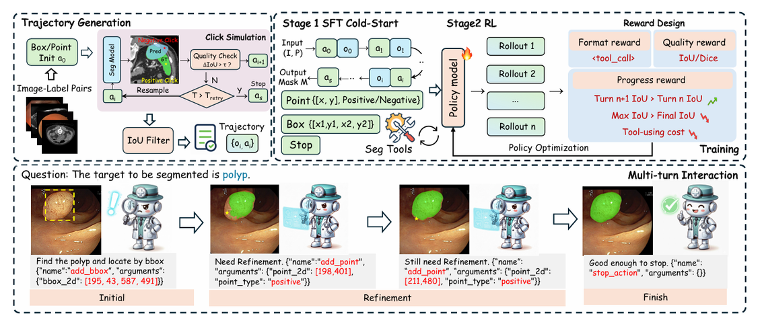
MedSAM-Agent — Hybrid Action Space & Process Rewards
Liu et al., 2026 · CUHK · Tencent Hunyuan · Stanford
Three Key Innovations
01
Hybrid Action Space
Draw a box first to anchor the target area, then refine with clicks, then tell it to stop
02
Box-to-Point + Sequential-Click Trajectories
Two simulation strategies. Each click must improve IoU by at least 0.04 (ΔIoU ≥ τ=0.04) or get retried up to 5(N=5) times. Result: 449K–519K quality trajectories.
03
Clinical-Fidelity Process Rewards
Four process rewards: mask quality, step improvement, overshoot penalty, and cost — together they teach the model when to stop
Figure 5: MedSAM-Agent Pipeline Overview
Rtotal = w1·Rfmt + w2·clip(Rqual + λ1Rimp − λ2Rover − λ3Rcost, 0, 1)
20/04/2026
CSE 3230 – Technical Writing & Seminar
10

Slide 11
MedSAM-Agent — Two-Stage Training Pipeline
Expert Trajectory Generation → Cold-Start SFT → Clinical-Fidelity RL
Expert Trajectory Generation — Hybrid Prompting Strategy
Image–Mask
Pairs
Box-to-Point
Init a₀
Error-Driven
Clicks
ΔIoU ≥ τ
Check
IoU Filter
≥ threshold
449K SFT
Trajectories
21 datasets
419K images
bbox with jitter
ε~U(−δ,δ)
FN → positive
FP → negative
retry N=5
if fails → stop
prune low-
quality seqs
monotonically
improving seqs
STAGE 1: COLD-START SFT
STAGE 2: AGENTIC RL (GRPO)
01
Format :
01
RL Data:
Every action is wrapped in <tool_call> tags. The model learns to predict the next token in sequence — standard supervised learning.
Just 9K samples — but all hard cases needing 3–5 rounds. Easy examples teach nothing useful for RL
02
Loop:
02
Reward: Rqual:
After every click, the new mask is drawn on the image and shown back to the model. It sees how its own work is improving
wiou·IoUfinal + wdice·Dicefinal. Dice added because it is more sensitive to small lesions in class-imbalanced medical scenarios.
03
What is Frozen vs Trained:
03
Reward: Rimp (Progressive):
Visual encoder stays frozen. Only the language model weights get updated, using DeepSpeed ZeRO-3 for memory efficiency.
Σ max(0, IoUt − IoUt−1). Cumulative bonus for monotonic improvement. Discourages redundant clicks that don't contribute.
04
Dataset Scale:
04
Reward: Rover + Rcost:
449K samples (MedSAM2 trajectories) or 519K (IMISNet). IoU filter ≥ 0.7 applied. Both Box-to-Point and Sequential-Click paradigms included.
Rover = IoUmax - IoUfinal penalizes overshoot past peak. Rcost = linear length penalty. Together teach optimal stopping without ground truth IoU access.
20/04/2026
CSE 3230 – Technical Writing & Seminar
11

Slide 12
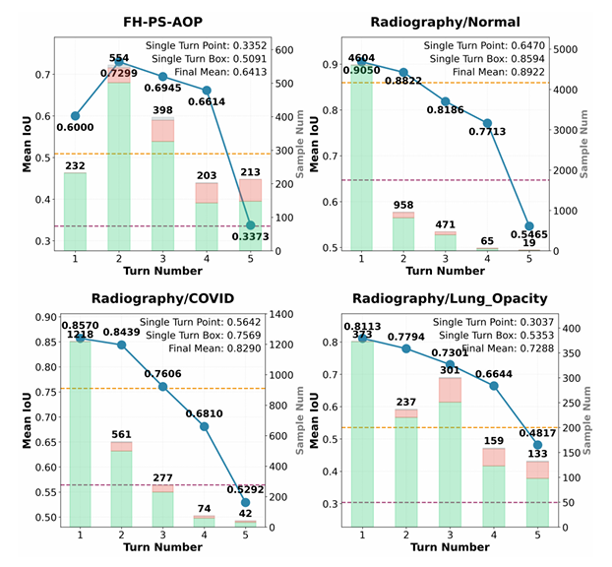
MedSAM-Agent — Results Across 6 Modalities & 21 Datasets
CT · MRI · X-Ray · Ultrasound · Fundus · Endoscopy
0.794
0.705
2.11
21
Avg Dice (MedSAM2)
Avg IoU (MedSAM2)
Avg interaction turns
Datasets evaluated
Ablation: Action Strategy Impact
Base (Qwen3-VL-8B) | 4.34 | 0.263 | 0.178
SFT only — Hybrid | 2.35 | 0.769 | 0.686
SFT — Click only | 2.94 | 0.719 | 0.623
SFT — Box only | 2.06 | 0.745 | 0.649
RL only | 2.23 | 0.678 | 0.593
Full SFT + RL | 2.11 | 0.794 | 0.705
Setting
nTurns
Dice
IoU
Figure 6: Multi-Turn Interaction Analysis
20/04/2026
CSE 3230 – Technical Writing & Seminar
12

Slide 13
Comparative Analysis — Action Space & Dataset Scale
Key differentiating factors across the three systems
Strengths & Trade-offs
IBISAgent
IBISAgent
Fine-grained spatial reasoning preserved
Action: Point clicks only
{Target, ±1, (x,y) ∈ [0,1]²} + Termination
Must initialize every mask from empty — potentially inefficient for large structures
Data: 456K SFT + 888K RL
BioMedParseData: 3.4M images, 9 modalities
MedSAM-Agent
MedSAM-Agent
Box initialization reduces avg turns 2.94 → 2.06; IoU 0.623 → 0.649
Action: add_bbox + add_point (±1) + stop_action
Hybrid Box-to-Point & Sequential-Click
More complex action space requires careful trajectory curation
Data: 449K SFT + 9K RL (curated)
21 open-source datasets, 6 modalities
MedVistaGym
MedVistaGym
Action: Structured JSON tool calls
{tool_name, arguments} from 15 medical tools
Flexible multi-modal reasoning; handles knowledge retrieval beyond vision
Smallest training corpus; complex deployment (15 live tool services)
Data: ~10.5K SFT QA pairs
PathVQA · SLAKE · VQA-RAD + OOD benchmarks
20/04/2026
CSE 3230 – Technical Writing & Seminar
13

Slide 14
Comparative Analysis — Reward Function Design
From outcome-only to rich process-level supervision
Reward Components Across Systems
 | MedVistaGym | IBISAgent | MedSAM-Agent
Format / Structure | Rformat (token order) | Sformat (token order) | Rfmt (tool + stop)
Final Answer Quality | Racc (binary match) | Sans (piecewise IoU) | Rqual (IoU + Dice)
Spatial Click Validity |  | Sclick (FN/FP regions)
Per-Step Improvement |  | Spseg (ΔIoU > 0) | Rimp (cumulative ΔIoU)
Stopping / Efficiency |  | Slen (length penalty) | Rover (overshoot) + Rcost (tool cost)
Tool Use Alignment | Rtool (conditional: tool + correct)
Component
20/04/2026
CSE 3230 – Technical Writing & Seminar
14

Slide 15
Synthesis - Convergent Design Principles Approaches Compared
Three Independently Confirmed Principles
01
Two-Stage Training: SFT Cold-Start → RL
All three systems confirm that SFT alone is insufficient and RL alone struggles with cold start. SFT establishes syntactic/semantic priors; RL optimizes long-horizon outcomes. Combined SFT+RL consistently outperforms either stage alone by substantial margins across all ablations.
Evidence: IBISAgent: +~15% IoU · MedSAM-Agent: 0.686 → 0.705 · MedVistaGym: +8.72% via RL
02
Visual Observation as Re-encoded Pixel Input
All three systems treat the current segmentation state as a visual object rather than a symbolic summary. IBISAgent and MedSAM-Agent overlay masks on the original image, re-encoding through the vision encoder at each step. MedVistaGym passes processed images (zoomed regions, segmentation masks) as multimodal evidence.
Evidence: Enables pixel-level reasoning to directly condition on evolving segmentation boundaries
03
Tool Access Without Policy Training is Insufficient
Critically, all three papers demonstrate that simply giving VLMs tool access degrades or fails to improve performance. IBISAgent: tools without RL = ~37% IoU. MedVistaGym: InternVL3+tools = 38.88% vs InternVL3 alone = 54.66%. MedSAM-Agent: direct RL without SFT fails in complex modalities.
Evidence: Policy training (not tool access) is what unlocks effective tool-integrated reasoning
20/04/2026
CSE 3230 – Technical Writing & Seminar
15

Slide 16
Open Challenges & Future Research Directions
Critical Open Problems
Future Research Direction
01
3D Volumetric Extension
01
Unified Action Space
All three work only on 2D slices. Real clinical CT and MRI is 3D — a harder problem none of these systems can handle yet.
Combine IBISAgent's spatial click precision with MedVistaGym's 15-tool library — neither system currently realizes this
02
Richer Process Rewards
02
Data Construction Bottleneck
Combine MedSAM-Agent's overshoot penalty + IBISAgent's click placement reward + conditional tool-use — for denser training signal
IBISAgent: GPT-5 reasoning synthesis on 456K samples + human review. MedVistaGym: live deployment of 15 tool services during generation. Significant engineering overhead limits reproducibility.
03
Standardized Evaluation
IBISAgent, MedVistaGym and MedSAM-Agent use different metrics and benchmarks — a common evaluation suite is urgently needed
03
Knowledge Gap Failure Mode
A case in MedVistaGym: all tools worked perfectly, fracture located correctly — yet the agent named the wrong fracture type. RL can't fix bad medical knowledge
04
Medical Knowledge Integration
Supplement tool augmentation with structured diagnostic knowledge bases to close the knowledge-gap failure mode
04
Clinical Deployment & Latency
Efficient Multi-turn Inference
None of these systems has been tested on real patients. IBISAgent takes 28.7 seconds per image — too slow for emergencies.. Adaptive stopping + early-exit mechanisms are essential for high-throughput clinical use.
05
Speculative decoding, KV-cache optimization, early-exit mechanisms for near-real-time clinical deployment
20/04/2026
CSE 3230 – Technical Writing & Seminar
16

Slide 17

Conclusion
01
Reformulating segmentation as iterative MDP yields consistent, substantial improvements across all benchmarks and imaging modalities.
02
Two-stage SFT + RL is a convergent, principled solution — not an implementation detail — confirmed independently by all three teams.
03
Tool access alone is harmful without policy training. RL is the essential ingredient that transforms tool availability into tool effectiveness.
04
Richer process rewards (click validity, monotonic improvement, overshoot penalty) outperform outcome-only rewards at every ablation point.
20/04/2026
CSE 3230 – Technical Writing & Seminar
17

Slide 18
Thank You
20/04/2026
CSE 3230 – Technical Writing & Seminar
18

Slide 19
References
01.
MedSAM-Agent: Empowering Interactive Medical Image Segmentation with Multi-turn Agentic Reinforcement Learning
02.
IBISAgent: Reinforcing Pixel-Level Visual Reasoning in MLLMs for Universal Biomedical Object Referring and Segmentation
03.
MEDVISTAGYM: A Scalable Training Environment for Thinking with Medical Images via Tool-Integrated Reinforcement Learning
20/04/2026
CSE 3230 – Technical Writing & Seminar
19

Slide 20
QUESTIONS
AND
ANSWERS
20/04/2026
CSE 3230 – Technical Writing & Seminar
20

