Slide 1





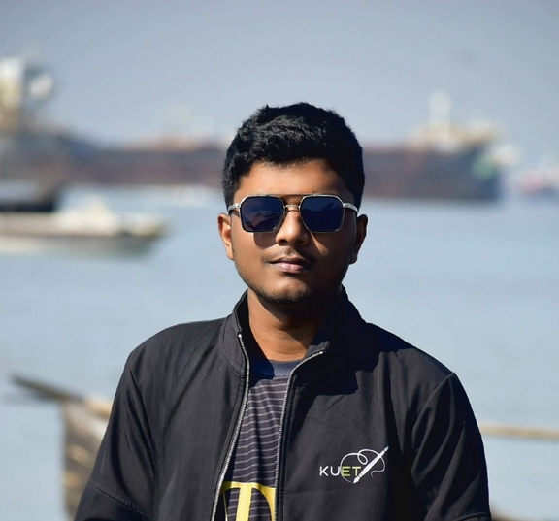












MD Jahid Hasan Jim
CSE Undergraduate, KUET
01581705456
mdjahidhasanjim277@gmail.com
jim2107054
md-jahid-hasan-jim
Rangpur, Bangladesh
Education
Building strong computer science fundamentals for real-world problem solving.
Tech Stack
Khulna University of Engineering and Technology
Bachelor of Science - BSc, Computer Science
Jan 2023 - Present
Android, iOS, Web app ,
Desktop App Development
Core Concepts
Chilmari Government College
Higher Secondary Certificate (H.S.C.) , Science
Oct 2019 - Dec 2021
Programming, Algorithms, Database,
System Design, Statistics.
28/01/2026
01

Slide 2


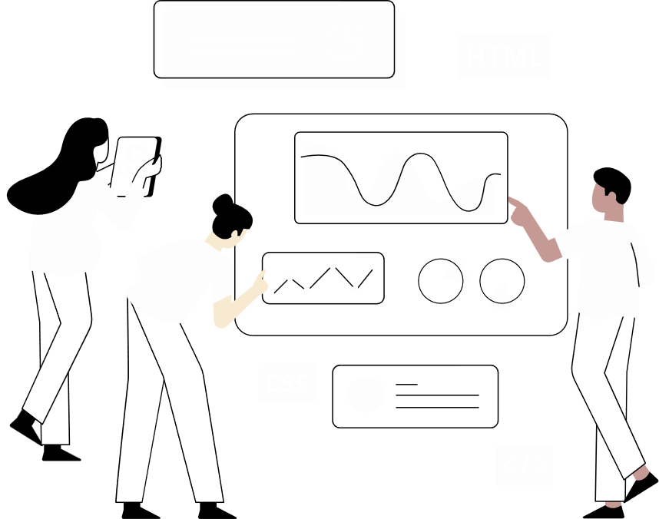









Skills
Competitions
Using modern technologies to build reliable and scalable software.
Strengthening problem-solving and teamwork through competitive environments.
Frontend
Backend
Database
Datathon
Hackathon
Nextjs
Fastify
MongoDB
Reactjs
Nodejs
MySQL
Finalist CUET CSE Fest-2025
DU AI Hackathon-2025
React-Native
FastAPI
PostgreSQL
TailwindCSS
Rest API
Firebase
BUET CSE Fest-2026
PHP
Laravel
Finalist KU CSE Fest-2024
Finalist Bit Fest-2025, KUET
Projects
Codeforces : 1140(Max)
LeetCode: 1472(Max)
Developing real-world applications that solve practical problems.
250+ problems solved (Codeforces , LeetCode)
01
Housely (Mobile app)
Experiences
Housely is a mobile app that helps people find rental houses easily.
Delivering real client projects
in professional software
environments.
02
Clicon (Web app)
Clicon is an online shopping website for electronic gadgets.
Software Developer
AlgoSoft Technologies Limited
Duration: 6 Months
03
Prescripto (Web app)
Prescripto is a system for patients to book doctor appointments online.
Co-Founder
AlgoOasis
Oct 2025 - Present
28/01/2026
02

