Slide 1
A New Approach to Use Big Data Tools to Substitute Unstructured Data Warehouse
2020 IEEE Conference on Big Data and Analytics (ICBDA)
School of Computing, Southern Institute of Technology Invercargill, New Zealand
Author: Oras Baker, Chuong Nguyen Thien
Presenter : 李冠宏

Slide 2
Outline
Abstract
Introduction
Related works
Proposed system
Database design
Test method
Implementation and result
Conclusion

Slide 3
Outline
Abstract
Introduction
Related works
Proposed system
Database design
Test method
Implementation and result
Conclusion

Slide 4
Abstract
Data warehouse and big data have become the trend to help organize data effectively. Business data are originating in various kinds of sources with different forms from conventional structured data to unstructured data, it is the input for producing useful information essential for business sustainability.
In this research, we utilized the IBM BigInsights Text Analytics, PostgreSQL, and Pentaho tools, an unstructured data warehouse is implemented and worked excellently with the unstructured text from Amazon review datasets, the new proposed approach creates a practical solution for building an unstructured data warehouse.
Notes:
數據倉庫和大數據目前已經成為有效幫助組織數據的趨勢。 而商業的資料源於各種不同形式的來源，從傳統的結構化數據到非結構化數據，它是產生對商業可持續發展性至關重要之有用訊息的輸入。 本文利用了 IBM BigInsights 文字分析、PostgreSQL 和 Pentaho 工具，實作了一個非結構化數據倉庫，並與來自亞馬遜評論資料集的非結構化文本協同工作的很好，而新提出的方法為建構非結構化數據倉庫創建了一個實用的解決方案 .

Slide 5
Outline
Abstract
Introduction
Related works
Proposed system
Database design
Test method
Implementation and result
Conclusion

Slide 6
Introduction
Conventional structured data : details of employees stored in relational databases
Unstructured data : like emails or text documents
Most of the data is unstructured data, which occupies about 80 percent of an enterprise’s data
As more and more enterprises recognize the values and advantages associated with big data insights, the adoption of big data tools like Hadoop ecosystem is growing.
Notes:
資料的分類大約分成兩種
傳統的結構化資料：像是儲存在關聯式資料庫的員工詳細資料
非結構化資料：像是電子郵件或文字檔
大多數的資料都是非結構化資料，在企業中，非結構化資料大約佔了80% 隨著越來越多的企業認知到與大數據洞察力相關的價值和優勢，Hadoop 生態系統等大數據工具的採用正在增長。

Slide 7
Introduction
The aim of this research is to propose a solution for building an unstructured data warehouse with big data tools and to demonstrate that traditional data warehouses can support unstructured data by an intermediate phase to convert unstructured data to structured data before it is loaded into data warehouses.
With the help of this method, organizations can still use their current data warehouses with an additional component to support unstructured data.
Notes:
本研究的目的是提出一種使用大數據工具構建非結構化數據倉庫的解決方案，並演示傳統數據倉庫可以透過中間階段支援非結構化數據，且在非結構化數據加載到數據倉庫之前將其轉換為結構化數據。
在這種方法的幫助下，企業組織仍然可以使用他們當前的數據倉庫和一個額外的組件來支持非結構化數據。

Slide 8
Outline
Abstract
Introduction
Related works
Proposed system
Database design
Test method
Implementation and result
Conclusion

Slide 9
Related works
[3] : Gupta and Rathore summarized the challenges to deal with unstructured data
[4] : Text mining, information retrieval, and information extraction
[5] : Text mining and natural language processing (NLP) are two techniques for knowledge discovery from textual context
[6] : Prasad and Ramakrishna examined various text analytics techniques to process text documents.
[3] Gupta, V., & Rathore, N. (2013). Deriving Business Intelligence from Unstructured Data. International Journal of Information and Computation Technology, 3(9), 971-976.
[4] Gonzalez, S. M., & Berbel, T. d. (2014). Considering unstructured data for OLAP: a feasibility study using a systematic review. Salesian Journal on Information Systems, 14, 26-35.
[5] Gharehchopogh, F. S., & Khalifelu, Z. A. (2011). Analysis and Evaluation of Unstructured Data: Text Mining versus Natural Language Processing. 2011 5th International Conference on Application of Information and Communication Technologies (AICT) (pp. 1-4). IEEE.
[6] Prasad, K. S., & Ramakrishna, S. (2010). Text Analytics to Data Warehousing. International Journal on Computer Science and Engineering (IJCSE), 02(06), 2201-2207.
Notes:
[3]：Gupta 和 Rathore 總結了處理非結構化數據的挑戰
[4]：文本挖掘、信息檢索、信息抽取
[5]：文本挖掘和自然語言處理（NLP）是從文本上下文中發現知識的兩種技術
[6]：Prasad 和 Ramakrishna 檢查了各種文本分析技術來處理文本文檔。

Slide 10
Related works
[7] : Sukumaran and Sureka indicated that the named entity extraction technique has been a research topic for many years
[8] : Gupta discussed the deriving facts and dimensions from unstructured data
[9] : Alqarni and Pardede proposed using WordNet, a large lexical database of English
[10] : Tekadpande and Deshpande proposed a system with the ETL process in Hive and traditional dimensional modelling in Hadoop.
[7] Sukumaran, S., & Sureka, A. (2006). Integrating structured and unstructured data using text tagging and annotation. Business Intelligence Journal, 11(2), 8-17.
[8] Gupta, V. (2013). Extracting Facts And Dimensions From Unstructured Data For Business Intelligence. International Journal of Engineering Research & Technology (IJERT), 2(7), 2602-2606.
[9] Alqarni, A. A., & Pardede, E. (2012). Integration of data warehouse and unstructured business documents. 2012 15th International Conference on Network-Based Information Systems (pp. 32-37). IEEE.
[10] Tekadpande,S.,&Deshpande,L.(2015).AnalysisandDesignofETL process using Hadoop. International Journal of Engineering and Innovative Technology (IJEIT), 4(12), 171-174.
Notes:
[7]：Sukumaran 和 Sureka 表示，命名實體提取技術多年來一直是一個研究課題
[8]：Gupta 討論了從非結構化數據中導出事實和維度
[9]：Alqarni 和 Pardede 提出使用大型英語詞彙數據庫 WordNet
[10]：Tekadpande 和 Deshpande 提出了一個系統，在 Hive 中使用 ETL 過程，在 Hadoop 中使用傳統的維度建模。

Slide 11
Related works
[10] : Tekadpande and Deshpande used the star schema for multidimensional modelling and different transformations such as filter, aggregations, and joins were carried out.
[11] : Sahiet and Asanka, proposed an approach to construct a data warehouse for unstructured data stored in NoSQL databases by supporting an ETL framework to extract, transform and load unstructured data from NoSQL databases to the traditional data warehouses.
[10] Tekadpande,S.,&Deshpande,L.(2015).AnalysisandDesignofETL process using Hadoop. International Journal of Engineering and Innovative Technology (IJEIT), 4(12), 171-174.
[11] Sahiet,D.,&Asanka,P.D.(2015).ETLframeworkdesignforNoSQL databases in dataware housing. International Journal of Research in Computer Applications and Robotics, 3(11), 67-75.
Notes:
[10]：Tekadpande 和 Deshpande 使用星型模式進行多維建模，並進行了過濾、聚合和連接等不同的轉換。
[11]：Sahiet 和 Asanka 提出了一種為存儲在 NoSQL 數據庫中的非結構化數據構建數據倉庫的方法，通過支持 ETL 框架從 NoSQL 數據庫中提取、轉換和加載非結構化數據到傳統數據倉庫。

Slide 12
Outline
Abstract
Introduction
Related works
Proposed system
Database design
Test method
Implementation and result
Conclusion

Slide 13
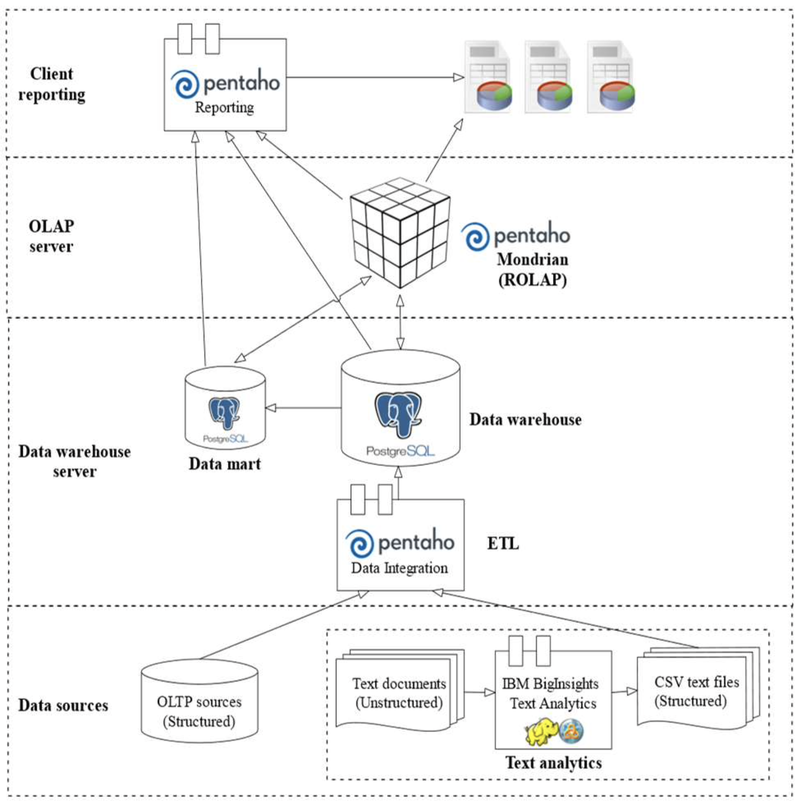
Proposed system
The proposed unstructured data warehouse follows the three-tier architecture.
unstructured textual data will be handled first by the Text Analytics platform before its structured results are combined with other structured data sources to be loaded into data warehouse servers in the bottom tier by Pentaho Data Integration tool in ETL process. ETL tasks will help transform the input structured text to match with the multidimensional data design.
Notes:
提出的非結構化數據倉庫遵循三層架構。 在此設計中，IBM BigInsights 文本分析平台不是替代而是擴充了組織現有的傳統數據倉庫，使它們能夠從非結構化文本源接收數據。
如圖 1. Architecture Design 所示，非結構化文本數據將首先由文本分析平台處理，然後其結構化結果與其他結構化數據源結合，由 Pentaho Data Integration 工具加載到底層的數據倉庫服務器中 ETL 過程。 ETL 任務將幫助轉換輸入的結構化文本以匹配多維數據設計。

Slide 14
Proposed system
Online analytical processing (OLAP) server is implemented with Pentaho Mondrian located at the middle layer to support reporting and querying the data warehouse. The top tier is the frontend layer with Pentaho reporting tools integrated with the OLAP server or data warehouse servers to help users make various analytics reports.
Notes:
位於中間層的Pentaho Mondrian實現了聯機分析處理（OLAP）服務器，支持數據倉庫的報表和查詢。 頂層是前端層，Pentaho 報告工具與 OLAP 服務器或數據倉庫服務器集成，以幫助用戶製作各種分析報告。

Slide 15
Proposed system
In order to import text documents into data warehouse, Text Analytics tool is used first to extract structured information from text documents to a Comma Separated Value (CSV) files, then Pentaho Data Integration tool is used to transform and load dimension data into data warehouse before fact data is transformed, mapped with dimension data and loaded into data warehouse.
Notes:
為了將文本文檔導入數據倉庫，首先使用Text Analytics工具將文本文檔中的結構化信息提取為逗號分隔值（CSV）文件，然後使用Pentaho Data Integration工具將維度數據轉換並加載到數據倉庫中 事實數據被轉換，與維度數據映射並加載到數據倉庫中。

Slide 16
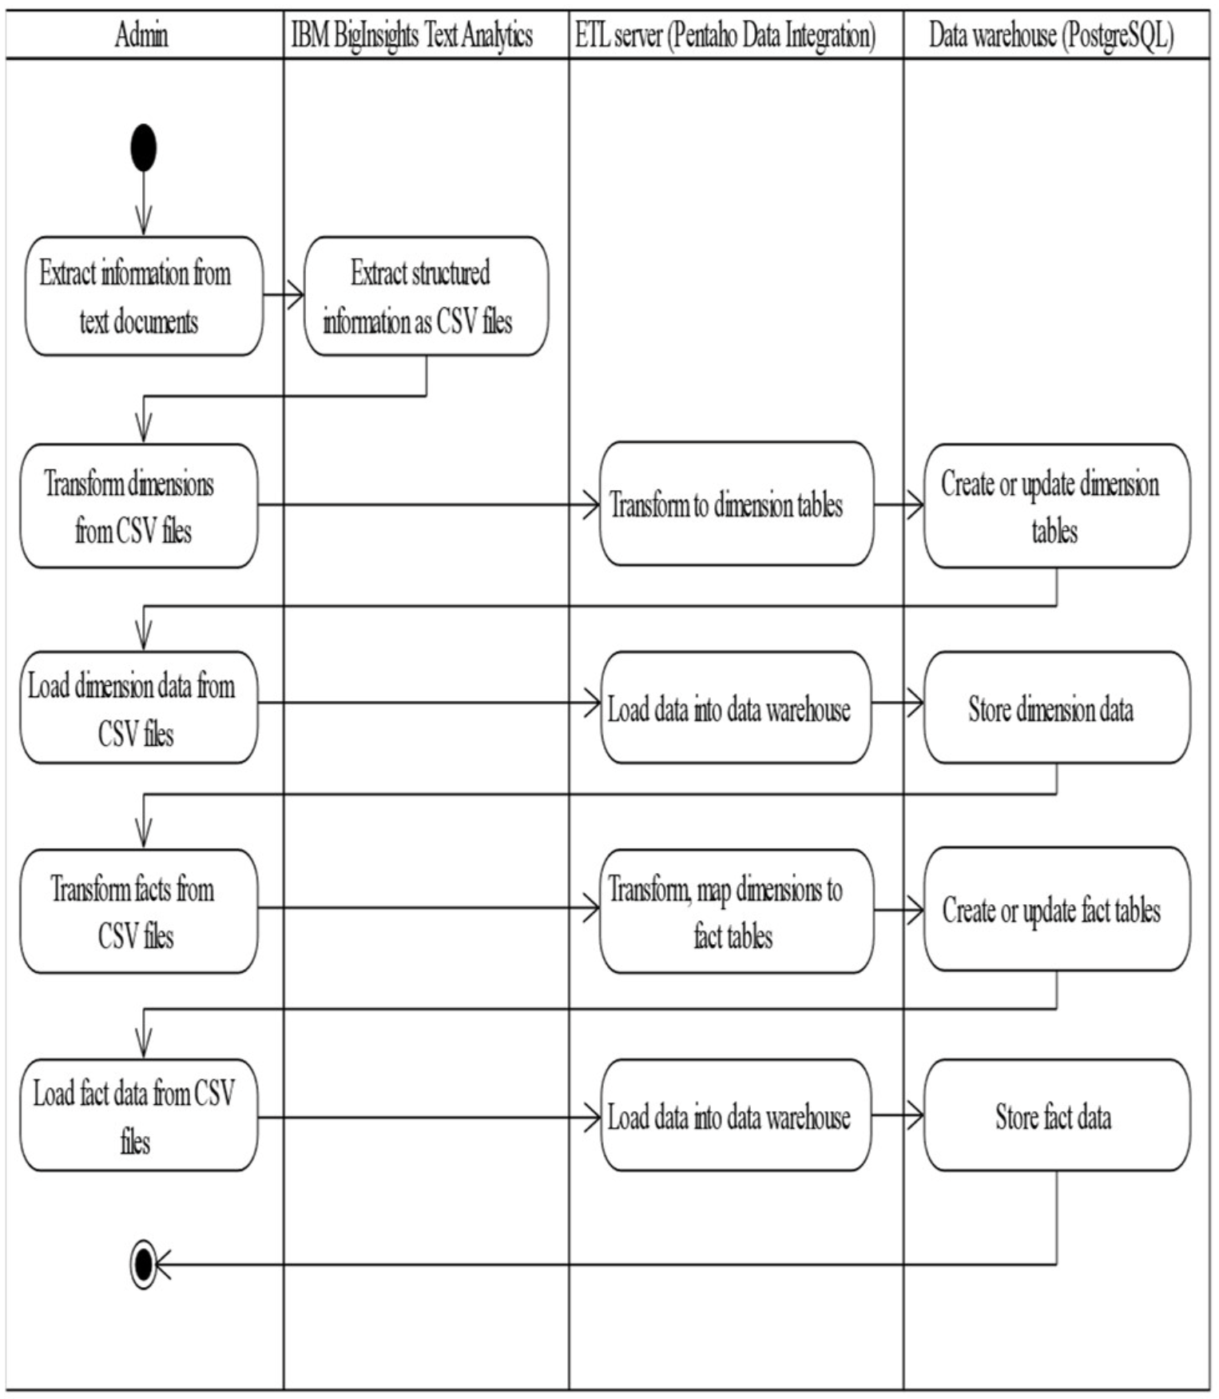
Proposed system
For new data import, new data tables for dimensions and facts will be created. For incremental data import, existing data tables of dimensions and facts will be updated or refreshed as shown in the activity diagram Fig. 2.
Notes:
對於新數據導入，將創建維度和事實的新數據表。 對於增量數據導入，維度和事實的現有數據表將被更新或刷新，如圖2的活動圖所示。

Slide 17
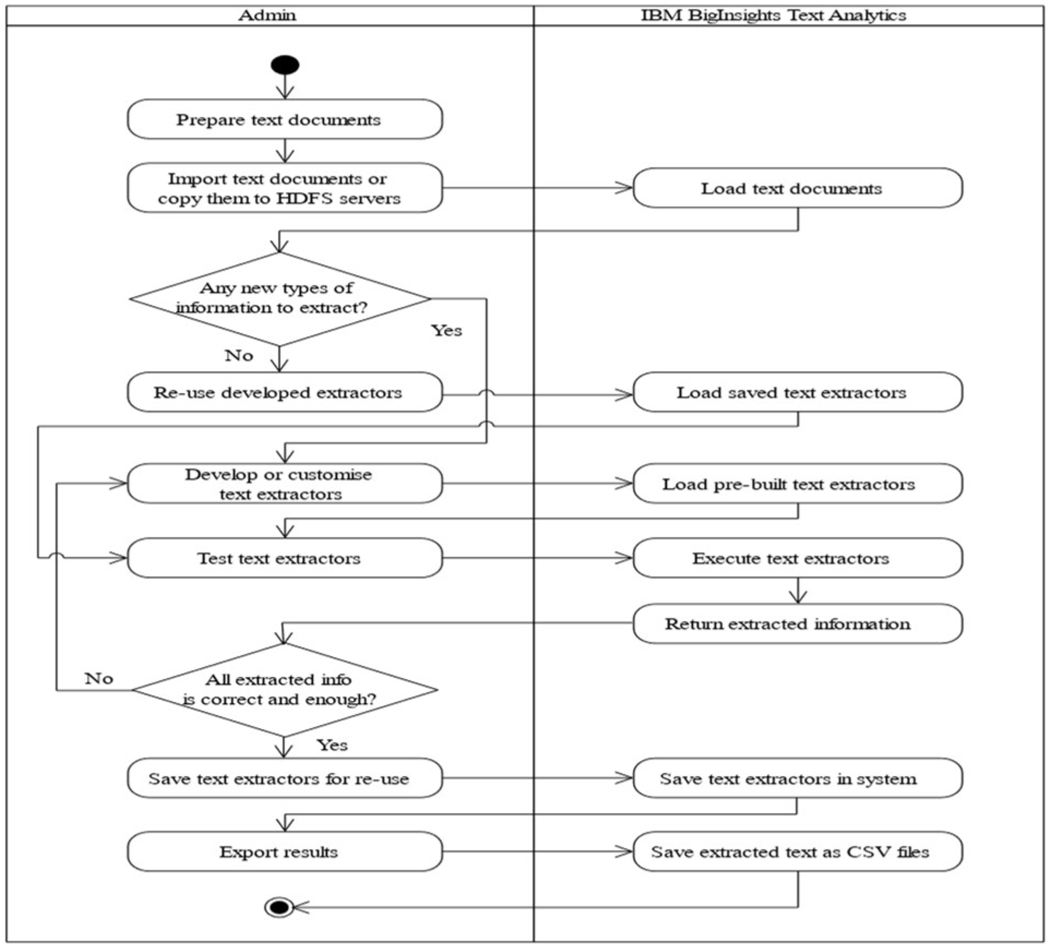
Proposed system
The process of extracting new text documents with incremental illustrated in Fig. 3. below show the detailed steps to extract new text documents that contain either new or existing types of information. The input files can be imported into Text Analytics web tool or put in HDFS servers. Users identify all the information to extract.
Notes:
圖 3 說明了使用增量提取新文本文檔的過程。下面顯示了提取包含新信息或現有類型信息的新文本文檔的詳細步驟。 輸入文件可以導入文本分析 web 工具或放在 HDFS 服務器中。 用戶識別要提取的所有信息。

Slide 18
Proposed system
Amazon customer reviews dataset will be used for this experiment. As introduced in its documentation page [14] this public dataset is available for academic researches, especially with millions of customer reviews as a rich source of unstructured text data for text analytics in this research.
[14] Amazon. (n.d.). Amazon Customer Reviews Dataset.
Notes:
亞馬遜客戶評論數據集將用於此實驗。 正如其文檔頁面 [14] 中所介紹的，此公共數據集可用於學術研究，尤其是將數百萬客戶評論作為本研究中文本分析的非結構化文本數據的豐富來源。

Slide 19
Outline
Abstract
Introduction
Related works
Proposed system
Database design
Test method
Implementation and result
Conclusion

Slide 20
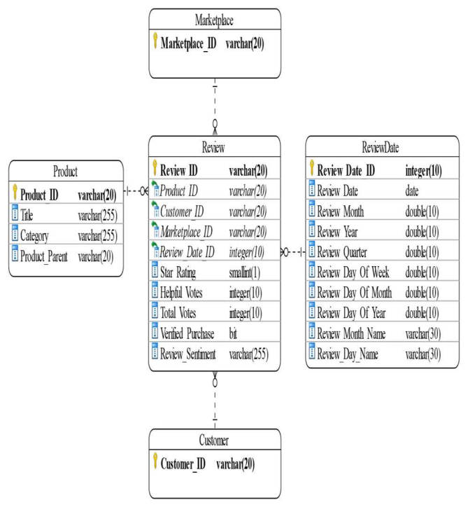
Database design
Data is designed with a multidimensional star schema as shown in Fig. 4. to support the multidimensional analytics reporting. Fact data is retrieved from the Text Analytics extractor results, and data for dimensions are extracted from the selected Amazon datasets.
Notes:
數據採用多維星型模式設計，如圖 4 所示，以支持多維分析報告。 事實數據是從文本分析提取器結果中檢索的，維度數據是從選定的 Amazon 數據集中提取的。

Slide 21
Database design
The review date is extracted along with the review data, then it is modelled in a separate time dimension with additional fields generated at the transformation step to help analyze review data with this time dimension from different perspectives.
Notes:
評論日期與評論數據一起提取，然後在單獨的時間維度中建模，並在轉換步驟中生成額外的字段，以幫助從不同角度分析具有該時間維度的評論數據。

Slide 22
Outline
Abstract
Introduction
Related works
Proposed system
Database design
Test method
Implementation and result
Conclusion

Slide 23
Test method
Testing will be conducted manually along with the implementation by verifying each phase output with the acceptance criteria:
Data extraction: Sample dataset files will be tamed by Text Analytics tool.
ETL process: Extracted text as CSV files will be transformed, cleansed and loaded into data warehouse.
Analytics reporting: OLAP cube can be created from data warehouse.
Notes:
通過使用驗收標準驗證每個階段的輸出，測試將與實施一起手動進行：
數據提取：樣本數據集文件將被文本分析工具馴服。
ETL 過程：將提取的文本作為 CSV 文件進行轉換、清洗並加載到數據倉庫中。
分析報告：可以從數據倉庫創建 OLAP 多維數據集

Slide 24
Outline
Abstract
Introduction
Related works
Proposed system
Database design
Test method
Implementation and result
Conclusion

Slide 25
Implementation and result
d
Notes:
數據提取：樣本數據集文件將被文本分析工具馴服。
ETL 過程：將提取的文本作為 CSV 文件進行轉換、清洗並加載到數據倉庫中。
分析報告：可以從數據倉庫創建 OLAP 多維數據集

Slide 26
Outline
Abstract
Introduction
Related works
Proposed system
Database design
Test method
Implementation and result
Conclusion

Slide 27
Conclusion
text

