Slide 1
深度視覺 Final Project
M113040064 李冠宏

Slide 2
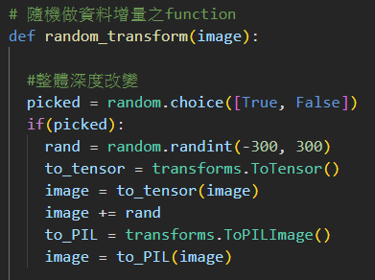
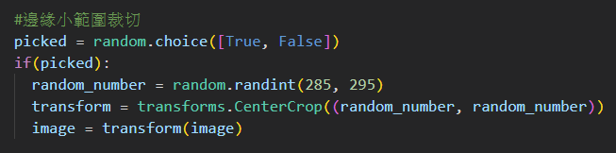
Augmentation Function
整體深度改變
邊緣小範圍裁切

Slide 3
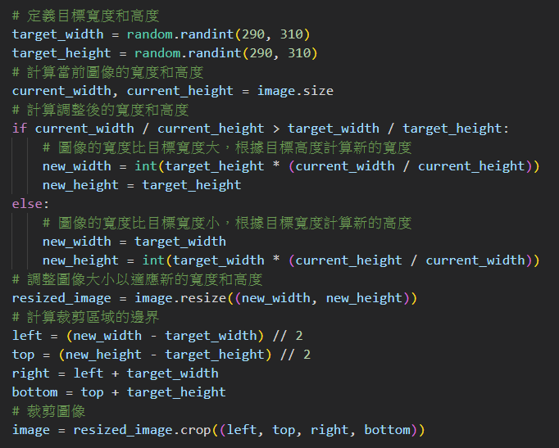
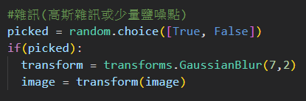
Augmentation Function
長寬比小範圍改變
雜訊

Slide 4
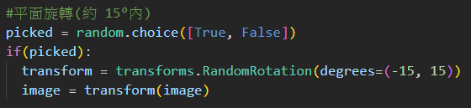
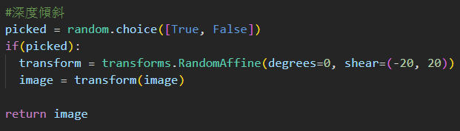
Augmentation Function
平面旋轉
深度傾斜

Slide 5
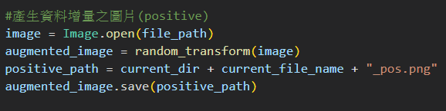
Generating Positive Image

Slide 6
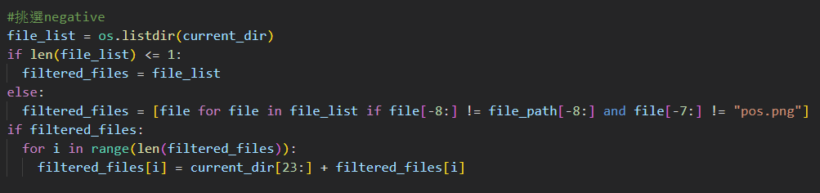
Picking Negative Image

Slide 7
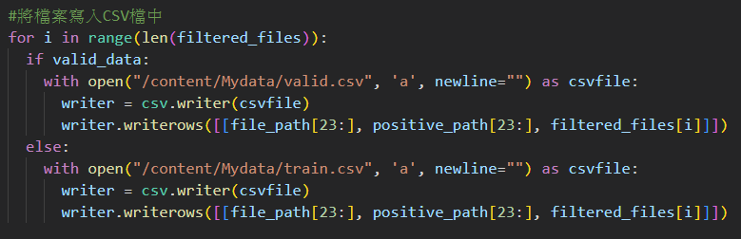
Writing file path into CSV file

Slide 8
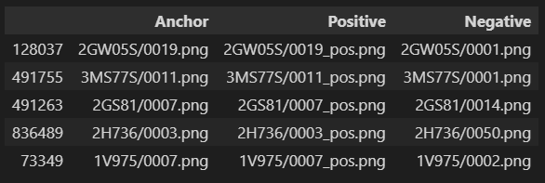
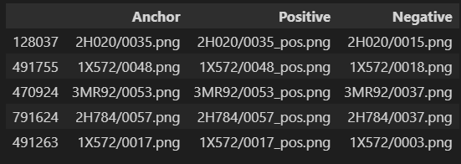
Data Processing Results
Training Data
Valid Data

Slide 9
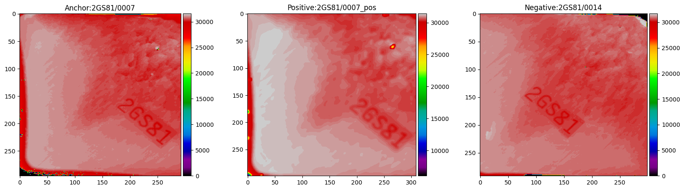
Data Processing Results

Slide 10
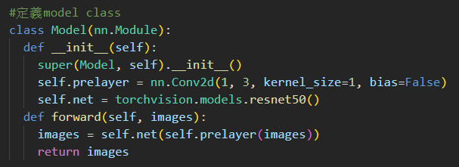
Model 1

Slide 11
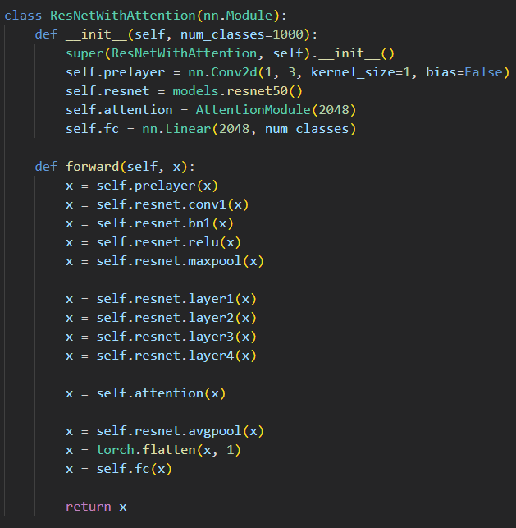
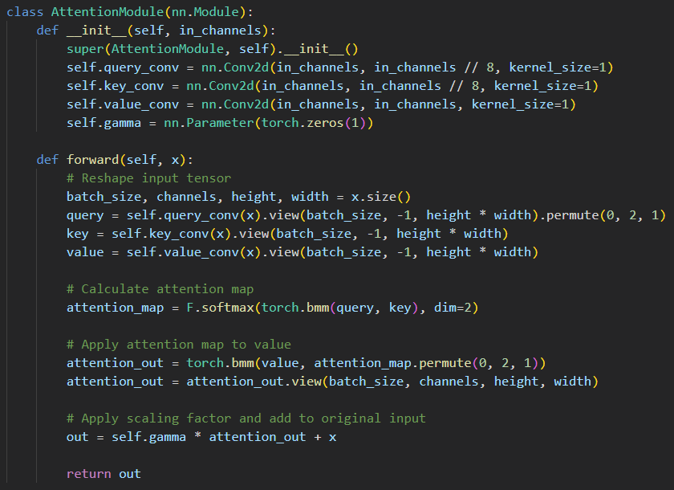
Model 2

Slide 12
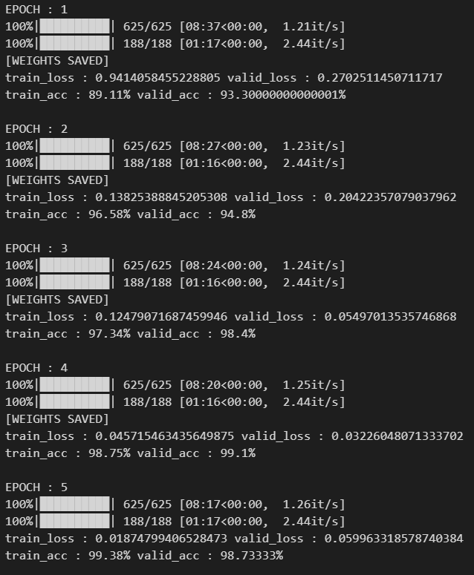
Training

Slide 13
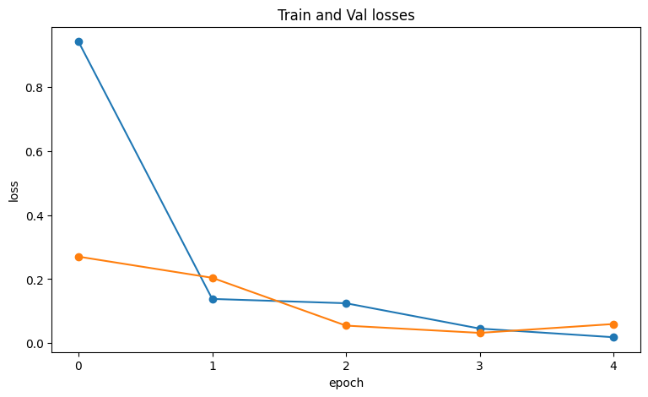
Training Learning Curve (loss)

Slide 14
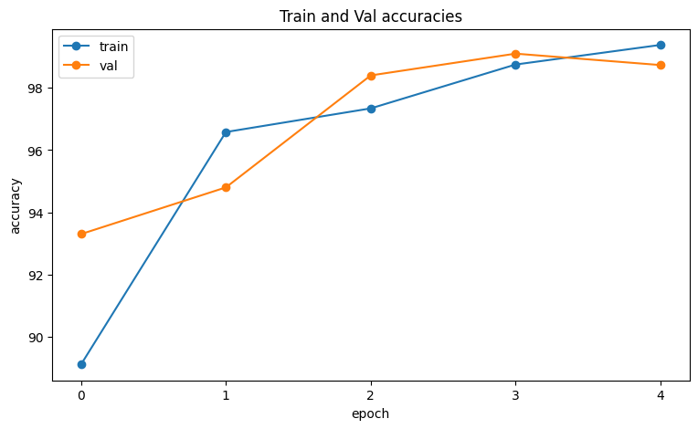
Training Learning Curve (accuracy)

Slide 15

Result of Formal Test Data

