Slide 1
Syllabus
網路系統程式設計：CSE385 & CSE578
上課時間：週二13:30-16:20
上課地點：EC5007
Email and Office:
instructor lin@cse.nsysu.edu.tw EC5005
TA: sp_ta@net.nsysu.edu.tw EC5018
Textbooks:
Advanced Programming in the UNIX Environment, 3rd Ed., by R. Stevens and S.A. Rago, 2013. (有進口)
The Linux Programing Interface, by M. Kerrisk, 2010. (主要課本，有翻譯成中文本，分上下冊)
The Linux Command Line, 2nd Edition: A Complete Introduction, by William Shotts, 2019.
How Linux Works, 3rd Edition: What Every Superuser Should Know, by Brian Ward, 2021.
Grading:
Homework and Quiz (over Ubuntu Linux): 55%
Final exam: 30%
Term report and oral presentation: 15%
OS: Ubuntu Linux, installing it from Microsoft Store at Windows 10 environment.

Slide 2
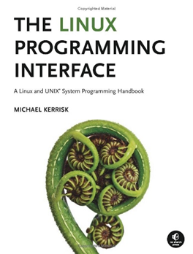
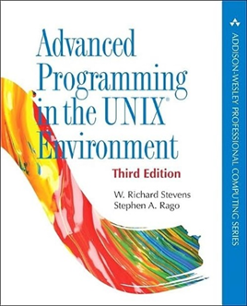
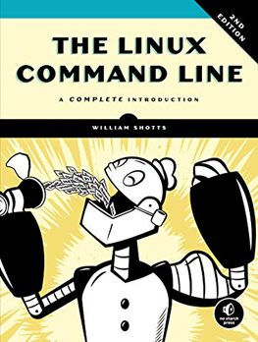


Slide 3


