Slide 1
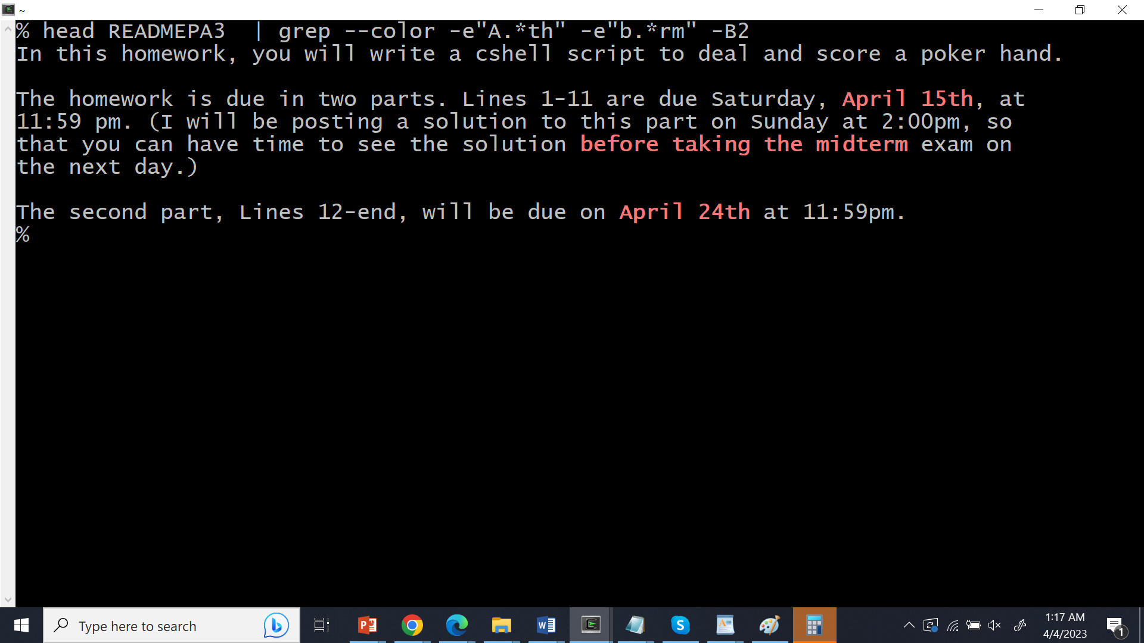
But wait!
This date
is not before
This date!
(Because I
thought the
midterm was on April 10th)...

Slide 2
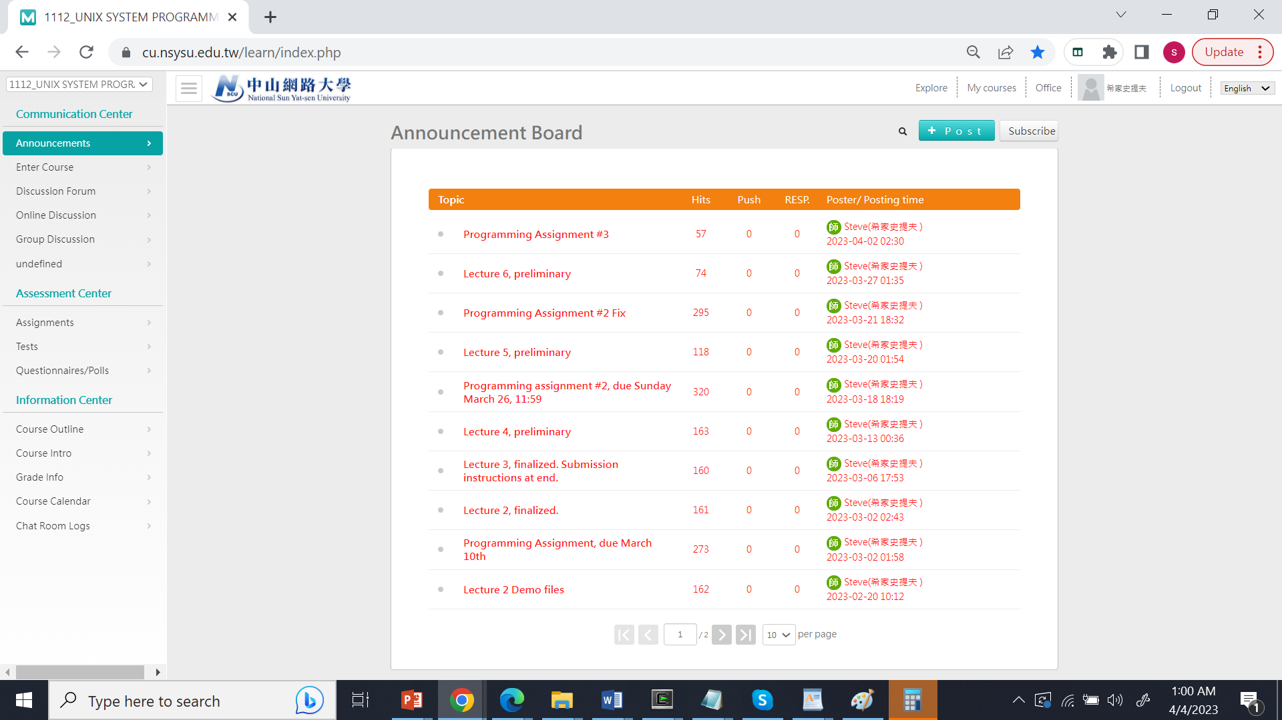
If I click here

Slide 3
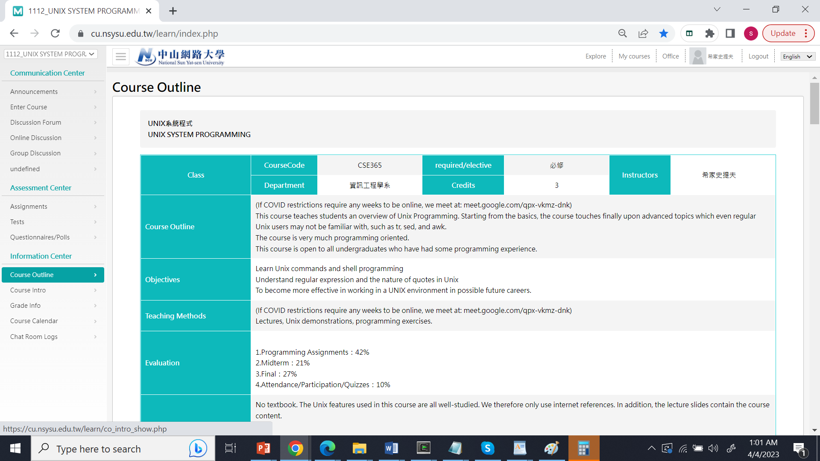
This is the syllabus.
If I scroll down…

Slide 4
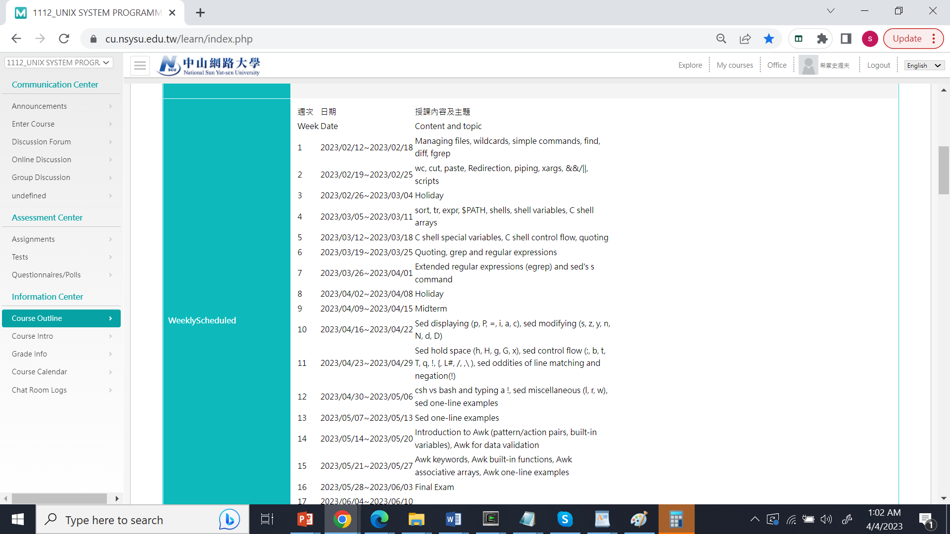
It says midterm is April 10th

Slide 5
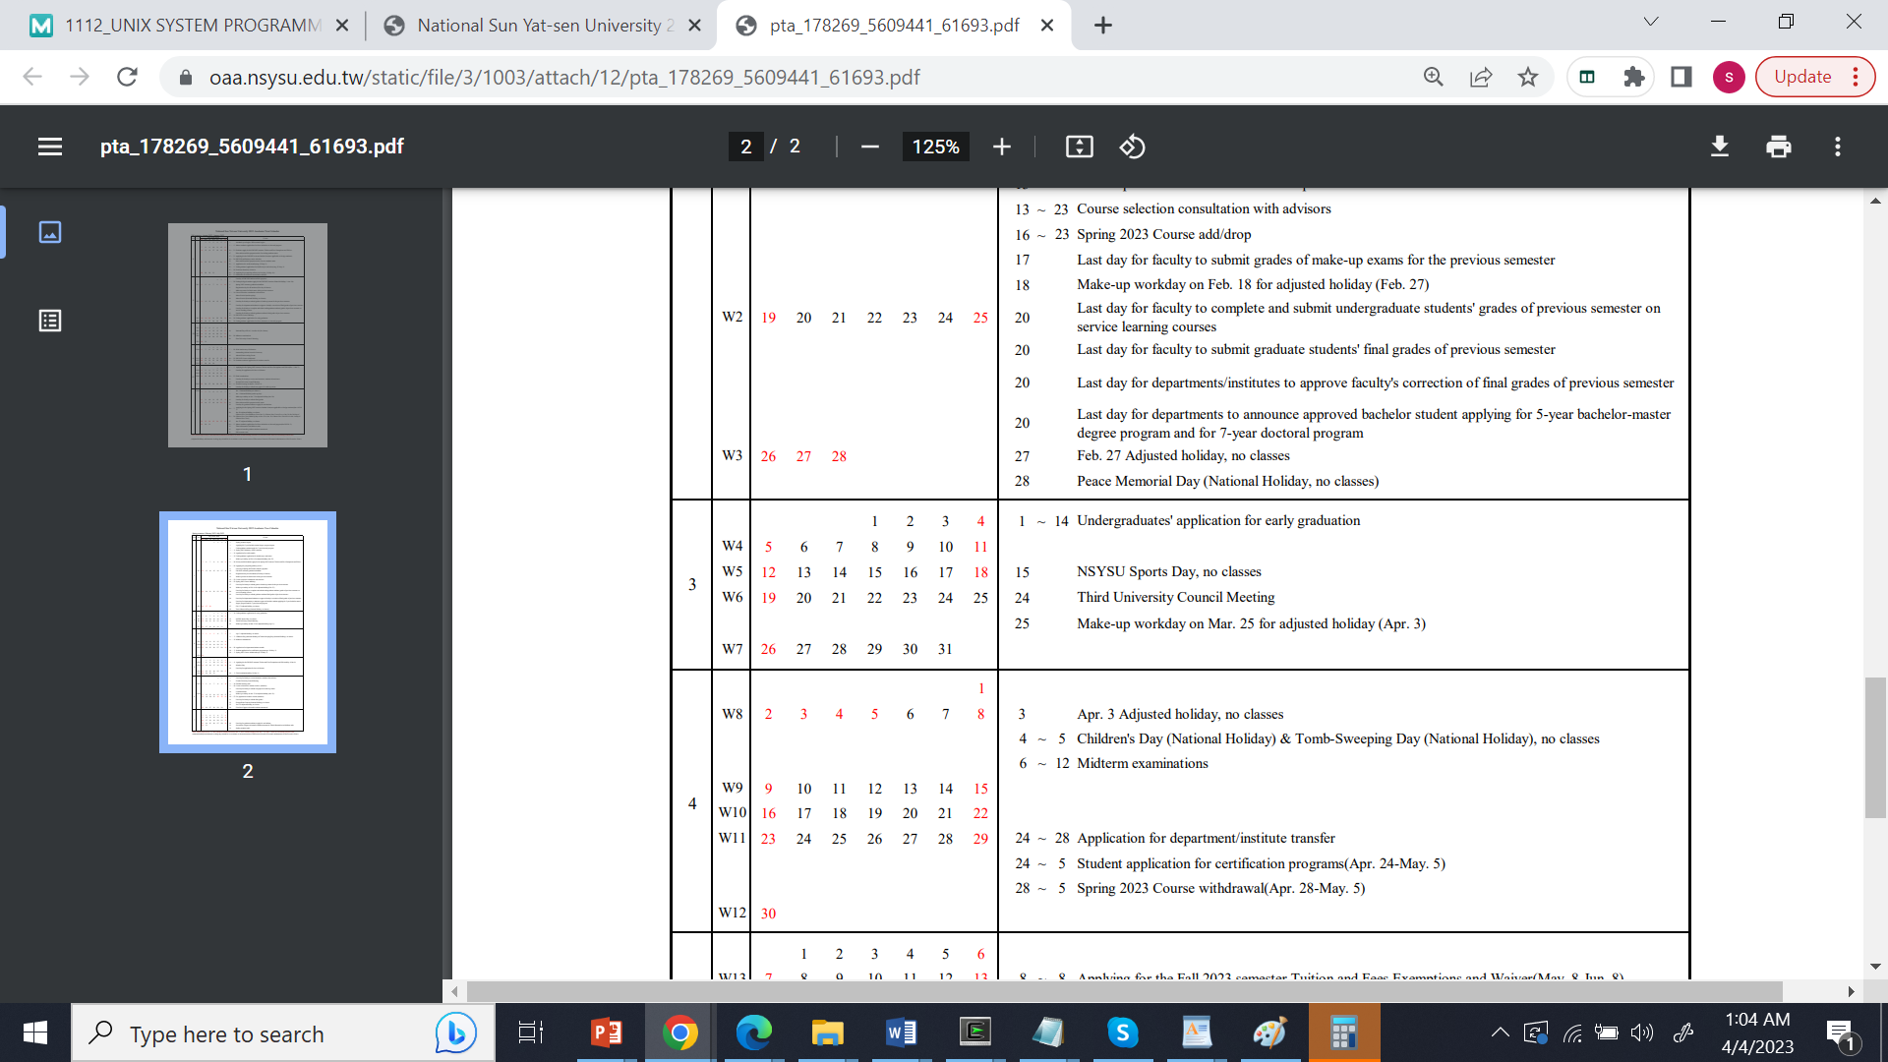
NSYSU’s Academic Calendar also indicates April 10th.

Slide 6
Q. So what is the point? A. The homework assignment had a typo. (I had
intended to make it due on April 8th.)
Q. So what are we supposed to do about it? A. It seem unfair to change a homework’s posted due
date, so the homework will be due on April 15th.)
Q. But wouldn’t that mean that we won’t see the
solution before the midterm?
A. Correct. The midterm will still be on April 10th.

