Slide 1
NIGERIAN LISTED COMPANIES • 2020 – 2025
Investment Performance
Dashboard
Comparative Analysis of Six Nigerian Listed Companies
Using Fundamental Financial Data
PRESCO
SEPLAT
DANGCEM
MTN
GTCO
ZENITH BANK
Data Source: Annual Reports (2020–2025) • Analysis: Jimie Idiong • Tools: Microsoft Excel | Tableau Public

Slide 2
CONTEXT & MOTIVATION
The Business Problem
As a personal investor with holdings across six publicly listed Nigerian companies spanning three different sectors, I needed a structured, data-driven way to evaluate which companies were actually performing — not just one metric, but across profitability, growth, and financial health simultaneously.
❓
Which company delivers the best risk-adjusted return for a long-term investor?
📊
How do Banking, Agriculture, Oil & Gas, Telecoms, and Industrial sectors compare?
⚠️
Which companies show warning signs — negative ROE, declining profits, or heavy debt?
🏆
Can a single composite Investment Score rank companies objectively across all metrics?
6 companies · 3 sectors · 6 years (2020–2025) · 36 annual observations

Slide 3
DATA OVERVIEW
Dataset Description
Ticker
Company
Sector
Years
PRESCO
Presco Plc
Agriculture
2020–2025
SEPLAT
Seplat Energy Plc
Oil & Gas
2020–2025
DANGCEM
Dangote Cement Plc
Industrial Goods
2020–2025
MTN
MTN Nigeria Communications Network
Telecomunications
2020–2025
GTCO
Guaranty Trust Holding Company
Banking
2020–2025
ZENITH
Zenith Bank Plc
Banking
2020–2025
36
6
3
6
9
Annual
Observations
Companies
Covered
Sectors
(+ Telecoms)
Years
2020–2025
Financial
Metrics
Source: Company Annual Reports 2020–2025 • All figures in Nigerian Naira unless noted

Slide 4
DATA QUALITY
Data Cleaning & Preparation
01
Structured the raw data
Created a structured RAW_DATA sheet with 36 rows (6 companies × 6 years) and 14 columns: Company, Ticker, Sector, Year, Total Assets, Total Liabilities, Equity, PBT, PAT, Net Interest Income, Fees, EPS, DPS, and Retained Earnings.
02
Handled missing values
Presco's 2020 data excluded from consolidated totals (first consolidated report was 2021, post-Siat acquisition). DPS not disclosed in 2022–2023 for Presco — handled as excluded data points, not imputed.
03
Currency standardisation
Seplat declares dividends in USD. DPS was converted to Nigerian Naira using the CBN official year-end exchange rate for each year to ensure comparability across all six companies.
04
Computed derived ratios
RATIOS sheet auto-calculated: ROE (PAT ÷ Equity), ROA (PAT ÷ Total Assets), Debt-to-Equity (Liabilities ÷ Equity), Equity Ratio (Equity ÷ Assets), Year-on-Year Asset Growth %, and Profit Growth %.
05
Flagged anomalies & negatives
Three company-years showed negative PAT (MTN 2023–2024, Seplat 2020). These were preserved as-is to reflect real financial stress — not removed — since negative profitability is analytically meaningful.
Excel workbook: 6 sheets — Data_Dictionary | RAW_DATA | COMPANY SUMMARY | RATIOS | Score Sheet | INVESTMENT_NOTES

Slide 5
SCORING FRAMEWORK
Methodology — The Investment Score
A composite Investment Score was built in three layers, each normalised to 0–100 using min-max scaling across all six companies:
Profitability Score (40%)
Growth Score (30%)
Financial Health Score (30%)
• ROE (Return on Equity)
• Asset Growth % YoY
• Equity Ratio (Equity ÷ Assets)
• ROA (Return on Assets)
• Profit Growth % YoY
• Debt-to-Equity (inverted — lower is better)
• EPS (Earnings Per Share)
• ROA (leverage-adjusted)
• DPS (Dividend Per Share)
= Average(ROE_score, ROA_score, EPS_score, DPS_score)
= Average(Asset_Growth_score, Profit_Growth_score)
= 0.3×ROA_score + 0.4×Equity_score + 0.3×Debt_score
Final Investment Score = (Profitability × 40%) + (Growth × 30%) + (Financial Health × 30%)
Min-max normalisation: Score = (Value − Min) ÷ (Max − Min) × 100 | Applied independently per metric across all 6 companies

Slide 6
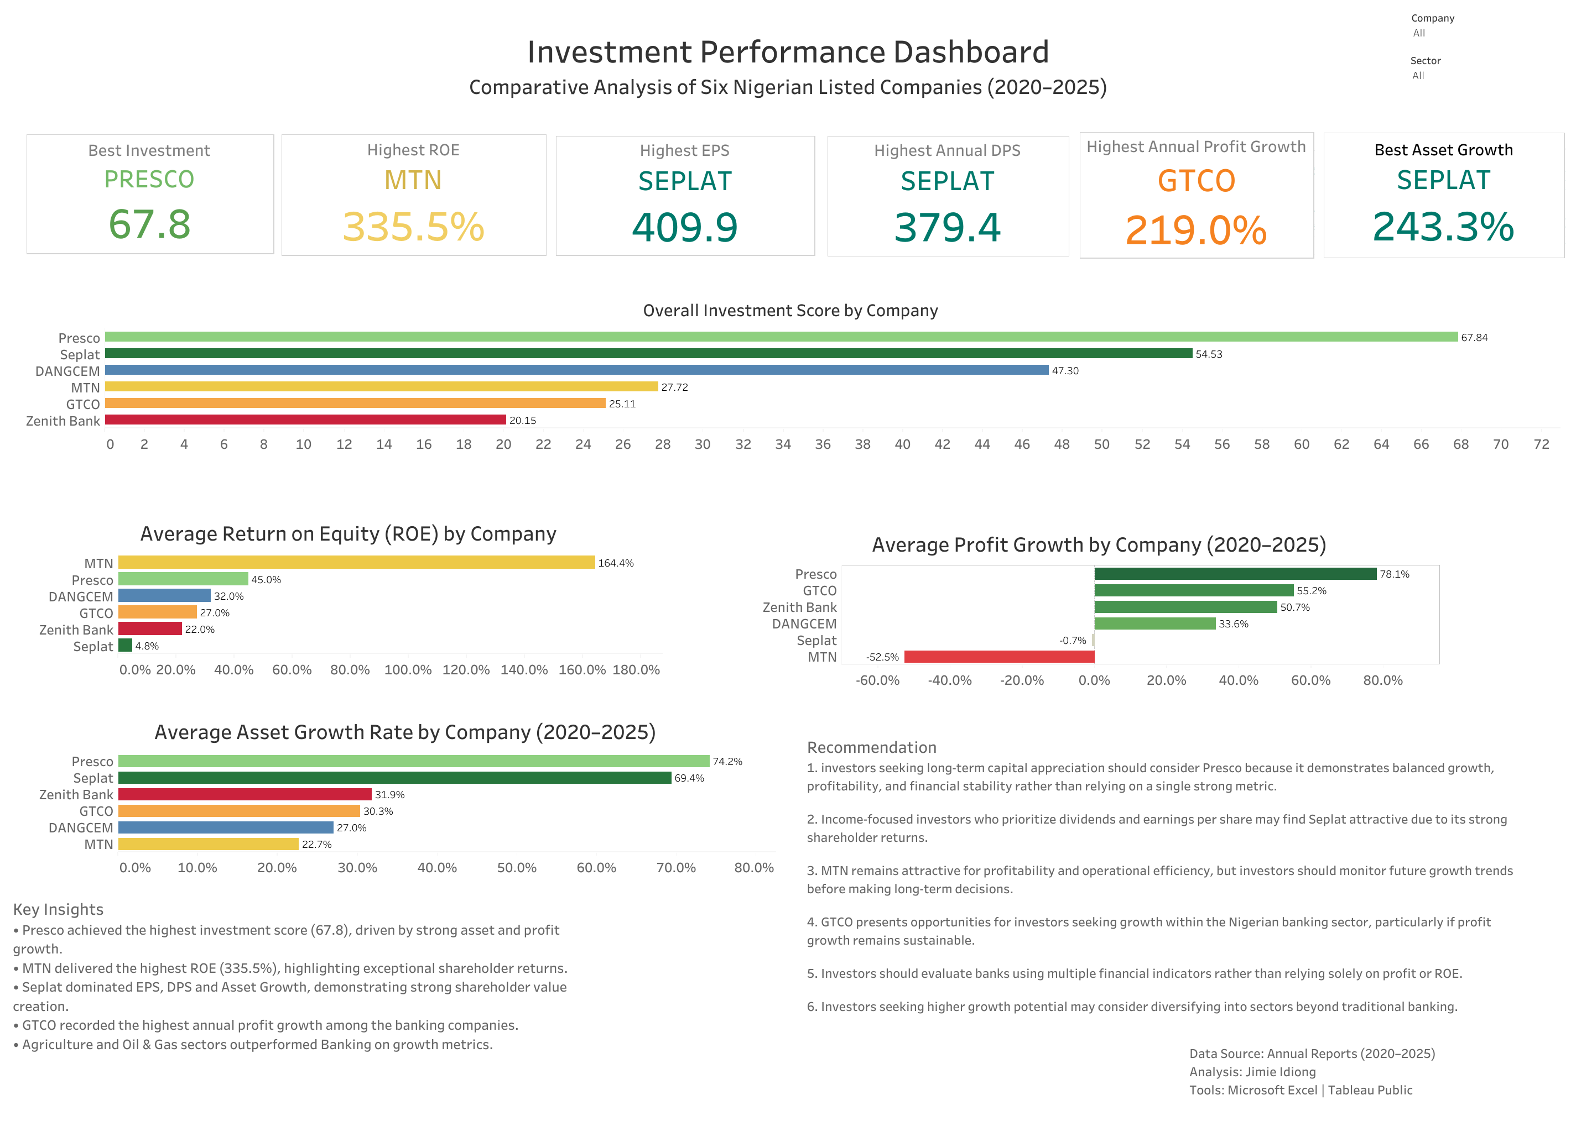
TABLEAU PUBLIC DASHBOARD
Dashboard Preview
Built in Tableau Public • Source: Nigerian_Stock_Fundamental_Data.xlsx • Analysis: Jimie Idiong

Slide 7
KPI SUMMARY
Headline Metrics at a Glance
Best Investment Score
Highest DPS (₦)
PRESCO
67.84
SEPLAT
379.4
Balanced: profit + growth + health
Strong dividend payer
Highest Avg ROE
Highest Profit Growth
MTN
164.4%
GTCO
219.0%
Exceptional shareholder returns
Banking sector surge 2023–2024
Highest EPS (₦)
Best Asset Growth
SEPLAT
409.9
SEPLAT
243.3%
Peak EPS in 2025
Highest single-year asset growth
Average figures computed over available years 2020–2025 per company

Slide 8
OVERALL RANKING
Overall Investment Score by Company
Score = Profitability (40%) + Growth (30%) + Financial Health (30%) • Scaled 0–100 via min-max normalisation

Slide 9
PROFITABILITY & GROWTH
ROE and Profit Growth Comparison
Average Return on Equity (%)
Average Profit Growth (%)
MTN's negative average profit growth driven by FX-linked losses in 2023–2024; recovery seen in 2025

Slide 10
KEY INSIGHTS
What the Data Reveals
01
PRESCO scores highest overall (67.84)
Driven by the strongest asset growth (74.2% avg) and profit growth (78.1% avg) — balanced across all three score components, not a one-metric outlier.
02
MTN leads ROE at 164.4% — but with major caveats
Extremely high ROE is partly a function of very thin (or negative) equity base. MTN reported net losses in 2023 and 2024 due to FX-related exposure, pulling average profit growth to −52.5%.
03
SEPLAT dominates EPS (409.9) and DPS (379.4)
Strong shareholder value creation metrics. Despite negative PAT in 2020, the 2024–2025 recovery was dramatic. Best choice for income-focused investors.
04
GTCO leads banking sector profit growth (55.2%)
Banking sector overall shows solid growth post-2022. GTCO's 219% highest annual growth in 2023 reflects the sector-wide revaluation uplift from naira devaluation.
05
Agriculture & Oil and Gas outperform Banking on growth metrics
PRESCO (Agriculture) and SEPLAT (Oil & Gas) both rank above all three banking stocks on the overall investment score — a sector-level finding for portfolio diversification.
Avg = arithmetic mean over available years 2020–2025 per company

Slide 11
STRATEGIC GUIDANCE
Business Recommendations
1
BUY / ACCUMULATE — PRESCO
4
HOLD — GTCO
Best overall investment score (67.84). Balanced growth across assets, profits and financial health. Suitable for long-term capital appreciation. Continue accumulating.
Strong profit growth trend in banking sector. GTCO's 219% highest annual profit growth shows momentum. Evaluate alongside Zenith Bank using multiple metrics.
2
HOLD for INCOME — SEPLAT
5
SECTOR DIVERSIFICATION INSIGHT
Income-focused investors should hold SEPLAT for its superior EPS (409.9) and DPS (379.4). Monitor oil price exposure and USD dividend conversion risk.
Agriculture and Oil & Gas both outrank all Banking stocks in this analysis. Portfolio diversification beyond traditional banking improves the overall risk-return profile.
3
MONITOR — MTN
6
AVOID single-metric decisions
Attractive ROE but 2023–2024 FX losses are a red flag. Wait for two consecutive profitable years before adding. Strong 2025 recovery (EPS ₦53.07) is encouraging.
ROE alone is misleading — MTN's 164% ROE co-exists with years of net losses. Always use a composite scoring approach before making allocation decisions.
Recommendations are based on fundamental data analysis and are not financial advice

Slide 12
ANALYTICAL PROCESS
Tools Used
📊 Microsoft Excel
📈 Tableau Public
Built RAW_DATA sheet (36 rows, 14 cols)
Connected directly to Excel workbook
RATIOS sheet with live formula links
Built 6-chart interactive dashboard
COMPANY SUMMARY with AVERAGEIF/SUMIF/MAXIFS
Applied consistent company colour coding
Score Sheet: min-max normalisation across 6 companies
KPI summary cards for headline metrics
INVESTMENT_NOTES: year-by-year narrative commentary
Published publicly for portfolio sharing
Annual Reports
→
Excel RAW_DATA
→
RATIOS & Scores
→
Tableau Dashboard
→
This Presentation

Slide 13
Data beats
guesswork.
Six companies. One composite score.
Objective investment decisions.
Thank You • Questions & Discussion
Analysis: Jimie Idiong | Data: Annual Reports 2020–2025 | Tools: Microsoft Excel | Tableau Public

