Slide 1
Enhancing SwinIR for Image Deblurring via Pyramid
Feature Branching
Presenter:Cheng-Yi Lu
Advisor: Yi-Leh Wu
Intelligent Database Lab @ Dept. CSIE, NTUST
June, 2025

Slide 2
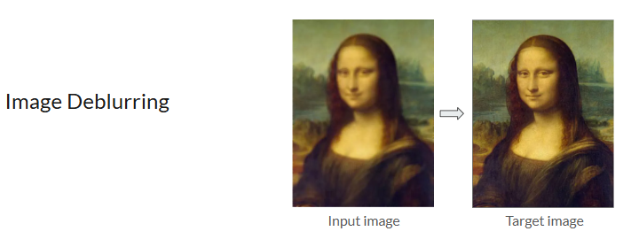
Introduction
Background

Slide 3
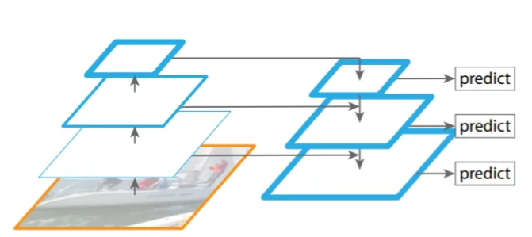
Introduction
Motivation
Propose the Pyramid Branch Module for multi-scale feature extraction
Add the Pyramid Branch into the second stage of SwinIR[1] backbone
Performance Improvements compared to backbone method
Analyze the impact of Pyramid Branch at different stages
Feature Pyramid Network[9]
[9] T.-Y. Lin, P. Dollar, R. Girshick, K. He, B. Hariharan, and S. Belongie, “Feature pyramid networks for object detection,” in Proceedings of the IEEE Conference on Computer Vision and Pattern Recognition (CVPR), July 2017.

Slide 4
Introduction
Main Contributions
Propose the Pyramid Branch Module for multi-scale feature extraction
Add the Pyramid Branch into the second stage of SwinIR[1] backbone
Performance Improvements compared to backbone method
Analyze the impact of Pyramid Branch at different stages
[1] J. Liang, J. Cao, K. Sun, Y. Zhang, L. V. G. Wang, and R. Timofte, “Swinir: Image restoration using swin transformer,” in Proceedings of the IEEE International Conference on Computer Vision Work- shops (ICCVW), 2021.

Slide 5
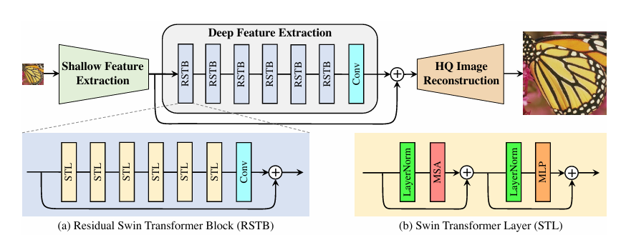
Proposed Method
Baseline Architecture
[1] J. Liang, J. Cao, K. Sun, Y. Zhang, L. V. G. Wang, and R. Timofte, “Swinir: Image restoration using swin transformer,” in Proceedings of the IEEE International Conference on Computer Vision Work- shops (ICCVW), 2021.

Slide 6
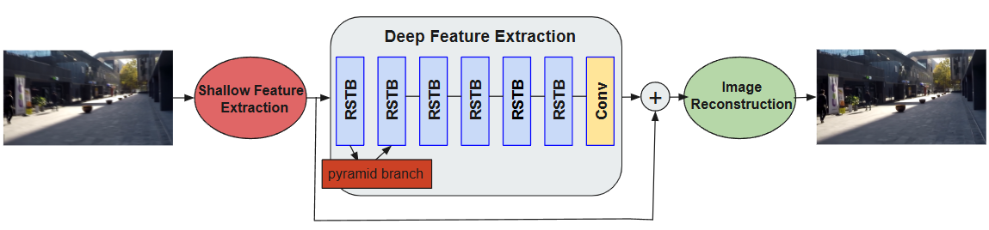
Proposed Method
Proposed Architecture
Input
Downsample
conv, 3x3
Upsample
LayerNorm
Partition
Windows
Window
Attention
Merge
Window
+
Output

Slide 7
Proposed Method
Pyramid Branch
Input
Downsample
conv, 3x3
Upsample
LayerNorm
Partition
Windows
Window
Attention
Merge
Window
+
Output

Slide 8
Experiments
Datasets
 | GoPro | HIDE | Real-Blur
Images | 3214 | 8422 | 4738
Image size | 1280*720 | 1280*720 | Varies (mostly high-res)
Training | 2103 | 6397 | 3758
Testing | 1111 | 2025 | 980
[10] S. Nah, T. H. Kim, and K. M. Lee, “Deep multi-scale convolutional neural network for dynamic scene deblurring,” in Proceedings of the IEEE conference on computer vision and pattern recognition (CVPR), pp. 3883–3891, 2017.
[11] S. Shen, J. Chen, Y. Liu, and X. Tao, “Human-aware motion deblurring,” in Proceedings of the IEEE International Conference on Computer Vision (ICCV), pp. 5572–5581, 2019.
[12] J. Rim, S. Kim, S. Lee, and S. J. Kim, “Real-world blur dataset for learning and benchmarking de- blurring algorithms,” in European Conference on Computer Vision (ECCV), pp. 184–201, Springer, 2020.

Slide 9
Experiments
Evaluation Metrics
PSNR
Peak Signal-to-Noise Ratio
SSIM
Structural Similarity

Slide 10
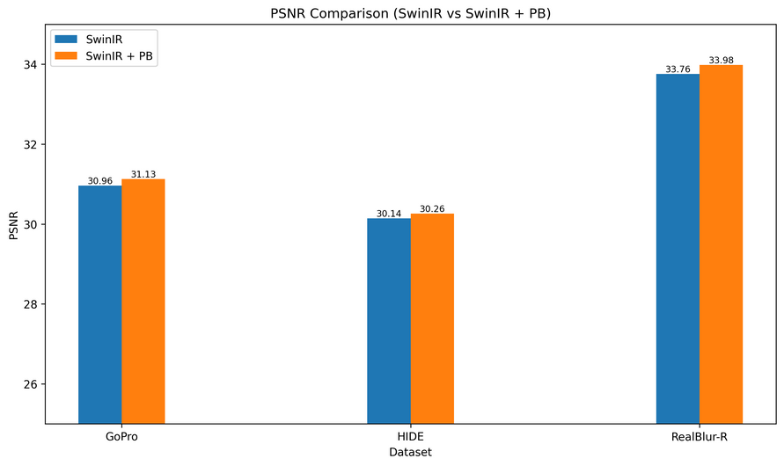
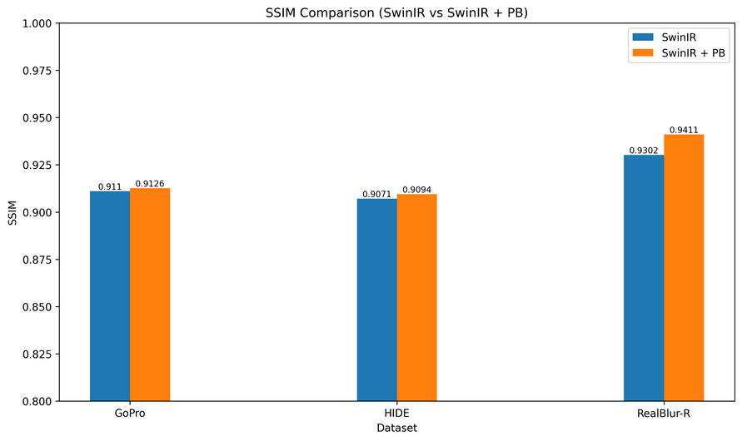
Experiments
Overall Performance Comparison
GoPro | PSNR↑ | SSIM↑
SwinIR (Baseline) | 30.96 | 0.9110
PBSwinIR (Ours) | 31.13 | 0.9126
HIDE | PSNR↑ | SSIM↑
SwinIR (Baseline) | 30.14 | 0.9071
PBSwinIR (Ours) | 30.26 | 0.9094
RealBlur-R | PSNR↑ | SSIM↑
SwinIR (Baseline) | 33.76 | 0.9302
PBSwinIR (Ours) | 33.98 | 0.9411

Slide 11
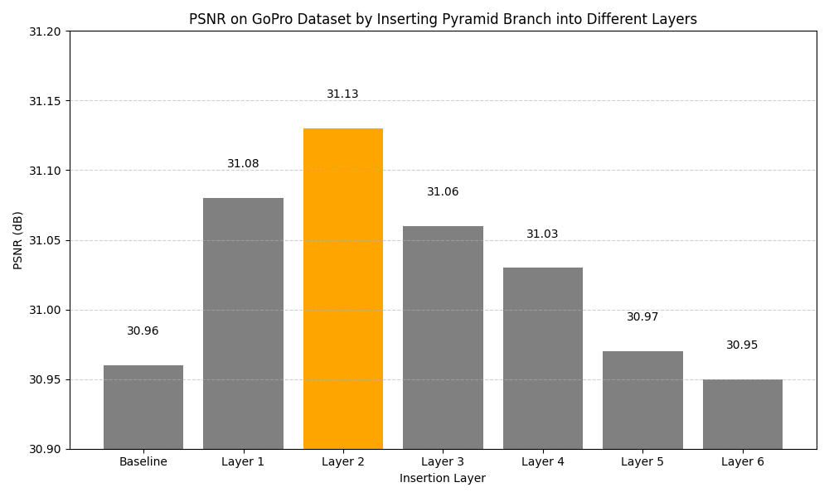
Experiments
The Impact of Pyramid Branch
Insertion Layer | PSNR↑
SwinIR(Baseline) | 30.96
+PB in layer 1 | 31.08
+PB in layer 2(Ours) | 31.13
+PB in layer 3 | 31.06
+PB in layer 4 | 31.03
+PB in layer 5 | 30.97
+PB in layer 6 | 30.95

Slide 12
Conclusion and Future Work
Conclusion
Adding PyramidBranch module into SwinIR for lightweight multiscale feature fusion.
Incorporating the PyramidBranch into SwinIR leads to a slight but consistent performance improvement over the original architecture on deblurring tasks.

Slide 13
Conclusion and Future Work
Future Work
Build a deeper or multi-stage PyramidBranch structures
Extend to other tasks like image deraining or dehazing

Slide 14
Thank you
For your attention

Slide 15
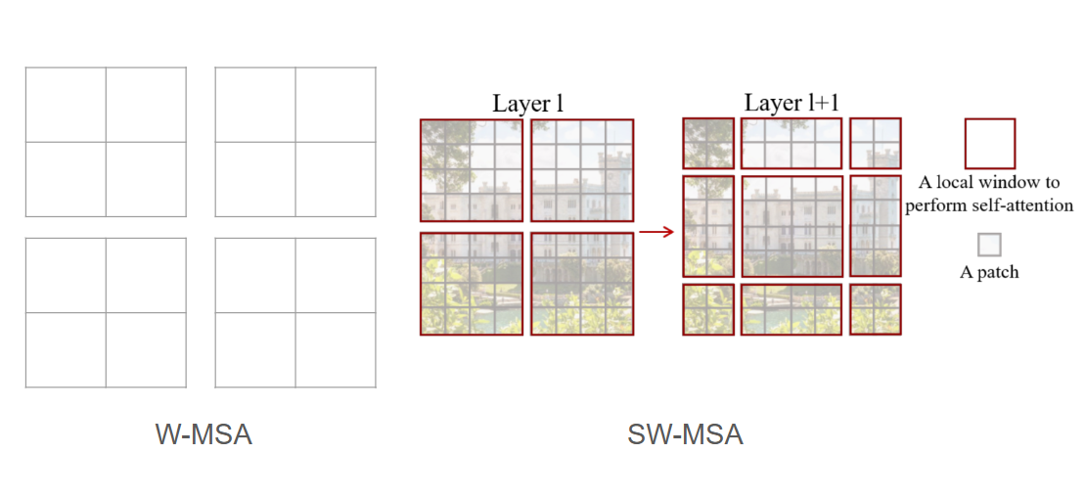
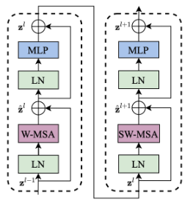
Appendix(Background)
Background
Swin Transformer[1]
[1] J. Liang, J. Cao, K. Sun, Y. Zhang, L. V. G. Wang, and R. Timofte, “Swinir: Image restoration using swin transformer,” in Proceedings of the IEEE International Conference on Computer Vision Work-
shops (ICCVW), 2021.

Slide 16
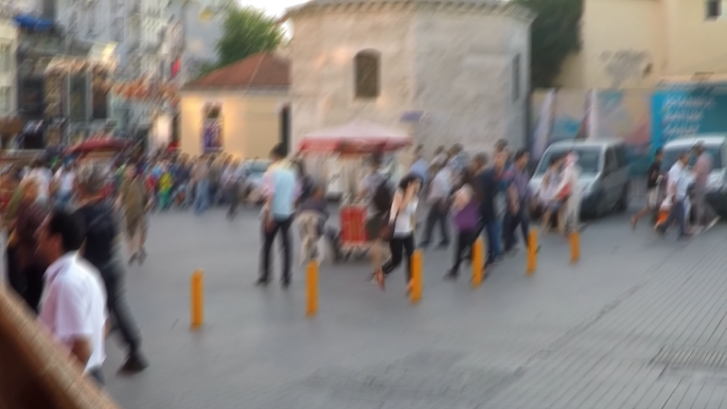


Appendix(Loss Function)
Loss Function

Slide 17
Appendix(Training Details)
Training Details
Model Architecture
Image Patch Size | 96*96
Window Size | 8
Embedding Dimension | 180
Depths | [6, 7, 6, 6, 6, 6]
Number of Attention Heads | [6, 6, 6, 6, 6, 6]
MLP Ratio | 2
Training Configuration
Loss Function | Charbonnier (ϵ = 1 × 10−6)
Optimizer | Adam
Activation Function | GELU
Learning Rate | 2 × 10−4
Weight Decay | 0
Batch Size | 4

Slide 18
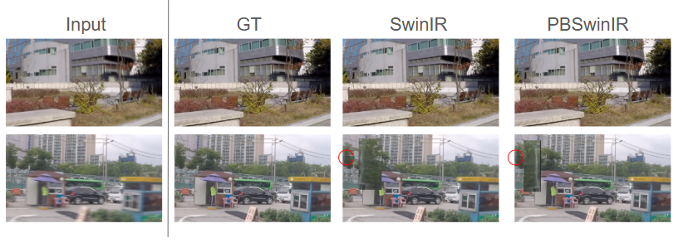
Appendix(Experiment Results)
Experiment Results

