Slide 1
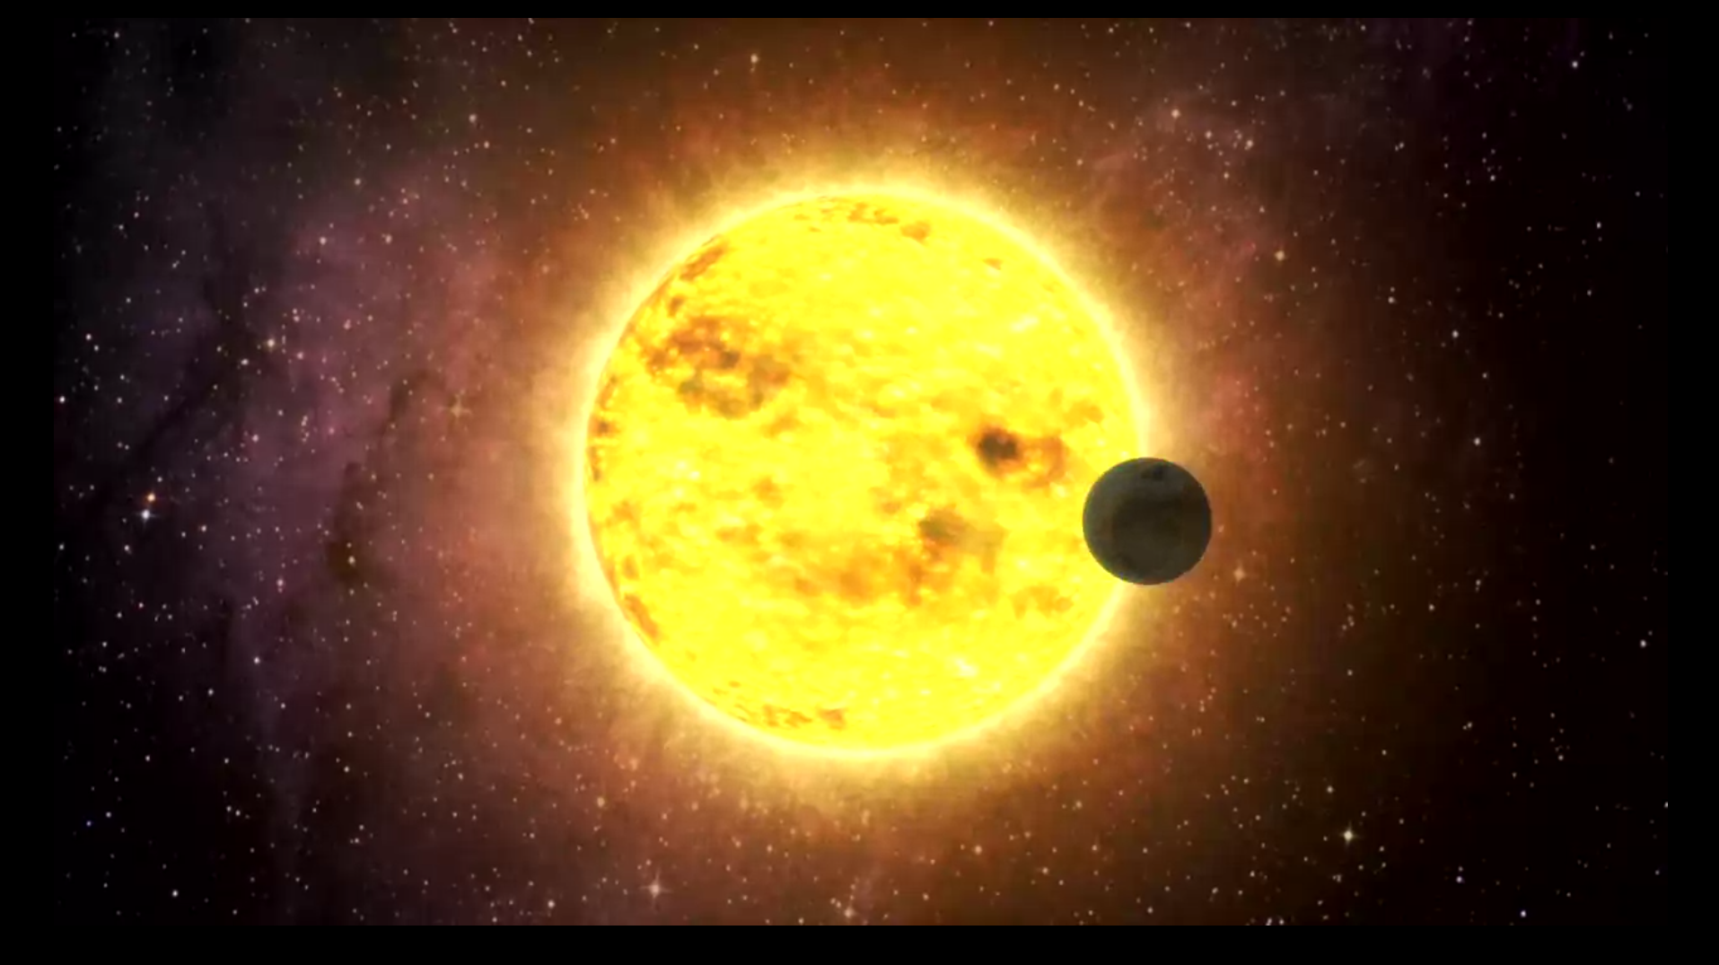
Exoplanets – Jim Barrett

Slide 2
Contents
Planets – What are they?
Planets – How do they form?
Orbits
Detecting Exoplanets
Life on other planets?
Planet Nine?

Slide 3
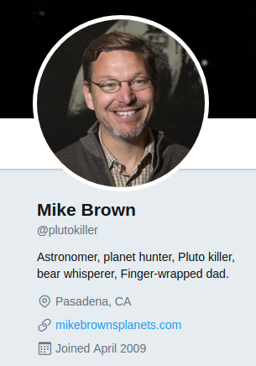
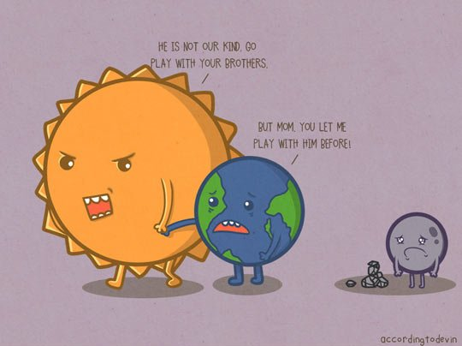
Planets – What Are They?
There are 8 planets in our solar system
What happened to Pluto?

Slide 4
Why isn’t Pluto a planet?

Slide 5
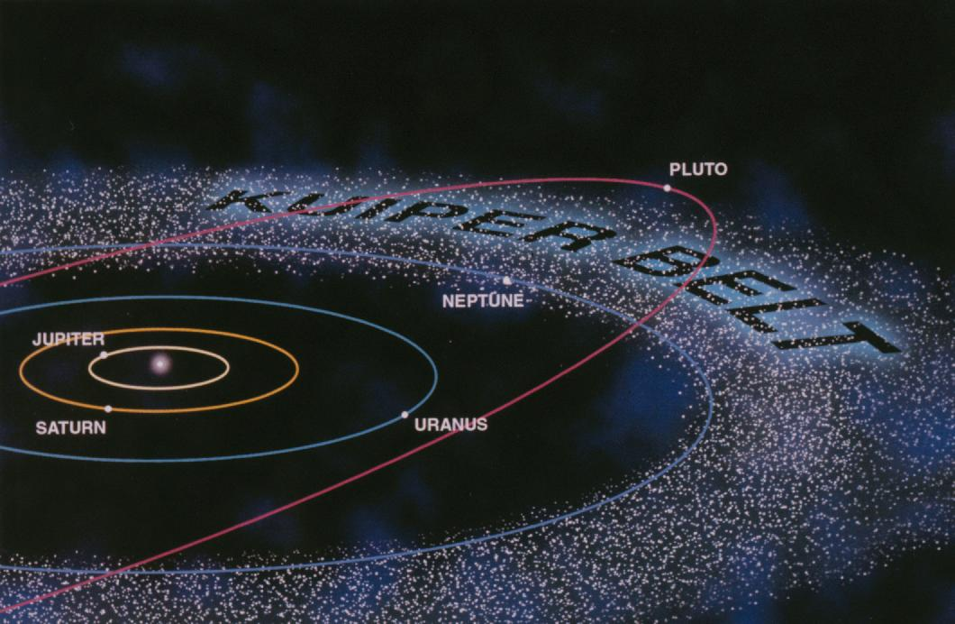
Why isn’t Pluto a planet?
Dwarf Planet
Shares its orbit with other similar planets

Slide 6
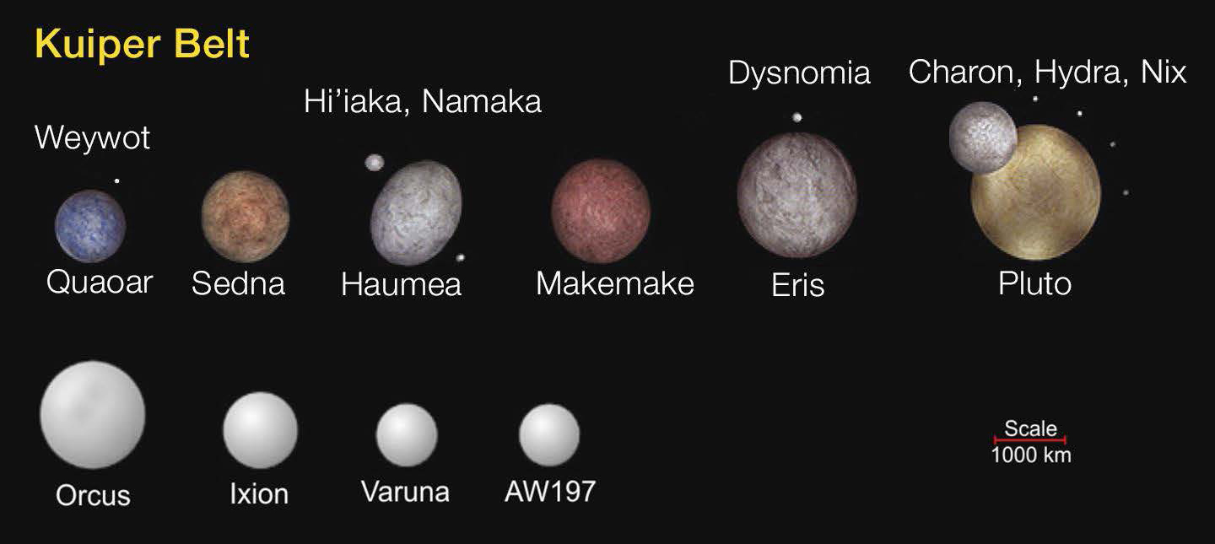
Other Kuiper Belt Objects

Slide 7
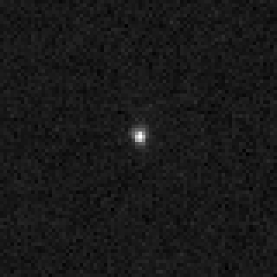
Sedna
11400 (Earth) years to orbit
86 AU (currently)
As far as 937 AU

Slide 8
How do Planets Form?
?

Slide 9
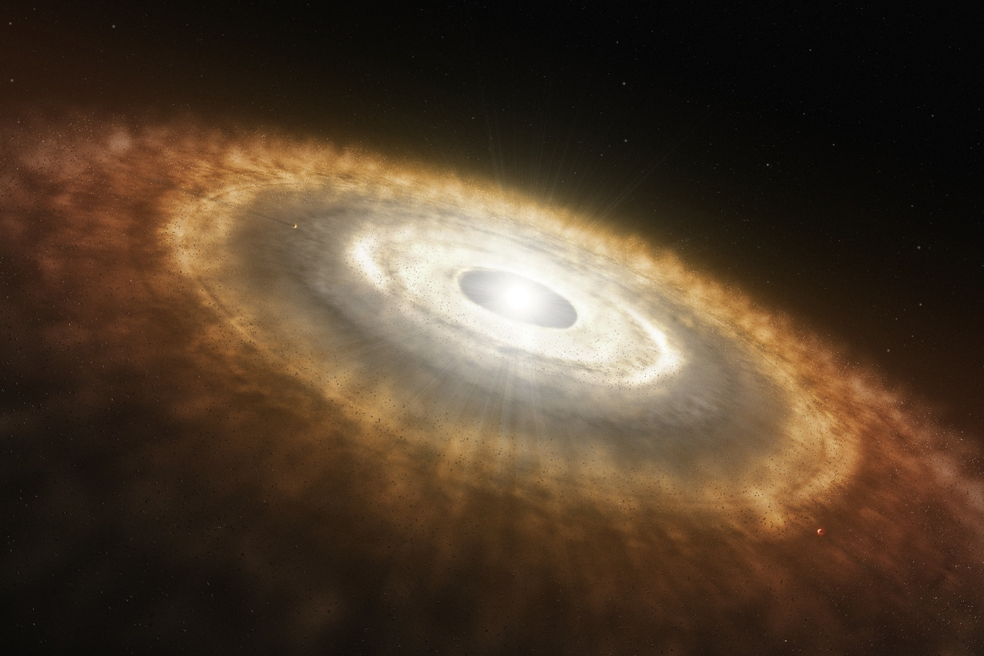
How do Stars Form?
Big Cloud of Gas
Small defects → clumps → protostars

Slide 10
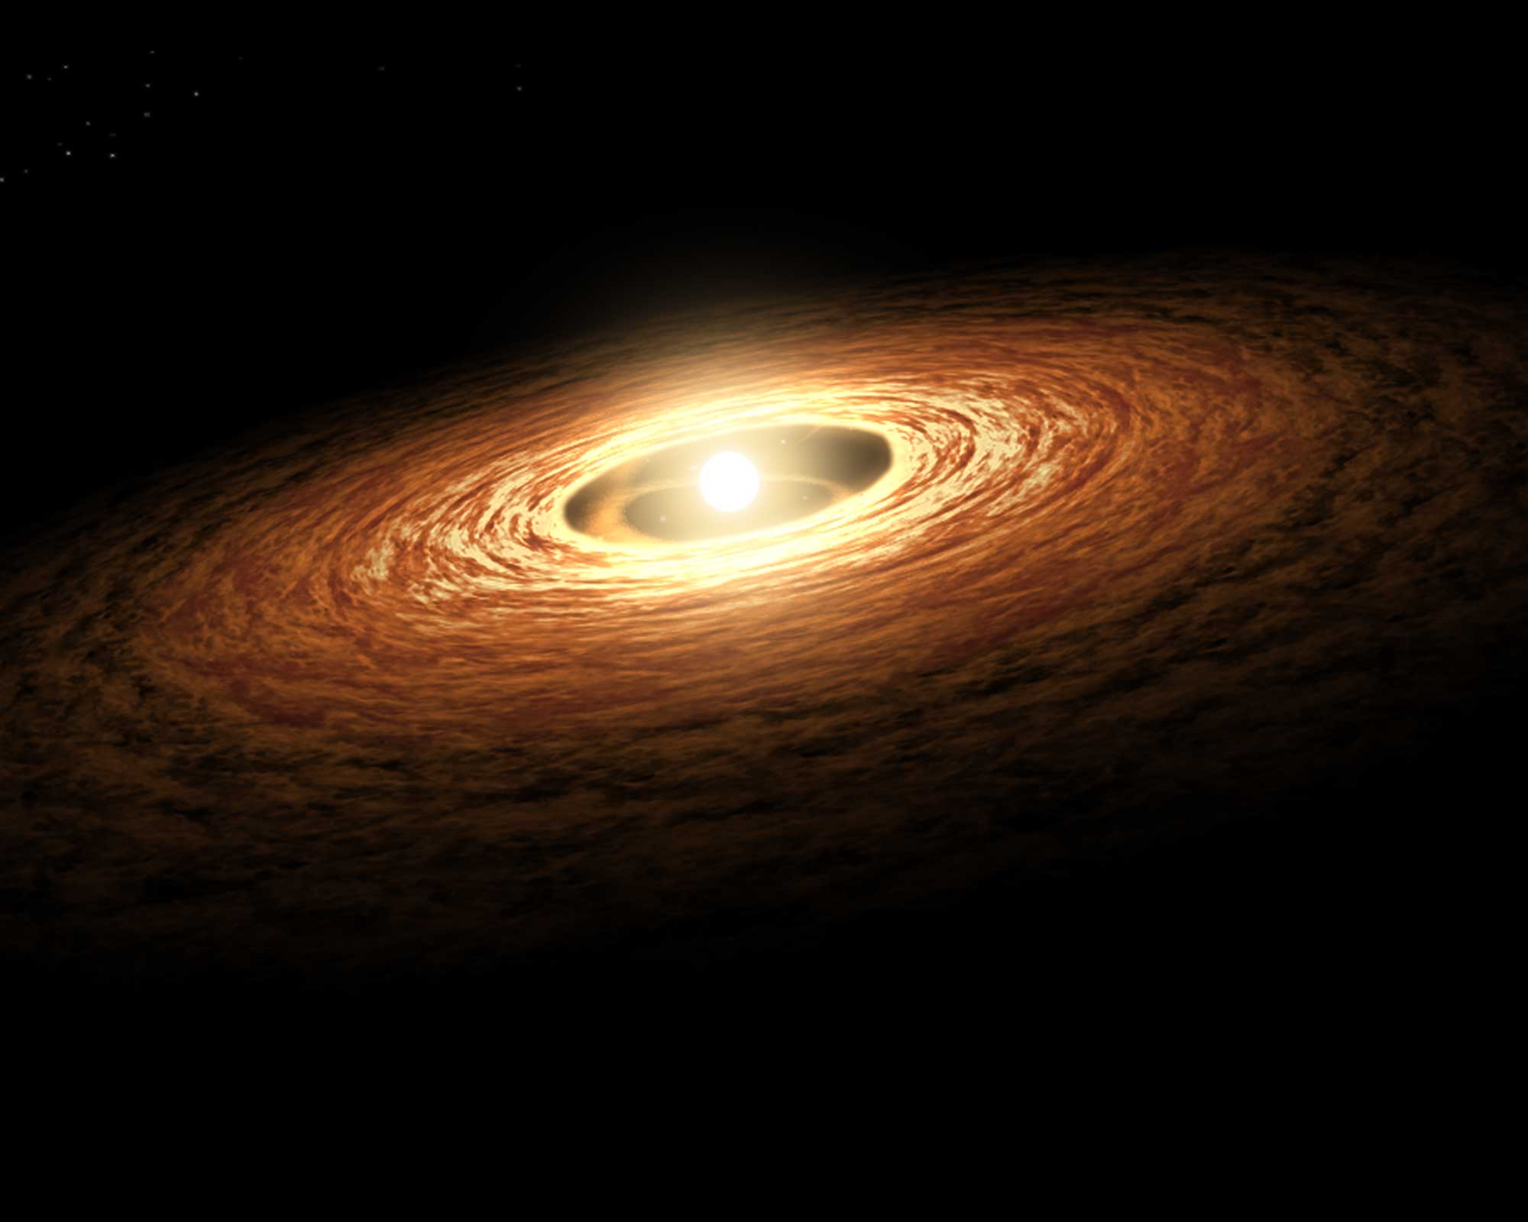
Things Start to get Hot

