Slide 1
Gravitational Waves
Jim Barrett

Slide 2
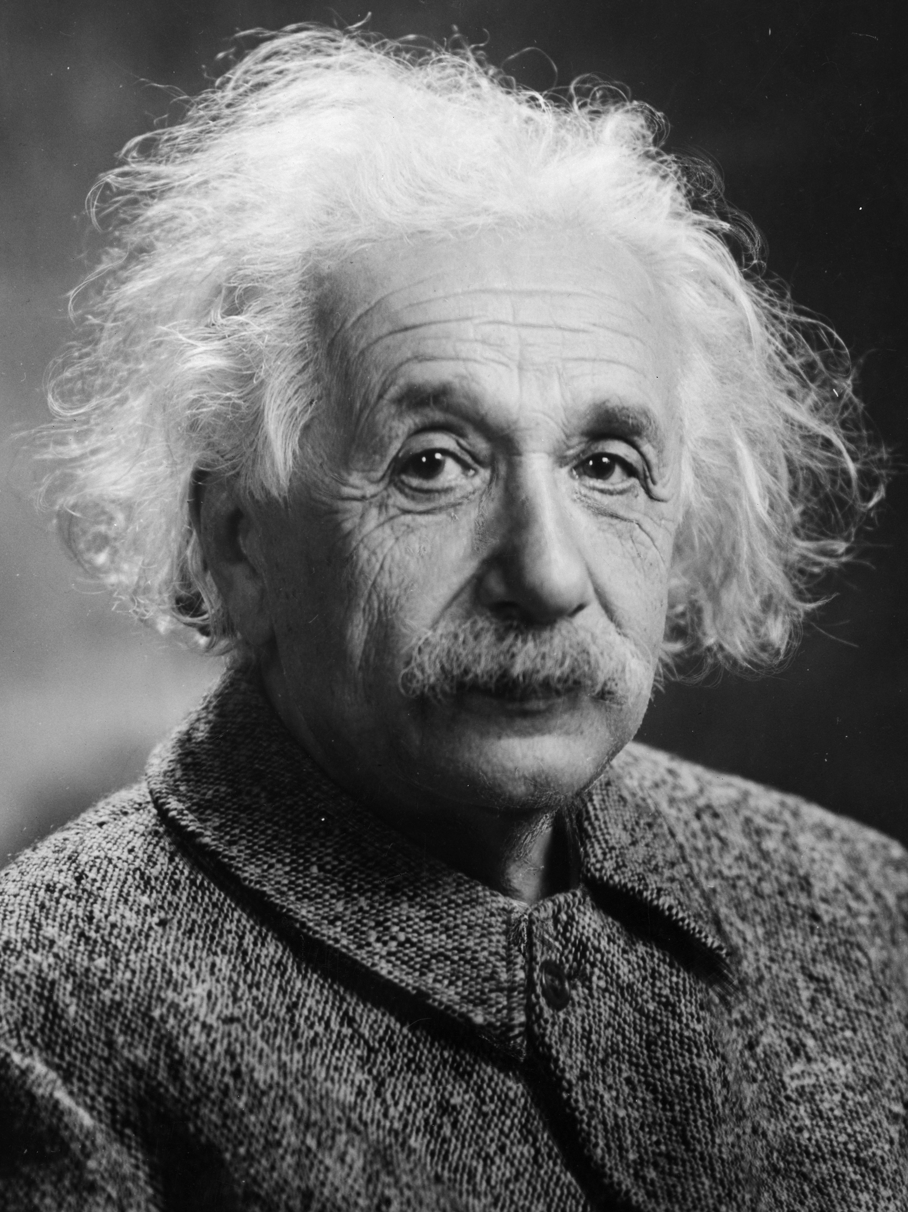
General Relativity
Einstein published his papers on General Relativity in 1916
Treats gravity as a geometric phenomenon
I’ll go/have gone into a bit more detail in my relativity lecture

Slide 3
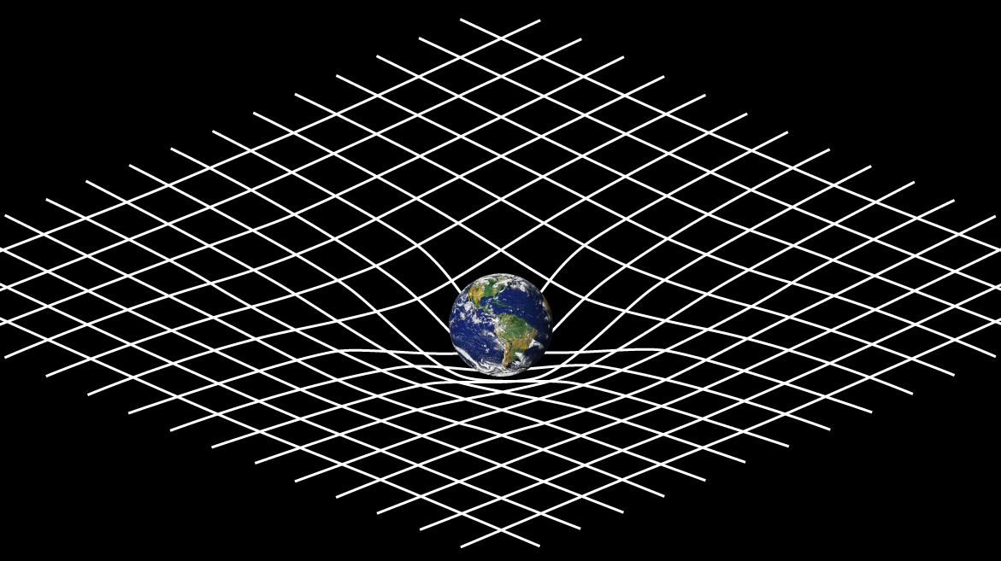
Spacetime Curvature

Slide 4
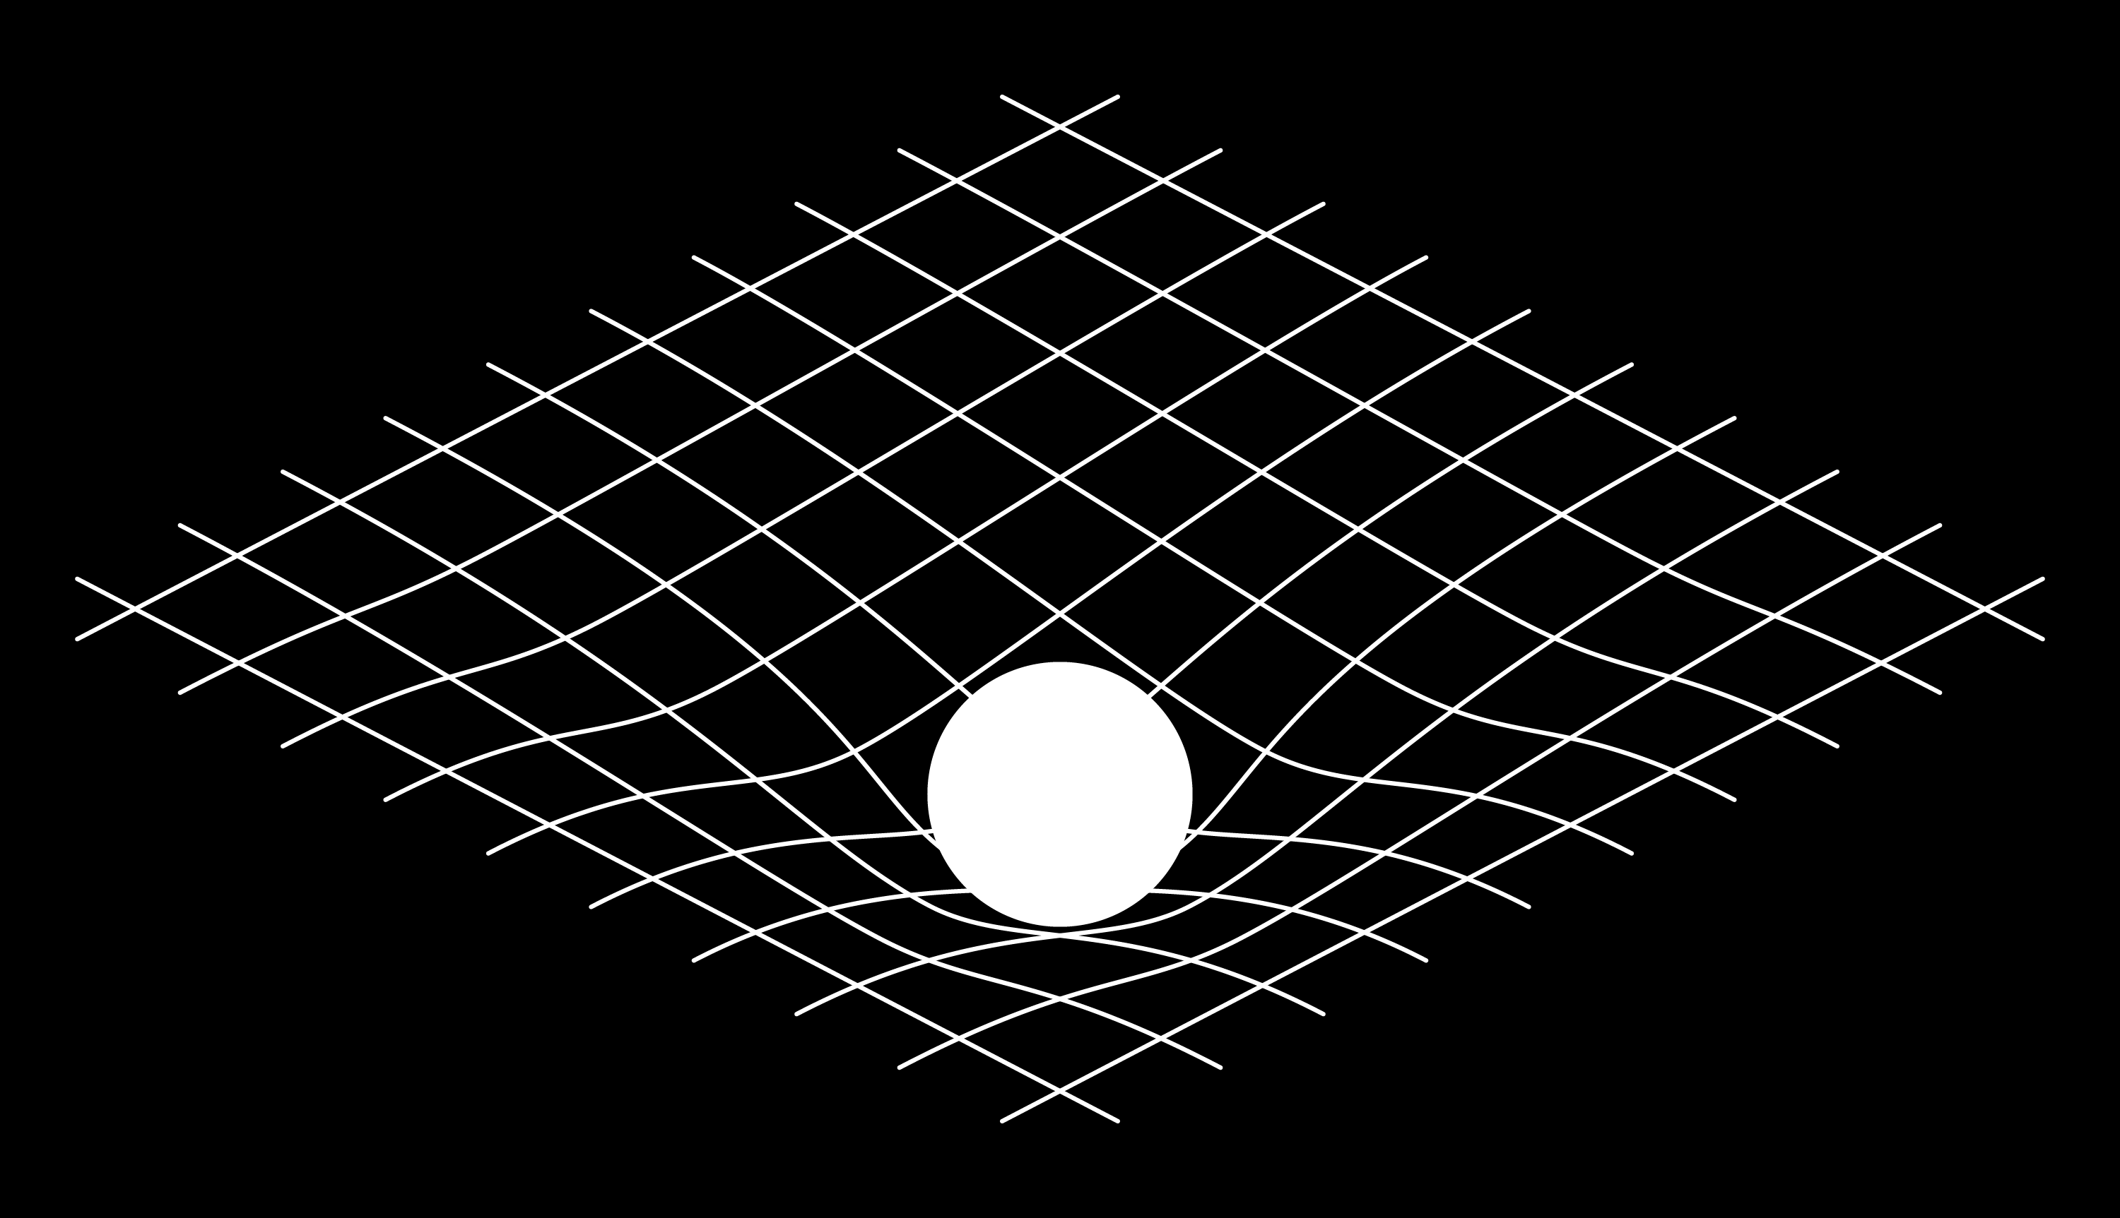
A Thought Experiment

Slide 5
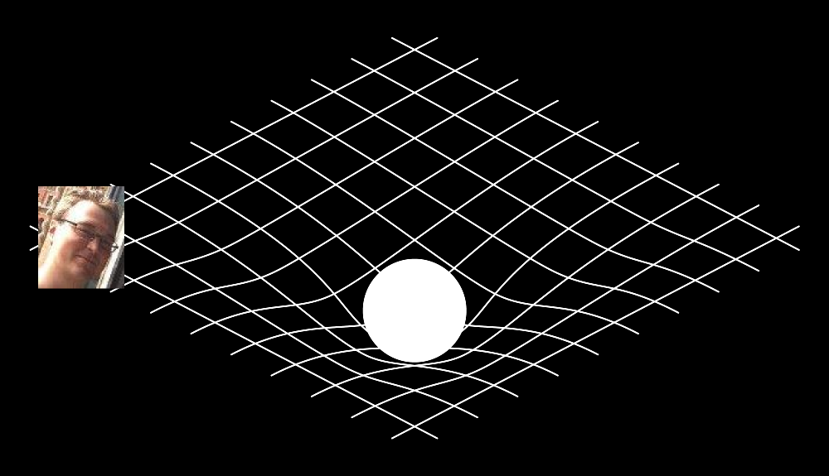
A Thought Experiment

Slide 6

A Thought Experiment

Slide 7
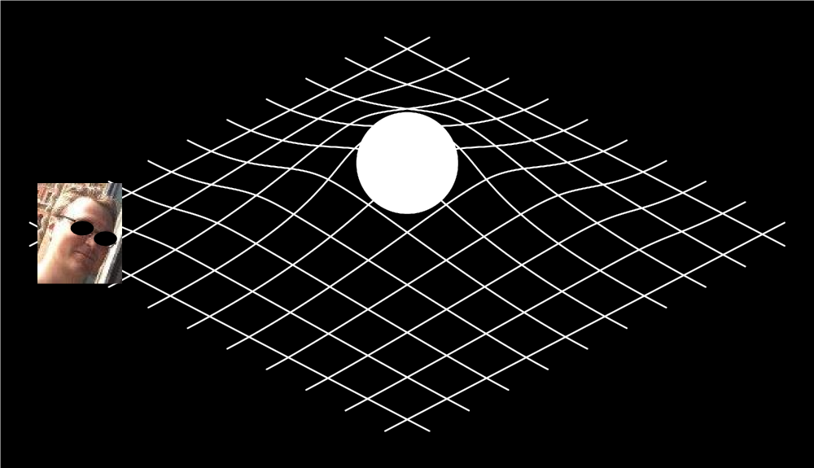
A Thought Experiment

Slide 8
A Thought Experiment
I’m feeling a gravitational pull in a different direction
I didn’t see the ball move (electromagnetically), but I know it’s moved
The information that the ball moved had to reach me somehow…
How did that information travel to me?

Slide 9
A Thought Experiment
I’m feeling a gravitational pull in a different direction
I didn’t see the ball move (electromagnetically), but I know it’s moved
The information that the ball moved had to reach me somehow…
How did that information travel to me?
Gravitational Waves

Slide 10
Gravitational Waves
Come from changing Gravitational fields
Propagate at the speed of light
Incredibly tiny!
Energy emitted in gravitational waves from the orbit of the sun around the earth is around 200W
This is about the same as a human walking briskly…
We need much more extreme gravitational events

Slide 11
Black Holes
When sufficiently massive stars die, they leave behind incredibly dense region of space time
These regions are so dense, that even light can’t escape their gravity
These regions are called Black Holes
A typical black hole might be around 10 times heavier than the sun, whilst only being a few 10s of kilometers across.

Slide 12
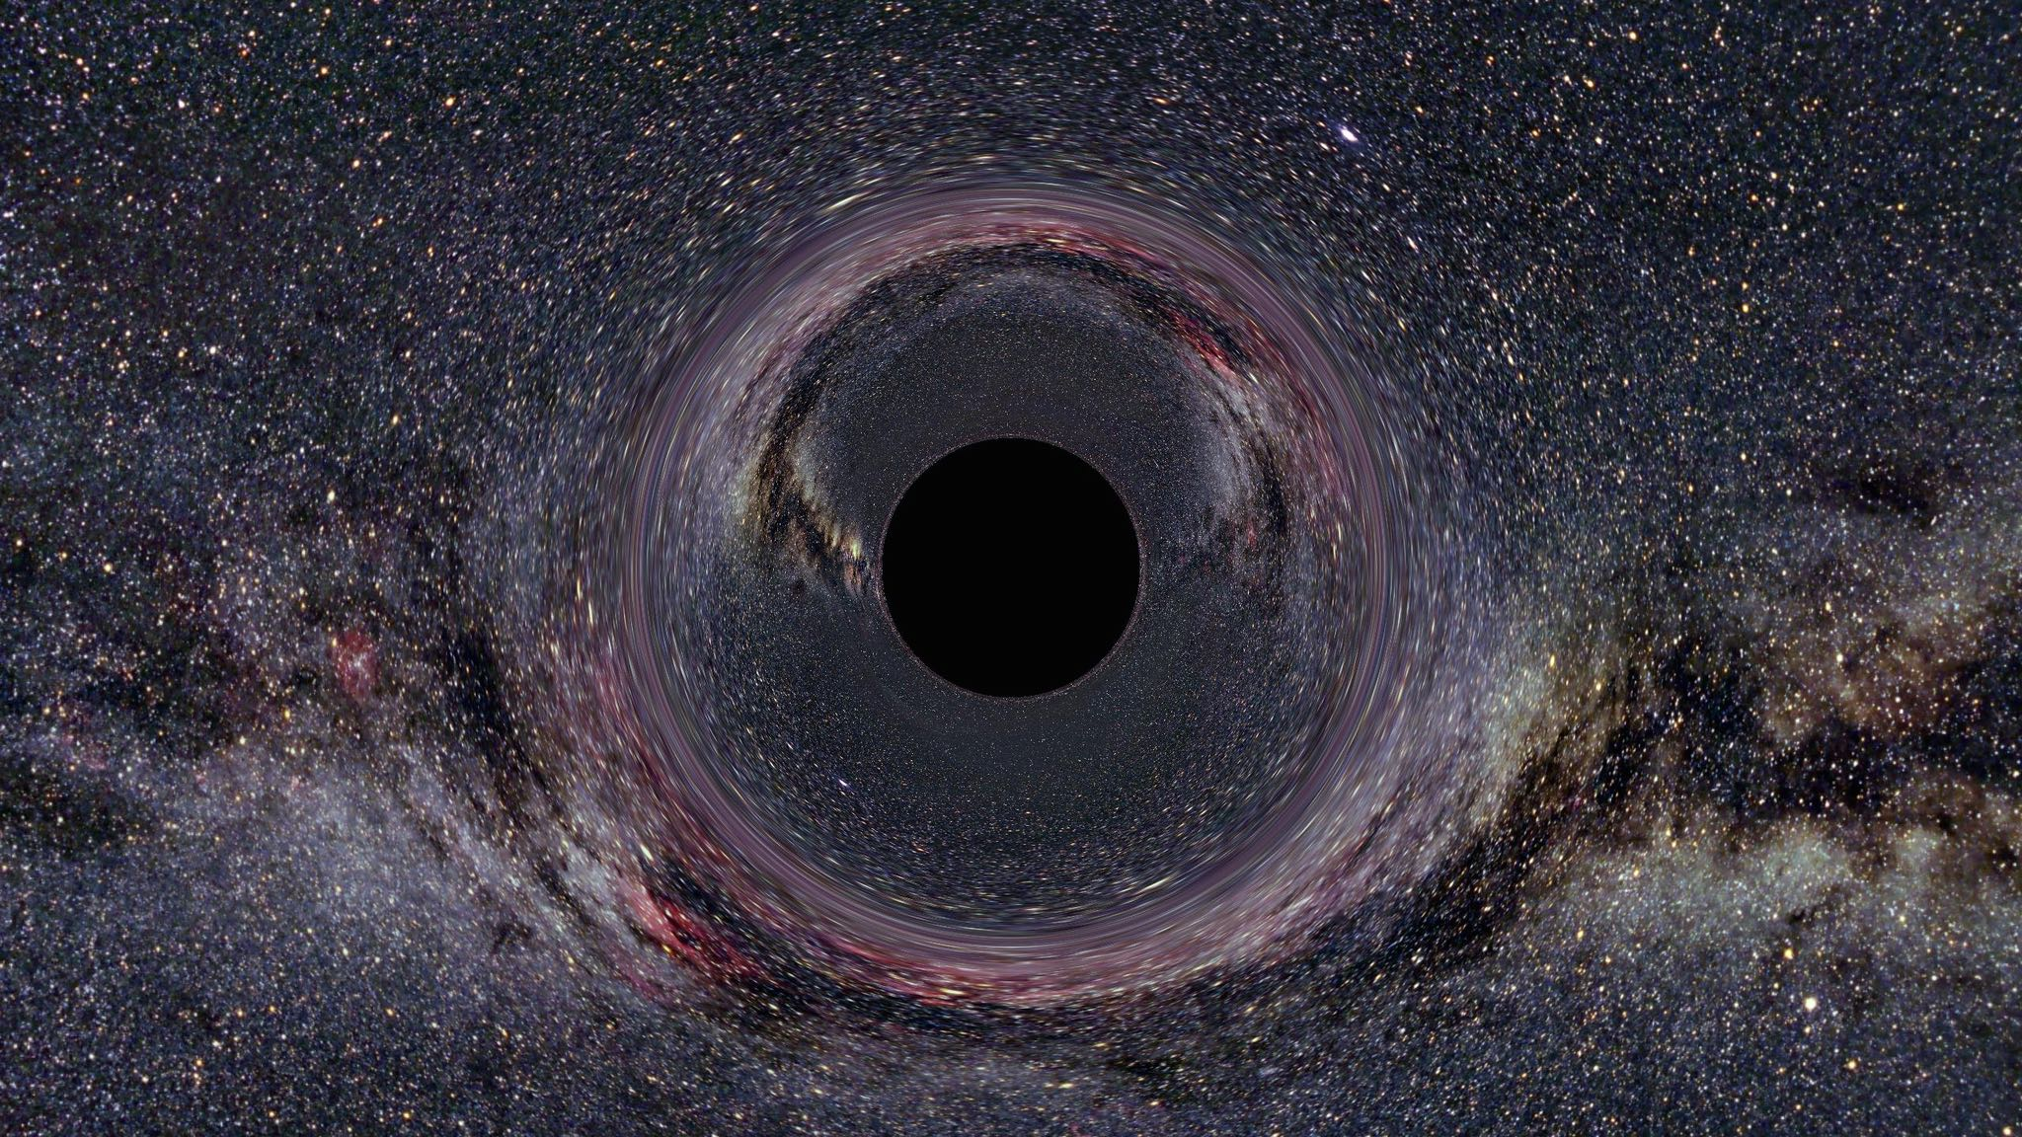
Black Holes

Slide 13
Question
What’s more gravitationally extreme than a black hole?

Slide 14
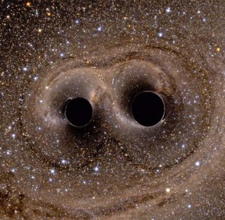
Question
Two Black Holes!

Slide 15
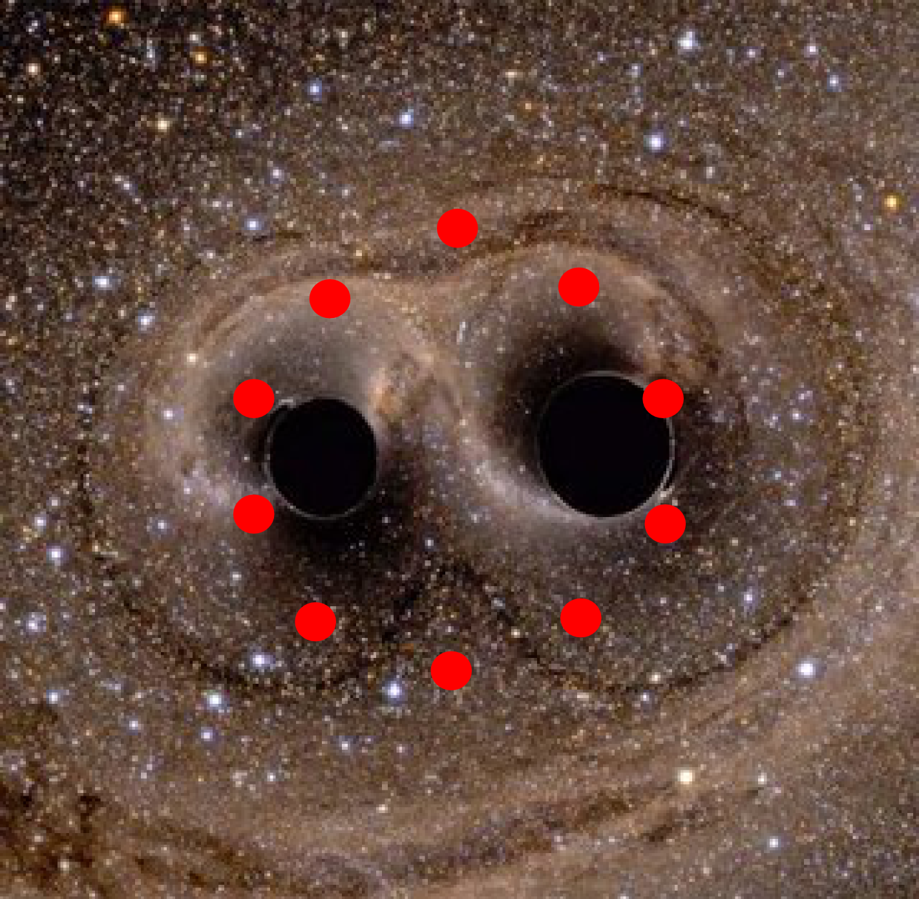
What do Gravitational Waves Feel Like?

Slide 16
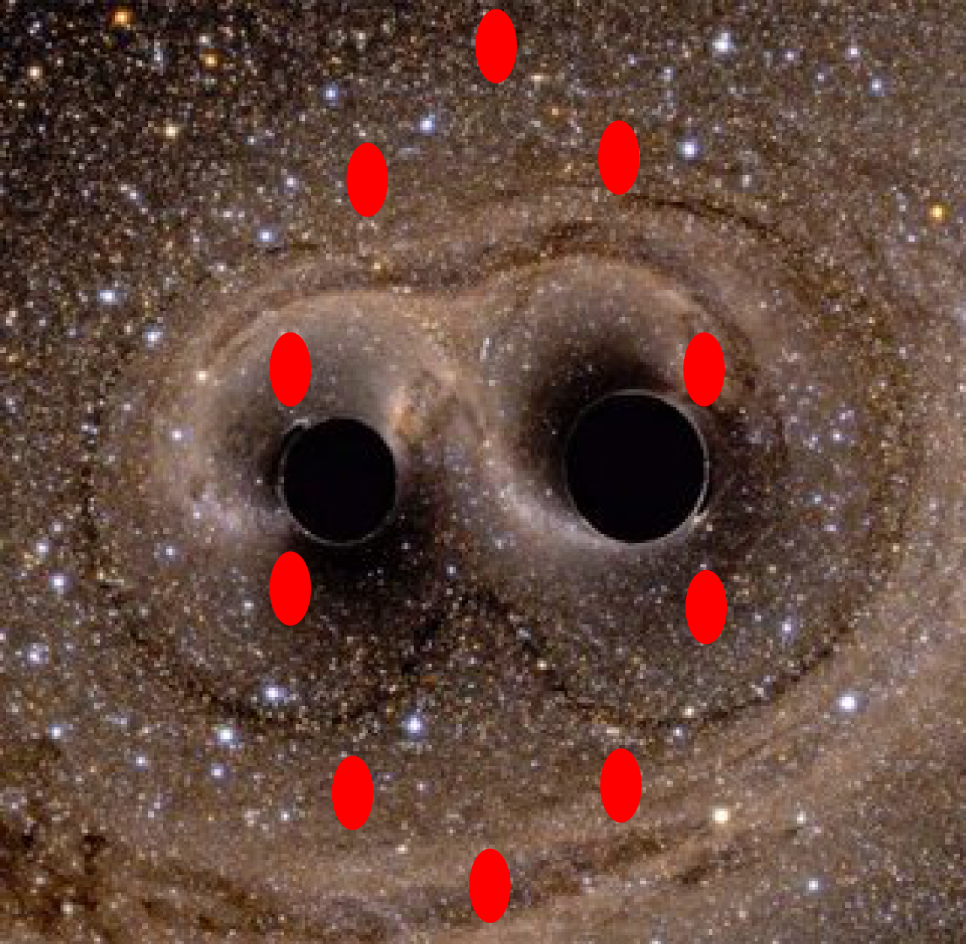
What do Gravitational Waves Feel Like?

Slide 17
What do Gravitational Waves Feel Like?

Slide 18
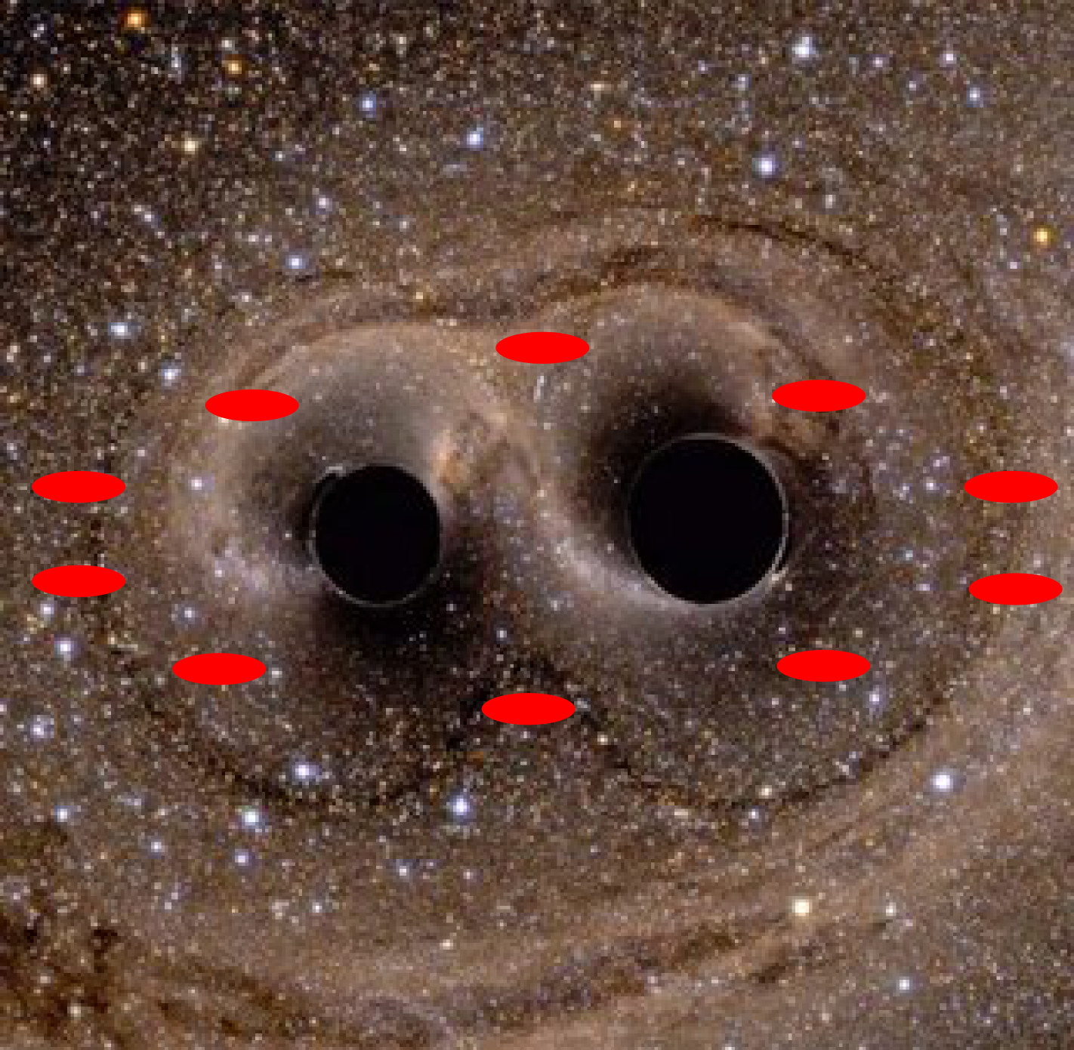
What do Gravitational Waves Feel Like?

Slide 19
What do Gravitational Waves Feel Like?

Slide 20
What do Gravitational Waves Feel Like?

Slide 21
What do Gravitational Waves Feel Like?

Slide 22
What do Gravitational Waves Feel Like?

Slide 23
What do Gravitational Waves Feel Like?

Slide 24
What do Gravitational Waves Feel Like?

Slide 25
What do Gravitational Waves Feel Like?

Slide 26
What do Gravitational Waves Feel Like?

Slide 27
Laser Interferometer Gravitational Wave Observatory (LIGO)
By the time they reach earth, this stretching and squashing changes distances by about 1 part in 10^21
This is roughly equivalent to the diameter of a human hair (micrometres) compared to the distance to Alpha Centauri (4.35 lightyears)
How do we go about measuring these kinds of differences?

Slide 28
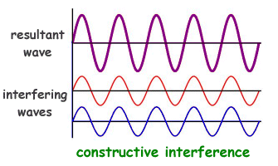
Brief Aside: Interference

Slide 29
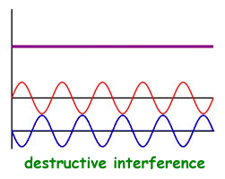
Brief Aside: Interference

Slide 30
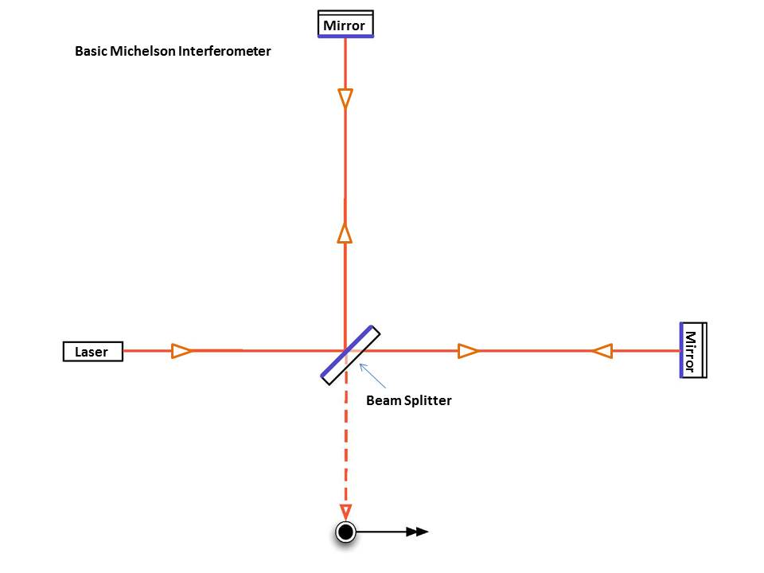
Michelson Interferometer

Slide 31
Question
What’s better than a laser interferometer for detecting gravitational waves?

Slide 32
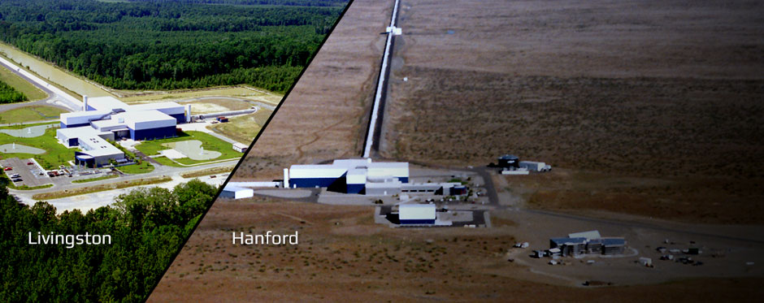
Question
Two Interferometers!

Slide 33
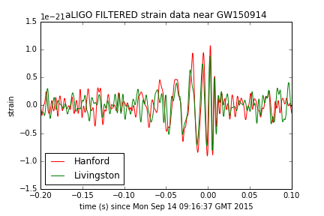
GW150914

Slide 34
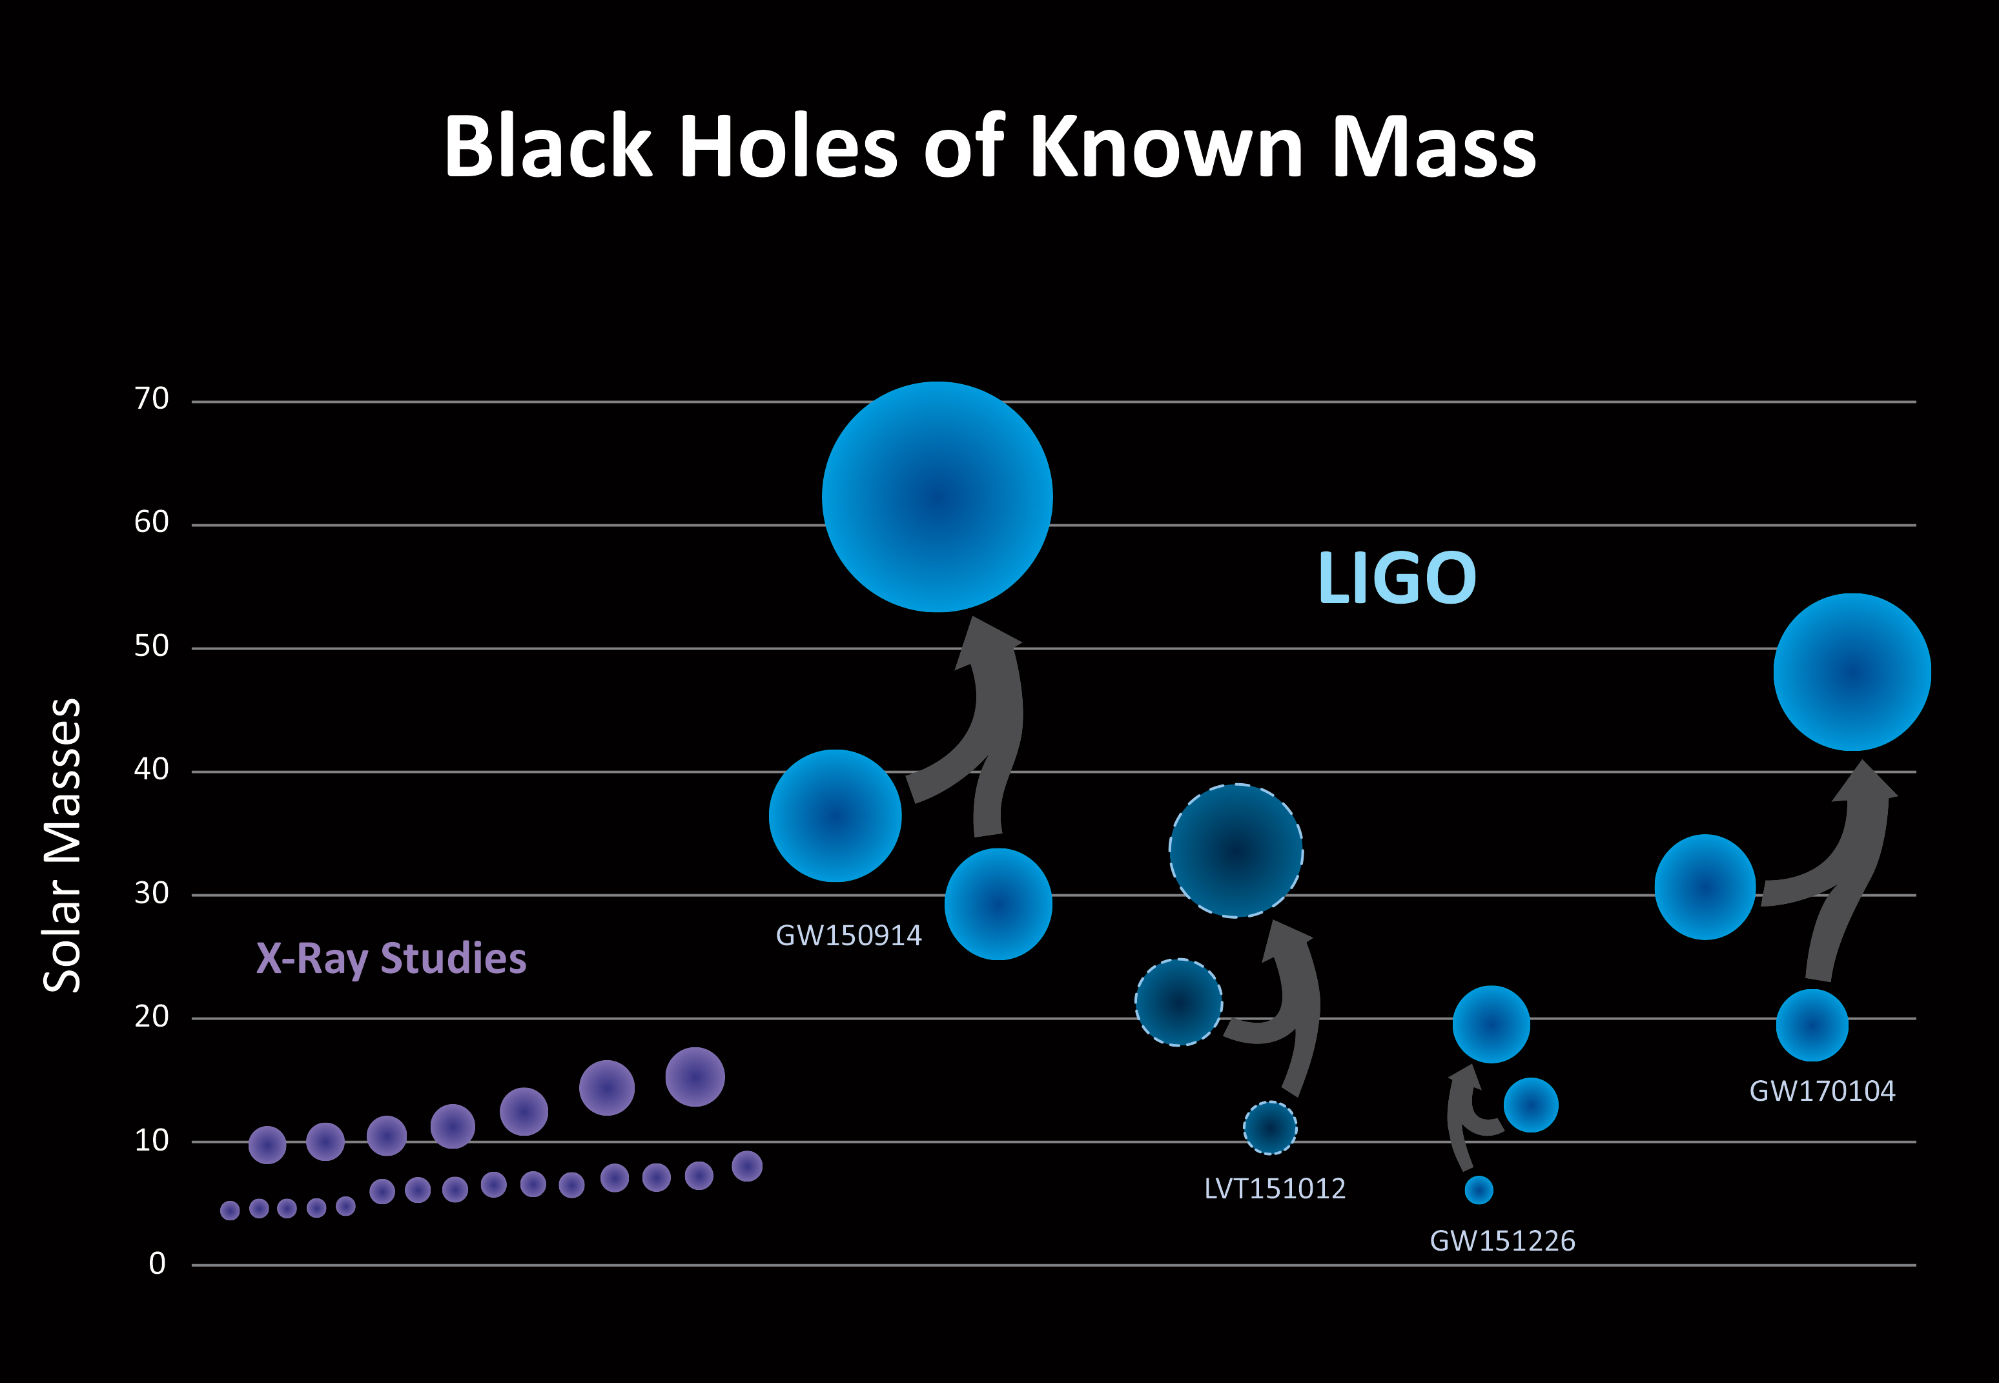
Other Gravitational Waves

Slide 35
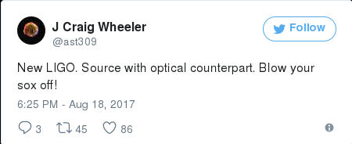
Some Gossip - GW170818(ish)

Slide 36
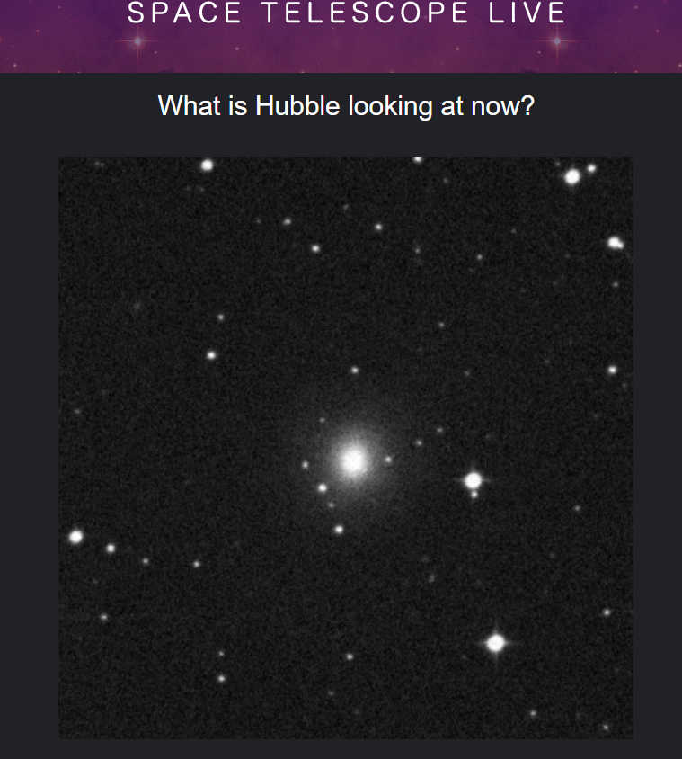

Some Gossip - GW170818(ish)
https://spacetelescopelive.org/

Slide 37

Shameless Self Plug – Binary Evolution

Slide 38
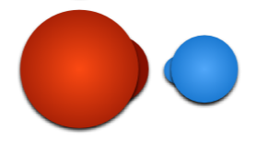
Shameless Self Plug – Binary Evolution

Slide 39

Shameless Self Plug – Binary Evolution

Slide 40
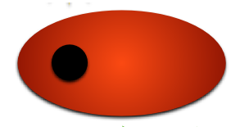
Shameless Self Plug – Binary Evolution

Slide 41

Shameless Self Plug – Binary Evolution

Slide 42
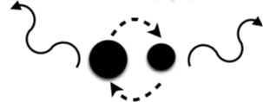
Shameless Self Plug – Binary Evolution

Slide 43
Shameless Self Plug – Binary Evolution
?

Slide 44
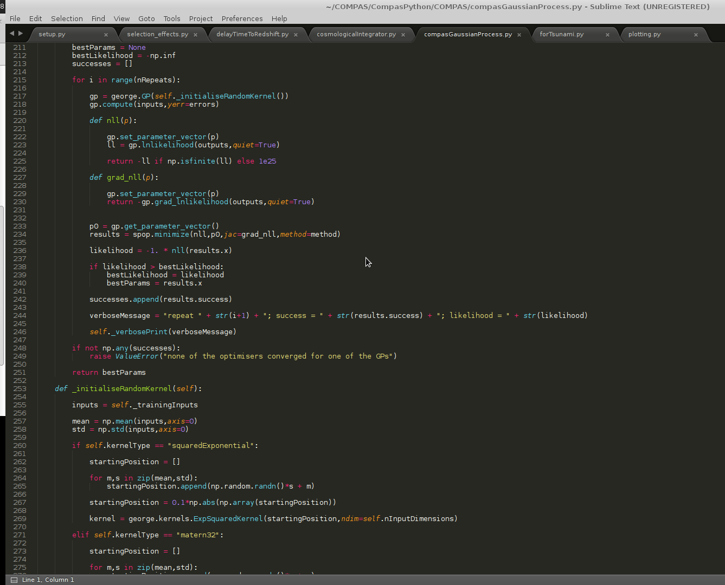

Shameless Self Plug – Binary Evolution

Slide 45
Questions?

