Slide 1
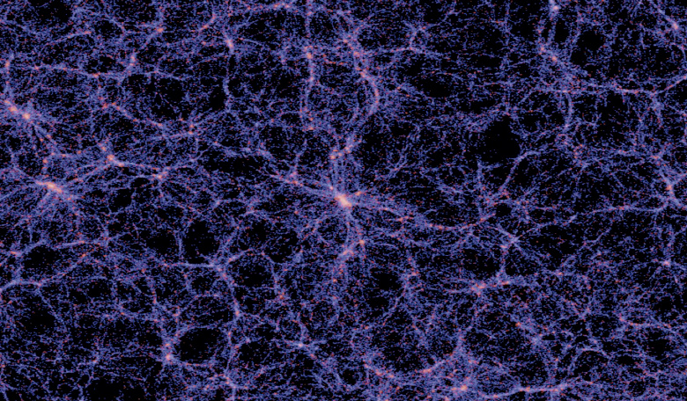
The Universe on the Grandest Scales
Jim Barrett
(with inspiration from Sean Elvidge)

Slide 2
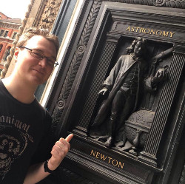
Me!
PhD Student at University of Birmingham
Gravitational Waves and Binary Evolution
More on this later in the week

Slide 3
Me!
Born 1991
Lowestoft, Suffolk

Slide 4
Me!
Born 1991
Lowestoft, Suffolk
Finished GCSEs 2007
A*AAAABBBC

Slide 5
Me!
Born 1991
Lowestoft, Suffolk
Finished GCSEs 2007
A*AAAABBBC
Finished A-Levels 2009
Physics (A), Maths (A)
Further Maths (A)

Slide 6
Me!
Born 1991
Lowestoft, Suffolk
Finished GCSEs 2007
A*AAAABBBC
Finished A-Levels 2009
Physics (A), Maths (A)
Further Maths (A)
Started Degree in
Particle Physics and
Cosmology
2009

Slide 7
Me!
Born 1991
Lowestoft, Suffolk
Finished GCSEs 2007
A*AAAABBBC
Finished A-Levels 2009
Physics (A), Maths (A)
Further Maths (A)
Switched to Physics
2010
Started Degree in
Particle Physics and
Cosmology
2009

Slide 8
Me!
Born 1991
Lowestoft, Suffolk
Finished GCSEs 2007
A*AAAABBBC
Finished A-Levels 2009
Physics (A), Maths (A)
Further Maths (A)
Switched to
Theoretical Physics
2012
Switched to Physics
2010
Started Degree in
Particle Physics and
Cosmology
2009

Slide 9
Me!
Born 1991
Lowestoft, Suffolk
Finished GCSEs 2007
A*AAAABBBC
Finished A-Levels 2009
Physics (A), Maths (A)
Further Maths (A)
Switched to
Theoretical Physics
2012
Switched to Physics
2010
Started Degree in
Particle Physics and
Cosmology
2009
Graduated 2013
Started Job in
Software

Slide 10
Me!
Born 1991
Lowestoft, Suffolk
Finished GCSEs 2007
A*AAAABBBC
Finished A-Levels 2009
Physics (A), Maths (A)
Further Maths (A)
Switched to
Theoretical Physics
2012
Switched to Physics
2010
Started Degree in
Particle Physics and
Cosmology
2009
Graduated 2013
Started Job in
Software
Applied for PhDs
In Condensed Matter
Theory
2014

Slide 11
Me!
Born 1991
Lowestoft, Suffolk
Finished GCSEs 2007
A*AAAABBBC
Finished A-Levels 2009
Physics (A), Maths (A)
Further Maths (A)
Switched to
Theoretical Physics
2012
Switched to Physics
2010
Started Degree in
Particle Physics and
Cosmology
2009
Graduated 2013
Started Job in
Software
Applied for PhDs
In Condensed Matter
Theory
2014
Started PhD in
Astrophysics
2014

Slide 12
Me!
Born 1991
Lowestoft, Suffolk
Finished GCSEs 2007
A*AAAABBBC
Finished A-Levels 2009
Physics (A), Maths (A)
Further Maths (A)
2017
Writing up PhD
Interviewing for Jobs in Machine Learning
Switched to
Theoretical Physics
2012
Switched to Physics
2010
Started Degree in
Particle Physics and
Cosmology
2009
Graduated 2013
Started Job in
Software
Applied for PhDs
In Condensed Matter
Theory
2014
Started PhD in
Astrophysics
2014

Slide 13
The Universe on the Grandest Scales

Slide 14
Contents
Big Stuff
Parallax and Parsecs
Cosmology

Slide 15
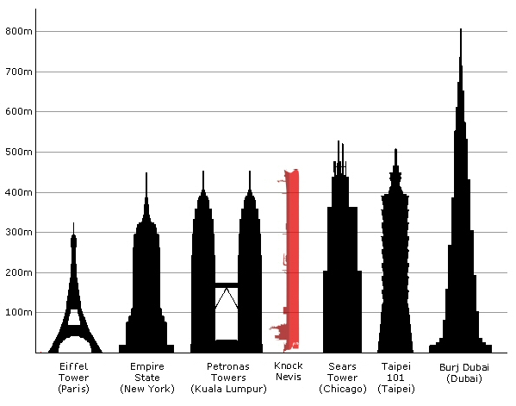
Big Stuff on Earth

Slide 16
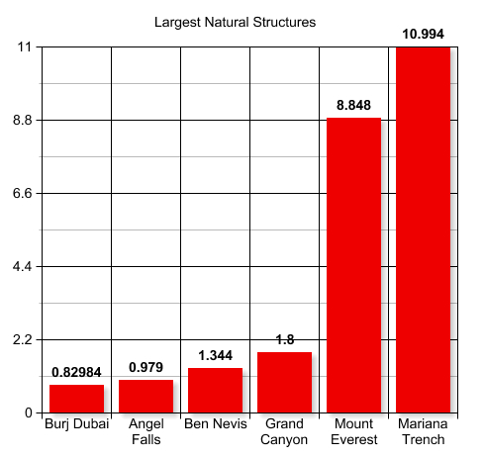
Big Stuff on Earth
km

Slide 17
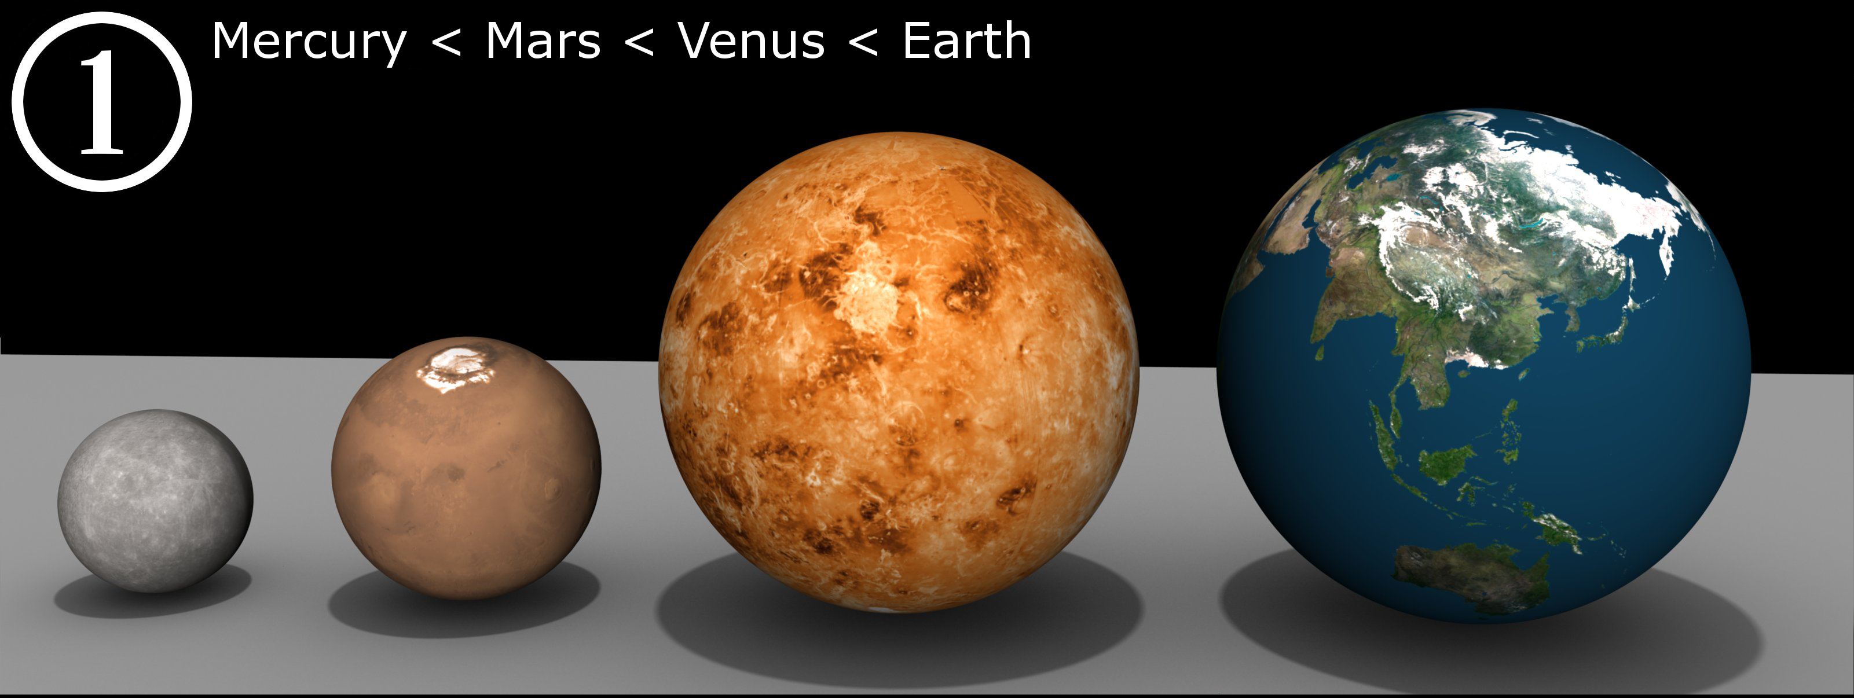
Planets

Slide 18
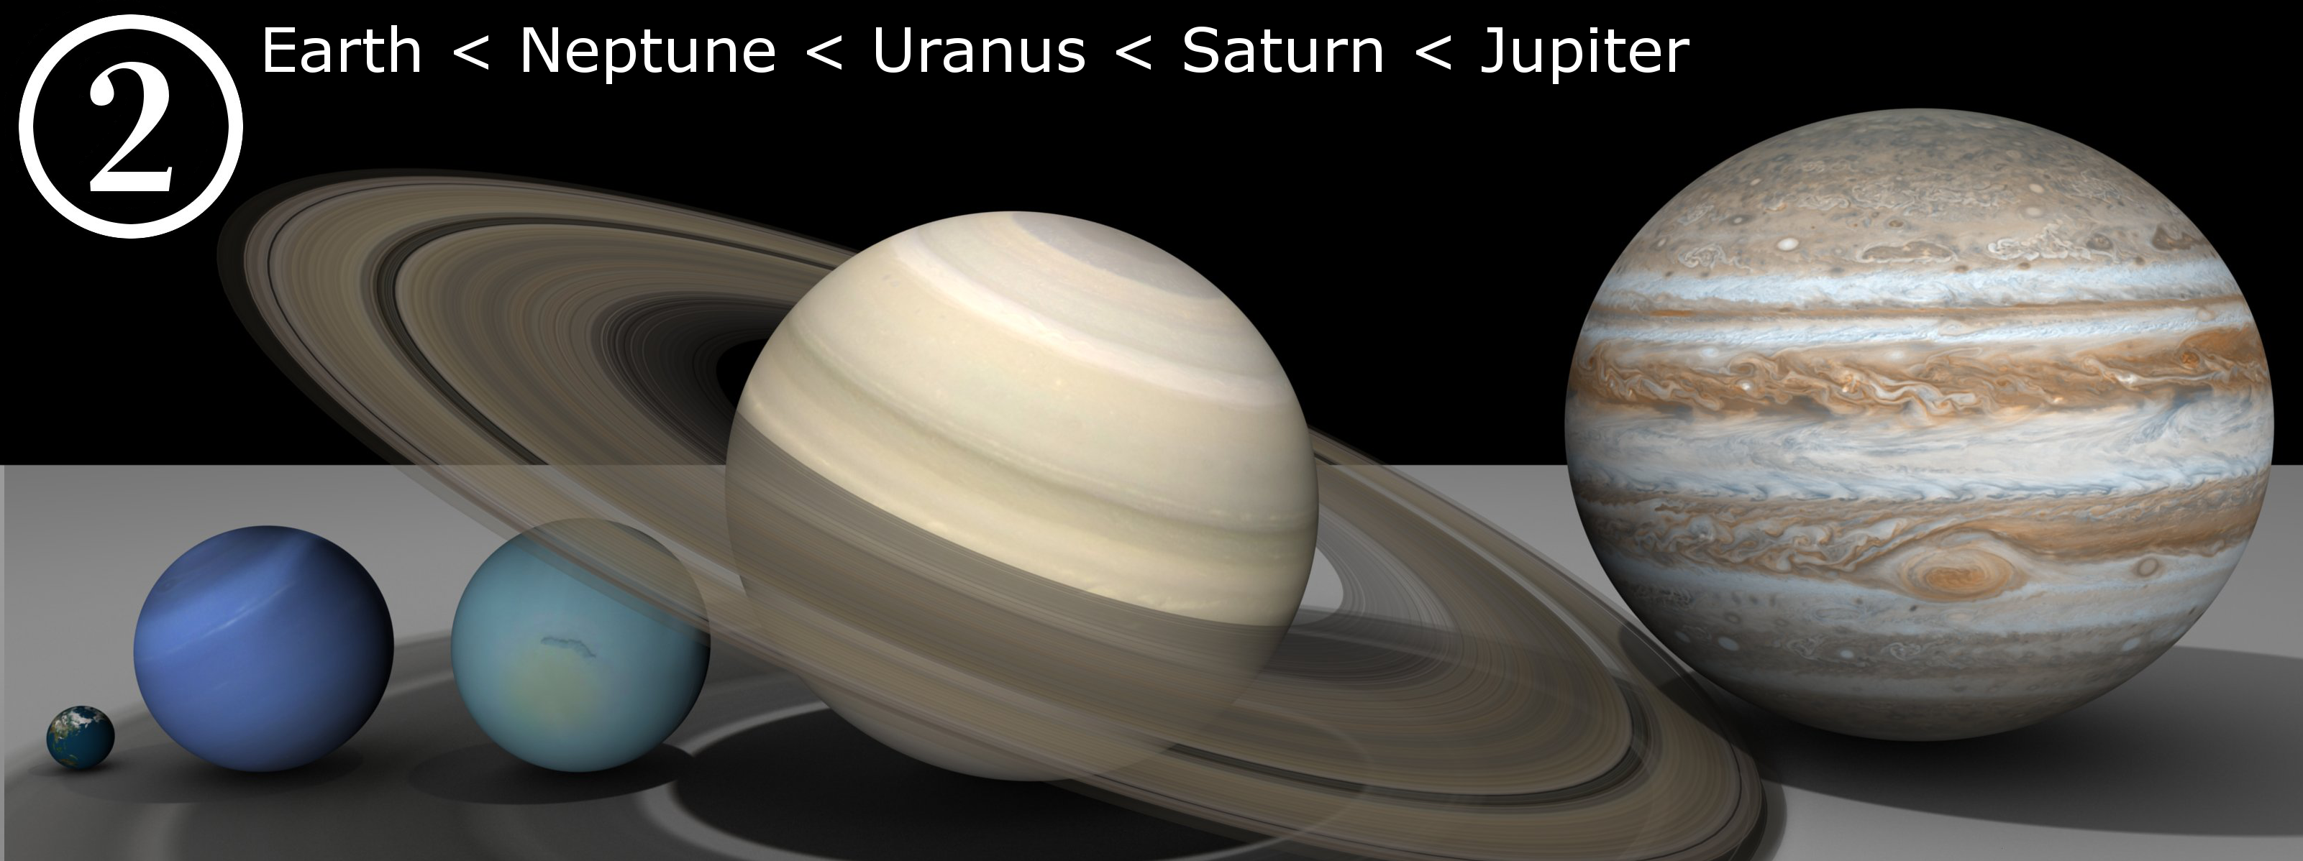
Planets

Slide 19
Exercise
How far is the moon from the Earth?
How big is the Sun?
How far away is the Sun?

Slide 20
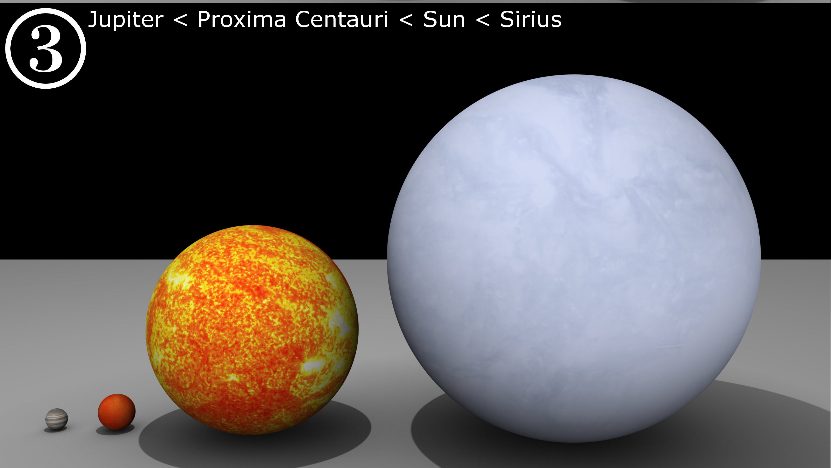
Scaling it up - Stars

Slide 21
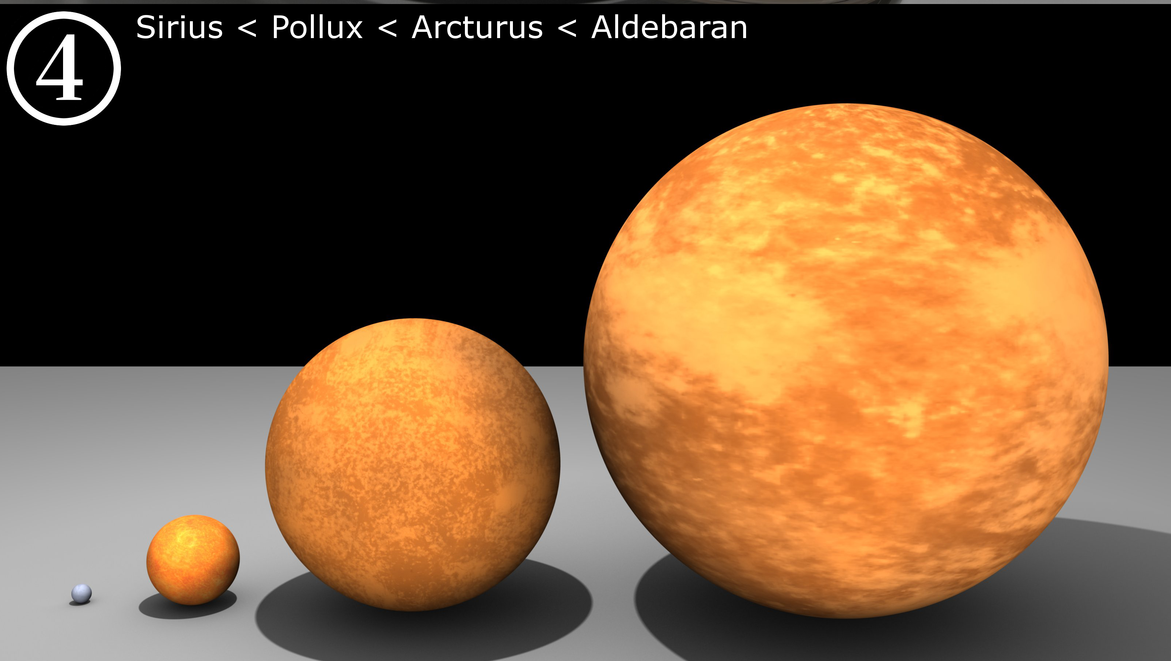
Scaling it up - Stars

Slide 22
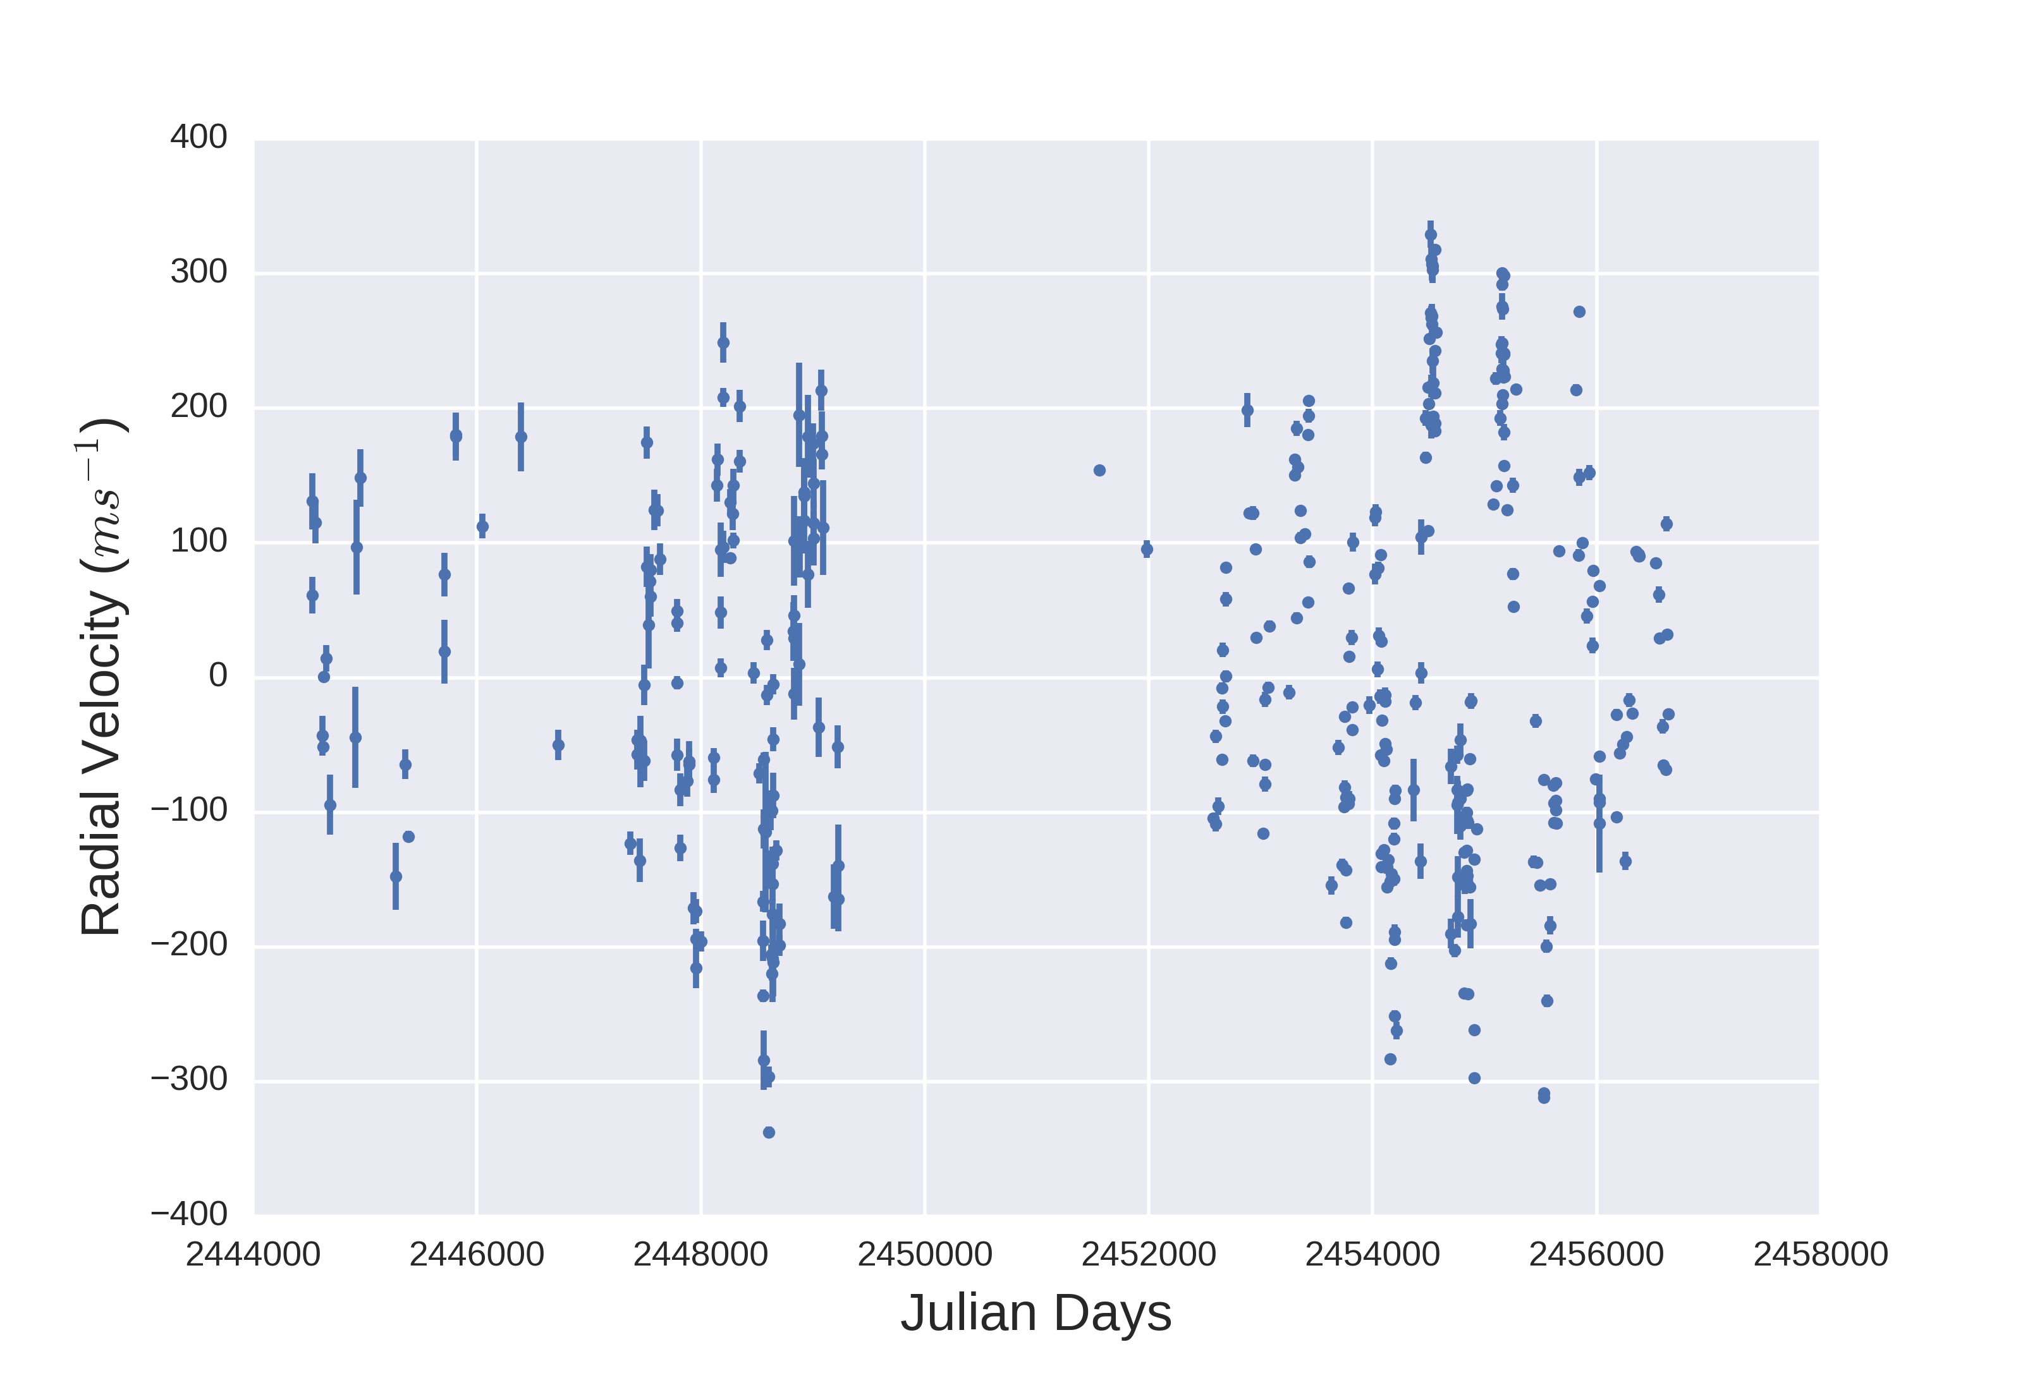
Brief Aside - Aldebaran
My first research project
Looking for periodicity in bad data

Slide 23
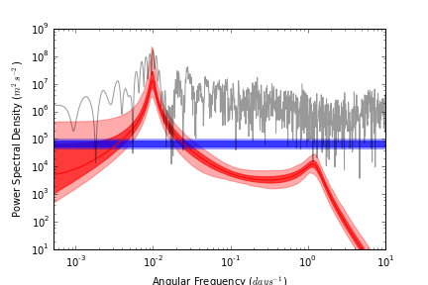
Brief Aside - Aldebaran

Slide 24
Scaling it up - Stars

Slide 25
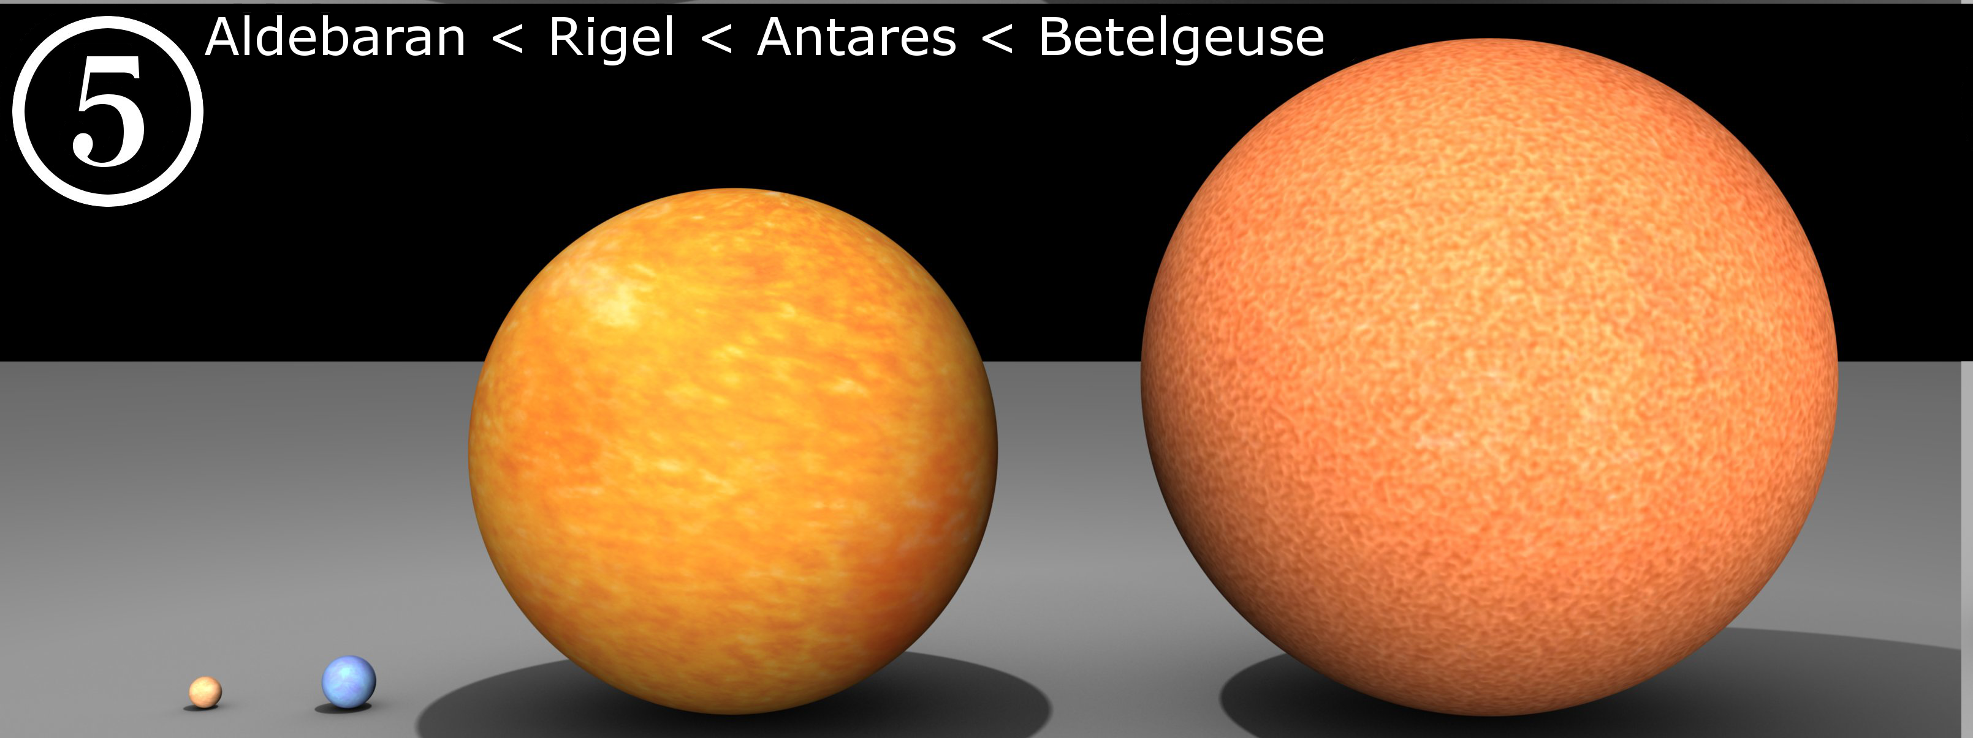
Scaling it up - Stars

Slide 26
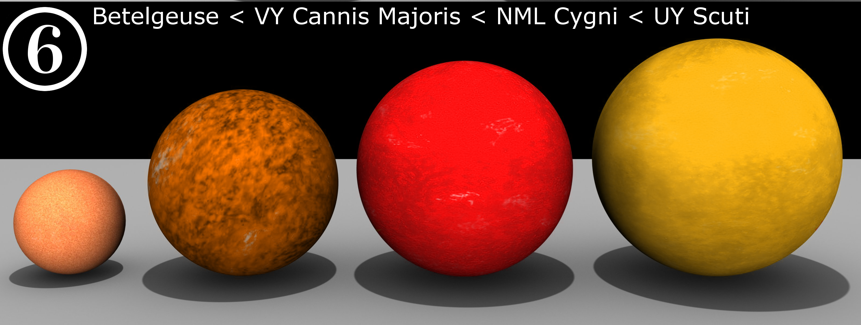
Scaling it up - Stars
Radius of Earth ~ 6300km
Radius of UY Scuti ~ 1.1 x 10^9 km

Slide 27
Distances to Stars
All of the sizes so far pale in comparison to the distance between stars.
The closest star to us, α-Centauri, is ~4.37 lightyears away
~ 20000 UY Scuti
How can we measure these distances?

Slide 28
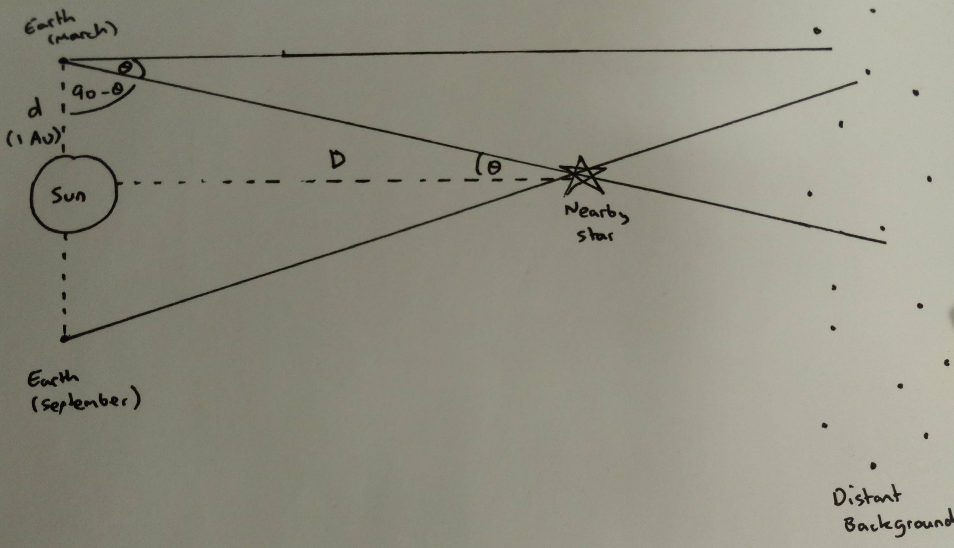
Parallax

Slide 29
Tiny Angles
Unit | Number of Degrees
Degree ( ° ) | 1
Arcminute ( am ) | 1/60
Arcsecond ( as ) | 1/3600
Milliarcsecond ( mas ) | 1/3600000
Microarcsecond ( μas ) | 1/3600000000

Slide 30
Worksheet

Slide 31
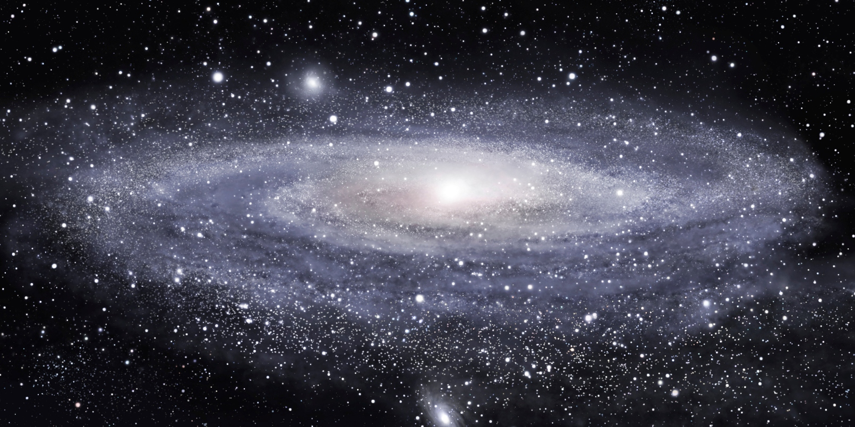
Biggest Scales - Galaxies
Milky Way
100 Billion Stars
~150000 lightyears in diameter

Slide 32
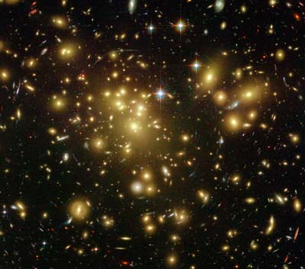
Biggest Scales – Galaxy Clusters
100s to 1000s of Galaxies
Up to 10^15 suns worth of mass

Slide 33
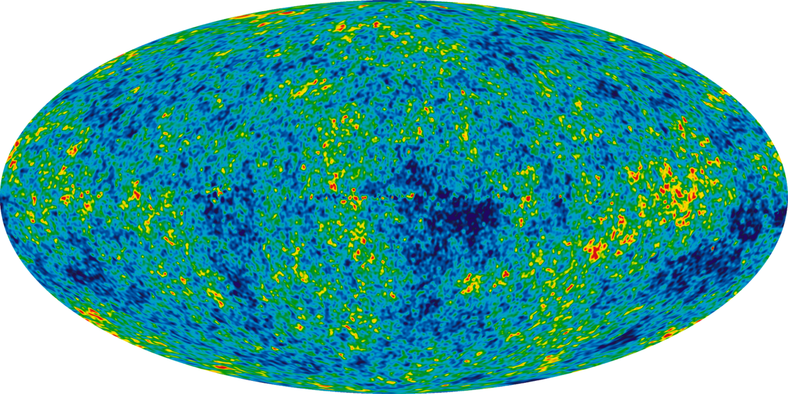
Biggest Scales – Observable Universe

Slide 34
Cosmology
Study of the universe as a whole
“Standard Model” of Cosmology brings us from the Big Bang to the present day expanding universe
We will derive one key result;
Hubble’s law

Slide 35
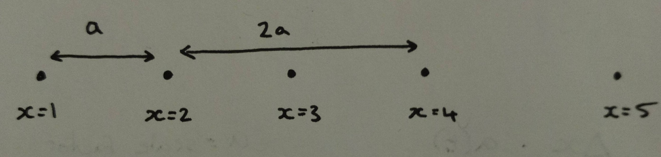
Cosmology in 1D
Leonard Susskind lectures on Youtube
Evenly spaced Galaxies in a line, each one is a distance “a” from its nearest neighbours
We label the galaxies as x=1,x=2 etc

Slide 36

Cosmology in 1D
The distance between two galaxies is;

Slide 37
Cosmology in 1D
Imagine the galaxies are on a piece of elastic, and two giants stand at either end pulling it apart.
Our galaxy labels don’t change, and they’re still evenly spaced. But now a changes with time

Slide 38
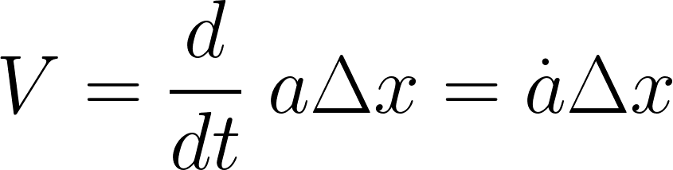
Cosmology in 1D
The distance between two galaxies is;

Slide 39
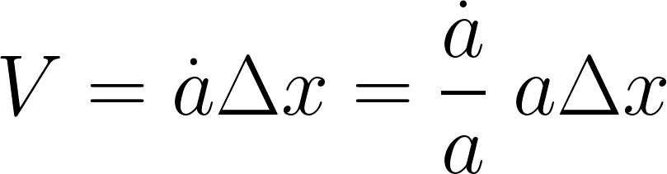
Cosmology in 1D
Sneaky trick time

Slide 40
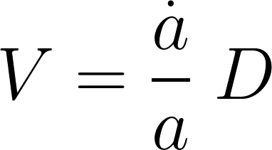

Cosmology in 1D
a-dot over a has another name, the Hubble constant

Slide 41
Cosmology in 1D
The bigger the distance, the bigger the velocity

Slide 42
Questions?

