Slide 1
Your Zip Code is Your Health Sentence
Food Deserts, Geographic Inequality, and Chronic Disease in America
Team 2Kim | Jimmy + Alice
SBU AI Community Datathon 2026 | Healthcare & Wellness Track
37 million Americans have diabetes ($327B/year). 19 million live in food deserts. Are these the same people? And is it their fault — or their zip code's?

Slide 2
Research Question
How do food access, income, and race independently and jointly predict
diabetes, obesity, and life expectancy across U.S. census tracts?
Three sub-questions:
1. Does food desert status predict diabetes and obesity after controlling for poverty
and insurance? → the direct test
2. How much of the variation in diabetes is geographic, and what predicts
life expectancy most? → the scale
3. Does race remain a significant predictor of diabetes after accounting for
income and food access? → the depth
Flow: test it → measure its scale → probe deeper → identify where to act

Slide 3
Data: 5 Federal Datasets → 27,235 Census Tracts
USDA Food Access Atlas (2019)
Food desert classification by tract — ers.usda.gov
CDC PLACES (2025)
Diabetes, obesity, BP, depression prevalence — data.cdc.gov
ACS 5-Year Estimates (2022)
Income, poverty, race, education by tract — Census Bureau API
CDC Life Expectancy (USALEEP)
Life expectancy at birth by tract — ftp.cdc.gov
HRSA HPSA (2026)
Primary care shortage designations — data.hrsa.gov
All joined on 11-digit FIPS census tract code | Cleaning: sentinel values, group-quarters removal, FIPS standardization

Slide 4
Methods at a Glance
OLS Regression
diabetes/obesity ~ food_desert + poverty + uninsured, with HC1 robust standard errors
VIF Check
Variance Inflation Factor — confirms no multicollinearity between predictors
Odds Ratio + t-test
2x2 table (food desert x high/low diabetes) + Welch t-test for mean comparison
Variance Decomposition
Between-county vs within-county diabetes variance, weighted by tract count
Standardized Betas
Z-scored predictors → coefficients show relative importance for life expectancy
Interaction Model
diabetes ~ income x race + food_desert — tests if income's effect differs by race
Health Disadvantage Index
Equal-weighted z-score composite: food access + poverty + healthcare access

Slide 5
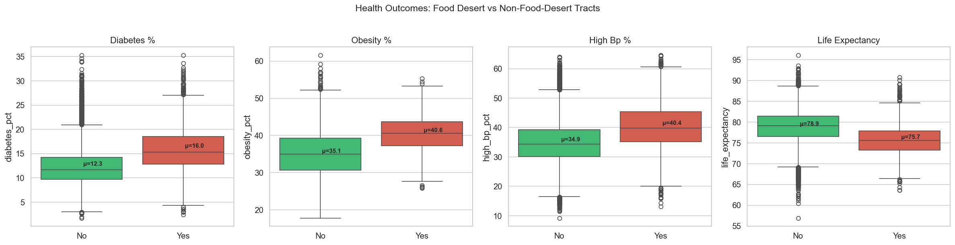
EDA: Food Desert Tracts Have Worse Outcomes
Food desert tracts show ~3.7pp higher diabetes, elevated obesity/BP, and lower life expectancy. This motivates sub-question 1: is this just poverty, or does food access itself matter?

Slide 6
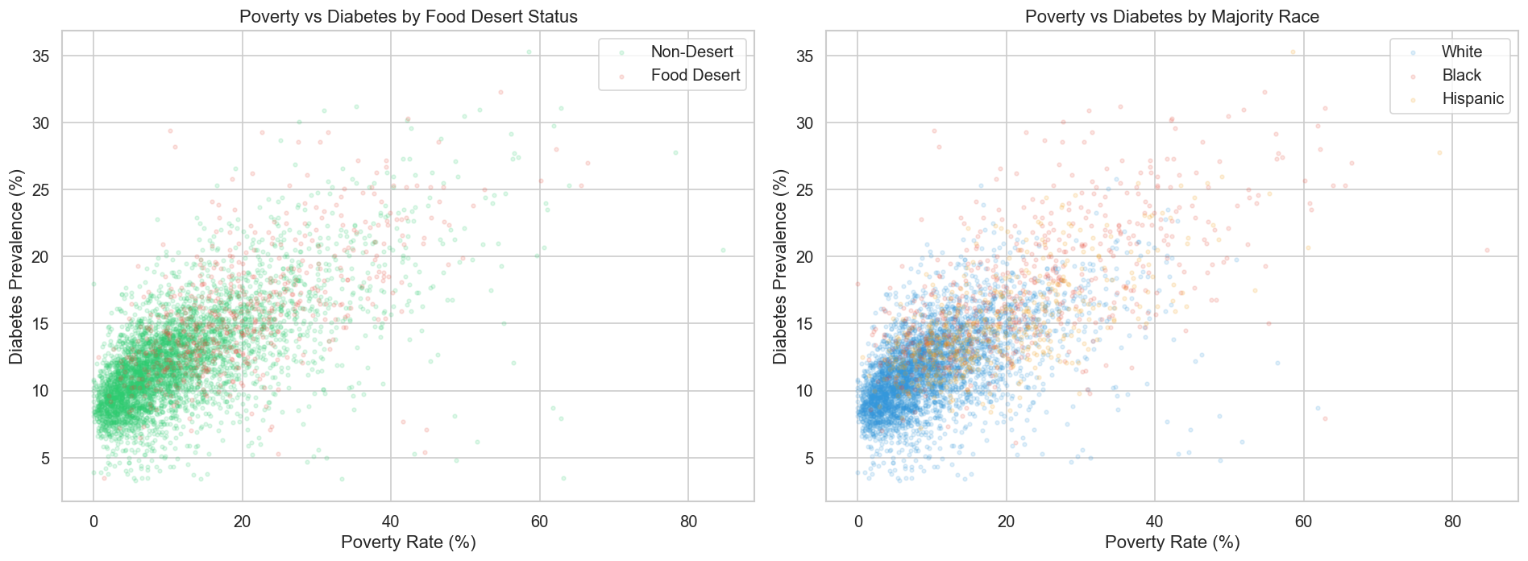
EDA: Poverty, Food Deserts, and Race Cluster Together
Left: Food deserts (red) cluster in high-poverty, high-diabetes areas. Right: Majority-Black and -Hispanic tracts occupy the same region. This overlap motivates sub-question 3.

Slide 7
Sub-Q 1: Does food access independently predict diabetes? Answer: YES
5.45x
Ecological odds of above-median diabetes in food desert tracts
R² = 0.50
Of diabetes variance explained by 3 predictors
15.95%
Mean diabetes in food deserts vs 12.28% in non-deserts
OLS Regression Results:
diabetes_pct ~ is_food_desert + poverty_rate + uninsured_pct
Food desert remains significant (p < 0.001) AFTER controlling for poverty and insurance
Partial correlation confirms food access predicts diabetes independent of income
95% CI for odds ratio: 4.90 – 6.06 | VIF < 1.5 for all predictors
Takeaway: Food access is not just a proxy for poverty. It independently predicts diabetes.

Slide 8
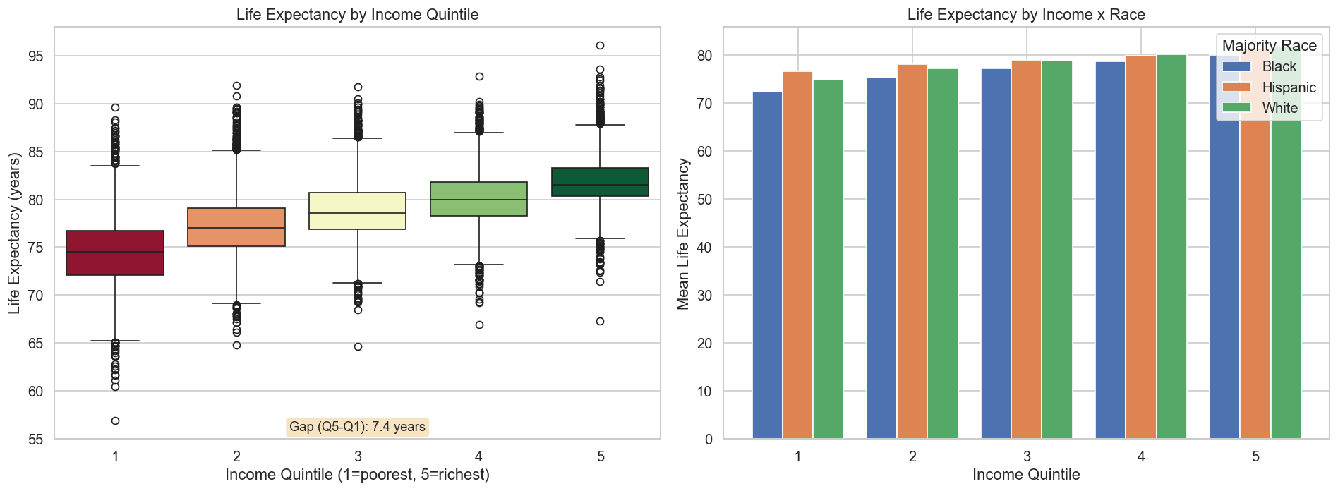
Sub-Q 2: How much does geography matter? 44% of diabetes variance
43.9%
Between-county diabetes variance
7.4 yrs
Life expectancy gap Q5 vs Q1 income
B=+1.31
Education is #1 life expectancy predictor
B=-1.13
Race is #2 (shorter life)
Takeaway: 7.4 years of life — nearly a decade — determined by neighborhood income.

Slide 9
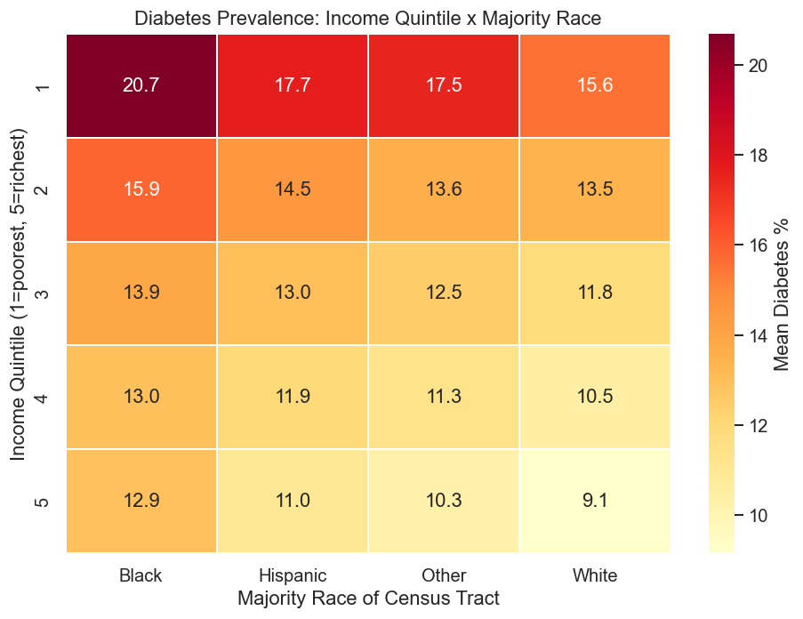
Sub-Q 3: Does race persist after controlling income + food? YES
R² 0.50 → 0.56
Race adds 6% explanatory power beyond income + food access
p near 0
Race is statistically significant
What the heatmap reveals:
Across rows: diabetes falls as income rises
(expected pattern)
Down columns: at the SAME income,
majority-Black tracts have higher diabetes
Richest Black tracts ~ middle-income White
Suggests structural factors beyond economics:
redlining, environmental racism, care access

Slide 10
Synthesis: Health Disadvantage Index — Where Inequality Compounds
Equal-weighted composite: Food Access + Poverty + Healthcare Access
8.6pp
Diabetes gap worst vs best 10%
12.2pp
Obesity gap worst vs best 10%
5.9 yrs
Life expectancy gap worst vs best 10%
27.6pp
Poverty gap worst vs best 10%
Pathway: Poverty → Food Desert → Obesity → Diabetes
Each link shows a statistically significant bivariate association
When food access, poverty, and healthcare shortage stack up in the same tract, outcomes are dramatically worse
These tracts are identifiable — the data tells us exactly where to intervene
Note: bivariate associations, not formal mediation analysis
The worst-HDI tracts: 8.6pp more diabetes, 12.2pp more obesity, residents die ~6 years earlier.

Slide 11
Honest Limitations
Transparency strengthens our analysis.
Ecological fallacy
Tract-level data — cannot infer individual risk from area-level patterns
Correlation ≠ causation
Cross-sectional, observational study with unmeasured confounders
Census tract mismatch
USDA (2010) vs PLACES (2020) tracts; ~85-95% match rate
Race classification
40% plurality among White/Black/Hispanic; erases Asian, Native, multiracial groups
Spatial autocorrelation
Neighboring tracts correlated → inflated sample size → anti-conservative p-values
Multiple comparisons
~15 tests without FDR correction; family-wise error rate ~54%
No population weighting
Rural tracts (1,500 people) weighted same as urban tracts (7,500)
Modeled data
CDC PLACES uses small-area estimation, not direct measurement

Slide 12
Conclusion: Target Places, Not Just People
Food access, income, healthcare availability, and race compound geographically to create
zones of health disadvantage. Diabetes and obesity are systemic outcomes, not personal failings.
Policy Recommendations:
Bring grocery stores and fresh food to USDA-classified food deserts
Expand Medicaid and community health centers in HRSA shortage areas
Invest in education — the #1 predictor of life expectancy (B = +1.31)
Target the worst-HDI tracts directly — they are identifiable in our data
Future Work:
Validate with individual-level NHANES data | Spatial regression (Moran's I) | COVID-19 temporal analysis

Slide 13
Thank You
Team 2Kim | Jimmy + Alice
27,235 census tracts | 5 federal datasets | 4 analysis phases github.com/jimbo111/datathon-kims
"We identified the tracts. The data is public. The question is whether we act on it."

