Slide 1
The AI Hype Cycle
Are We in a Bubble?
Comparing NVIDIA 2023-2026 to Cisco 1998-2001
Team 2Kim: Jimmy Kim & Alice Kim
SBU AI Community Datathon 2026 — Finance & Economics Track

Slide 2
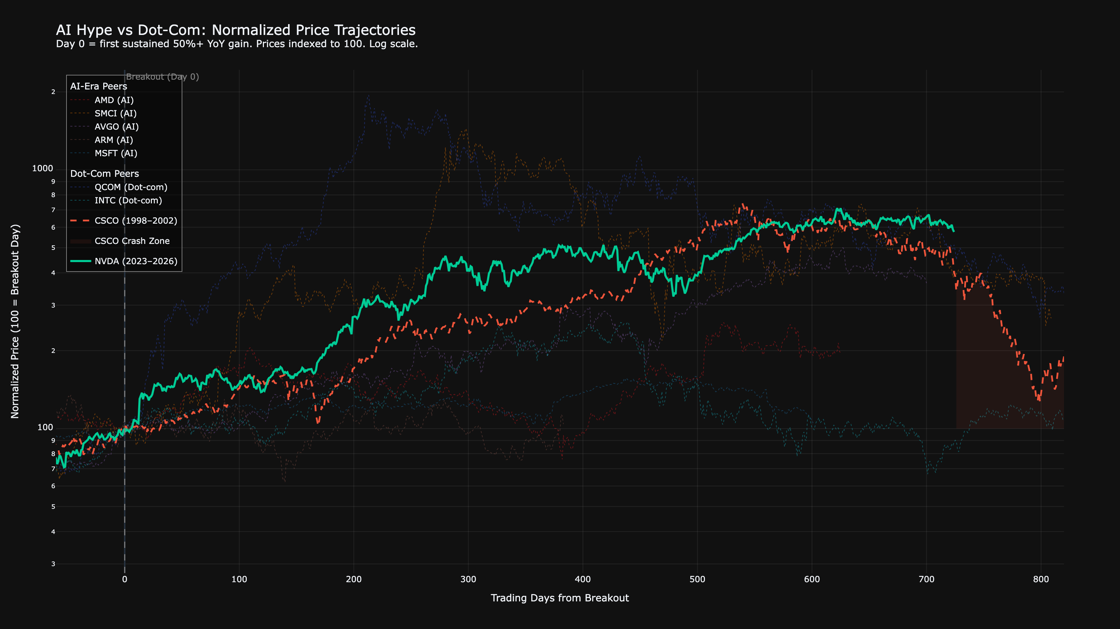
"Does This Look Familiar?"
■ NVIDIA 2023-2026
■ Cisco 1998-2001
- - Nortel Networks (bankrupt 2009)
Team 2Kim | SBU AI Community Datathon 2026 | Finance & Economics

Slide 3
Five-Layer Analytical Framework
1 PRICE
Same trajectory?
2 FUNDAMENTALS
Same detachment?
3 CONCENTRATION
Same fragility?
4 MACRO
Same environment?
5 SENTIMENT
Same euphoria?
A price pattern alone means nothing — but if all five dimensions align, that's different.
Team 2Kim | SBU AI Community Datathon 2026 | Finance & Economics

Slide 4
Data Sources & Methodology
Yahoo Finance — Daily prices, volumes, financials (1996-2026)
FRED API — 10 macro series: Fed Funds, M2, yields, CPI, GDP
SEC EDGAR — 10-Q/10-K filings for earnings call NLP
Alpha Vantage — Quarterly fundamentals (P/E, revenue, FCF)
Google Trends — Search interest for AI/dot-com terms
OpenAI API — Sentiment scoring of earnings call sentences
Reddit API — r/wallstreetbets NVDA mention frequency
S&P 500 Constituent Data — Market cap weights, concentration
38
features engineered
384
months of training data
8
data sources merged
5
analytical layers
3
ML models (ensemble)
Time-series CV • No lookahead bias • All trailing features
Team 2Kim | SBU AI Community Datathon 2026 | Finance & Economics

Slide 5
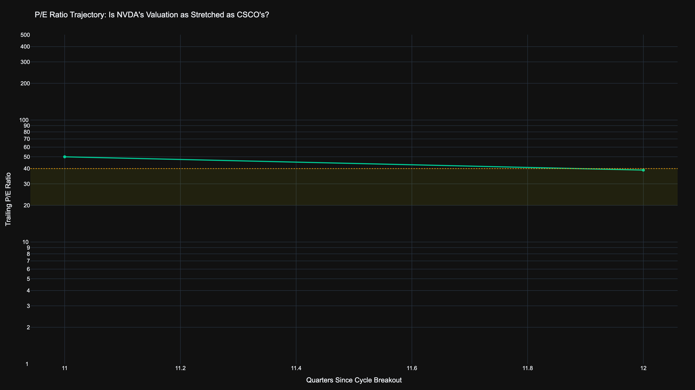
Valuations: Night and Day
CISCO AT PEAK
~200x
Price-to-Earnings
NVIDIA CURRENT
~50x
Price-to-Earnings
Cisco's P/E was 4x NVIDIA's at equivalent cycle stage
Team 2Kim | SBU AI Community Datathon 2026 | Finance & Economics

Slide 6
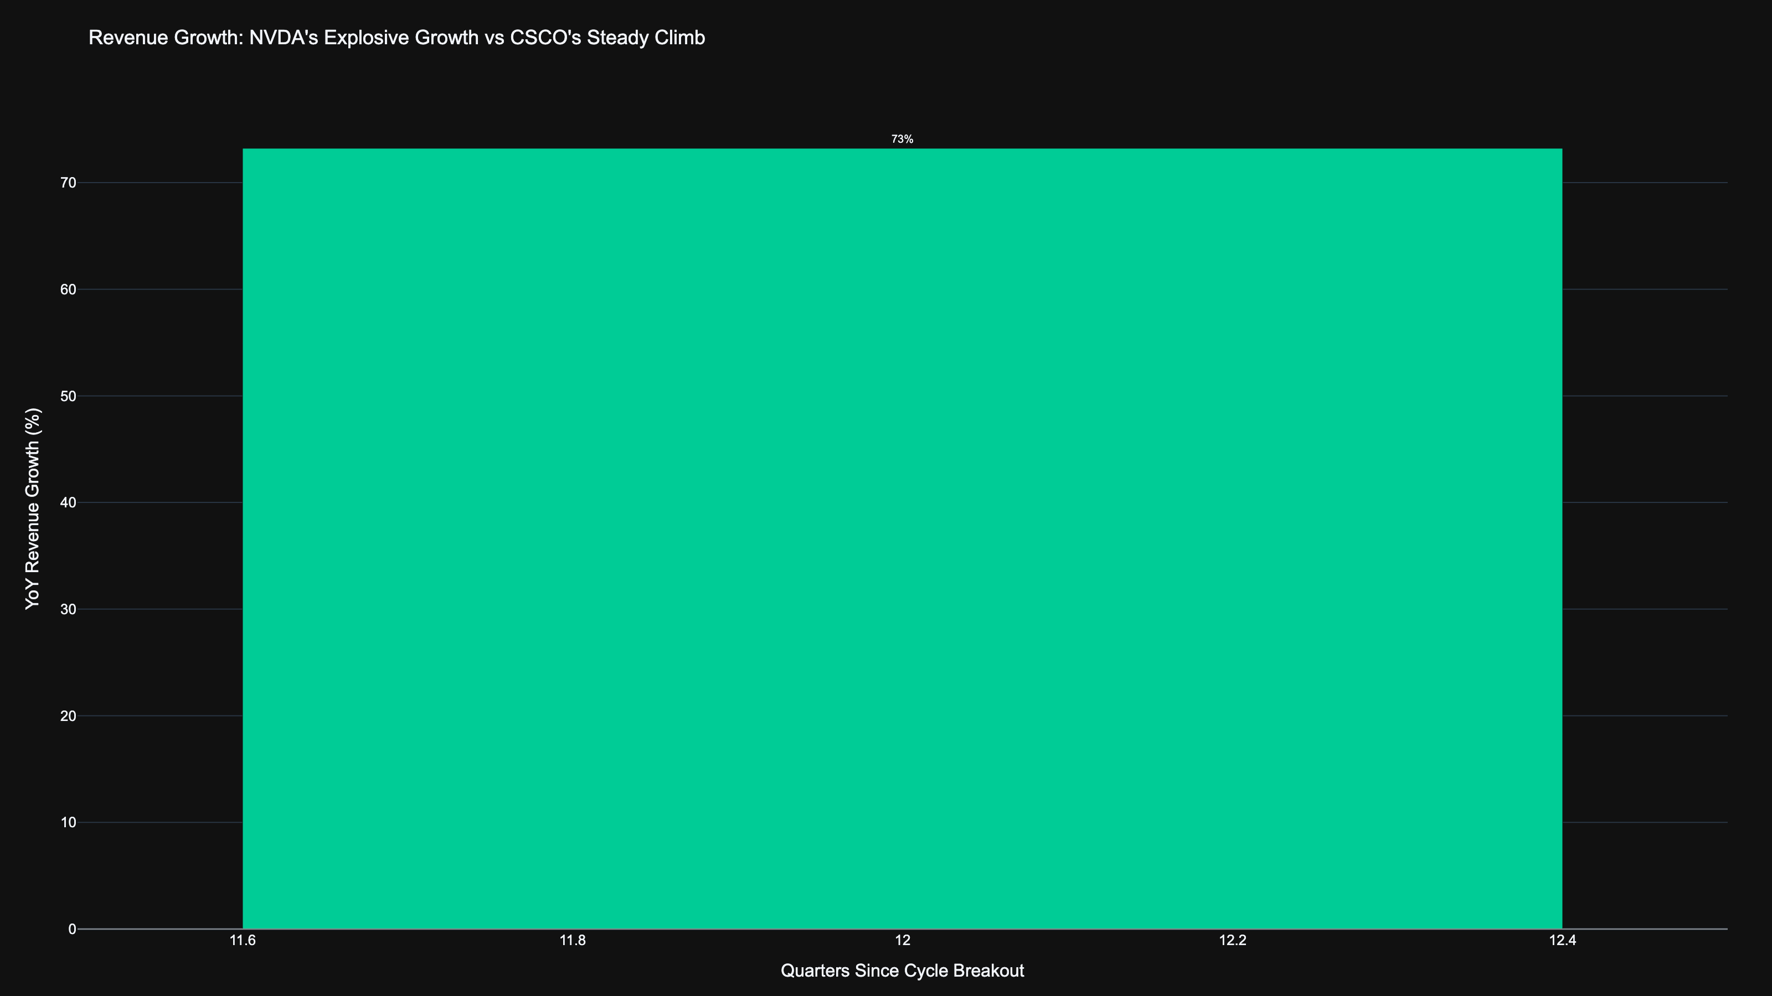
Revenue Growth: 4x Faster Than Cisco
265%
66%
NVDA peak YoY revenue growth
CSCO peak YoY revenue growth
Team 2Kim | SBU AI Community Datathon 2026 | Finance & Economics

Slide 7
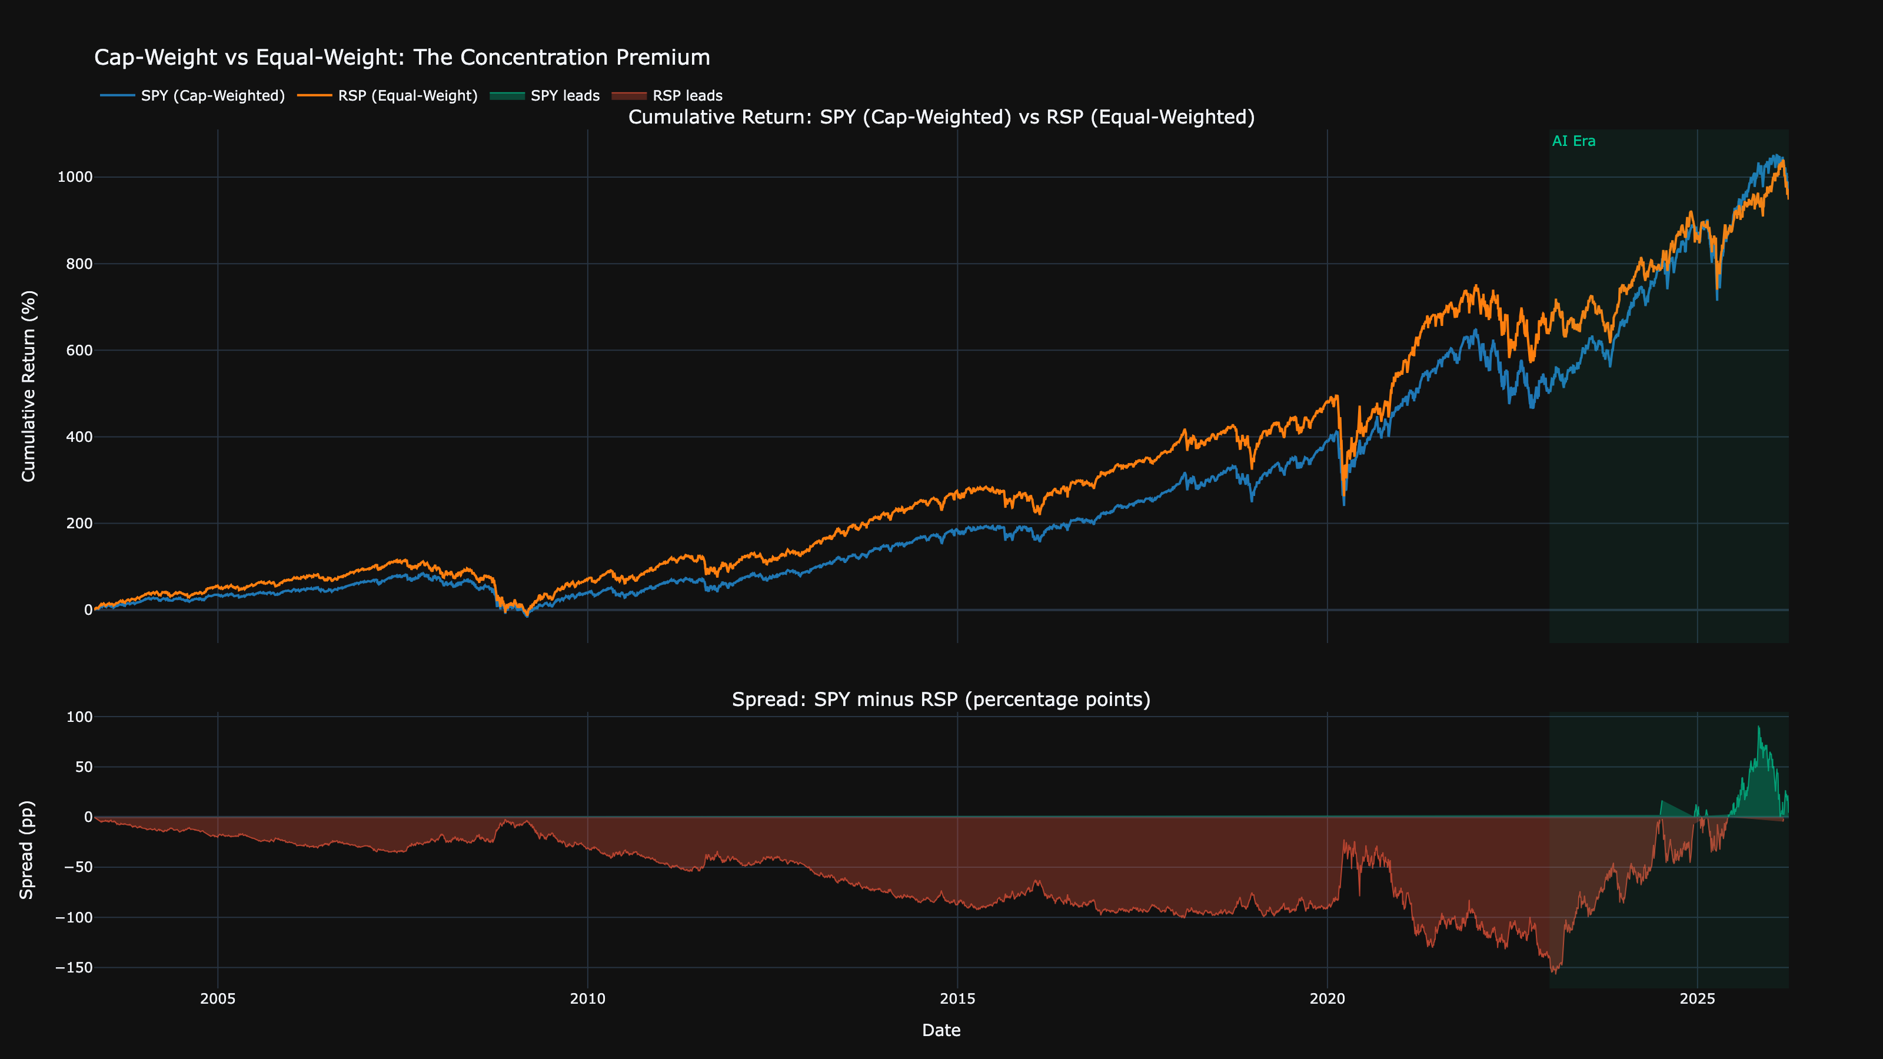
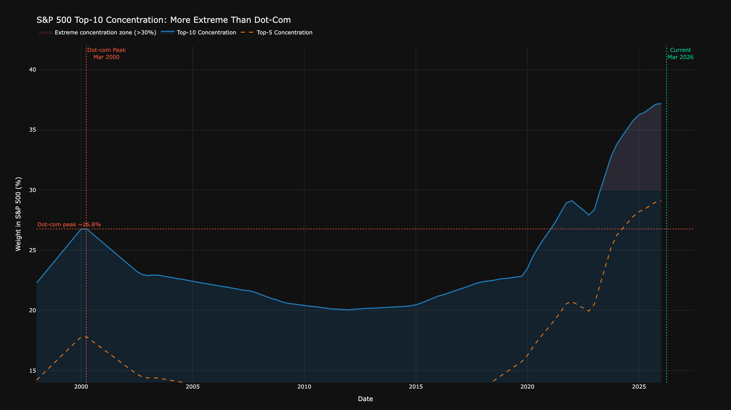
Market Concentration Is at Dot-Com Levels
TOP 5 STOCKS % OF S&P 500
28%
2026
18%
2000
More concentrated than at the dot-com peak.
Team 2Kim | SBU AI Community Datathon 2026 | Finance & Economics

Slide 8
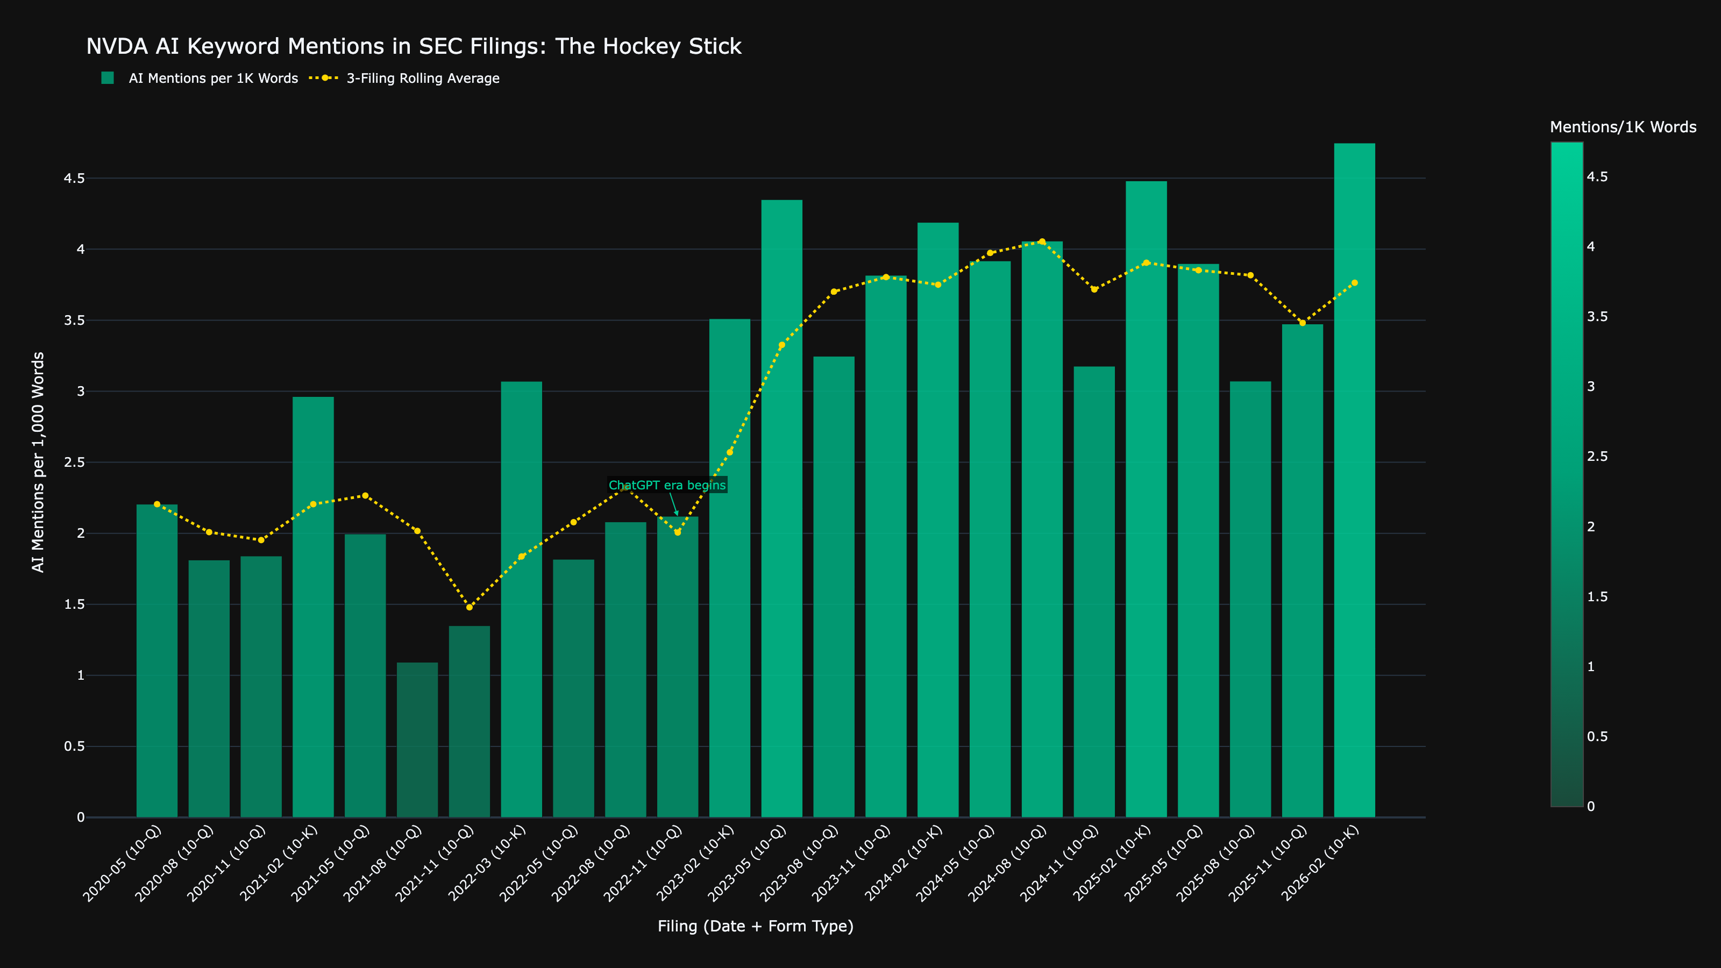
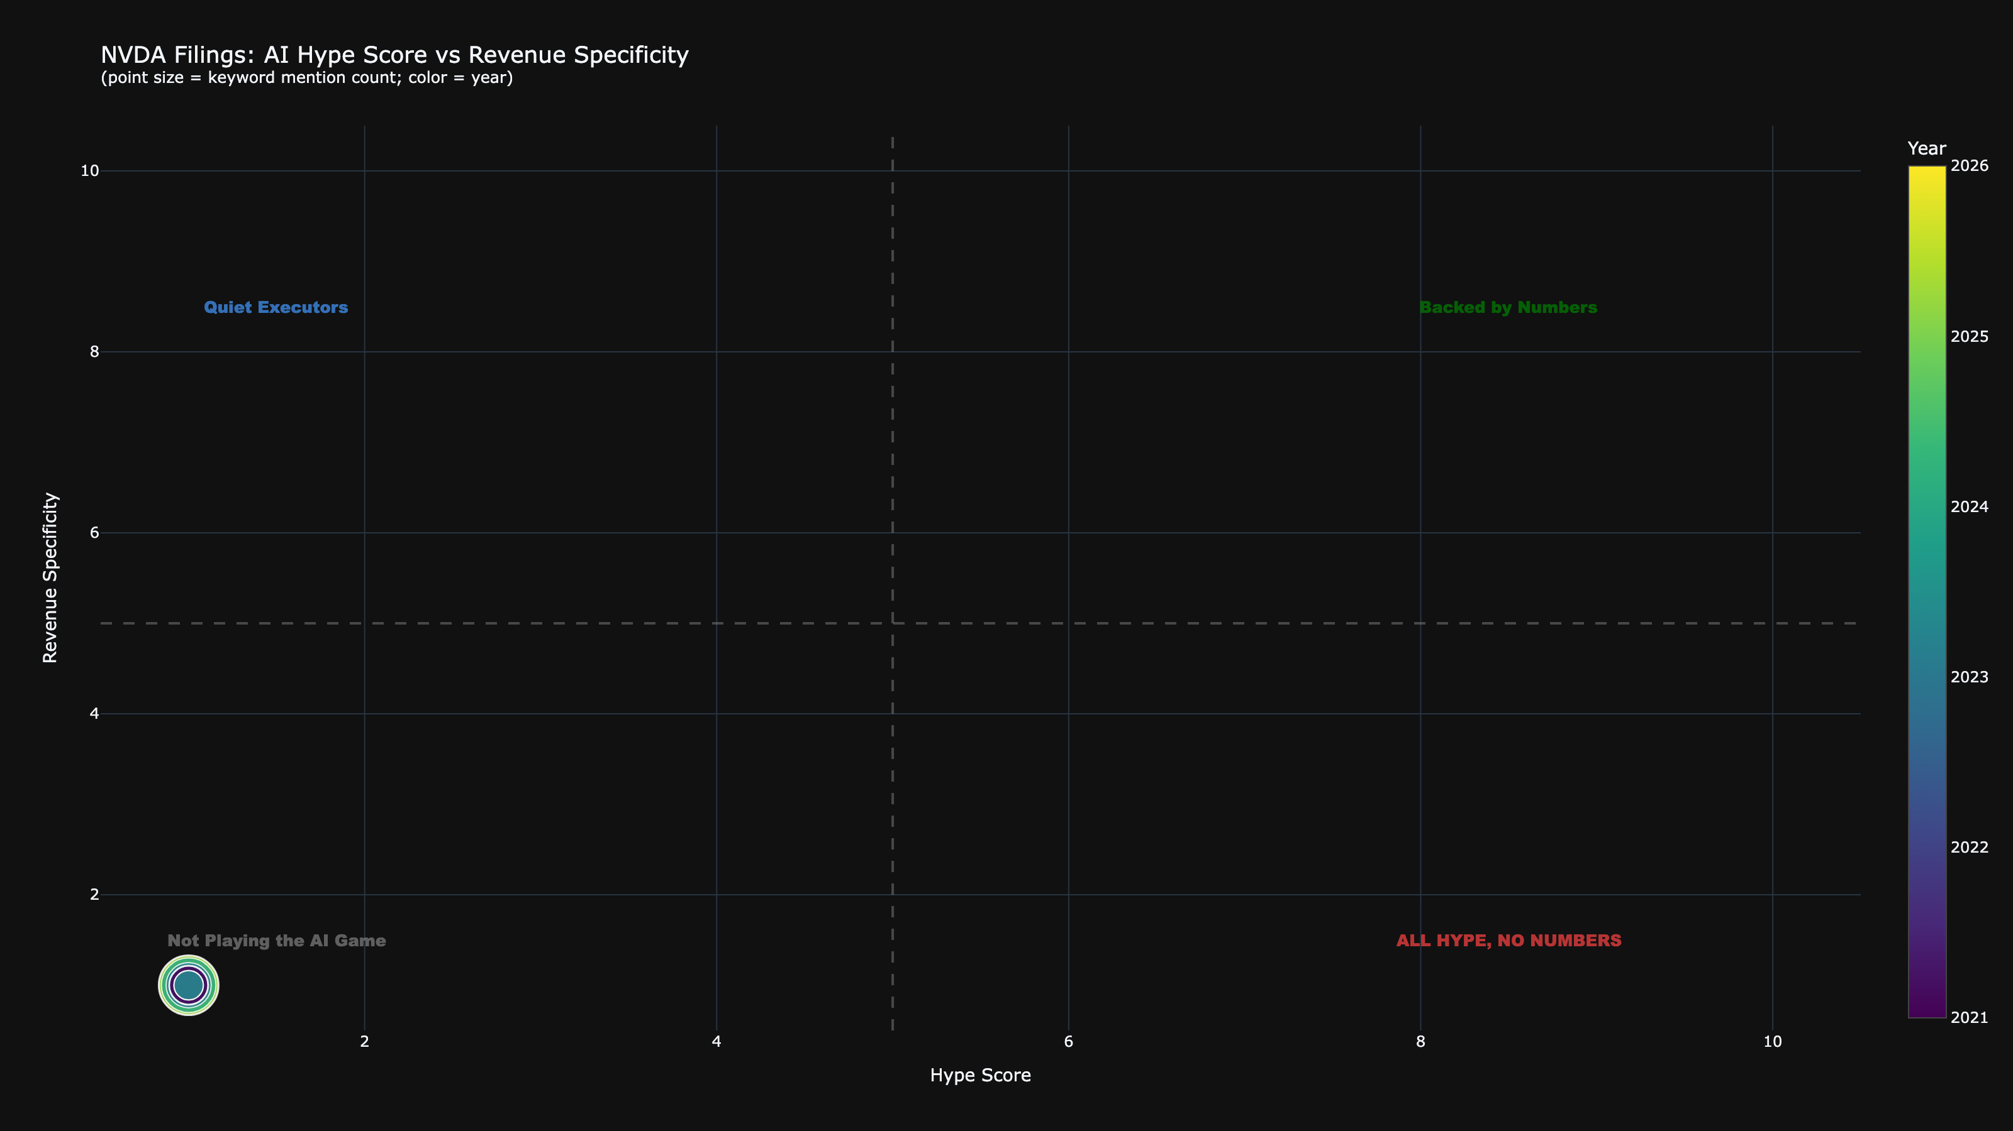
Hype Is Real — But So Is Substance
Team 2Kim | SBU AI Community Datathon 2026 | Finance & Economics

Slide 9
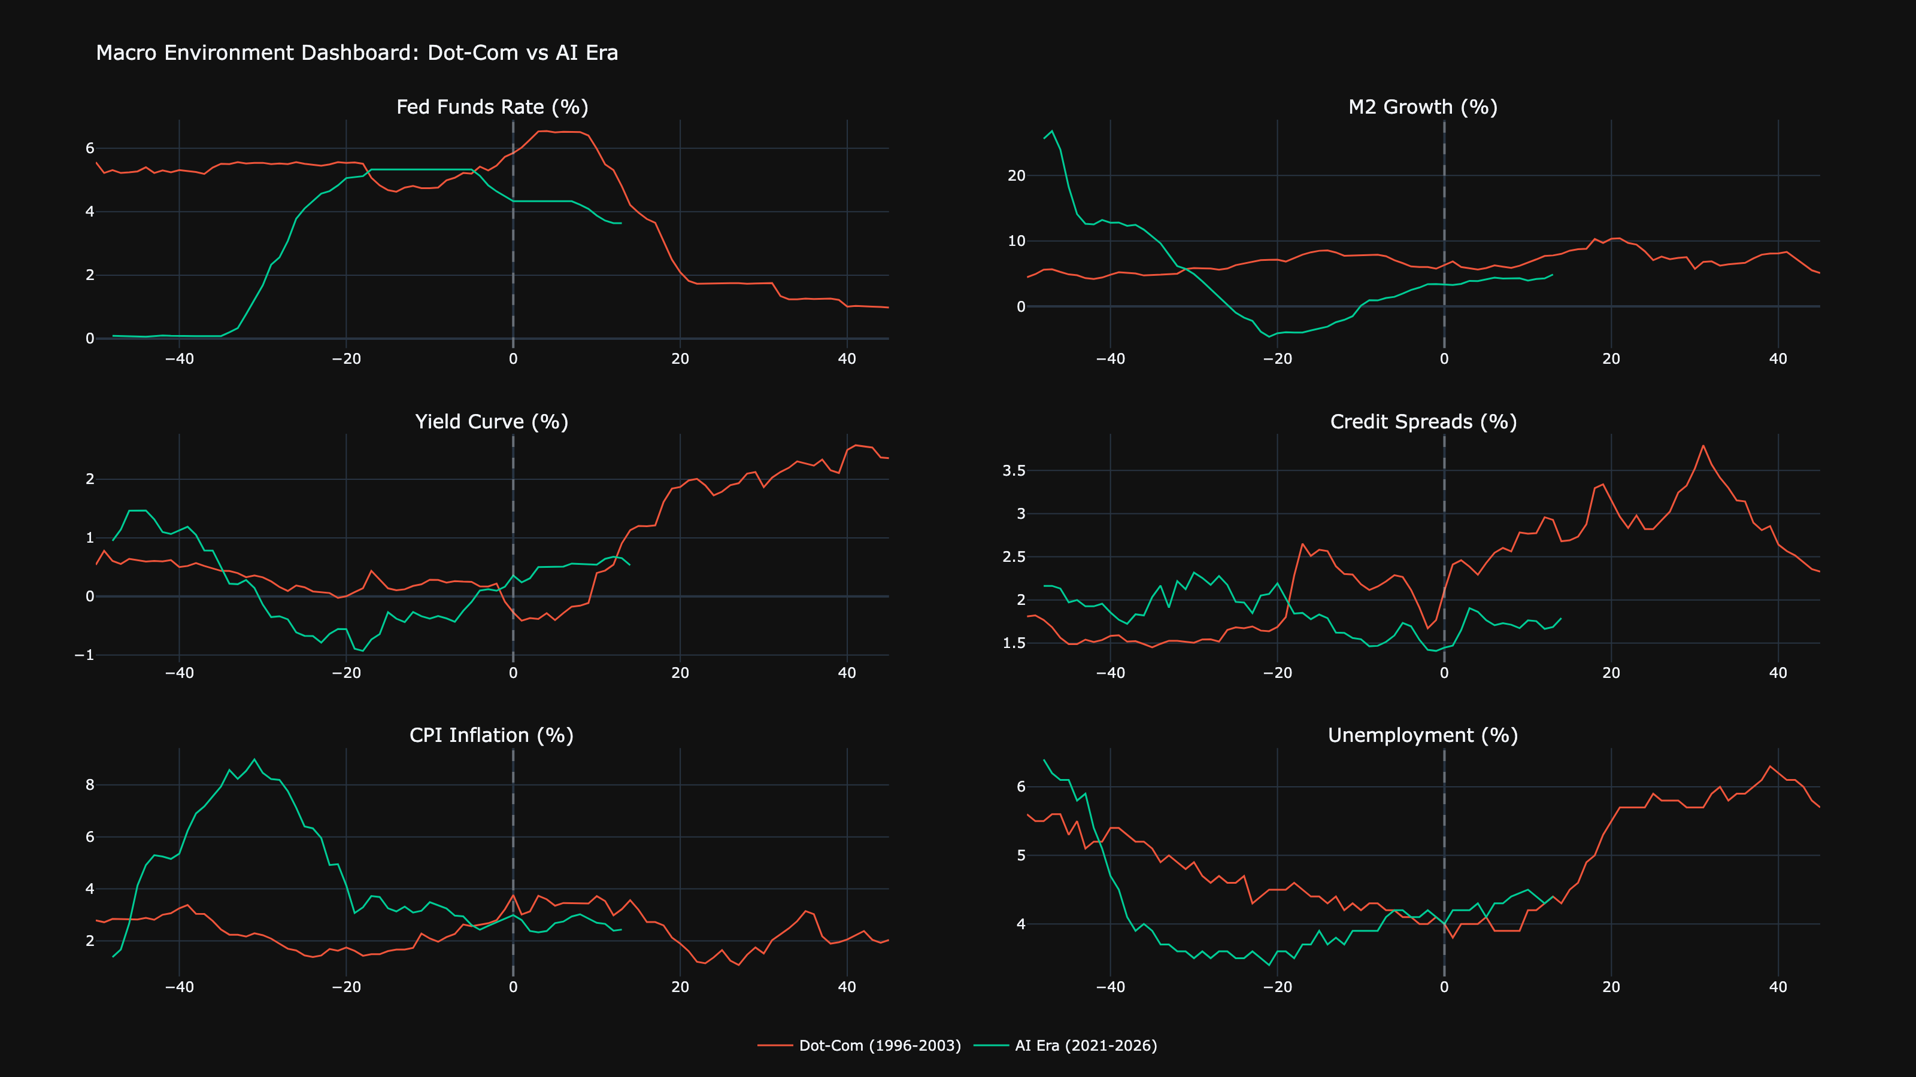
The Macro Wild Card
The macro environment is fundamentally different from 1999-2000 — but the yield curve inverted for the longest period in history.
Team 2Kim | SBU AI Community Datathon 2026 | Finance & Economics

Slide 10
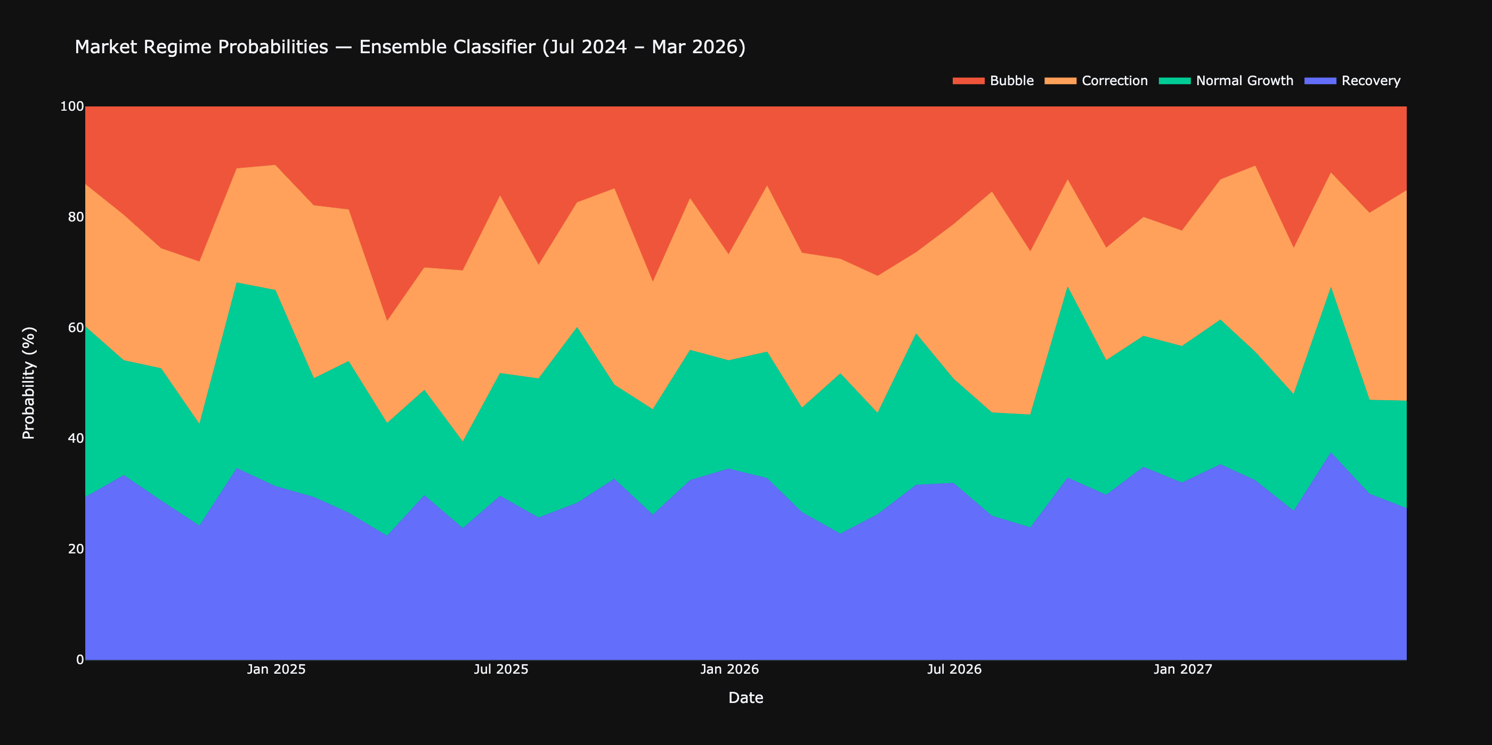
What Do the Models Say?
MARCH 2026
Ensemble Regime Probabilities
Bubble
XX%
Normal Growth
XX%
Recovery
XX%
Correction
XX%
3-model ensemble: RF + XGBoost + Logistic Regression. 38 features, 28 years.
Team 2Kim | SBU AI Community Datathon 2026 | Finance & Economics

Slide 11
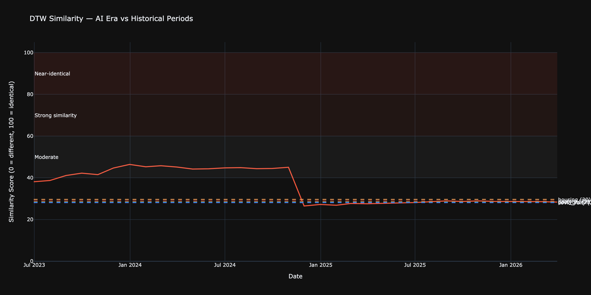
The Tug-of-War: Bubble Signals vs Counter-Signals
[Chart ML.4 — SHAP Waterfall: What's pushing toward/away from 'Bubble' for March 2026]
Concentration + sentiment push toward bubble | Revenue + FCF push away

Slide 12
Synthesis: A Bubble? Not Quite. But Not Safe Either.
LAYER
DOT-COM SIGNAL?
VERDICT
Price Trajectory
YES (similar)
CAUTION
Fundamentals
NO (much stronger)
SUPPORT
Market Concentration
YES (worse)
DANGER
Macro Environment
MIXED
NEUTRAL
Sentiment / Hype
YES (elevated)
CAUTION
3 of 5 layers flash bubble signals. Strong fundamentals are the only thing preventing a bubble classification.
If fundamentals disappoint even slightly, the downside could be severe.
Team 2Kim | SBU AI Community Datathon 2026 | Finance & Economics

Slide 13
THE KEY INSIGHT
"The AI rally is fundamentally justified but structurally fragile. The gap between a justified rally and a bubble is measured in quarters — not years — of continued earnings delivery."
NVIDIA must keep executing. Any deceleration in revenue growth would remove the one factor separating this from a classic bubble.
Team 2Kim | SBU AI Community Datathon 2026 | Finance & Economics

Slide 14
Limitations & Ethical Considerations
1. Small sample of historical bubbles — only 2-3 comparable events in training data.
2. Labels are subjective — sensitivity analysis shows ±15% variance in results.
3. Structural market changes — passive investing (55% today vs 10% in 2000), algorithmic trading, different Fed tools mean history may not repeat.
4. Not investment advice — academic analysis only. The model classifies regime risk, it does not predict future prices.
5. AI tools used responsibly — OpenAI API for NLP classification. All results manually validated on a 200-sentence sample (~85% agreement).
Team 2Kim | SBU AI Community Datathon 2026 | Finance & Economics

Slide 15
Thank You
Team 2Kim: Jimmy Kim & Alice Kim
Questions?
Notebook: 2kim_finance_notebook.ipynb | Interactive dashboard available for live demo if requested

Slide 16
BACKUP
Feature Importance Deep Dive: SHAP Summary
[Chart ML.3 — SHAP Summary Plot (Beeswarm): 38 features ranked by importance]
Team 2Kim | SBU AI Community Datathon 2026 | Finance & Economics

Slide 17
BACKUP
Model Validation: Walk-Forward Results
[Walk-Forward Validation Accuracy Chart]
[Confusion Matrix — Test Set]
[Ensemble Agreement Statistics]
Team 2Kim | SBU AI Community Datathon 2026 | Finance & Economics

