Slide 1
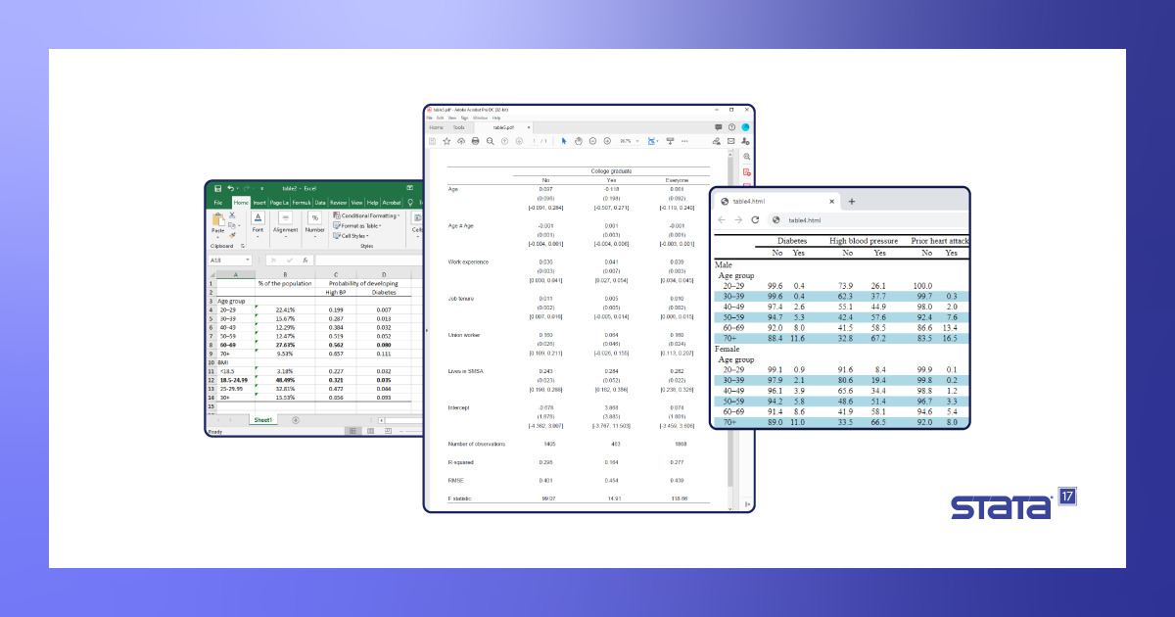
Scripting StataTables
Notes:
This presentation/workshop concentrates on the new functionality in version 17.

Slide 2
Introducing me
I’m Jim.
I work in the Digital Skills Development team.
We are part of Digital Education at UCL.
I watch lots of StataCorp training webinars, so that you don’t have to.

Slide 3
What do we aim to learn?
How to
create simple tabulations using the table command – and collections (along with styles and formatting);
do as much as possible by script;
arrange the contents of your table to your liking and add detail such as statistics;
save and export tables to file and to Microsoft Word.
Notes:
So, I’m not covering tabulate, tabstat, estout, tabout etc.

Slide 4
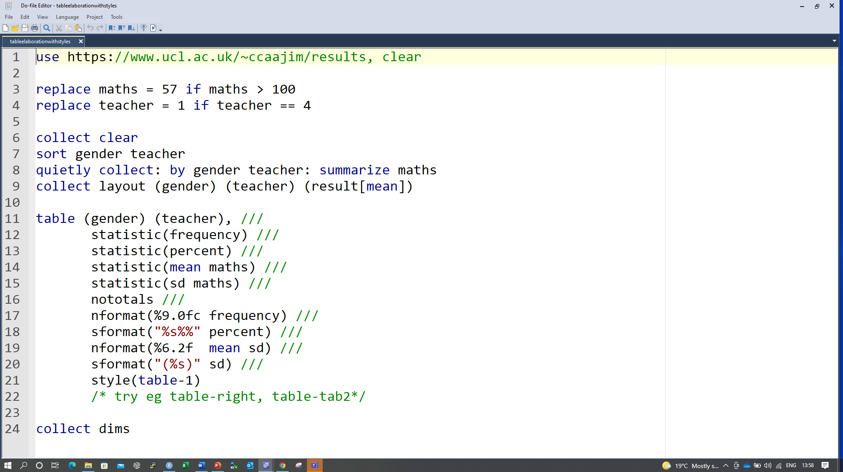
What do we assume?
working knowledge of Stata;
experience of writing a do file (Stata script);
google fu;
courage to brave the statalist forums or stackexchange to answer a question.

Slide 5
URL for the data used and example code
https://bit.ly/statatableresources

Slide 6
Exercise
Download the resources zip file.
Create a folder for these files on a local or network drive.
Extract all the files in the zip file to the new folder.
Open the results data in Excel and determine
how many variables there are in the dataset;
how many cases there are in the dataset.

Slide 7
Exercise
Open the Stata script file tablesetup.do.
With your neighbour look through the code and explain each line. If you don’t understand any line, ask one of the facilitators for help.
Notes:
This file opens a data set in csv format and does some simple data prep. All the further scripts depend on this file. If you need to return to the starting position for later code, run this file again. The exception is medregress.co which uses a different set of data wrangled to allow for some semi-sensible logistic regression models.
It is very well worth obeying some minimal coding standards – certainly break lines sensibly (\\\), and indent code, and write as much commentary as your purpose requires.

Slide 8
Tables?
tabulate?
tabulate, summarize?
estout?
esttab?
tabout?
table
Notes:
It maybe that table (and associated collection) isn’t the right tool for your job, but at least after today you will know if that is the case.

Slide 9
put* command family
putdocx
putpdf
putexcel
All of these dump content (text, formatting etc) created by Stata processes into external files.
There is also an example of using html export.
Notes:
I hope that the power of the combination of the tables suite and the put* family will convince you that the initial effort using them is worth it compared to the pain of copying and pasting Stata table output. The output you will produce will be real word and excel (and pdf/latex?) tables properly formatted.
I have found dyndoc/stmd/markstat etc to be too complicated/complicated to set up and not flexible enough for my needs. I’m content with getting the content into the format I need. If I do need something more dynamic, I use Rmarkdown with Stata chunks. I haven’t tried that with collect yet.

Slide 10
return list
Remember: A Stata command or process typically stores more than it displays as default output. There are two basic ways to see the output, in lists
e() for estimation results
r() for most other commands
Notes:
There are s and c class results lists as well, but I have no idea what is in those.
Test out some examples.

Slide 11
Exercise
Run the do file tablesetup.do.
Summarize the maths variable and use return list to look at the results.
Regress avxm against maths english and history and use ereturn list to look at the results.
Choose any quantity in the e() list and multiply it by 2.
Notes:
use disp to do this

Slide 12
Some table basics
The fundamental table command:
table (row_data) (col_data)
table ()(col_data)
table (row_var1 row_var2)(col_data)
and combinations of these plus two important options:
table (row_data) (col_data), command()statistic()
Notes:
so, canonical order of variables is RC – as in mathematics etc, not CR as in Excel.
You can nest in either or both dimensions.
Explain that you’re going to illustrate some tables and that they are not expected to learn the commands from this – we will go over examples in a moment.
open the medxtrial data
Create some example tables with nesting and statistics
gender smoker, command(summarize)
gender smoker, statistic(mean hbefore) statistic(var hbefore)
and so on

Slide 13
Exercise
Create a table of the variables gender and teacher arranged in columns only.
Try the exercise before looking at the solution.

Slide 14
Solution
table () (gender teacher)

Slide 15
Add a statistic
table (teacher)(gender), statistic(mean maths)

Slide 16
Exercise
Create a cross tabulation of gender and stream and show the mean and standard deviation of the average exam score (avxm).

Slide 17
Solution
table (stream)(gender), statistic(mean avxm) statistic(sd avxm)

Slide 18
More than two variables
We can nest variables in either or both of rows and columns.
table (teacher)(gender stream)
table (gender teacher)(stream), statistic(mean maths)

Slide 19
Format cell documentation (for nformat and sformat)
https://www.stata.com/manuals/tablescollectstylecell.pdf

Slide 20
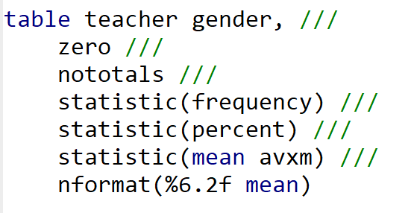
Formatted table code
This code is in the resource files associated with this tutorial.
Notes:
zero seems to be broken on desktop@ucl.
totals/nototals – show example of selectively displaying totals
explain nformat.
mention sformat.

Slide 21
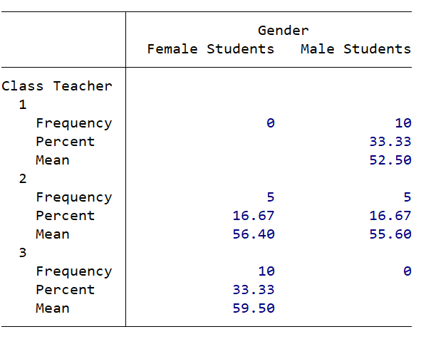
Produces this table
Notes:
Check this code:
collect style cell result[percent]#location[.m],sformat(%s%%) nformat(%3.0f)

Slide 22
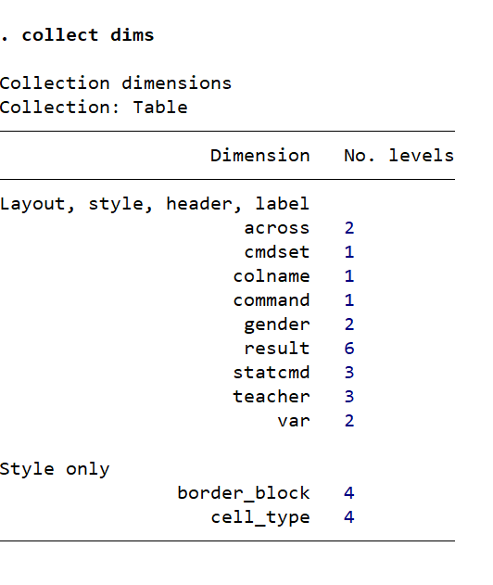
and a collection with these dimensions

Slide 23
Know your dims
Problems getting the output you want can often be avoided by knowing and understanding the dimensions and levels of the collection you are working with.
Before you can manipulate the contents of a collection you have created, you must normally have created a layout. (At least, as far as I can tell: nothing in the documentation says this).
Notes:
Have a look at
collect clear
sysuse auto, clear
regress price mpg collect get r() e()
collect layout (result)(colname)
collect label list colname, all
collect label list rowname, all
The two dimensions colname and rowname allow you to select which of the rows and columns in your collection are displayed and how.

Slide 24
levelsof
Knowing what the dimensions contain is critical.
Check the contents of a dimension with levelsof.
collect levelsof gender
and
collect label list gender, all
Understanding these is key to designing the layouts you want.
Notes:
A dimension will be created for each variable in the table or command output and a dimension for any results (of a Stata command or process)

Slide 25
A first collection
A collection is a data structure produced by either a table command or the combination of a Stata command and collect or collect get.
A collection contains the results of a Stata process – sometimes more than you are used to.
You can access, format and layout the contents of the collection.

Slide 26
This table

Slide 27
has a collection with these dimensions

Slide 28
Using tags
tags allow us to select which levels of which dimensions we will add to the collection layout;
we can run the following commands to layout a custom table using tags. First:
table (gender) (stream) (result[frequency])
to create the table and collection and then:
collect layout (stream)(gender) (result[frequency])
(Notice how we swap rows and columns with layout)
tag
dimension
level

Slide 29
Exercise
Create a collection of the variables gender and teacher as described above but without including frequency and adding the statistic(mean maths).
Inspect the dimensions of the table.

Slide 30
Solution
collect: table (teacher)(gender), statistic(mean maths)
collect dims

Slide 31
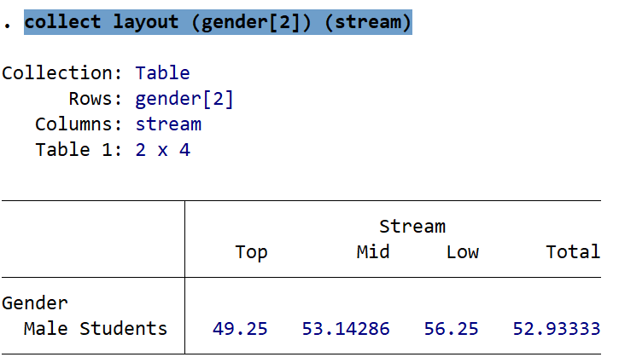
Custom selection from a collection
If we produce a table with
table gender stream, statistic(mean avxm)
The command:
collect layout (gender[2]) (stream)
Produces
tag

Slide 32
Exercise
Make a table of teacher over stream.
Check the dimensions of the table.
Check the levels of stream.
Create a layout with stream in rows and teacher in columns for just levels 1 and 3 of teacher.

Slide 33
Solution
collect layout (stream)(teacher[1] teacher[3])

Slide 34
Changing labels
Create a new collection with
table gender stream, statistic(var avxm) totals(stream)
Now we can change the labels on the levels of the dimension gender:
collect label levels gender 1 "Girl" 2 "Boy", modify
We can check the result with
collect preview

Slide 35
Exercise
Modify the collection from the previous command to make all numeric values display to two decimal places of precision.
Add standard deviation to the collection with the label ‘SD’.
Remove the right borders from the table.
Surround the standard deviation values in parentheses.

Slide 36
Borders and spacing
See the code in tableborders.do and run each command examining the output.

Slide 37
Using table with other commands
We can combine table with an option command to perform Stata computations based on the table structure
table (teacher) (), command(regress english history)
table (teacher) (gender), command(regress english history)

Slide 38
With markstat?
See collectwithmarkstat.stmd

