Slide 1
Tables of Estimation Results With Stata 17
Chuck Huber
StataCorp
Stata Webinar
March 9, 2022

Slide 2
You can download all of the
slides, do-files and datasets here:
https://tinyurl.com/StataEtable

Slide 3
table/collect Examples
Table 1: Descriptive statistics by hypertension status

Slide 4
table/collect Examples
Table 2: Differences in anthropometric and lab results by hypertension status

Slide 5
table/collect Examples
Table 3: Logistic regression model for hypertension status

Slide 6
table/collect Examples
Table 4: Three logistic regression
models for hypertension

Slide 7
etable/collect Examples

Slide 8
etable/collect Examples
Table 6: Odds ratios and marginal
probabilities of diabetes

Slide 9
Outline
Tables for one model
Tables for multiple models
Tables for margins
Tables for models and margins
Customization using collect

Slide 10
The Dataset

Slide 11
Tables for One Model

Slide 12
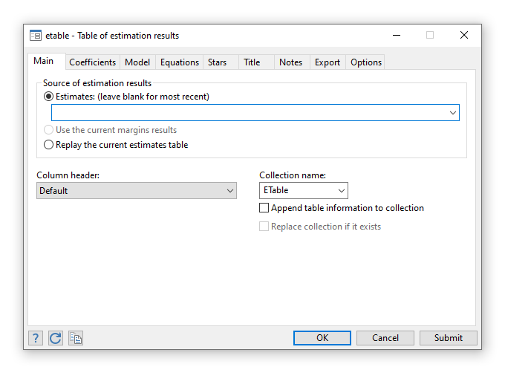
Tables for One Model
Statistics > Summaries, tables, and tests > Table of estimation results

Slide 13
Tables for One Model

Slide 14
Tables for One Model

Slide 15
Tables for One Model

Slide 16
Tables for One Model

Slide 17
Tables for One Model

Slide 18
Tables for One Model

Slide 19
Tables for One Model

Slide 20
Tables for One Model

Slide 21
Tables for One Model

Slide 22
Tables for One Model

Slide 23
Tables for One Model

Slide 25
Tables for One Model

Slide 26
Tables for One Model

Slide 27
Tables for One Model

Slide 28
Tables for One Model

Slide 29
Tables for One Model

Slide 30
Tables for One Model

Slide 31
Tables for One Model

Slide 32
Tables for One Model

Slide 33
Tables for One Model

Slide 34
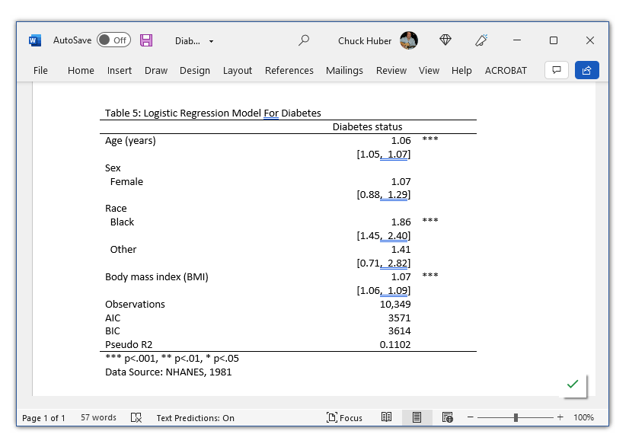
Tables for One Model

Slide 35
Tables for One Model
quietly logistic diabetes age i.sex i.race bmi
etable, keep(age sex race bmi) column(dvlabel) ///
cstat(_r_b, nformat(%4.2f)) ///
cstat(_r_ci, cidelimiter(,) nformat(%6.2f)) ///
showstars showstarsnote ///
stars(.05 "*" .01 "**" .001 "***", attach(_r_b)) ///
mstat(N, nformat(%8.0fc) label("Observations")) ///
mstat(aic, nformat(%5.0f)) ///
mstat(bic, nformat(%5.0f)) ///
mstat(pseudo_r2 = e(r2_p), nformat(%5.4f) label("Pseudo R2")) ///
title("Table 5: Logistic Regression Model For Diabetes") ///
titlestyles(font(Lucida Console, size(14) bold)) ///
note("Data Source: NHANES, 1981") ///
notestyles(font(Lucida Console, size(10) italic)) ///
export(Diabetes.docx, replace)

Slide 36
Tables for Multilevel Models
fixed
random

Slide 37
Tables for Multilevel Models

Slide 38
Tables for Multilevel Models

Slide 39

Outline
Tables for one model
Tables for multiple models
Tables for margins
Tables for models and margins
Customization using collect

Slide 40
Tables for Multiple Models

Slide 41
Tables for Multiple Models

Slide 42
Tables for Multiple Models

Slide 43
Tables for Multiple Models

Slide 44
Tables for Multiple Models

Slide 45
Tables for Multiple Models

Slide 46
Tables for Multiple Models

Slide 48
Tables for Multiple Models

Slide 49
Tables for Multiple Models

Slide 50
Tables for Multiple Models

Slide 52
Tables for Multiple Models

Slide 53
Outline
Tables for one model
Tables for multiple models
Tables for margins
Tables for models and margins
Customization using collect

Slide 54
Tables for margins

Slide 55
Tables for margins

Slide 56
Tables for margins

Slide 57
Tables for margins

Slide 58
Outline
Tables for one model
Tables for multiple models
Tables for margins
Tables for models and margins
Customization using collect

Slide 59
Tables for models and margins

Slide 60
Tables for models and margins

Slide 61
Tables for models and margins

Slide 62
Outline
Tables for one model
Tables for multiple models
Tables for margins
Tables for models and margins
Customization using collect

Slide 63
Customization Using collect

Slide 64
Customization Using collect

Slide 65
Customization Using collect
A collection is analogous to a dataset
A dimension is analogous to a variable
A level is analogous to a category of a variable

Slide 66
Customization Using collect

Slide 67
Customization Using collect

Slide 68
Customization Using collect

Slide 69
Customization Using collect

Slide 70
Customization Using collect

Slide 71
Customization Using collect

Slide 72
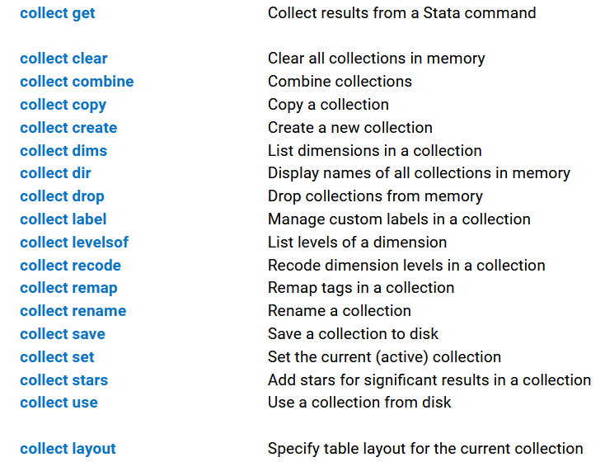
Customization Using collect

Slide 73
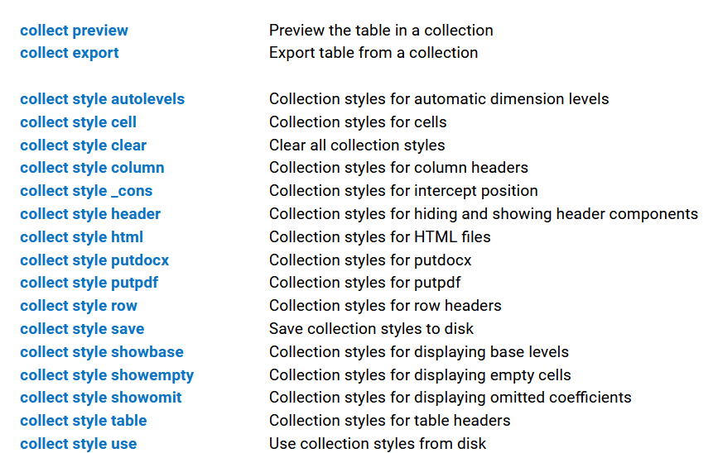
Customization Using collect

Slide 74
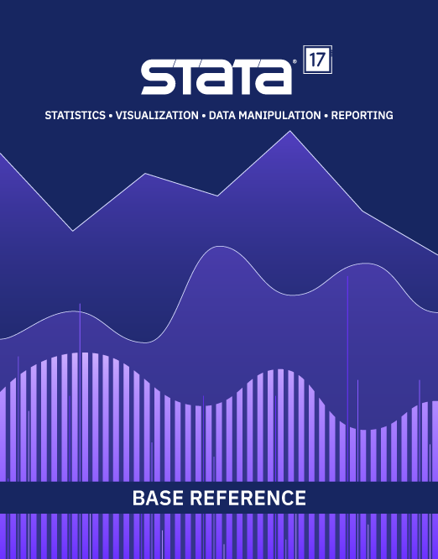
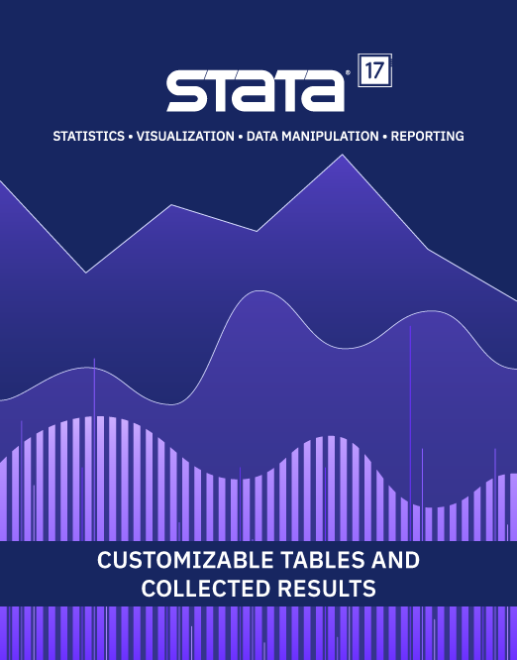
Read The Fine Manuals!
etable
https://www.stata.com/manuals/retable.pdf
collect
https://www.stata.com/manuals/tablesintro.pdf

Slide 75
Outline
Tables for one model
Tables for multiple models
Tables for margins
Tables for models and margins
Customization using collect

Slide 76
Stata Blog
Stata News
In the spotlight: Customizable tables in Stata 17
Customizable tables in Stata 17, part 1: The new table command
Customizable tables in Stata 17, part 2: The new collect command
Customizable tables in Stata 17, part 3: The classic table 1
Customizable tables in Stata 17, part 4: Table of statistical tests
Customizable tables in Stata 17, part 5: Tables for one regression model
Customizable tables in Stata 17, part 6: Tables for multiple regression models
Customizable tables in Stata 17, part 7: Saving and using custom styles and labels

Slide 77
YouTube Videos
Customizable tables in Stata 17: Crosstabulations
Customizable tables in Stata 17: One-way tables of summary statistics
Customizable tables in Stata 17: Two-way tables of summary statistics
Customizable tables in Stata 17: How to create tables for a regression model
Customizable tables in Stata 17: How to create tables for multiple regression models

Slide 78
Thank you!
Questions?
You can download the slides, datasets, and do-files here:
https://tinyurl.com/StataEtable

