Slide 1
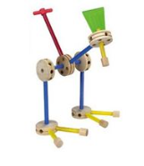
$20 FPGA kit Boot Camp for Digital Systems Education
Jim Brakefield jim.brakefield@ieee.org
IEEE Computer Society
Notes:
Tinker toy (or LEGO block) construction embodies the generation/design of abstract objects from simple uniform components

Slide 2
Preliminaries
Funding provided by a grant from the IEEE Computer Society as part of their Emerging Technologies program
I’m Jim Brakefield, jim.brakefield@ieee.org
Full set of files at: https://github.com/jimbrake/20-dollar-FPGA-kit
Introduction to FPGA video: https://www.youtube.com/watch?v=EVy4KEj9kZg

Slide 3
My view of binary
Zero and ones: One names a single such signal or a group of such signals (subscripted by bit number)
A binary number is a polynomial:
A[n-1]x^{n-1} + A[n-2]x^{n-2} + … A[1]x¹ + A[0]x⁰
Where X = 2, and A[n] are 0 or 1 bits from the number. If A[n-1] is 0/-1 then it is 2’s complement and negative if A[n-1] is -1.
It is typical for the bit numbers to run from N-1 to 0 where N is the number of bits.
Adding or subtracting 2’s complement wraps around in a circle where the most positive and most negative numbers are adjacent (any carry or borrow beyond x^{n-1} is discarded).
Windows calculator has binary features: https://www.youtube.com/watch?v=PK5WQqN3_44
Notes:
The youtube video covers all the calculator features including radix (binary, hex, decimal) and the binary operations (AND, OR, XOR, shifts and rotate).

Slide 4
The $20 FPGA Kit agenda
To make the FPGA experience available to all
Very few FPGA boards for under $20
The Tang 9K Nano board has:
8,640 LUTs
HDMI connector
SD card slot
8MB DRAM
$15 price tag
Notes:
The LUT count, DRAM and SD card slot means that the board can be used for soft core processors such as 6502, Z80, AVR etc. The SD card can be used as a disk file device supporting an operating system.

Slide 5
The $20 FPGA Kit agenda
The Tang 9K FPGA board does not have:
7-segment digits
Only two push buttons
No slide switches
Use add-on components:
Display board: $2.90
DIP switch $0.88
Plug board $6.00 for four?
Some user provided wiring on-hand?
Notes:
The pro-rata cost of the breadboard and DIP switch drop in quantity to approximately $1.71 for a total kit price of $20.64. In very large quantities further reductions possible. The goal here is an under $20 kit price so almost any student or any school can afford a kit(s).

Slide 6
The $20 FPGA Kit agenda
Supplement the Tang 9K Nano FPGA board:
Display board: $2.90
12 position DIP switch $0.88
Solderless bread board $6.00 for four
Will require some user wiring
Insulated 22 gauge jumper wire
Male-female wires for display board
or replacing display board pins with jumper wires
Pins on Tang FPGA board will require soldering
And learning the Nano board software tools
VHDL, Verilog and constraint files supported.

Slide 7
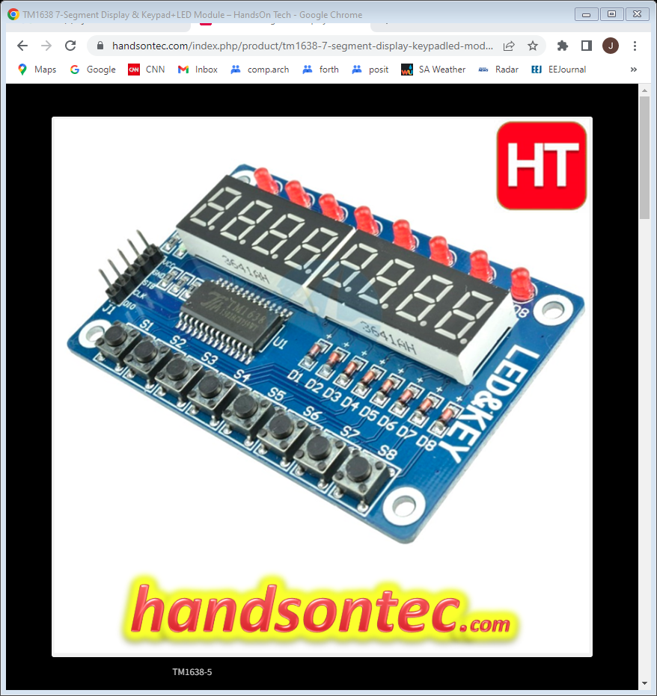
Display board tm1638-7-segment-display-keypadled-module
Provides:
8 7-seg digits
8 discrete LEDs
8 push buttons
for $2.90
Notes:
Uses 4 volt driver chip, will it work at 3.3 volts?

Slide 8
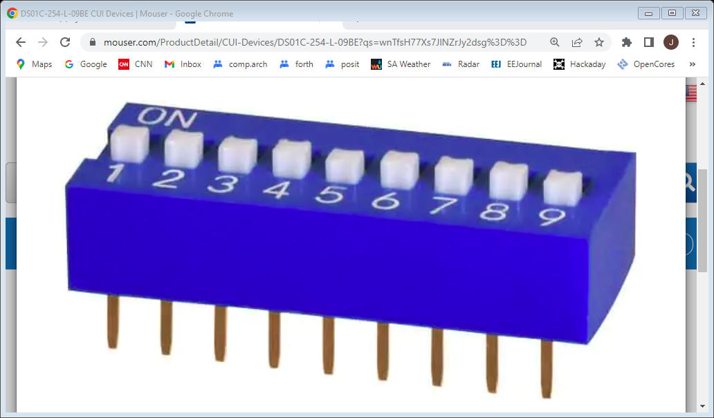
DIP switch example
Twelve position DIP switch gives best cost/benefit ratio
For use on breadboard will need to fold in every 6th pin
Notes:
Individual slide switches are relatively expensive compared to the other items.

Slide 9
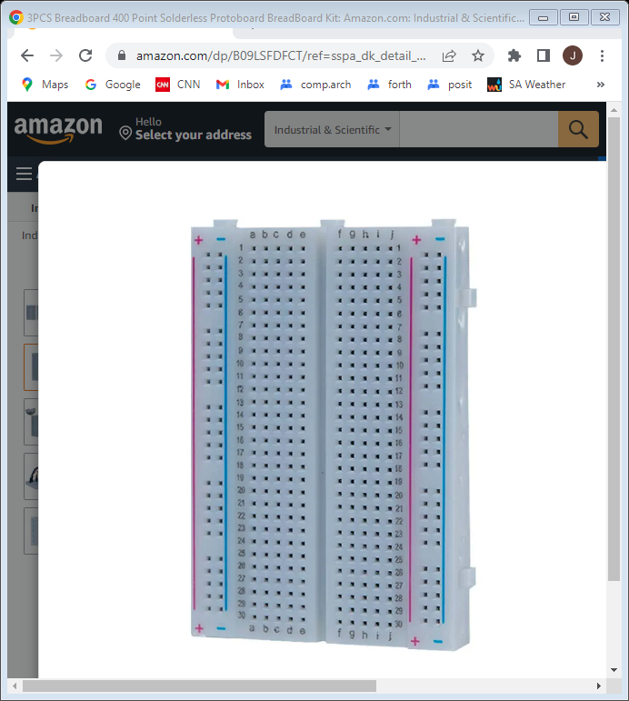
Solderless Breadboard
Best deal in quantity three
or sixteen
The DIP switch
to straddle
ground column
and signal rows
Sufficient size to hold Tang Nano and DIP switch
Notes:
As the ground column has breaks every six spaces, will fold the DIP switch pins in for those positions

Slide 10
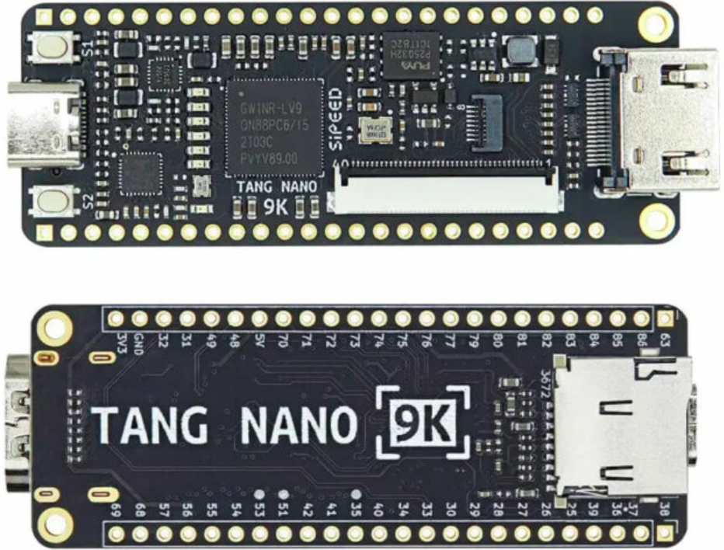
Tang 9K Nano
approximately $15
12/29/2022
10
Notes:
Uses Gowin GW1NR-9 FPGA: 8,640 LUTs, 2 push buttons, 6 LEDs, HDMI connector, SD slot, DRAM, LCD connector.
Usually has unsoldered pins. User to solder in the pins needed for the breadboard.

Slide 11
LUTs
Performing Boolean Algebra inside an FPGA using Look-Up Tables (LUTs)
https://nandland.com/lesson-4-what-is-a-look-up-table-lut/:
Note to the reader: many textbooks and classrooms will spend a
significant amount of time discussing how LUTs can be wired to
create the optimal solution to a Boolean expression. Optimal
means that it uses the least number of gates possible. Topics
such as De Morgan’s Law, Karnaugh Maps, the Quine-McCluskey
method, and others are usually discussed at great length that
describe how to optimize digital logic. However I feel that this is
not necessary to begin learning about FPGAs.

Slide 12
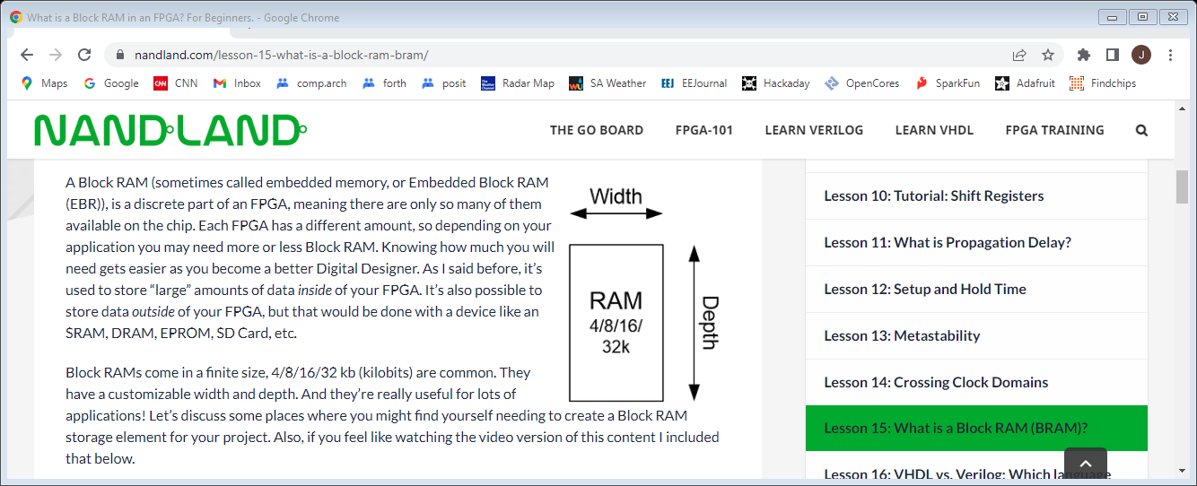
Block RAM tutorial
https://nandland.com/lesson-15-what-is-a-block-ram-bram/

Slide 13
FPGA References
Twelve youtube videos on specific FPGA features (uses verilog RTL): https://www.youtube.com/playlist?list=PLEBQazB0HUyT1WmMONxRZn9NmQ_9CIKhb
Three Ages of FPGAs: A Retrospective…, Steve Trimberger, Proc. IEEE v103#3p318, 2015
www.cpe.virginia.edu/grads/pdfs/January%202016/VLSI.pdf
https://www.youtube.com/watch?v=4ntXSyOhlBY
Xilinx Part Family History, John Lazzaro,
www-inst.eecs.berkeley.edu/~cs294-59/fa10/resources/Xilinx-history/Xilinx-history.html
Altera History, corporate, http://www.fundinguniverse.com/company-histories/altera-corporation-history/
Low cost FPGA boards
https://www.joelw.id.au/FPGA/CheapFPGADevelopmentBoards
Open source IP https://opencores.org/projects
Github projects: search on “github vhdl verilog cpu”
Notes:
http://www.fundinguniverse.com/company-histories has histories of Xilinx and many other companies

Slide 14
In conclusion
It is thought that ownership of an FPGA board will lead to greater usage and knowledge. As opposed to shared laboratory equipment.
Oriented towards a beginner’s board at the lowest possible cost. Lots of switches, LEDs etc. eliminate need for discrete components and their fragile wiring.
Here we are trading cost for convenience:
$20 versus $70
Some user wiring/soldering versus no user wiring
Niche software tools versus mainstream tools
Notes:
Files at https://github.com/jimbrake/FPGA_Boot_Camp have a date code suffix and are updated frequently. Currently several universities issue an FPGA board to each student for a one semester course.

Slide 15
“Digital” logic simulator
Web site: https://github.com/hneemann/Digital/
Authored by: Helmut.Neemann@mosbach.dhbw.de
Open source, other simulators available
Modified to support the Boolean board
BASYS3.config renamed to Boolbd.config
BASYS3_IO.dig renamed to Boolbd.dig
And pin assignments updated
And PMOD pins moved to Boolbd_pmod.dig
In the subdirectory examples/hdl

Slide 16
Interactive digital simulation
Schematic editor and simulator
Provides an intermediate step before RTL (Register Transfer Logic) and full FPGA tools.
Requires nothing beyond a PC.
Requires Java
Totally interactive
Generates VHDL or Verilog RTL files
Generates constraint file for vivado (xilinx FPGA tool)
Notes:
The two main RTLs are verilog and VHDL. Most recent verilog is called System Verilog. ASIC people prefer verilog. DOD and Europe like VHDL. There are linting tools that can check your code including adherence to code standards.

Slide 17
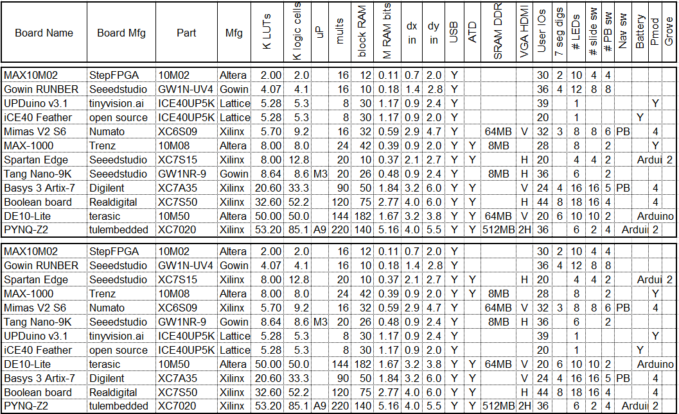
FPGA board rankings
Top version sorted by LUT count, bottom version by block RAM bit count
This listing is only a sample of the hundreds of boards available.
12/29/2022
12/29/2022
17
17

Slide 18
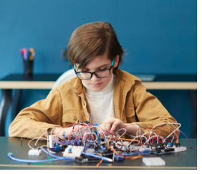
mess of wires not cool any more
In today’s world
most wires are
in the PCB and
In the FPGA !
OK as long as you
don’t need to
move the device
From https://life.ieee.org/
Notes:
For more organized and stable proto-board wiring see a Ben Eater's web page: https://www.reddit.com/r/beneater/comments/w447u3/created_a_random_maze_program_for_my_putey1_ttl/

Slide 19
RTL (Register Transfer Language) VHDL and Verilog are “hardware description” languages
Separates design into combinatorial (logic) and sequential (registers).
For simple designs use a single clock
Boolean Board clock input is 100MHz
Digital will generate slower clocks
Right click on clock icon & set frequency
Registers update on rising edge clock
Notes:
This FPGA Boot Camp avoids teaching VHDL or Verilog, instead you learn by seeing the VHDL or Verilog generated from your schematic. This is done to get to a working “ FPGA flow” more easily.

Slide 20
Side by side VHDL and Verilog
Digital generates both
RealDigital’s treatment:
https://www.realdigital.org/downloads/e06bddc63669cbc91ae981df18bcf3c5.pdf
Side by side System-Verilog & VHDL:
Digital Design and Computer Architecture, Harris & Harris, 2nd ed. Also ARM and RISC-V editions
Highly recommended, goes from transistors to PCs
Side by side Verilog & VHDL:
HDL Programming Fundamentals: VHDL and Verilog, Nazeih Botros 2006
Also: https://www.fpga4student.com/2017/08/verilog-vs-vhdl-explain-by-example.html
Notes:
System Verilog is a modern version of Verilog and provides the same capabilities as VHDL.

Slide 21
What FPGA tools do
Much goes on behind the scenes
Circuit is optimized (logic simplification)
unused stuff is pruned, if no outputs then all pruned
Circuit is mapped into FPGA primitives
Circuit wired up with FPGA routing resources
Bit file generated that configures the chip
Error checking especially missing semicolons
Reports on timing, resources used, error messages
A schematic viewer will show chip details
Elaborated Design show’s vivado’s version of schematic

