Slide 1
CMSC 611: Advanced Computer Architecture
Instruction Set Architecture
Some material adapted from Mohamed Younis, UMBC CMSC 611 Spr 2003 course slides
Some material adapted from Hennessy & Patterson / © 2003 Elsevier Science

Slide 2
Instruction Set Architecture
To command a computer's hardware, you must speak its language
Instructions: the “words” of a machine's language
Instruction set: its “vocabulary
Goals:
Introduce design alternatives
Present a taxonomy of ISA alternatives
+ some qualitative assessment of pros and cons
Present and analyze some instruction set measurements
Address the issue of languages and compilers and their bearing on instruction set architecture
Show some example ISA’s

Slide 3
Interface Design
A good interface:
Lasts through many implementations (portability, compatibility)
Is used in many different ways (generality)
Provides convenient functionality to higher levels
Permits an efficient implementation at lower levels
Design decisions must take into account:
Technology
Machine organization
Programming languages
Compiler technology
Operating systems
use
imp 1
Interface
use
imp 2
Time
use
imp 3
Slide: Dave Patterson

Slide 4
Memory ISAs
Terms
Result = Operand <operation> Operand
Stack
Operate on top stack elements, push result back on stack
Memory-Memory
Operands (and possibly also result) in memory

Slide 5
Register ISAs
Accumulator Architecture
Common in early stored-program computers when hardware was expensive
Machine has only one register (accumulator) involved in all math & logic operations
Accumulator = Accumulator op Memory
Extended Accumulator Architecture (8086)
Dedicated registers for specific operations, e.g stack and array index registers, added
General-Purpose Register Architecture (MIPS)
Register flexibility
Can further divide these into:
Register-memory: allows for one operand to be in memory
Register-register (load-store): all operands in registers

Slide 6
Other types of Architecture
High-Level-Language Architecture
In the 1960s, systems software was rarely written in high-level languages
virtually every commercial operating system before Unix was written in assembly
Some people blamed the code density on the instruction set rather than the programming language
A machine design philosophy advocated making the hardware more like high-level languages

Slide 7
Well Known ISA
Stack
Memory-Memory
Accumulator Architecture
Extended Accumulator Architecture
General-Purpose Register Architecture

Slide 8
ISA Complexity
Reduced Instruction Set Architecture
With the recent development in compiler technology and expanded memory sizes less programmers are using assembly level coding
Drives ISA to favor benefit for compilers over ease of manual programming
RISC architecture favors simplified hardware design over rich instruction set
Rely on compilers to perform complex operations
Virtually all new architecture since 1982 follows the RISC philosophy:
fixed instruction lengths, load-store operations, and limited addressing mode

Slide 9
Compact Code
Scarce memory or limited transmit time (JVM)
Variable-length instructions (Intel 80x86)
Match instruction length to operand specification
Minimize code size
Stack machines abandon registers altogether
Stack machines simplify compilers
Lend themselves to a compact instruction encoding
BUT limit compiler optimization

Slide 10
Evolution of Instruction Sets
Single Accumulator (EDSAC 1950)
Accumulator + Index Registers
(Manchester Mark I, IBM 700 series 1953)
Separation of Programming Model
from Implementation
High-level Language Based
Concept of a Family
(B5000 1963)
(IBM 360 1964)
General Purpose Register Machines
Complex Instruction Sets
Load/Store Architecture
(Vax, Intel 432 1977-80)
(CDC 6600, Cray 1 1963-76)
RISC
(MIPS,SPARC,IBM RS6000, . . .1987)
Slide: Dave Patterson

Slide 11
Register-Memory Arch
Effect of the number of memory operands:

Slide 12
Memory Alignment
The address of a word matches the byte address of one of its 4 bytes
The addresses of sequential words differ by 4 (word size in byte)
Words' addresses are multiple of 4 (alignment restriction)
Misalignment (if allowed) complicates memory access and causes programs to run slower

Slide 13
Byte Order
Given N bytes, which is the most significant, which is the least significant?
“Little Endian”
Leftmost / least significant byte = word address
Intel (among others)
“Big Endian”
Leftmost / most significant byte = word address
Motorola, TCP/IP (among others)
Byte ordering can be as problem when exchanging data among different machines
Can also affect array index calculation or any other operation that treat the same data a both byte and word.

Slide 14
Addressing Modes
How to specify the location of an operand (effective address)
Addressing modes have the ability to:
Significantly reduce instruction counts
Increase the average CPI
Increase the complexity of building a machine
VAX machine is used for benchmark data since it supports wide range of memory addressing modes
Can classify based on:
source of the data (register, immediate or memory)
the address calculation (direct, indirect, indexed)

Slide 15
Example of Addressing Modes

Slide 16
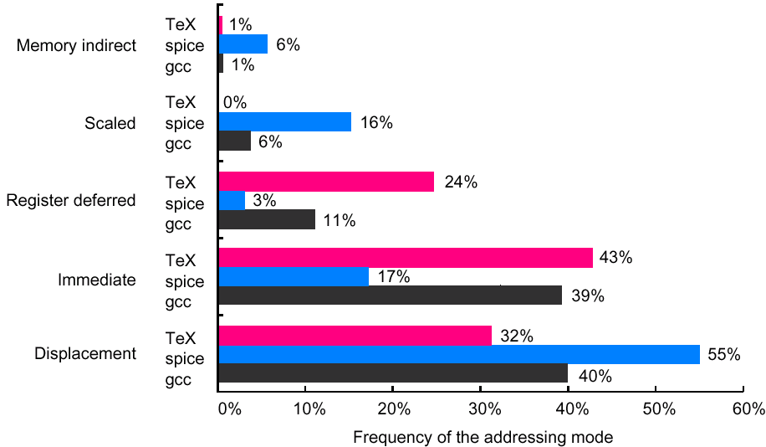
Addressing Mode Use
Focus on immediate and displacement modes since they are used the most
Based on SPEC89 on VAX

Slide 17
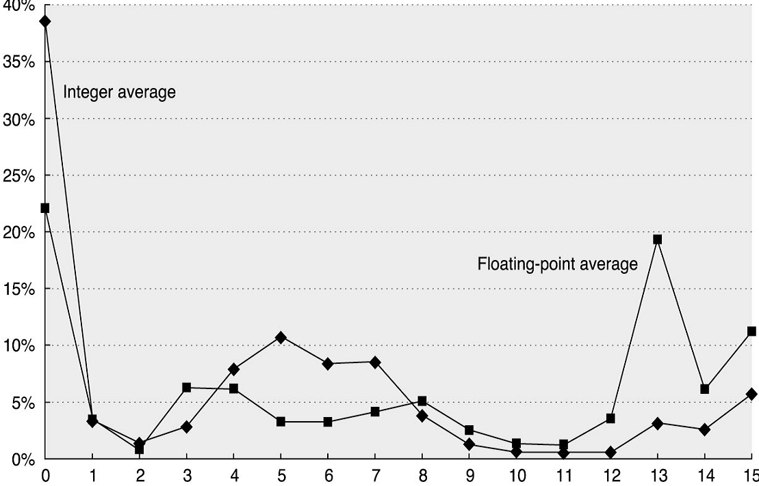
Displacement Addressing Modes
The range of displacement supported affects the length of the instruction
Data is based on SPEC2000 on Alpha (only 16 bit displacement allowed)
Percentage of displacement
Number of bits needed for a displacement value in SPEC2000 benchmark

Slide 18
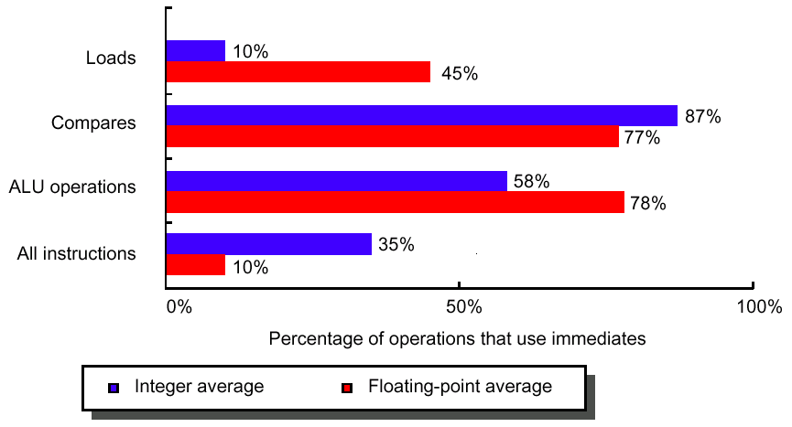
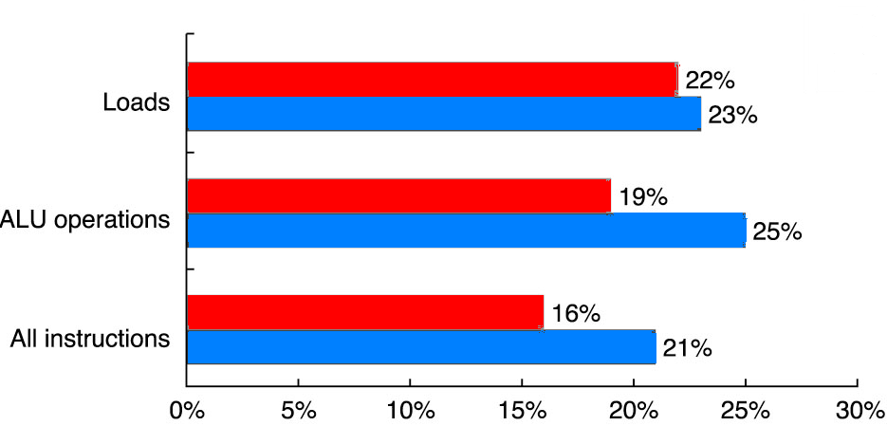
Immediate Addressing Modes
Immediate values for what operations?
Statistics are based on SPEC2000 benchmark on Alpha

Slide 19
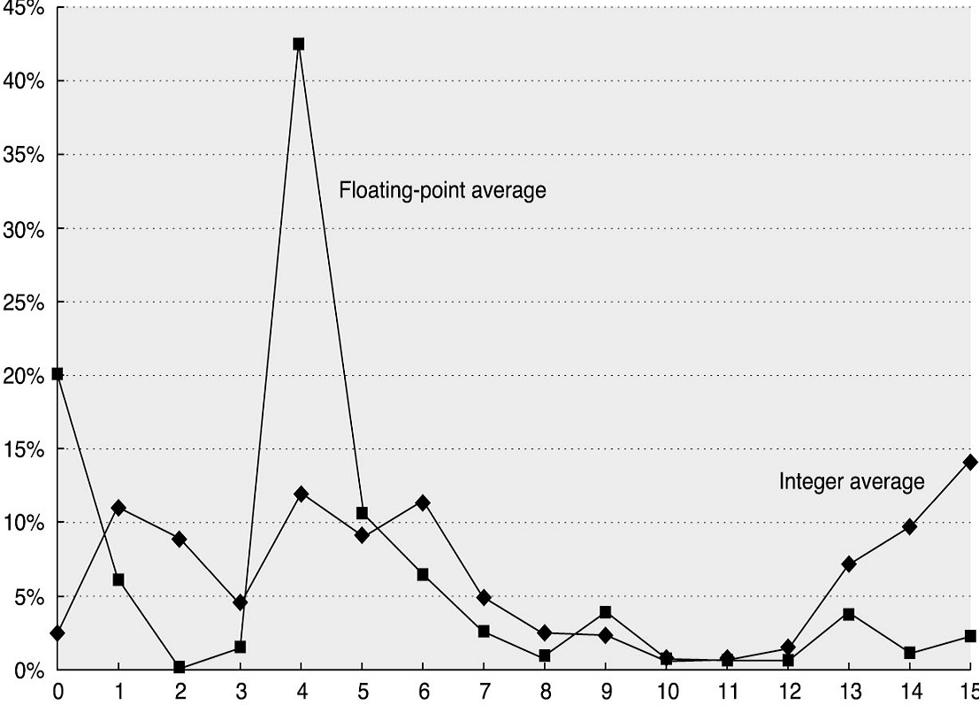
Distribution of Immediate Values
Range affects instruction length
Similar measurements on the VAX (with 32-bit immediate values) showed that 20-25% of immediate values were longer than 16-bits
Measurements were taken on Alpha (only 16 bit immediate value allowed)
Percentage of Immediate Values
Number of bits needed for a immediate values in SPEC2000 benchmark

Slide 20
Addressing Mode for Signal Processing
DSP offers special addressing modes to better serve popular algorithms
Special features requires either hand coding or a compiler that uses such features

Slide 21
Addressing Mode for Signal Processing
Modulo addressing:
Since DSP deals with continuous data streams, circular buffers common
Circular or modulo addressing: automatic increment and decrement / reset pointer at end of buffer
Reverse addressing:
Address is the reverse order of the current address
Expedites access / otherwise require a number of logical instructions or extra memory accesses
Fast Fourier Transform
0 (000₂) ➔ 0 (000₂)
1 (001₂) ➔ 4 (100₂)
2 (010₂) ➔ 2 (010₂)
3 (011₂) ➔ 6 (110₂)
4 (100₂) ➔ 1 (001₂)
5 (101₂) ➔ 5 (101₂)
6 (110₂) ➔ 3 (011₂)
7 (111₂) ➔ 7 (111₂)

Slide 22
Summary of MIPS Addressing Modes

Slide 23
Operations of the Computer Hardware
“There must certainly be instructions for performing the
fundamental arithmetic operations.”
Burkes, Goldstine and Von Neumann, 1947
MIPS assembler allows only one instruction/line and ignore comments following # until end of line
Example:
Translation of a segment of a C program to MIPS assembly instructions:
C: f = (g + h) - (i + j)
(pseudo)MIPS:
add t0, g, h # temp. variable t0 contains "g + h"
add t1, i, j # temp. variable t1 contains "i + j"
sub f, t0, t1 # f = t0 - t1 = (g + h) - (i + j)

Slide 24
Operations in the Instruction Set
Arithmetic, logical, data transfer and control are almost standard categories for all machines
System instructions are required for multi-programming environment although support for system functions varies
Others can be primitives (e.g. decimal and string on IBM 360 and VAX), provided by a co-processor, or synthesized by compiler.

Slide 25
Operations for Media & Signal Process.
Partitioned Add:
Partition a single register into multiple data elements (e.g. 4 16-bit words in 1 64-bit register)
Perform the same operation independently on each
Increases ALU throughput for multimedia applications
Paired single operations
Perform multiple independent narrow operations on one wide ALU (e.g. 2 32-bit float ops)
Handy in dealing with vertices and coordinates
Multiply and accumulate
Very handy for calculating dot products of vectors (signal processing) and matrix multiplication

Slide 26
Frequency of Operations Usage
The most widely executed instructions are the simple operations of an instruction set
Average usage in SPECint92 on Intel 80x86:
Make the common case fast by focusing on these operations

Slide 27
Control Flow Instructions
Data is based on SPEC2000 on Alpha
Jump: unconditional change in the control flow
Branch: conditional change in the control flow
Procedure calls and returns

Slide 28
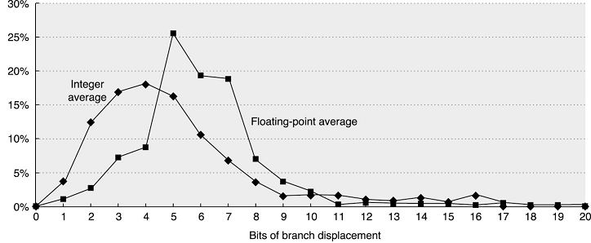
Destination Address Definition
Data is based SPEC2000 on Alpha
PC-relative addressing
Good for short position-independent forward & backward jumps
Register indirect addressing
Good for dynamic libraries, virtual functions & packed case statements

Slide 29
Type and Size of Operands
Operand type encoded in instruction opcode
The type of an operand effectively gives its size
Common types include character, half word and word size integer, single- and double-precision floating point
Characters are almost always in ASCII, though 16-bit Unicode (for international characters) is gaining popularity
Integers in 2’s complement
Floating point in IEEE 754

Slide 30


Unusual Types
Business Applications
Binary Coded Decimal (BCD)
Exactly represents all decimal fractions (binary doesn’t!)
DSP
Fixed point
Good for limited range numbers: more mantissa bits
Block floating point
Single shared exponent for multiple numbers
Graphics
4-element vector operations (RGBA or XYZW)
8-bit, 16-bit or single-precision floating point
8-bit exponent
24-bit mantissa
fixed exponent
32-bit mantissa

Slide 31
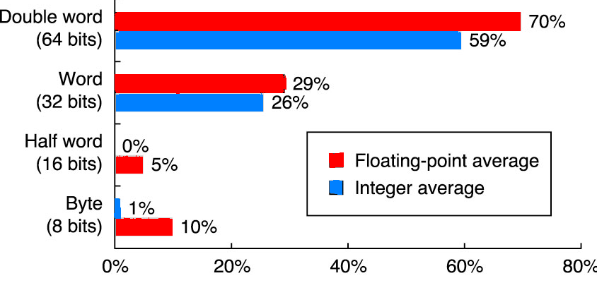
Size of Operands
Frequency of reference by size based on SPEC2000 on Alpha
Double-word: double-precision floating point + addresses in 64-bit machines
Words: most integer operations + addresses in 32-bit machines
For the mix in SPEC, word and double-word data types dominates

Slide 32
Instruction Representation
All data in computer systems is represented in binary
Instructions are no exception
The program that translates the human-readable code to numeric form is called an Assembler
Hence machine-language or assembly-language
Example:
Assembly: ADD $t0, $s1, $s2
Note: by default MIPS $t0..$t7 map to reg. 8..15, $s0..$s7 map to reg. 16-23
ADD
$t0, $s1, $s2
$t0
$s1
$s2
0x12
0x8
0x020
M/C language (hex by field):
M/C language (binary):
0x0
0x11
000000
10001
10010
01000
00000100000
0x02324020
M/C language (hex):

Slide 33
Encoding an Instruction Set
Affects the size of the compiled program
Also complexity of the CPU implementation
Operation in one field called opcode
Addressing mode in opcode or separate field
Must balance:
Desire to support as many registers and addressing modes as possible
Effect of operand specification on the size of the instruction (and program)
Desire to simplify instruction fetching and decoding during execution
Fixed size instruction encoding simplifies CPU design but limits addressing choices

Slide 34
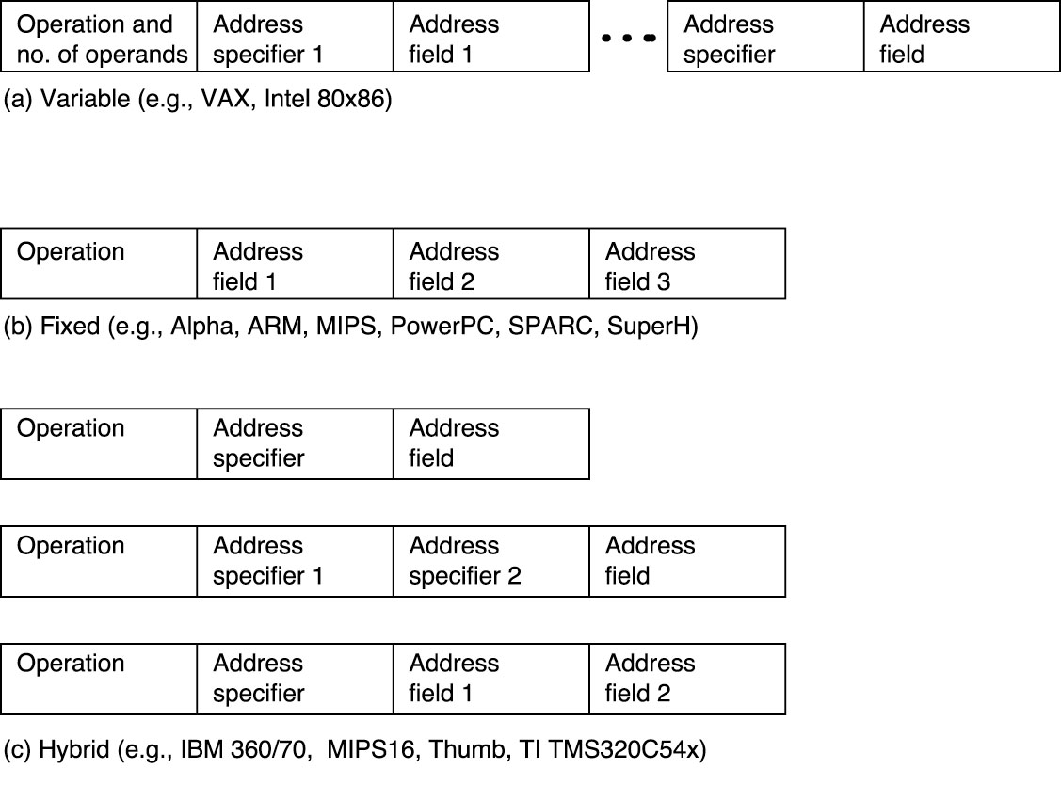
Encoding Examples

Slide 35
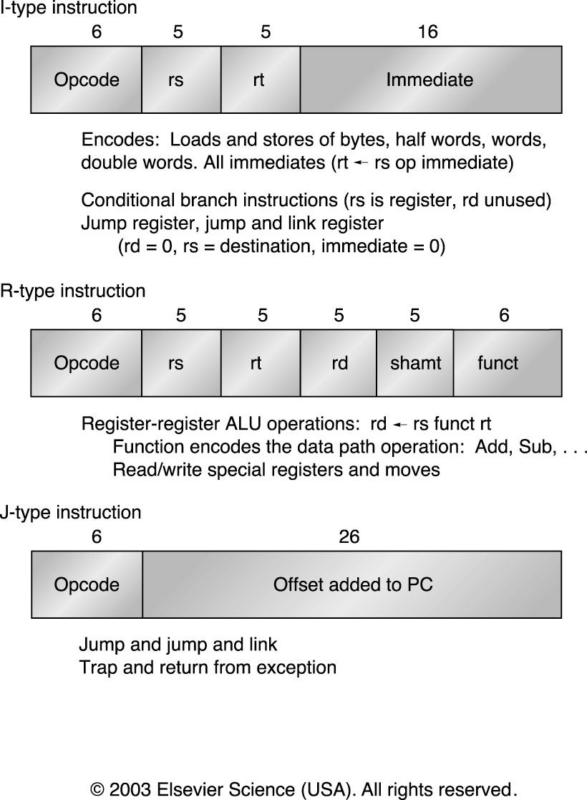
MIPS Instruction Formats

Slide 36
GPU Shading ISA
Data
IEEE-like floating point
4-element vectors
Most instructions perform operation on all four
Addressing
No addresses
ATTRIB, PARAM, TEMP, OUTPUT
Limited arrays
Element selection (read & write)
C.xyw, C.rgba

Slide 37
GPU Shading ISA
Instructions:

Slide 38
GPU Shading ISA
Notable:
Many special-purpose instructions
No binary encoding, interface is text form
No ISA limits on future expansion
No ISA limits on registers
No ISA limits on immediate values
Originally no branching! (exists now)

