Slide 1
Design & Implement a Custom Micro-Controller in One Week or Less
AKA
Hello World for FPGAs
by James Brakefield
Notes:
Cut and paste from trinity_talk_041129.doc

Slide 2
Spartan-3 Evaluation Board
From Xilinx or www.digilentinc.com for $99
Spartan-3 XC3S200: 12 18K-bit block RAMs, 3840 LUTs
JTAG programming cable
VGA connector, keyboard connector
Four digit / 7-segment multiplexed display
Four digit enables, active low
Eight segment enables, active low
Switches, LEDs, buttons
256Kx32 SRAM
Serial EPROM for booting FPGA chip
WebPack software

Slide 3
Design Realm
Single Clock Synchronous Design
All FF & registers clocked on rising edge
Block RAM synchronous only
Distributed RAM with asynchronous read and synchronous write
Therefore:
Read Block RAM for instructions at rising clock edge
Decode instruction & forward register address to distributed RAM
Perform combinatorial function on distributed RAM value
Write combinatorial result back to distributed RAM, block RAM,
and registers/FF on next rising clock edge
Scheme works as block & distributed RAM very fast (~2 & ~1 ns)
And distributed RAM write occurs during block RAM read

Slide 4
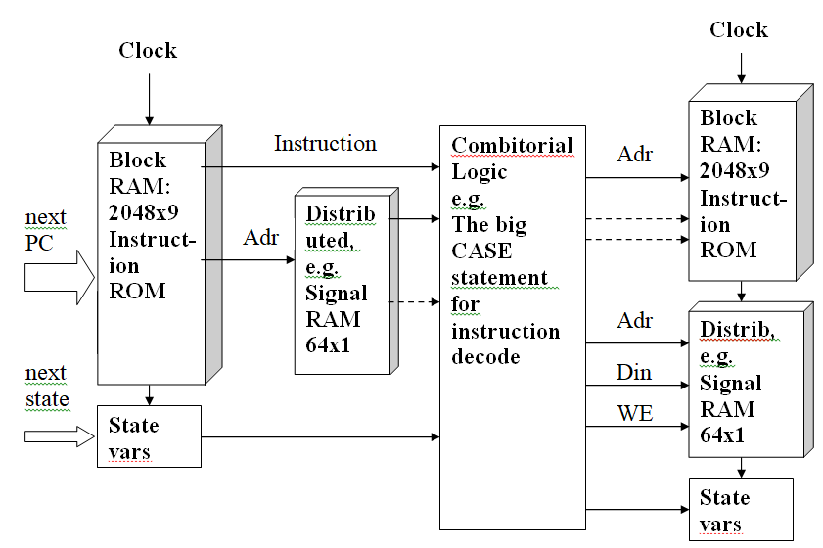
Design Realm

Slide 5
And now for a really simple micro-controller
3-bit op-code, 6-bit address
Block RAM organized as 2048x9
Bit serial arithmetic
Memory organized as 64x1
Execute / Wait cycle
Execute until halt instruction, wait for next start signal
Designed for logic emulation
And really low LUT counts

Slide 6
Instruction Set
LD load memory bit to accumulator
LDC load complement memory bit to accumulator
ST store accumulator to memory
AND and memory bit with accumulator
OR or memory bit with accumulator
XOR exclusive-or memory bit with accumulator
ADC add memory bit to accumulator and update carry
HLT zero program counter and wait for start signal
Misc variety of functions on accumulator and carry
(clear, set, complement, copy, swap)

Slide 7
VHDL Code
Processor (d3_lem9_1min.vhd):
RAM definitions
Interface description
Signal declarations
RAM Port maps, Initialize Block RAM with assembler output
Combinatorial section
Register update section
Test Fixture(d3_lem9_1min_hw.vhd):
Define interface to circuit board
Watch distributed RAM writes
Constraint File(d3_lem9_1min_hw.ucf): pin #s and clock speed

Slide 8
Register Update Section
update: process(clk,reset) begin if reset='1' -- master reset
then dly <= hlt;
acc <= '0'; ….. mem_rd <= (others => '0');
elsif (clk'event and clk='1') then
dly <= nxdly; --
-- state variable update
if xacc = '1' then acc <= nxacc; end if; -- accum update
if xcry = '1' then cry <= nxcry; end if; -- update carry bit
if xpc = '1' then pc <= nxpc; end if; -- PC update
-- monitoring signals
acc_cpy <= acc; ….. mem_rd <= inst & nxadr;
end if; end process update;

Slide 9
Combinatorial Section: default values
-- instruction processing
decode: process(dly,start,memrd,acc,cry,inst,pc,ir) begin
-- default values for update enables & "nx" signals
nxdlyv <= hlt; xpc <= '-'; nxpc <= (others => '-');
nxwe <= '-'; nxmem <= '-'; xacc <= '-';
nxacc <= '-'; xcry <= '-'; nxcry <= '-';

Slide 10
Combinatorial Section: state machine
-- state dispatch
case dly is -- “dly” is the state variable
when hlt =>
if start = '1' then nxdly <= run; else nxdly <= hlt; end if;
xacc <= '1'; nxacc <= '0';
xpc <= '1'; nxpc <= (others => '0'); -- keep PC reset
xcry <= '1'; nxcry <= '0'; nxwe <= '0';
when run =>

Slide 11
Combinatorial Section: misc. instructions
case inst is -- op-code dispatch
when opMSC =>
case ir(5 downto 4) is
when opHLT => nxdly <= hlt;
when opAnC => nxdly <= run;
case ir(3 downto 0) is
when "0000" => xacc <= '1'; nxacc <= '0'; xcry <= '1'; nxcry <= '0'; -- A,C = 0,0
when "1001" => xacc <= '1'; nxacc <= not acc; xcry <= '0'; -- A = not A
when "1100" => xacc <= '0'; xcry <= '1'; nxcry <= acc AND cry; -- C = A & C
when "1101" => xacc <= '1'; nxacc <= cry; xcry <= '0'; -- A = C
end case;
xpc <= '1'; nxpc <= pc + 1; nxwe <= '0';
when others => null;
end case;

Slide 12
Combinatorial Section: normal instructions
when opST =>
nxdly <= run;
xacc <= '0';
xpc <= '1'; nxpc <= pc + 1;
xcry <= '0';
nxwe <= '1'; nxmem <= acc;
when opADC =>
nxdly <= run; xpc <= '1'; nxpc <= pc + 1; nxwe <= '0';
xacc <= '1'; nxacc <= acc xor memrd xor cry;
xcry <= '1'; nxcry <=
(acc and cry) or (acc and memrd) or (cry and memrd);

Slide 13
Results:
No pipelines
And 50+ Mhz (the 166 instructions in “hello world” in 3.32us)
Design will run at 121 Mhz (need to do a clock generator)
Which uses a “slow” speed grade Spartan-3
100-200 Mhz ? for Virtex-4 & Stratix-2
Instruction set easily edited
CASE construct
Each instruction entered separately
Enables for register updates
And then optimized by VHDL compiler
Altera does not have distributed RAM
Requires a 2nd clock phase to emulate asynchronous read

Slide 14
After FPGA Hello World
To get a realistic micro-controller:
Expand instruction set
Expand instruction word size
Expand memory word size
Can add dual port distributed RAM (for MIPS & RISC)
Design Process Supports:
Classical accumulator designs
Register to register designs
Stack machines
De-coupled pipelines
High levels of parallelism:
24 u-controllers on XC3S200 (via 12 shared block RAMs)

Slide 15
After FPGA Hello World cont’d
LEM1_9MIN expansion via unused op-code space:
Repeat loops
Hold loop instructions in shift registers
Auto-increment memory addresses each loop
Branches & calls using a PC stack
Lookup table instructions with tables in program memory
Requires 2nd address register and block RAM address mux
“Hello World” should be implemented as
24-bit memory increment
4-bit add
Digit-select table lookup (four entries of 4-bits each)
Seven-segment table lookup (16 entries of 7-bits each)

Slide 16
After FPGA Hello World cont’d
Uses:
Interrupt controllers, one for each interrupt
Parallel processing research
Motor/motion control:
At 50M instructions/sec one can do
5K instructions 10K times per second.
Other tools:
JHDL: unified environment & simulation
Confluence: 3X denser than VHDL or Verilog
Custom microprocessor environments: Tensilica, etc.
TBD: new class of FPGAs for processor design

