Slide 1

CONDITION BASED MONITORING AND PROGRNOSTICS APPROACH
FOR AN AGING AIRCRAFT MAINTENANCE SYSTEM USING DEEP NEURAL NETS
Jim Brakefield

Slide 2

OBSI
CBM & Prognostic Outline
Background: the plant, current practice
Converting University research into engineering
Neural Net background
Deep NN & Long Short Term Memory NN

Slide 3
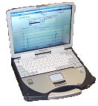
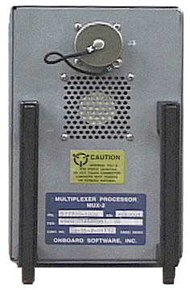
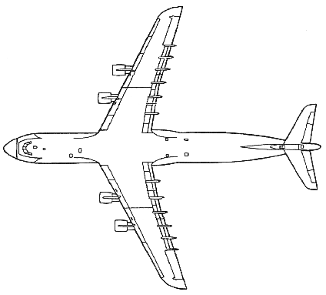
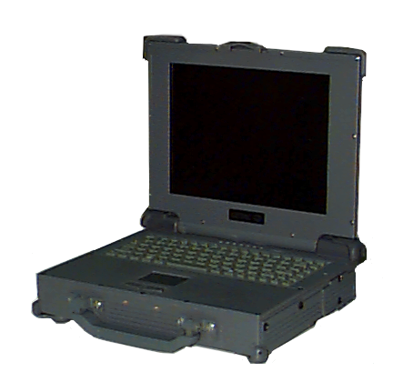
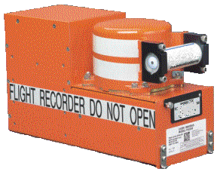

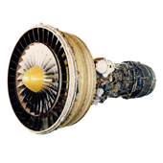
OBSI C-5 Modernization
Onboard Condition Monitoring
Fault Isolation
Fault Reporting
GPIS
Access to Flight Data and Reports
Electronic/Hard Copy Displays
Avionics Data Loading
SATCOM Terminal
Digital Documentation
Digital Flight Data Recorder
Aircraft/Fleet Status Reports
Configuration Management
Remote Maintenance Support
Engine Monitoring
Vibration Monitoring
Fan Trim Balance

Slide 4
C-5 Modernization
Replaced 1750 with PowerPC
Replaced Jovial with C++
Replaced Flight Engineer console with military laptop
Replaced Tape Deck with PC-card
Replaced printer
Replaced Ground station with laptop
Implemented SQL database
Implemented interactive flight data viewer

Slide 5
C-5 Instrumentation Background
C-5 Flight data recording
  800+ sensors
    Most are discrete (digital)
  Fault codes:
    Implemented via scripting language using state & time
  Variable recording rates
    Typically use linear interpolation of analog signals
    Use straight line interpolation of discrete signals

Slide 6
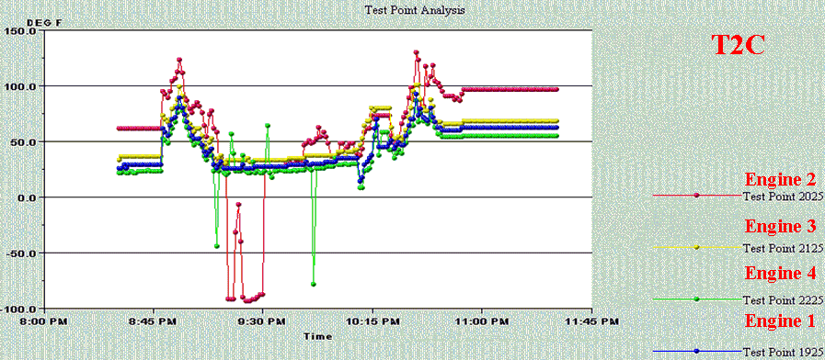
C-5 Turbine Inlet Temperature
Flight data file showing sensor problems: spikes, drop-out, offset error
From OBSI QLD briefing 2003

Slide 7
CBM Algorithm Background
Statistical Techniques
  Extensive literature & numerous methods
  Hot areas:
    Bayesian Networks
    Support Vector Machines
    Independent Component Analysis
Artificial Neural Net Techniques
  Often used as a general purpose adaptive fit
  AKA “non-linear modeling”
  Advanced capabilities: Deep NN, LSTM

Slide 8
Other Applicable Technology
Frequency Domain analysis
  Bacharowski (2006)
  Electronic signature analysis (ORNL)
Accurate Modeling
  Turso & Litt (2004)
3-layer Neural Net examples
  Turso & Litt (2004)
  Brotherton & Johnson (2001)

Slide 9
Implementation Perspective
2D map of data & computation dimensions
  Effect of Moore’s Law
2D map of complexity & maturity dimensions
  Practicality
Wetware versus software
  The biological models give reassurance

Slide 10
Perspective: Data & Computation Dimensions
Moore’s law =>
  With time, can approach problems using more memory & greater processing
Computer Science has evolved along with hardware
  Small Data & Efficient Computation =>
    Exact reasoning using small data sets
    Emphasis on efficient algorithms
  Large Data =>
    Statistical & Inexact Reasoning on large data sets
  Big Computation =>
    Genetic algorithms & gradient based learning
  Both =>
    Hybrids of Genetic Algorithms & Neural Nets

Slide 11
Perspective: Practicality
Additional dimensions:
  Algorithm Complexity
    Occam’s razor: Bias or prejudice against complexity
    The world is getting more complex anyway
    Automation (adaptive systems) is the solution
  Algorithm Maturity
    Engineering requires “well behaved” algorithms
    Having a choice of algorithms so as to avoid over constraining the implementation

Slide 12
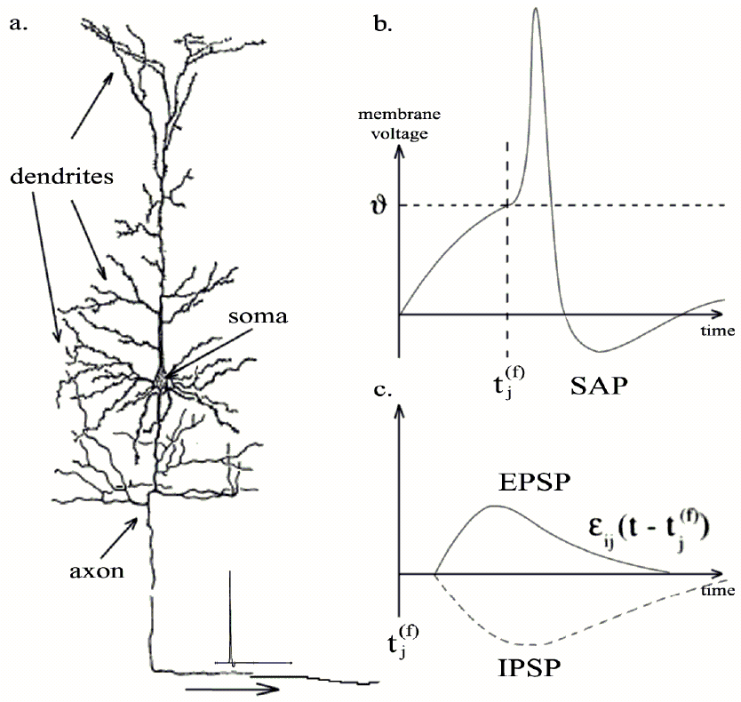
Biological neuron
Fig. 2 Koopman (2003)

Slide 13
Wetware Modeling
O’Reilly & Frank (2006)
  LSTM versus biology
  Training efficiency match
Koopman etal (2003)
  LSTM versus spiking models
  Performance match
Izhikevich (2004)
  Can generate many spiking behaviors via parameter adjustment

Slide 14
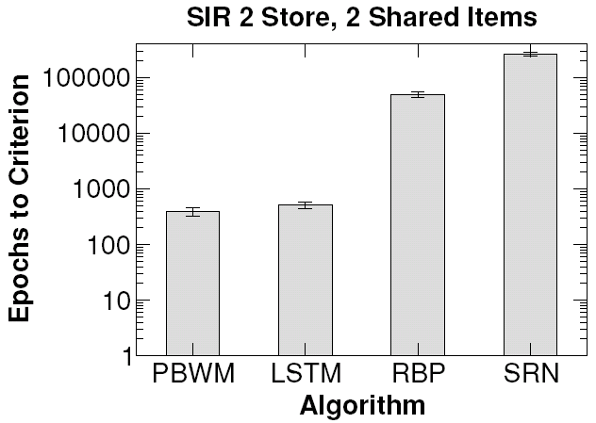
LSTM performance comparison
Fig 11b O’Reilly (2006)

Slide 15
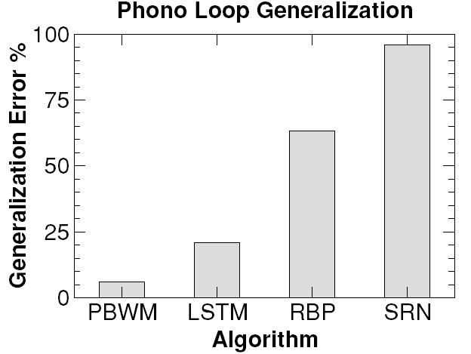
LSTM generalization error
Fig. 14b O’Reilly (2006)

Slide 16
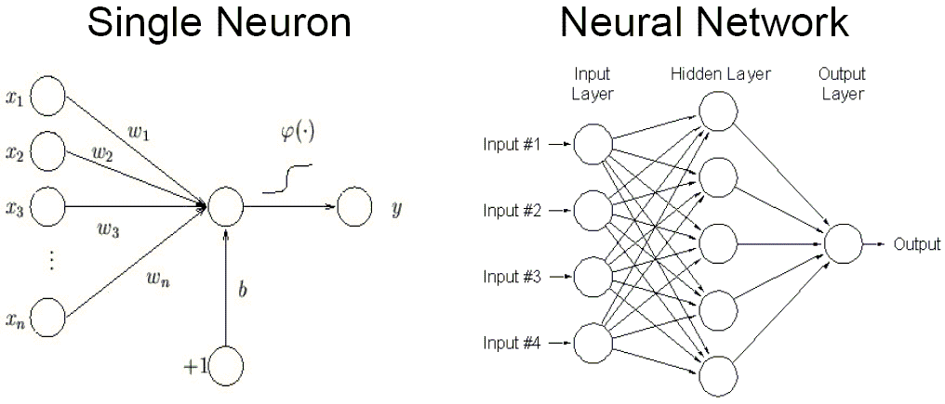
3-layer Neural Net
From pg. 3 Kushal (2006)

Slide 17
Neural Net Technology
Kohonen Self-Organizing Map
  Unsupervised classification
3-Layer
  Assumes feature detectors are known
  Many variations
Multi-Layer
  Learns feature detectors
  Success with Convolutional Nets
  Not suited for time domain (IMHO)
Recursive
  Full generality
  Success with LSTM
  Can handle long & variable time patterns

Slide 18
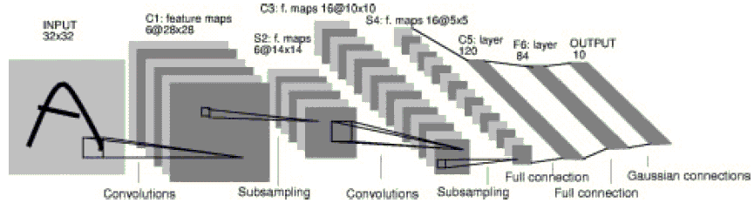
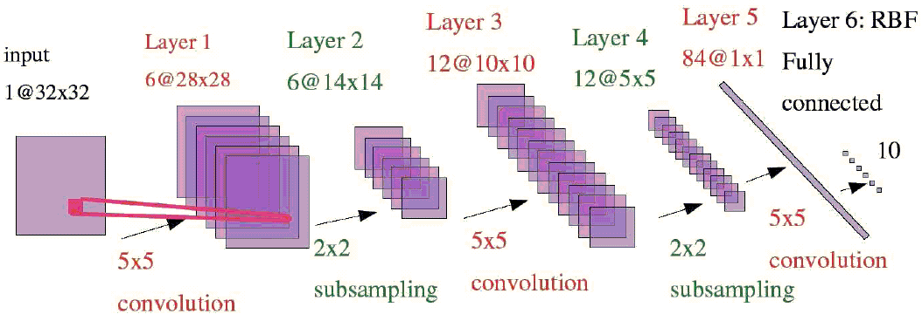
Convolutional NN
Fig. 2 LeCun 1998
Pg. 6 Kushal 2006

Slide 19
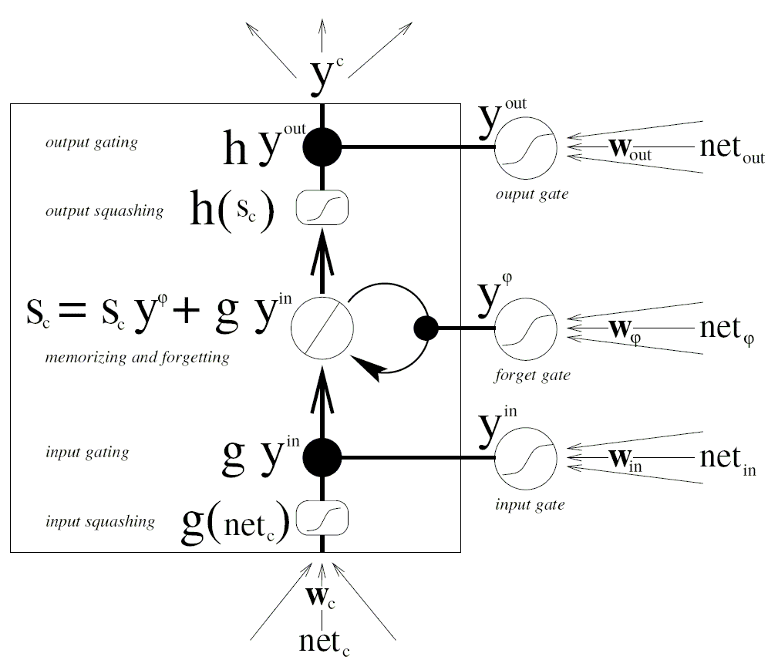
LSTM “neuron”
Fig. 3.1 Gers (2001)

Slide 20
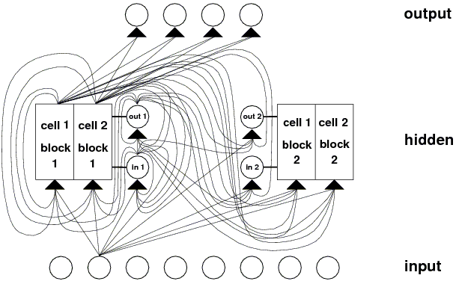
LSTM Neural Net
Fig. 2 Hochreiter (1997)

Slide 21
LSTM Applications
Signal integrity
  Noise spikes
  Offset errors (drop outs, calibration error)
  Gain errors (e.g. transducer malfunction)
Condition codes
  Match existing
  Refine existing
Anomaly detection
  Requires trainer

Slide 22
Summary
Convolutional Nets can learn feature detectors
LSTM Nets can handle variable time delays
LSTM Nets comparable in performance to biological models
LSTM can learn fault conditions

Slide 23


Slide 24
LSTM References
S. Hochreiter & J. Schmidhuber 1997: Long Short-Term Memory, Neural Computation 9(8):1735-1780.
F. Gers 2001: Long Short-Term Memory in Recurrent Neural Networks, Ph.D. Thesis, Ecole Polytechnique Federale De Lausanne.
D. Wierstra, F. Gomez & J. Schmidhuber 2005: Modeling Systems with Internal State using Evolino, GECCO’05 pp1795-1802 ACM Press.
Y. Bengio, P. Simard & P. Frasconi 1994: Learning long-term dependencies with gradient descent is difficult, IEEE Trans. Neural Networks 5(2)157-166.

Slide 25
Deep Neural Net References
Y. LeCun et al. 2005: Off-Road Obstacle Avoidance through End-to-End Learning, NIPS 2005 & DARPA Q458.
Y. LeCun et al. 1998: Gradient-Based Learning Applied to Document Recognition, Proceedings of the IEEE vol. 86, no. 11, pp. 2278-2324.
G. Hinton, S. Osindero & Y. Teh 2006:
A fast learning algorithm for deep belief nets, Neural Computation (to be published).
A. Kushal: Gradient Based Learning, courses.ece.uiuc.edu/ece598/ ffl/paper_presentations/AkashKushal_NN.pdf

Slide 26
Current Best Practice References
W. Bacharowski 2006: Improving Machinery Vibration Analysis, SIGNAL PATH designer #104, National Semiconductor.
J. Turso & J. Litt 2004: Intelligent, Robust Control of Deteriorated Turbofan Engines via Linear Parameter Varying Quadratic Lyapunov Function Design, First Intelligent Systems Technical Conference.
Oak Ridge National Laboratory: Electrical Signature Analysis (ESA) for aging aircraft and other defense applications. http://www.ornl.gov/sci/esa/basis_background_sub.shtml
T. Brotherton & T. Johnson 2001: Anomaly Detection for Advanced Military Aircraft Using Neural Networks, Proceedings of the 2001 IEEE Aerospace Conference, Big Sky Montana.

Slide 27
Neurological Modeling References
A. Koopman, M. van Leeuwen & J. Vreeken 2003: Dynamic neural networks, comparing spiking circuits and LSTM. archive.cs.uu.nl/pub/RUU/ CS/techreps/CS-2003/2003-007.pdf
R. O’Reilly & M. Frank 2006: Making Working Memory Work: A Computational Model of Learning in the Prefrontal Cortex and Basal Ganglia, Neural Computation 18:283-328.
E. Izhikevich 2004: Which Model to Use for Cortical Spiking Neurons, IEEE Trans. Neural Networks 15:1063-1070. http://vesicle.nsi.edu/users/ izhikevich/publications/whichmod.htm

Slide 28
General References
T. Hastie, R. Tibshirani & J. Friedman 2001: The Elements of Statistical Learning, Springer.
R. Neapolitan 2004: Learning Bayesian Networks, Prentice Hall.
N. Cristianini & J. Shawe-Taylor 2000: Support Vector Machines, Cambridge.
J. Stone 2004: Independent Component Analysis, MIT Press.
Judith Dayhoff 1990: Neural network architectures: An introduction, Van Nostrand Reinhold.
Michael Arbib ed. 2002: The Handbook of Brain Theory and Neural Networks, 2nd ed., The MIT Press.
T. Kohonen 2001: Self-Organizing Maps, 3rd ed., Springer.
J. Sheppard & M. Kaufman 2004: Advances in Diagnosis and Prognosis, Autotestcon-2004 seminar.
C. Villarreal & I. Cicek 2004: Automated Troubleshooting Tools for Minimizing Downtime and Reducing the Labor and Material Costs of C-5 Aircraft, Autotestcon-2004 pp 504-510.

Slide 29
Researcher’s Web Sites
Jurgen Schmidhuber: www.idsia.ch/~juergen/rnn.html
Extensive LSTM references
Sepp Hochreiter: ni.cs.tu-berlin.de/~hochreit
Simplest LSTM software
Felix Gers: www.felixgers.de
Ph.D. thesis on LSTM
Faustin Gomez: http://www.idsia.ch/~tino/
Genetic Evolution of LSTM
Randall C. O’Reilly: psych.colorado.edu/~oreilly
PDP++
Yann LeCun: yann.lecun.com
Convolutional NN, tutorials & video examples
Geoffrey E. Hinton: www.cs.toronto.edu/~hinton
Convolutional NN, ibid.

Slide 30
LSTM Software
Hochreiter: ni.cs.tu-berlin.de/~hochreit/soft.shtml
  Simplest LSTM code
LSTM Toolbox: idelnx81.hh.se/bioinf/index.html
  In Matlab
SigmaPi: sigmapi.sourceforge.net
  Complete package based on LSTM
O’Reilly: www.cnbc.cmu.edu/Resources/PDP++
  Extensive neural simulation package, includes LSTM
Gers: C++ www.felixgers.de/SourceCode_Data.html
  As part of his thesis

