Slide 1
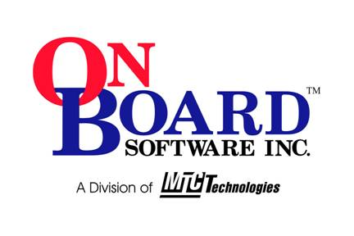
Introduction to Programmable Logic as Software Process
Jim Brakefield ©2006
OnBoard Software

Slide 2
FPGA (Field Prog. Gate Array) Usages
Flow thru calculation/processing
  Supercomputer acceleration
  Signal processing
  Compression & de-compression & encryption
Rapid prototyping
  ASIC (Application Specific IC) emulation
  Processor emulation
  Time-to-market acceleration
Interfacing
  Non-standard interfaces
  Pulling all miscellaneous logic into one chip
  Signal voltage or format conversion

Slide 3
FPGA Usages cont’d
Field updateable hardware
  Via communications link or memory stick/card
Custom processors
  Adding co-processor
  Adding a few acceleration instructions to processor
  Design a unique processor
Simplifying real-time validation
  Off loading interrupt handlers
Migration: keeping your product up-to-date
  FPGAs early adopters of latest silicon process: currently 90nm
System level design
  Does all of the above on a single chip
  Lets one choose the design focus

Slide 4
Rational for Programmable Logic
Supercomputing
  Silicon Graphics and/or Cray:
  http://www.sgi.com/pdfs/3863.pdf
  http://www.fpgajournal.com/articles_2006/20060207_cray.htm
  ASIC emulation (contains 1500 multipliers, 4 PowerPCs) http://www.dinigroup.com/index.php?product=DN8000k10
User generated hardware
  Digilent Inc (typical evaluation board): http://www.digilentinc.com/Products/Detail.cfm?Nav1=Products&Nav2=Programmable&Prod=S3BOARD
  Opal Kelly (USB connection communicating with widgets on PC): http://opalkelly.com/products/xem3001/
  Using simple USB interfaces from FTDI http://www.ftdichip.com/Products/EvaluationKits/FPGA.htm
  PowerPC & ethernet in very small form factor: http://www.em.avnet.com/evk/home/0,1719,RID%253D0%2526CID%253D25726%2526CCD%253DUSA%2526SID%253D4742%2526DID%253DDF2%2526SRT%253D1%2526LID%253D18806%2526PVW%253D%2526BID%253DDF2%2526CTP%253DEVK,00.html

Slide 5
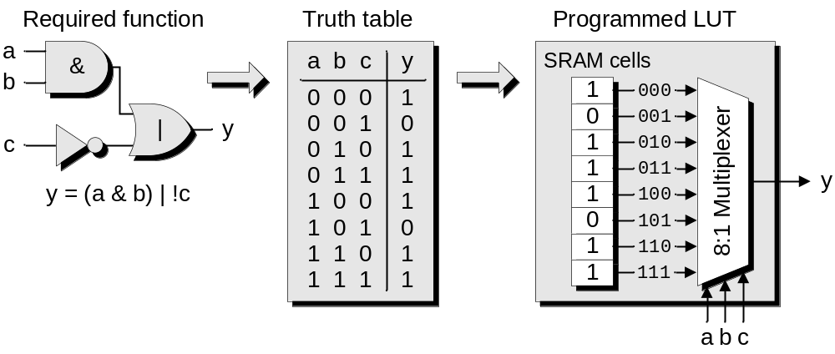
FPGA LUT
Logic implemented via many small lookup tables !!!
Figure 3-18 from Design Warrior’s Guide to FPGAs ISBN 0750676043

Slide 6
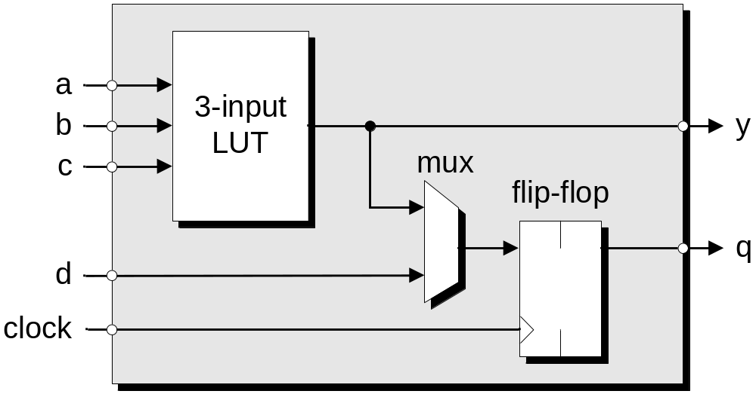
Simple FPGA “CLB”: 3LUT + flip-flop
Most FPGA CLBs use 4LUTs and include carry logic (for adders, counters)
Figure 3-19 from Design Warrior’s Guide to FPGAs ISBN 0750676043

Slide 7
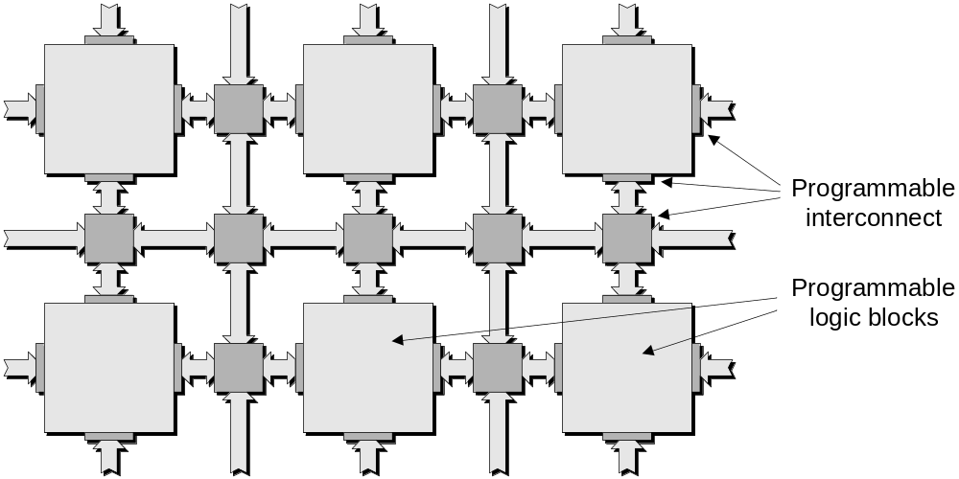
FPGA “Tiles”
A programmable logic block may contain from one to 16 CLBs (typically 8)
The interconnect takes more silicon than the logic blocks !!!
Figure 3-20 from Design Warrior’s Guide to FPGAs ISBN 0750676043

Slide 8
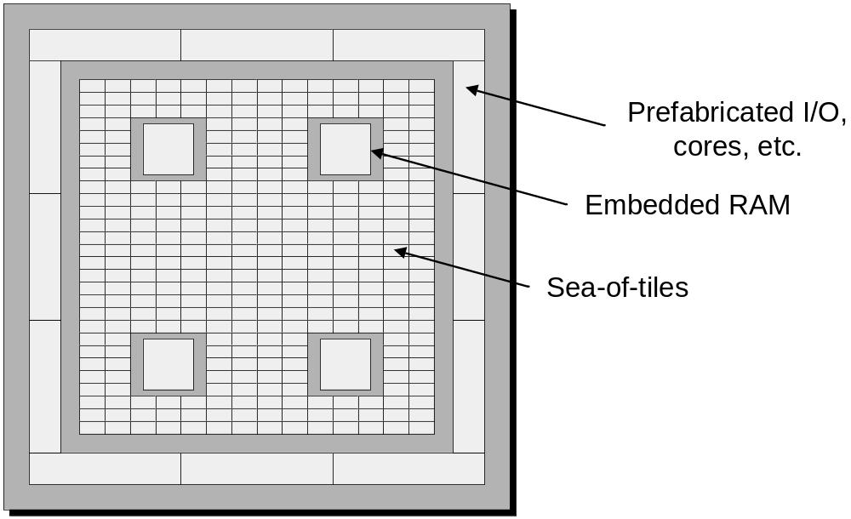
The FPGA chip
Figure 3-16 from Design Warrior’s Guide to FPGAs ISBN 0750676043

Slide 9
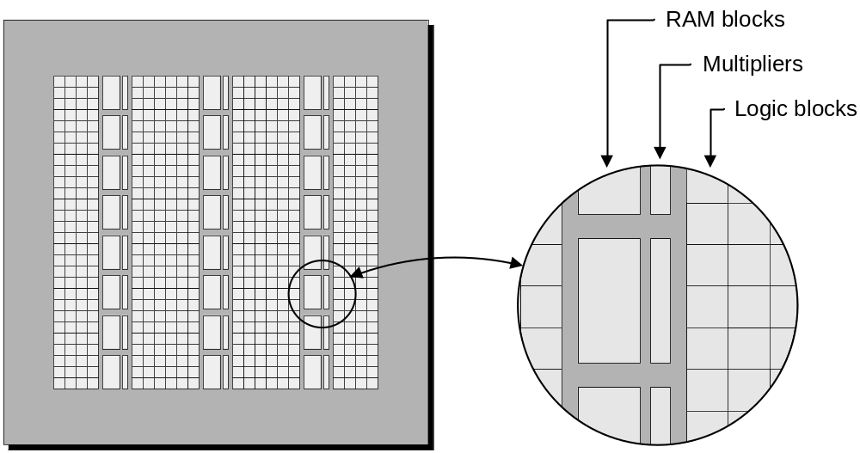
FPGA chip with multipliers & RAM
Close proximity of RAM & multiplier facilitates DSP
Figure 4-11 from Design Warrior’s Guide to FPGAs ISBN 0750676043

Slide 10
Programmable Logic Features
Logic:
  Thousands of LUTs (4-bit lookup tables)
  Support for adders & counters
Registers: one per LUT, several per IO pin
  Can be automatically replicated for faster operation
  Use of latches discouraged
Memory: dual port, also useful for FIFOs, ROM
  Each vendor’s RAM is slightly different
IO: hundreds of pins, various voltages & interfaces
  Support for external DDR & QDR & Flash memory
Frequency & phase (clock) generators
Multipliers: fixed point DSP
High speed serial interfaces: up to 11 Ghz

Slide 11
Programmable Logic Features cont’d
Cut & paste IP (intellectual property)
  Hundreds if not thousands of unique hardware blocks
  Such as UART, FFT, ADPCM, …
User defined microprocessors
  Typically a few new instructions added to an existing core (Nios, microBlaze, PPC, etc)
Built-ins:
  Microprocessors: PowerPC, ARM, AVR
  AES & DES
  Ethernet interface
  Analog processing (Actel, Cypress)

Slide 12
Current Chips
Altera:
  MAX II: CPLD replacement
  Cyclone II: low cost FPGA, multipliers
  Stratix II: three RAM sizes
Lattice Semiconductor:
  MachXO: CPLD replacement
  ECP/EC: multipliers
  XP: on-chip configuration Flash, low power mode
Xilinx:
  CoolRunner: low power “CPLD”
  Spartan-3: low cost FPGA, multipliers
  Virtex-4: PowerPC, multipliers, SERDES to 11Ghz
Actel: Both Flash & Anti-Fuse based FPGA parts
Atmel: AVR microprocessor + FPGA fabric
Quicklogic: Anti-Fuse parts with a CPLD flavor
Cypress: CPLDs, PSoC (programmable analog + uP)

Slide 13
Current Chips cont’d
 | # LUTs | # IO's | # RAMs | multipliers | SERDES | uP
Altera |  |  | (128*36) | (18*18) | 6.4 Ghz
MAX II | 240 to 2210 | 80 to 272
Cyclone II | 5K to 68K | 90 to 616 | 26 to 250 | 13 to 150 |  | Nios
Stratix II | 12K to 144K | 104 to 1173 | 78 to 768 * | 48 to 384 | 38 to 152 | Nios
Lattice |  |  | (256*36) | (18*18) | 3.4 Ghz
MachXO | 256 to 2280 | 78 to 271 | 0 to 3 |  |  | Micro8
ECP/EC | 1.5K to 40K | 112 to 576 | 2 to 70 | 0 to 40 |  | Micro8
XP | 3K to 20K | 136 to 340 | 6 to 44 |  |  | Micro8
Xilinx |  |  | (512*36) | (18*18) | 11 Ghz
CoolRunner |  | 33 to 270
Spartan-3 | 1.5K to 67K | 124 to 784 | 4 to 104 | 4 to 104 |  | uBlaze
Virtex-4 | 12K to 178K | 320 to 960 | 36 to 552 | 32 to 512 | 0 to 24 | PPC & uBlaze
* Stratix II has three RAM sizes of 32*18 (104 to 930), 128*36 & 4K*144 (0 to 9)
MAX II, MachXO & XP have on-chip configuration, XP has low power mode

Slide 14
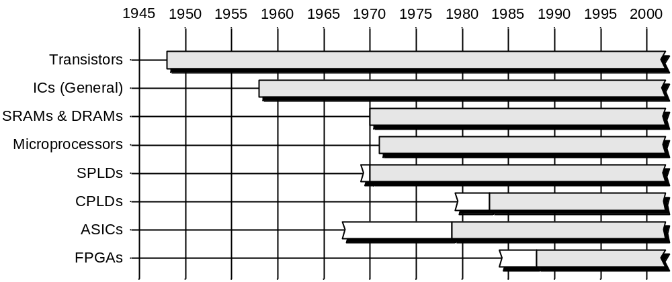
Silicon Timeline
Rate of adoption: microprocessors could leverage existing mini-computer
tool chains whereas PLDs, CPLDs & FPGAs needed new tool chains
Figure 3-01 from Design Warrior’s Guide to FPGAs ISBN 0750676043

Slide 15
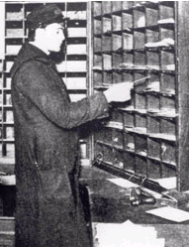
Perspective: Hardware versus Software
Software relies on enumeration:
  Giving all program & data an address
  E.g., “the enumeration transform”
  Application is sequenced by single processor
  Analogy: postal clerk moving & marking paper from pigeon hole to another pigeon hole at several gigahertz

Slide 16

Hardware versus Software cont’d
Digital hardware: “fundamental” mode:
  Clocked registers with connecting logic
  Problem is mapped to non-addressable flip-flops & logic: labeling but no uniform adrs.
  FPGA debugging can be reconfigured:
    Instrumentation added/removed as needed
    (e.g. reconfigurable logic analyzer)
  Analogy: an extensive assembly line operating at hundreds of megahertz

Slide 17
Programmable Logic Process
Create a “golden” or reference design
  In “C”, Matlab, VHDL, Verilog, SystemC, …
Verify design (e.g. create a “test bench”)
Convert to VHDL or Verilog
  Often done manually
  Chip specific features invoked as “black boxes”
Compile to EDIF
  somewhat similar to generating byte-code
IO pins assigned & clocks defined
Place & Route
  similar to converting byte-code & linking
Simulate & Perform timing analysis
Download to chip & test

Slide 18
Serial versus Parallel Processing
Software: specify a sequential calculation
  However, Functional programming:
    no state, no sense of time or space
  Layering: raise the level of abstraction
Hardware: specify the hardware to do a calculation
  State must be managed
  No hidden feedback paths permitted
  Layering: implement emulation & abstraction
QED: hardware is at a more primitive level
  Slow stuff belongs in software? Area vs Power

Slide 19
Starting a Design: Memory Organization
Microprocessor memory uses uniform address space
  Usually not fully populated on 32-bit processors
  Many have various kinds: SRAM, DRAM, Flash with various access times
Use FPGA memory supplied in dual-port RAMs
  And must be gathered into larger blocks (can be automated)
  Dual-port RAMs allow two independent accesses per clock
    Such as for FIFOs (one read & one write)
    Via duplication, register files (two reads & one write)
    Each port can have a distinct aspect ratio (such as 4Kx1 or 512x8)
  Some FPGAs provide a variety of RAM sizes
Or, additional memory is attached to FPGA
  External SRAM choices: async, sync, QDR
Registers: FPGAs are register rich – not a limiting factor

Slide 20
Starting a Design: Algorithm Selection
Chose algorithm(s) within FPGA’s capability
  This means estimating LUT & pin counts
  No current FPGAs provide hardware floating-point
  Many current FPGAs provide 18-bit signed multipliers
    Some support 9 by 9 and 36 by 36 multipliers
    Some provide a double width accumulator
Various serial/parallel strategies available
Duplication strategy available (AKA loop unrolling)

Slide 21
Design Refinement
Run the design through the FPGA tools
  Will show size of part needed
  Will show # FFs, RAMs, mults & LUTs
  Can run design on various FPGA families
Designs tend to shrink as it gets refined
  Can start with large part and expect will eventually fit into a smaller part
Accurate timing (performance) only possible by adding constraints
  Otherwise tools assume all clocks have same frequency & try to optimize to overall best frequency

Slide 22
VHDL & Verilog
Both are simulation languages
  IEEE Standard 1076: VHDL-85, VHDL-93, VHDL-2001
  IEEE Standard 1364: Verilog-1995, Verilog-2001, System Verilog-2005
Often the "golden" model is done in C/C++ (or Matlab)
So, only a subset of the language is used to implement the design
These are RTL (register transfer languages), you must deal with bits & wires
Simulation & testing may take 70% of a large project's man-hours

Slide 23
Sample VHDL Design
32 bit binary counter
50 Mhz clock, so 25th bit is ~ 1 hertz
Source code:
  library IEEE;
  use IEEE.STD_LOGIC_1164.ALL;
  use IEEE.STD_LOGIC_ARITH.ALL;
  use IEEE.STD_LOGIC_UNSIGNED.ALL;
  entity count32 is
  Port ( clk : in STD_LOGIC;
  cntr32 : out STD_LOGIC_VECTOR (31 downto 0));
  end count32;
  architecture Behavioral of count32 is
  signal cnt32: std_logic_vector(31 downto 0);
  begin
  cntr32 <= cnt32;
  process(clk)
  begin
  if rising_edge(clk) then cnt32 <= cnt32 + 1; end if;
  end process;
  end Behavioral;

Slide 24
Chip vendors
Chip Vendor | strengths | known for
Xilinx.com | FPGA | FPGA market leader, low power CPLDs
Altera.com | CPLD | CPLD market leader, close #2 to Xilinx
Latticesemi.com | CPLD | #3 in CPLDs & FPGAs, digital cross-point switches
Actel.com | anti-fuse | flash & anti-fuse FPGAs
Quicklogic.com | anti-fuse | anti-fuse CPLDs
Cypress.com | PSoC | does CPLDs, RAMs, solar cells & other chips
Atmel.com | AVR + FPGA | legacy parts, uPs, flash memory, RF, etc
eASIC.com | structured ASIC | single programmable via layer, 3 week turn-around
(ranked by approximate programmable logic sales volume)

Slide 25
Closing Comments
FPGA has more process steps
  More things to test & places to test them
  Timing analysis
  IO pin allocation & clock specs
Larger projects have more elaborate process
  Getting started:
    buy a evaluation board
    use free tools
  Not easy:
    traps lie in wait (may take several people to do one chip)
    pioneering opportunities (partial dynamic reconfiguration)
C to VHDL/Verilog tools available
  Handel-C, ImpulseC, SystemC, System Verilog, MyHDL

Slide 26
Closing Comments (cont’d)
Deterministic performance
Speed adequate for most projects
  100 to 500 Mhz clock rates achievable
  External DDR RAM support, etc.
  Serial links of 600 Mhz to 10 Ghz
Quality IP for free (FIR, FFT, etc)
  ISE 8.1i Webpack CORE Generator & opencores.org
Soft core microprocessors (Nios & uBlaze)
  Can have several per chip (helps if the data & programs are small)
  Capable of running Linux @ ~200 MIPs

Slide 27
Book References
Fundamentals of Logic Design, 5th ed., Charles Roth Jr., 2003 (over emphasis on optimization, has CD with tools).
Programmable Logic Quick Start Handbook, Karen Parnell & Nick Mehta, 2004, (included with Xilinx kits)
  PDF version available from Xilinx web site:
  www.xilinx.com/publications/products/cpld/logic_handbook.pdf
HDL Programming Fundamentals: VHDL and Verilog, N.M. Botros, 2005 (modern & complete text, includes process flow)
The Designer's Guide to VHDL, P.J. Ashenden, 2002 (reliable reference)
The Design Warrior’s Guide to FPGAs, Clive “Max” Maxfield, 2004 (folksy, caters to experienced hardware engineers, lots of “process” material).
Architecture and CAD for Deep-Submicron FPGAs, V. Betz J. Rose & A. Marquardt, 1999 (academic, graduate level)

Slide 28

Misc. Web pointers
German cuisine
www.aufzu.de/FPGA/
4fun
www.fpga4fun.com/index.html
Free cores (IP)
www.opencores.com/
FPGA board list
www.fpga-faq.org/FPGA_Boards.shtml
  Not 100% complete or accurate
  Also has FAQ & usenet comp.arch.fpga & Xilinx chip comparison tool
Experimental tools
  MyHDL myhdl.jandecaluwe.com/doku.php
  Confluence & HDCaml www.confluent.org

Slide 29
History of Programmable Logic
1973 | Philips | PLA | sum of products: AND & OR fuses
1975 | Signetics | FPLA |  | purchased by Philips 1977
1978 | Monolithic Memories | PAL |  | acquired by AMD ~1979
1979 | Data General | Eclipse mini-computer | Eagle project in Tracy Kidder's "The Soul of a New Machine" | project saved by programmable logic
1980 | AMD | 16R8 | 16 inputs & 8 registers | currently mfg'd by Atmel, Lattice & others
1982 | Monolithic Memories | PALASM | PLD programming language
1983 | Altera | founded
1983 | Data I/O | ABEL | PLD programming language | ABEL now owned by Xilinx
1984 | AMD | 22V10 | 22 inputs & 10 registers | currently mfg'd by Atmel, Lattice & others
1984 | Xilinx | founded |  | partly owned by AMD

Slide 30
History of Programmable Logic
1985 | Actel | ACT | antifuse | one-time programmable, fast, low power, difficult to reverse engineer
1985 | Altera | EP1200 | 1st CPLD
1985 | Gateway Design Automation | Verilog | hardware description language | C “flavor”
1985 | Xilinx | XC2000 | 1st FPGA
1987 | DOD | VHDL | hardware description language | ADA “flavor”
1988 | Quicklogic | ESP | antifuse | one-time programmable, fast, low power, difficult to reverse engineer
1991 | Lattice | ispLSI | in-system reprogrammable PLDs | JTAG: IEEE Std 1149.1
1994 | Philips | CoolRunner | low power CPLDs | purchased by Xilinx 1999
1997 | Lattice | ispGDX | programmable digital crosspoint switch
1998 | Xilinx | Virtex-1 | 4K dual-port RAMs | Various aspect ratios: 1x4K, 2x2K, 4x1K, 8x512, 16x256
2000 | Altera | Nios | 16 & 32-bit soft uP core
2000 | Lattice | ispPAC | programmable analog

Slide 31
History of Programmable Logic
2001 | eASIC | structured ASIC | single programmable layer, 3 week turn-around | FPGA like cells, ASIC wiring with customized vias
2001 | Xilinx | Virtex-2 | FPGA with multipliers | 18K dual-port RAMs
2001 | Xilinx | micro-Blaze | 32-bit soft core uP, ~1000 LCs | has floating-point option
2002 | Altera | Stratix | FPGA with three RAM sizes | 18x32, 36x128 & 144x4K
2002 | Cypress | PSoC | programmable analog | includes digital as well
2002 | Lattice | ispXPGA | FPGA with on chip Flash boot ROM | Flash reload to SRAM in 1-2 ms
2002 | Xilinx | Virtex-2P | SERDES @ 3.125 Ghz | PowerPC cores @ 600 DMIPS
2004 | Altera | Max II | FPGA targeting CPLD market
2004 | Xilinx | Virtex-4 | FPGA with ethernet controller | Also PowerPC cores, 10Ghz SERDES & AES
2004 | Xilinx | Spartan-3 | FPGA in 90nm silicon
2006 | fpga-faq.org |  | up-to-date board list | also Xilinx chip comparison tool
2006 | opencores.org |  | free VHDL & Verilog IP | large collection of microprocessor cores
2006 | Xilinx | ISE 8.1i | free CORE generator | ISE takes > 1GB disk space

Slide 32
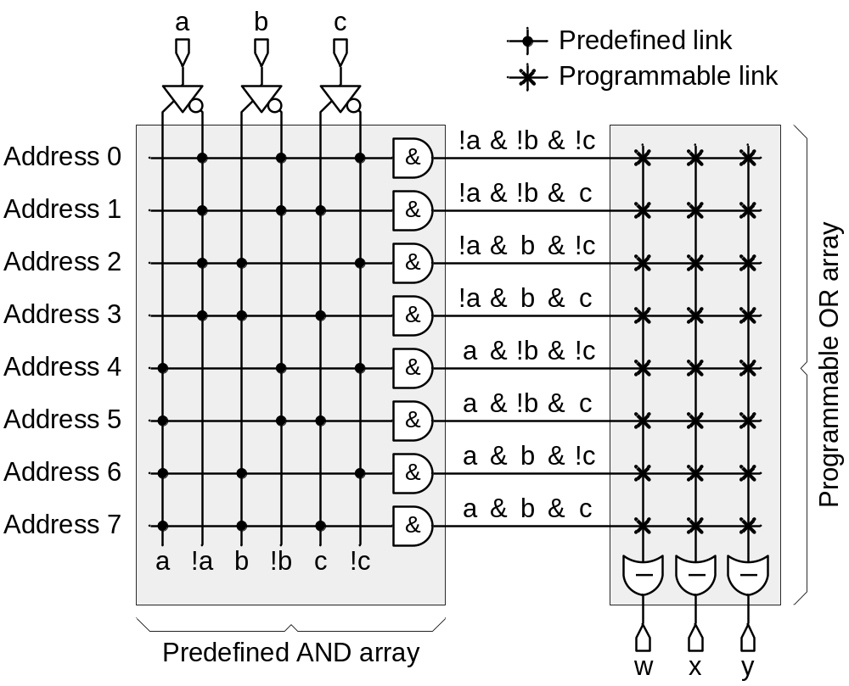
PROM (programmable read only memory)
Figure 3-03 from Design Warrior’s Guide to FPGAs ISBN 0750676043

Slide 33
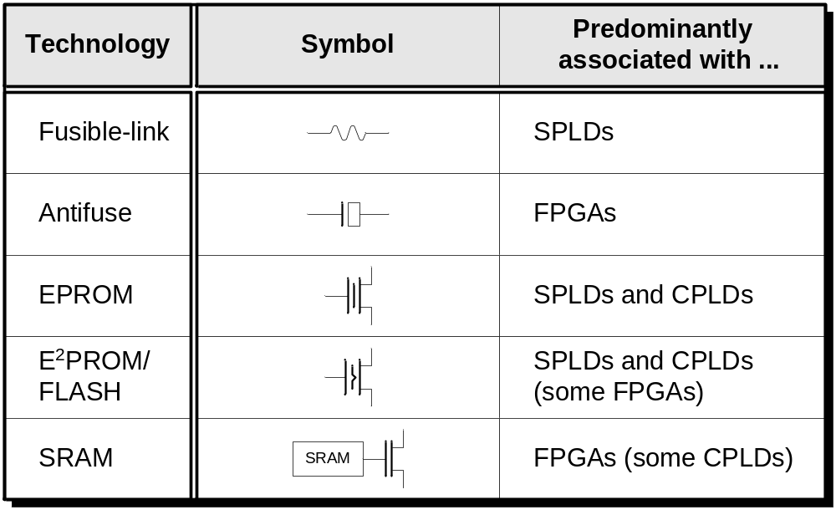
Fuse Technology
Figure 2-13 from Design Warrior’s Guide to FPGAs ISBN 0750676043

Slide 34
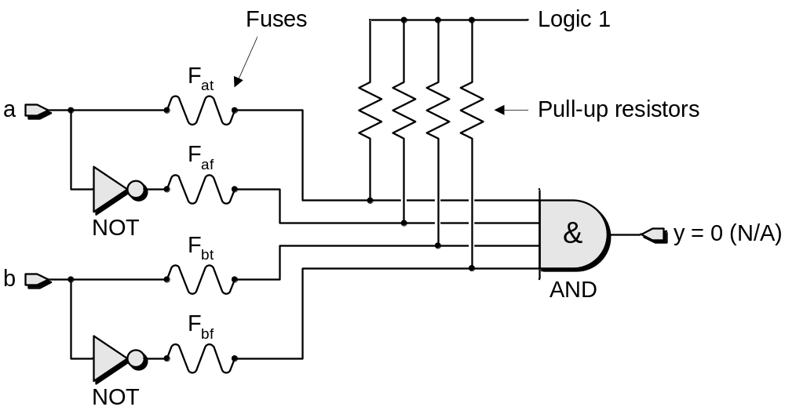
Programmable AND gate
Figure 2-2 from Design Warrior’s Guide to FPGAs ISBN 0750676043

Slide 35
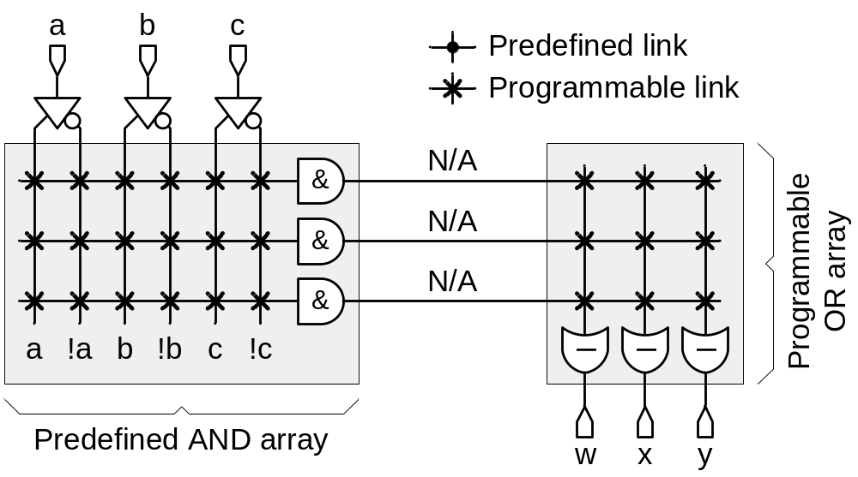
PLA schematic
Reducing PROM chip size by using a subset of the address locations
Figure 3-06 from Design Warrior’s Guide to FPGAs ISBN 0750676043

Slide 36
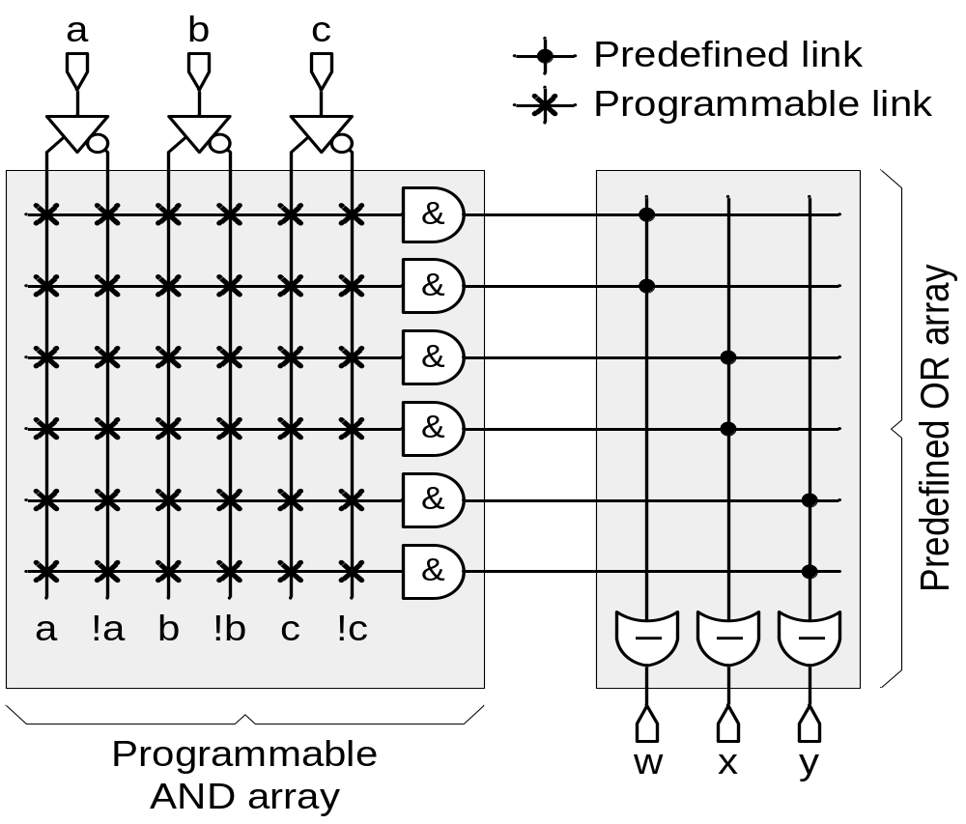
PAL schematic
Hard-wiring the OR array gave better speed with little detriment to capacity
Figure 3-08 from Design Warrior’s Guide to FPGAs ISBN 0750676043

Slide 37
PAL examples
Evolved into “sum-of-products” + flipflop
PAL16R8:
  8 or’d product terms of 16 inputs per FF
  quicklogic_b0_birkner.pdf page 14
  ATF16V8_DOC0425.pdf page 9
22V10:
  12 or’d product terms of 22 inputs per FF
  ATF22V10_doc0735.pdf page 11
Altera (and Lattice) Macrocell:
  5 or’d product terms of 36+ inputs, XOR & expanders per FF
  m7000.pdf page 9

Slide 38
Free stuff
accellera.org |  | combined VHDL & Verilog standards organization
opencores.org |  | free VHDL & Verilog IP (cores)
fpga-faq.org |  | mostly up-to-date FPGA related circuit board list
systemc.org | SystemC | C++ object library for simulation
myhdl.jandecaluwe.com/doku.php | MyHDL | Python object library for simulation & Verilog generation
confluent.org | Confluence | functional approach to generating VHDL/Verilog
wikipedia.org | CPLD | complex PLD
wikipedia.org | FPGA | field programmable gate array
wikipedia.org | PAL | Sum Of Products with no OR fuses
wikipedia.org | SPLD | simple PLD
Outdated sites: fpgacpu.org & tech-www.informatik.uni-hamburg.de/vhdl/

Slide 39
MyHDL
Recently announced
  Developed by Jan Decaluwe http://myhdl.jandecaluwe.com/doku.php
  Open source (LGPL)
  Written in Python 2.4
Uses “generators” (Python 2.2) for simulation
  Similar to SystemC
    E.g., an add-on to an existing language
Uses Python for test harness
MyHDL to Verilog converter
  VHDL conversion in the works

Slide 40
The Ten Commandments of Excellent Design (Peter Chambers, VLSI Technology)
1. All state machine outputs shall always be registered
2. Thou shalt use registers, never latches
3. Thy state machine inputs, including resets, shall be synchronous
4. Beware fast paths lest they bite thine ankles
5: Minimize skew of thine clocks
6. Cross clock domains with the greatest of caution. Synchronize thy signals
7. Have no dead states in thy state machines
8. Have no logic with unbroken asynchronous feedback lest the fleas of myriad Test Engineers infest thee
9. All decode logic must be crafted carefully---eschew asynchronicity
10. Trust not thy simulator---it may beguile thee when thy design is junk

Slide 41
DSP versus FPGA
Vendor | part | performance | detail
DSP
Texas Instruments | C6000 | 8000+ MIPs | eight instructions/clock, $5-20 in high volume
Analog Devices | AD21000 | 2 Gflop | dual ALUs, $10-20 in high volume
IBM | "cell“ Playstation-3 | 0.2 Tflop | one 64-bit powerPC & eight multi-media DSPs @ 3.2 Ghz on one chip
FPGA
Xilinx | largest Virtex-4 | 0.5 TIPS | 512 multiply-adders @ 500 Mhz
Altera | largest Stratix-II | 0.4 TIPS | 384 multiply-adders @ 500 Mhz
TIPS: One Trillion Instructions Per Second

Slide 42
Design Issues
Device independence
  the tools do provide the ability to hide chip details
  but, you must still write your code considering the chip architecture
Design
  you will spend considerable time mapping the problem into "time & space"

Slide 43
Free Tools
Most chip vendors offer free FPGA & CPLD development tools downloadable from the Web
Include VHDL/Verilog compiler
Xilinx: ISP 8.1i Altera Quartus II version 5.1
Free is only for the small and medium size chips: Large designs get expensive in many ways: compilers, simulators, testing

Slide 44
Software vendors
Software Vendor |  | known for
Aldec.com |  | VHDL & Verilog simulation
Andraka Consulting Group | andraka.com | FPGA design house: DSP & signal processing
Cadence |  | ASIC tools
Celoxica | Handel-C | C to VHDL/Verilog
Dillon Engineering | dilloneng.com | FPGA design house: fastest FFT
ImpluseC | ImpulseC | C to VHDL/Verilog
Mathworks | Matlab | Signal processing algorithm development Optional conversion to VHDL/Verilog & C
Mentor | ModelSim | VHDL/Verilog simulation
Mentor | Precision | VHDL & Verilog compiler
OrCad |  | PCB tools
Synopsys | Design Compiler | ASIC tools
Synplicity | Synplicity | fast VHDL & Verilog compiler
(incomplete list)

