Slide 1

Small Chips and their Usages Jim Brakefield

Slide 2
Reasons for Small
Lower power
Battery driven design
Thermal management is simpler
Lower cost: silicon area savings are passed on
Newer/smaller chips are faster and more capable
Use single PCB
Connectors are a weak point
Lower weight
And of course, less volume: in X, Y and Z

Slide 3
IC Transistor Density
7nm process: ~100M transistors / mm²
https://en.wikipedia.org/wiki/7_nm_process
Small uP: 10K transistors
https://en.wikipedia.org/wiki/Transistor_count
Microprocessor with cache: 1M transistors
Large FPGA: 100 billion transistors
Single chip 3D nand flash: 2 trillion transistors
+ Multiple chips in single package

Slide 4
Small IC Applications
Analog to digital, Digital to analog
Computation
Control
Communication
RF
Wired
LED
Camera
DC to DC (chip & PCB voltage needs)
Protection (over voltage, transients, fuse)

Slide 5
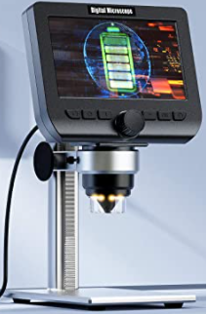
LCD Digital Microscope
Battery powered
HD resolution
LED illumination
Many products all
made by the same
company?

Slide 6
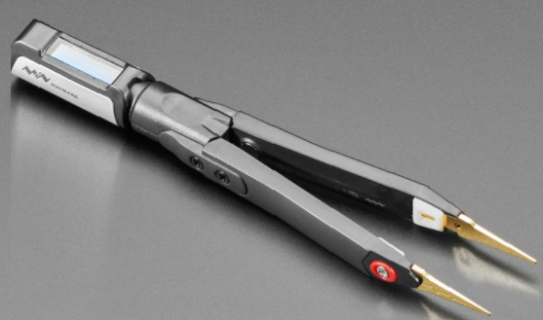
Digital Tweezers
Miniware DT71 Mini Digital Tweezers
Resistance, Capacitance, Inductance, Voltage & Frequency

Slide 7
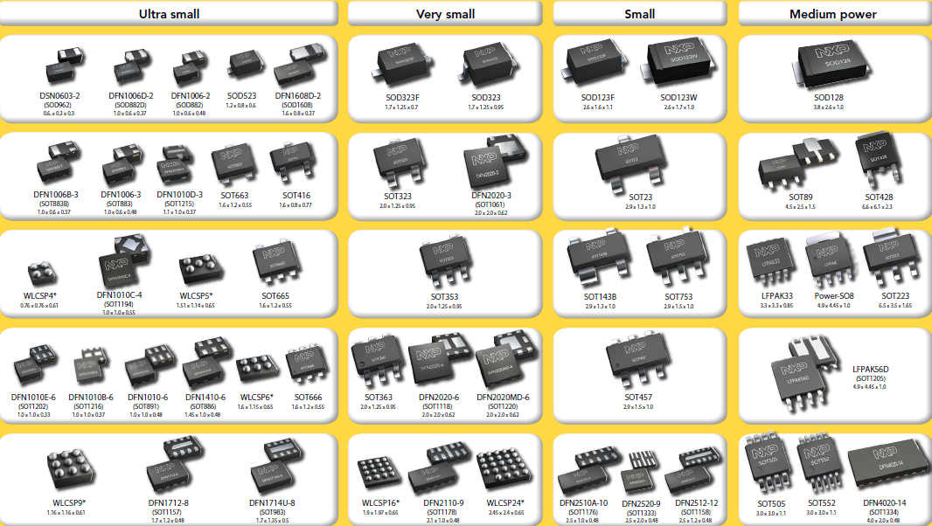
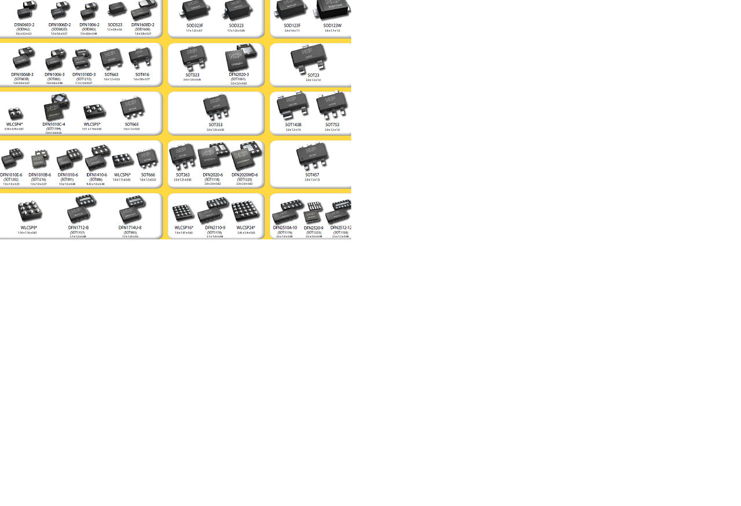
Small Packages https://www.nxp.com/packages/search?q=

Slide 8
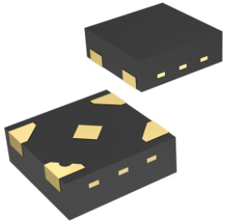
Digital logic
nexperia two input XOR gate 74LV1T86GXH
0.8mm by 0.8mm by 0.35mm = .64mm² and .224mm³
Five lead QFN package
1.2 to 5.0 vdc
100X area advantage
Compare with TTL logic
11mm by 20mm by 8 mm
16 pins
5.0 vdc
One chip (4 gates) uses both sides of PCB

Slide 9
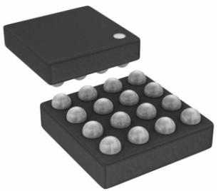
Tiny FPGA chip
Latticesemi ICE40UL1K
1.4mm X 1.4mm X 0.6mm = 1.99mm² & 1.19mm³
10 user IOs
Flash, I2C, SPI, PWM & oscillator built-in
1.2 vdc to 3.3 vdc IOs
1280 LUTs, 14 block RAMs

Slide 10
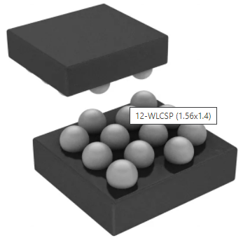
Tiny microprocessor chip
Atmel/Microchip AVR ATTINY20
1.4mm by 1.56 mm WLCSP package
2K bytes of flash
10-bit A2D
IO: PWM, I2C, SPI, …
Same uP as Arduino

Slide 11
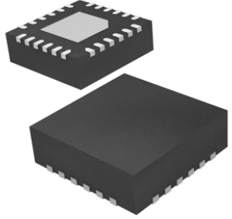
3D gyro accelerometer and magnetometer combo
Invensense MPU-9250
3mm X 3mm X 1mm
24 pins, I2C and SPI
Three stacked chips
Includes signal processor
Add pressure sensor for complete inertial package
Bosch BMP183: 3.6mm x 3.8mm
1 foot altitude resolution

Slide 12
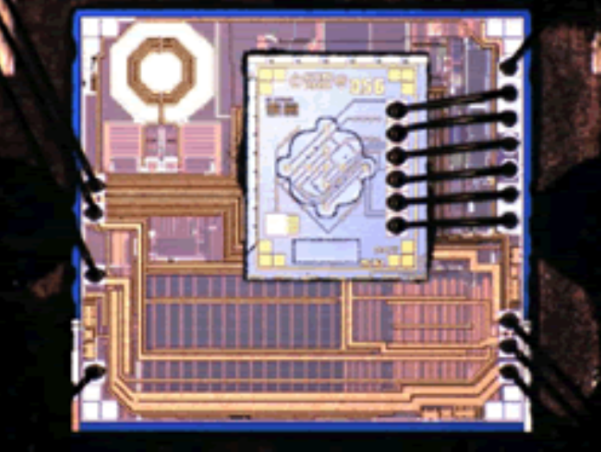
Silicon oscillator
SiTime SiT1532
0.8mm X 1.5mm X 0.55mm = 1.2mm² & 0.66mm³
4 pins, 32.768KHz
Frequencies to 200MHz in standard oscillator packages
Very low jitter

Slide 13
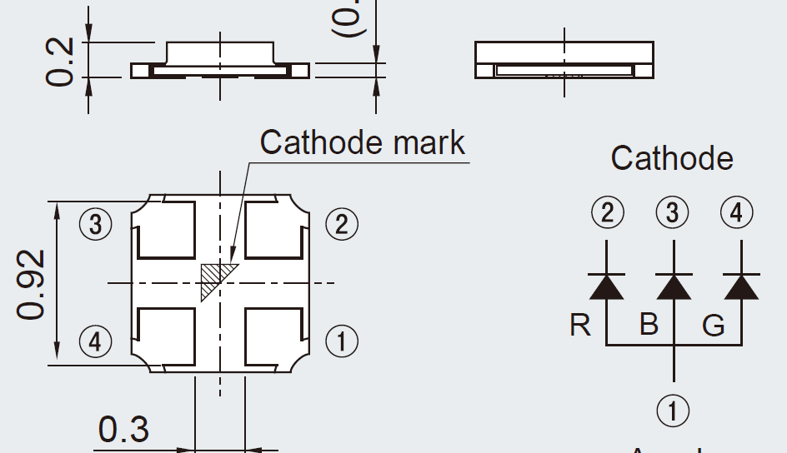
LED
Rohm SLMP34 RGB LED
1mm X 1mm X 0.2mm = 1mm² and 0.2mm³
4 pins, V_{F} RGB of 2.2, 3.3 & 3.2vdc
Rohm SLM-P1
1mm X 0.6mm
Single color

Slide 14
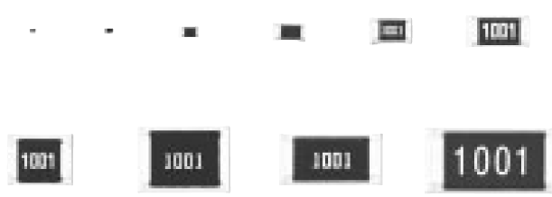
Resistors, capacitors & inductors
Standardized sizes in hundredths of inch (mm)
01005 (0.4 x 0.2 x .13), 1/32 watt, “black dots”
0201 (0.6 x 0.3 x .23), 0.05 watt
0402 (1.0 x 0.5 x .35), 0.1 watt
0603 (1.6 x 0.8 x .45), 0.1 watt, sometimes printed resistance code
0805 (2.0 x 1.25x.60), 0.125 watt
1206 (3.2 x 1.6 x .60), .25 watt
2010 (5.0 x 2.5 x .60), .5 watt
2512 (6.4 x 3.2 x .60), 1 watt
Color: 01005 0201 0402 0603 0805 1206
resistors: black
caps: light brown
inductors: ferrite
1210, 1812, 2010, 2512 =>

Slide 15
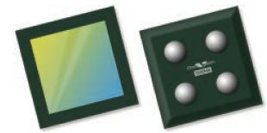
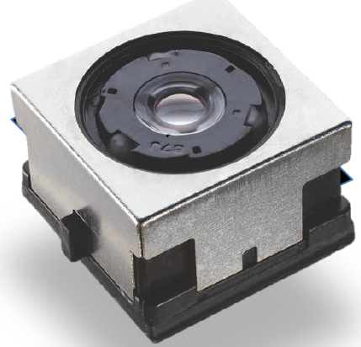
Digital cameras
OmniVision OV6948(200x200 pixels)
0.75mm X 0.75mm, thickness depends on lens
4 pins
Analog out
Digital Optics mems/cam
8mm X 8mm X 5mm
Autofocus
UWXGA

Slide 16
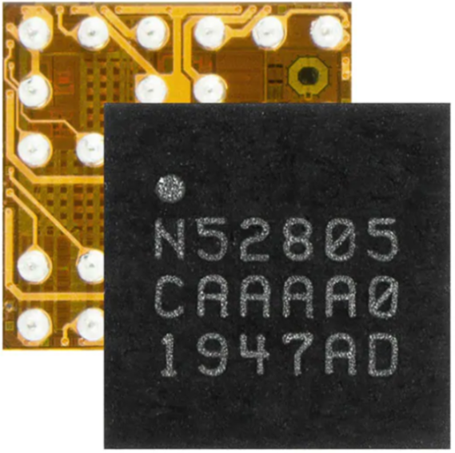
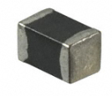
Radio
Nordic Semi: Nrf52805 low power Bluetooth
2.5mm by 2.5mm by 0.5mm
Includes ARM cortex M4 uP
Taiyo-Yuden AF216M245001 antenna
2.5mm by 1.6mm by 1.6mm = 4mm² and 6.4mm³
2.4GHz band

Slide 17
Places to get chips
www.digikey.com original mail-order house
www.mouser.com some parts only at mouser
www.newark.com stock oscilloscopes & such
www.avnet.com high volumes
www.arrow.com high volumes
Manufacturer’s web sites
Keep an eye on inventory levels:
choose popular and stocked parts if possible

Slide 18
Some chip Manufacturers
actel (now microsemi), altera (now intel), amd, analog (devices), arm, atmel, austriamicrosystems, bosch, cirrus, cree, cypress, diodes, everspin, fairchildsemi, freescale, ftdichip, hittite, holtic, ibm, idt, infineon, intel, intersil, issi, latticesemi, linear, marvell, maxim-ic, microchip, micron, national (now TI), nec, nordic, nvidia, nxp, okisemi, onsemi, panasonic, rabbitsemiconductor, renesas, samsung, silabs, spansion, sst, st, ti, toshiba, we-online, xilinx, xmos, zilog
FPGA uP analog memory diverse passives simple

Slide 19
PCB fabrication & assembly
Use CAD package to input schematic
Auto or manually route signal traces
Generate Gerber files
Have PCB fabricated
Send chips and PCBs to assembly house
Or DIY with hot air gun or oven
See if board works
Solder stencils now optional: can ink-jet print solder paste

Slide 20
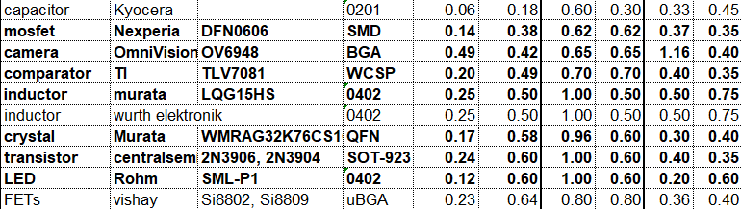
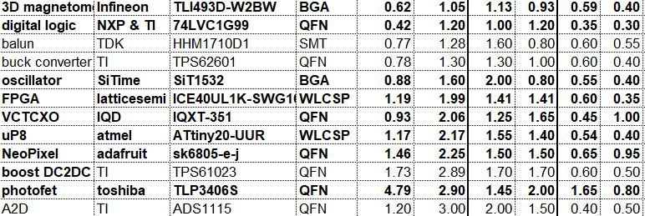
Small parts spreadsheet excerpts

