Slide 1
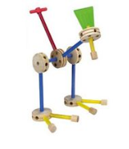
DIY soft-core uP Microprocessor design using an FPGA “made simple”
Jim Brakefield

Slide 2
Introduction
FPGAs: digital circuit with its resources connected by programmable/configurable wiring
uP: mechanism to sequentially execute instructions (at high speed). Has addressable memory and IO.
Soft-core uP: uP implemented using FPGA resources. Written in VHDL or Verilog.

Slide 3
Table of Contents
Rational
FPGA resources
Eval/Dev Board/Kit
A uP definition
Instruction set
FPGA tools & flow
What else is available
Difficulties
Finding the minimal design
Next steps
Advanced steps
References

Slide 4
Caveats
Presentation may conflict with your course material?
Am not a professor or even a career FPGA designer
This talk summarizes how I have learned to go at the problem efficiently
Computer architecture is one of my hobbies

Slide 5
Why design & implement a microprocessor from scratch?
Useful skill set
Broaden your design capability from simple state machines to high performance uP
Term project
Talk directed towards fast start & clear path
Architectural exploration
Instructions & addressing modes of your choosing
High performance real-time

Slide 6
FPGA resources
LUT Lookup table 3 to 6 inputs, 1 to 2 outputs
Include carry chain for building adders
DFF D flip-flop 1 to 2 per LUT
IO Tristate transceiver with optional DFFs
RAM Variable aspect ratio, usually dual port
LUT RAM: 16x1, 64x1
Small block RAM: 32x18, 32x20, 64x18
Block RAM: 128x36 to 1024x36
Large block RAM: 2Kx72, 4Kx72, 4Kx144
External DRAM: Built-in controller
Wiring Fabric
Horizontal and vertical wire segments of various lengths

Slide 7
Additional FPGA resources not used herein
PLL/DLL Generation of additional clock frequencies
Differential IO High speed interfaces
SERDES High speed serial IO (gigabits/sec)
Hard core uP ARM Cortex M3, R5, A9, A53
Vendor soft cores (32-bit, full tool chains)
Altera NIOS II
Xilinx microBlaze
www.opencores.org processor soft cores

Slide 8
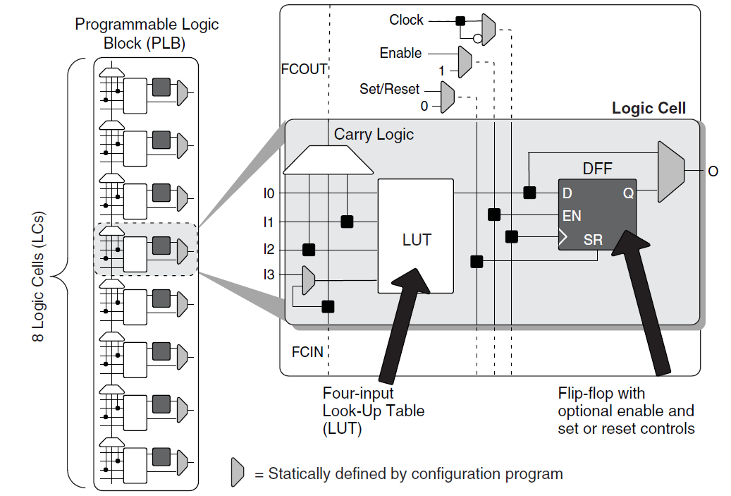
LUT + DFF Lattice Semiconductor iCE40FamilyHandbook.pdf pg6-2

Slide 9
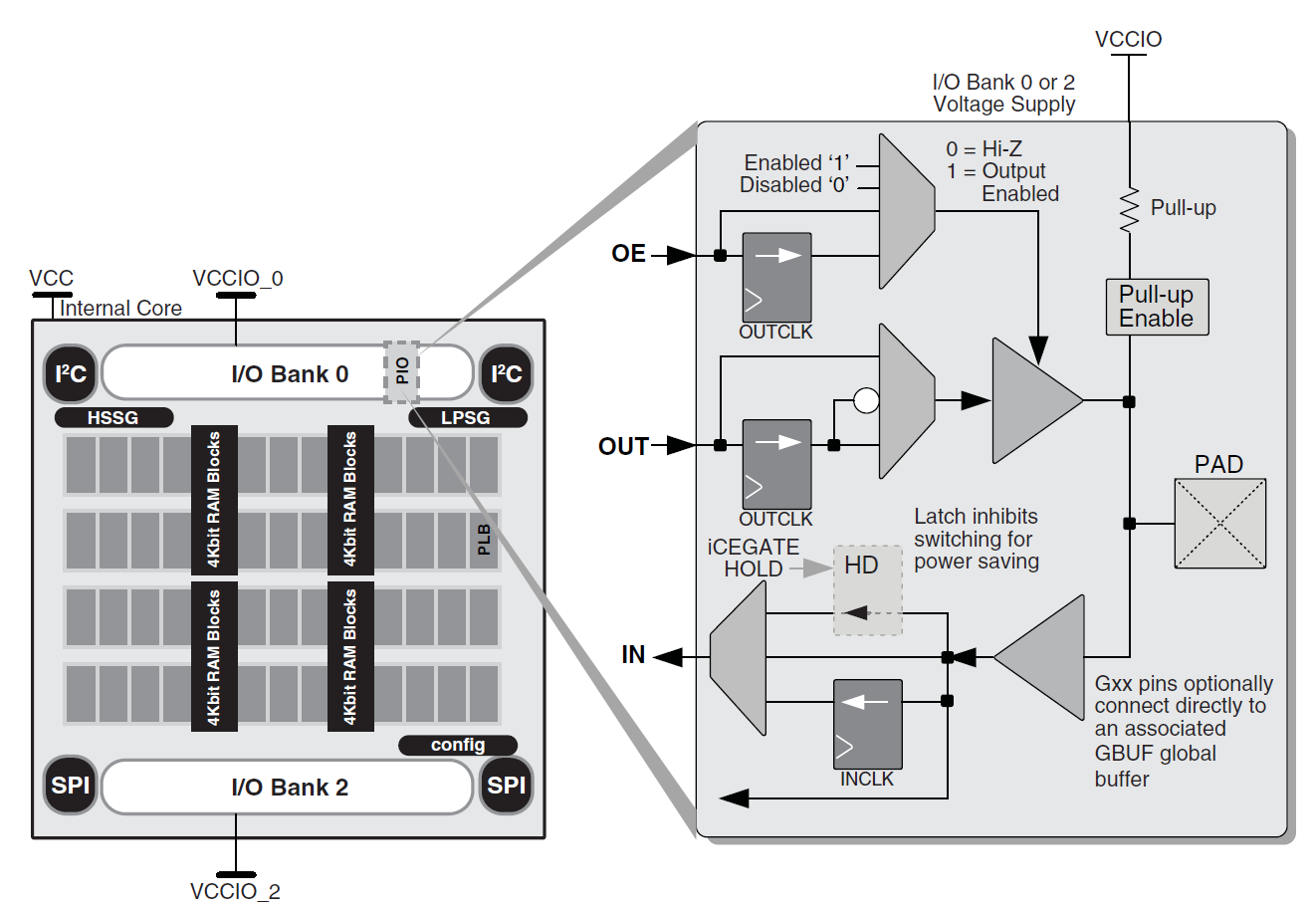
Input – Output pins Lattice Semiconductor iCE40FamilyHandbook.pdf pg6-7

Slide 10
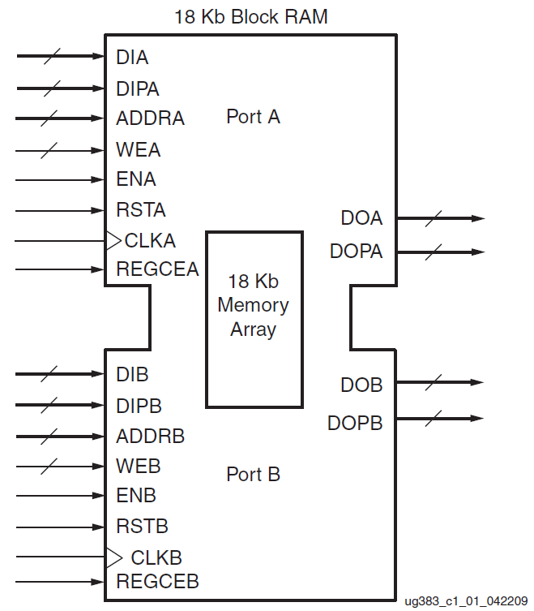
Block RAM Xilinx Spartan-6 FPGA Block RAM Resources User Guide pg12

Slide 11
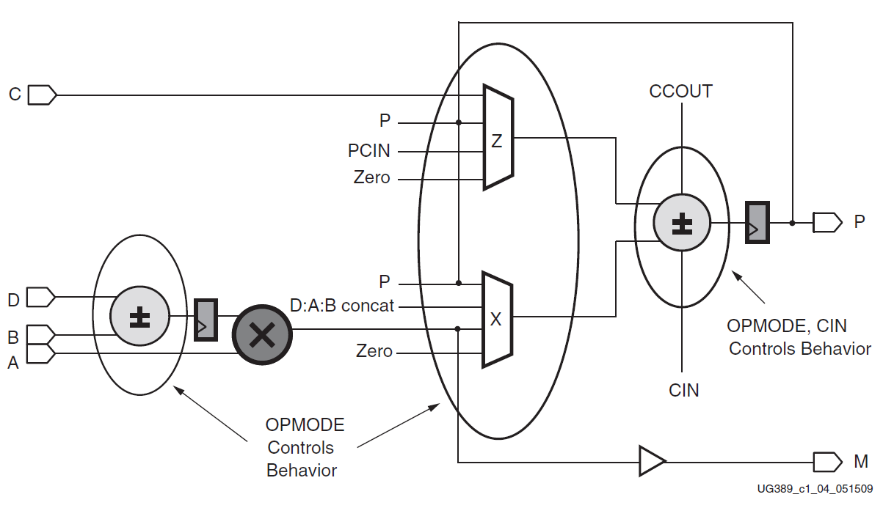
Simplified DSP48A1 slice Xilinx Spartan-6 FPGA DSP48A1 Slice pg 17

Slide 12
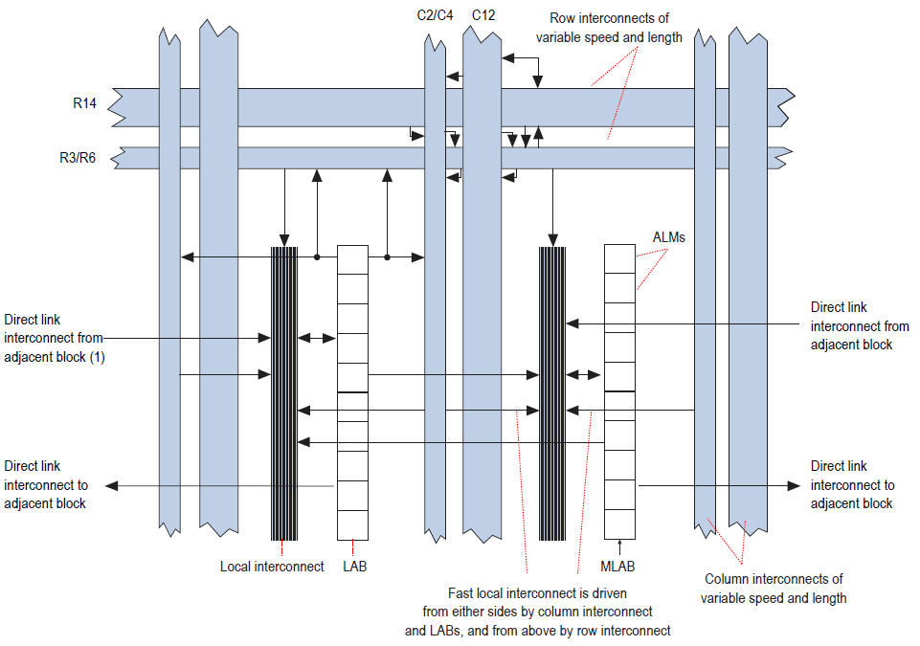
Wiring Fabric Altera CycloneV Device Handbook pg1-2

Slide 13
FPGA Vendors
Name web site market share revenue
Xilinx Xilinx.com 51% $2.4B
Intel Altera.com 34% $1.9B
Lattice Semiconductor ~7% $0.4B
Latticesemi.com
Microsemi Actel.com ~7% $0.4B?
Cypress Cypress.com ? ?

Slide 14
FPGA Tools
HDL (Hardware Design Languages)
VHDL, Verilog, System Verilog
High Level Synthesis(HLS): C, C++, Matlab
Compilation HDL into “gates” & DFF
Place & Route Vendor proprietary
Timing analysis How fast will it run?
Performance analysis LUT count & Fmax
Simulation Unit testing on a PC
Download Transfer bit file to the chip

Slide 15
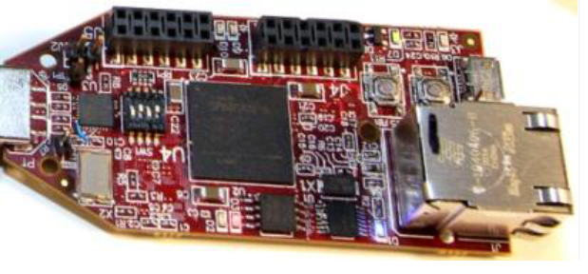
Spartan-6 resources (XC6LX9-3CSG324)
Avnet Spartan-6 FPGA LX9 Micro-Board
4 LEDs, 4 switches, 1 push button, 2 PMOD (16 IO)
Ethernet jack, 64MB DRAM, boot flash
Power & download via USB cable
6K 6LUTs, 11K Dffs, 64 8K block ram, 200 IOs
16 18x18 MUL/DSP, 2 PLL, no SERDES
100MHz clock

Slide 16
ROIS24_24uP
64 24-bit registers: uses 96 LUTs, quad ported
24 bit instruction with 6-bit op-code and three 6-bit register designators
XXXXXX DDDDDD RRRRRR SSSSSS (DRS)
XXXXXX DDDDDD RRRRRR sNNNNN (DRsN)
XXXXXX DDDDDD sNNNNN NNNNNN (DsNN)
XXXXXX sNNNNN NNNNNN NNNNNN (sNNN)
24-bit by 1024 word block RAM main memory
IO ports directly connected to LEDs, Switches, Push button, 100MHz clock

Slide 17
rois24_24uP block diagram write enables on all registers and RAM
Memory read data
Input pins
S value
clock
R value
Write
clock
Read &
Write
clock
D value
Combinatorial logic
Adders,
MUXes,
Etc.
D
LUT RAM
64x24
R
state
CCR
PC
S
Block RAM
1024x24
D in
PC/mem adr
Memory write data
Output reg

Slide 18
Clock cycle events
Read instruction out of block RAM
Use R & S to read operands from LUT RAM
Generate control signals
Do the arithmetic
Select appropriate result
Set write enables
Update PC, CCR, LUT RAM, post address (new PC) to block RAM

Slide 19
rois24_24uP instruction set
Register zero always reads as zero
XXXXXX DDDDDD RRRRRRR SSSSSSS (DRS)
Two operands & result registers
Add, add with carry, subtract, subtract with carry,
AND, ANDC(2nd operand complemented), OR, XOR
Call (Jump if D=0; branch to mem[R+S])
XXXXXX DDDDDD RRRRRR sNNNNN (DRsN)
Sign extended 6-bit immediate combined with R value
Addi, adci, andi, ori, xori
Call (Jump if D=0; absolute call/jmp if R=0; return if sN=0)
In, Out

Slide 20
rois24_24uP instruction set cont’d
Load and store: DRS & DRsN
Load to D, Store from D
XXXXXX DDDDDD sNNNNN NNNNNN (DsNN)
Conditional branch relative (D is condition code)
Load immediate
Call relative
XXXXXX sNNNNN NNNNNN NNNNNN (sNNN)
Prefix: sNNN will be prefixed to next sN inst
28 instructions currently, room for 64 inst.

Slide 21
The difficulties
FPGA Complexity
FPGAs have a lot of features
Each family is different
VHDL/Verilog Complexity
Must code with FPGA primitives in mind
HLS doesn’t handle control logic well
uP Complexity
Large instruction sets, high performance

Slide 22
Crunch time
Devise an instruction set
Text & spreadsheet versions
Define file with op-code mnemonics
Lets one change op-code encoding easily
Find a minimal initial set of instructions
Write a short program for blinking LEDs
Place program into case statement
Implement each instruction as a line in another case statement

Slide 23
Rois24_24uP minimal program
At 100MHz need more than 24-bits to get blinking lights
Use two registers:
Add one to first register
Add carry to second register
Output second register to LEDs
Branch back to first instruction
Four instruction loop
2nd register increments every 0.67 seconds

Slide 24
Op-code encoding
constant op_ADD : std_logic_vector(5 downto 0) := "100000"; -- R + S => D
constant op_SUB : std_logic_vector(5 downto 0) := "100001"; -- R - S => D
constant op_ADC : std_logic_vector(5 downto 0) := "100010"; -- R + S + carry => D
constant op_SBC : std_logic_vector(5 downto 0) := "100011"; -- R - S + carry => D
constant op_AND : std_logic_vector(5 downto 0) := "100100"; -- R and S => D
constant op_ANDC : std_logic_vector(5 downto 0) := "100101"; -- R and not S => D
. . .

Slide 25
The program case statement
program_ROM: process(pc)
Begin
case pc(3 downto 0) is
-- location op-code D reg R reg sN or S reg
when "0000" => inst <= op_ADDI & "000001" & "000001" & "000001";
when "0001" => inst <= op_ADCI & "000010" & "000010" & "000000";
when "0010" => inst <= op_OUTsN & "000010" & "000000" & "000000";
when "0011" => inst <= op_JMPsN & "000000" & "000000" & "000000";
when others => inst <= (others => '0');
end case;
end process;

Slide 26
Instruction evaluation case statement
-- instruction decode and implementation
decode: process(inst, pc, sN, R, RR, SS, CCR, Dloc,opcode,aluout)
begin
-- default signal values
pcN<=PC+1;
ALUout<=(others => '0');
LUTwe<='0'; CCRwe<='0'; outwe<='0';
RR<= '0'&R; -- need one additional bit so can save carry out
SS<= '0'&sN; -- the program only uses the DRsN mode

Slide 27
Instruction evaluation case statement cont’d
-- instruction implementation
-- (for each instruction specify non-default signal values)
case opcode is
when op_JMPsN => ALUout<=RR+SS; pcN<=ALUout(23 downto 0);
when op_ADDI => ALUout<=RR+SS; LUTwe<='1'; CCRwe<='1';
when op_ADCI => ALUout<=RR+SS+CCR(24); LUTwe<='1'; CCRwe<='1';
when op_OUTsN => ALUout<=RR+SS; outwe<='1';
when others => pcN<=pc;
-- effectively a branch to itself, eg HALT
end case;

Slide 28
Instruction evaluation case statement cont’d
-- prohibit writes to register zero
if Dloc = "000000" then LUTwe<='0'; end if;
end process;
-- connect result to register file write port
Din <= ALUout(data_size-1 downto 0);
-- condition code register is copy of ALU result
CCRN <= "000" & ALUout; -- no overflow for now

Slide 29
Register update process
update: process(clk)
begin
if (rising_edge(clk)) then
pc<=pcN; -- always update the PC
if CCRwe = '1' then CCR<=CCRN; end if;
if outwe = '1' then out0<=Dout; end if;
-- LUTwe does its enable at the LUT RAM
end if;
end process;

Slide 30
Is it working?
Constraint file
Sets clock speed
Sets IO pin assignment
Evaluation kit usually has a sample constraint file
Simulate/debug
Tools will generate a simple test bench
Need to relay observed signals out to test bench
Program acts as the test script
Performance metrics & goals
Track LUT count and Fmax

Slide 31
Some results & experiments
Directory name | # of inst | Fmax MHz | KHz per LUT | LUT count | MUXCY count | Comments | Data path | Block RAM
rois24_24up_s6_noram | 4 | 109 | 590 | 184 | 56 | basic "Hello World": blinking LEDs | No | No
rois24_24up_s6_dpnoram | 4 | 142 | 1043 | 136 | 32 | experiment to test simple data path | Yes | No
rois24_24up_s6_bram | 25 | 83 | 74 | 1119 | 264 | all inst except PFX, IN & shifts; Hello World only | No | Yes
rois24_24up_s6_dpbram | 28 | 105 | 206 | 512 | 52 | all inst; experiment to test full set of data paths | Yes | Yes
rois24_24up_s6_dpbram | 28 | 106 | 375 | 283 | 52 | area mode, high effort | Yes | Yes
rois24_24up_k7_dpbram | 28 | 176 | 471 | 373 |  | determine best Fmax & KHz/LUT | Yes | Yes
rois24_24up_k7_dpbram | 28 | 143 | 506 | 282 |  | area mode, high effort | Yes | Yes

Slide 32
Moving forward
Migrate to a data path?
Getting block RAM running
Add instructions
Migrate to more pipeline stages?
Not that big of a gain!
Adding modalities
Addressing modes
Whatever fits into your schedule/interests

Slide 33
Advanced features
Floating-point: figure at least 2K LUTs
External RAM:
Use block RAM for Caches
Use vendor’s DDR interface
Writing an assembler
Writing a compiler
Adding peripherals (see www.opencores.org)
Barrel processors
Multiple dispatch

Slide 34
Insights
A deliberate process:
Get something bare bones working
Minimum instruction set, minimum program
Add instructions
Add to test program
Migrate to block RAM and data-path?
Data-path logic is harder to debug
Lots of soft-core uPs at www.opencores.org

Slide 35
My next steps
Expand program with tests for each inst.
Get the block RAM/data path version debugged
Do two+ stage pipeline
Add multiply, shift & floating-point instructions
Do a variation with five-bit register designators
Two instruction flag bits: CCR update & return
Stack like usage of register file
Do 12, 16, 32 and 48-bit data size versions
Do 12/16-bit instruction format: D & R partially implied

Slide 36
FPGA evaluation kits all use USB download, check frequently for new boards
Vendor Price FPGA “LUTs” Mults Comments
Cypress CY8CKIT-59 $10 Cypress PSoC5 384 0
ARM Cortex M3, digital & analog, schematic editor, not a true FPGA
Arrow BeMicro MAX10 $30 Altera Max 10M08 8K 24 oscillator, 12-bit A2D, flash, DRAM
Arrow BeMicroCV $49 Altera Cyclone V 25K 50
Some versions of Cyclone V have (2) Cortex A9: DE0-Nano-SoC $104
Arrow SmartFusion Kick Start $60 Actel SmartFusion2 12K 22
Cortex M3, security & reliability features
XESS XuLA2-LX9 $69 Xilinx Spartan-6 9K 16 40-pin DIP, SDRAM (might want to use $99 “Arty” Atrix-7 instead)
Digilent ZYBO(student $) $125 Xilinx Zynq 7010 28K 80 (2) Cortex A9, 512MB, HDMI…
Adapteva Parallella-16 $149 Xilinx Zynq 7010 28K 80 (2) Cortex A9, 16-core uP

Slide 37
Videos & Training
www.YouTube.com: hundreds of videos
Xilinx
http://www.xilinx.com/training/free-video-courses.htm
http://www.xilinx.com/support/university.html
Altera
https://www.altera.com/support/training/university/overview.html
Altium
https://altiumvideos.live.altium.com/

Slide 38

Free Range VHDL

Slide 39
Guidelines & PDFs
“Fundamental mode”: Single clock, no latches
Two process VHDL:
Distinct combinational and sequential processes
Jiri Gaisler 2014: A structured VHDL design method
VHDL, Verilog and System Verilog Quick Reference Cards
Crockett etal 2014:
The Zynq Book: ARM Cortex A9 + FPGA
Mealy & Tappero 2012:
Free Range VHDL: A to-the-point VHDL text

Slide 40
Books
Harris & Harris 2013: Digital Design and Computer Architecture, 2nd ed.
VHDL & System Verilog, all the way from 0s & 1s to x86
Shows trade-off of performance versus pipe length
Max Maxfield 2004: The Design Warrior’s Guide to FPGAs
Folksy, good coverage at the chip level
Nazeih Botros 2006: HDL Programming Fundamentals – VHDL and Verilog
Side by side VHDL & Verilog
Peter Ashenden 2008: The Designer’s Guide to VHDL, 3rd ed.
Thee VHDL reference
Steve Kilts 2007: Advanced FPGA Design

