Slide 1
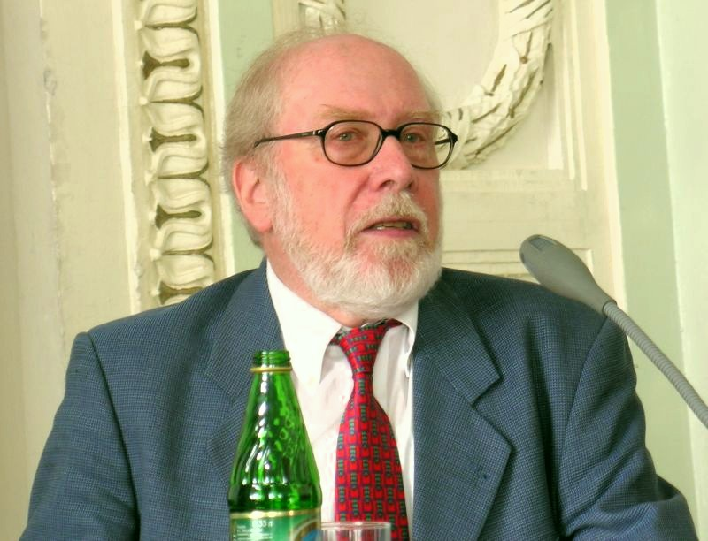
Nicklaus Wirth retrospective
James Brakefield jim.brakefield@ieee.org
IEEE Computer Society, Lone Star section
Slides at https://events.vtools.ieee.org/m/404641
Notes:
Slide deck at: https://events.vtools.ieee.org/m/404641

Slide 2
Outline
Go back in time to the Pascal era
Wirth’s thesis
From Algol to Pascal
Turbo Pascal, UCSD Pascal and P-code
Career at ETH-Zurich
Sabbaticals at Xerox Parc
Lilith and Ceres-1…3 workstations
His FPGA courses, soft core processor
His books, publications & web presence
Pascal now and in the future
Quiz questions
Notes:
Born 1934, died Jan. 1 2024 at age 89. BS EE from ETH-Zurich, MS from Université Laval Canada, PhD UC Berkeley 1963, several children https://en.wikipedia.org/wiki/Niklaus_Wirth

Slide 3
Going back time to the time of Pascal
Back to the 1960s (~60 years ago):
Small core memory, punch cards and transistor computers
Single university computer, batch mode
Fortran dominates, Algol appears
Computer Science departments start appearing
From Wirth himself (pages 1-6):
https://people.inf.ethz.ch/wirth/Miscellaneous/ComputersAndComputing.pdf
Notes:
I was an undergraduate. Learned Fortran first semester, started reading journals (senior), read every computer book in the engineering library

Slide 4
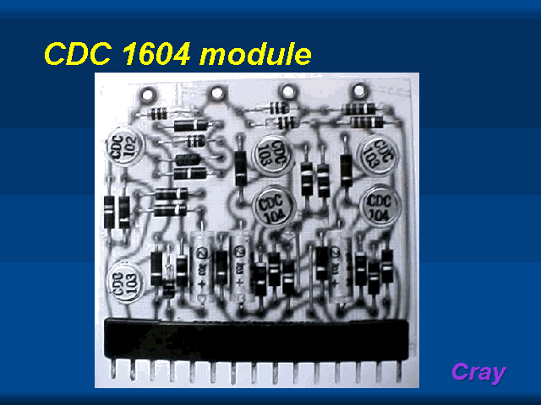
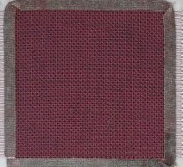
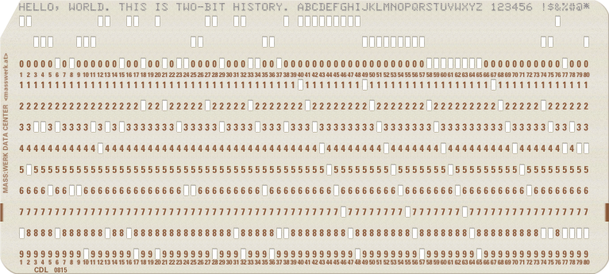
Core memory, punch cards, transistors
Notes:
http://www.aholme.co.uk/Core/Flipper.htm https://twobithistory.org/2018/06/23/ibm-029-card-punch.html https://gordonbell.azurewebsites.net/craytalk/sld021.htm

Slide 5
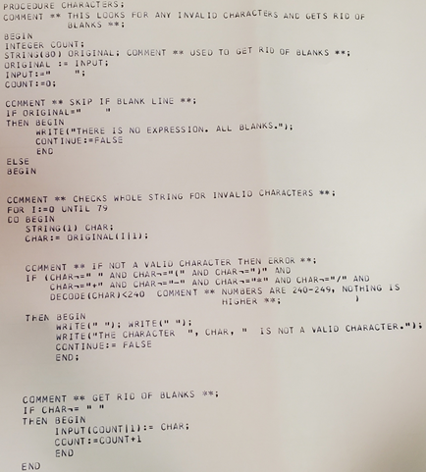
ALGOL-W
Notes:
Excerpt from Prof. Carol Redfield, 1978, University of Michigan

Slide 6
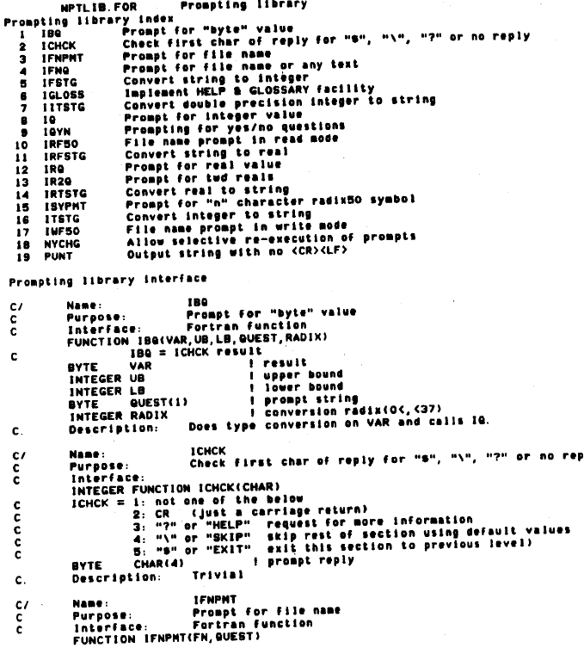
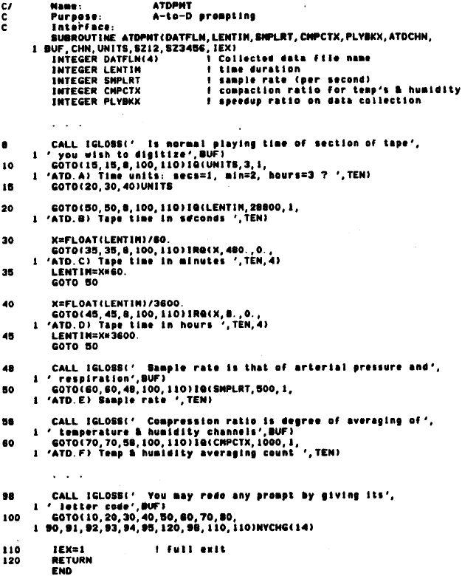
Structured Fortran code
Notes:
From 1984 Spring DECUS proceedings, pages 411-414 and Languages and Tools SIG Session Notes, pages 7-11 by James Brakefield
Notes contains excerpts from 1979, 1981 and 1983 versions of the library showing the evolution of the library. Above is 1983 version.

Slide 7
Wirth’s thesis
Wirth-Weber thesis programming language Euler 1965:
Euler: A Generalization of Algol and its Formal Definition
Documented in: Communications of the ACM
Volume 9 / Number 1 & 2 / January & February, 1966
Problems with Algol and what Euler accomplished:
http://pascal.hansotten.com/uploads/wirth/euler.pdf
Read chapter 1 (by Thomas W. Christopher 1996)
Thesis provided source code for precedence grammar analysis
Thesis provided source code for the compiler
Recursion was new & part of Algol, not part of Fortran
Notes:
https://en.wikipedia.org/wiki/Euler_(programming_language)

Slide 8
Significance of Wirth’s thesis
Excerpts from Thomas W. Christopher 1996 (see previous page):
“It was the mid-1960’s, and ALGOL 60 was a success, or at least, the ALGOL 60 Revised Report1 was a success”
“There were problems, though. The ALGOL 60 grammar was not fully reduced”
“ALGOL 60 had language features that compiler writers did not yet know how to implement”
“Wirth and Weber … found fault with the attempts to define programming languages in any terms other than programming”
“Their (Wirth & Weber)’s approach is to define a language by its compiler, but not simply providing a compiler as a black box upon which to perform experiments. The source code of the compiler is provided for inspection to aid understanding”
“We generally follow Wirth and Weber’s code. We use LL(1) parsing rather than their simple precedence technique, but we preserve the data structures and algorithms of the translation and interpretation code”
Notes:
BNF: Backus–Naur Form https://en.wikipedia.org/wiki/Backus%E2%80%93Naur_form
WSN: Wirth Syntax Notation https://en.wikipedia.org/wiki/Wirth_syntax_notation

Slide 9
From Algol to Pascal
Algol Recursion, formal definition
Euler
Open source compiler and BNF analysis
Precise semantics
Algol-W Simplified Algol-68
PL360 For IBM-360, low level
Pascal High level, education language for PCs
LL(1) grammar https://en.wikipedia.org/wiki/LL_grammar
BNF: Backus–Naur form https://en.wikipedia.org/wiki/Backus%E2%80%93Naur_form
Notes:
Pascal caused me to change my Fortran code: Full parameter and function declarations, structured layout of libraries, structured “paragraph” comments

Slide 10
Turbo Pascal, UCSD Pascal and P-code
P-code was first (P stands for portable)
UCSD Pascal used P-code to implement on 8-bit microprocessors
Turbo Pascal had a complete IDE
Turbo Pascal cost $50 and could be shared
Books appeared
Pascal overtook Fortran and dominated for ~10 years
Programming language usage 1965-2022
https://www.youtube.com/watch?v=qQXXI5QFUfw
Wirth: Pascal never had any corporate sponsorship
Notes:
IDE: Integrated Development Environment Pascal was popular topic at conferences. Borland grew rapidly and even challenged Microsoft.

Slide 11
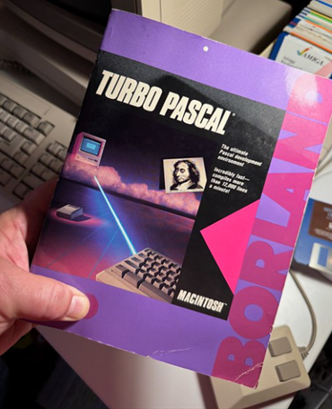
Turbo Pascal

Slide 12
Career at ETH-Zurich 1968-1999
After teaching a Stanford, went back to ETH-Zurich
Started ETH Computer Science program
Sabbaticals at Xerox-Parc: Alto workstation
Helped found Logitec with today’s mouse
An academic, programmer and engineer
Academic: PhD thesis, publications, books
Programmer: Wrote compilers, IDE and OS
Engineer: Personal workstation
Pioneered FPGA course and created Lola RTL language
Developed UAV software
https://asl.ethz.ch/research/flying-robots.html
Notes:
https://people.inf.ethz.ch/wirth/ Has several levels

Slide 13
Lilith and Ceres-1…3
Unable to take a Xerox Alto back to Switzerland
Designed and built an equivalent: Lilith http://pascal.hansotten.com/niklaus-wirth/lilith/photos-of-lilith/
Lilith used bit-slice TTL (Am2901 chip) and microprogramming (standard practice for the time)
Ceres used National Semiconductor 32032 micro https://www.computerhistory.org/collections/catalog/X2321.2002A
100+ Ceres manufactured and used at ETH
Oberon created as it’s programming language, operating system and user interface
Notes:
Ugh, Oberon used black & white portrait monitor and had Unix like windows. Probably Wirth’s emphasis on simplicity?

Slide 14
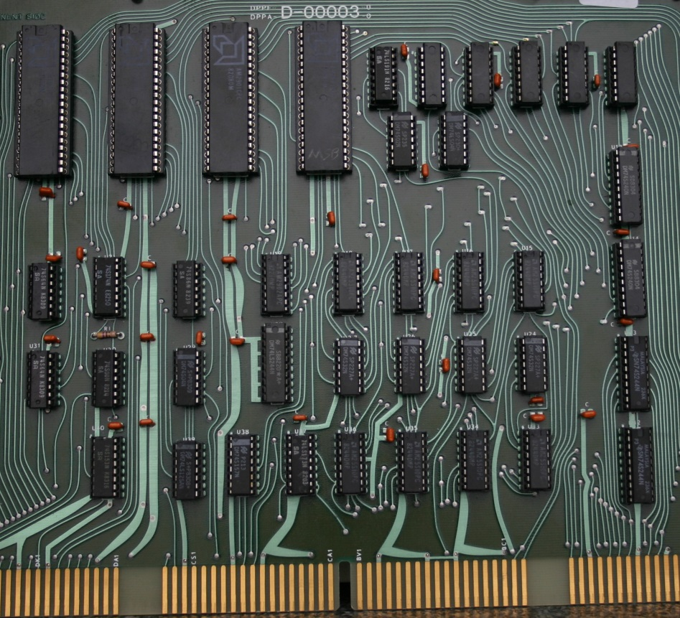
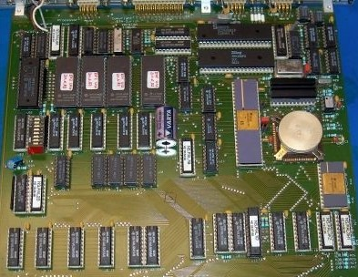
Lilith & Ceres
http://pascal.hansotten.com/niklaus-wirth/lilith/photos-of-lilith/
https://www.computerhistory.org/collections/catalog/X2321.2002A
Lilith bit-slice (ALU) board
Ceres NS32032 board

Slide 15
His FPGA course
Introduced course in programmable logic
Created Lola as a simple RTL language
Lola2 does not have case statements nor enumerations
Created 32-bit soft-core RISC processor (RISC5)
(16) 32-bit registers, 32-bit instructions
RISC5 implemented in both Lola and Verilog
Modified Oberon System for RISC5
Card cage of TTL or NS32000 boards replaced by single FPGA board (Spartan-3) pages 30-37: https://www.xilinx.com/publications/archives/xcell/Xcell91.pdf
FPGA & ARM support at www.astrobe.com
https://people.inf.ethz.ch/wirth/FPGA-relatedWork/index.html
Notes:
RTL: digital hardware description language Risc5 has the least FPGA resource usage of any soft core processor with floating-point: 2-3K 6LUTs.

Slide 16
Wirth’s publications
~86 of his publications: https://dl.acm.org/profile/81332536058/publications?Role=author
https://people.inf.ethz.ch/wirth/SelectedArticles.pdf
His short papers show a personal, less formal side
Extensive web pages
Best remembered for:
A Plea for Lean Software
"Software is getting slower more rapidly than hardware becomes faster."
Program Development by Stepwise Refinement
The Pascal User Manual and Report
A whole raft of programming languages (next slide)
Reviving a Computer System of 25 Years ago Wirth-2014
“Programs must not be regarded as code for computers, but as literature for humans”
Notes:
“Reviving a Computer System of 25 Years ago” slide deck has Alto, Lilith, Ceres & RISC5 pictures https://www.wirth-symposium.ethz.ch/programme.html (session 4)

Slide 17
Wirth’s programming languages
Euler, PL360, Algol-W, Pascal, Modula, Modula-2, Oberon, Lola
Wikipedia links:
en.wikipedia.org/wiki/ALGOL for reference purposes
en.wikipedia.org/wiki/Euler_(programming_language) en.wikipedia.org/wiki/ALGOL_W en.wikipedia.org/wiki/Pascal_(programming_language) en.wikipedia.org/wiki/Modula
en.wikipedia.org/wiki/Modula-2 en.wikipedia.org/wiki/Oberon_(programming_language) en.wikipedia.org/wiki/Lola_(computing)
Derivative languages: Turbo Pascal, Object Pascal, Delphi
https://blogs.embarcadero.com/the-long-and-winding-road-to-todays-delphi-happy-29th-birthday/
https://www.youtube.com/watch?v=n68luA9X_KU
Notes:
https://en.wikipedia.org/wiki/Philippe_Kahn founded Borland https://en.wikipedia.org/wiki/Anders_Hejlsberg Turbo Pascal, Delphi, Typescript and C#

Slide 18
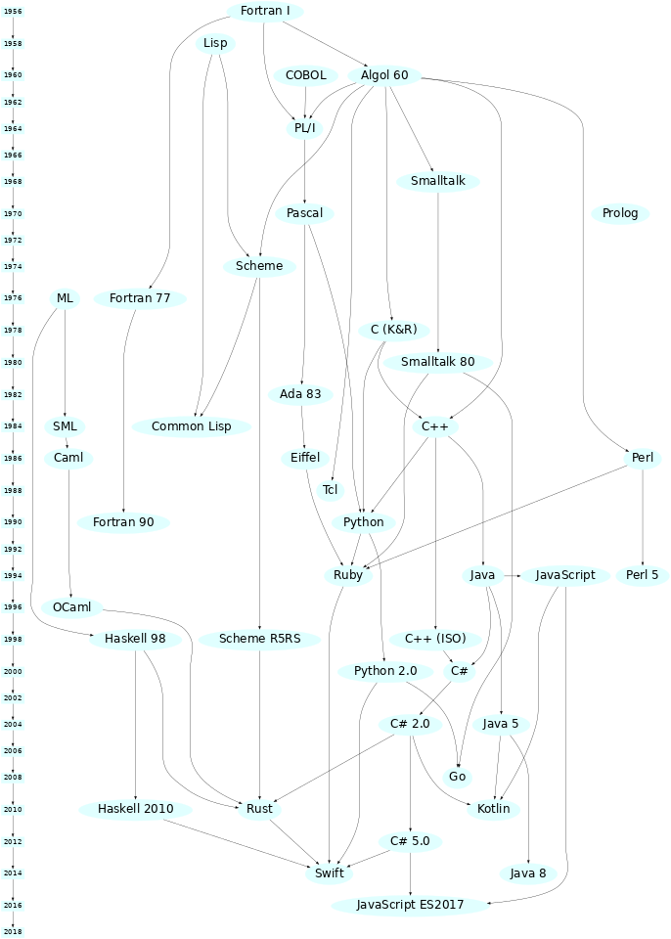
Programming Language history
Notes:
http://rigaux.org/language-study/diagram.html https://wiki.c2.com/?ProgrammingLanguageNamingPatterns ☺ & dated

Slide 19
20+ books in several languages 1973-2012
1973 Systematic Programming: An Introduction
1976 Algorithms + Data Structures = Programs
1976 PASCAL User Manual and Report also 1978
1983 Programming in Modula-2 also 1985
1985 Algorithms and Data Structures
1985 Pascal User Manual and Report: ISO Pascal Standard also 2012
1988 Programming in Modula-2
1990 Modula-2
1992 Programming in Oberon: Steps Beyond Pascal and Modula
1992 Project Oberon: The Design of an Operating System and Compiler
1995 Digital Circuit Design for Computer Science Students: An Introductory Textbook
1996 Compiler Construction
2011 The Future of Software Engineering: Panel Discussions (Wirth narrator)
2001 The School of Niklaus Wirth: The Art of Simplicity
Notes:
Many available in PDF form on the web. List derived from:
https://www.amazon.com/Books-Niklaus-Wirth/s?rh=n%3A283155%2Cp_27%3ANiklaus+Wirth also: http://pascal.hansotten.com/niklaus-wirth/books-by-niklaus-wirth/

Slide 20
Wirth Web pages
At ETH: https://people.inf.ethz.ch/wirth/
Multiple layers of web pages
http://pascal.hansotten.com/niklaus-wirth/
Multiple layers of web pages
Delphi history: https://blogs.embarcadero.com/the-long-and-winding-road-to-todays-delphi-happy-29th-birthday/
http://pascal.hansotten.com/niklaus-wirth/books-by-niklaus-wirth/
Oberon videos (25th anniversary): https://video.ethz.ch/events/2011/oberon.html

Slide 21
Critiques of Pascal
Critical comments on Pascal for embedded systems
https://dl.acm.org/doi/pdf/10.1145/987335.987337
Reidar Conradi Sigplan Notices Nov. 1976
Why Pascal is Not My Favorite Programming Language
https://www.lysator.liu.se/c/bwk-on-pascal.html#bwk
Brian W. Kernighan, April 2, 1981
Recollections on the Development of Pascal
https://dl.acm.org/doi/pdf/10.1145/234286.1057812
Wirth 1996 see pages 97 (Abstract) & 109 (Retrospect)
Somewhat defensive, otherwise objective
Notes:
Programming languages evolved in style and substance. Features added once it was understood how to efficiently implement them (see last slide).

Slide 22
Pascal now and in the future
Delphi AKA Object-Pascal at
https://www.embarcadero.com/products/delphi/starter
A complete, modern IDE with generics
Free Pascal at
https://en.wikipedia.org/wiki/Free_Pascal
Aims to support various Pascal variants, has generics
Supports variety of microprocessors:
ARM, x86, AVR, PIC32, ESP32
Lazarus IDE: https://www.lazarus-ide.org/
Oberon+ at
https://github.com/rochus-keller/Oberon
A modern and colorful Oberon IDE with generics
Notes:
https://en.wikipedia.org/wiki/Timeline_of_programming_languages (comprehensive, web links)

Slide 23
Projects by N. Wirth, 1962 – 1999 http://pascal.hansotten.com/niklaus-wirth/
1962-65 Euler
1964-67 ALGOL-W
1968-72 Pascal
1970-71 Venus timesharing
1972-74 Pascal-P
1973-76 Modula
1977-81 Lilith workstation
1977-80 Modula-2
1980-82 Computer-Network
1982 Laser Printer
1983-85 Modula-2 Compiler
1984-90 Ceres workstations
1986-90 Oberon Language and System
1990-99 Hardware Design with FPGAs
Automatic Control of Model Helicopter
Notes:
Wirth retired in 1999. He continued to produce reports and articles: https://people.inf.ethz.ch/wirth/Miscellaneous/index.html

Slide 24
Eulogies
A Renaissance Man of computer science:
https://cacm.acm.org/blogs/blog-cacm/279178-niklaus-wirth-or-the-importance-of-being-simple/fulltext
Testimonials:
https://news.ycombinator.com/item?id=38858275
Obituary:
https://www.theregister.com/2024/01/04/niklaus_wirth_obituary/
Obituary:
https://jackivaughan.medium.com/pascal-language-originator-nicholas-wirth-89-8967ab0782d1

Slide 25
Most Popular Programming Languages 1965 – 2022
https://www.youtube.com/watch?v=qQXXI5QFUfw
The Era of Fortran (1957 to 1980)
The Rise of Pascal (1970 to 1985)
The C and Ada Wars (1985 to 1987)
The Absolute Reign of C (1987 to 2001)
The Ascent of the Javas (1998 to 2018)
The Python Empire (2018 and beyond)
Notes:
Several other timeline videos available using different rating mechanisms. https://spectrum.ieee.org/the-top-programming-languages-2023 for top 50

Slide 26
Programming Language questions
Precedence parsing
Recursion
Formal grammars (e.g. BNF, LL(1) etc.)
Type checking, type inference
Dynamic arrays
Independent compilation, linking loader
Polymorphic
Objects
IDE
Generics
Notes:
Required reading: EULER An Experiment in Language Definition, Christopher 1996 http://pascal.hansotten.com/uploads/wirth/euler.pdf Read chapter 1
https://en.wikipedia.org/wiki/Timeline_of_programming_languages

